Slide 1
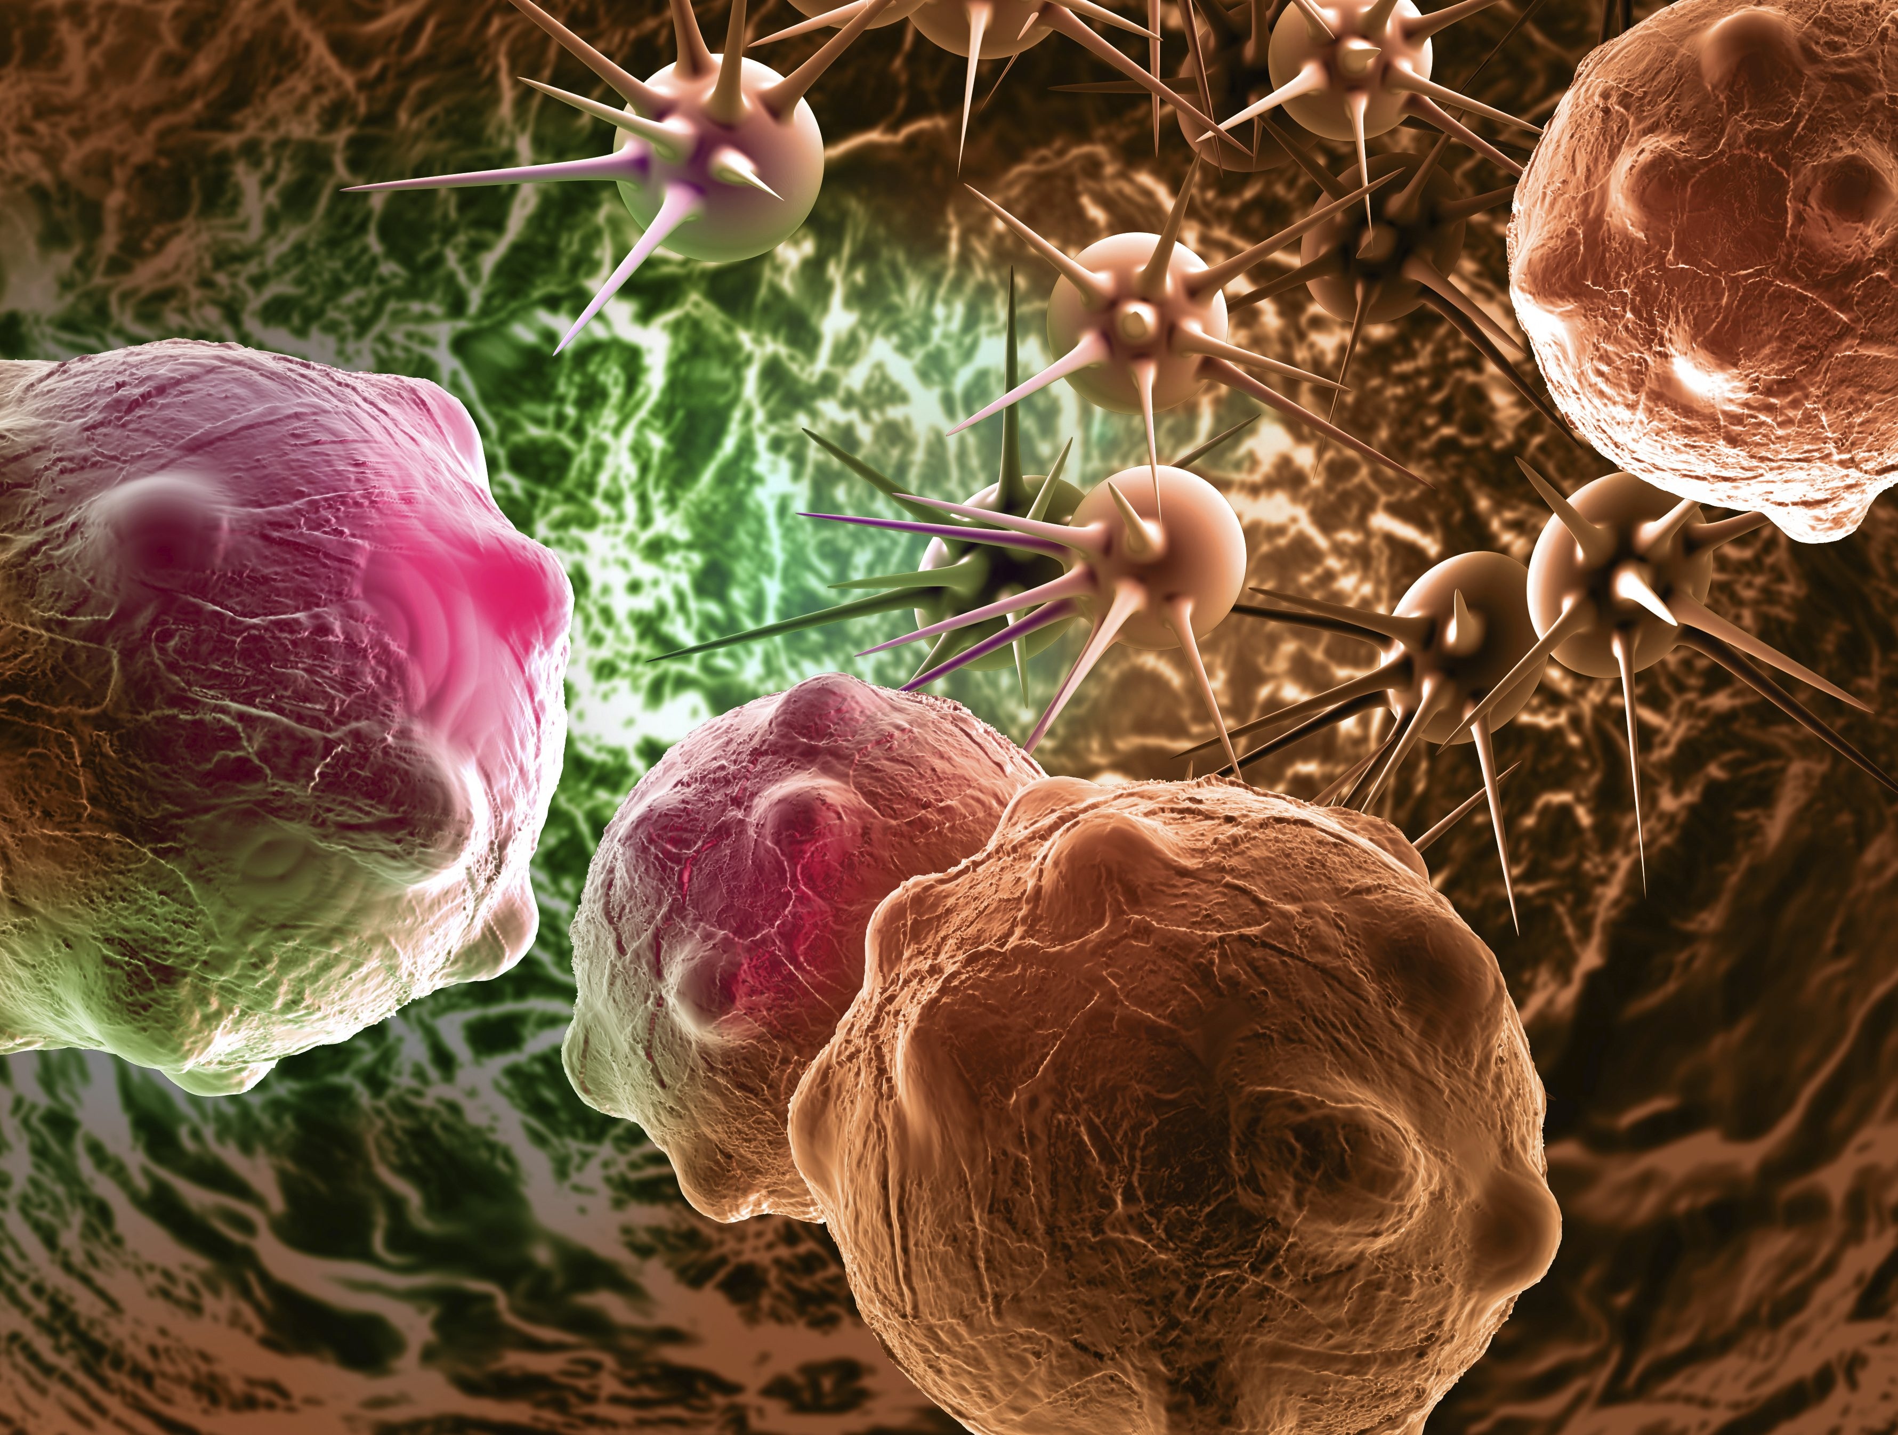

Novel approaches in cancer treatment:
preclinical and clinical development of small
non-coding RNA therapeutics
Presented by:
Muhammad Hossein Ashoub

Slide 2
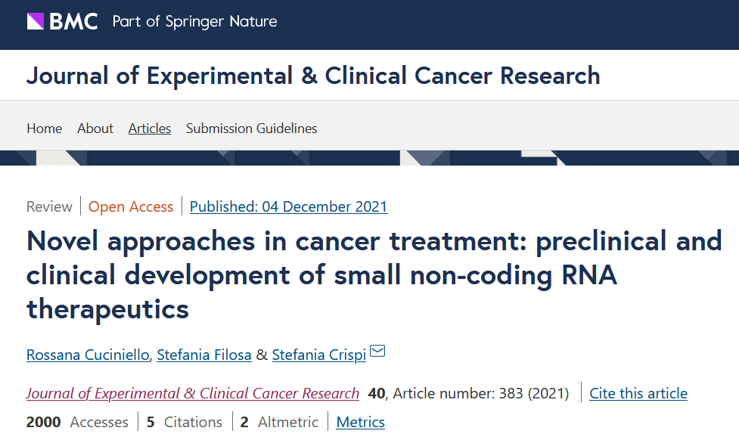

Slide 3
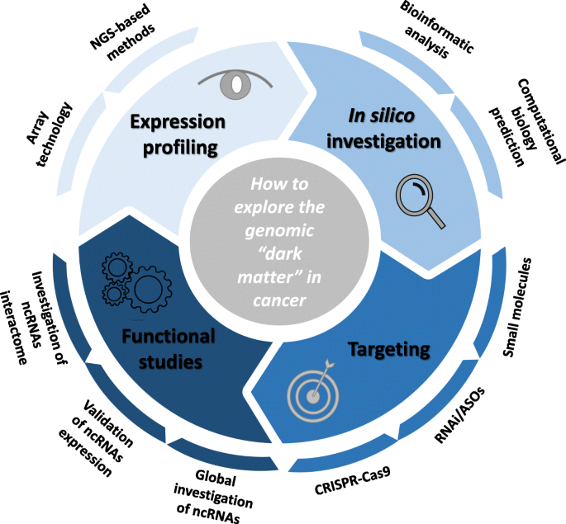
Non-coding RNAs
Background and History
Functions other than coding proteins, e.g., structural, catalytic, and regulatory factors
(-) No strong statistical features, such as ORFs, or polyadenylated, demonstrated in coding genes
(+) Transcribed ncRNA molecules can fold into secondary and tertiary structures (more conserved than sequences)

Slide 4

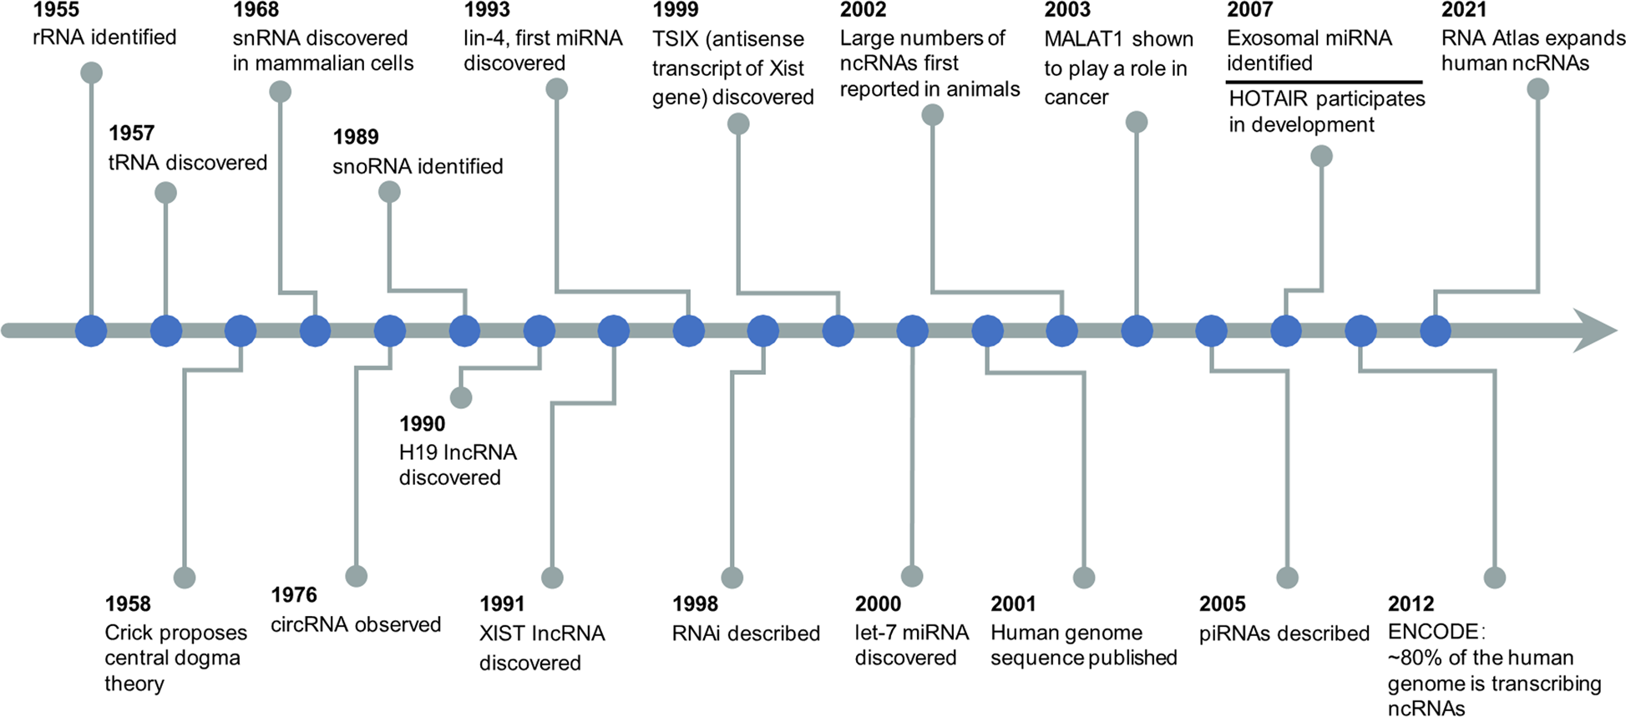
Background and History

Slide 5
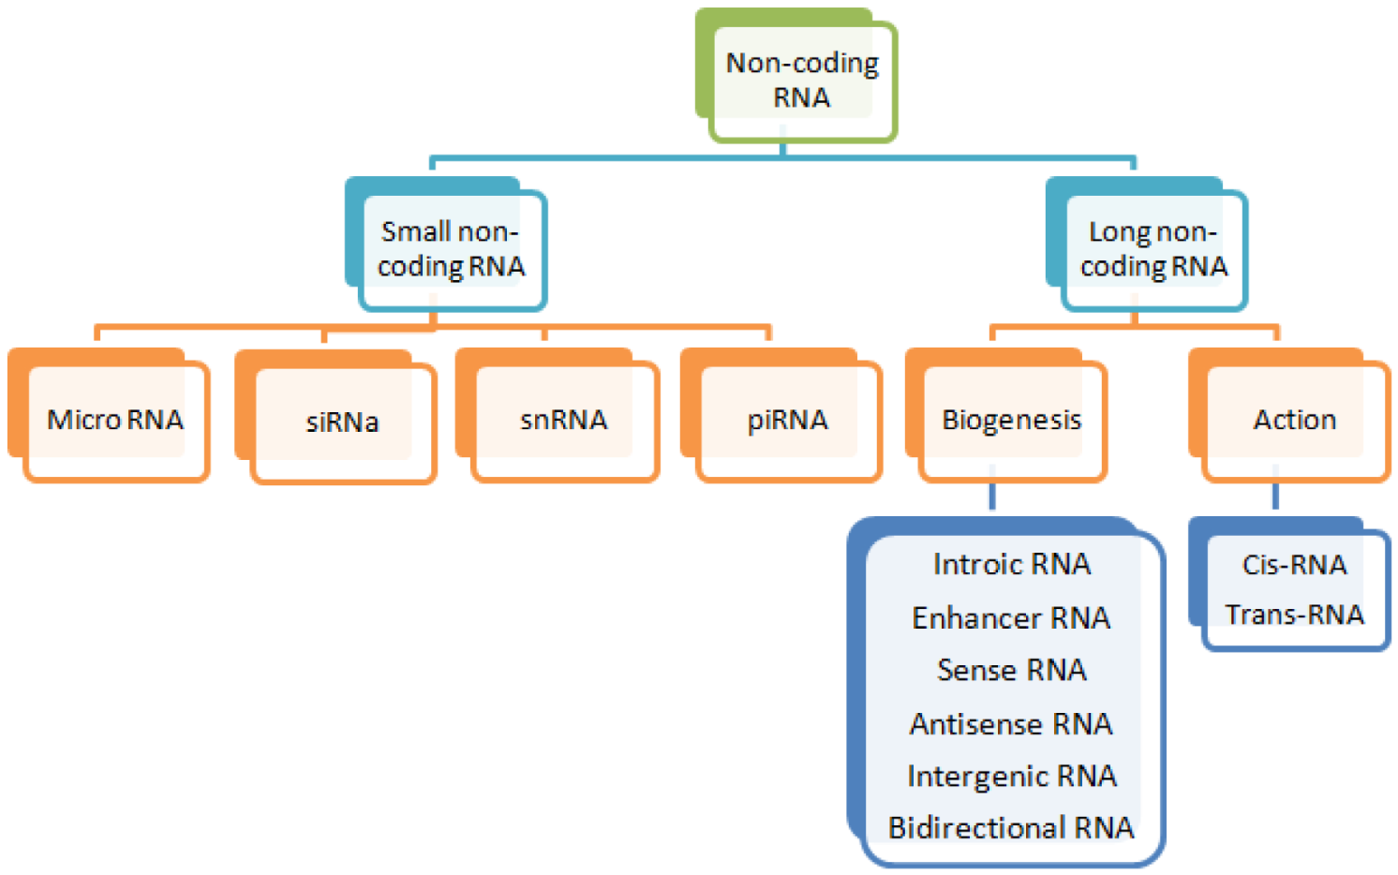
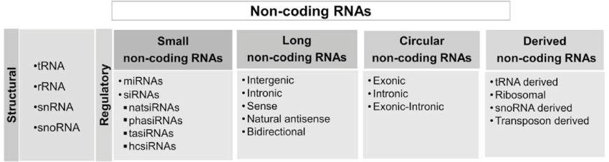
Classification

Slide 6
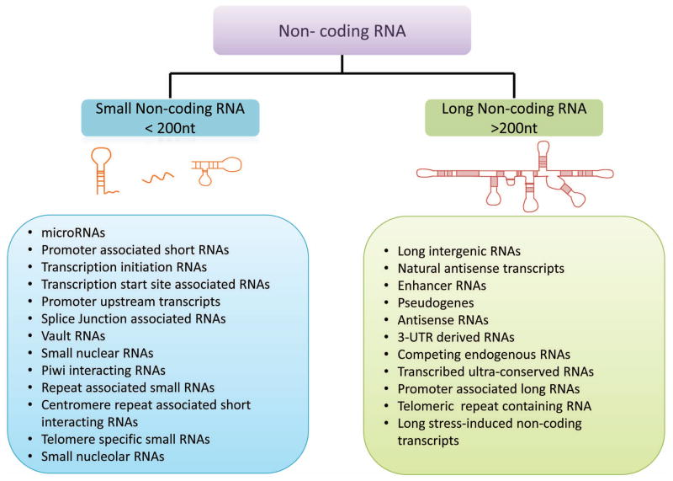
sncRNA vs lncRNA

Slide 7
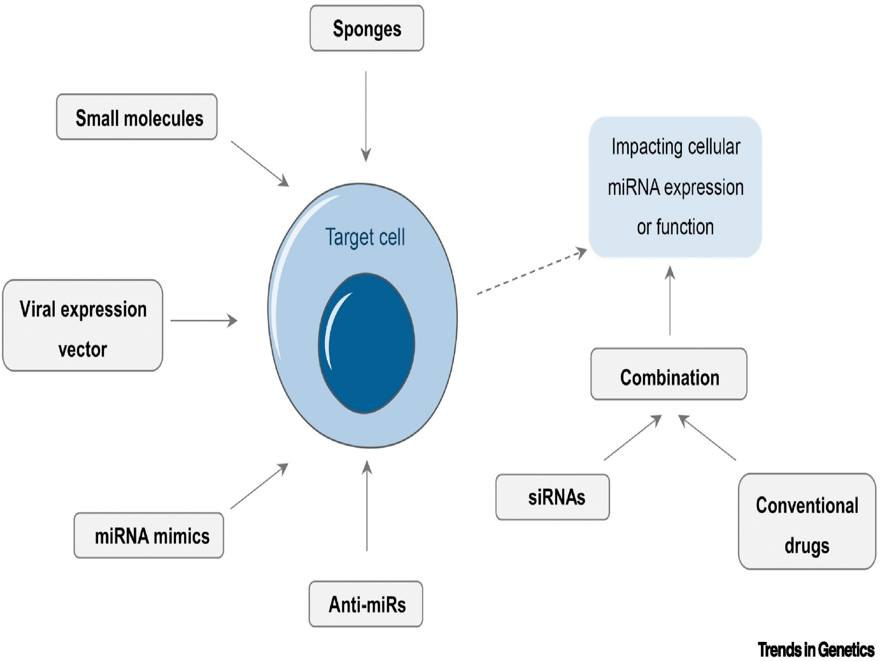
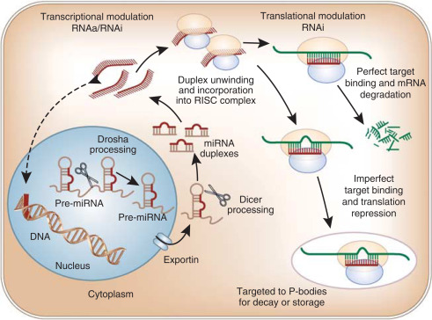
micro RNA

Slide 8
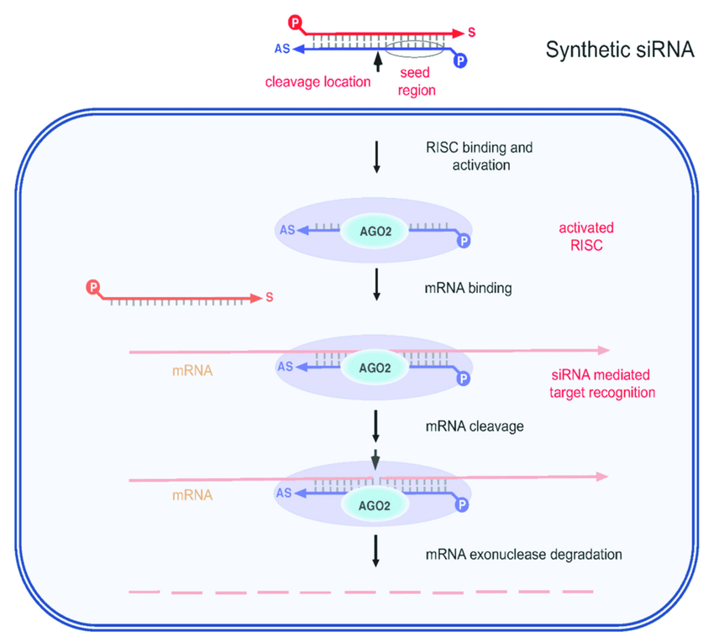
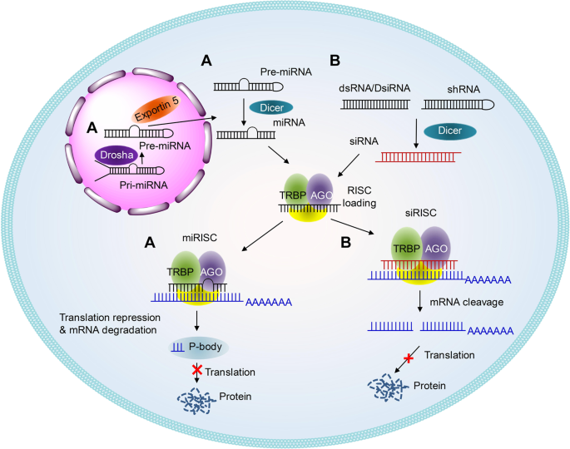
siRNA

Slide 9
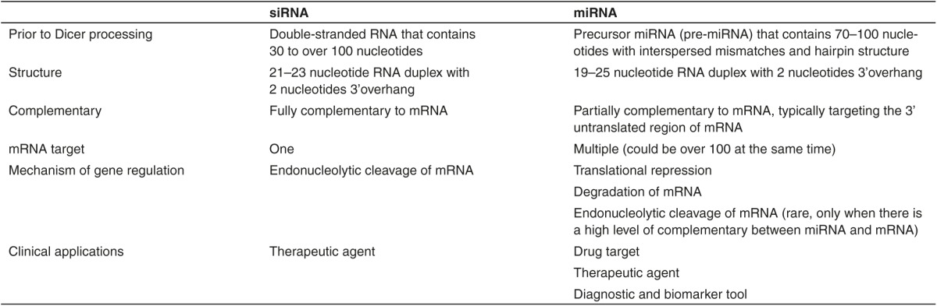
siRNA vs miRNA

Slide 10
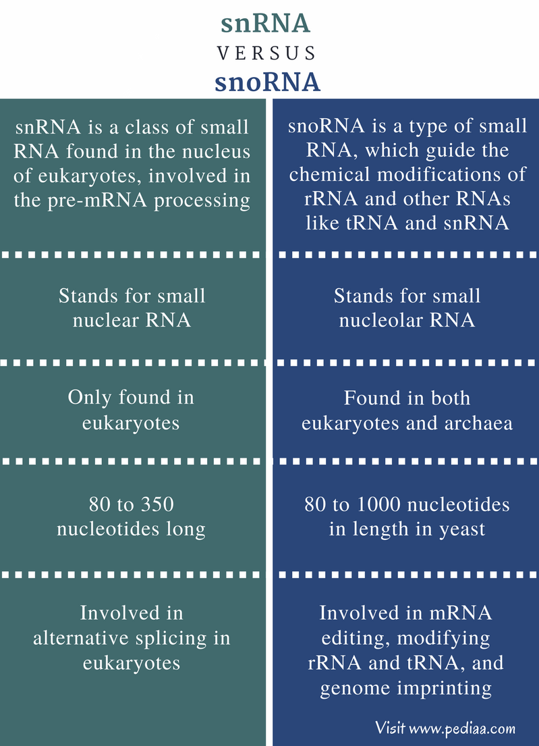
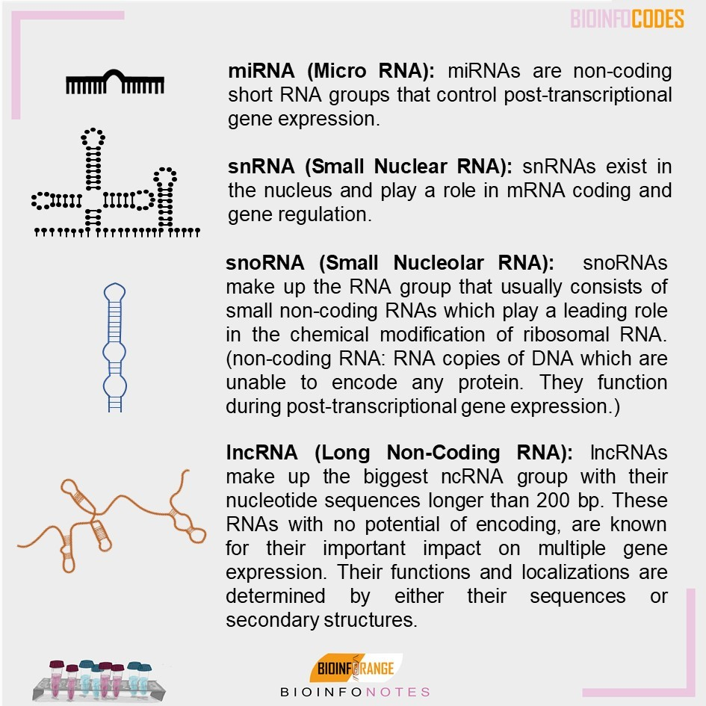
snoRNA vs snRNA

Slide 11
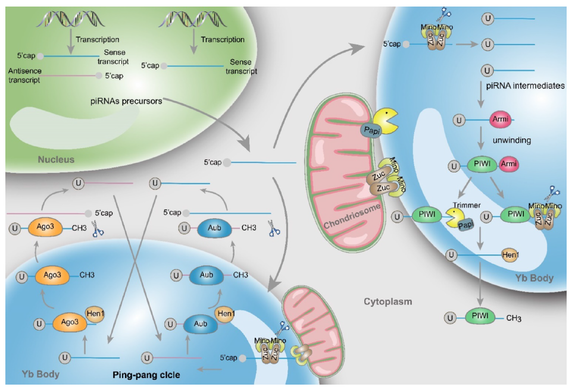
piRNA

Slide 12
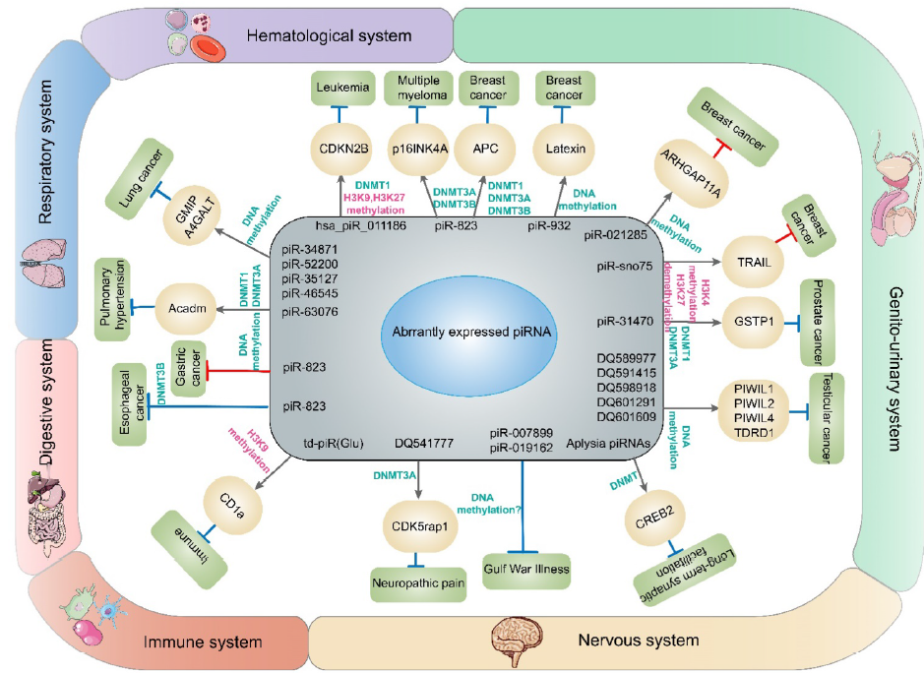
piRNA
Conventional drug delivery System
Controlled drug delivery system

Slide 13
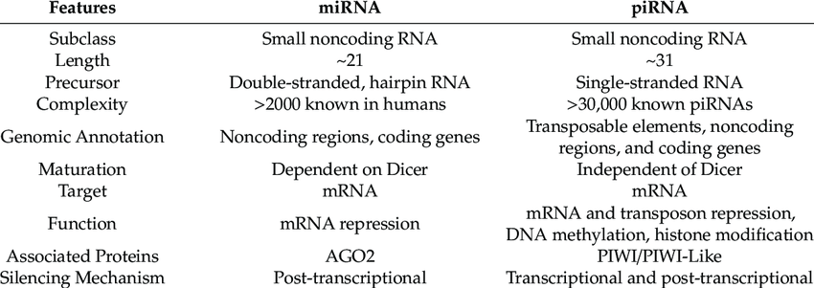
miRNA vs piRNA

Slide 14
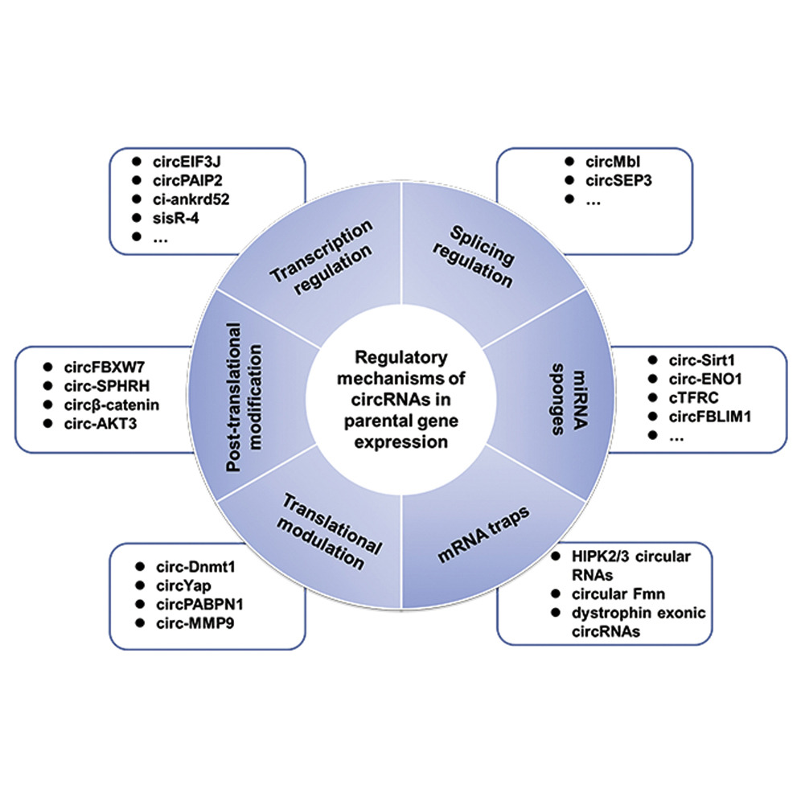
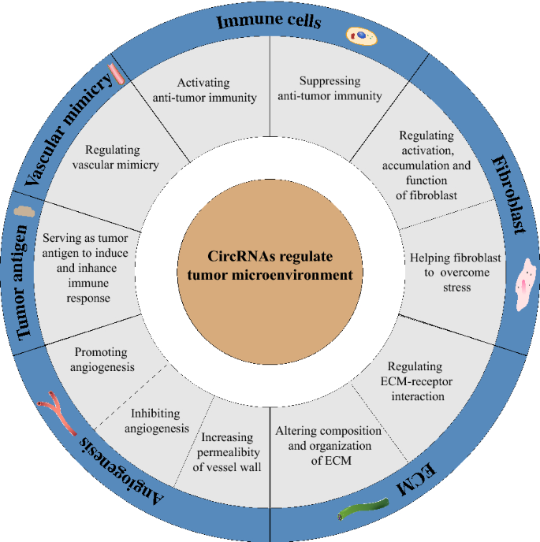
CircRNA

Slide 15
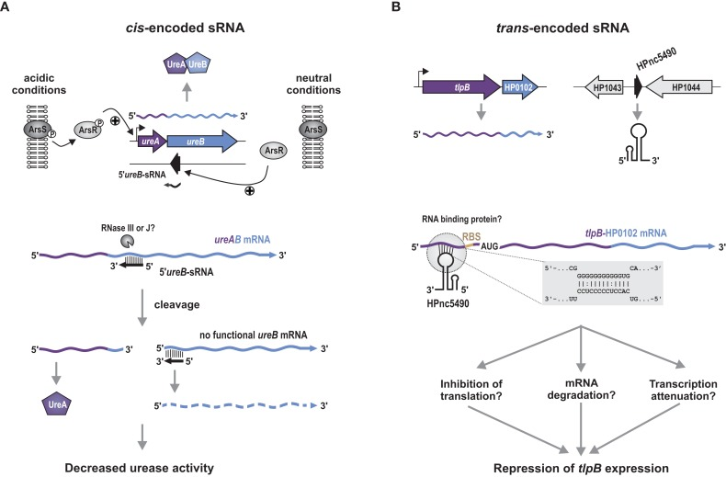
Cis-RNA vs trans-RNA

Slide 16
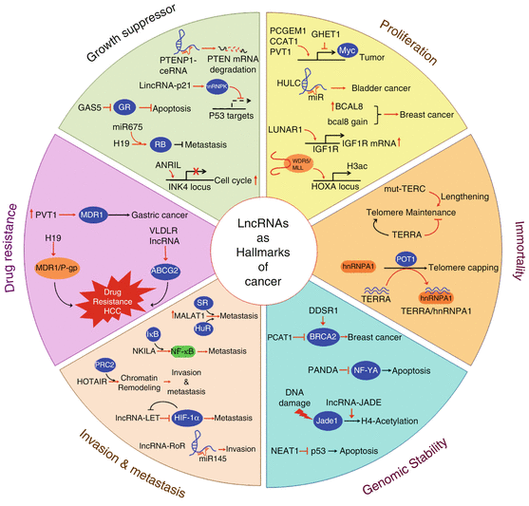
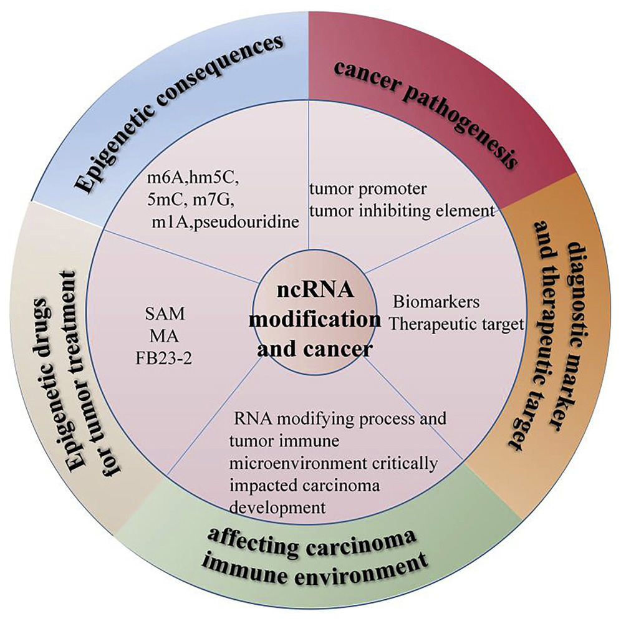
Noncoding RNAs in Cancer and Therapeutic Potential

Slide 17


Slide 18


