Slide 1







In The Name Of God
Effect of CoCl2 or H2O2 pre-conditioned mesenchymal
stem cells in a mouse model of pulmonary ﬁbrosis
Supervisor:
Dr. Ahmad Fatemi
Presented by:
Bahareh Ahmadi
Baharahmadi3875@gmail.com

Slide 2
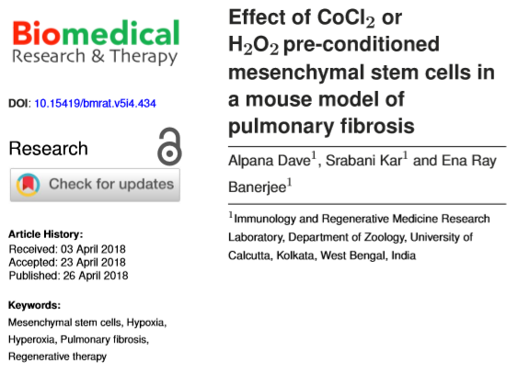

Slide 3
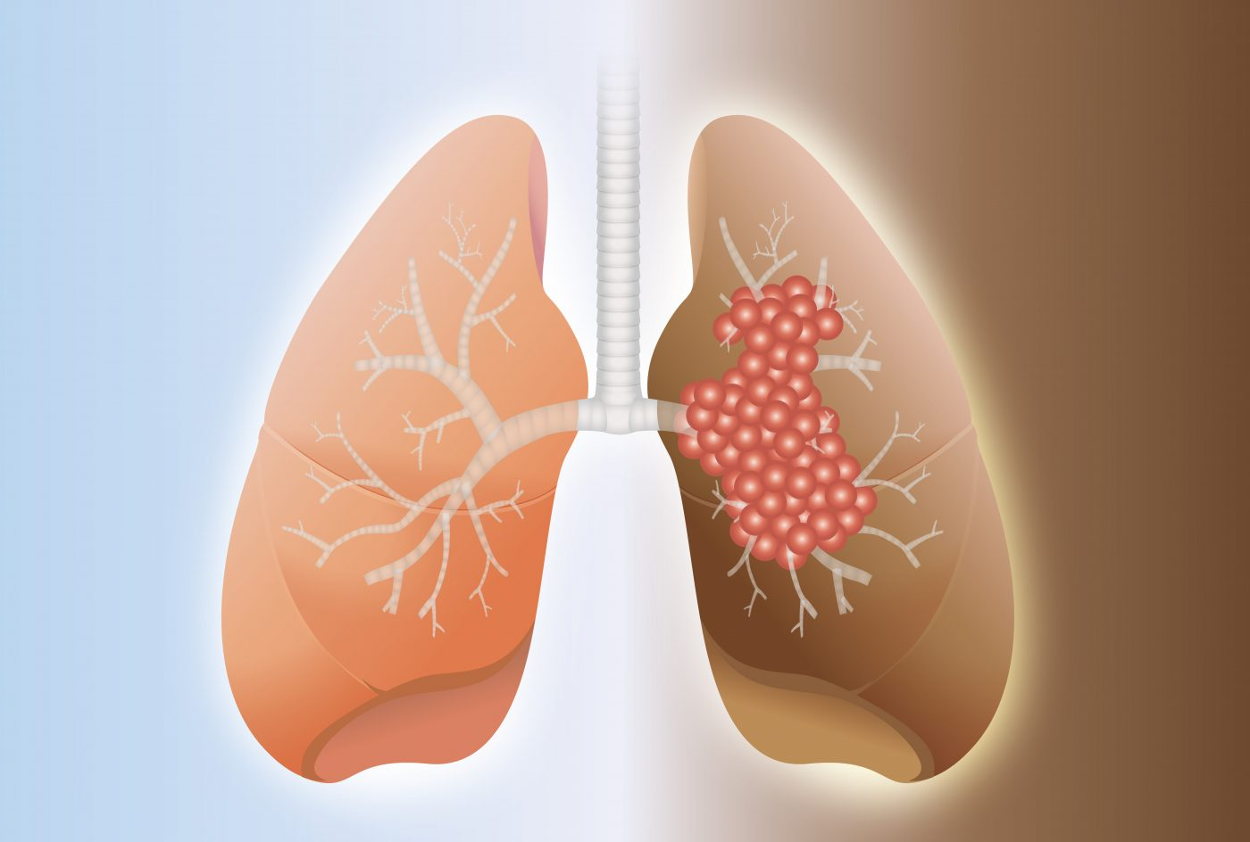
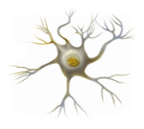
INTRODUCTION
Pulmonary ﬁbrosis (PF) excess deposition of ECM and ﬁbroblasts in the lung parenchyma stiffness in the lung and difﬁculty in breathing
Bleomycin (BLM) A chemotherapeutic agent has undesirable side-effects in inducing lung injuries and triggering apoptosis of alveolar epithelial cells
Mesenchymal stem cells (MSC) adult multipotent cells found in bone marrow, adipose tissue, umbilical cord and other adult tissues.
Pro-inﬂammatory cytokines
Angiogenic
Replacement of ﬁbrotic lesion with lung cells
Collagen content in the lung

Slide 4
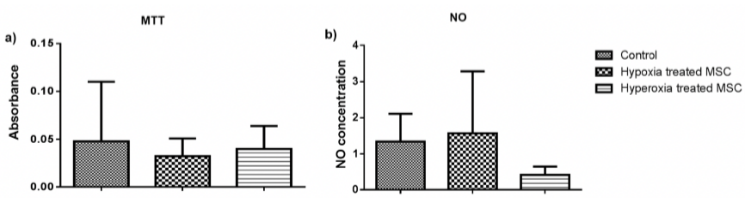
Effect of Pre-conditioning on MSC
Oct 3/4
CD105

Slide 5
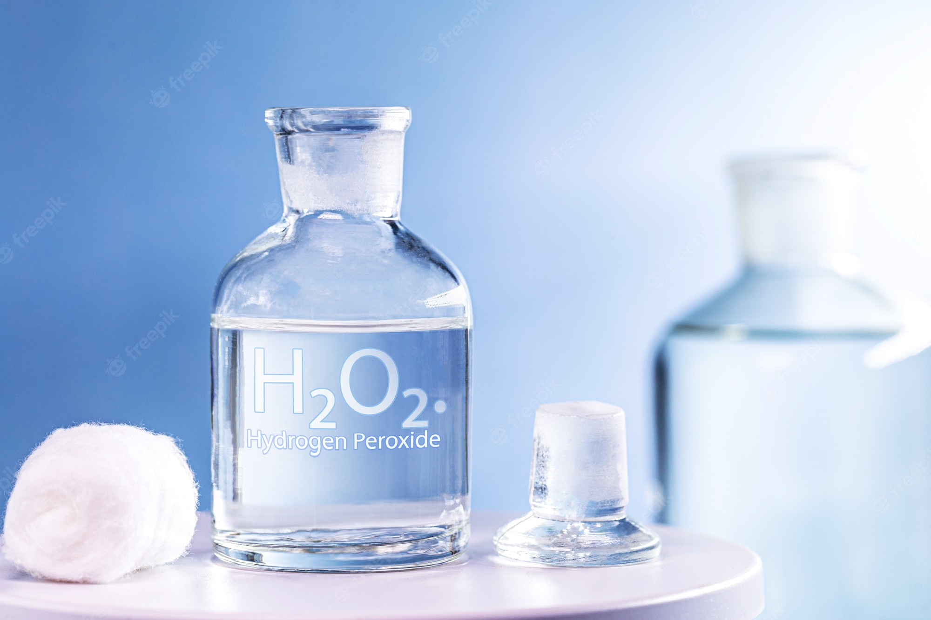
INTRODUCTION
Preconditioning provide a effective way of promoting survival and regenerative properties, and also the tissue repair capability of transplanted cells in stem cell-based therapy
Hypoxia
Hydrogen sulﬁde
Heat shock proteins
Exposure to factors such as erythropoietin, insulin growth factor1
Hydrogen peroxide
Anoxia

Slide 6
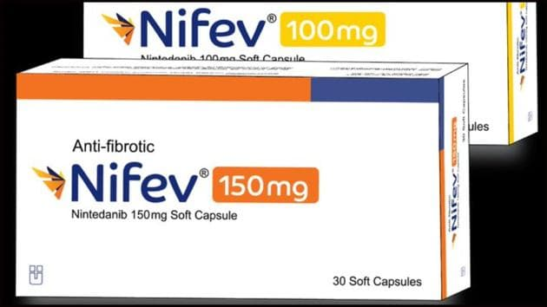
Treatment
(CBT) Cell –based therapy
Reduce progression of the disease but do not facilitate regeneration of damaged lung tissue
Pirfenidone
Ninetedanib

Slide 7
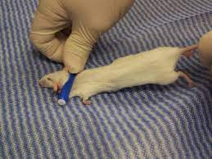
Material
BALB/c mice
Bone Marrow-Derived Mesenchymal Stem Cells
Dulbecco’s Modiﬁed Eagle Medium (DMEM)
Bleomycin
COCL2
H2O2

Slide 8

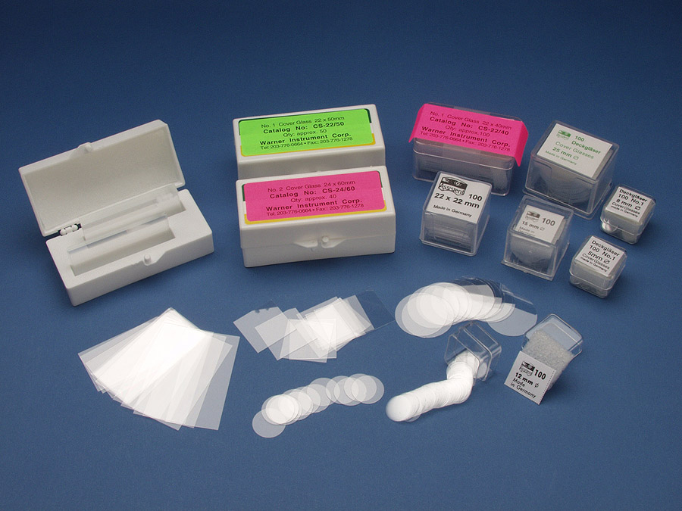
Method
Pre-conditioning cells using abiotic conditions
Cell-based Assays MTT
Nitric oxide production (NO)
NBT
Marker expression analysis
Anti-CD45
Flow cytometry Analysis Anti-B220-FITC
Anti-CD3-PE
Tissue sectioning and staining Hematoxylin
Eosin
Masson’s trichrome

Slide 9
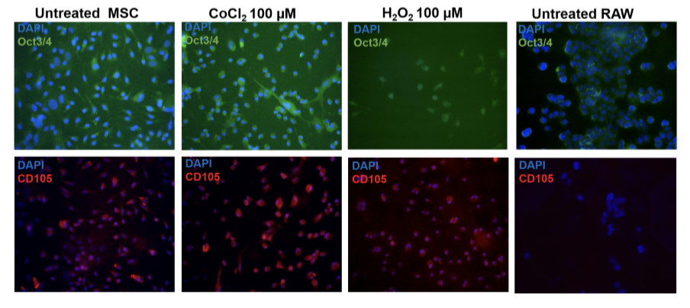
Marker expression analysis in pre-conditioned MSC

Slide 10
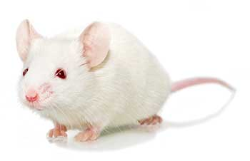
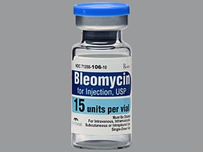
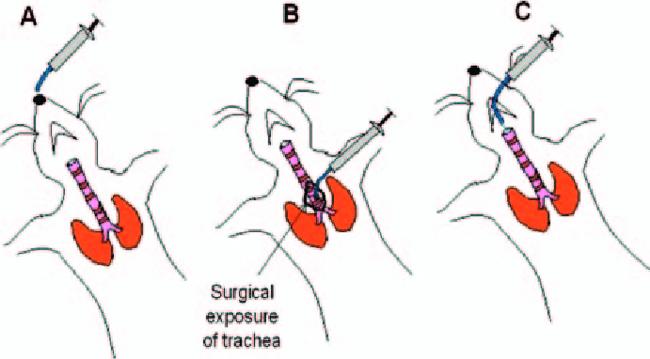
Bleomycin-induced ﬁbrosis
Control(n=2)
Bleomycin treated(n=2)
Bleomycin treated with MSC administration (n=3)
Bleomycin with hypoxia pre-conditioned MSC administration (n=3)
Bleomycin with oxidative stress pre-conditioned MSC administration (n=3)

Slide 11
Result
Hypoxia Pre-conditioning = Oxidative stress Pre-conditioning
inﬂammation
proliferation
3-fold reduction in inﬂammation

Slide 12
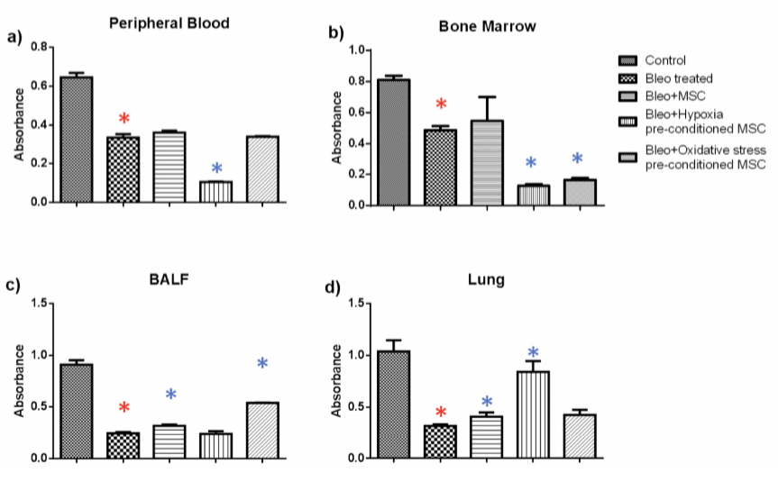
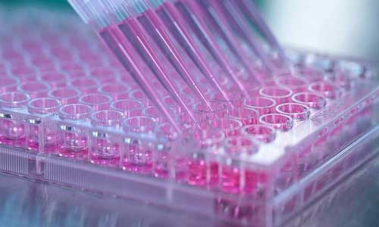
Cell viability analysis after MSC treatment
MTT

Slide 13
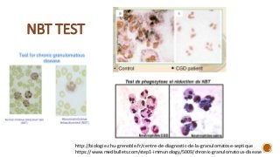
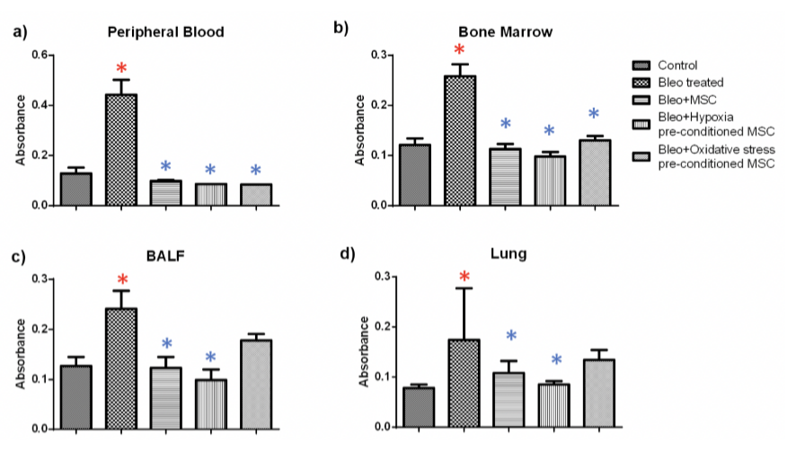
Cell inﬂammation analysis after MSC treatment

Slide 14
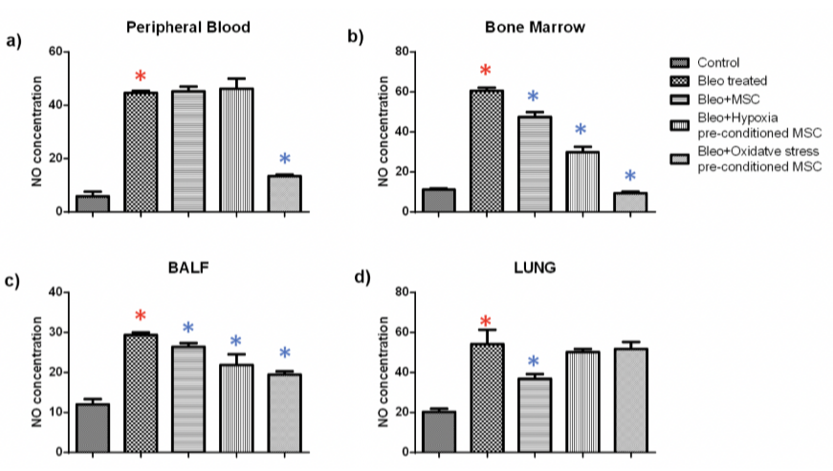
Effect of pre-conditioned MSC administration on Nitric Oxide (NO) production

Slide 15
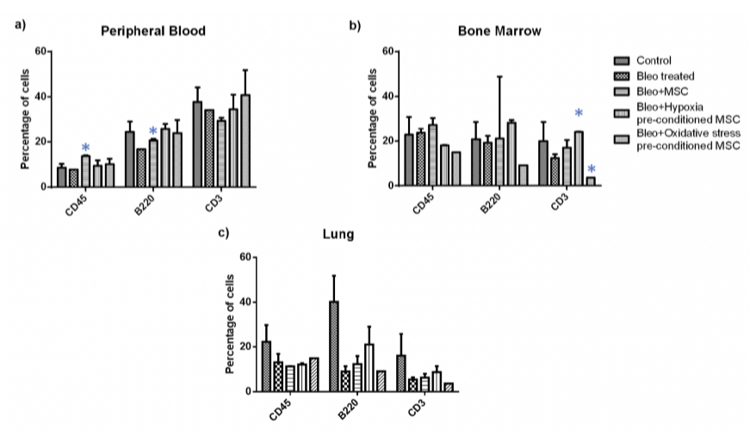
Flow cytometry analysis
Percentage of T-cell and B- cell population in MSC treated and untreated tissue

Slide 16
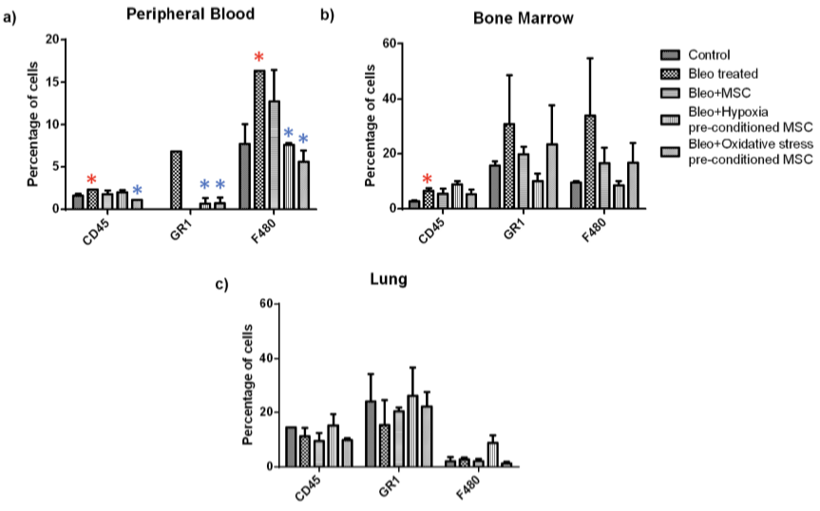
Flow cytometry analysis
Percentage of granulocyte and macrophages in MSC treated and untreated tissue

Slide 17
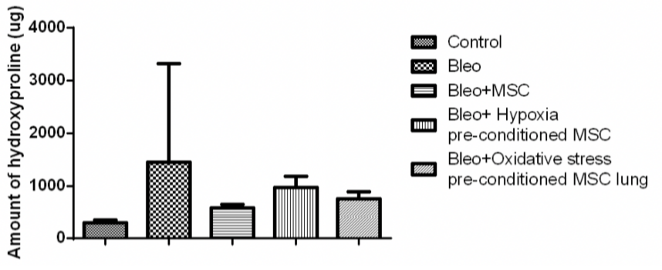
Hydroxyproline analysis

Slide 18
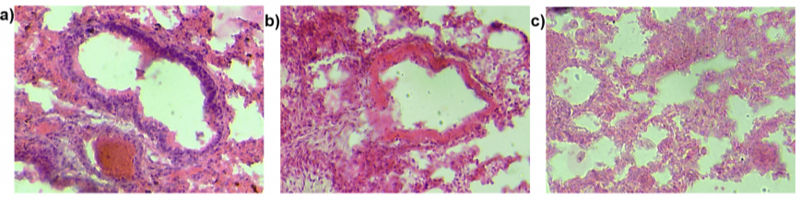
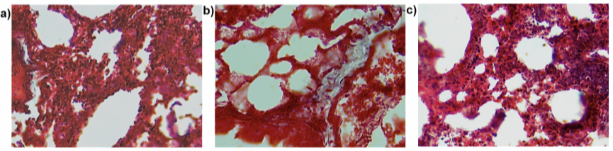
Histological analysis
Hematoxylin-Eosin staining of lung sections
Masson’s trichrome staining of lung sections

Slide 19
Result
Alteration of the dose of cocl2 and H2O2 improvement in lung histology
Induce
Hypoxia
oxidative stress
duration of pre-conditioning to 48 or 72 hours

Slide 20
Discussion
MSC Hepatocyte Growth Factor (HGF)
Epithelial Growth Factor (EGF)
Fibroblast Growth Factor (FGF)
Tumor Growth Factor-β (TGF. β)
Interleukins
Tumor Necrosis Factor-α (TNF-α)
Interferon-γ (INF-γ)

Slide 21
Discussion
Lee and colleagues
intravenously administered MSCs
Bleomycin-induced lung edema
Neutrophil inﬁltration
Collagen deposition
Overall mortality

Slide 22
Discussion
Ortiz and colleagues
after bleomycin exposure in mice
MSCs home to sites of lung injury
inﬂammation
ﬁbrosis
extracellular matrix collagen deposition
contribute to tissue repair
Hydroxyproline assay

Slide 23
Discussion
Earlier studies
Hypoxic pre-conditioning
Improving cell survival
Differentiation
Proliferation
Homing
umbilical cord-derived MSC

Slide 24
Conclusions
Transplantation of preconditioned -MSCs
Inﬂammation in all the tissues
Cell viability in the lung
paracrine effects
Anti- apoptotic and Regenerative ability of MSC

Slide 25
Thanks For Your Attention
Is there a question that I will gladly answer?

