Slide 1

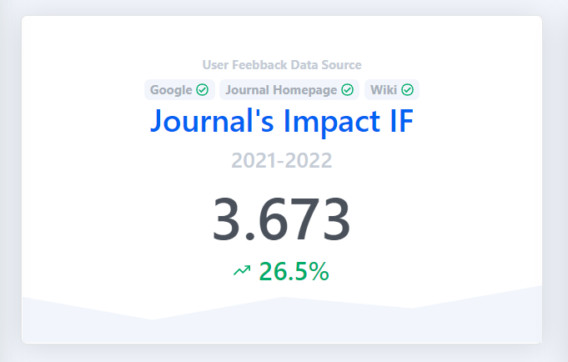
Expression of the immune checkpoint receptors CTLA‑4, LAG‑3, and TIM‑3 in β‑thalassemia major patients: correlation with alloantibody production and regulatory T cells (Tregs) phenotype (2021)
Annals
of
Hematology

Slide 2

Introduction
1
β-Thalassemia major
Phenotypes & Treatments
Complications associated with blood transfusion (responders & nonresponders)
anti-kell (50%), anti-D (15.8%), and anti-E (10.5%)
2

Slide 3
Introduction
nTregs
CD4
CD25
FoxP3
Immune checkpoint receptors
CTLA-4; CD152
LAG-3; CD223
TIM-3
PD-1
PD-L1; CD274

Slide 4
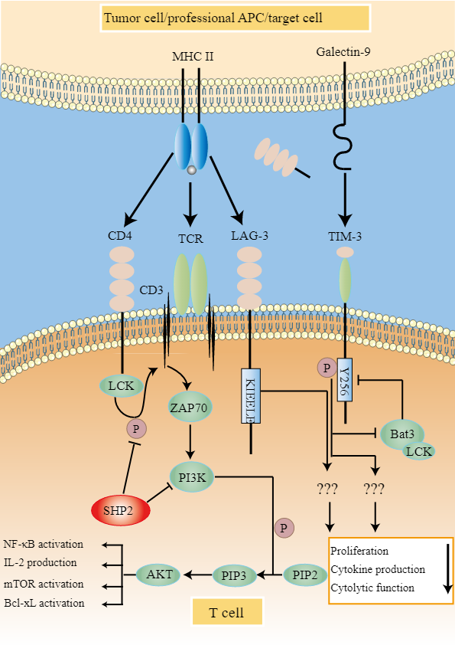
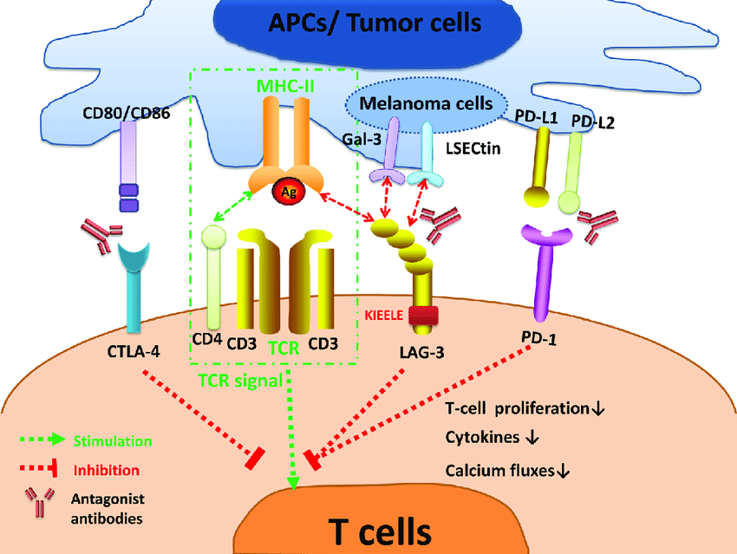
Aim of the study

Slide 5
Material and methods
2
Patient selection (groups, exclusion criteria)
Laboratory parameters (2 ml fresh blood, EDTA, hematologic parameters, CBC)
RNA isolation and cDNA synthesis (total RNA extraction, quality determination, cDNA synthesis)
Real‑time PCR (SYBR Green real-time PCR, ACT-β)
Statistical analysis (SPSS, one-way ANOVA)
5

Slide 6

Results
3
6

Slide 7
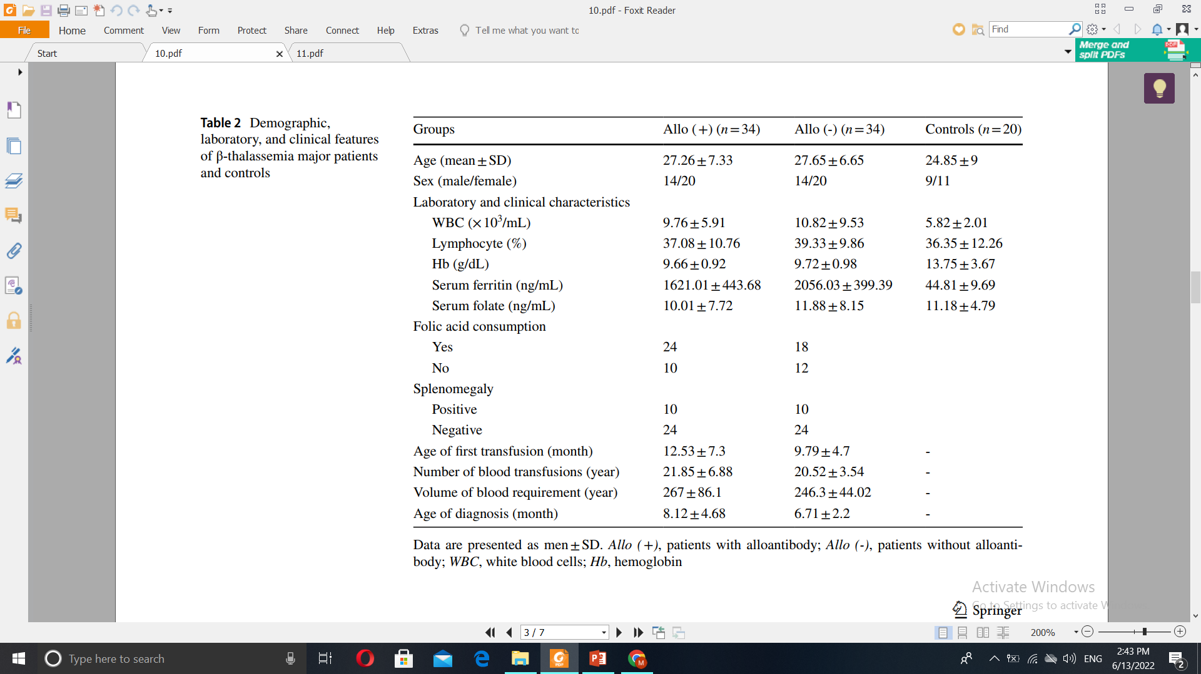
laboratory, and clinical
Features of β-thalassemia
major patients and controls
7

Slide 8
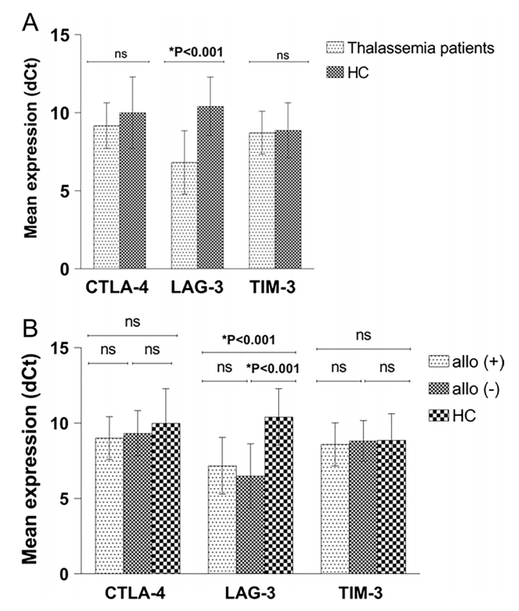
Analysis of
CTLA‑4, LAG‑3, and TIM‑3
expression
8

Slide 9
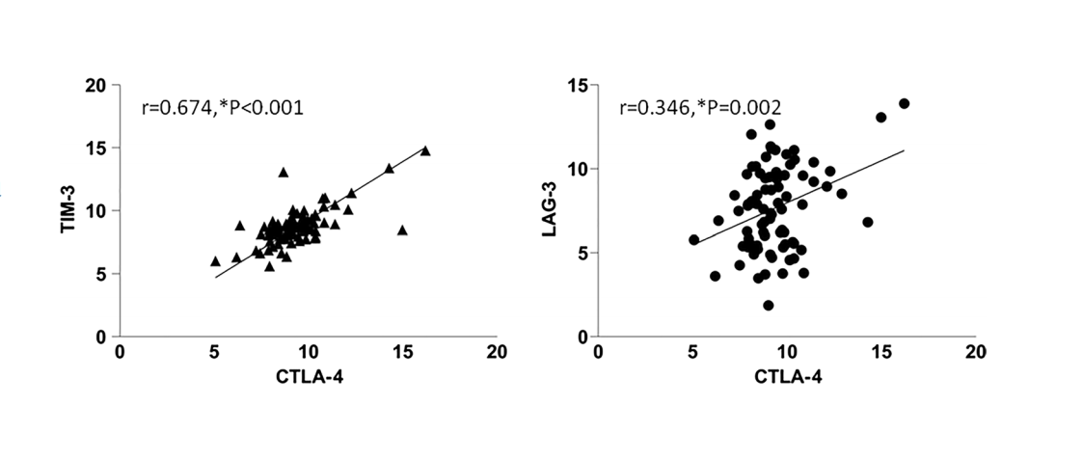
correlation between the relative
expression of
CTLA-4 and LAG-3 and TIM-3
Correlation between
CTLA‑4, LAG‑3, and TIM‑3 gene
expression and laboratory parameters
9

Slide 10
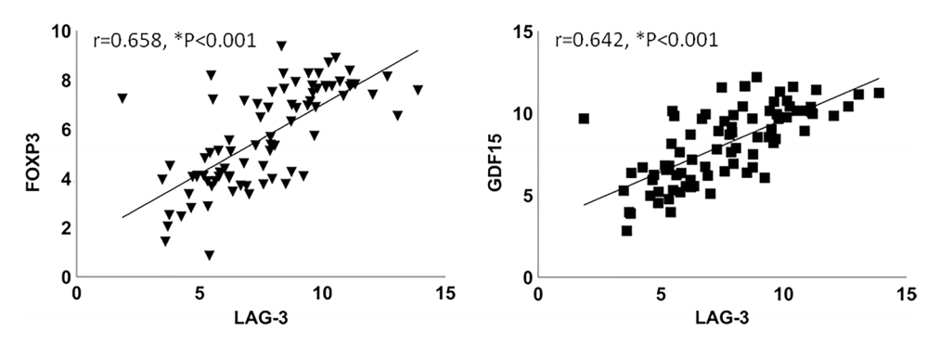
CTLA‑4, LAG‑3, and TIM‑3 gene expression and Treg
markers
10

Slide 11

Discussion

Slide 12
Dysregulation of
immune system
immune checkpoint receptors
Beta-thalassemia major
1
3
5
2
4
6
Iron overload &
alloimmunization
Treg
LAG-3

Slide 13

استاد راهنما:
جناب دکتر میرزایی
ارائه دهنده:
مهسا اصغری

