Slide 1

MicroRNA-204 Potentiates the Sensitivity of Acute Myeloid Leukemia Cells to ArsenicTrioxide
Wang et-al (2019)

Slide 2


Journal of oncology research

Slide 3
Introduction
AML
miRNAs
PATHOLOGY
miR-204
SURVIVAL
BIRC6
THERAPY

Slide 4
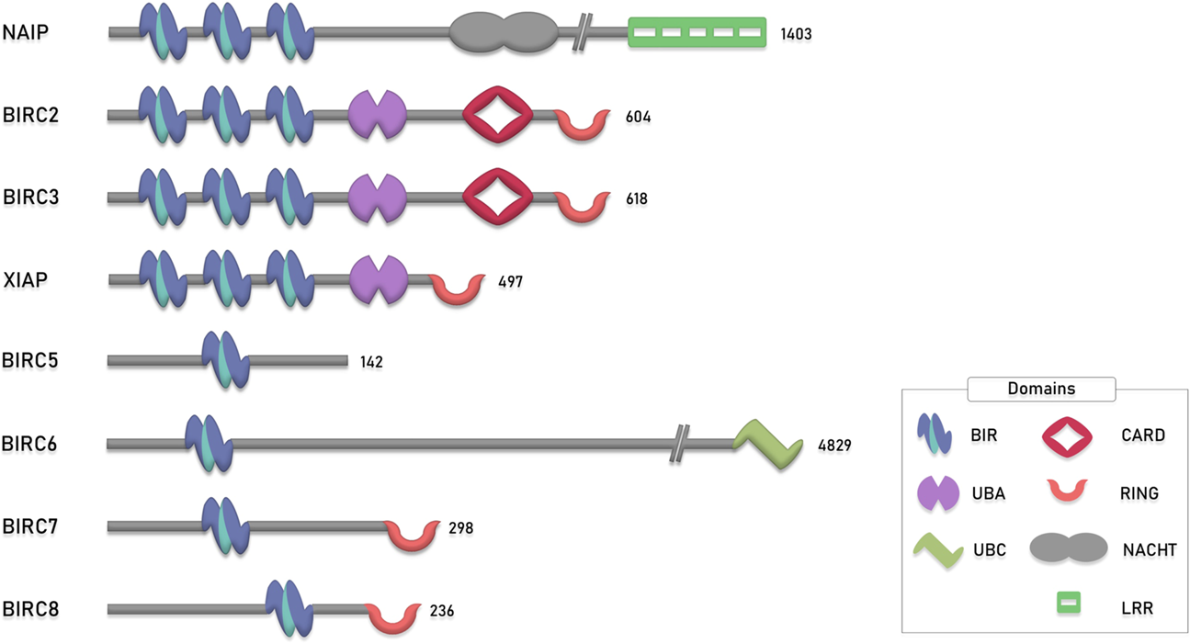
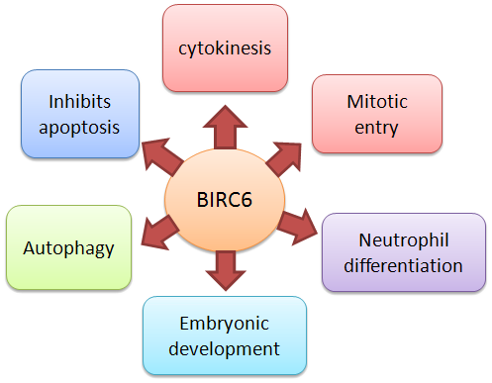
Introduction

Slide 5
MATERIALS AND METHODS
Patients and Specimen Preparation
1) subjects with a good response to ATO (10 mg daily then 10 mg for 2 weeks every 2 months) 2) subjects received no other chemotherapies
Cell Culture
AML-5 & HL-60 RPMI-1640 medium containing 10% FBS and 50 μg/ml gentamicin in a humidified incubator with 5% CO2 at 37°C
Cell Viability Assay
CCK-8
Quantitative Real-Time PCR
miR-204 level & mRNA expression of BIRC6
Cell Transfection
Human BIRC6 cDNA cloned into pSMCV expression vector confirmed by sequencing
AML-5 or HL-60 cells were transfected with: 1.miR-204 mimics 2.miRNA mimics negative control 3.BIRC6 plasmid 4.empty vector

Slide 6
MATERIALS AND METHODS
Apoptosis Detection Assay
annexin V–FITC and PI
Cell Cycle Analysis
flow cytometry with PI
ModFit software program
Western Blotting Analysis
Luciferase Assay
pmirGLO vector

Slide 7
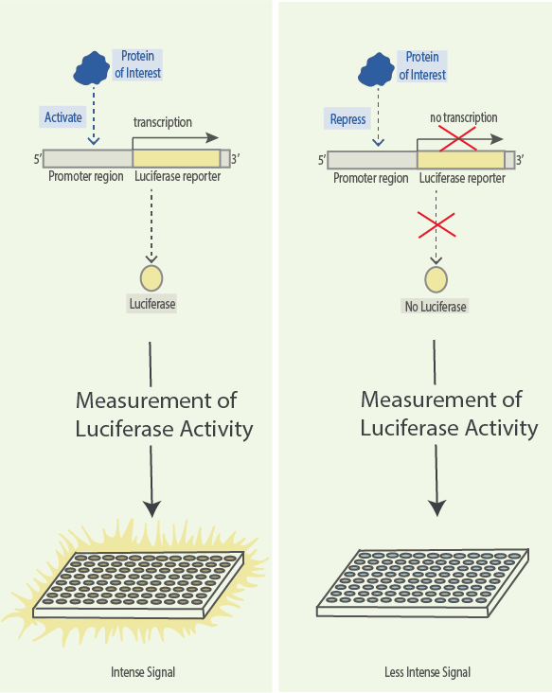
آزمون لوسیفراز (luciferase assay)

Slide 8
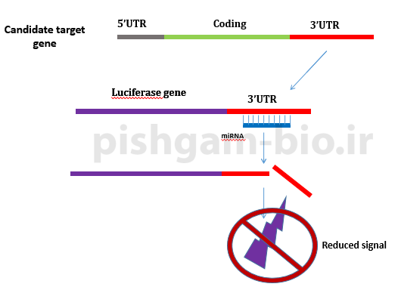
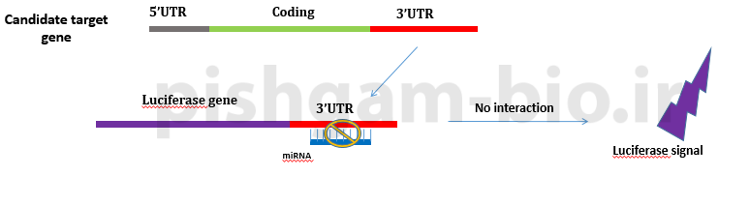
آزمون لوسیفراز دوگانه (dual luciferase assay)

Slide 9
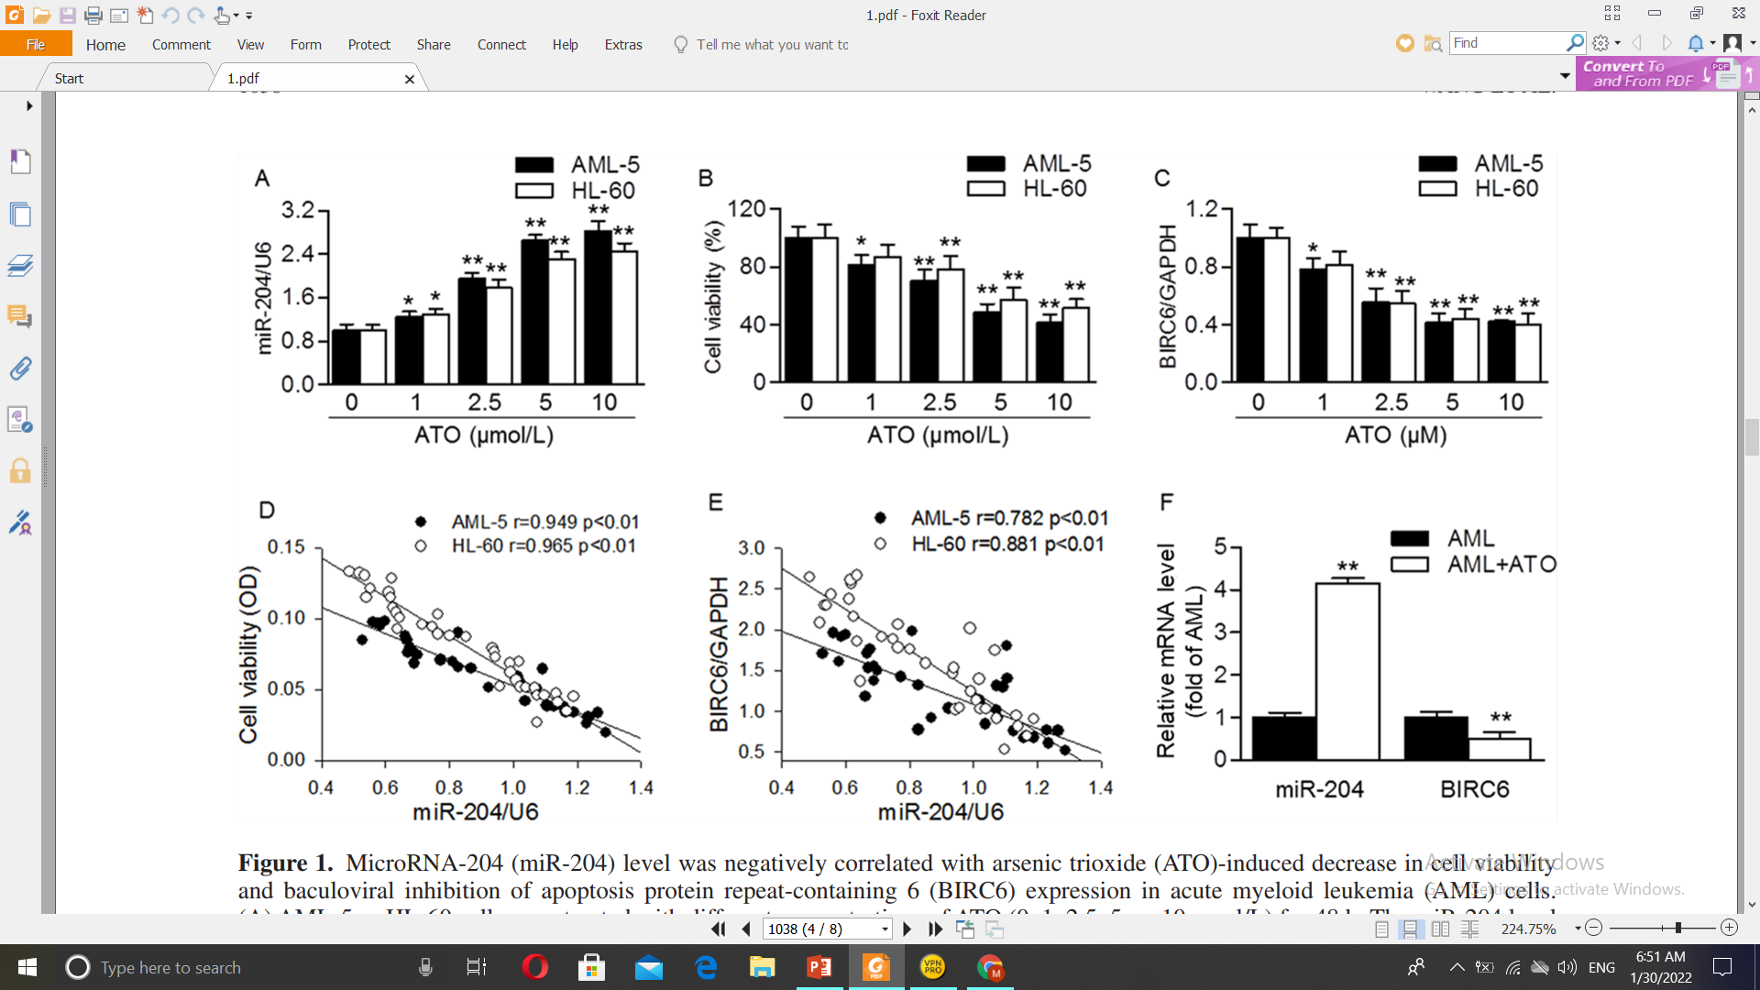
1. miR-204 Level Was Negatively Correlated With AML
Cell Viability and BIRC6 Expression After ATO Treatment
Results

Slide 10


Slide 11
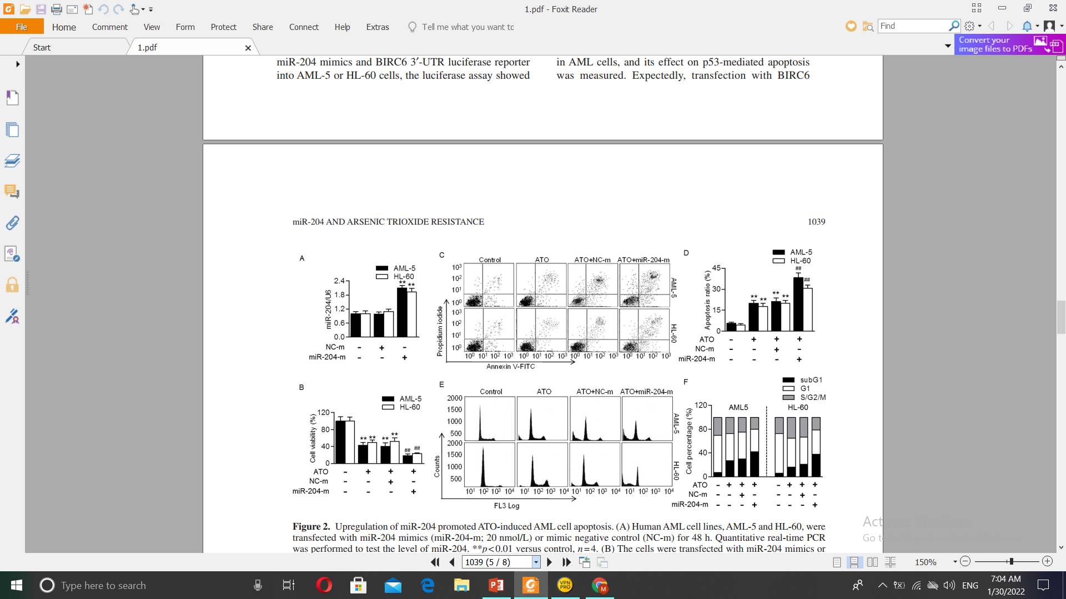
2. miR-204 Upregulation Promoted ATO-Induced
AML Cell Apoptosis
&

Slide 12
3. miR-204 increases ATO chemosensitivity via promoting
cell apoptosis rather than inhibiting cell proliferation

Slide 13
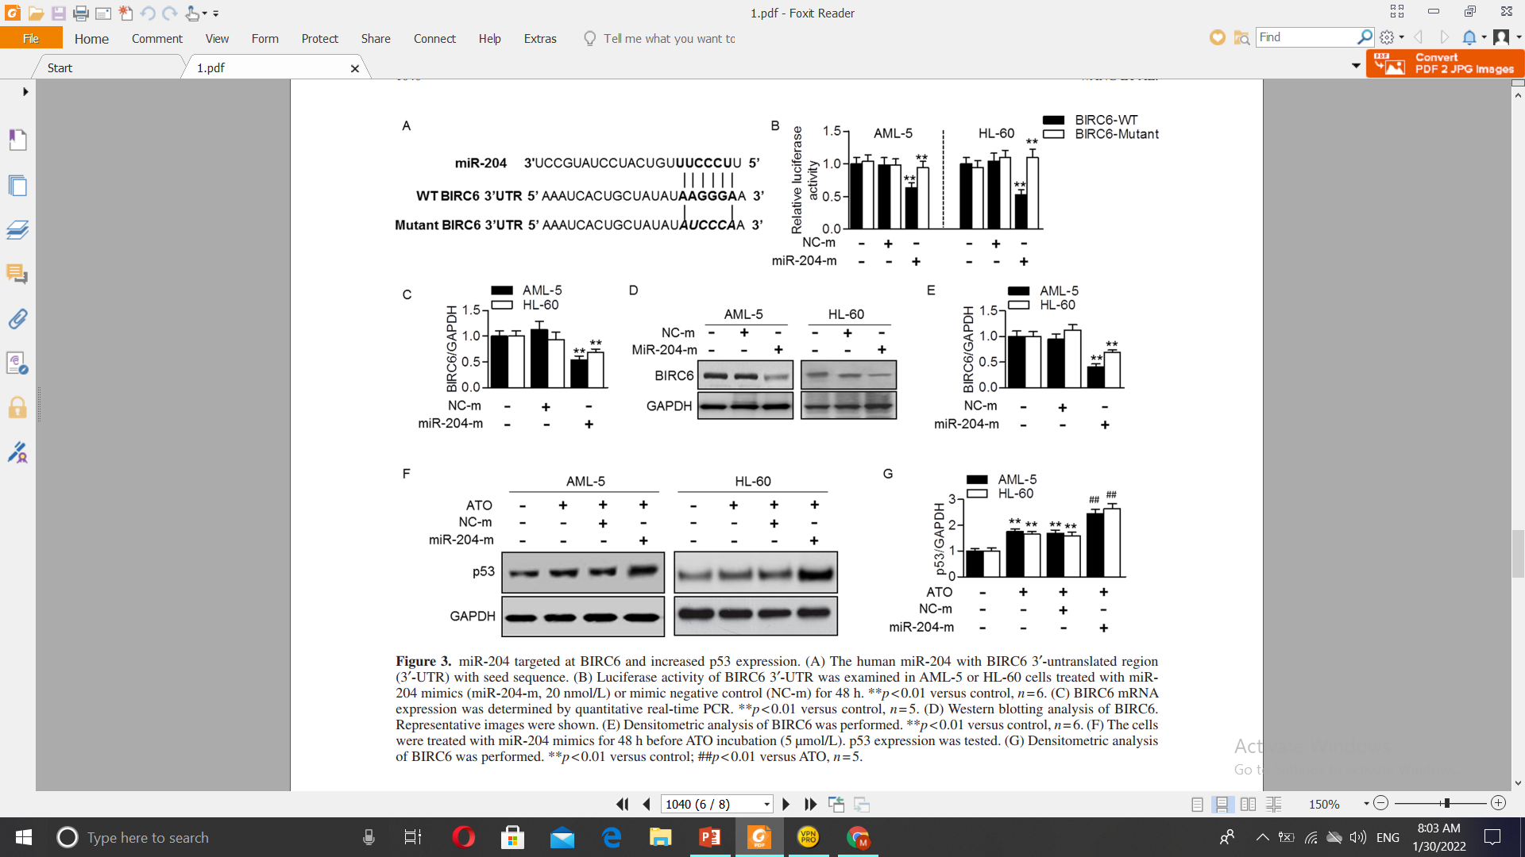
4. miR-204 Targeted to BIRC6 and Enhanced
p53 Expression
10

Slide 14
5. miR-204 increases
the sensitivity of AML cells to ATO at least partially
via BIRC6/p53-dependent apoptotic pathway

Slide 15
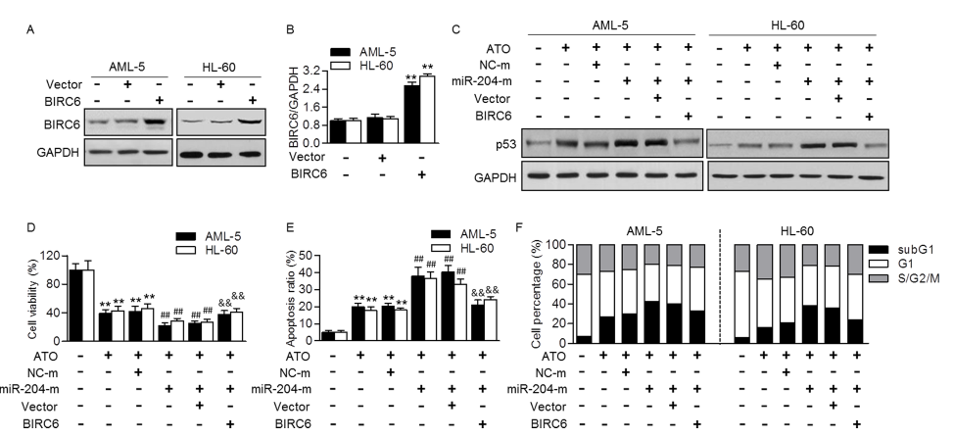
6. Restoration of BIRC6 reversed the effect of miR-204
on AML cell apoptosis induced by ATO
12

Slide 16


Discussion

Slide 17
miRNA
miR-192
miR-22
miR-204
Effect of ATO
Effect on ATO
BIRC6
miR-181a
miR-342
miR-446h
miR-204
p53

Slide 18
THANKS
FOR YOUR ATTENTION
Any questions?

