Slide 1


Gene Therapy of the Hemoglobinopathies
2020
HemaSphere
8.3
Advisor: Present by:
Dr.Mirzaee Mahsa Asghari

Slide 2
CONTENTS
Here’s what you’ll find in this presentation:
The clinical challenges of hemoglobinopathies
Principles of gene therapy for the hemoglobinopathies
History of gene therapy:
y-retroviral vectors
New self-inactivating (SIN) lentiviral vectors
Clinical results of “gene addition” for transfusion-dependent thalassemia and for sickle cell disease
Gene therapy beyond gene addition
Perspectives
2

Slide 3
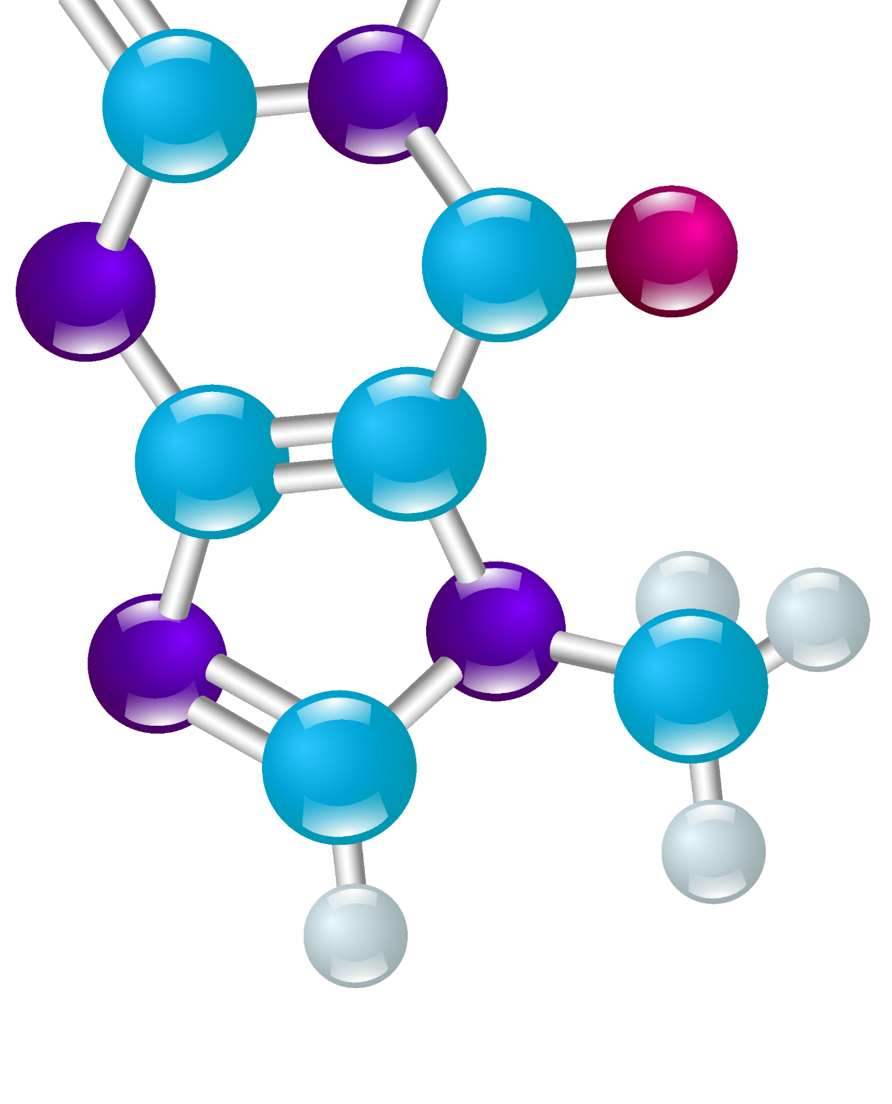

ß-thalassemia
Pathogenesis
Genotype
Phenotype
ß0
ß+
TDT
NTDT
Treatment
Economic burden
The clinical challenges of hemoglobinopathies
3

Slide 4
SCD
Pathogenesis
Manifestations
Treatment
The clinical challenges of hemoglobinopathies
3

Slide 5
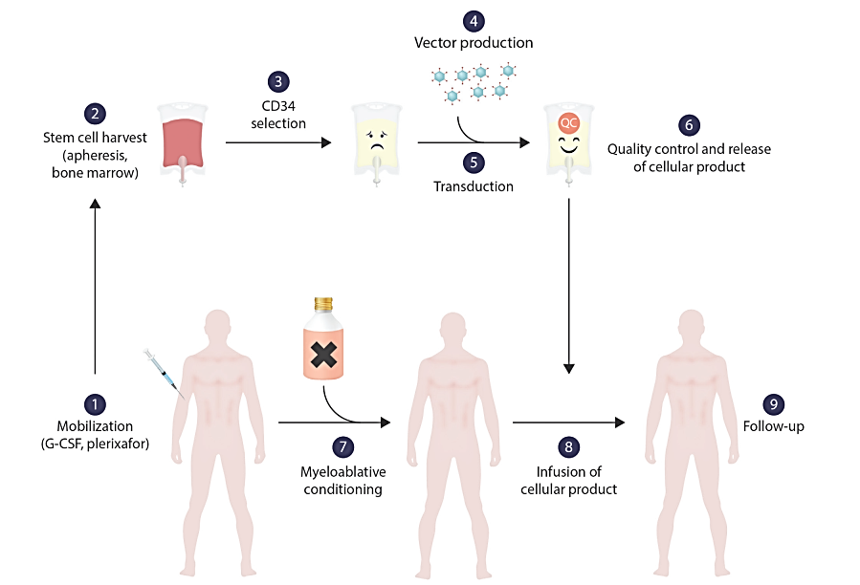
Principles of gene therapy for the hemoglobinopathies
4

Slide 6
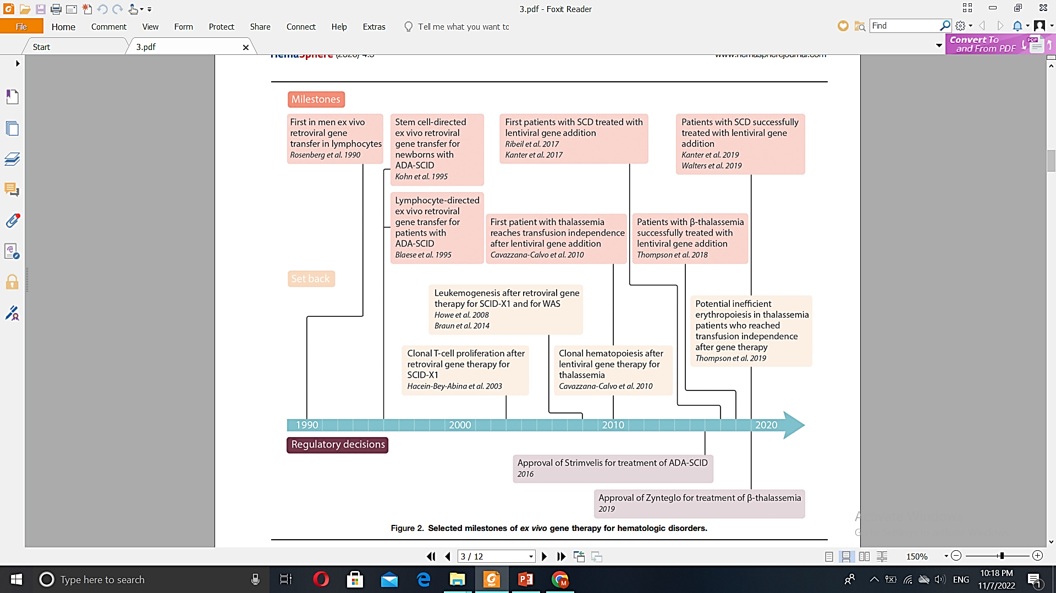

History of gene therapy
5

Slide 7
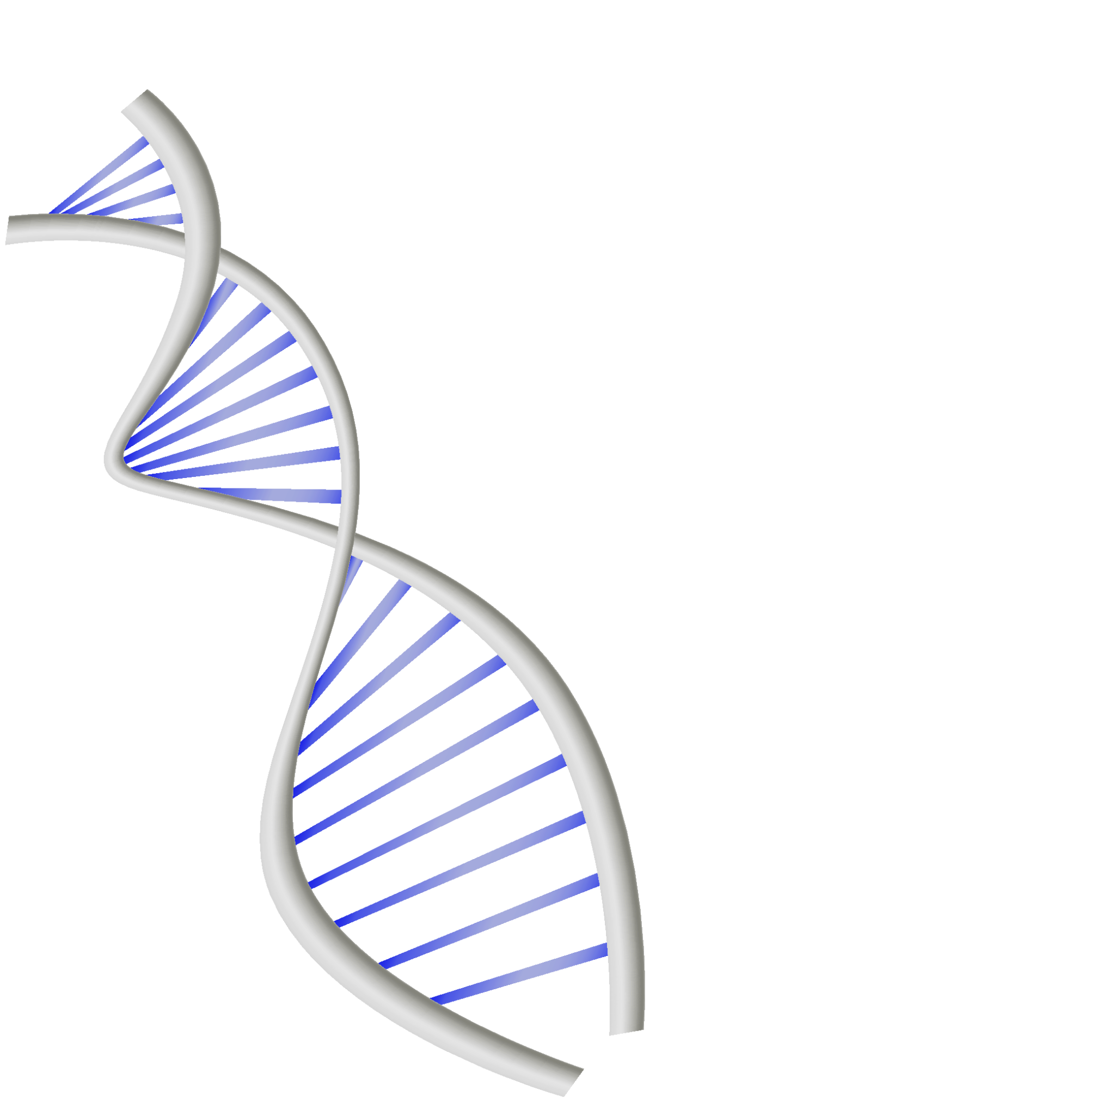
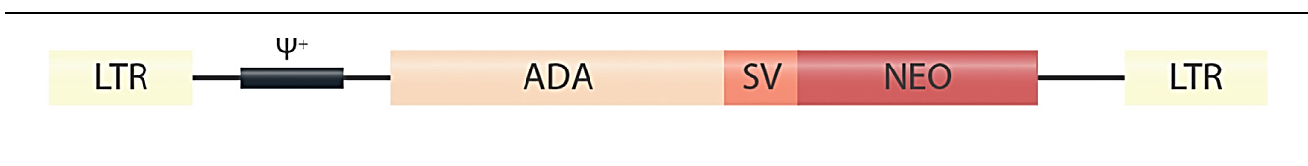

y-retroviral vectors
ADA-SCID
LTR
6

Slide 8
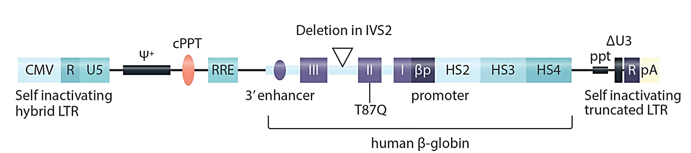

SIN
HIV
VSV
New self-inactivating (SIN) lentiviral vectors
7

Slide 9

2007
GLOBE vector
HGB-204 / HGB-205
SCD
HGB204 / HGB-212
BB305
1
4
lentiviral gene addition therapy TDT
4
1
TDT Children
2
2
5
Zynteglo
TDT
5
vaso-occlusive complications organ damage
3
6
TDT ß0/ß0
6g/dl Hb
3
6
Clinical results of “gene addition” for TDT and for SCD
8

Slide 10
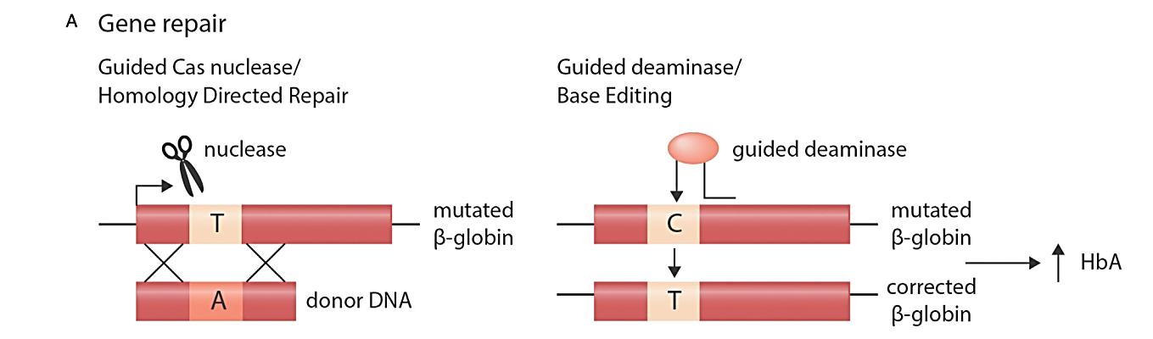

Direct correction of pathogenic mutations
Gene therapy beyond gene addition
9

Slide 11
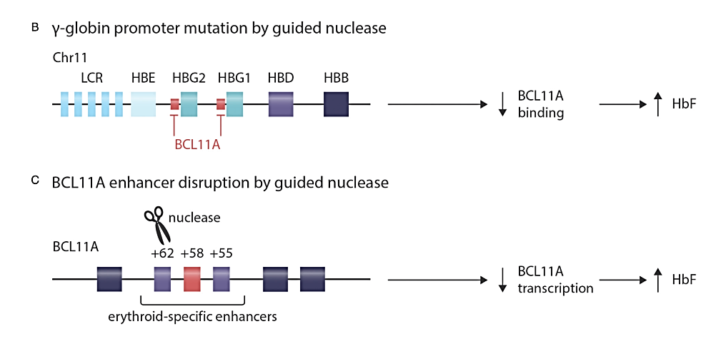
Edit to boost HbF expression
Gene therapy beyond gene addition
10

Slide 12
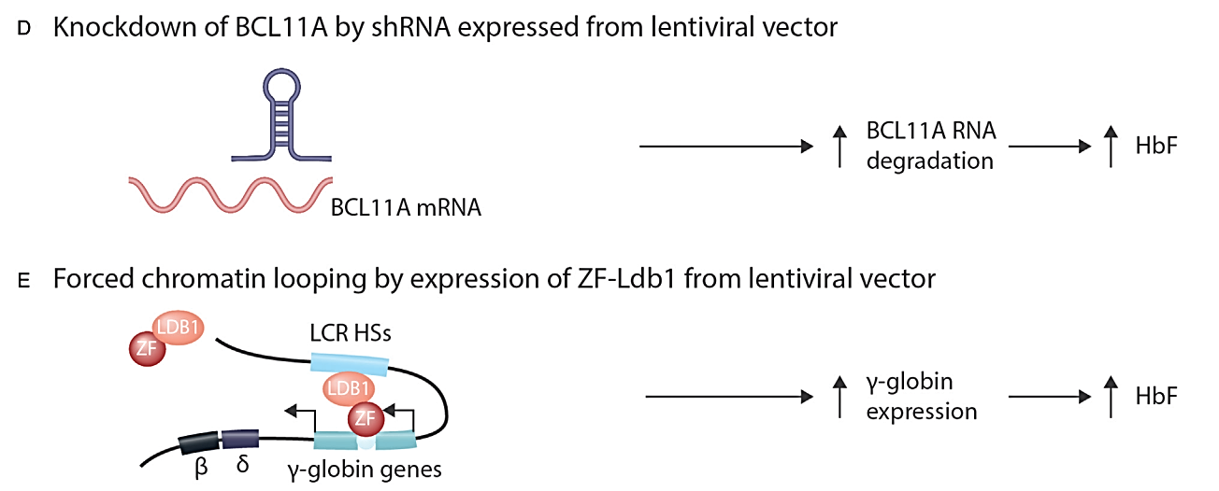

Edit to boost HbF expression
Gene therapy beyond gene addition
11

Slide 13
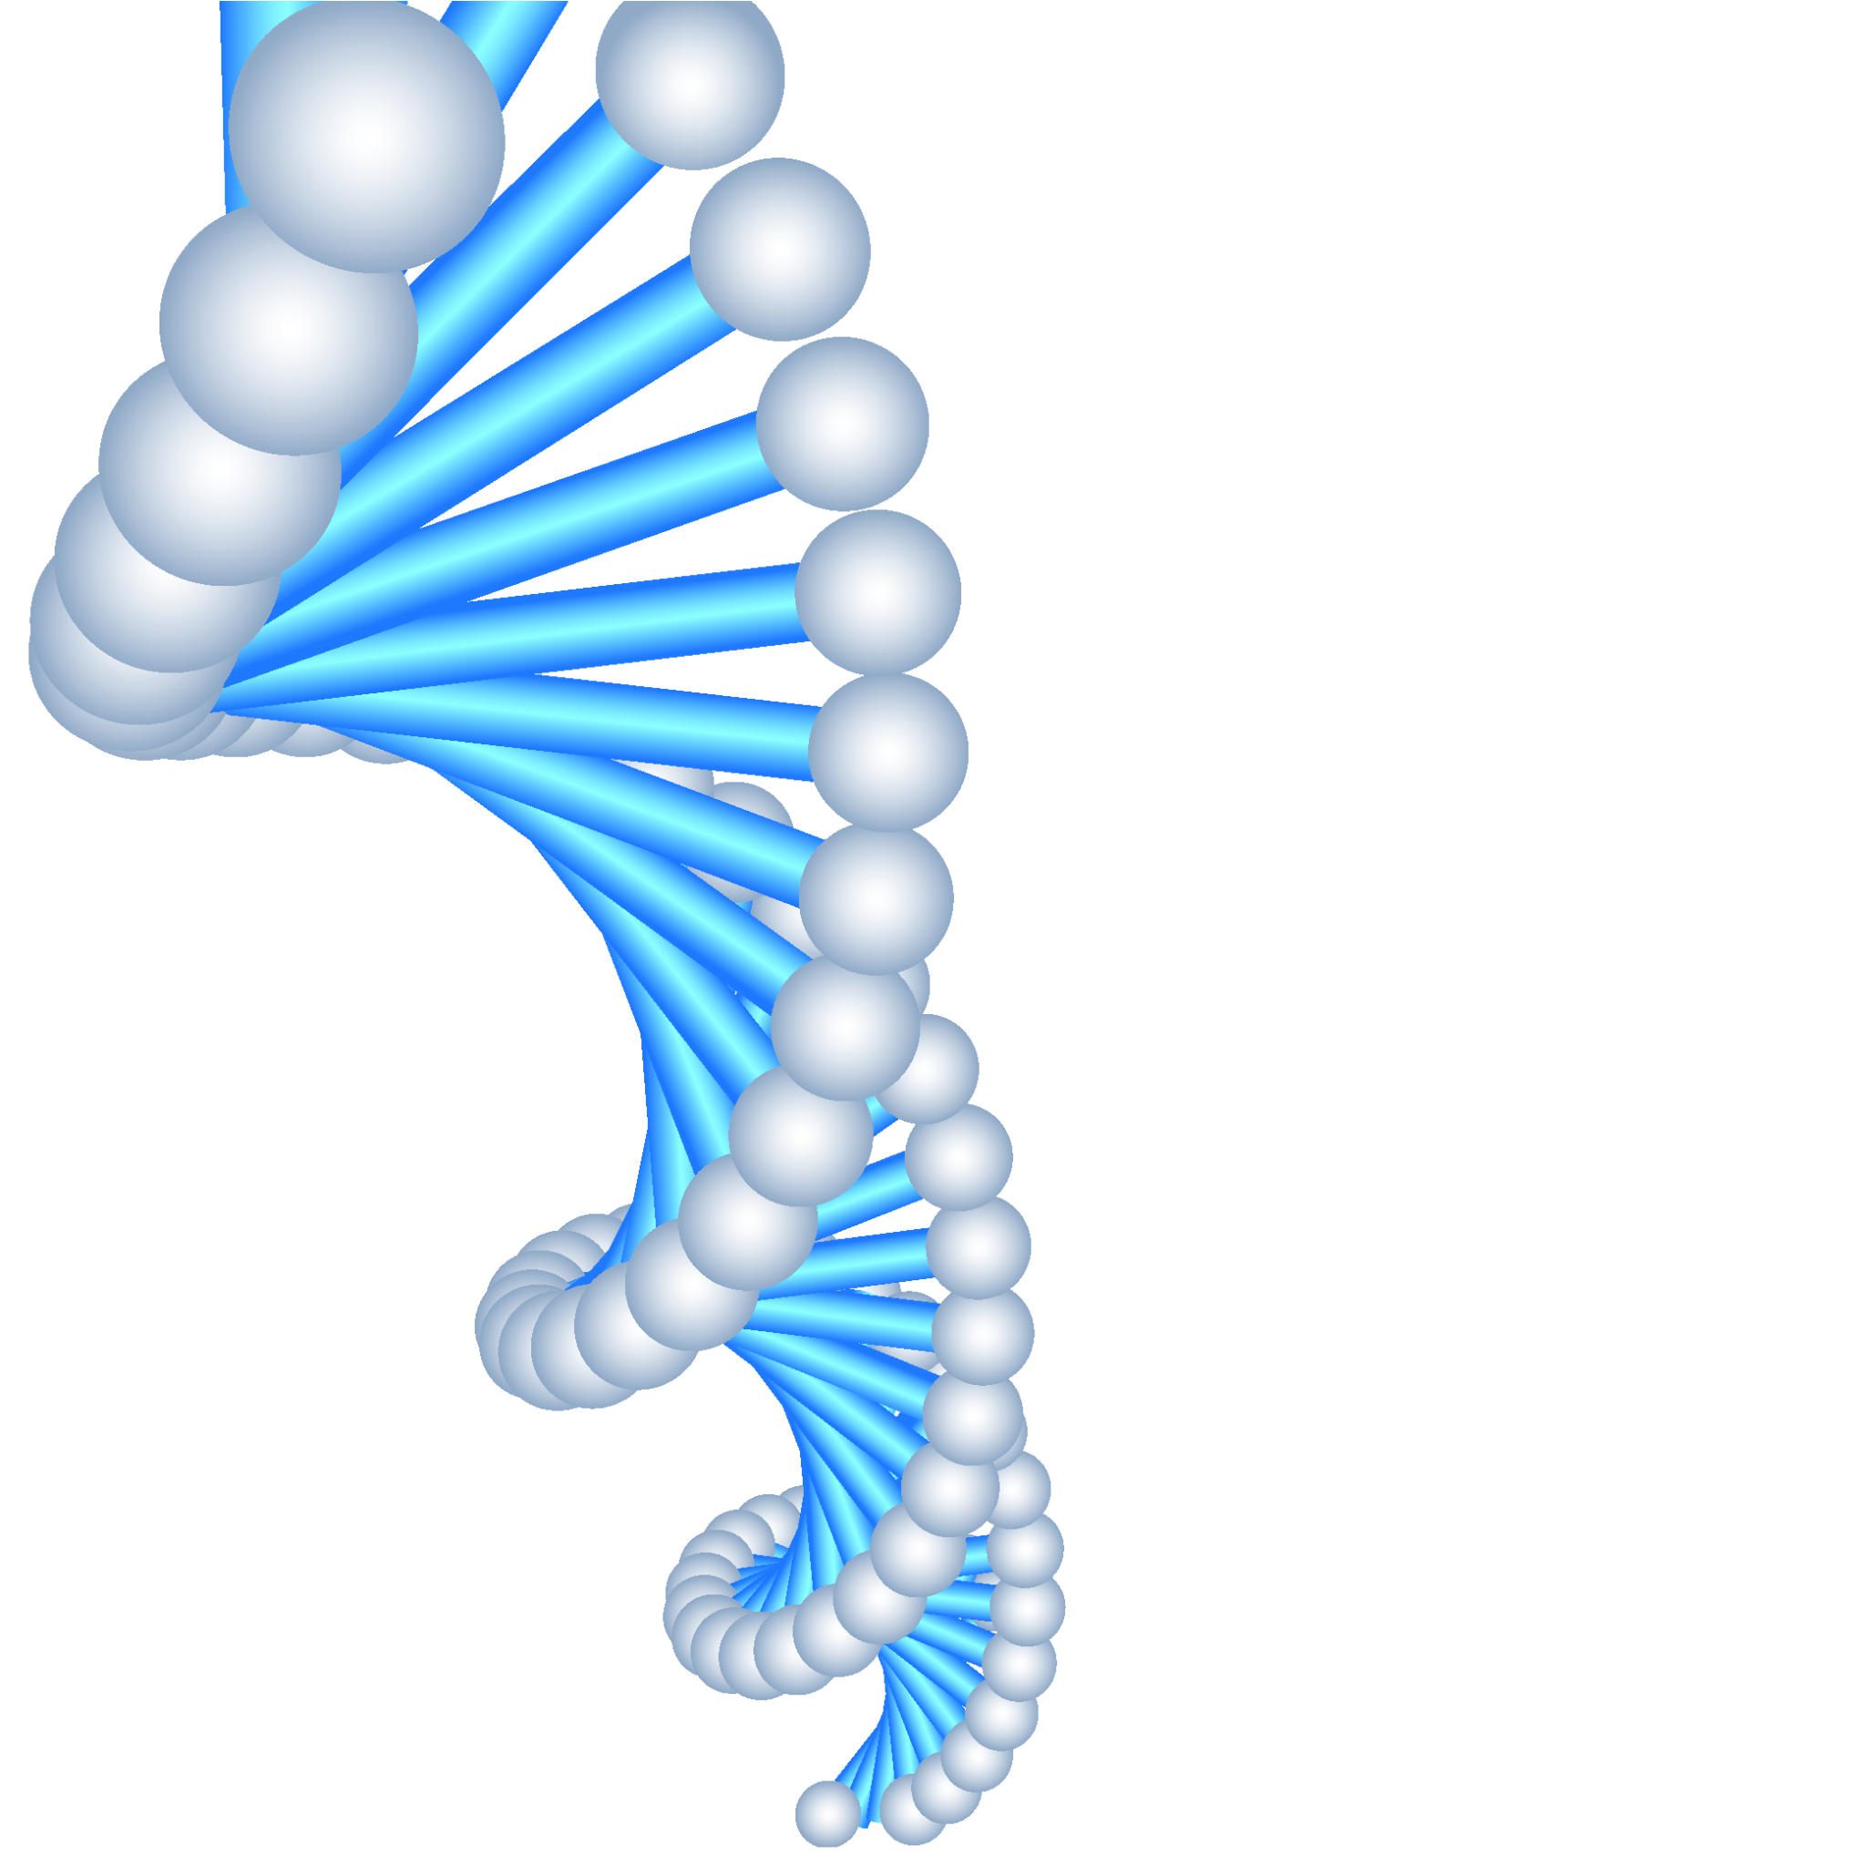
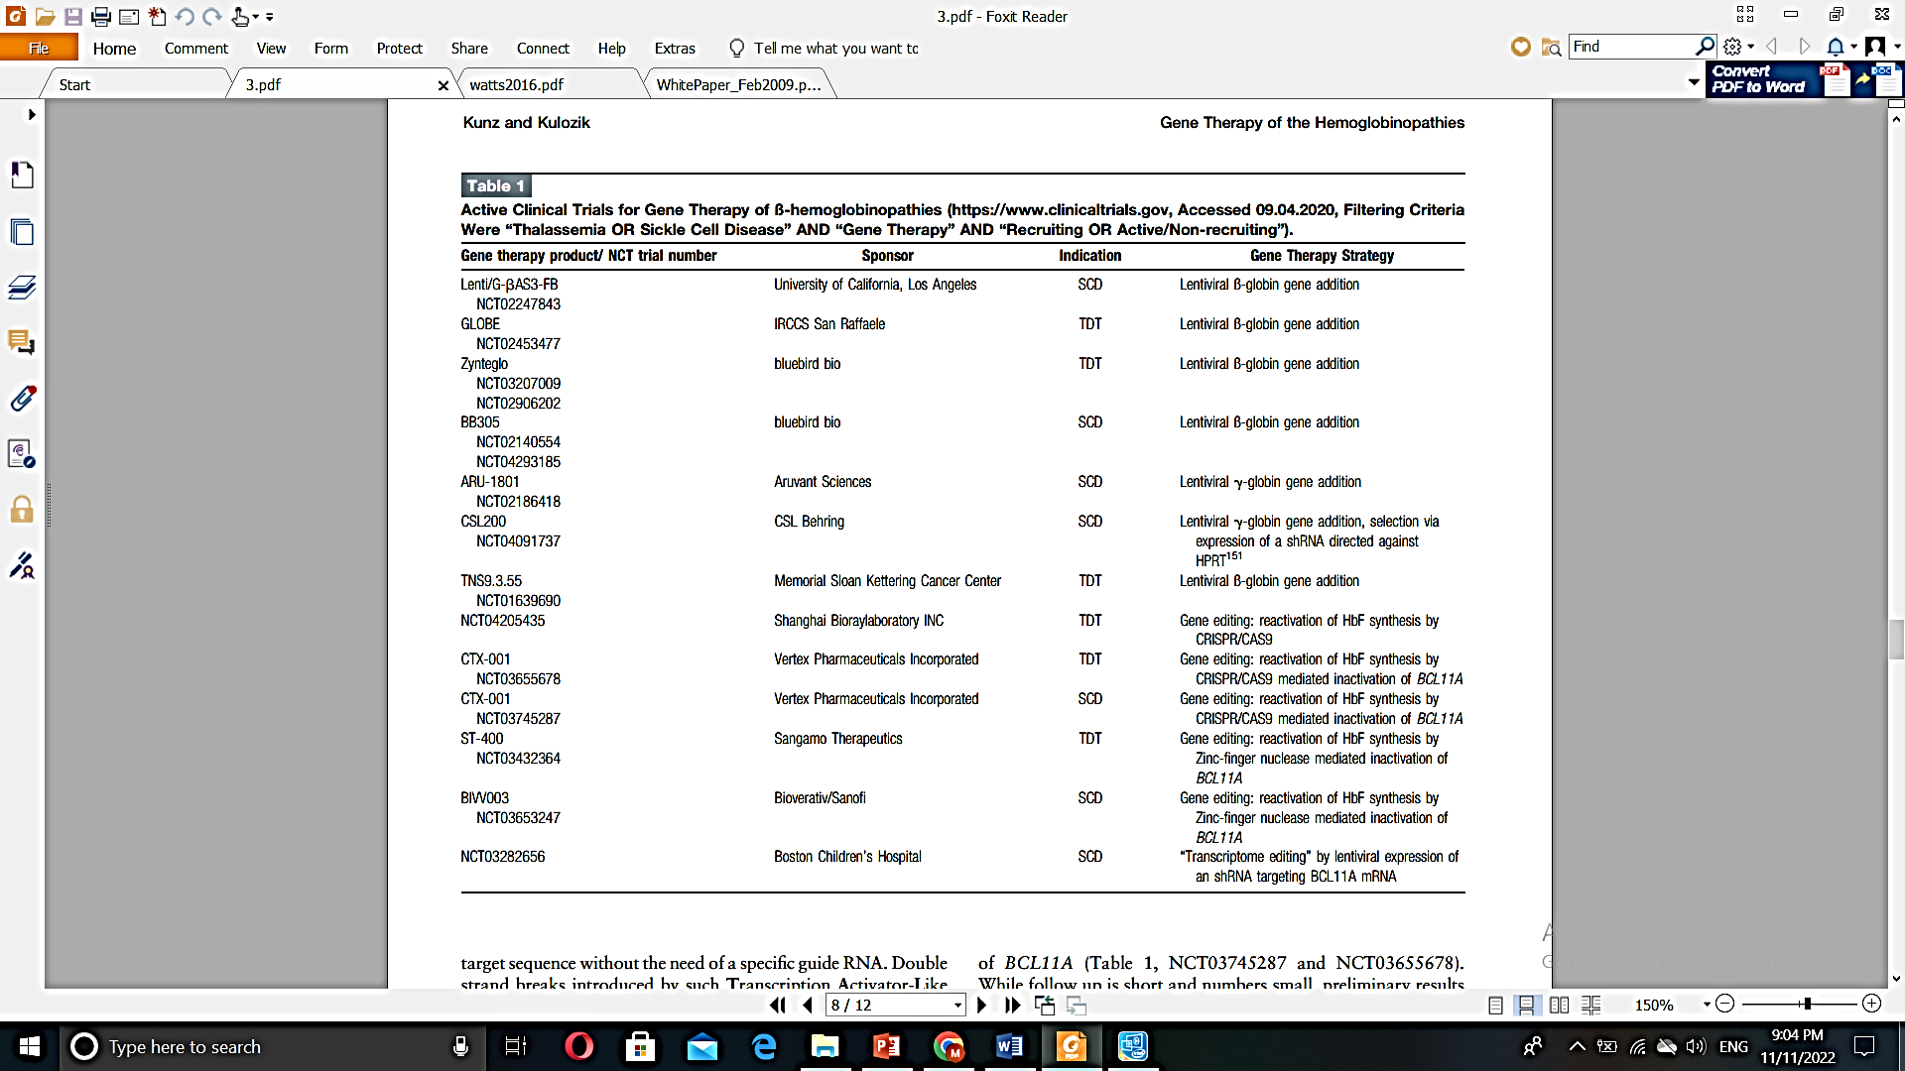

12

Slide 14

Perspectives
13

Slide 15



Thanks
For
Your Attention

