Slide 1


Advisor: Dr. Roohollah Mirzaee
Presented by : Elahe Reesi
Title:
Therapeutic Targeting of Mesothelin with Chimeric
Antigen Receptor T Cells in Acute Myeloid Leukemia

Slide 2

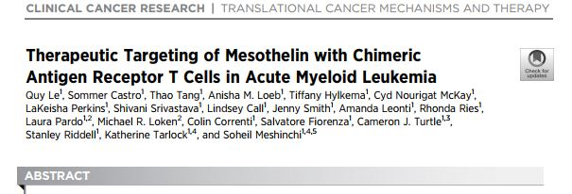
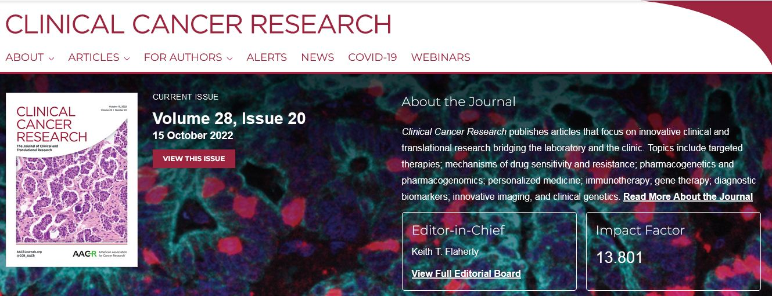

Slide 3

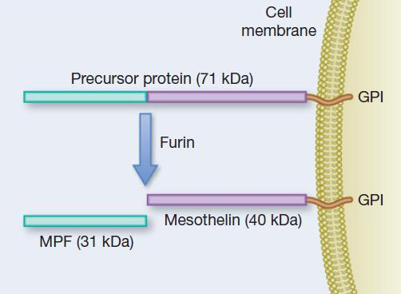

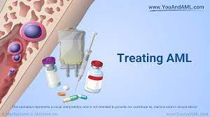
introduction

Slide 4
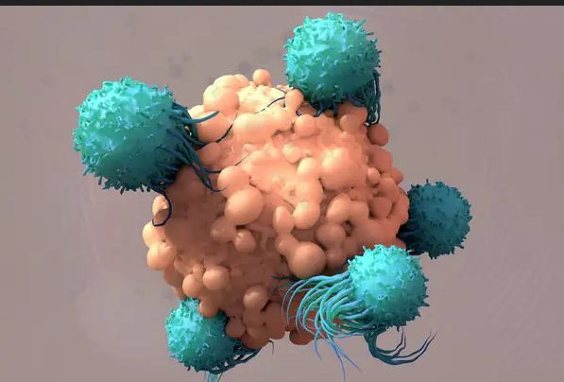
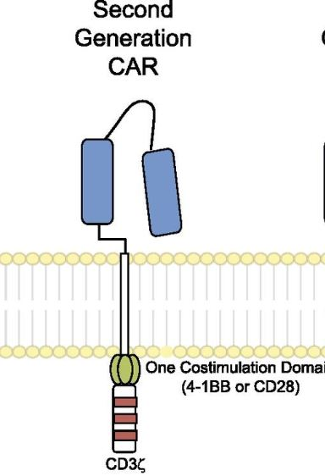
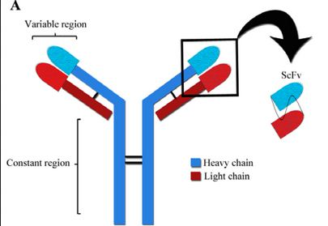
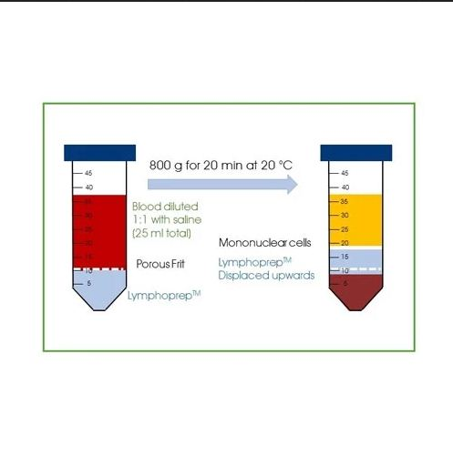

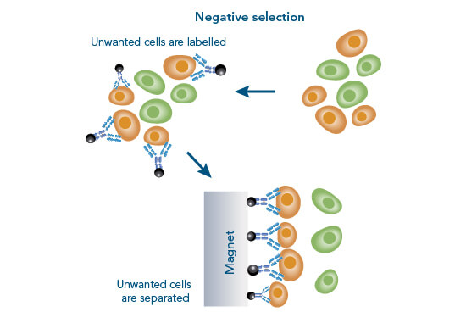
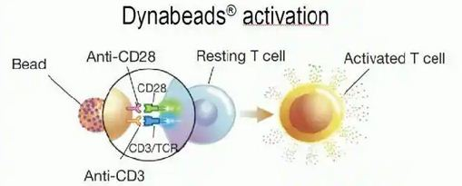
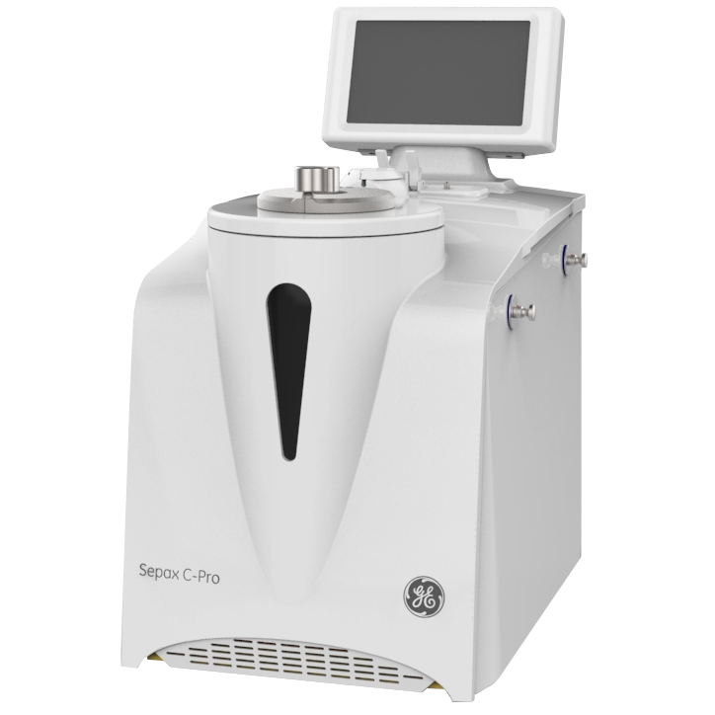
Generation of MSLN CAR constructs

Slide 5
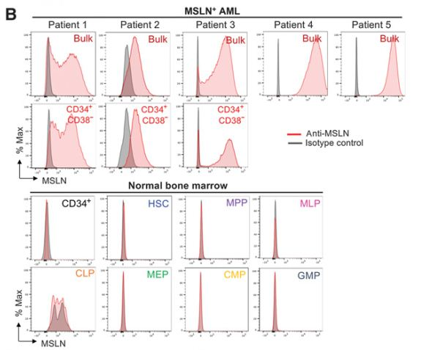
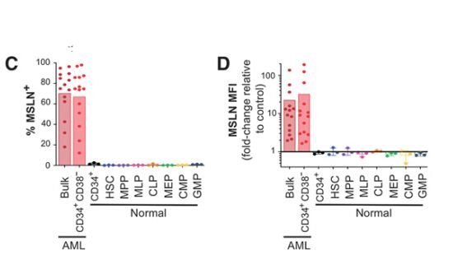
MSLN is expressed on the AML leukemic stem cell–enriched
CD34+CD38 subset

Slide 6


Invitro studies
CFSE
target
Nomo-1
Kasumi-1 MSLN+
Kasumi-1 parental
unmodified or MSLN CAR
T cells
Effector
Violet Cell Proliferation Dye
live/dead fixable viability
dyes

Slide 7
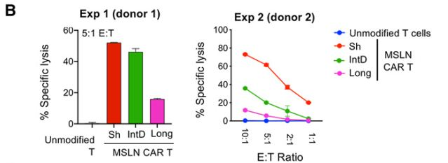
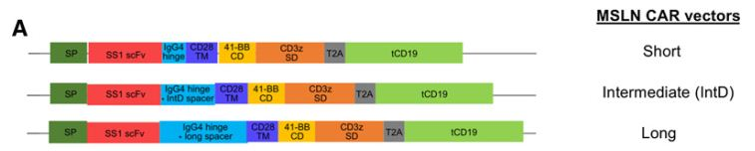
MSLN CAR with a short IgG4 hinge domain confers superior cytotoxicity over intermediate and long IgG4 domains

Slide 8
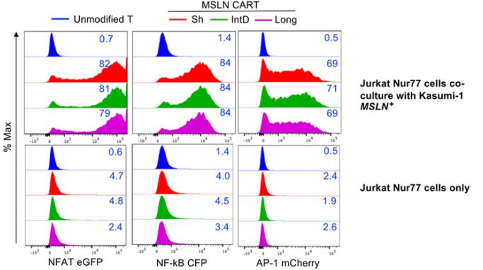

 | Outcome
Jurkat Nur77 reporter cells | NFAT | NFkB | AP-1
Co culture/ Kasumi-1 MSLN+ | NFAT | NFkB | AP-1

Slide 9
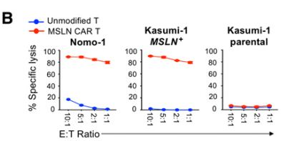
MSLN-directed CAR T cells demonstrate potent cytotoxicity in vitro and in vivo

Slide 10
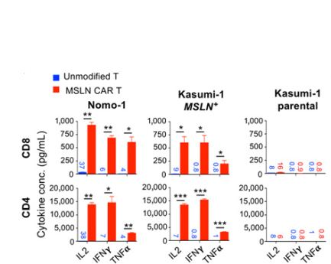
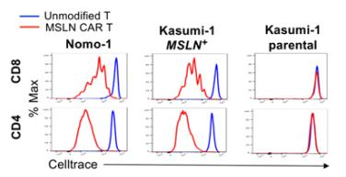
cytokine production and cell proliferation

Slide 11
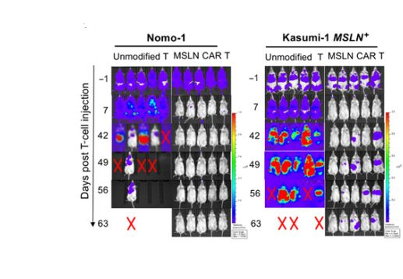
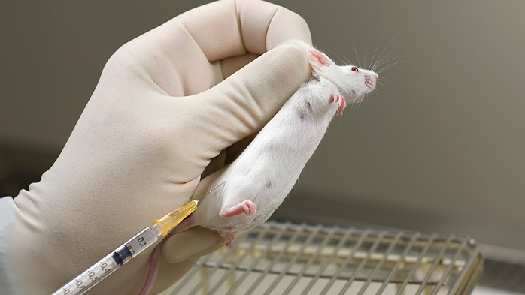
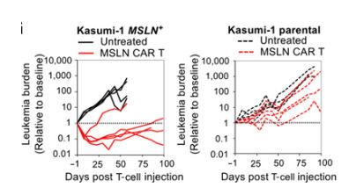
ability of MSLN CAR T cells to eradicate
AML in vivo

Slide 12
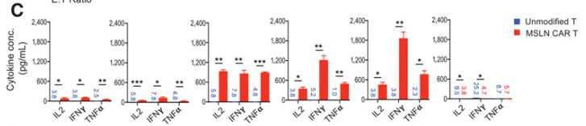
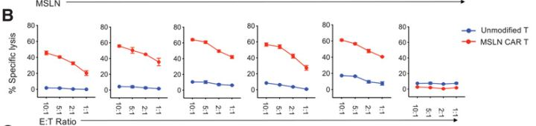
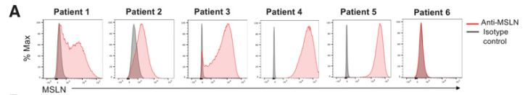
MSLN-directed CAR T cells demonstrate preclinical efficacy against primary MSLN-positive AML cells

Slide 13
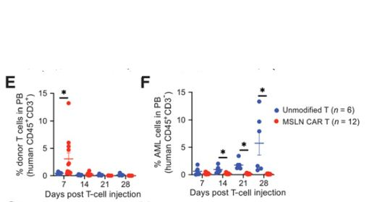
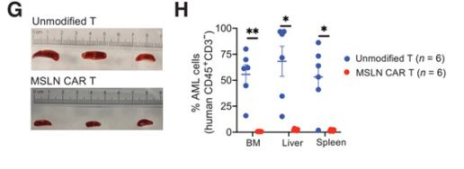
MSLN CAR T cells exhibit in vivo efficacy against primary AML cells

Slide 14
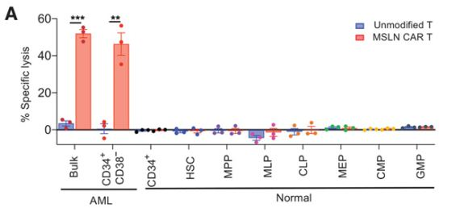
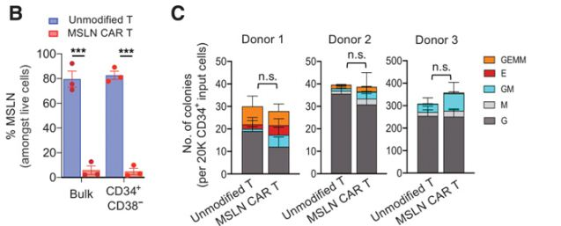
MSLN-directed CAR T cells effectively eliminate MSLN-positive
CD34+CD38 cells without impacting the viability of normal
HSCs

Slide 15
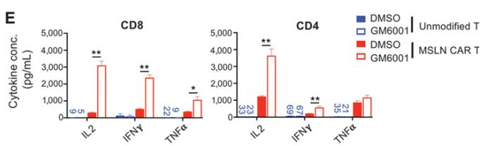
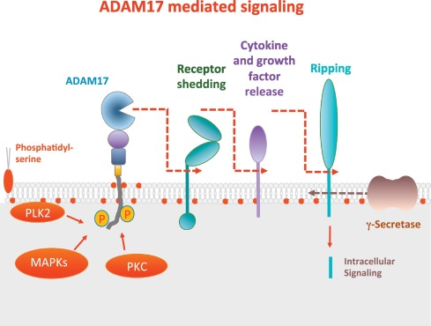
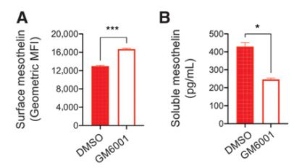
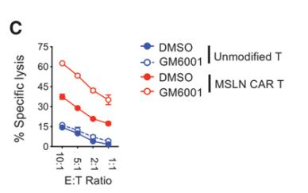
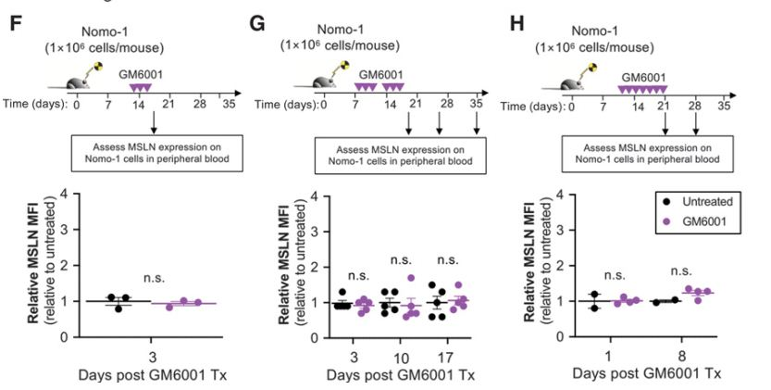
Modulating MSLN shedding improves the efficacy of MSLNdirected CAR T cells

Slide 16

Discussion

Slide 17
