Slide 1

Hematology Journal Club
Title:
transfusion-associated adverse reactions(TAARs) and cytokine accumulations in the stored blood components: the impact of pre-storage versus post-storage leukoreduction
Presented by:
Hossein arezoomand

Slide 2


INTRODUCTION
With the advance in transfusion medicine, blood transfusions are considered to be safe in general. However, the risk of complications takes place sometimes during or after transfusion. including:
FNHTRs (0.5–6.8% in all transfused blood units)
refractoriness to platelet transfusion
Transfer of viral infection (CMV & HTLV1 & EBV)
Allergic reactions
GVHD
TRALI

Slide 3

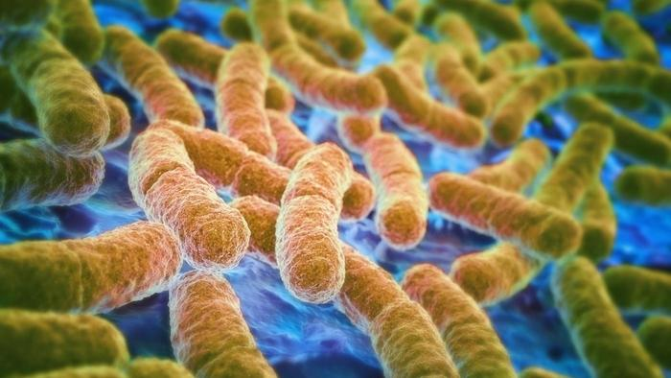
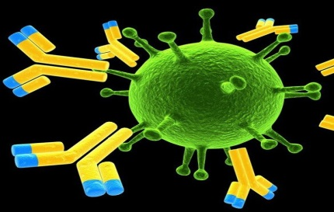

Theses side effects are due to presence of leukocytes in blood products , So we have to separate leukocytes from the products.
LR also reduce:
1) Pro inflammatory mediators
2) Transmission of blood infectious agents
3) HLA antibody production in sensitized transfusion recipients

Slide 4
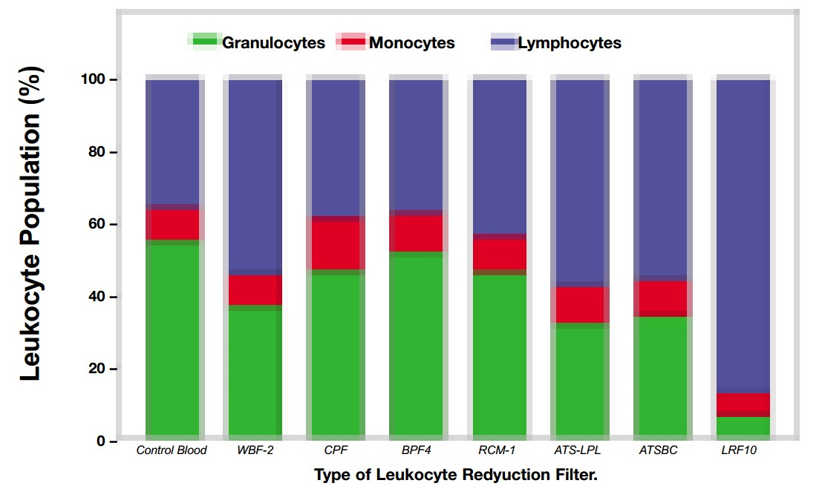

There are different methods for this process, but the most important method of separation is leukotrap filters.
Different types of filters:
WBF-2
CPF
BPF4
RCM-1
ATS-LPL
ATSBC
LRF10

Slide 5
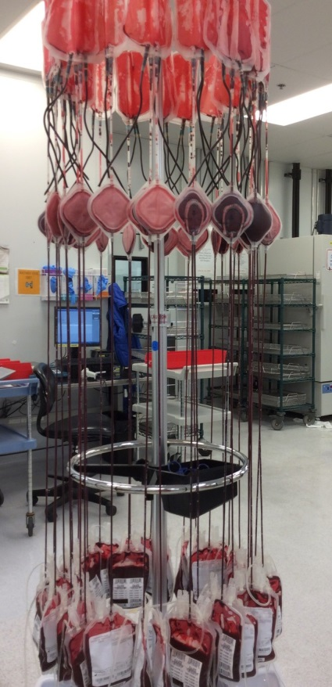
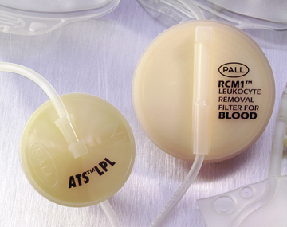

Theses filters are assessed according to:
*Pore size and porosity
*Cell cytotoxicity
*Hydrophobic or hydrophilic
*Hemolytic effect on RBC
*Performance
The process of leukoreduction:
pre-storage (within 24 hours of collection)
Post-storage (bedside)

Slide 6


Transfusion of leukocyte-depleted blood components used for:
1) Patients with organ or bone marrow transplantation
2) Immunocompromised status
3) Who had experienced FNHTR in previous transfusions
4) Thalassemia patients

Slide 7


In this study:
* Impact of pre-storage and post-storage leukoreduction (RBCs & PHs) on the incidence of FNHTRs and other TAARs
* The expression of cytokines in blood components with pre-storage and Post-storage leukoreduction as well as its association with the incidence of TAARs

Slide 8


MATERIALS AND METHODS
In this study: 4,707 adult patients (aged more than 20 years old) underwent allogeneic blood transfusions with 34,301 units.
1128 patients 10,409 units of pre-LR RBCs
1392 patients 13,165 units of post-LR RBCs
1490 patients 6,645 units of pre-LR PHs
697 patients 4,082 units of post-LR PHs

Slide 9

5970 to male 4072 to male
In the pre-LR RBCs in the pre-PHs
(60) (57)
4439 to female 2573 to female
7039 to male 2414 to male
In the post-LR RBCs in the post-PHs
(62) (57)
6126 to female 1668 to female

Slide 10


TAARs were considered and reported to the blood bank via a hemovigillance system. these adverse reactions including:
*Fever
*chills
*Urticaria/skin itching
*dyspnea/tachypnea
*Headache
*nausea/vomiting
*hypotension/hypertension
*Backache
*Hematuria/oligouria

Slide 11
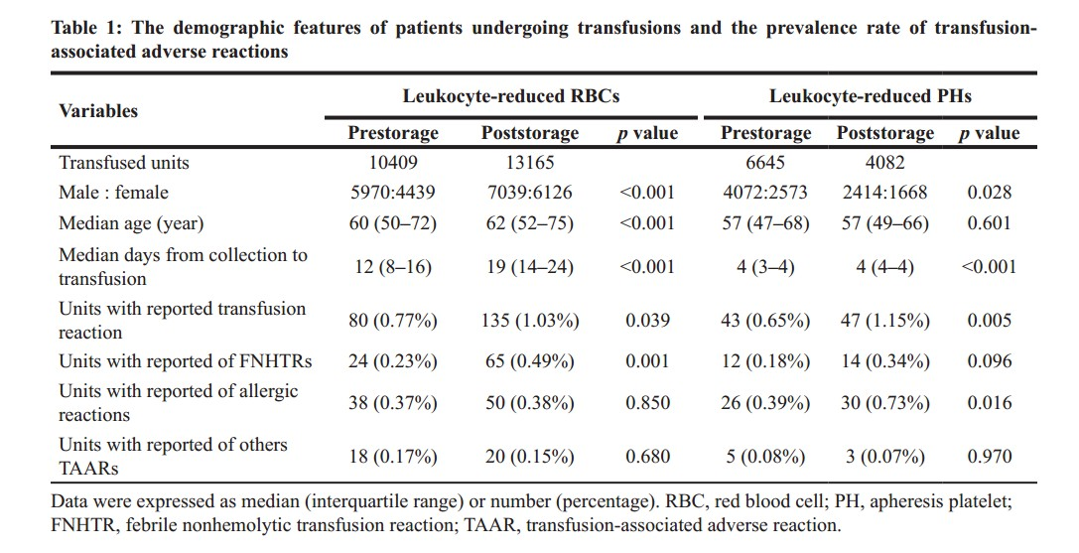

RESULTS

Slide 12
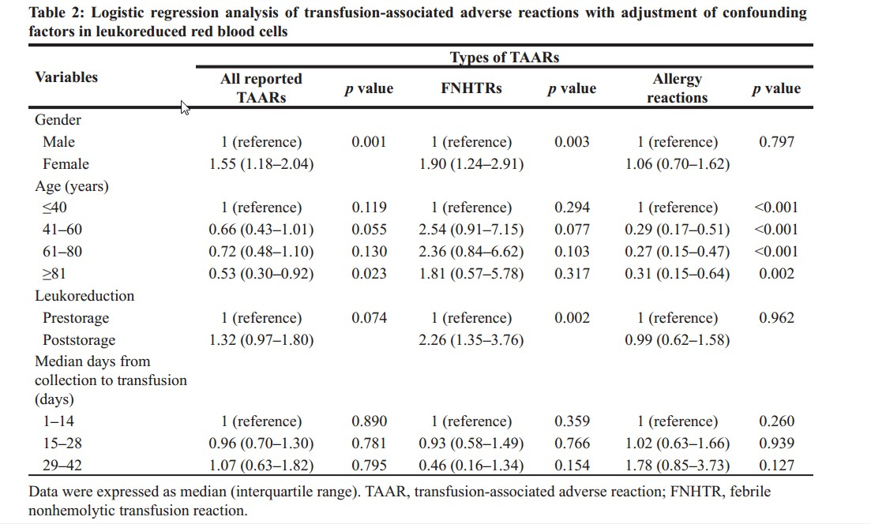


Slide 13
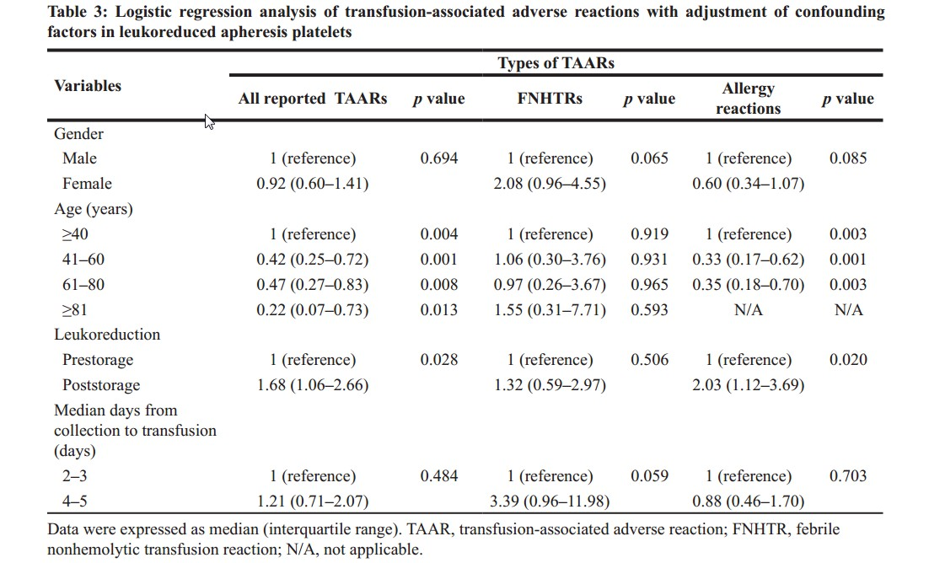


Slide 14
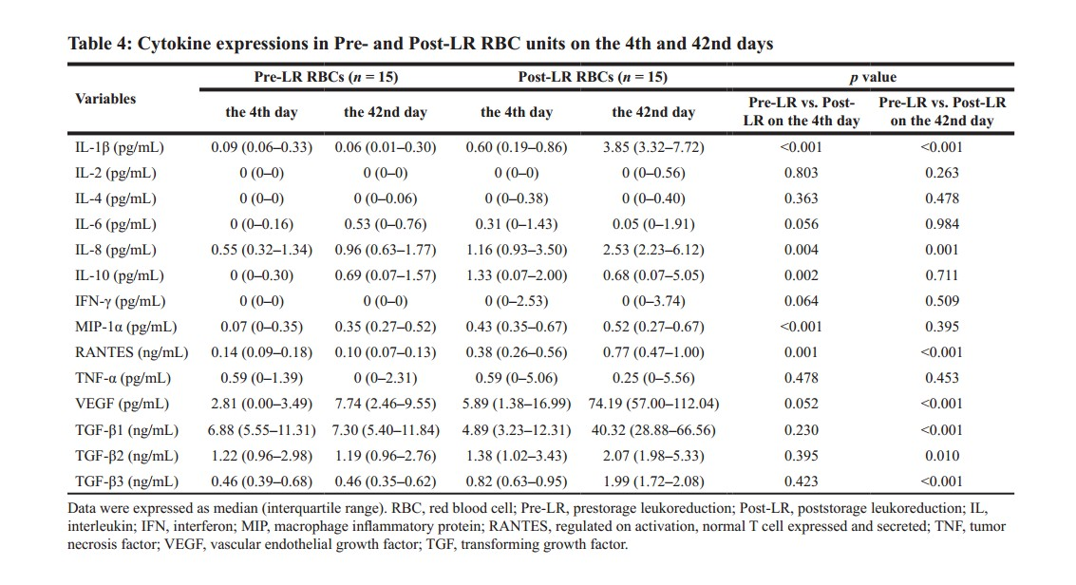


Slide 15
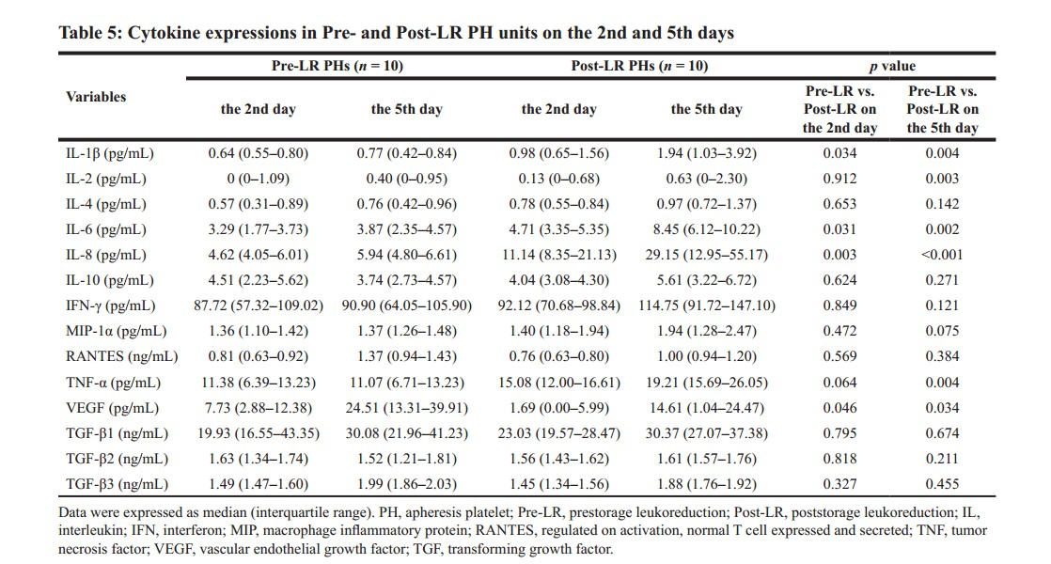


Slide 16

DISCUSSION
some physicochemical changes take place during the storage of blood components, subsequently affect the overall quality and leading to the TAARs in clinical.
Another items that contribute in TAAR:
1) Increased cell debris and oxidative stress
2) Abnormal rearrangement or loss of cellular membrane phospholipids
3) As well as morphological alteration of blood cells

Slide 17



Leukoreduction is the practice of filtering blood products to remove WBCs that eliminate
the adverse effect of blood component preservation.
The prevalence of FNHTRs was significantly increased in the post-LR RBC transfusions when compared with that in the transfusion of pre-LR RBCs.
The prevalence of allergy reactions was remarkably increased in the post-LR PH transfusions when compared with that in the pre-LR PH transfusions.

Slide 18


Leukoreduction prior to storage is effective in removing leukocytes from human RBCs and PLTs
that preventing cytokine accumulation during storage.
Also, in people, treatment with leukoreduced blood products has been associated with lower mortality rates and inflammatory response.

Slide 19

و انسان به زودی پاداش تلاش خود را خواهد دید.

