Slide 1

The iron chelator Deferasirox causes severe mitochondrial swelling without depolarization due to a specific effect on inner membrane permeability
Advisor:Dr mirzaee
Presented by: daneshikohan

Slide 2
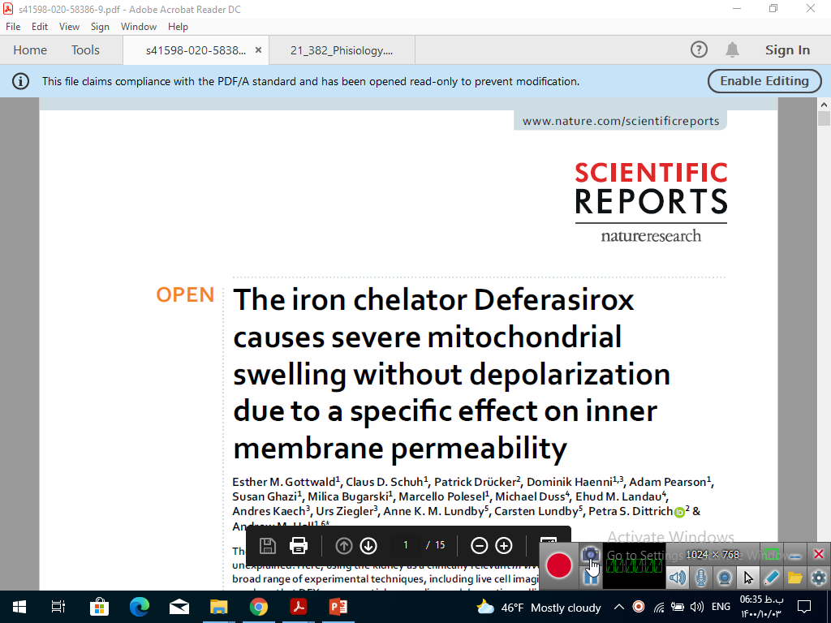
If:4.3 2020

Slide 3
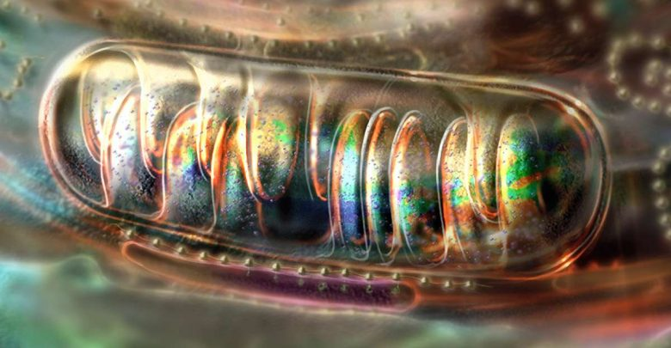
1)Structure 2)function ATP Ca apoptosis aging cancer heat
mitochondria

Slide 4
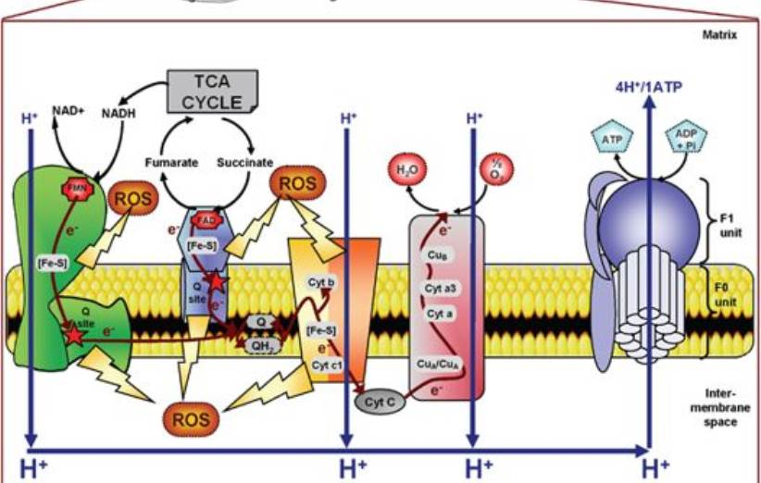

Slide 5
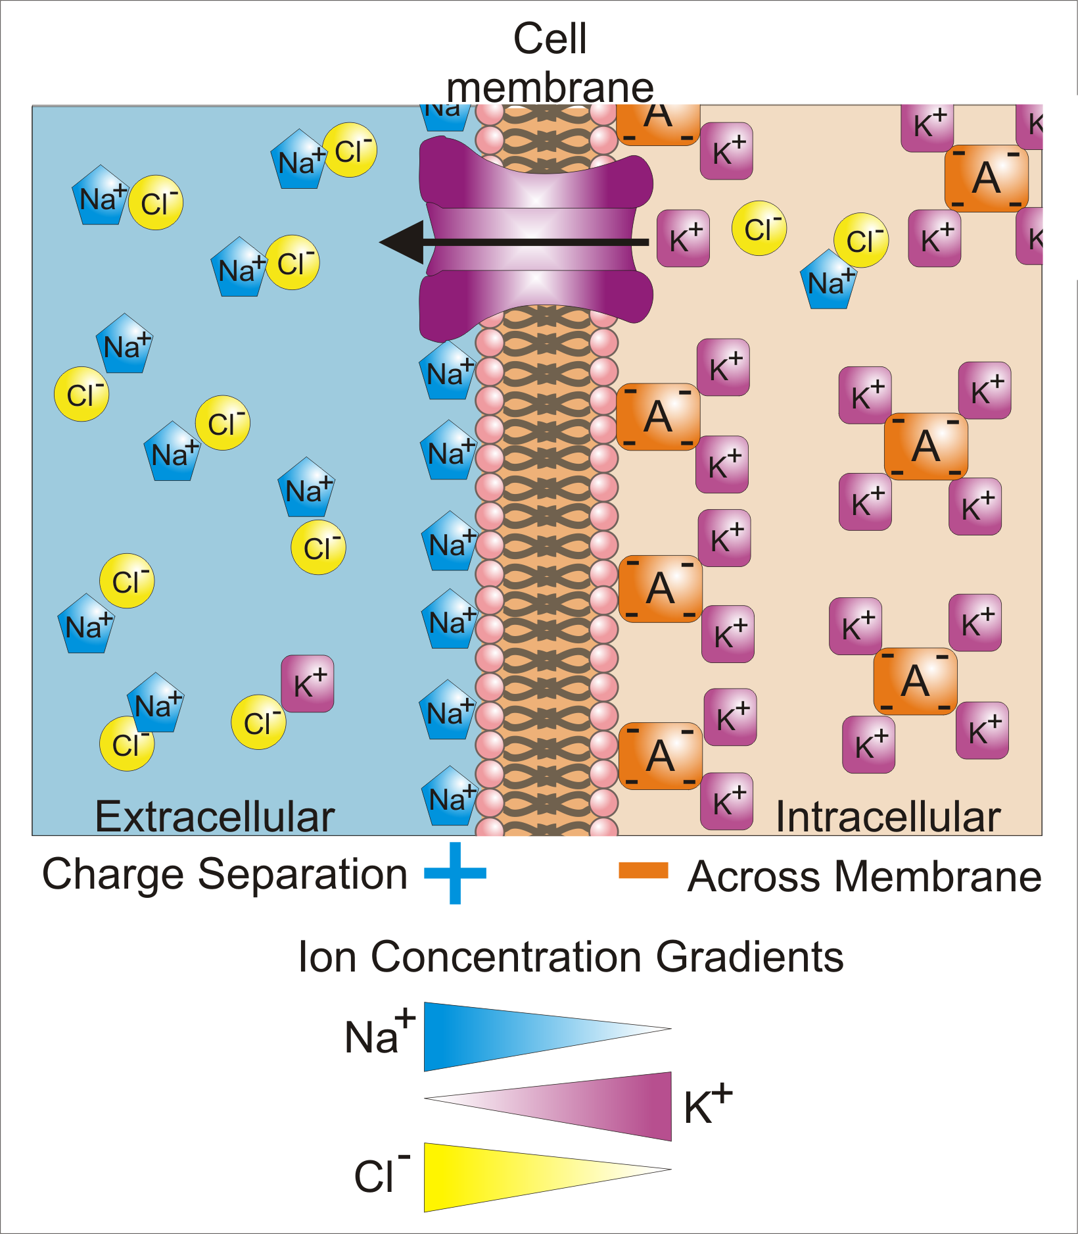
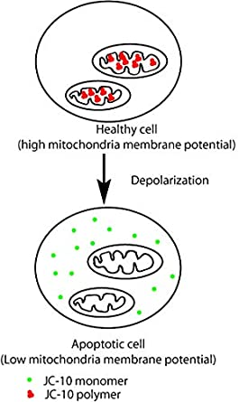
polarization & depolarization

Slide 6
Methods
Animal studies (8-12 week - mail mice c57bl/6jrj)
Cell lines (ok)
Immunofluorescence in cell
Staining in fixed kidney tissue

Slide 7
Methods
Live imaging
Electron microscopy
Cell viability
Oxygen consumption

Slide 8
Methods
ATP determination assay
Lipid vesicle experiments
Swelling in isolated mitochondria
Urinary KIM-1 analysis

Slide 9
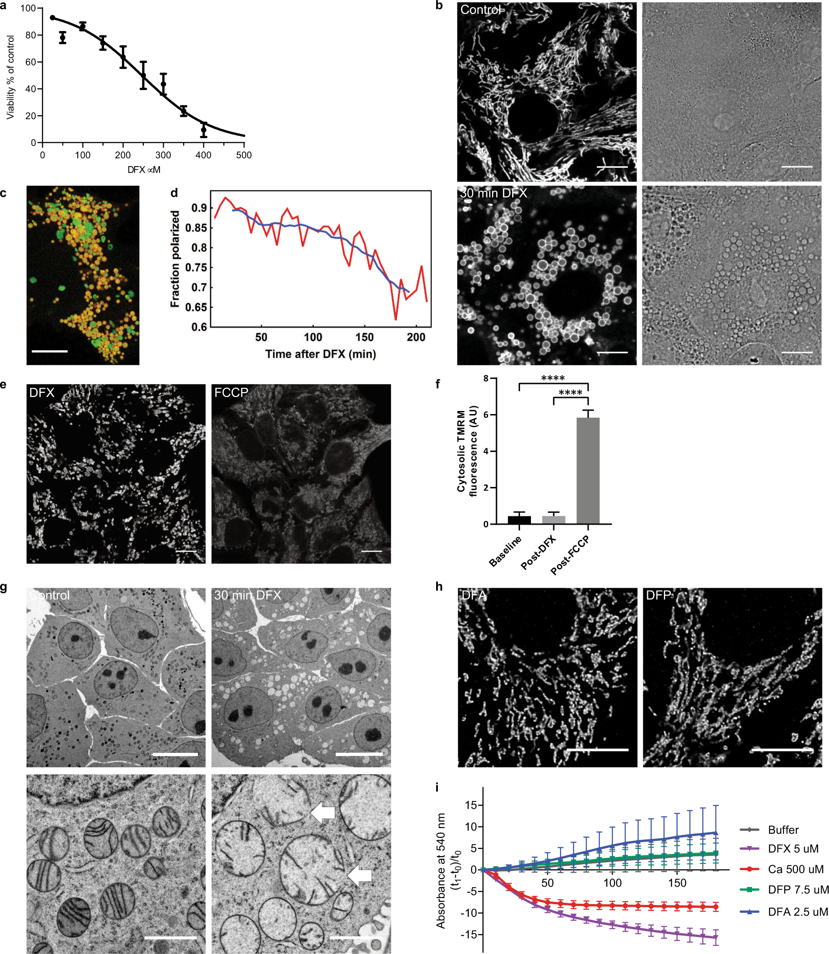
Results
1. Deferasirox causes acute mitochondrial swelling without depolarization

Slide 10

Results
1. Deferasirox causes acute mitochondrial swelling without depolarization

Slide 11
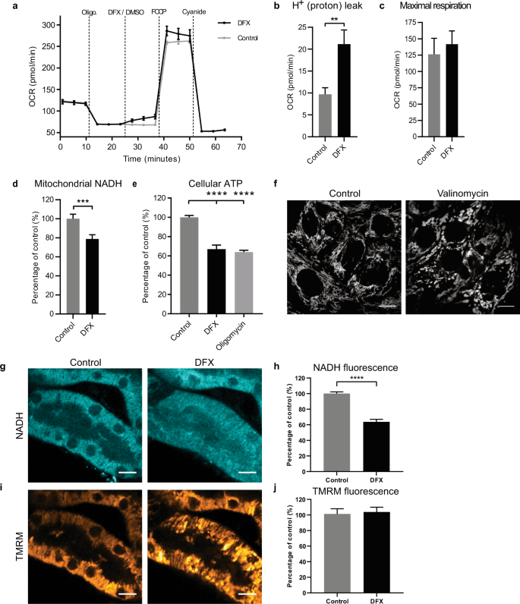
Results
2)Deferasirox causes partial uncoupling of the mitochondrial respiratory chain

Slide 12
Results
3)Deferasirox induces mitochondrial damage in kidney cortex tissue

Slide 13
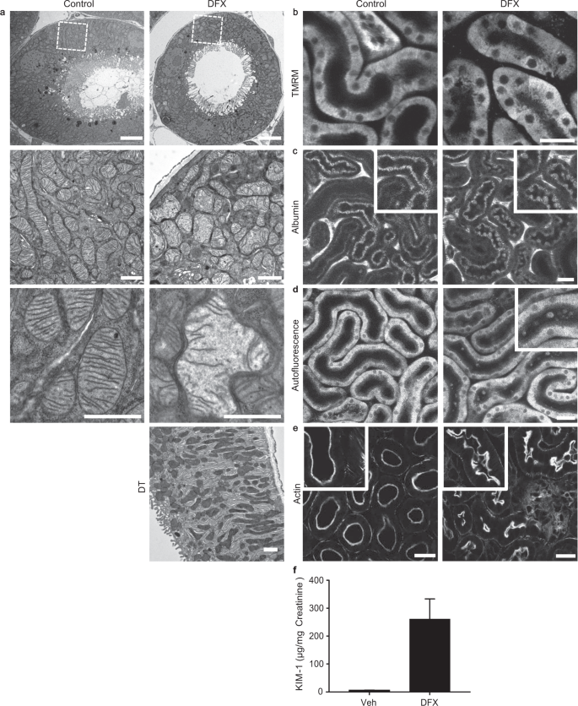
Results
4)Deferasirox induces mitochondrial swelling in the kidney proximal tubule in vivo

Slide 14
Results
4)Deferasirox induces mitochondrial swelling in the kidney proximal tubule in vivo

Slide 15
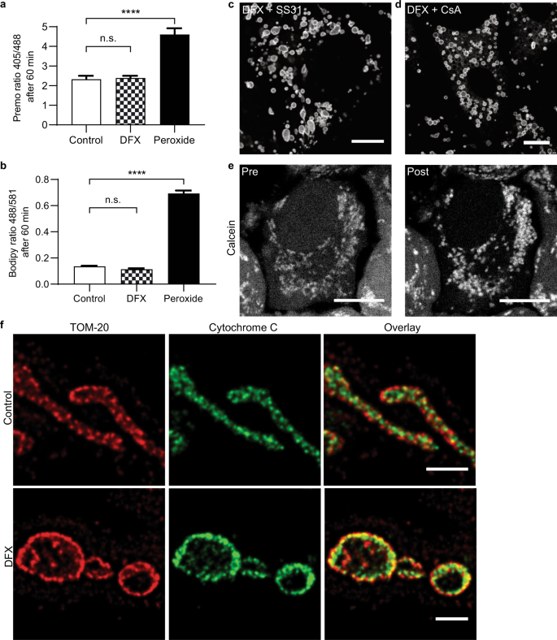
Results
5)Deferasirox-induced mitochondrial permeability swelling is independent of transition pore
opening

Slide 16
Results
5)Deferasirox-induced mitochondripermeability al swelling is independent of transition pore
opening

Slide 17
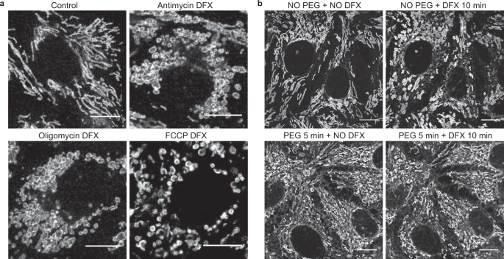
Results
6)Deferasirox-induced mitochondrial swelling occurs due to an influx of water

Slide 18
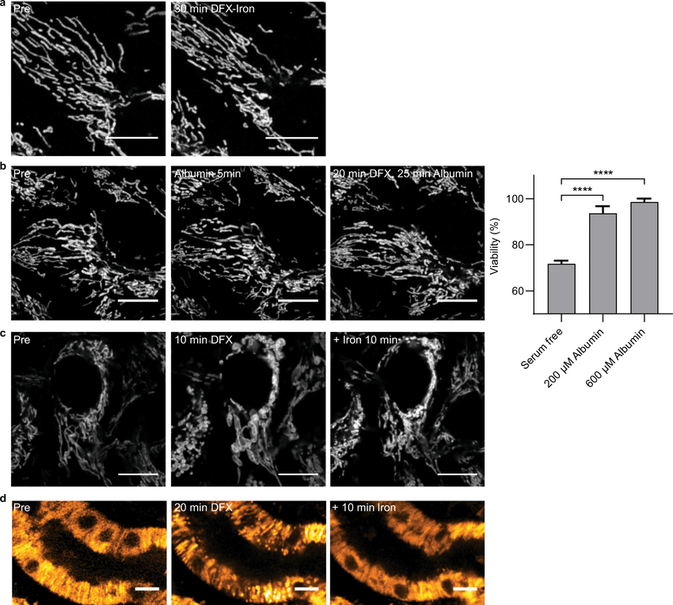
Results
7)Deferasirox-induced mitochondrial swelling is reduced by binding to iron or albumin

Slide 19
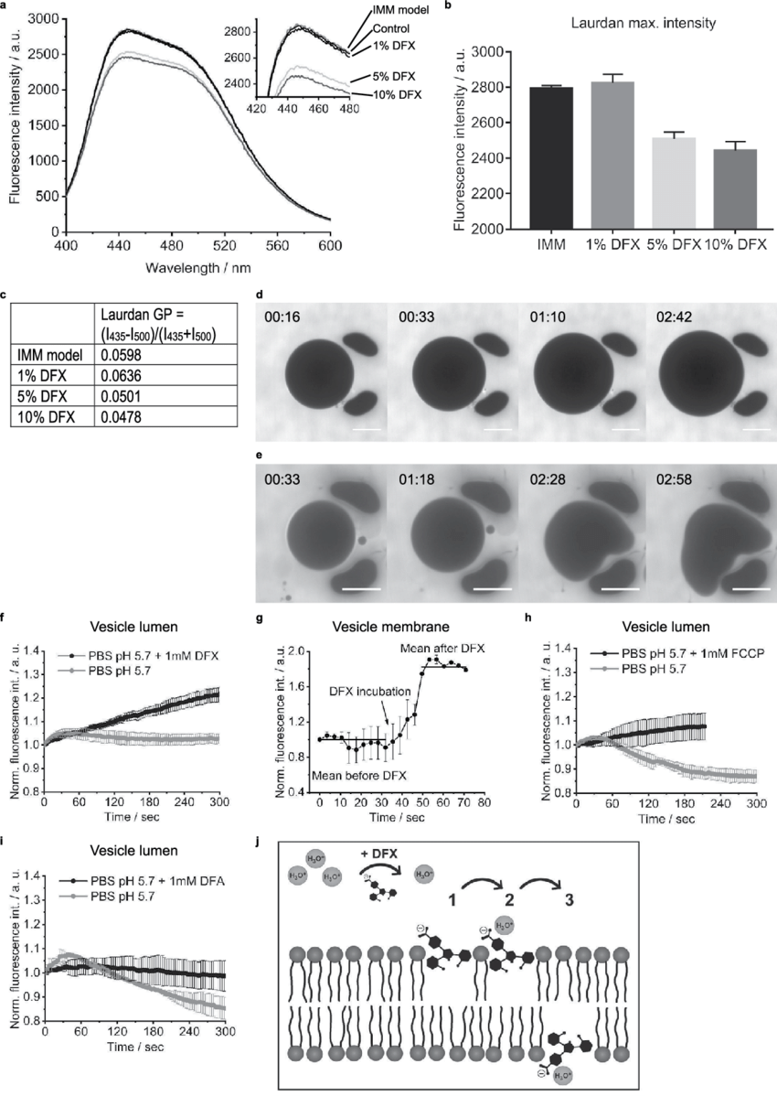
Results
8)Deferasirox directly alters membrane integrity in an artificial model of the inner mitochondrial
membrane

Slide 20
Results
8)Deferasirox directly alters membrane integrity in an artificial model of the inner mitochondrial
membrane

Slide 21
Results
8)Deferasirox directly alters membrane integrity in an artificial model of the inner mitochondrial
membrane

Slide 22

Discussion

Slide 23


