Slide 1


Slide 2
Delivery of CRISPR/Cas systems for
cancer gene therapy and immunotherapy
Presented by : Fateme zahra Rashidi
Supervisor : Dr.mirzaee

Slide 3


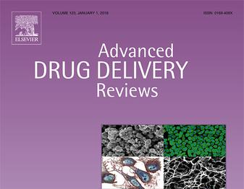
15.4

Slide 4

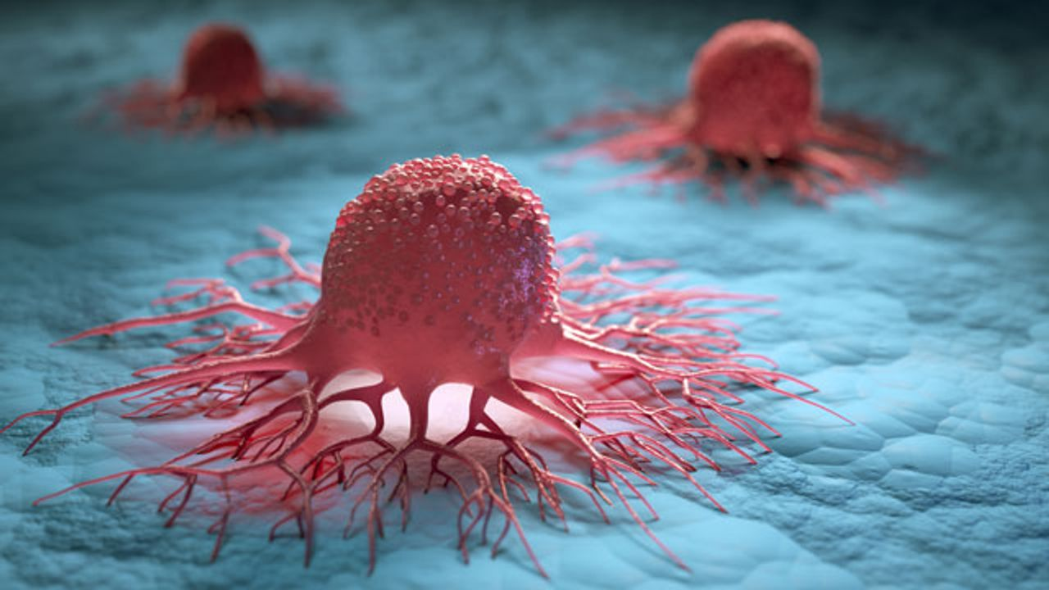
CANCER

Slide 5

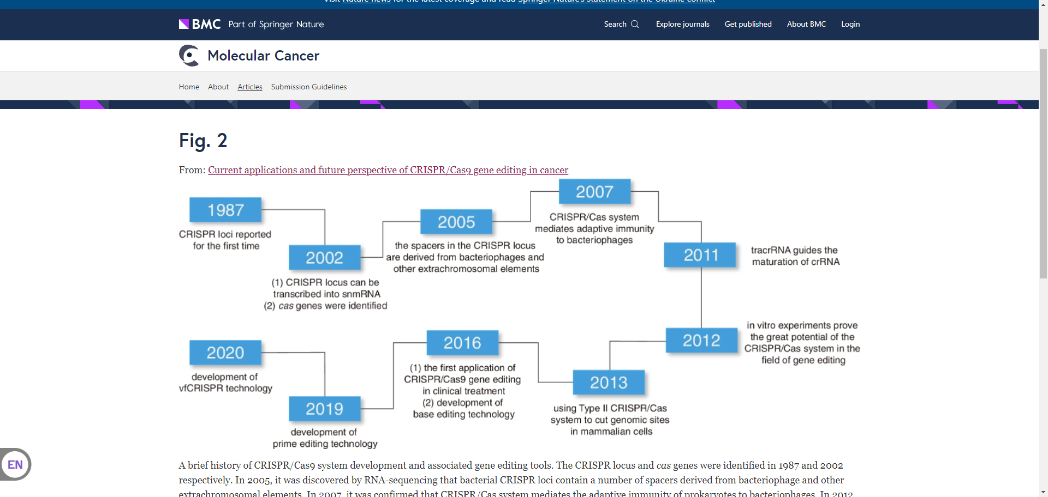
2007
1987
2005
2002
2011
2016
2012
2020
2013
2019

Slide 6
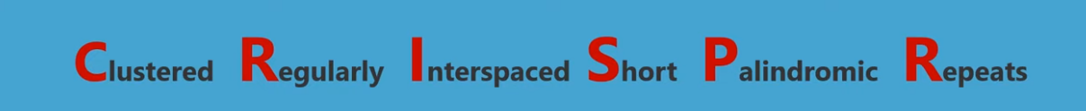
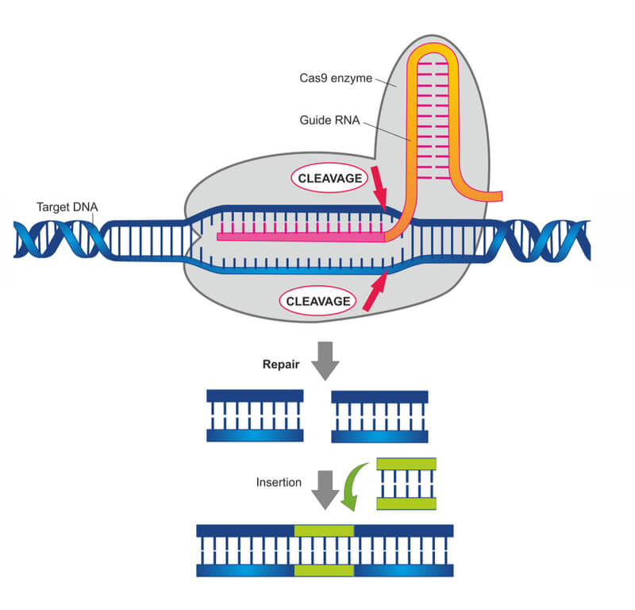

Slide 7
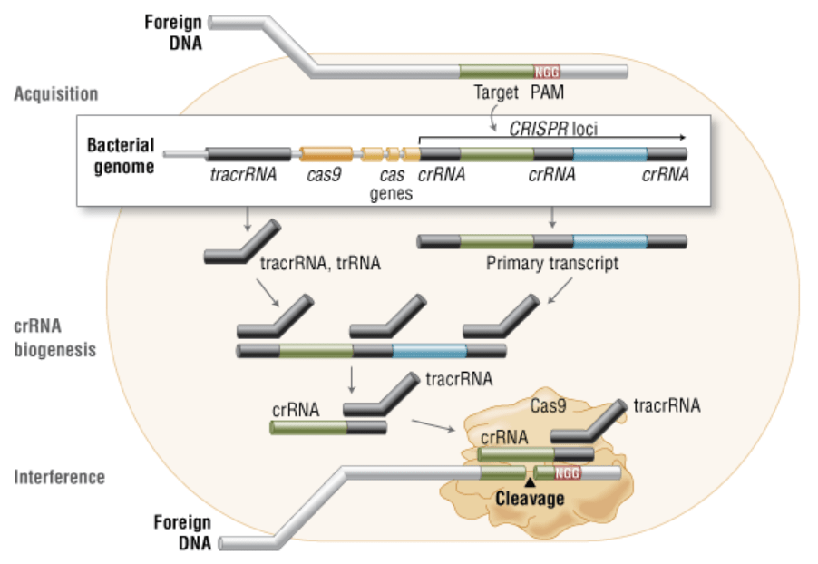

Slide 8
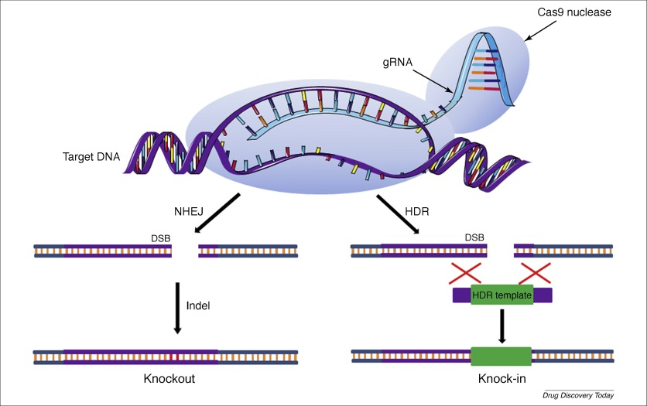

Slide 9
Re-engineered CRISPR-Cas tools
CRISPR/Cas12a
CRISPR/Cas9
CRISPR/Cas13a
The CRISPR/Cas systems

Slide 10
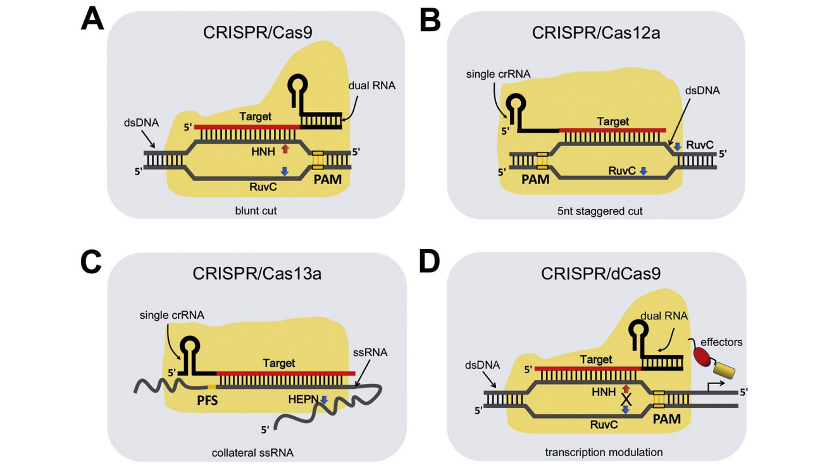

Slide 11
Anti-tumor targets for gene editing
Epigenetic genes
Oncogenes
Cell death-related genes
Tumor microenvironment-associated gene targets
Viral oncogenes
Immune-related genes

Slide 12
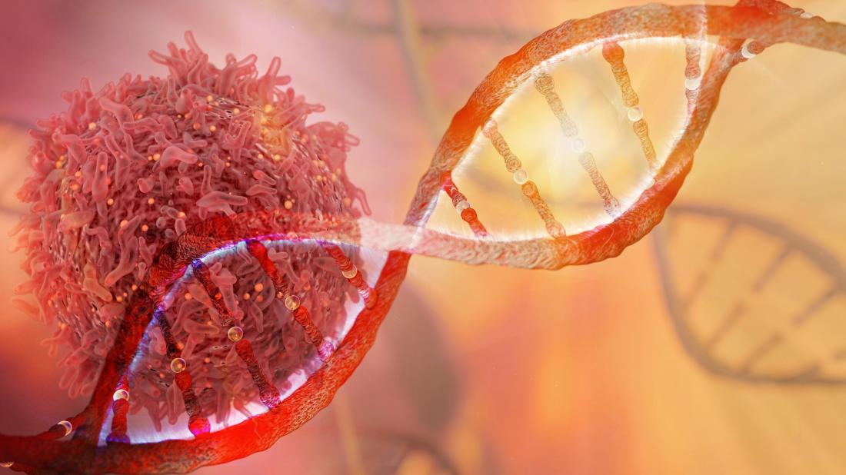

Anti-tumor targets for gene editing
Oncogenes
Cell death-related genes
kras
myc
MTH1

Slide 13
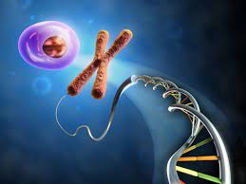
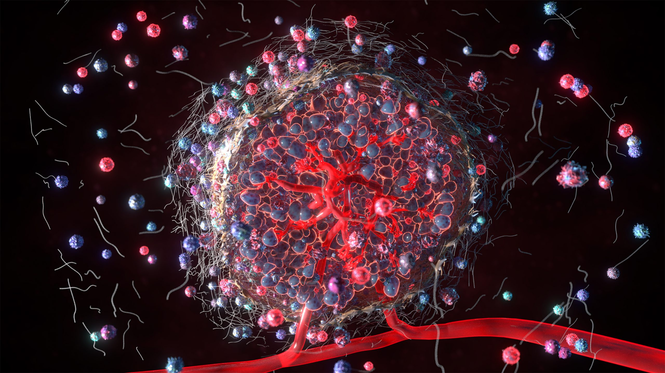
Anti-tumor targets for gene editing
Epigenetic genes
Tumor microenvironment-associated gene targets
DNMT1
VEGF

Slide 14
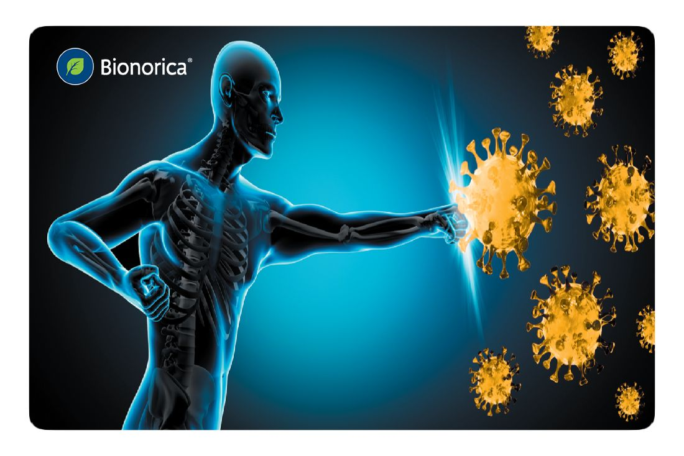
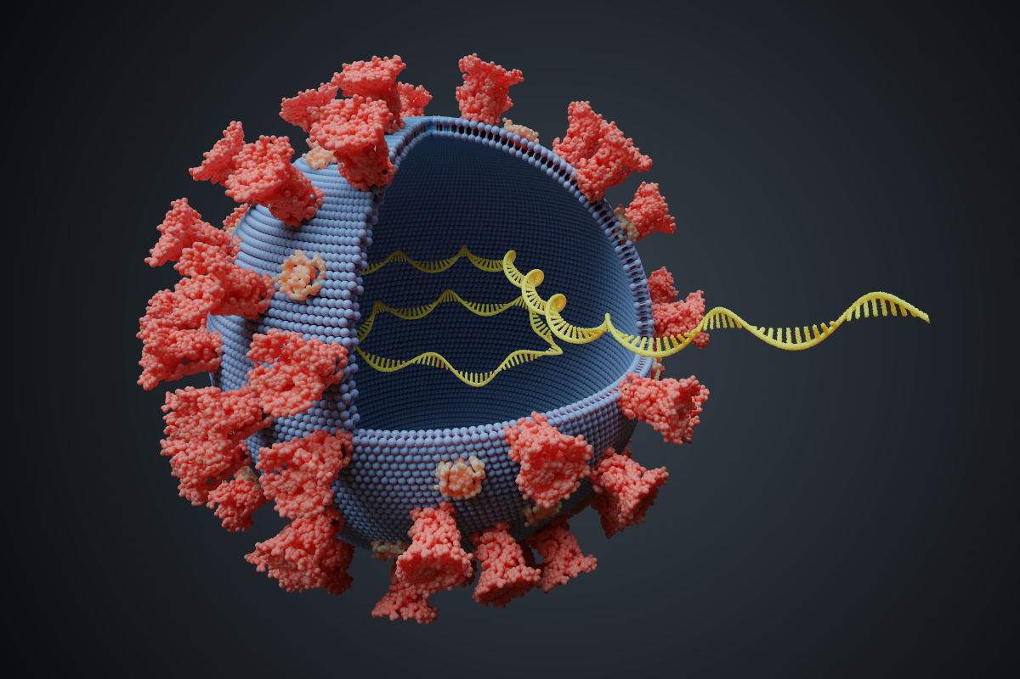
Anti-tumor targets for gene editing
Immune-related genes
Viral oncogenes
PD1
E6 , E7

Slide 15

In vitro delivery of CRISPR/Cas systems
Ex vivo delivery of CRISPR/Cas systems
In vivo delivery of CRISPR/Cas systems
Delivery systems

Slide 16
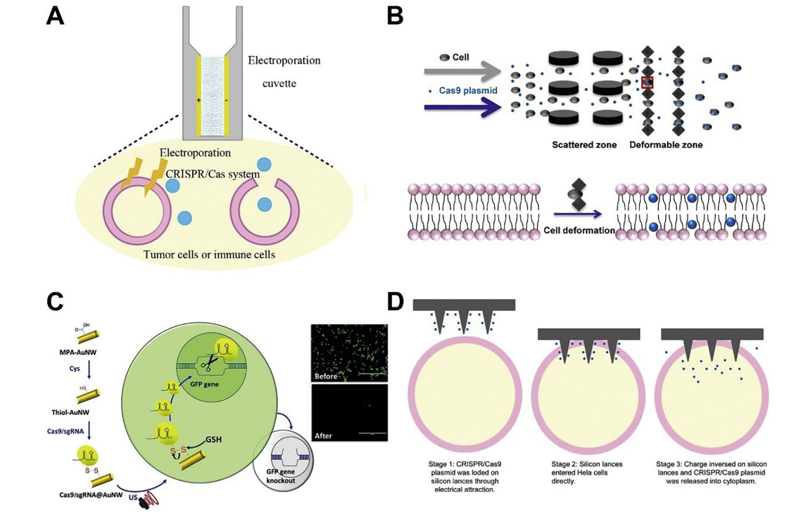
In vitro delivery of CRISPR/Cas systems
1. Physical methods
Electroporation
Membrane deformation-based microfluidic
Ultrasound-
propelled
nanomotors
LAN

Slide 17
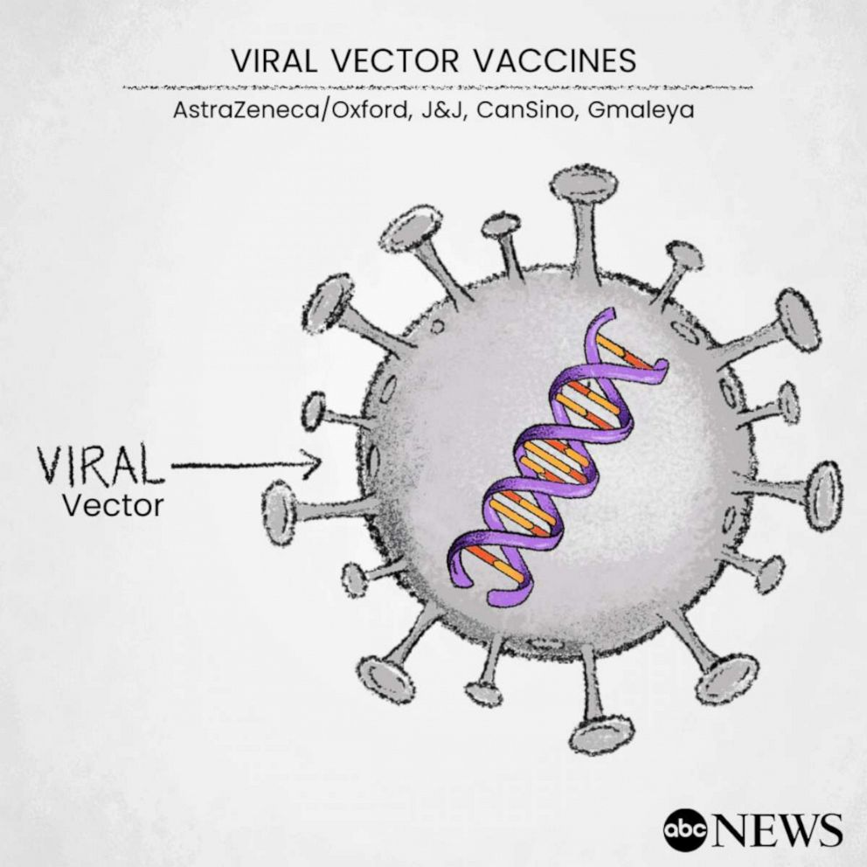
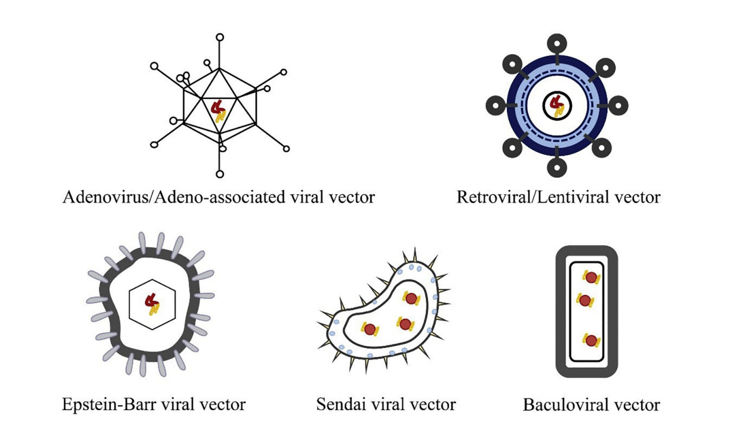
In vitro delivery of CRISPR/Cas systems
2. Viral vectors
3. Non-viral vectors
Commercial transfection reagents
Innovative vectors

Slide 18
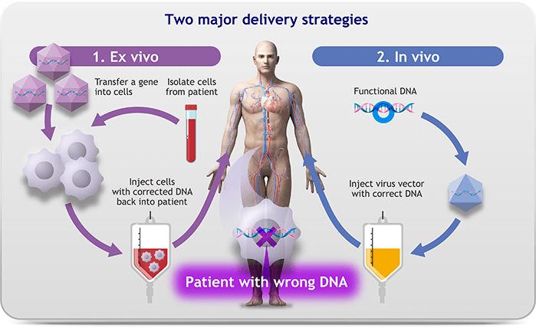
Ex vivo delivery of
CRISPR/Cas systems

Slide 19
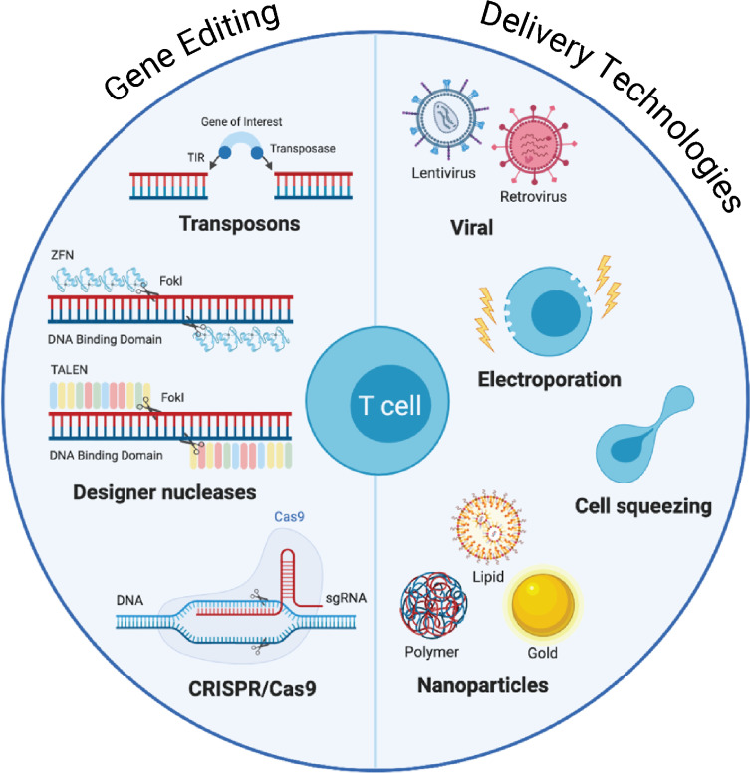
Ex vivo delivery of
CRISPR/Cas systems

Slide 20
Physical methods
Viral vectors
Non-viral vectors
In vivo delivery of CRISPR/Cas systems

Slide 21
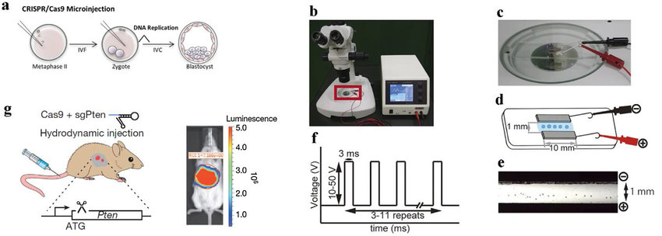
Hydrodynamic injection

Slide 22
Non-viral vectors
Common
nano-sized preparations
Cell-penetrating peptides (CPPs)-mediated delivery systems
Receptor-mediated delivery systems
Multi-modal nano-preparations

Slide 23
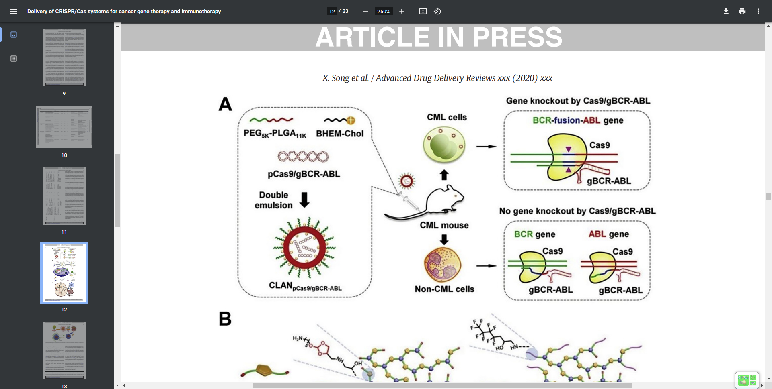
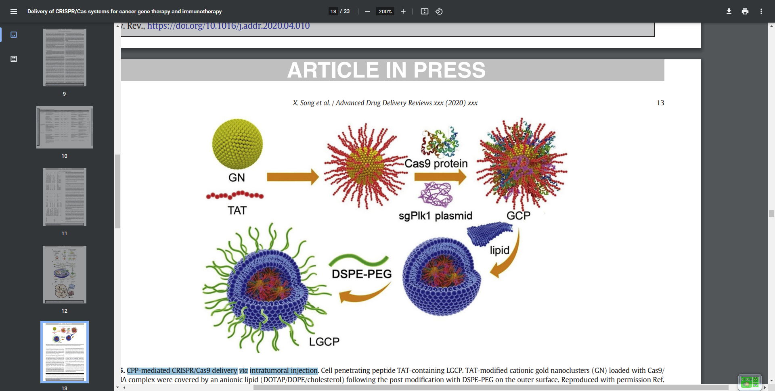
Common nano-sized preparations
CPP-mediated CRISPR/Cas9 delivery
via intratumoral injection

Slide 24
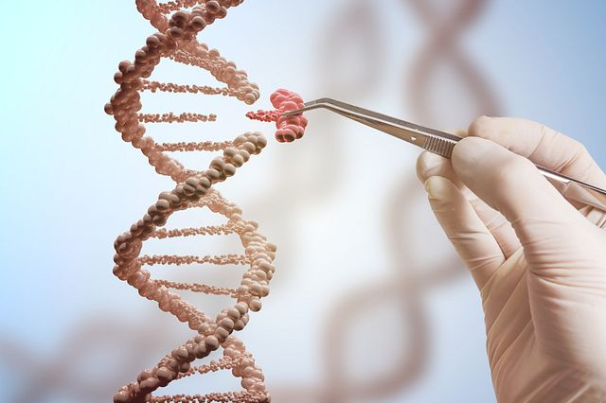
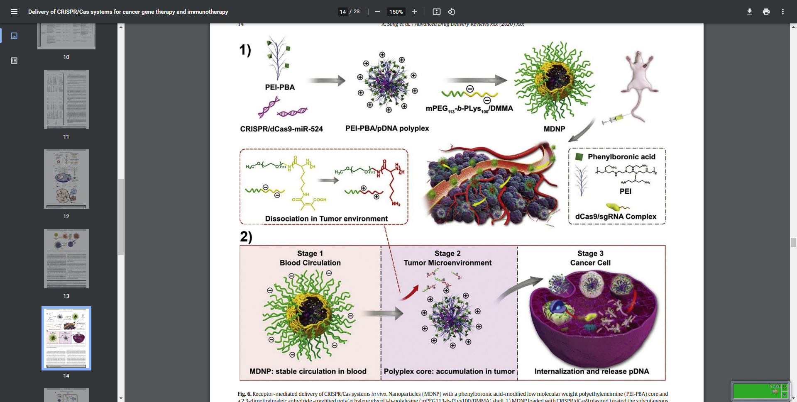
Receptor-mediated delivery of CRISPR/Cas systems in vivo

Slide 25
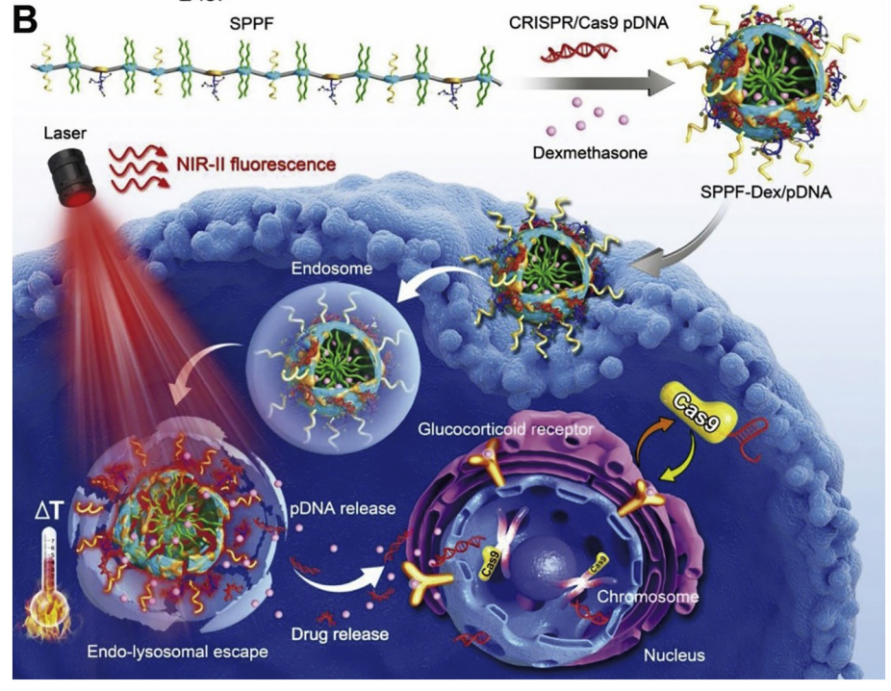
Multi-modal nano-preparations

Slide 26

conclusion

Slide 27
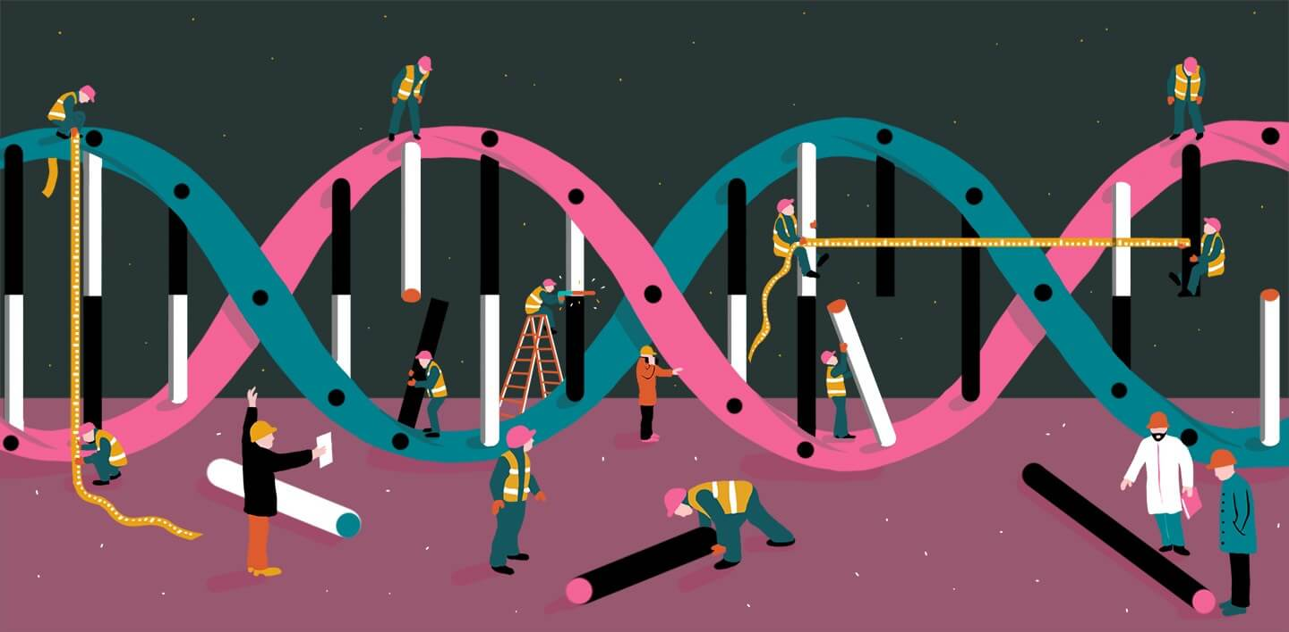
The future of CRISPR

Slide 28


