Slide 1

The pyruvate kinase activator mitapivat reduces hemolysis and improves anemia in a β-thalassemia mouse model
The journal of clinical investigation

Slide 2
In a nutshell
Introduction
                β-thalassemia
                Erythropoiesis
                Glycolytic pathway
                Pyruvate kinase
                Mitapivat
Methods
    Mouse strains and study design
    Measurement of pyruvate kinase activity and ATP
    Flow cytometric analysis of mouse erythroid precursors
    Analysis of liver and C-duodenum
    In vitro human erythropoiesis
    Results
    Discussion

Slide 3

Hello!
I am Amir Mohammad Zahedi
Advisor:
Dr.Hajar Mardani
Department of hematology and clinical laboratory sciences, kerman university of medical sciences

Slide 4

Introduction
Ineffective erythropoiesis and reduced red cell survival are key determinants in β-thalassemia.

Slide 5
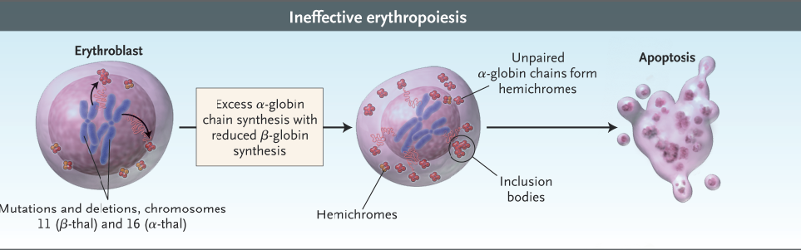
β-thalassemia and Erythropoiesis

Slide 6
ROS
increased apoptosis
ineffective erythropoiesis
block in cell maturation
Severe cellular oxidative damage
hemolysis

Slide 7
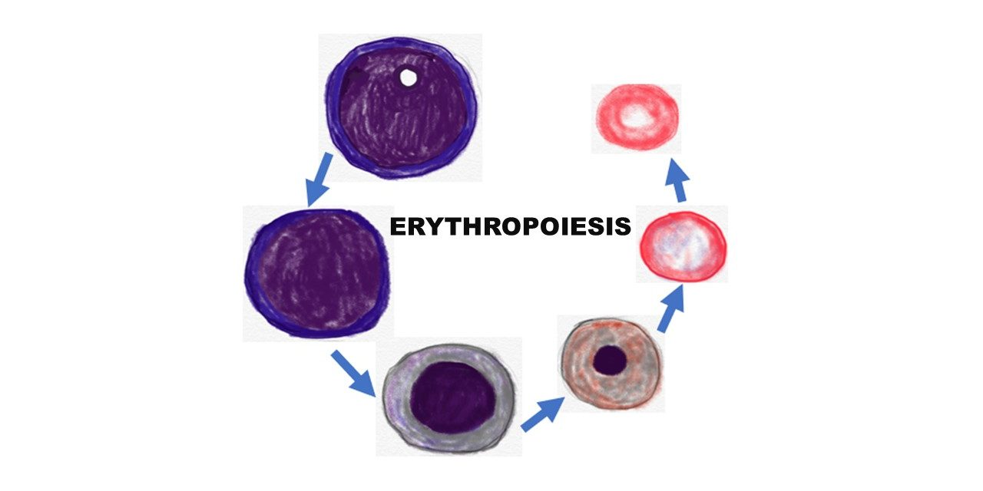
Glycolytic pathway
Erythroid maturation strictly depends on intracellular cyclic adenosine nucleotides and ATP.
Reduced ATP concentrations have been reported in β-thalassemic human red cells compared with healthy controls.

Slide 8
In a study decreased gene expression of some constituents of the glycolytic pathway in murine β-thalassemic erythroid precursors was described due to increase ROS, suggesting that erythrocyte metabolism and glycolysis are also decreased by ineffective erythropoiesis.
GSH and GSHPx reduced.
Peroxi-redoxin -2 increased.

Slide 9
Pyruvate kinase
Role
Key role in cell metabolism
Essential for red cell survival
Sustain TCA cycle
Isoforms
PKL
PKR
PKM1
PKM2
Altrations
The expression of PKM2 and to some extend PKR is inducible in response to oxidation or hypoxia.
In PK deficiency which is caused by reduced PKR activity , the expression of residual PKM2 is reported.

Slide 10
Mitapivat
activator of pyruvate kinase that binds to an allosteric pocket.
stabilize the active tetrameric form
enhance its affinity for its substrate, phosphoenolpyruvate

Slide 11
Mitapivat
Phase 2 clinical trial
Adult patients with pyruvate kinase deficiency
Increase in Hb levels in 50% of treated patients
Phase 2 study of mitapivat
In patients with non–transfusion-dependent thalassemia
92.3% achieved an Hb increase from baseline of ≥ 1 g/dL

Slide 12

Purpose of study

Slide 13

Methods

Slide 14
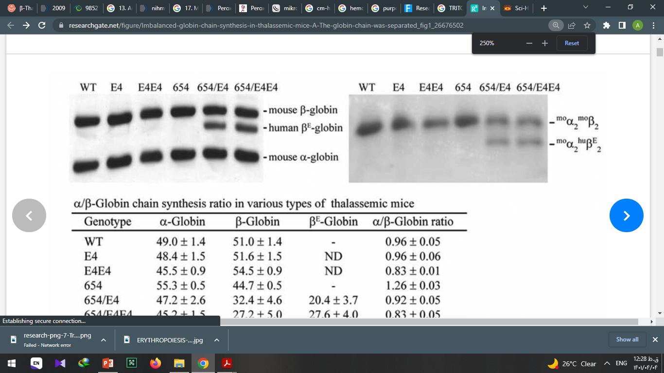
Mouse strains and study design
WT C57B6 and Hbbth3/+ mice.
Hematological parameters were evaluated.
α-globin membrane aggregates and soluble Hb were assayed.
hemichromes bound to cell membrane was assessed.
Total bilirubin, indirect bilirubin, lactate dehydrogenase, blood urea nitrogen (BUN), and creatinine.

Slide 15
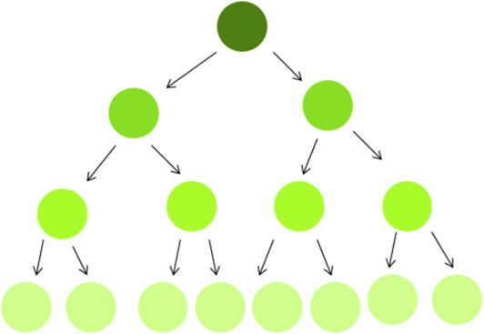
Mouse strains and study design
CFSE( Carboxyfluorescein Diacetate Succinimidyl Ester) staining to measure survival.
Analysis of reduced GSH and of GSSG.
The concentration of mouse EPO in plasma.
Erythrocyte morphology.

Slide 16
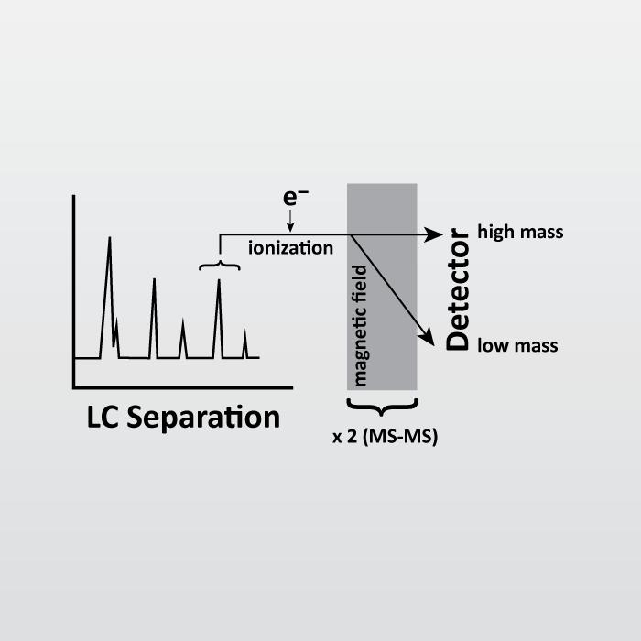
Measurement of pyruvate kinase activity and ATP
ATP concentration was determined using liquid chromatography tandem mass spectrometry (LC-MS/MS)
Pyruvate kinase activity measurements using ELISA.

Slide 17
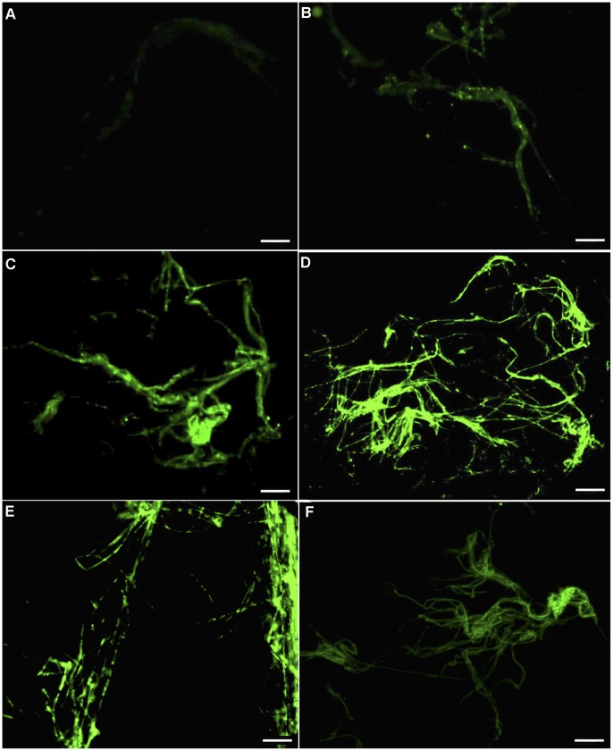
Flow cytometric analysis of mouse Erythroid precursors and molecular analysis of sorted Erythroid cells
Flow cytometric analysis of erythroid precursors from bone marrow and spleen from WT and Hbbth3/+ mice was carried out using the CD44-Ter119 schema.
Erythroblast ROS levels were evaluated as previously reported using the general oxidative stress indicator, CM-H2DCFDA on CD44-Ter119 gated populations.

Slide 18
Flow cytometric analysis of mouse Erythroid precursors and molecular analysis of sorted Erythroid cells
Flow cytometric analysis of the mitochondria was carried out using the MitoTracker Deep Red probe.

Slide 19
Molecular analysis of liver and C-duodenum
RNA isolation, cDNA preparation, and qRT-PCR using SYBER-green.
Immediately following dissection, the liver was formalin-fixed and paraffin-embedded for Perl’s staining.
Details of quantification of spleen and liver iron content and the ferroportin (Fpn1) immunohistochemistry assay.

Slide 20
In vitro human erythropoiesis.
10 erythroid cultures
antigen profiling, sorting of erythroid precursors
various concentratios, frequencies timings, and frequency of addition of mitapivat

Slide 21

Results

Slide 22
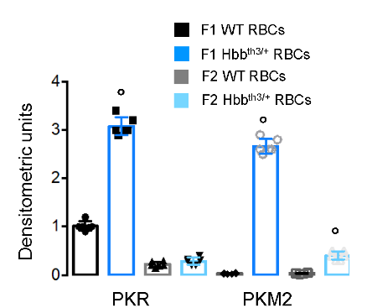
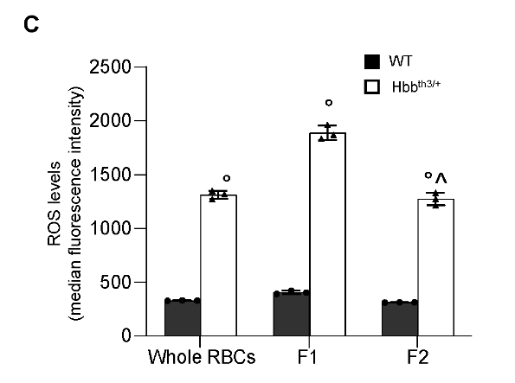
Expression of pyruvate kinase isoforms in red cells

Slide 23
Expression of pyruvate kinase isoforms in Precursors

Slide 24
Treatment with mitapivat improved anemia in a mouse model for β-thalassemia.

Slide 25
Treatment with mitapivat improved anemia in a mouse model for β-thalassemia.

Slide 26
Treatment with mitapivat improved anemia in a mouse model for β-thalassemia.

Slide 27
Treatment with mitapivat improved anemia in a mouse model for β-thalassemia.

Slide 28
Treatment with mitapivat improved anemia in a mouse model for β-thalassemia.

Slide 29
Treatment with mitapivat improved anemia in a mouse model for β-thalassemia.

Slide 30
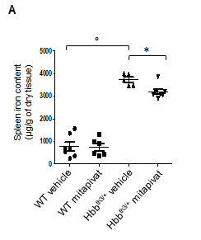
Treatment with mitapivat improved anemia in a mouse model for β-thalassemia.

Slide 31
Treatment with mitapivat improved anemia in a mouse model for β-thalassemia.

Slide 32
Treatment with mitapivat improved anemia in a mouse model for β-thalassemia.

Slide 33
Mitapivat improved mitochondrial dysfunction in Hbbth3/+ mouse erythroblasts

Slide 34
Mitapivat reduced liver iron overload and oxidative stress, and increased liver hepcidin expression in Hbbth3/+ mice.

Slide 35
Mitapivat reduced liver iron overload and oxidative stress, and increased liver hepcidin expression in Hbbth3/+ mice.

Slide 36
Mitapivat treatment reduced iron overload in duodenums of Hbbth3/+ mice

Slide 37
Mitapivat treatment reduced iron overload in duodenums of Hbbth3/+ mice

Slide 38
Mitapivat enhanced in vitro human erythropoiesis

Slide 39

Discussion

Slide 40
Thanks!
Any questions?

