Slide 1

Hematology Journal Club
Combating Osteoarthritis through Stem Cell Therapies by
Rejuvenating Cartilage
Presented by:
Samira Anvari
Adviser:
Dr.farsinezhad
1

Slide 2
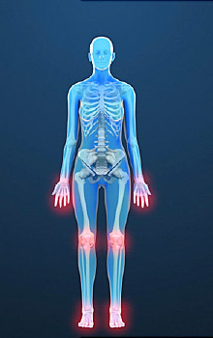
Arthritis
Over 100 forms of Arthritis
Type of Arthritis:
Rheumatoid
Osteoarthritis
Gout
Psoriasis
Osteoarthritis is the most common form
2

Slide 3
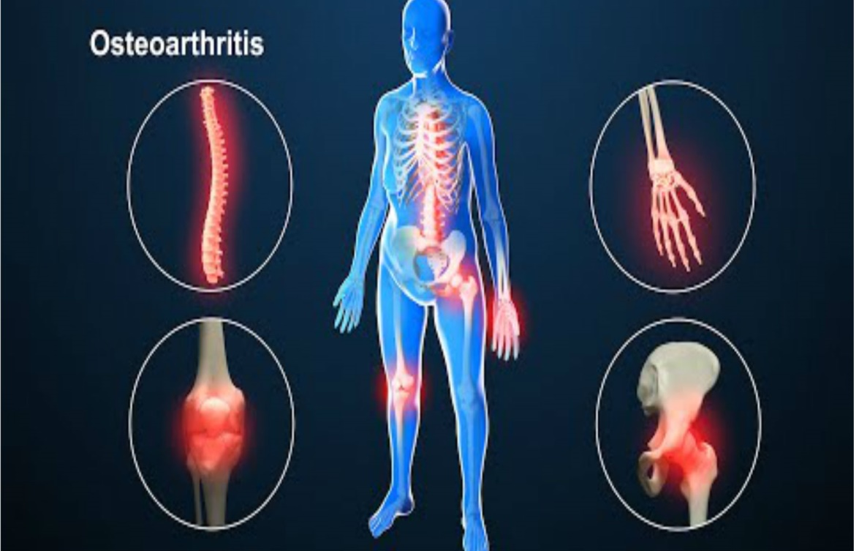
osteoarthritis
Osteoarthritis is a prevalent debilitating joint disorder
3

Slide 4
osteoarthritis
OA is classified as primary and secondary OA
Primary OA is associated with aging
Secondary OA is pertinent to disease or other factors
Obesity
Damage
Surgery
Metabolism disorder
4

Slide 5
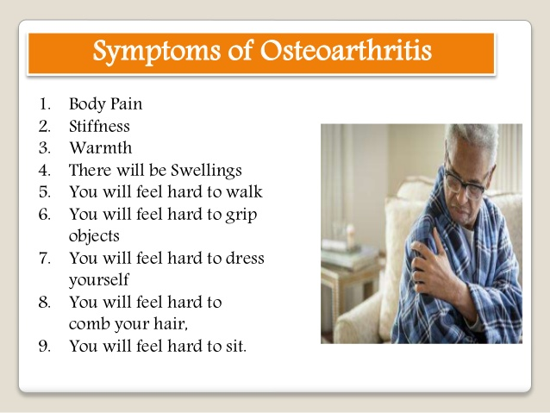
Clinical significant
Pain
Excessive stiffness
swelling
TEAM
Crepitus
5

Slide 6
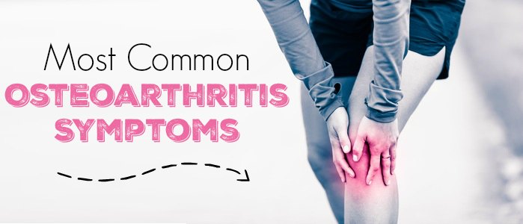

Slide 7
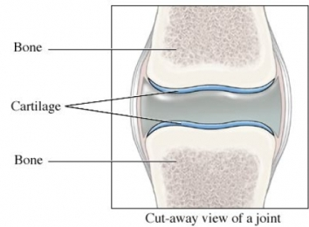
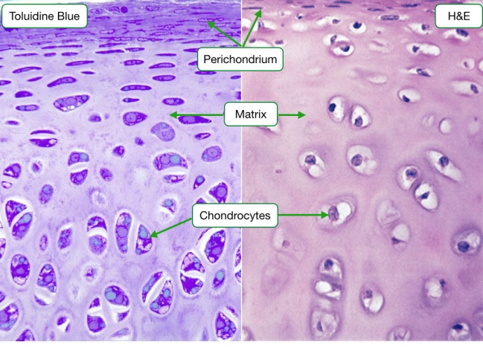
Cartilage
Cartilage is flexible connective tissue found mainly in joints
Produced of specialized cells called chondrocytes which originate from mesenchymal stem cells
When damaged, cartilage repairs very slowly.
7

Slide 8
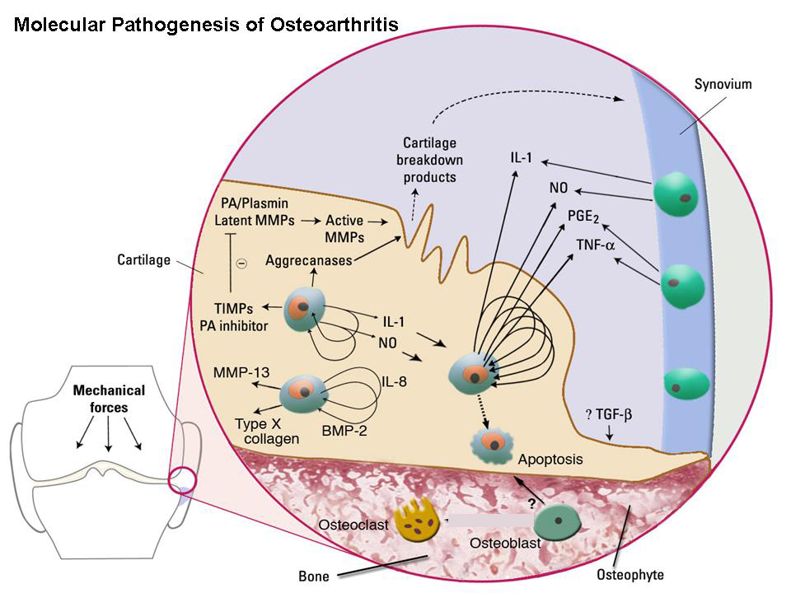
osteoarthritis
Aging
Imbalance between catabolic/anabolic pathways
Release of reactive oxygen species
IL-1
TNF-a
MMP-13
8

Slide 9
Treatment
Microfracture
Knee replacement
Mosaicplasty
Cell therapy
PRP
ACI
9

Slide 10
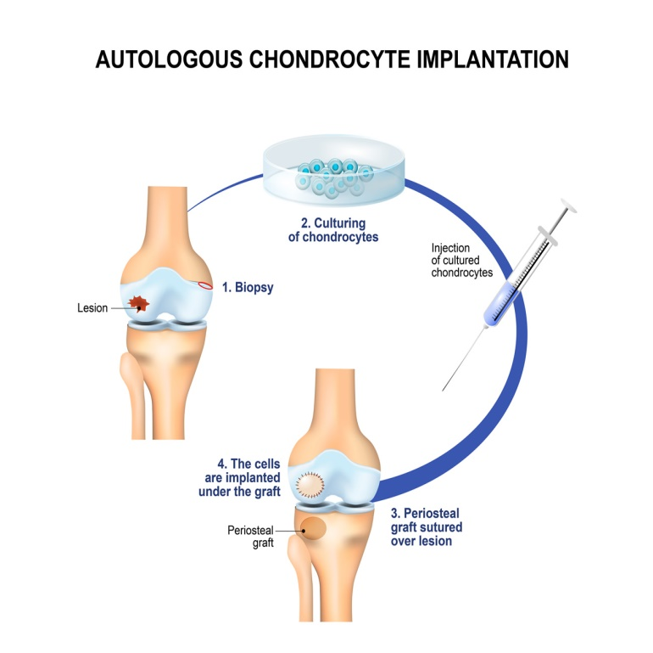
osteoarthritis
Autologous chondrocyte implantation (ACI)
Involves the autologous harvesting of cartilage from a non weight bearing area
Disadvantage
Paucity of autograft donor sites
Damage caused by the technique of harvesting
10

Slide 11
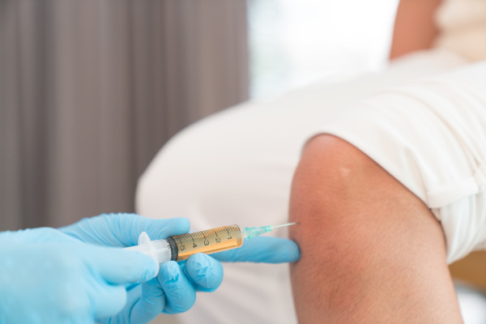
osteoarthritis
Platelet-rich plasma (PRP)
Minimally invasive treatment
1
MEDICAL
Profile
Type I insulin-like growth factor
VEGF
PDGF
Cytokines
11

Slide 12
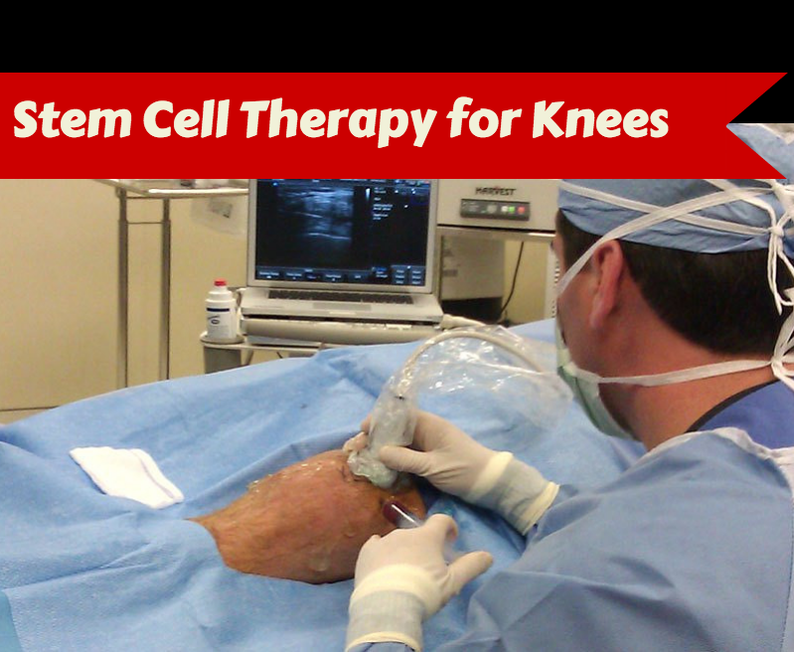
22

Slide 13
osteoarthritis
ESCs
BMSCs
IPSs
ADSCs
MSCs
SMSCs
13

Slide 14
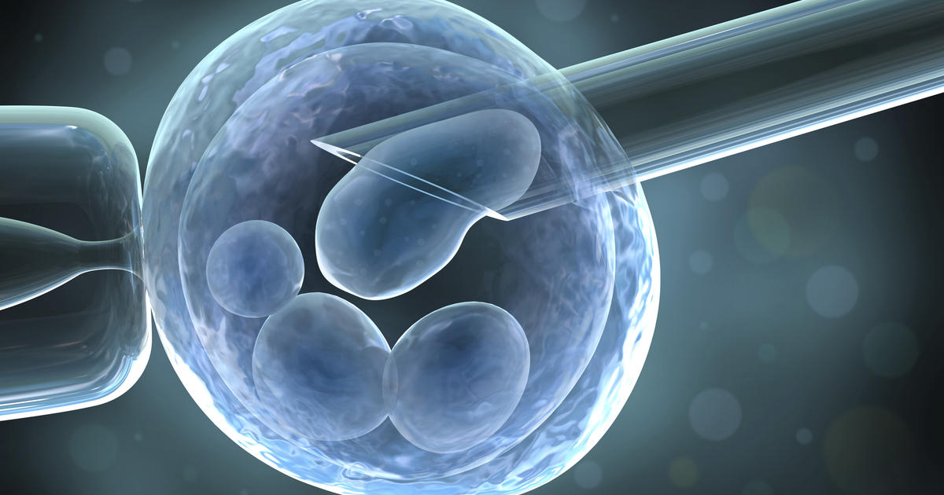
osteoarthritis
ESCs
ESCs are derived from inner cell mass of the blastocyst
3
Differentiated into:
Ectoderm Endoderm
Mesoderm
MEDICAL
SERIES
Disadvantages: Teratoma
Ethical issues
14

Slide 15
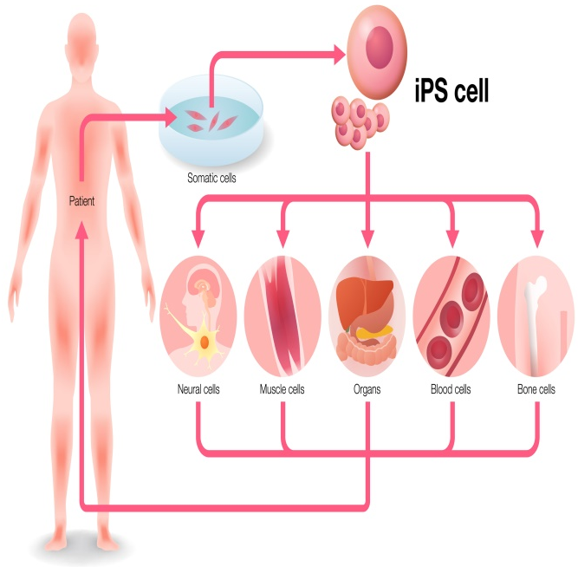
osteoarthritis
IPSs
iPSCs are the reprogrammed somatic cells similar to ESCs
3
MEDICAL
SERIES
Reprogramming and differentiation
KLF4
C-MYC
OCT4
SOX2
Disadvantages:
Oncogenes
15

Slide 16
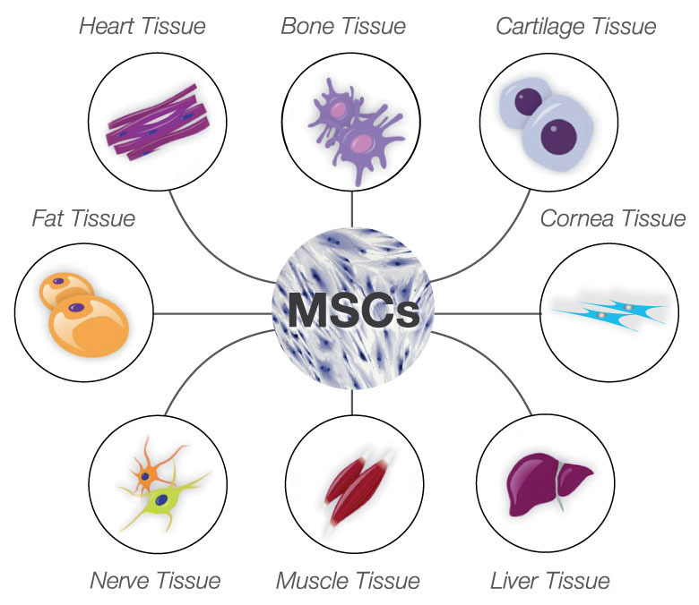
osteoarthritis
MSCs
NON-Ethical issues
Cartilage regeneration
3
MEDICAL
SERIES
Sources of MSCs: Bone marrow
Adipose tissues
Peripheral blood,
Umbilical cord blood (UCB)
Synovium
16

Slide 17
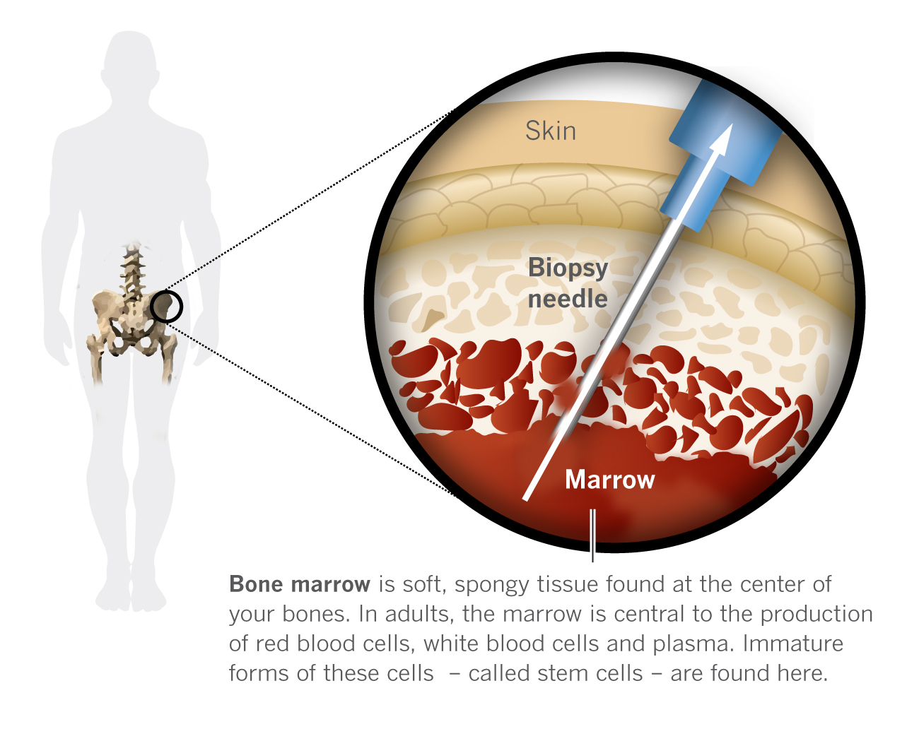
BMSCs
Differentiate into tissues such as bone and cartilage and mobilize at an injured cartilage site in knee joints
BMSC successfully regenerated injured cartilage in a rabbit model of OA
17

Slide 18
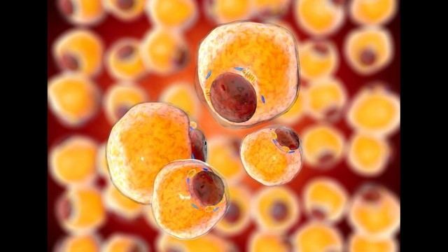
ADSCs
Adipose tissue was chosen as the source of autologous MSCs
shared chondrogenic potential
Minimally invasive
IFP(Infrapatellar Fat Pad)
18

Slide 19
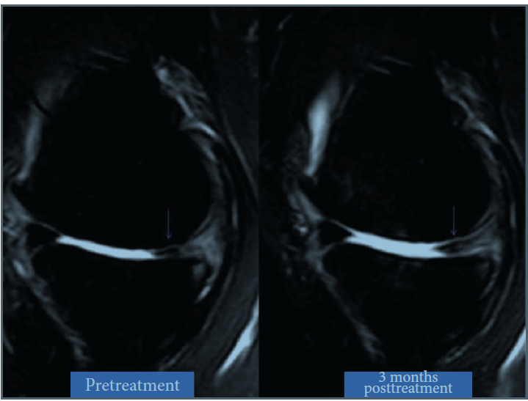
19

Slide 20
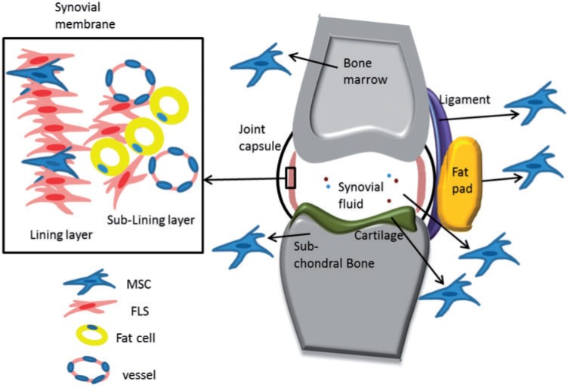
SMSCs
SMSCs have been considered more efficient for chondrocyte
differentiation than ADSCs or BMSCs
20

Slide 21
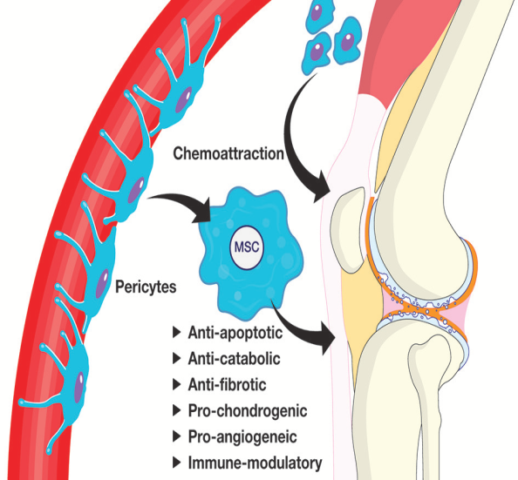
THE MSC SECRETOME
Anti-apoptoic
2
Anti- fibrotic
MEDICAL
SCOPE
Anti- catabolic
Condrogenesis
Immune- suppression
21

Slide 22
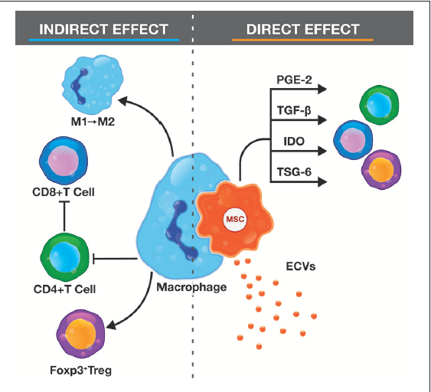
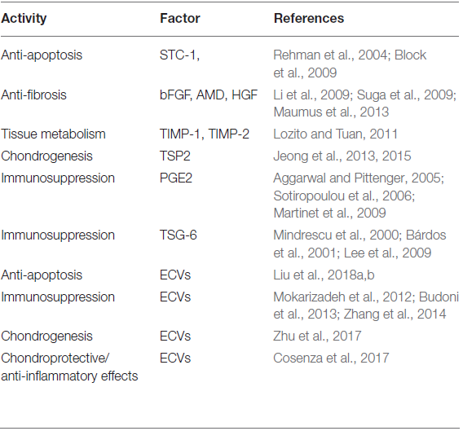
22

Slide 23
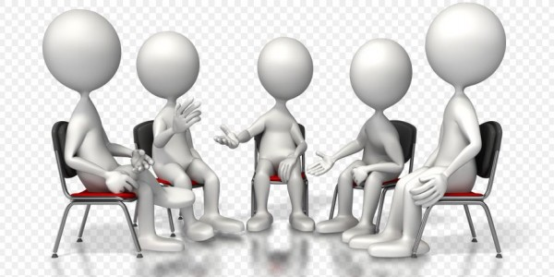
Discussion
23

Slide 24

24

