Slide 1



Hematology Journal Club
Title:
The CRISPR/Cas9 system efficiently reverts the tumorigenic ability of BCR/ABL in vitro and in a xenograft model of chronic myeloid leukemia
Presented by:
Sohaib Mohamadyar

Slide 2
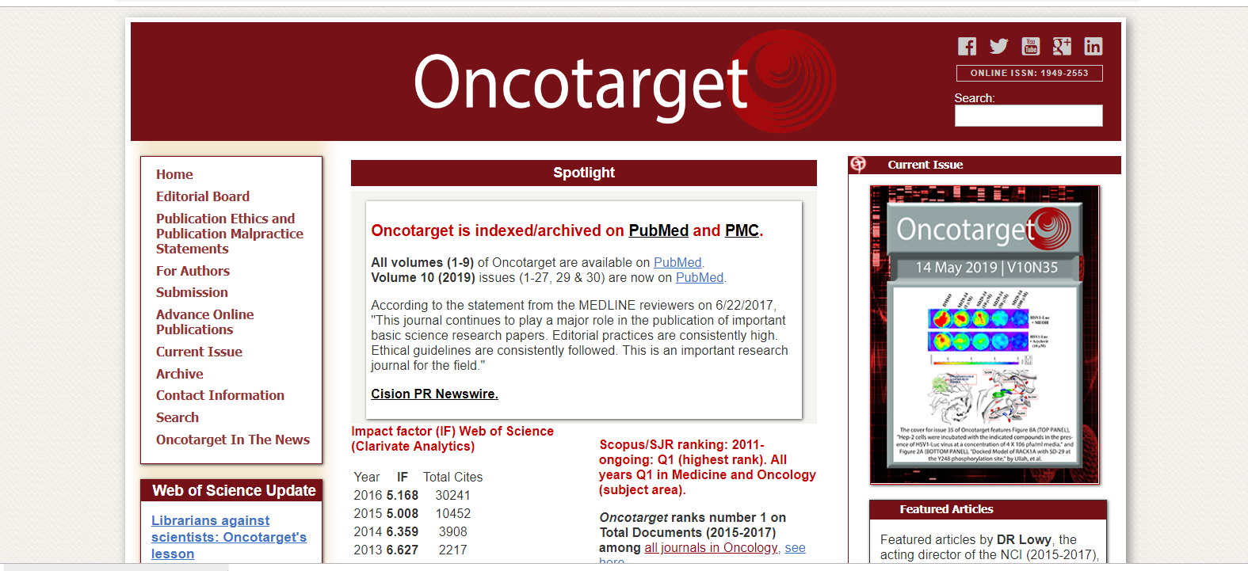
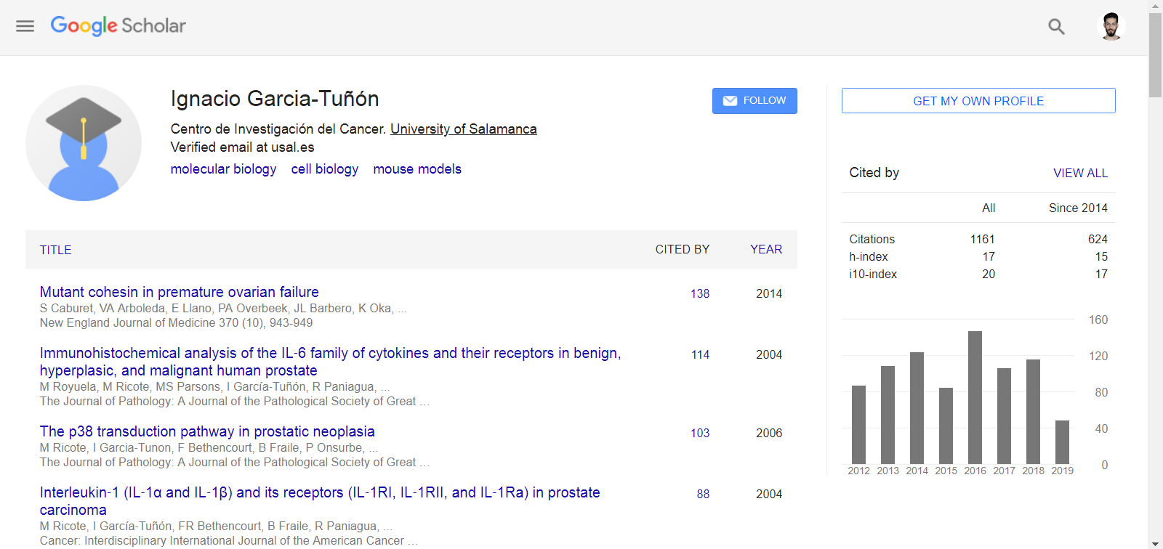
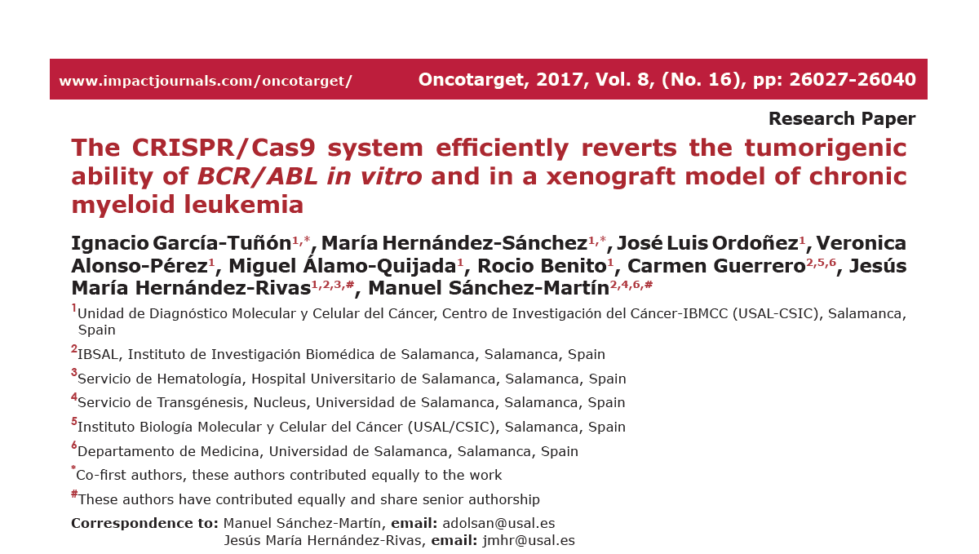
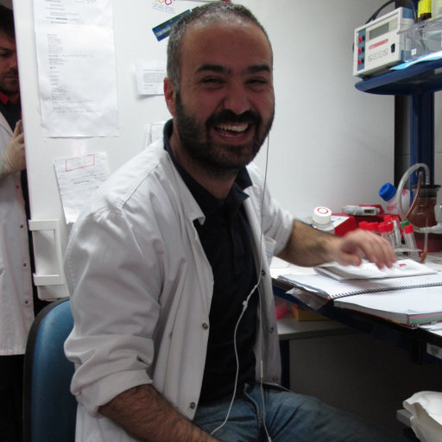

Slide 3


Contents
CML
CRISPR/CAS9
Material & Method

Slide 4

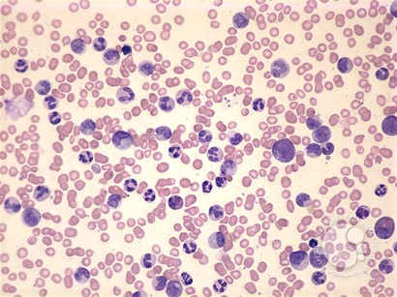
CML
Chronic myeloid leukemia (CML), a malignant
haematopoeitic stem cell disease, characterized by the
occurrence of the Philadelphia chromosome

Slide 5
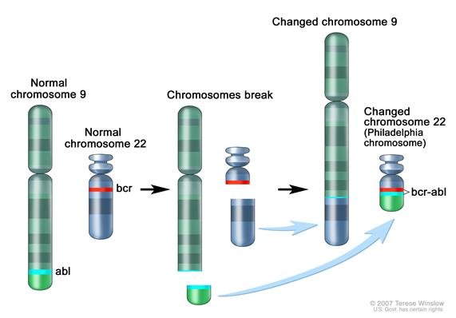
CML

Slide 6
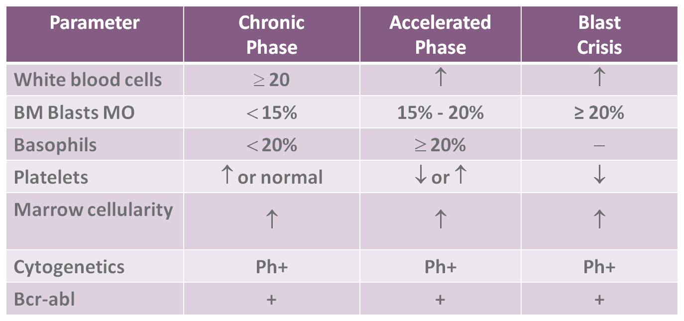
CML

Slide 7
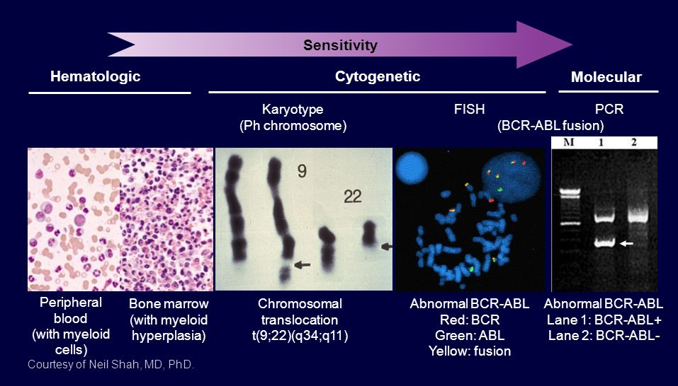
CML
Diagnose of CML :
PBS
Bone Marrow
Karyotype
FISH
PCR

Slide 8

CML
Treatment :

Slide 9

CRISPR-CAS9
a promising tool for gene editing

Slide 10
CRISPR-CAS9
CRISPR-Cas9 is a unique technology that enables geneticists and medical researchers to edit
parts of the genome by removing, adding or altering sections of the DNA Sequence
the most rapidly evolving technology which has revolutionized biological research
It represents a family of DNA repeats in most archaeal (~90%) and bacterial (~40%) genomes
provides acquired immunity and resistance to foreign genetic elements such as virus and phages

Slide 11
CRISPR: clustered regularly interspaced short palindromic repeat
The system CRISPER /CAS9 consists of three parts
CAS genes There are 4-20 different CASs
CRISPR area Repeat + spacer DNA
Leader A-T rich region، located on the upstream side of the Crisper array

Slide 12
There are six distinct types of bacterial CRISPR systems
three main types (types I to III)
Three additional types (types IV to VI)
Owing to their simplicity, class 2 systems have been adopted for genome engineering
The CRISPR-Cas9 Type II consists of two key molecules
From Streptococcus pyogenes
crRNA + tracrRNA
Enzyme cas9
Guide
RNA

Slide 13
CAS-9
CRISPER associated protein
Known as molecular scissors
RNA-guided DNA endonuclease enzyme
Associated with the CRISPR adaptive immunity system in Streptococcus pyogenes

Slide 14
Cas9 contains two nuclease domains:
HNH domain
cleaves the strand complementary to the cr RNA-guide sequence
2) RuvC-like domain
cleaves the non complementary strand
Cas9 protein induce double-strand breaks (DSBs) at the target site

Slide 15
Guide RNA (g-RNA)
The guide RNA directs the Cas9 protein to a target site
Cr RNA + tracr RNA = guide RNA (g RNA)
Cr RNA (Crisper RNA)
cr RNA is a 20 nucleotide sequence that is complementary to a target region
in your gene
tracrRNA(trans-activating crRNA)
tracrRNA provides a scaffold for the crRNA binding and stabilization

Slide 16
foreign DNA (viral or plasmid) is
inserted into the CRISPR locus of the host
CRISPR loci are transcribed and formed a mRNA called crRNA

Slide 18
transcription and translation of cas9 genes
Translation of tracrRNA
tracrRNA bind to crRNA an formed gRNA tracrRNA + crRNA
guide RNA bound to cas9 and formed Complex crRNA + tracrRNA+cas9

Slide 19
Complex (crRNA + tracrRNA + CAS9) goes through target DNA until finding a PAM and match sequence with crRNA
PAM : Protospacer Adjacent Motif
Short conserved sequences )NGG N is A, T, C, or G(
required for Cas9-DNArecognition
Double stranded DNA is cleaved by CAS9
DNA is repaired by the cell

Slide 20
CML eradication is still hindered by the emergence of TKI resistant cells.
BCR/ABL fusion, which is responsible for CML pathogenesis, is an ideal
target for CRISPR-Cas9- mediated gene therapy.
The present study shows a CRISPR-Cas9 application for truncating the specific
BCR-ABL fusion (p210) at the genetic level in a cellular model.

Slide 21
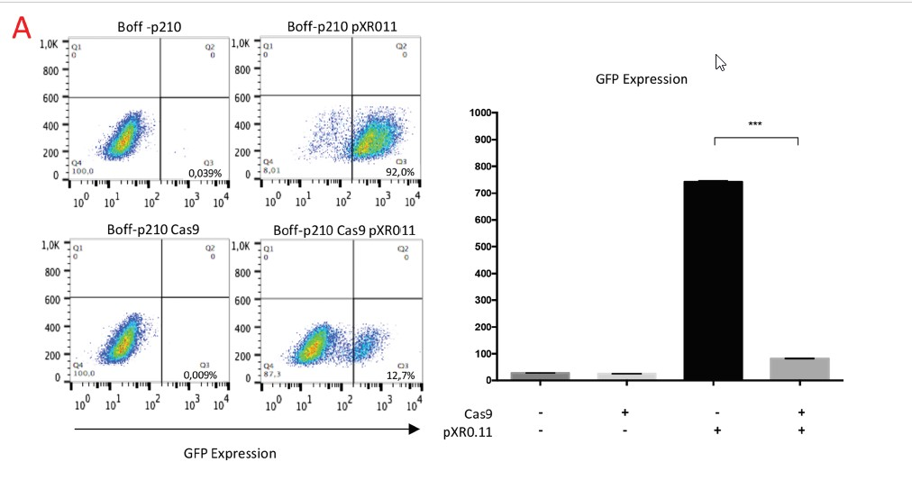
The CRISPR/CAS9 system efficiently and specifically disrupts the human oncogene
BCR/ ABL fusion in an oncogene-dependent cell line

Slide 24
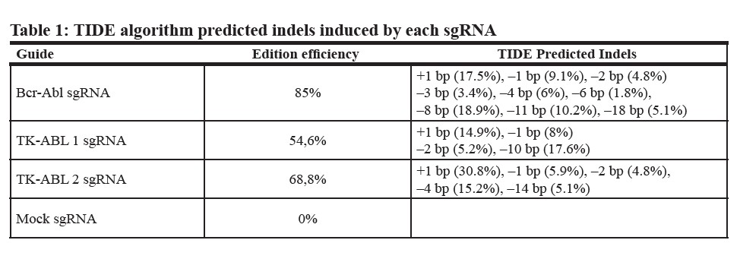

Slide 27
Establishment of a single cell derived-cell line carrying a specific
CRISPR/CAS9-mediated mutation in the BCR/ABL oncogene
41 single-cell clones were analyzed by Sanger sequencing
most of them (32/41) had an edited sequence
Four of these 32 clones, showing indel mutations that
generated a premature stop codon near the Cas9
cleavage point, were choose to functional analysis
One of them (Clone 1), which carried an 8-bp deletion
at the expected cleavage point, was selected to establish
the cell line known as :
Bcr-Abl-SC (single edited cell-derived Boff-p210-Cas9)

Slide 28
Obliteration of the BCR/ABL oncogene by CRISPR-CAS9 in the BOFF-P210 cell line
leads to an absence of the oncogenic protein

Slide 29
In vitro ablation of BCR/ABL by the CRISPR/ CAS9 system in tumorigenic p210 cells
induces cell cycle arrest and impairs survival

Slide 31
CRISPR-CAS9 impairs the tumorigenic capacity of edited
Boff-p210 selected cells

Slide 33
DISCUSSION

Slide 34

Any Question ?
SO
THANK YOU !!

