Slide 1
Purification of Nasulysin-1: a new toxin from Porthidium nasutum snake venom that specifically induces apoptosis in leukemia cell model through caspase-3 and apoptosis-inducing factor activation
ADVISED BY: DR. MARDANI
PRESENTER: MAHDIYEH ABBASPOOR

Slide 2
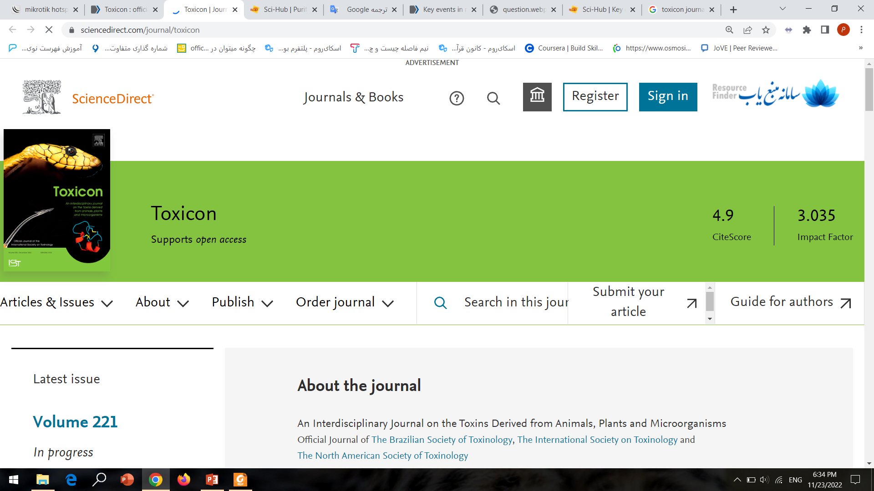

Slide 3
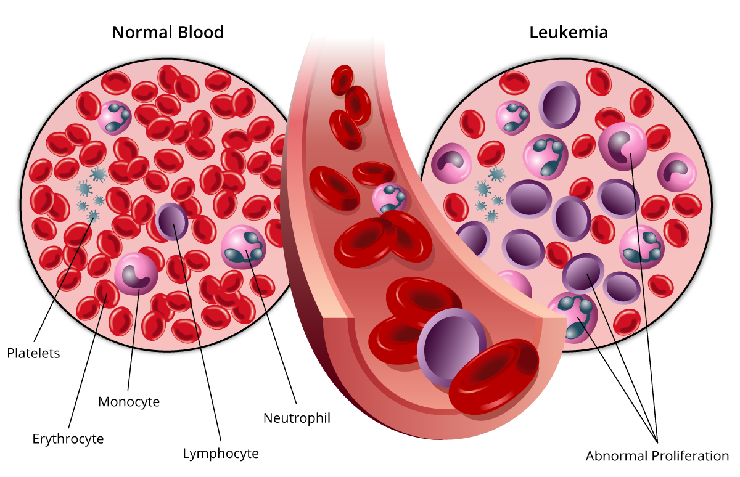

Slide 4
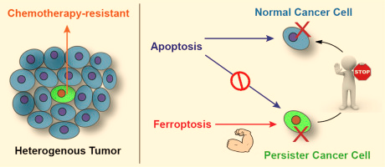
United States 2015
12910 New Cases
2,590 Deaths
Pediatric (~10%)
Adult (~30%)

Slide 5
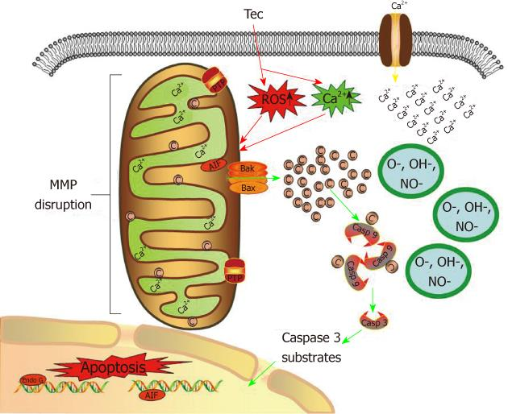
Evasion of Apoptosis

Slide 6
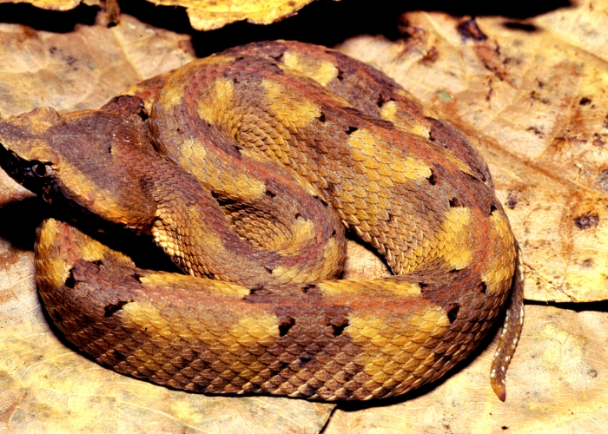
Porthidium Nasutum hognose pit vipers

Slide 7
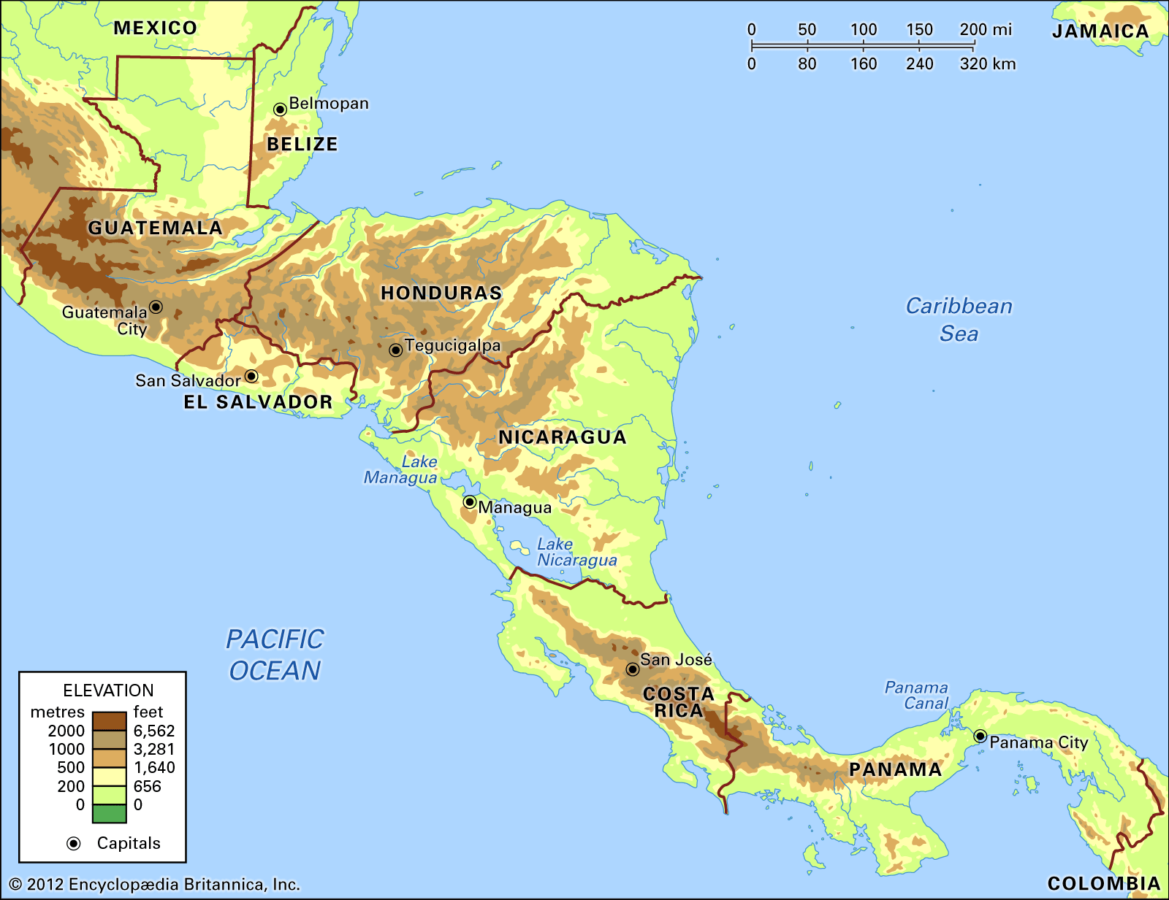

Slide 8
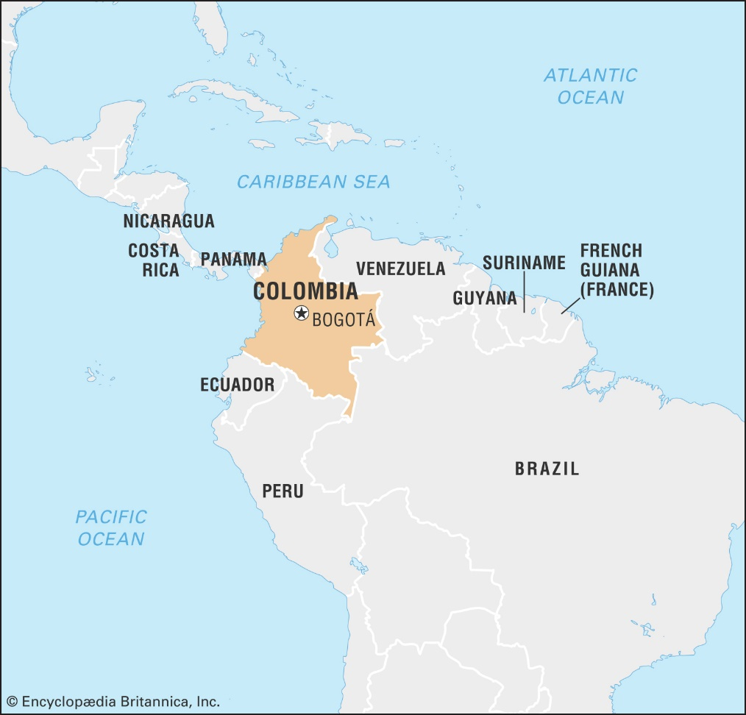

Slide 9
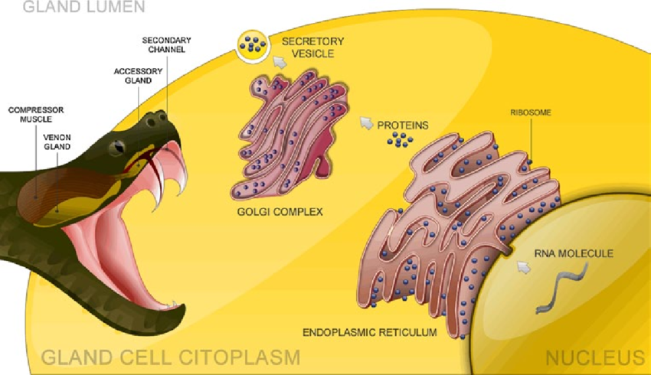
Snake Venoms & Apoptosis & Anticancer

Slide 10
Proteomic Analysis of the P. nasutum Venom from Costa Rica
Snake venom metalloproteinases OR SVMPs (52.1%)
Phospholipases A2 (PLA2, 11.6%) → antibacterial activity from Colombian P. nasutum
C-type lectin/lectin-like (CTL, 10.4%)
Disintegrins (DIS, 9.9%)
Serine Proteinases (SP, 9.6%)
L-amino acid oxidases (LAO, 3%)
Bradykinin-potentiating peptides (BPP, 1.9%)
Cystein-rich secretory proteins (CRISP, 1.3%)
Nucleotidases (NUCL, 0.2%)

Slide 11


Slide 12
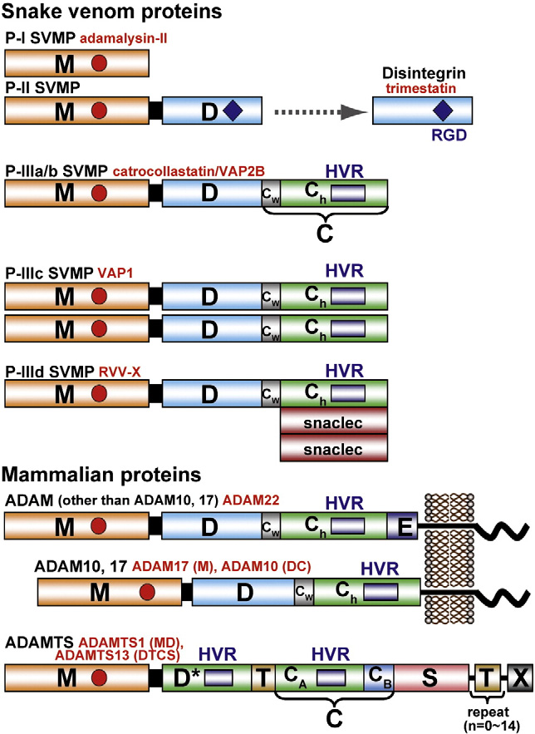
SVMP Monozinc Endopeptidases

Slide 13
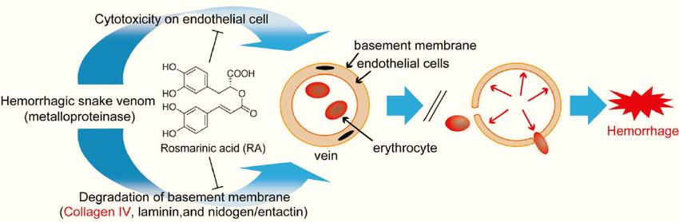
APOPTOSIS
Human umbilical-vein endothelial cells
Endothelial cells
Rat smooth muscle cells
Leukemia cells?????????

Slide 14

Colombian P. nasutum Venom
Crude P.nasutum Snake Venom
Isolated Venom Fractions
Small SVMP (MW ~26 kDa) nasulysin-1
Jurkat/K562 cells
Normal lymphocytes

Slide 15
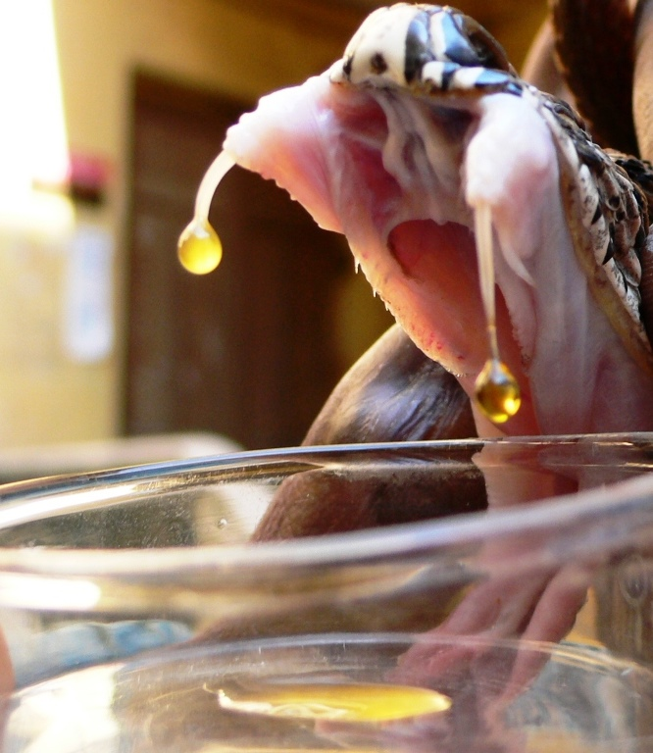
Material & Method
Venom extraction of 45 P. nasutum
State of Antioquia located in northwest Colombia.

Slide 16
Material & Method
Isolation & Culture of Lymphocytes (HEALTHY)
Leukemia Cancer Cell Culture Jurkat and K562
( crude/fractions/sub-fractions)
Morphological Assessment of Cell Death by Fluorescence Microscopy Using Acridine Orange/Ethidium Bromide
Immunocytochemistry Detection of Caspase-3 and Apoptosis-Inducing Factor (AIF).
Photomicrography
Statistical Analysis
Purification of the Venom of P. nasutum by Molecular Exclusion Chromatography and HPLC
One-Dimensional (1D) and Two-Dimensional (2D) Electrophoresis
((F I-VI) and (SF IV.5))
Protein Preparation and Analysis by LC-MS/MS
( SF IV.5)

Slide 17
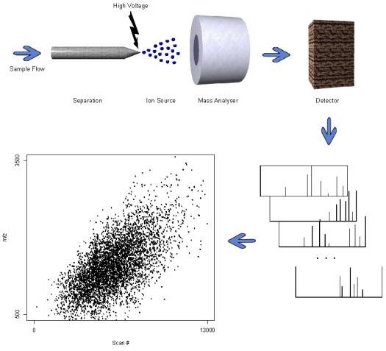
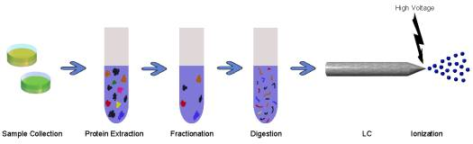
Liquid Chromatography Mass Spectrometry

Slide 18
Results

Slide 19
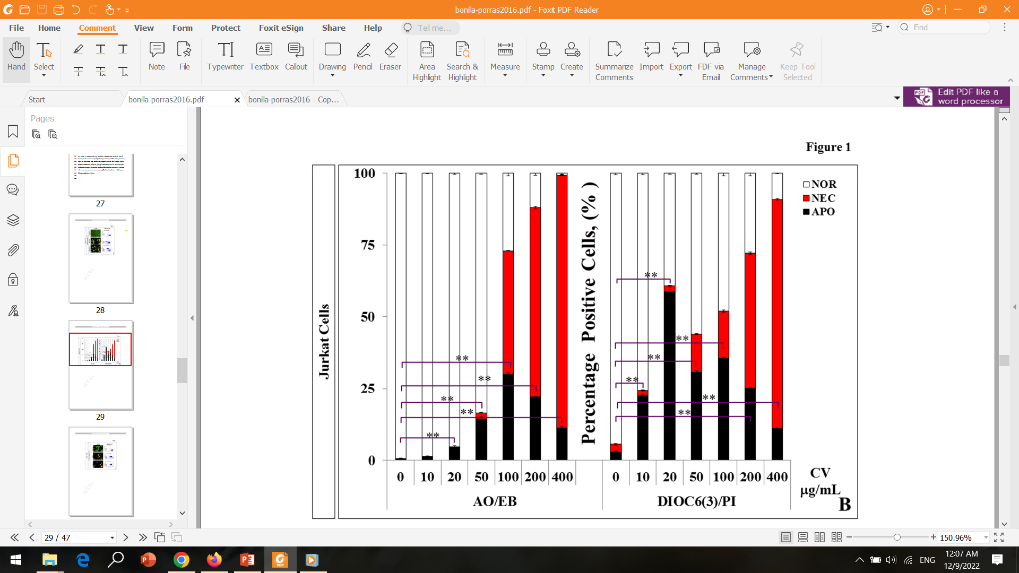
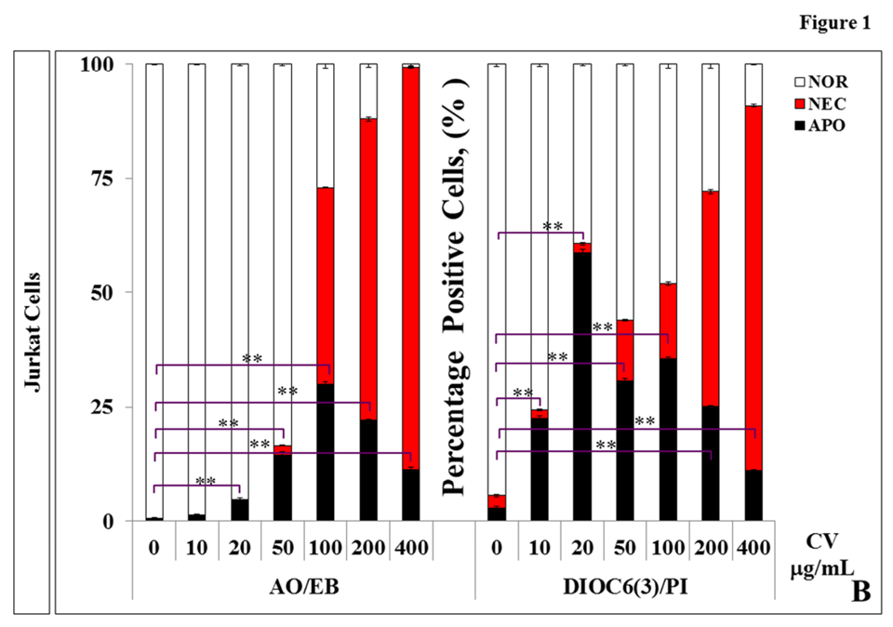
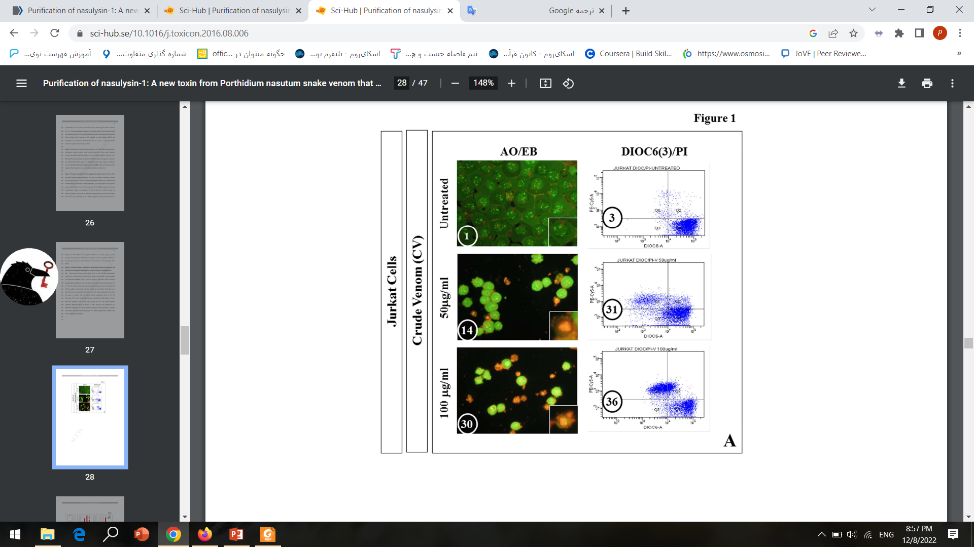
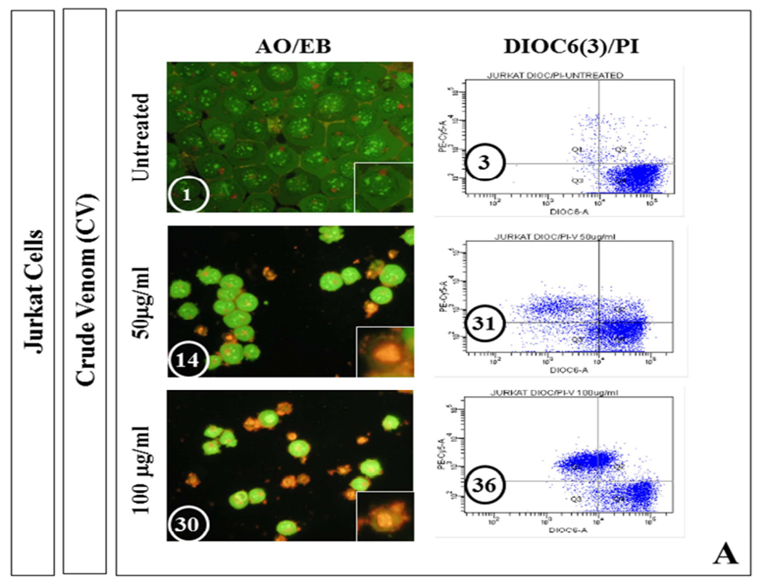
Crude P. nasutum snake venom induces both apoptosis and necrosis in Jurkat and K562 cells

Slide 20
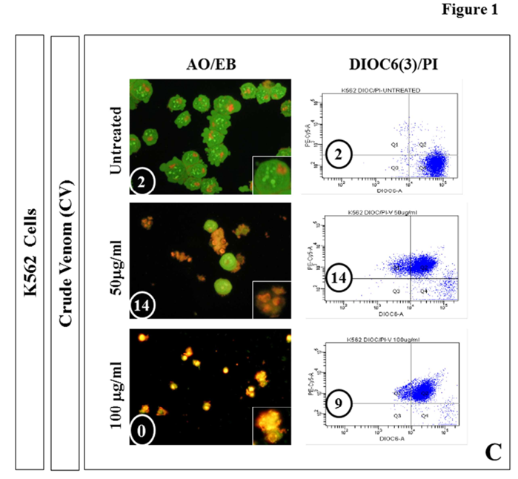
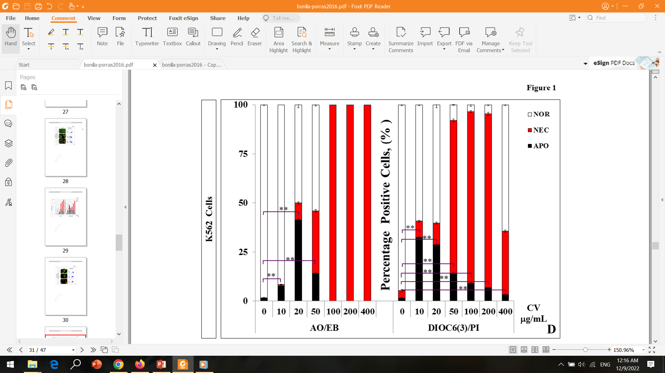
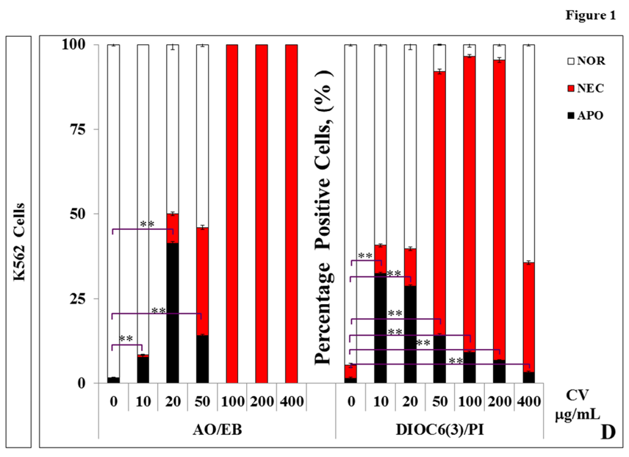
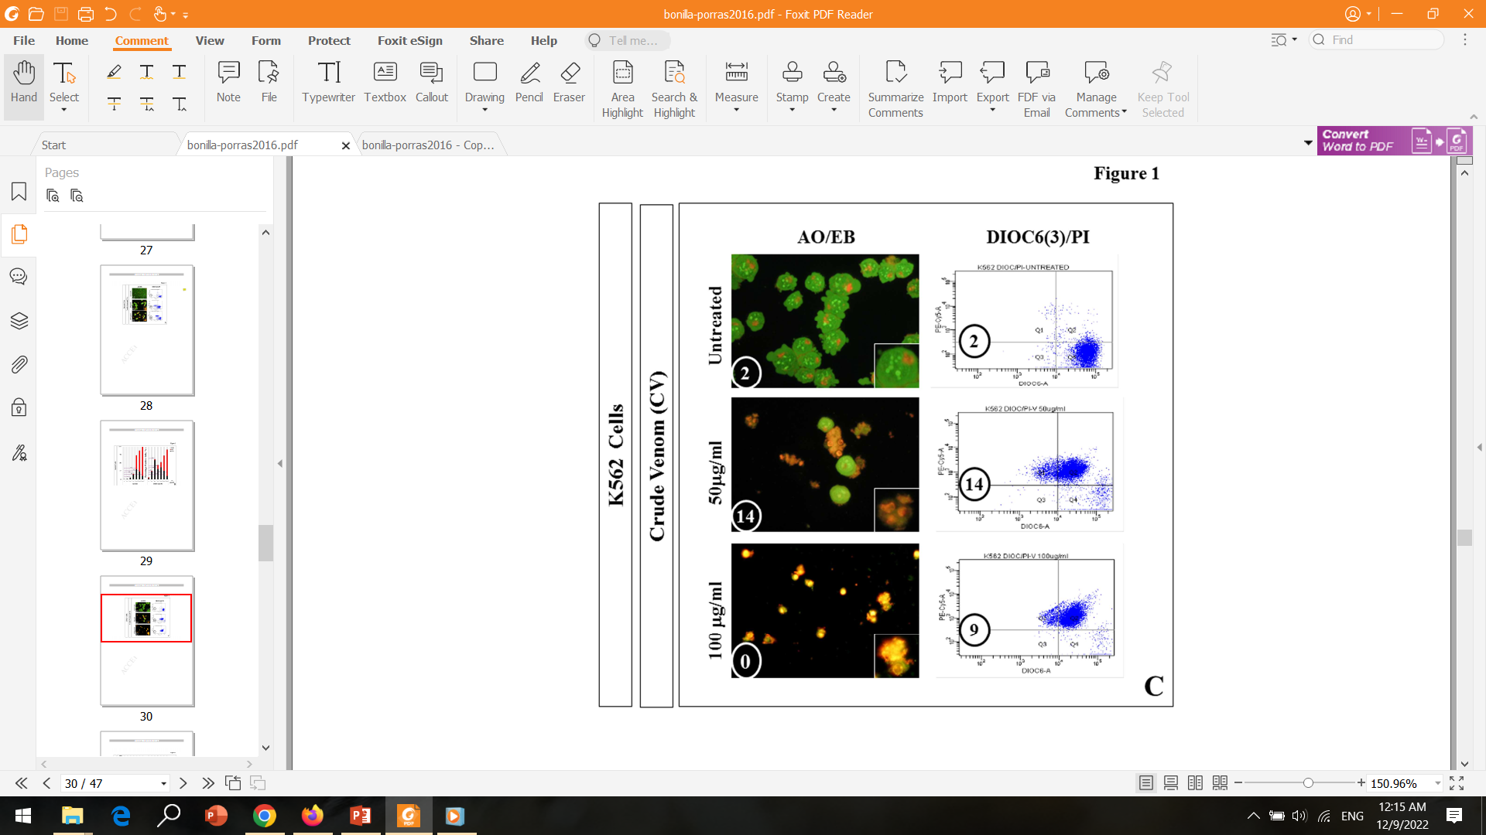
Crude P. nasutum snake venom induces both apoptosis and necrosis in Jurkat and K562 cells

Slide 21
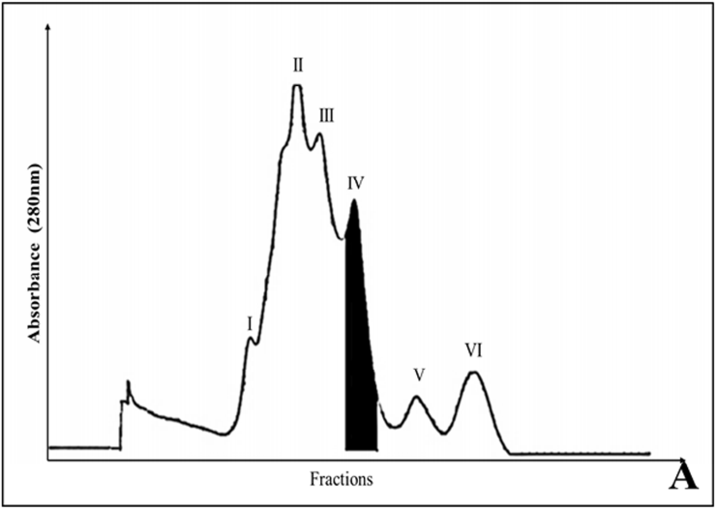
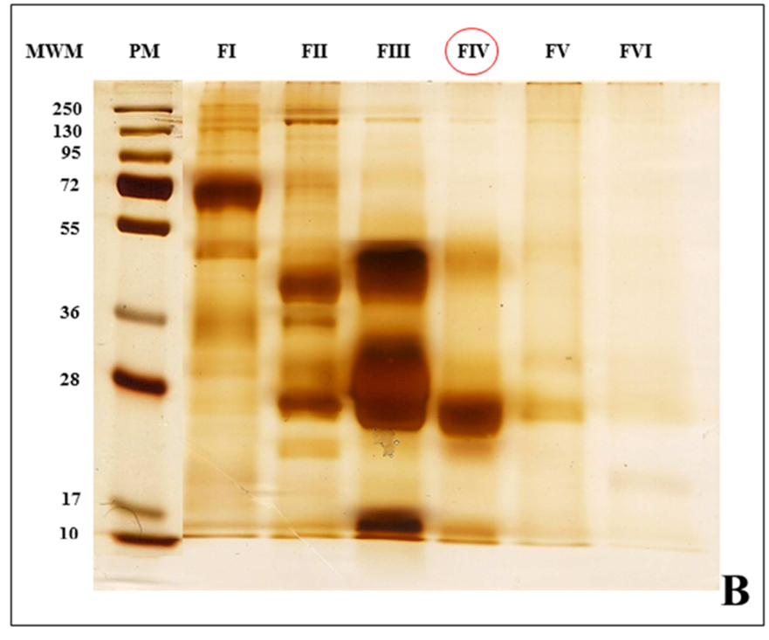
Purification of nasulysin-1 from P. nasutum.
molecular exclusion chromatography
Electrophoresis
~72 kDa to ~12 kDa

Slide 22
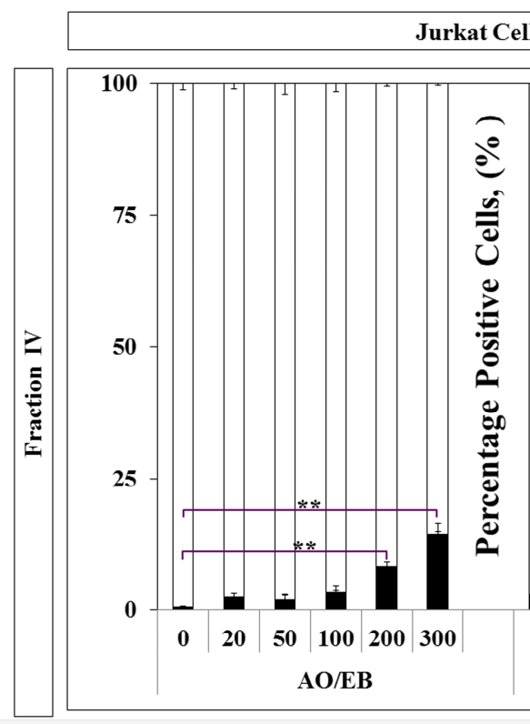
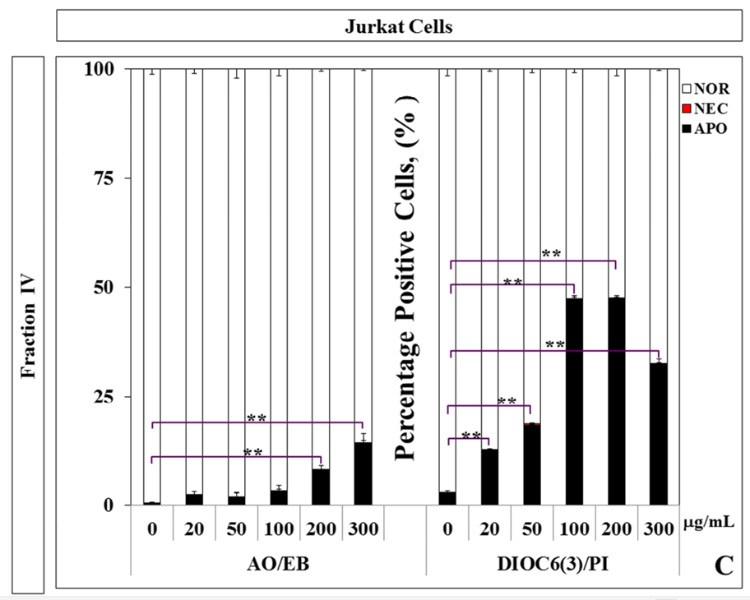
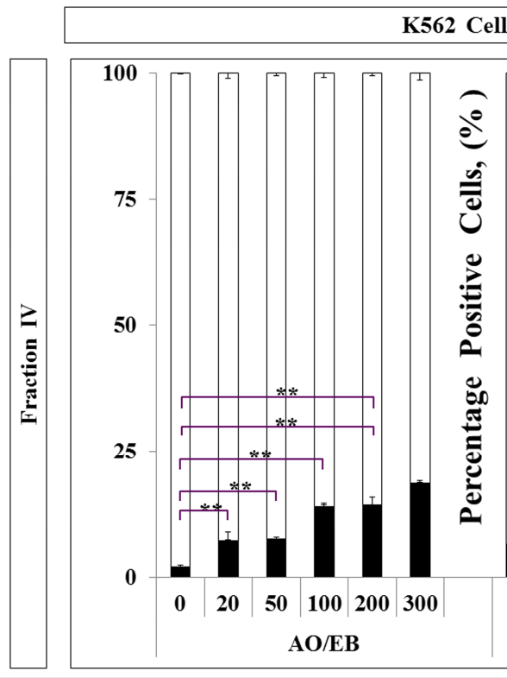
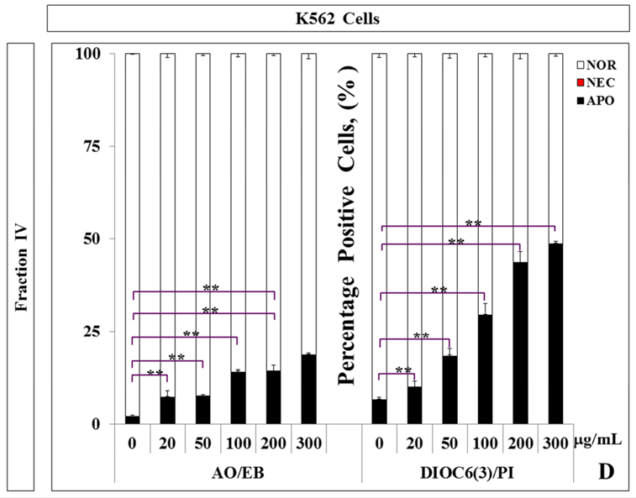
Purification of nasulysin-1 from P. nasutum.
Thick Single Band
~26 kDa
Low Molecular Weight Metalloproteinase

Slide 23
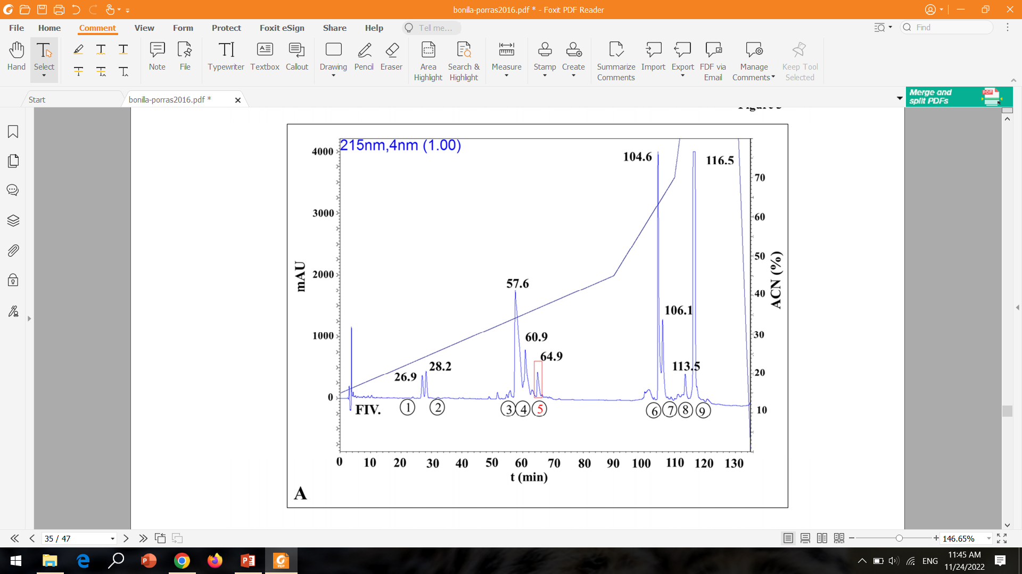
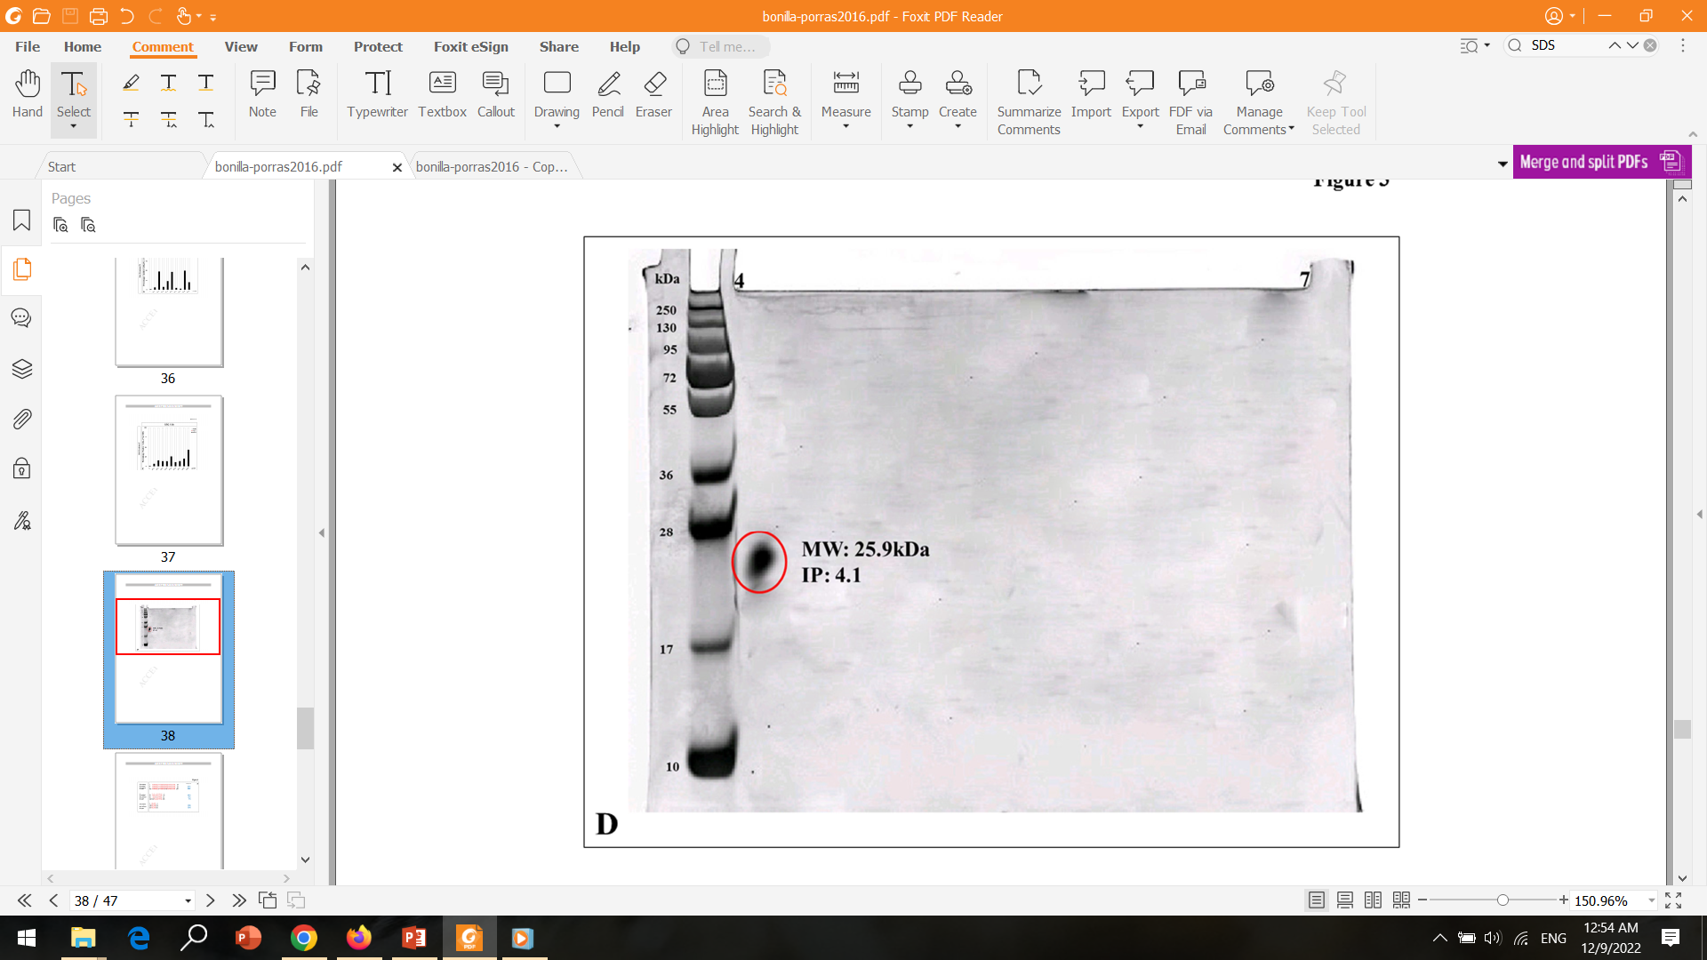
Purification of nasulysin-1 from P. nasutum.
Fractionation of Fraction IV
reverse- phase high performance iquid chromatography (RP-HPLC)
Electrophoresis

Slide 24
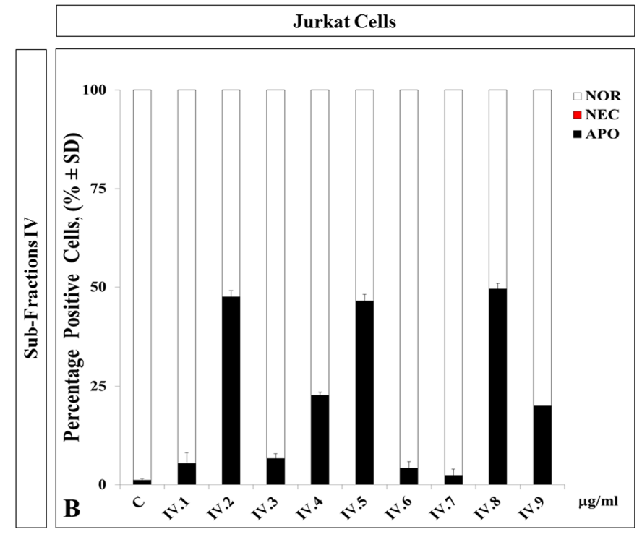
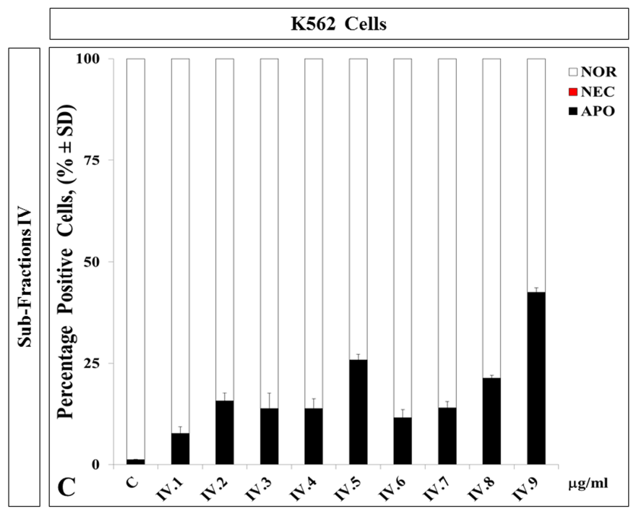
Purification of nasulysin-1 from P. nasutum.
>25% Apoptosis

Slide 25
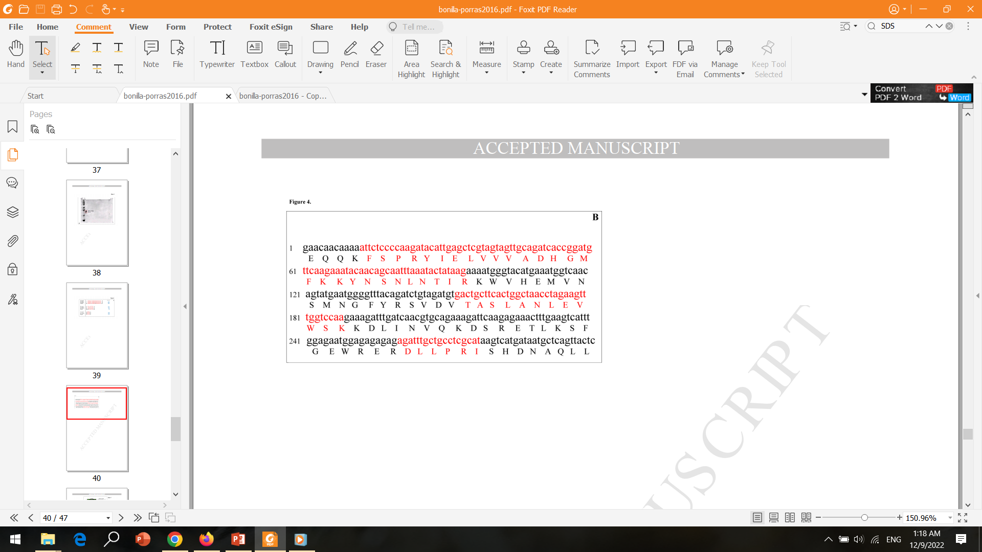
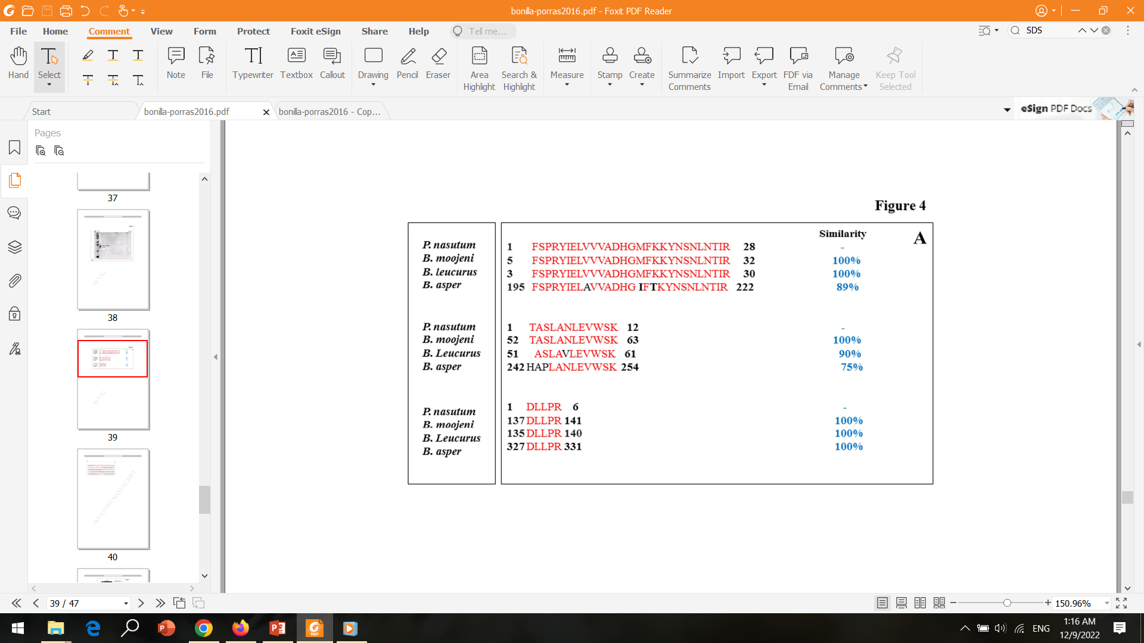
Nasulysin-1 shares homology with other SVMPs from Bothrops spp.
SVMPs are Conserved Through Several Genera and Species of Vipers.
Nasulysin-1 a P-I Class Metalloproteinase

Slide 26
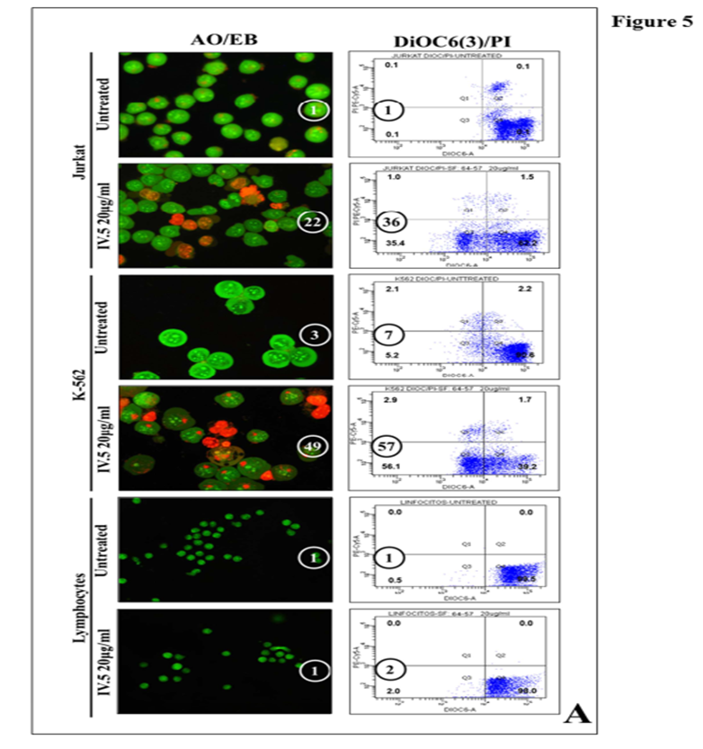
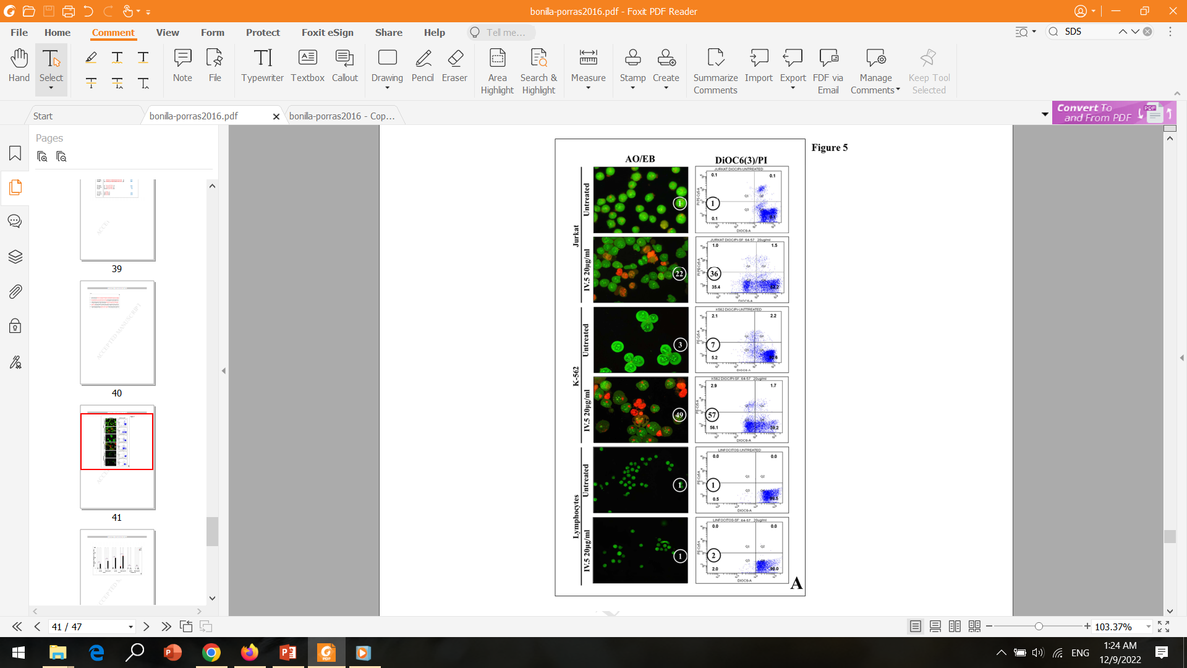
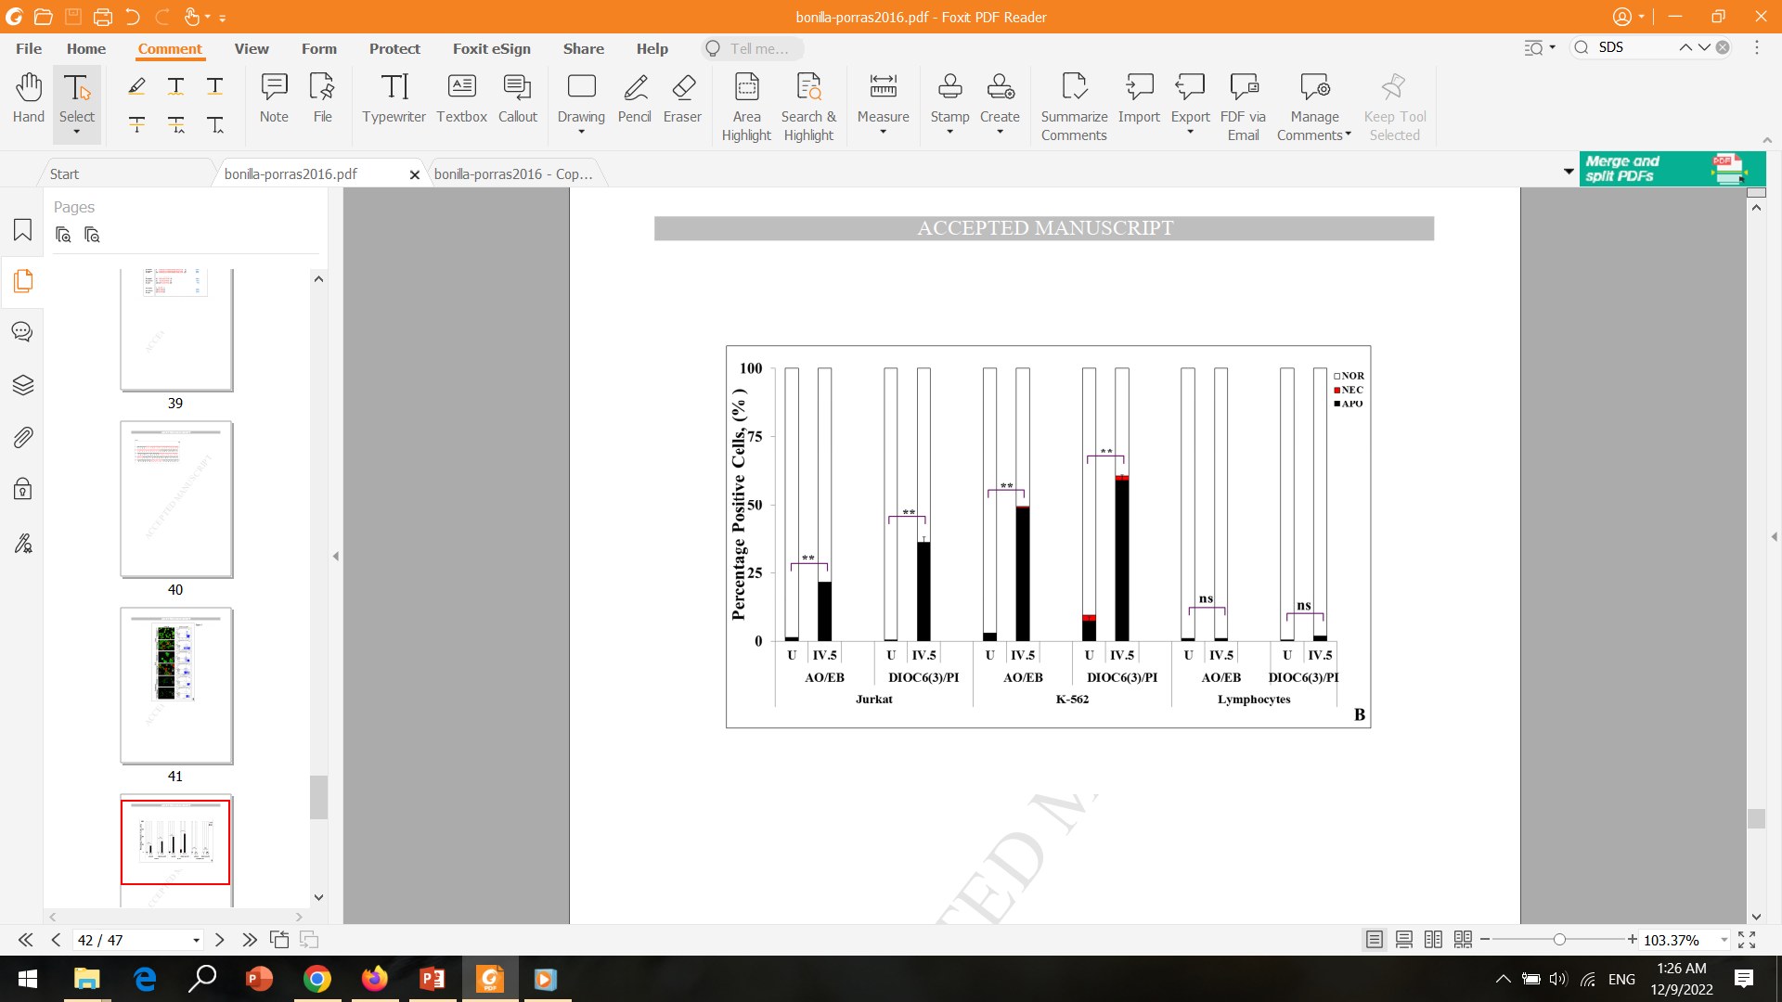
Nasulysin-1 selectively induces apoptosis in leukemia cells.

Slide 27
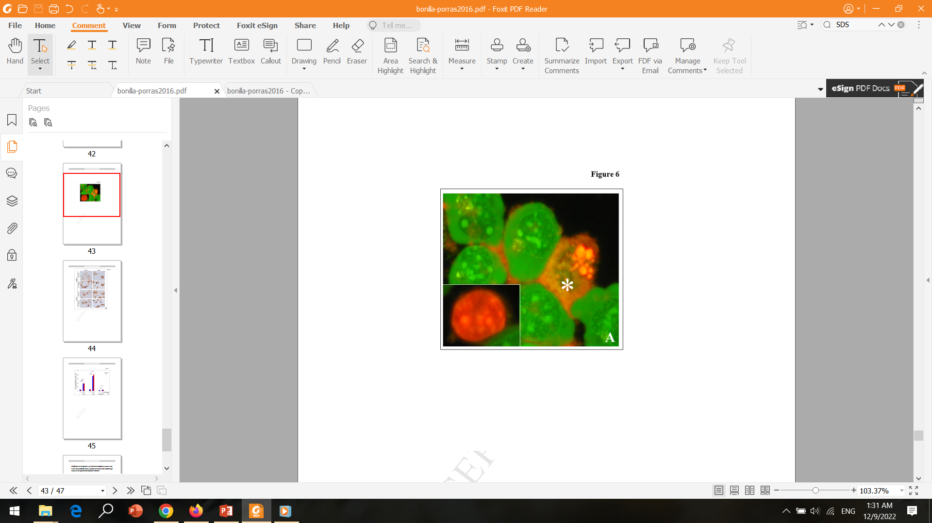
Nasulysin-1 selectively induces apoptosis in leukemia cells.
chromatin condensation
indication AIF activity
nuclei fragmentation
indication of the Cas-3 activity

Slide 28
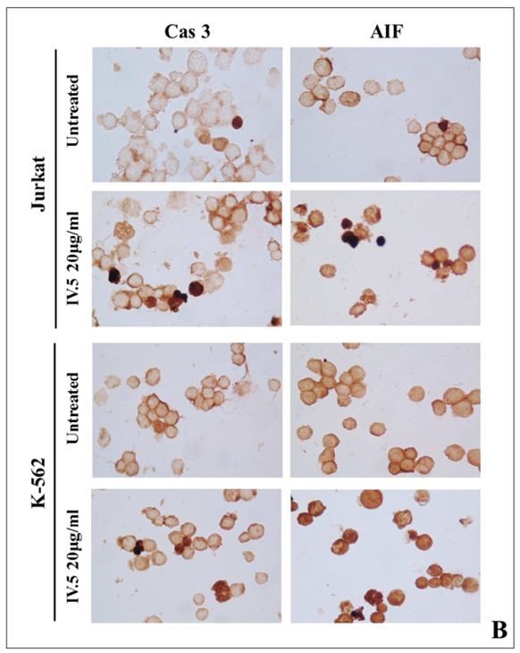
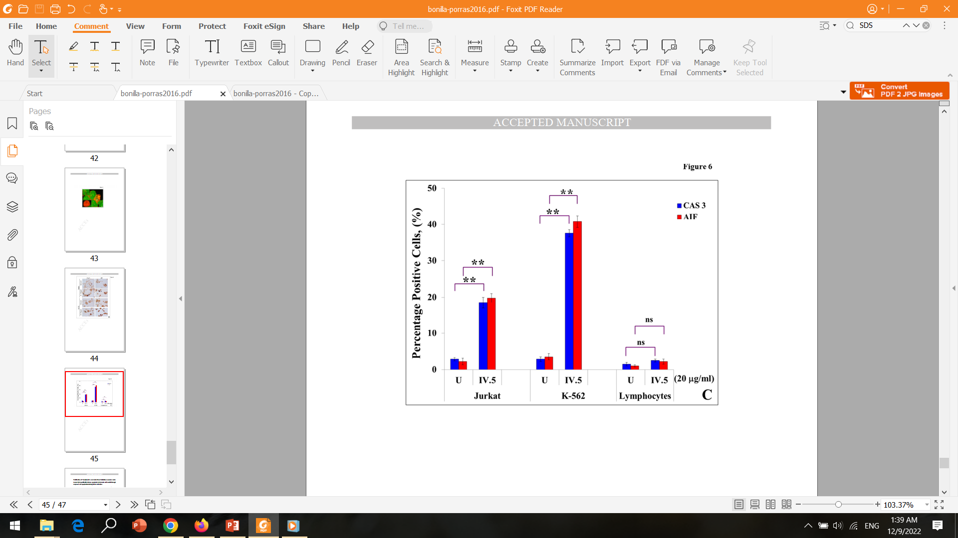
Nasulysin-1 selectively induces apoptosis in leukemia cells.
caspase-dependent caspase-independent

Slide 29
Discussion

Slide 30
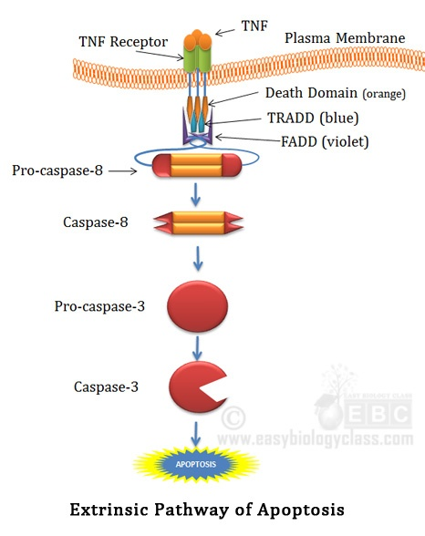
SVMPs PI class metalloproteins
Degrading Cellular Membrane Proteins
Interacting With Specific Receptors
Cellular Internalization of Toxin
Direct Damage of Mitochondria

Slide 31
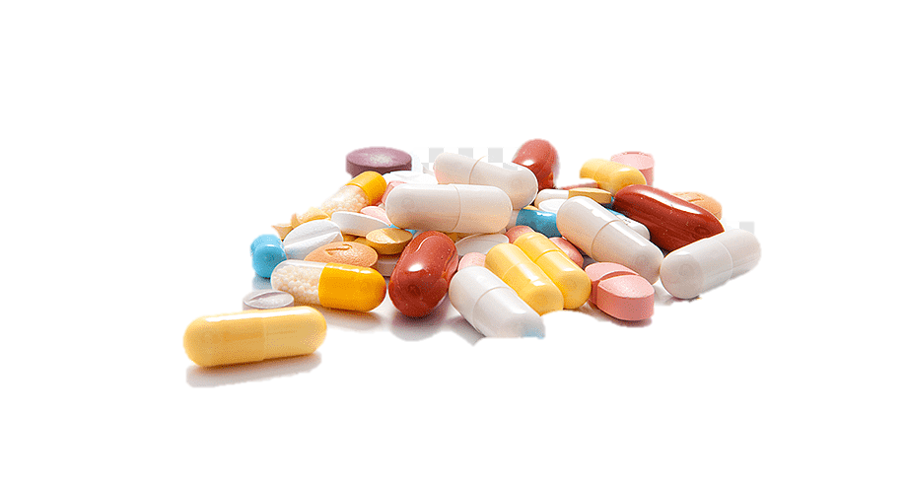
Uncharacterized SVMPs
Apoptosis by other Sub-Fractions
SVMP proteins or Partial Fragments of a Bigger SVMP
Sub-Fraction SF IV. 2 and 8 Induced 40- 50% Apoptosis
Toxic Specificity

Slide 32


