Slide 1
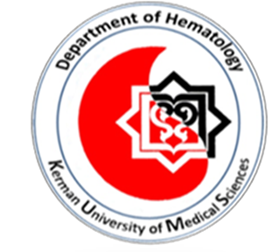
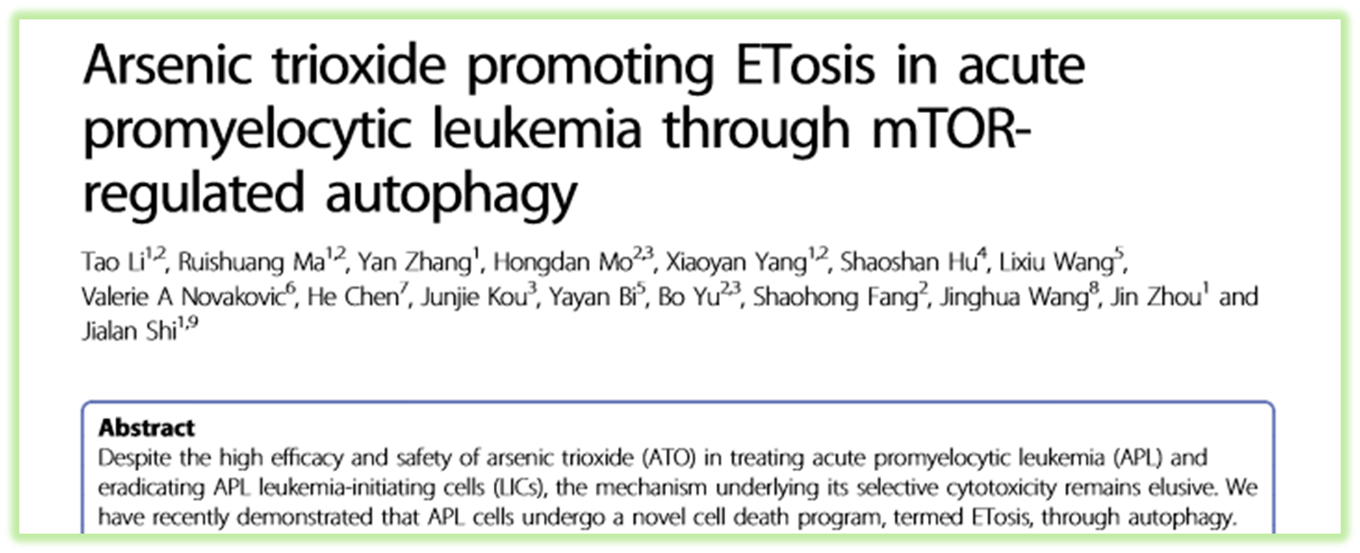
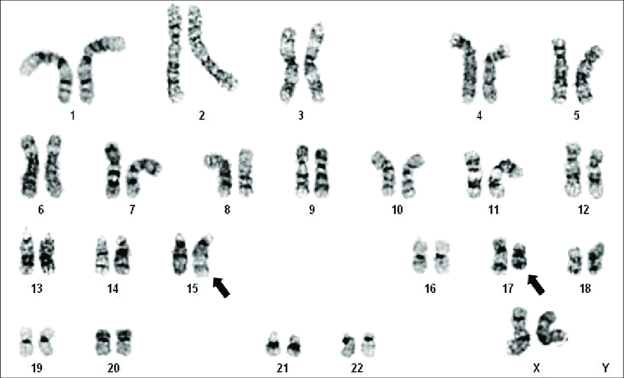
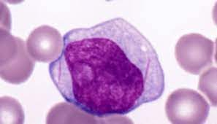
Supervisor : Dr.Mardani
Presenter : faezeh eshagh

Slide 2
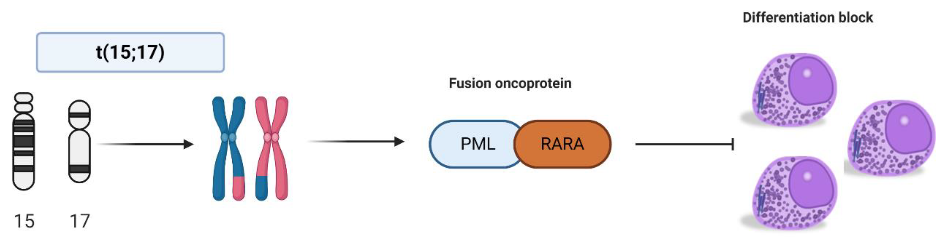

APL :
Treatment:
Chemotherapy ----- Apoptosis
ATRA --------------- differentiation
ATO ------------------ high: apoptosis
low: differentiation
dose
Relapse . resistance
LIC / LSC
ATO ---- CR -- relapse

Slide 3
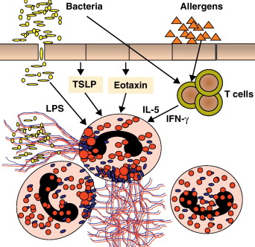
Autophagy contributes to arsenic-induced PML/RARα degradation, which is
responsible for LIC loss in APL cells
Autophagy
- natural degradation
- stress or deprive of nutrients
- recycling of cellular components
- cancer : progression and inhibition
- *mTOR
Etosis
- form of cell death - neither apoptosis nor necrosis
- release of the granule components, chromatin decondensation,
destruction of the nuclear envelope, pores in the plasma membrane
- neutrophil extracellular traps (NETs)
- Formed mainly by immune cells
- triggered by microorganisms/generation of reactive oxygen species (ROS)/inflammatory stimuli
- also human leukemia cells ----- APL ----- Autophagy

Slide 4
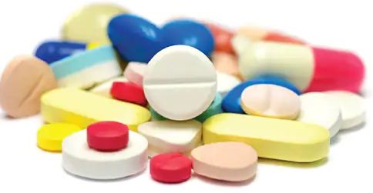
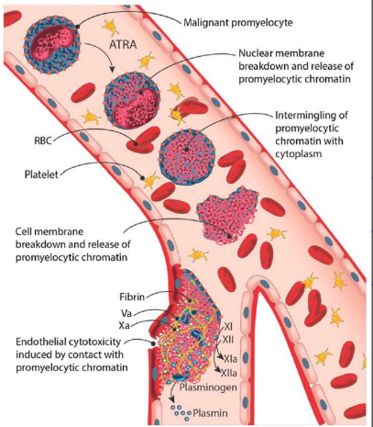
ATRA

Slide 5
characterized the Concentration dependent effects of ATO exposure on ETosis in APL
role of ETosis in APL LIC loss
Autophagy …….. ×LIC ?

Slide 6
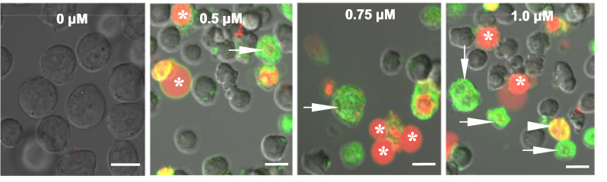

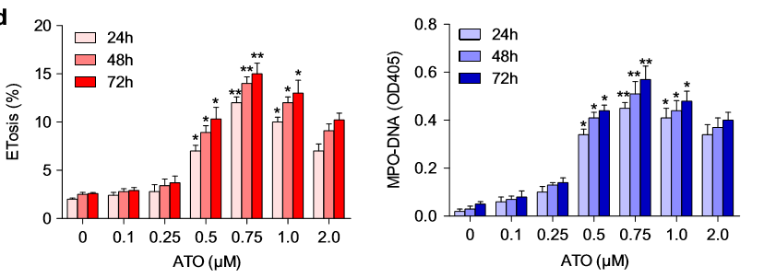
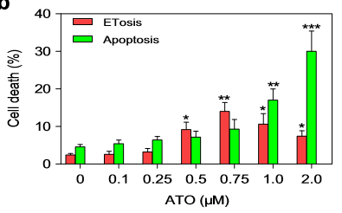

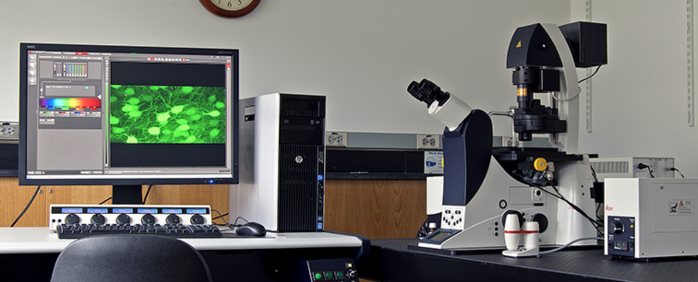
Results
1- ATO induces ETosis and apoptosis in NB4 cells in a dose dependent manner
a
c
b

Slide 7
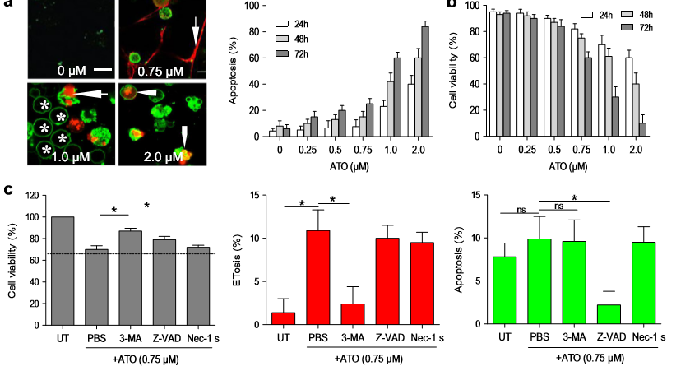
2- Moderate concentrations of ATO mainly promotes ETotic cell death in NB4 cells
majority of NB4 cell death induced by 0.75μM ATO was ETosis.

Slide 8
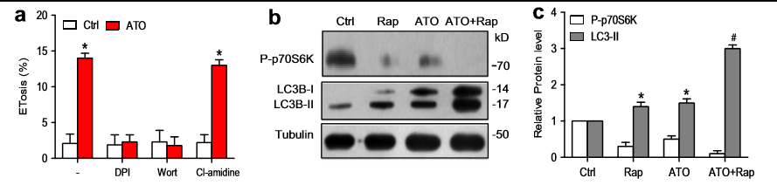
3- ATO increase mTOR signaling-dependent autophagy that mediated ETosis
reduced level of phosphorylated p70S6K can be used as an indicator of mTOR-dependent autophagy
LC3 expression
ATO-induced ETosis was dependent on mTOR-mediated autophagy.

Slide 9
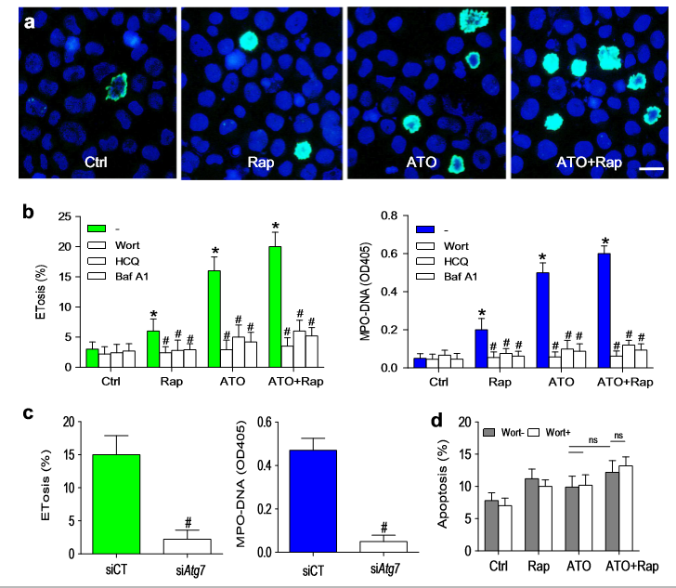
4- Rapamycin enhances the autophagy-dependent ETosis but not autophagy-independent apoptosis in response to ATO

Slide 10
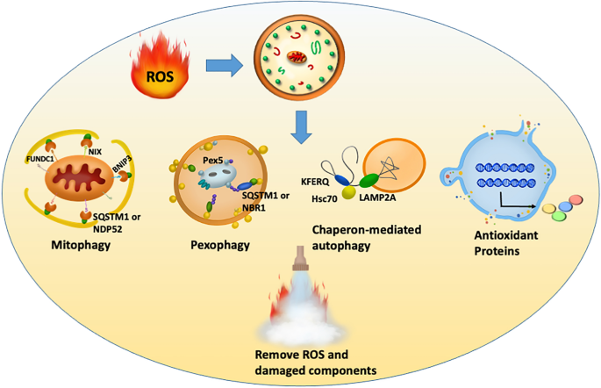
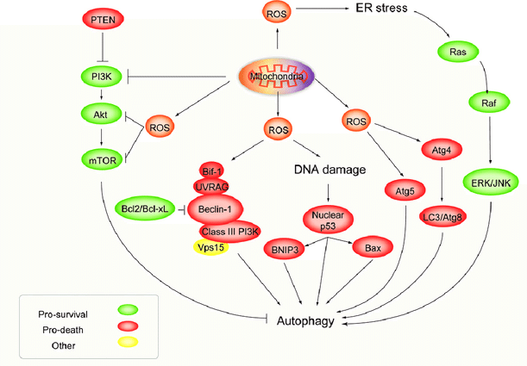
6-The role of ROS production during ETosis
monitored intracellular ROS production in NB4 cells
autophagy
Inhibition
activation
did not alter ROS levels
Nox dependent ROS production plays a key role of ATO-induced Etosis , independent of autophagy.

Slide 11
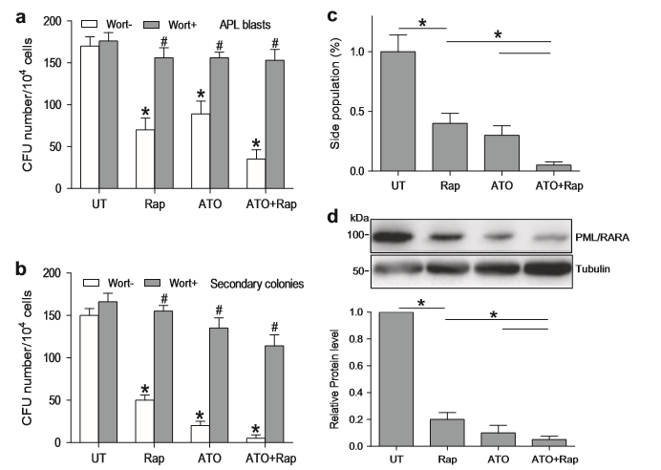
7- Combined rapamycin and ATO treatment synergistically decreases LIC production

Slide 12
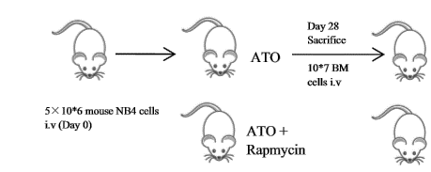
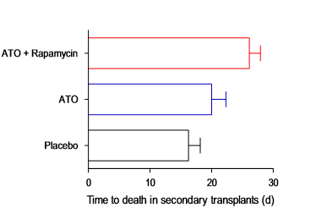
8- Combination of rapamycin and ATO reduces leukemic burden and LICs in an APL model

Slide 13


ATO signiﬁcantly increases the amount of ETosis in APL cells
ATO has dose-dependent ant leukemic effects on NB4 cells, preferentially inducing ETosis at moderate concentration (0.5–0.75μM) and switching to apoptosis at relatively high doses (1.0–2.0μM).
ATO-induced ETosis requires both mTOR-mediated autophagy and Nox-dependent ROS production
rapamycin promoted ATOinduced ETosis leading to decreased LIC activity, suggesting that ETosis facilitates LIC loss in APL cells.
B therapy-triggered ETosis could be used to target LICs and, therefore, reduce relapse risk in patients.

