Slide 1
In the name of god

Slide 2

Hematology Journal Club
Title:
Classification of myelodysplastic syndrome
Presented by:
Fatemeh Jamshidi

Slide 3
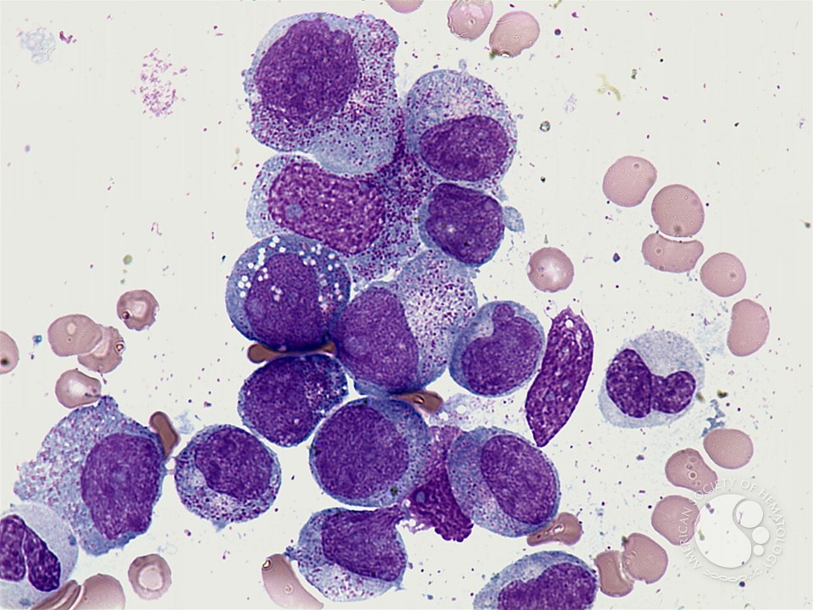
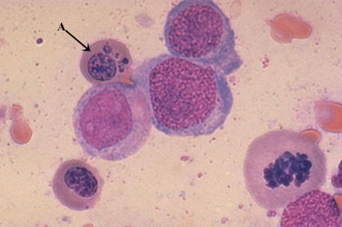
Myelodysplastic syndrome (MDS)

Slide 4

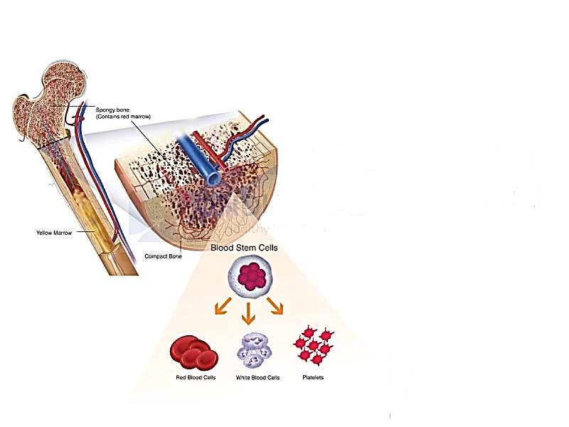
definition
Myelodysplastic syndromes (MDS) are clonal hematopoietic stem cell disorders characterized by dysplastic, ineffective and neoplastic hematopoiesis.
Transformation to AML is frequent.

Slide 5
1
PB:
Cytopenia
characteristics
2
BM:
Hypercellular
3
Dysplasia
4
varying degree of
tri-lineage cytopenia

Slide 6
incidence
70 years

Slide 7
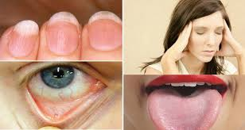

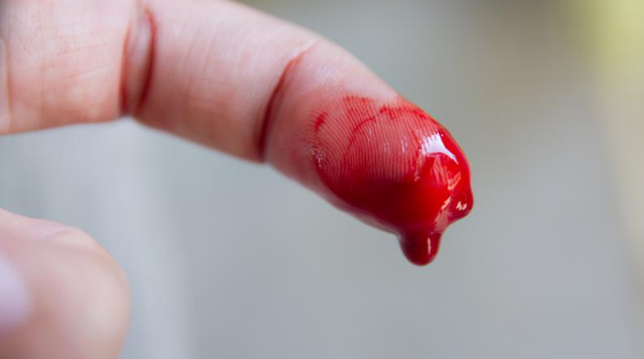
clinical manifestations
Anemia
Infection
bleeding

Slide 8
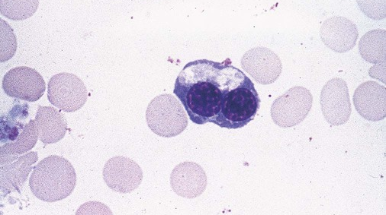
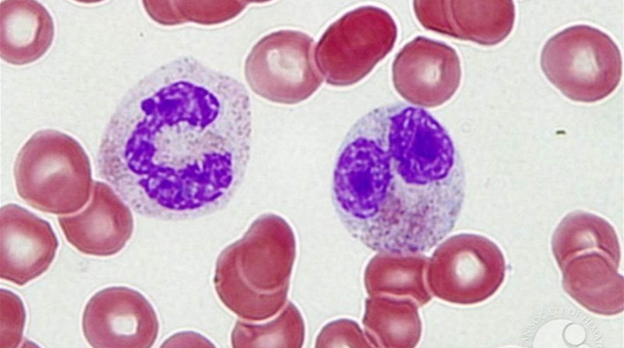
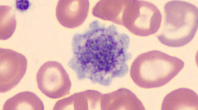
morphology
Dyserythropoiesis
Dysgranulopoiesis
Dysmegakaryopoiesis

Slide 9



MDS classification history
2016
2008
WHO
1982
WHO
FAB

Slide 10
FAB classification
FAB subgroup | PB blasts (%) | BM blasts (%) | Ring Sideroblasts (%) | PB Monocytes (×10/L)
RA | < 1<1 ≤ 1 | < 5 | < 15 | < 1
RARS | ≤ 1 | < 5 | ≥ 15 | < 1
RAEB | 1 - 5 | 5 - 20 | variable | < 1
CMML | < 5 | < 20 | variable | > 1
RAEB-t | ≥ 5 Auer rods | 21 – 30 Auer rods | variable | variable

Slide 11

Blasts (%)
20 – 30 ?
FAB
NO
YES
Monocytes
> 1000/ml ?
RAEB-t
NO
YES
Blasts (%)
5 – 20 ?
CMML
NO
YES
RS (%)
> 15 ?
RAEB
NO
YES
RA
RARS

Slide 12
FAB
WHO

Slide 13
×
RAEB-t
AML
×
CMML
FAB WHO
MDS/MPN
RAEB-1
RAEB
RAEB-2
RA
RA
RCUD
RN
RA
RCMD
RT

Slide 14
2008 WHO classification
WHO subgroup | PB blasts (%) | BM blasts (%) | Ring Sideroblasts (%) | PB Monocytes (×10³/L)
RCUD | < 1 | < 5 | < 15
RARS | _ | < 5 | ≥ 15
RCMD | _ | < 5 | < 15
RCMD-RS | _ | < 5 | ≥ 15
RAEB-1 | < 5 | 5-9
RAEB-2 | 5-19 | 10-19 Auer rods
Del (5q-) | < 5 | < 5
MDS-U | _ | < 5

Slide 15

Del 5q-
?
YES
MDS(5q-)
NO
Auer rods
?
YES
RAEB-2
NO
Blasts (%)
10 – 19 ?
YES
RAEB-2
NO
Blasts (%)
5 – 9 ?
YES
RAEB - 1
YES
RCMD-RS
YES
Multilineages ?
NO
RARS
NO
RS (%)
> 15 ?
YES
RCMD
Multilineages
?
NO
RA
NO

Slide 16
2008
2016
WHO

Slide 17
2016 WHO classification
WHO subgroup | Dysplastic lineages | cytopenias | PB blasts (%) | BM blasts (%) | Ring sideroblasts (%)
MDS-SLD | 1 | 1 or 2 | < 1 | < 5 | < 15
MDS-MLD | 2 or 3 | 1 - 3 | < 1 | < 5 | < 15
MDS-RS-SLD | 1 | 1 or 2 | < 1 | < 5 | ≥ 15
MDS-RS-MLD | 2 or 3 | 1 - 3 | < 1 | < 5 | ≥ 15
MDS-del 5q | 1 - 3 | 1 - 2 | < 1 | < 5 | -
MDS-EB-1 | 0 - 3 | 1 - 3 | 2 - 4 | 5 - 9 | -
MDS-EB-2 | 0 - 3 | 1 - 3 | 5 – 19 Auer rods | - 19 Auer rods | -
MDS-U | 1 - 3 | 1 - 3 | 1 | < 5 | -
RCC | 1 - 3 | 1 - 3 | < 2 | < 5 | -

Slide 18
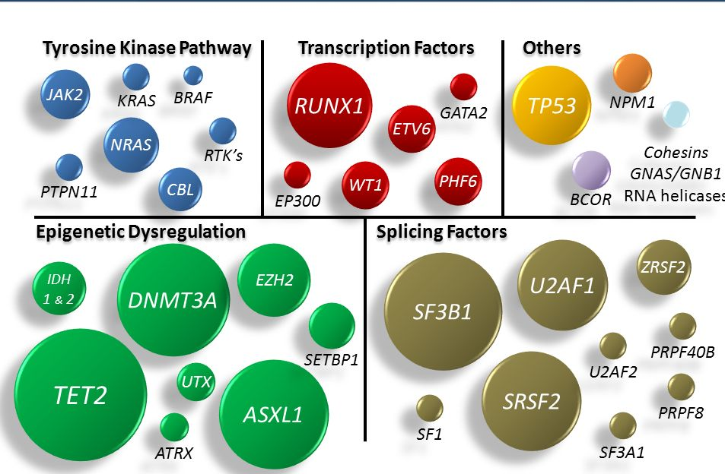
mutations

Slide 19
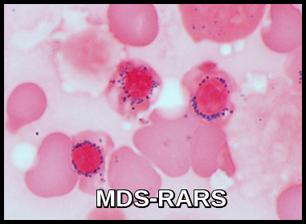
Ring sideroblasts

Slide 20
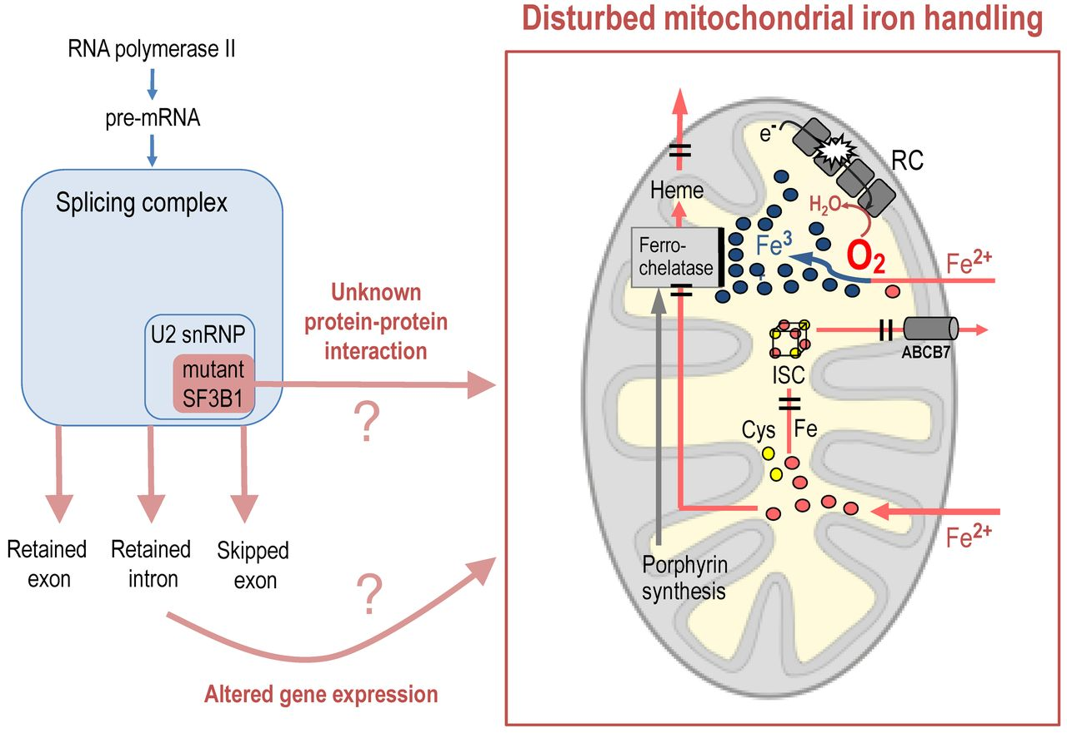

Slide 21
SF3B1??

Slide 22
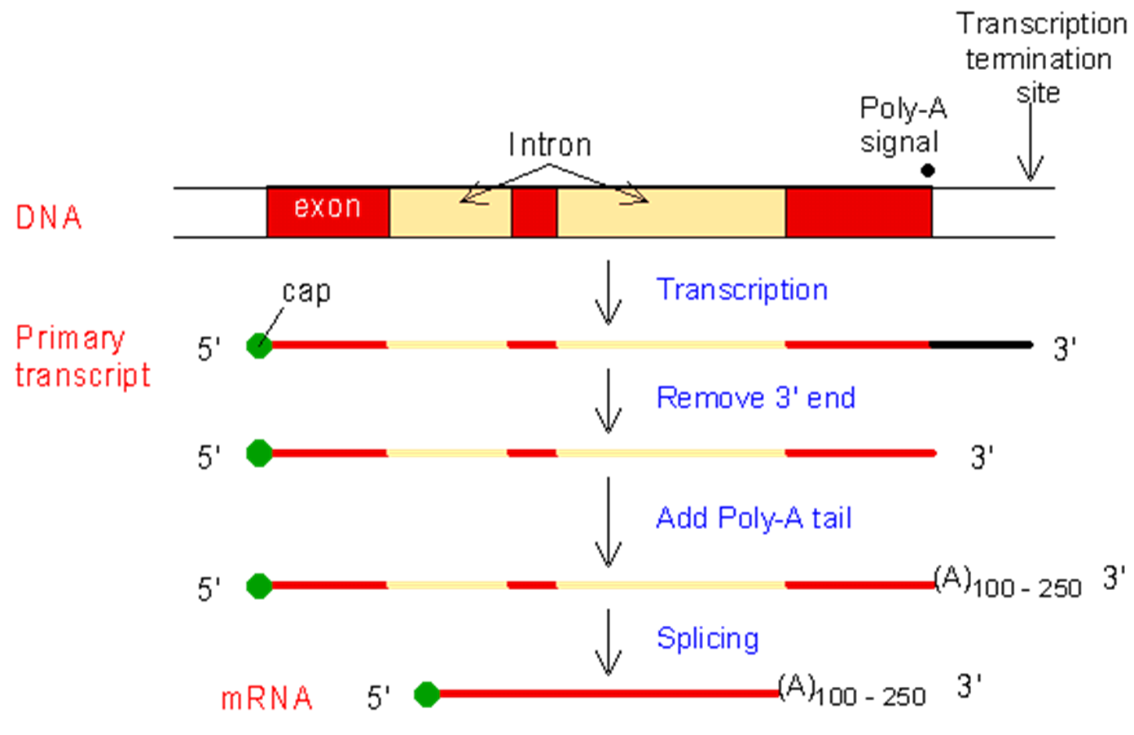
Maturity of mRNA

Slide 23
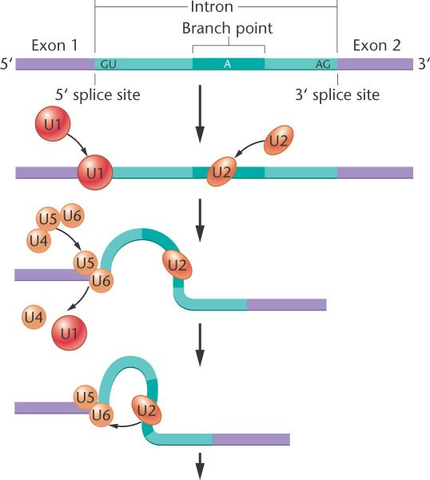
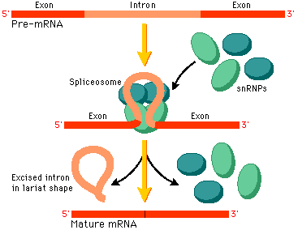
snRNPs (snurps)

Slide 24
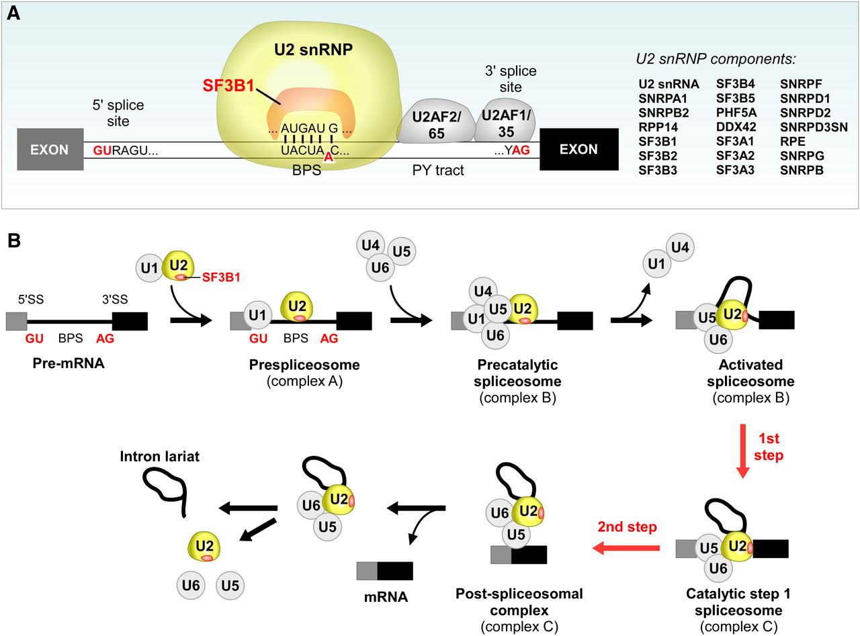
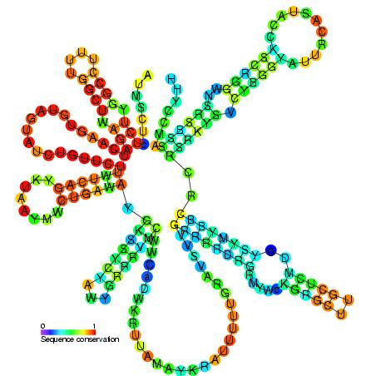
U2 snRNP

Slide 25
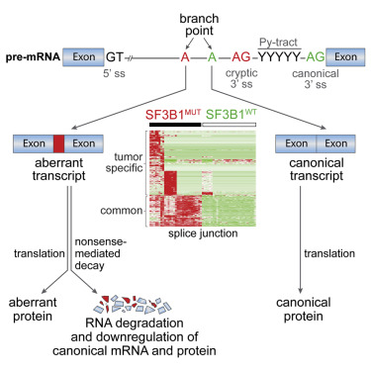
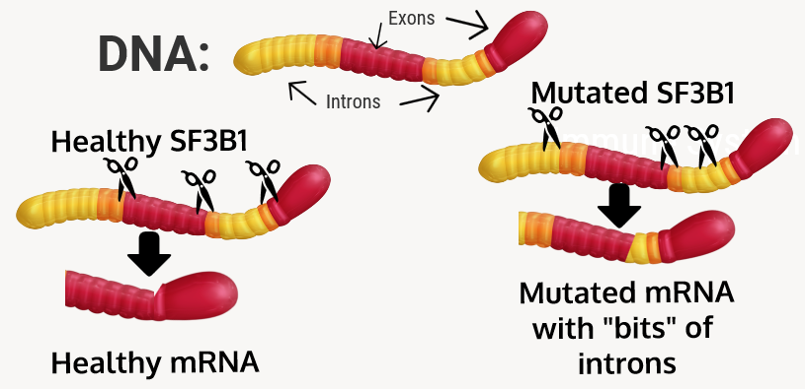
mutated sf3b1

Slide 26
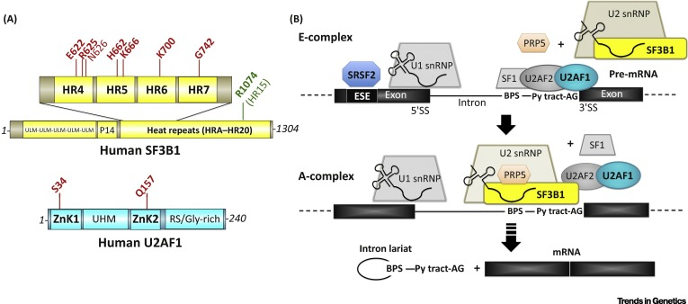

Slide 27
mutated sf3b1
ABCB7
Ring Sideroblasts

Slide 28
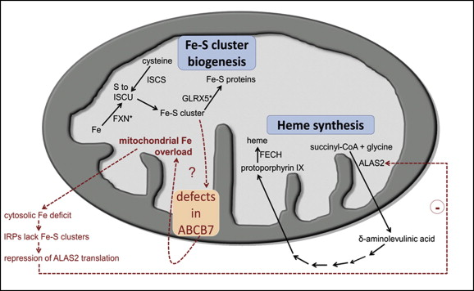

Slide 29
THANK YOU
AND
LETS
TALK

