Slide 1
Platelet Microparticles andmiRnA
Transfer in Cancer Progression
Presented By: Fariba Nikravesh
Adviser: Dr Mardani

Slide 2
Agenda
01
MicroParticle
02
Platelet Microparticles
03
Platelet Microparticles and
Cancer Progression
04
Conclution

Slide 3
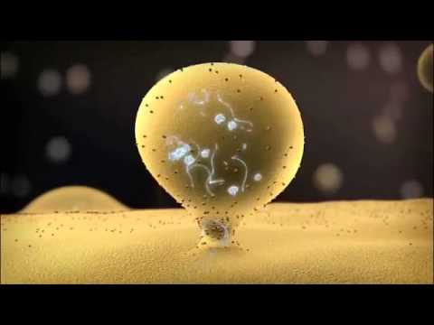
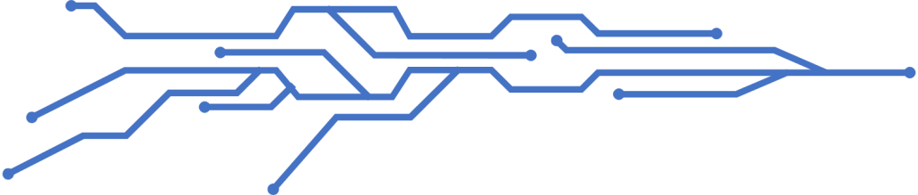
Microvesicles
Budding off the plasma membrance
100 – 1000 nm
Proteins, Lipids , mRNA, miRNA and cytosol

Slide 4
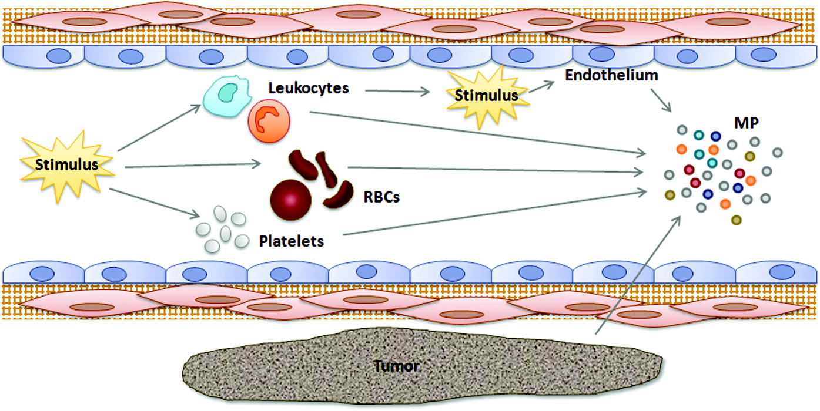
Source of Microparticles
Leukocytes
Erythrocytes
Endothelial cells
Platelets
Tumor Cell

Slide 5
Anucleate discoid-shaped cells
Level of 150–400
Initial stages of the blood coagulation
platelets
Include three types of granules
Covered with a glycoprotein layer

Slide 6
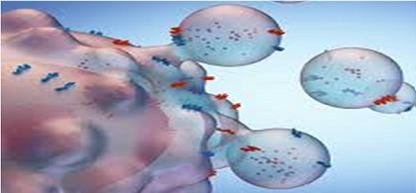
Platelet-derived Microparticles (PMPs)
90% of circulating micro particles
Contain many of proteins, lipids, and oligonucleotides
Enriched in microRNAs (miRNAs)

Slide 7
Platelet-cancer loop
Cancer/Tumor growth
Platelets
Factor Release (VEGF, PDGF, TFGβ)
Activated
Platelets

Slide 8

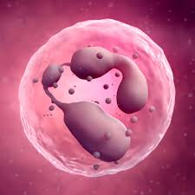
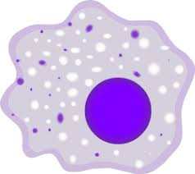
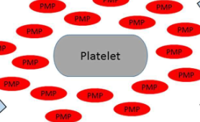
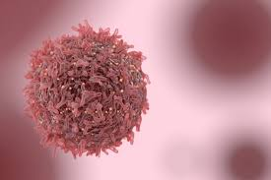

Platelet-derived Microparticles (PMPs)
Contents A
will your Time, Money and Reputation.
Contents
Contents
You can simply impress your audience and add a unique zing and appeal to your Presentations.
You can simply impress your audience and add a unique zing and appeal to your Presentations.
Contents
Contents
You can simply impress your audience and add a unique zing and appeal to your Presentations.
You can simply impress your audience and add a unique zing and appeal to your Presentations.

Slide 9
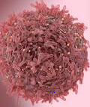
interactions of PMPs with tomur cell
Tumor-shrouding
Metastatic dissemination
Angiogenesis
Proliferative
PMPmiRnAs

Slide 10
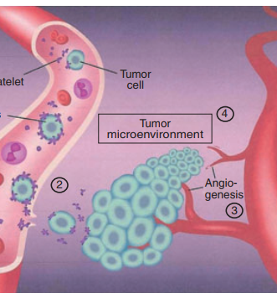
Get a Angiogenesis

Slide 11
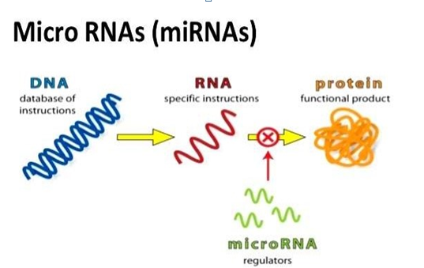
Infographic Style
.
CONTENTS
Binding MRNA And perevendig translation
Short non- coding RNA
Regulate the expression of genes
.

Slide 12
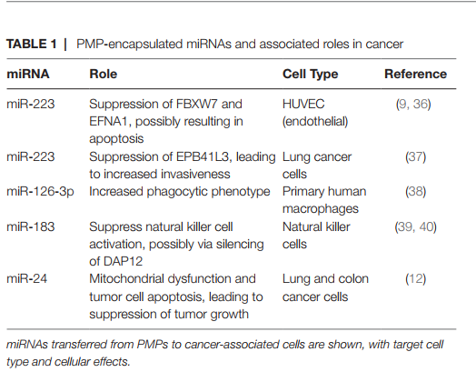
ALLPPT.com

Slide 13
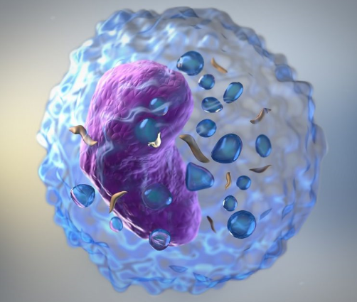
interactions of PMPs with NKcells
reduced expression of several activating surface receptors (NKG2D, NKp30, and DNAM-1)
Repress function via suppression of NK activation adaotor DAP12

Slide 14
Interactions of PMPs with Neutrophils
Mediate interaction with other leukocytes
Transfer Gp2b/3a receptor
.
Activate Neuttophils

Slide 15
Interactions of PMPs with monocytes
Induce motility via chemotaxis
Modify macrophage & dendritic cell differentiation
.
Promote monocyte differentiation tp M2 macrophages
Trigger cytokine responses via Il-1 signaling

Slide 16
Interactions of PMPs with macrophages
miR-126-3p lead to a more phagocytic phenotype
Induced release of TGF-b
Reduced the release of TNF-a and IL-10

Slide 17
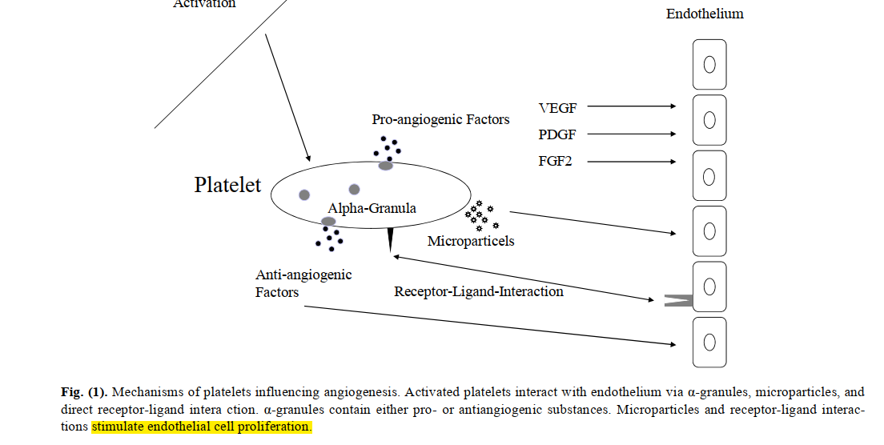
interactions of PMPs with endothelial cells

Slide 18
conclution

