Slide 1
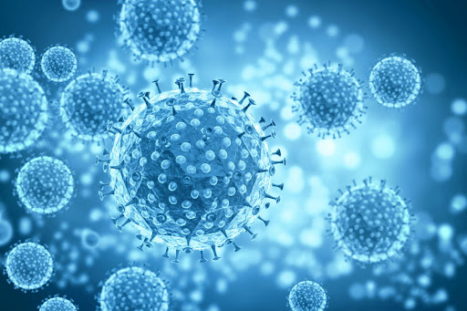

Title of Article
SARS-CoV-2 Infection: Differences in Hematological Parameters Between Adults and Children
Supervised by:
Dr. Ahmad Fatemi
Presented by:
Nafise Ghadyani
nafisghadyani@yahoo.com
1

Slide 2
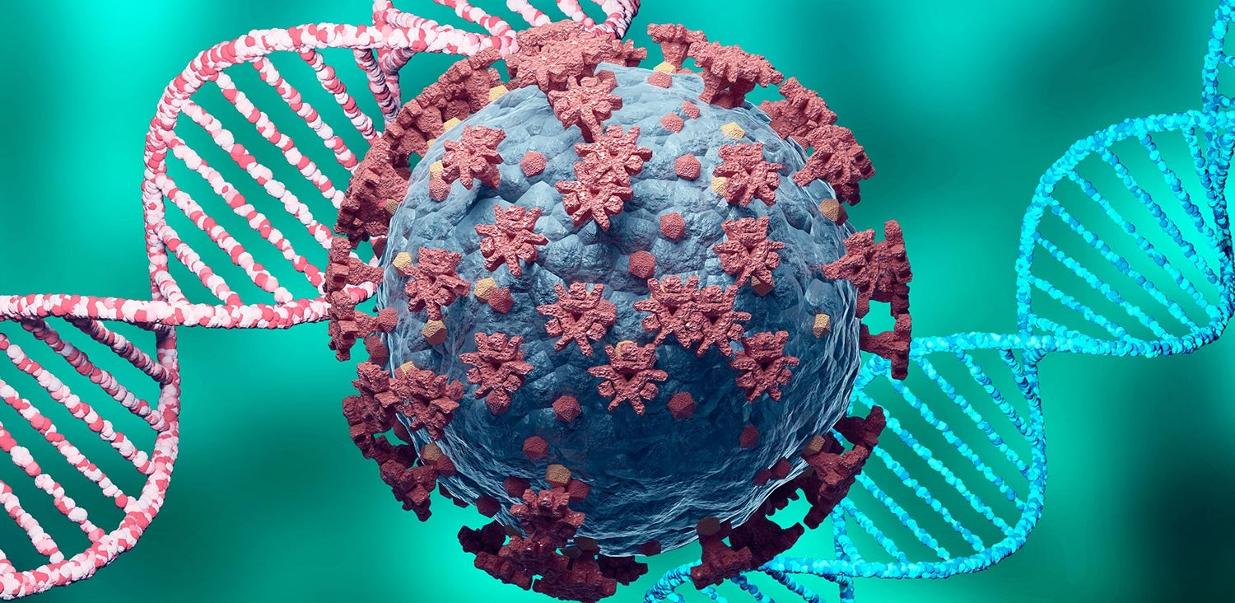
Content
Differences
Severity
WBC
Lymphocyte
Neutrophil
NLR
Eosinophil
Platelets
PLR
D-Dimer and Fibrinogen
Red blood cell
Blood cancers
2

Slide 3

SARS-CoV-2 And COVID-19:
Severe
Corona
What's The Difference?
Acute
Virus
Respiratory
Disease
Syndrome
19
CoronaVirus 2
3

Slide 4
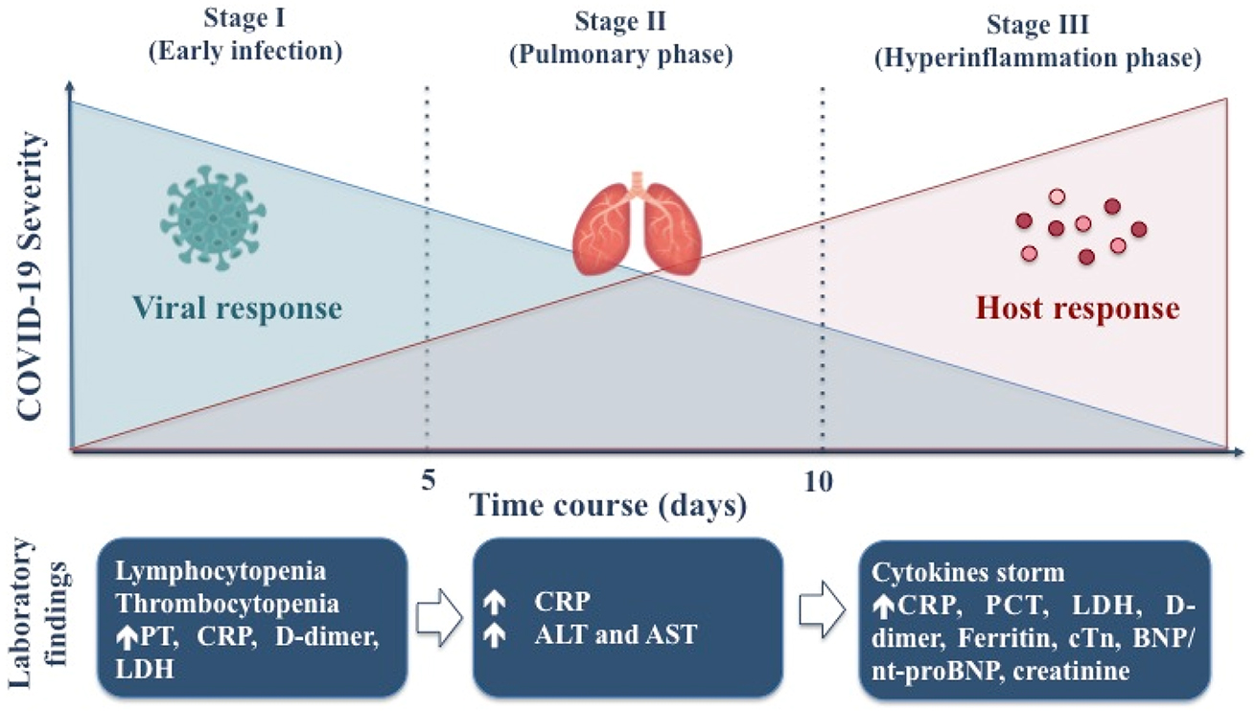
COVID-19
Replication
Respiratory
Cytokine storm
Non-severe
Severe
4

Slide 5
Why this subject?
clinical manifestations
understanding
Of
COVID-19
differences in hematological parameters
5

Slide 6
COVID-19 and WBC
Evidence
Slomka et al
Guan
Qin et al
Ferrari et al
one in four COVID-19 patients
PBC of 1099 COVID-19 patients
452 hospitalized COVID-19 patients
207 suspected COVID-19 patients
severe
rRT-PCR
WBC
WBC
LYM
WBC
Lym
Nut
Nut
LYM
6

Slide 7
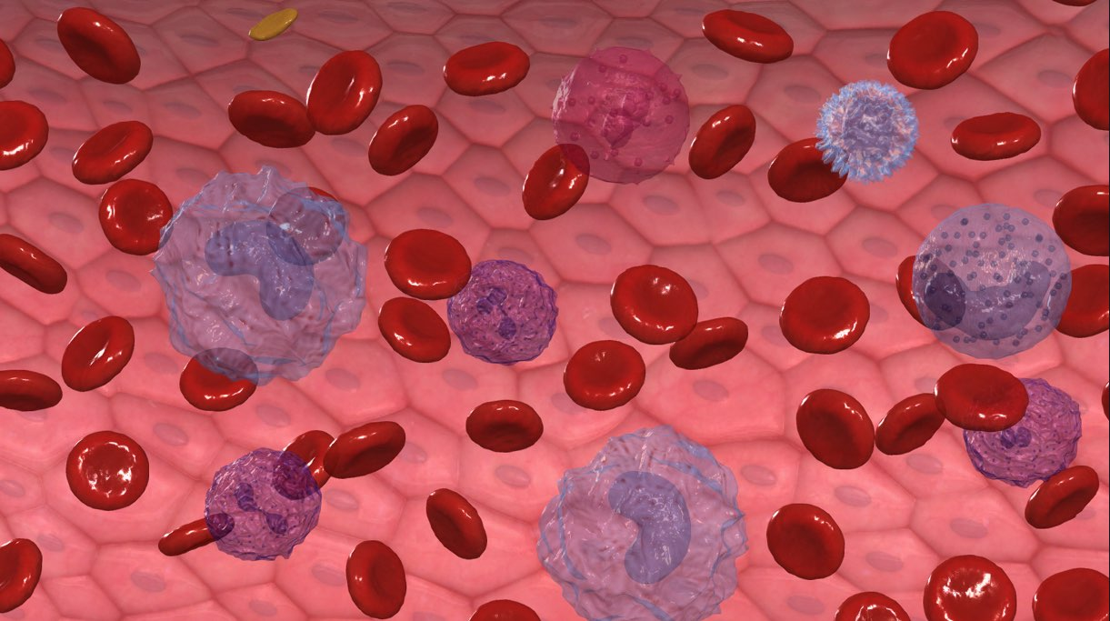
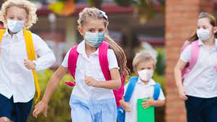

COVID-19 and WBC
WBC
some children may have WBC in the normal range
LYM
Rare
WBC
mostly occurs in the early stages
number of white blood cells in children is not statistically significant to the severity of the disease.
7

Slide 8
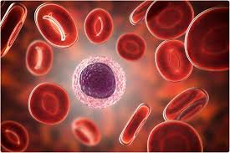
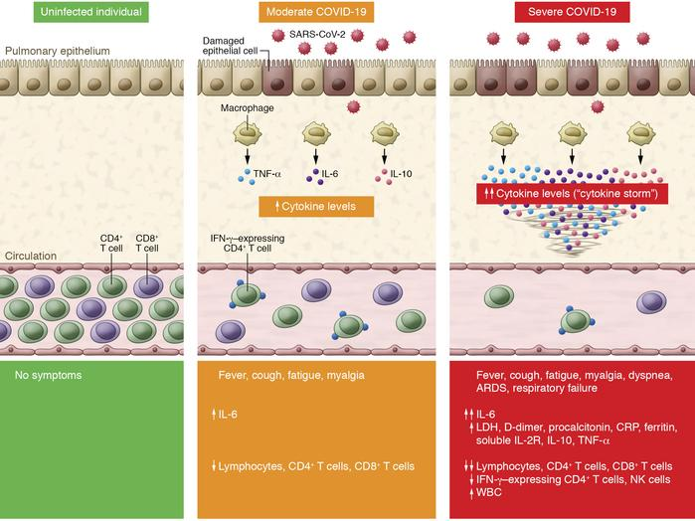
8

Slide 9
Evidence
Diao et al
99 COVID-19
Elderly
lym of 522 patients
PB of 14 COVID-19 patients
ICU
CD4+
PB
T
PD1
CD8+
CD4+
severity of COVID-19
CD8+
T
consumed and exhausted.
9

Slide 10

Acute phase
Evidence
CD4+T
Treg
68 children with SARS-COV-2 in Marrakech
171 children
obvious severe symptoms
3.5%
Lym
2
Lym
10

Slide 11
Reasons
NKC
effective innate immune system
maturity of ACE2
11

Slide 12
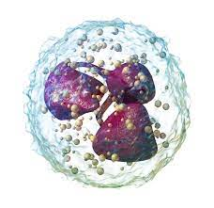
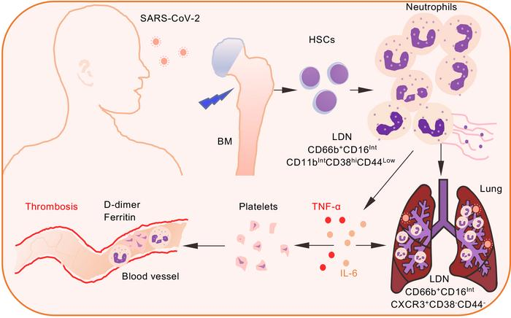
cell damage
Elastase
G-CSF
IL-10
12

Slide 13
Evidence
Wang et al
Shahin et al
number of neutrophils
88 children with COVID-19
severe
mild
neutrophil
dead patients
survivors
severe
13

Slide 14
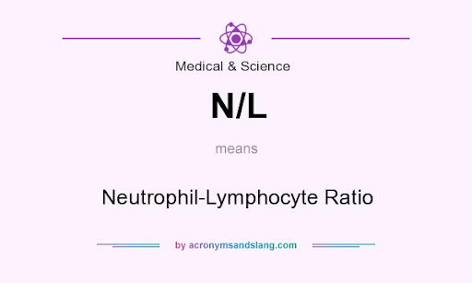
Neutrophils to Lymphocytes Ratio
marker of inflammation
NLR
PB
indicators of systemic inflammation
14

Slide 15
Evidence
Xu
Tan
Hakan Keski
187 patients
NLR and CT of patients
NLR
inflammation
NLR
Lym
neutrophils
apoptosis of lym
deaths
survivors
CT severity score
15

Slide 16
risk of death during hospitalization
biological indicator
severity of COVID-19
NLR
independent risk factor
prognosis
16

Slide 17
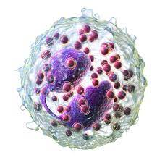
acute lung injury
mechanism of stress response
E
Treatment
E
SARS-CoV-2
Intensity
E
Count
Prognosis
17

Slide 18
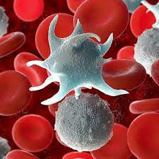
Evidence
Guan et al
Chen et al and Qian et al
1099 COVID-19 patients
Reason of PLT
Plt aggregation
SARS-COV-2
Auto-Abs and IC
PLT
BM
Immune system
Plt consumption
PLT
18

Slide 19
Evidence
Cheung et al
Yang
Lippi et al
Mechanism of Plt
1779 COVID-19 patients
1476 COVID-19 patients
viral infection
cytokine storms
lung injury
immune complex
Plt
severe illness
Plt
Plt
BM
Plt
Plt
mortality rate
19

Slide 20
PLR
Plt
Lym
PLR
degree of inflammation
prognosis
20

Slide 21
PLR
severe
ICU
reached a peak on the seventh day of treatment
Sun
116 patients
Non-ICU
general
Then
Evidence
PLR
6 elderly critical COVID-19 patients
Then
Qu et al
PLR
beginning of treatment
21

Slide 22
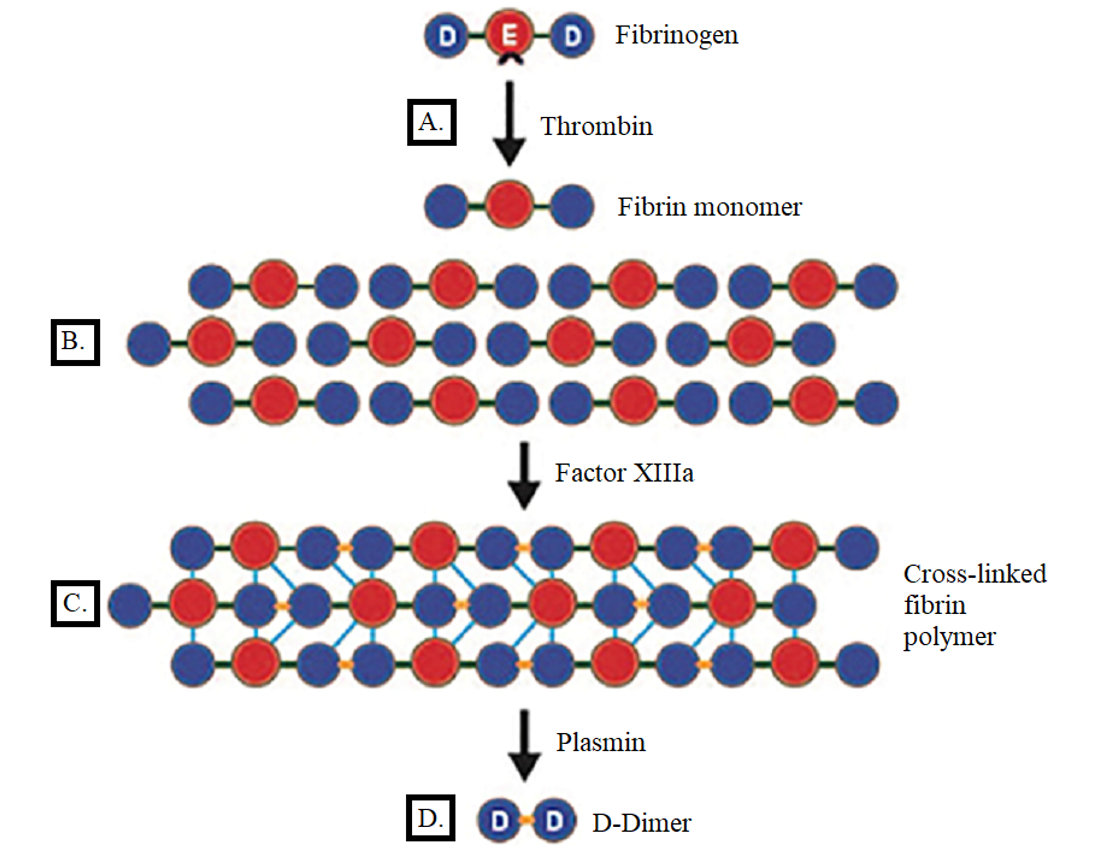
severe COVID-19 patients
acute lung injury
Stimulating the body
activate blood coagulation
large number of thrombin are formed
D-Dimer and Fibrinogen
severity of the disease
platelet consumption
use
ROTEM
TEG
secondary fibrinolysis and DIC
give the
anti-coagulant
treatment
Assess the risk of thrombosis in patients
22

Slide 23
:
Gizem
average value of fibrinogen
confirmed COVID-19 patients
suspicious patients
71.1% of patients
D-dimer
621μg/L
Evidence
disease progresses
D-dimer
:
Hakan Kesi
Normal range
SARS-CoV -2 people
fibrinogen
23

Slide 24
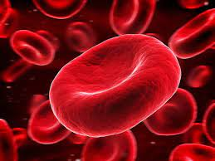
Hb
development of COVID-19
RBC
RBC
SARS-CoV-2
destroy kidney tissue
rich in ACE2 receptors
Anemia
red blood cell production
24

Slide 25
:
Sun et al
Hb changes
COVID-19 group
control group
:
Henry
Intensity of COVID-19
Hb
Evidence
:
Cen et al
Hb
110g/L
progression of COVID-19
:
Lazarian
7 cases of COVID-19 patients
AIHA
Average
Hb
70g/L
25

Slide 26

radiotherapy
and chemotherapy
cancer patients
damage normal cells
toxicity and side effects
more likely to be infected with COVID-19
prognosis of cancer patients
26

Slide 27
Evidence
Kim et al
Yang et al
COVID-19
+
Tumor
COVID-19
_
Tumor
COVID-19
+
Tumor
COVID-19
_
Tumor
WBC
LYM
PLT
The mortality rate
Mortality
27

Slide 28
Conclusion
Abnormality in hematological parameters
SARS-COV-2
Differences
In adult and children
Diagnosis
COVID-19
early clues
Treatment
28

Slide 29


Thanks a million for your attention
Have a good day

