Slide 1


Seminar of hematology
Title:
The role of chemokines in leukemia
Presented by:
Marzie Motaghi
پاییز1397

Slide 2
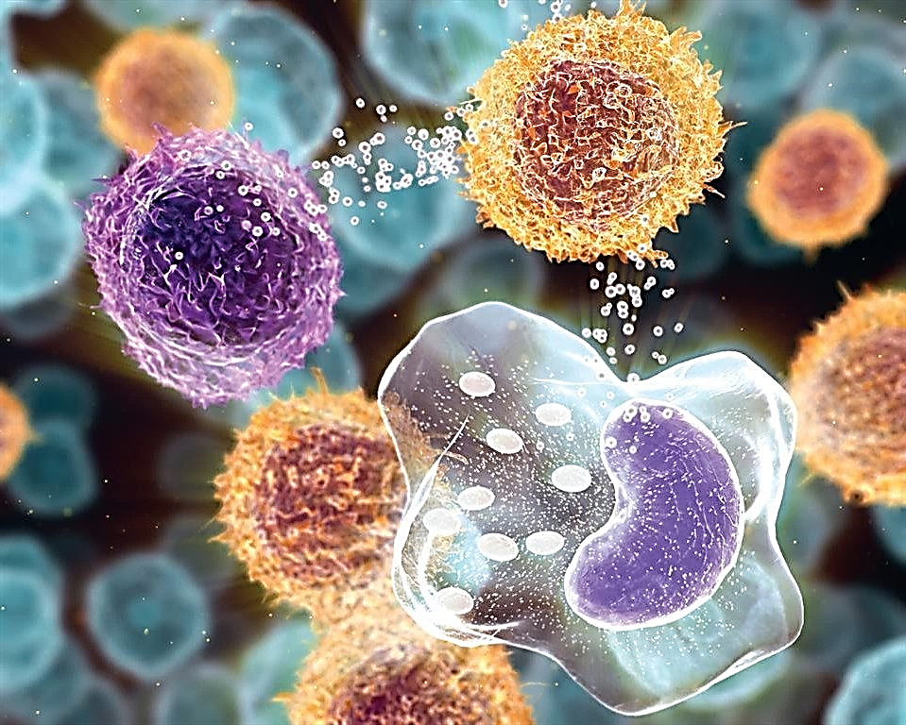

عناوین :
سیتوکاین ها
کموکاین ها
تعریف
انواع
گیرنده
مسیر سیگنالی
عملکرد
کموکاینها در لوکمی
عملکرد
مثال
0

Slide 3
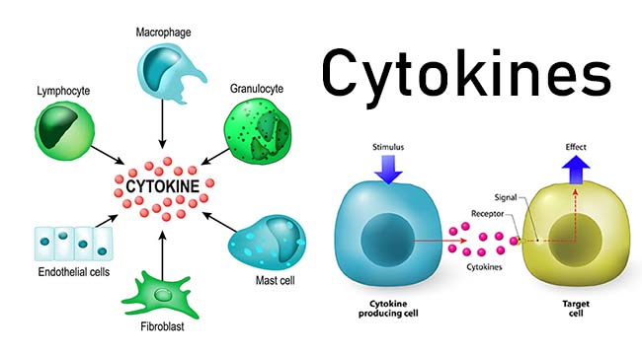
Cytokine
Different cells of the body, including immune cells, produce protein molecules that interact with different cells.
Interleukin (1-38)
Interfron (α,β ,……, γ)
Tumor necrosis factor(TNF)
Chemokine
Adipokine
…. .
1

Slide 4

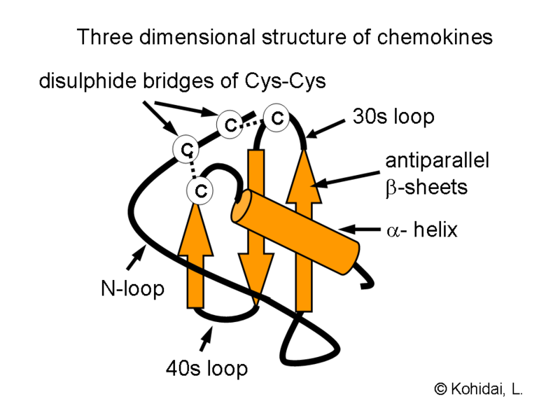
(CK) Chemokine
8-14 KD
On the leukocytes
Chemotaxi , Cytokine
50 chemokine , 20 reseptor
GREEK KEY
…. .
2

Slide 5
according to activiy Chemokine
according to structer Chemokine
Angiogenesis chemokines
Hemostatic chemokines (productive)
Inflammatory chemokines (inducible)
CXC chemokines (or α-chemokines)
CC chemokine (or β-chemokine)
CX₃C chemokine (or d-chemokines)
Angiostatic chemokines
…. .
C chemokines (or γ chemokines)
3

Slide 6
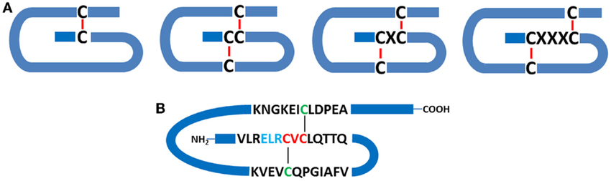
according to structer Chemokine
(ELR-negative)
(ELR-positive)
CXC chemokines (or α-chemokines)
CC chemokine (or β-chemokine)
CX₃C chemokine (or d-chemokines)
C chemokines (or γ chemokines)
4

Slide 7
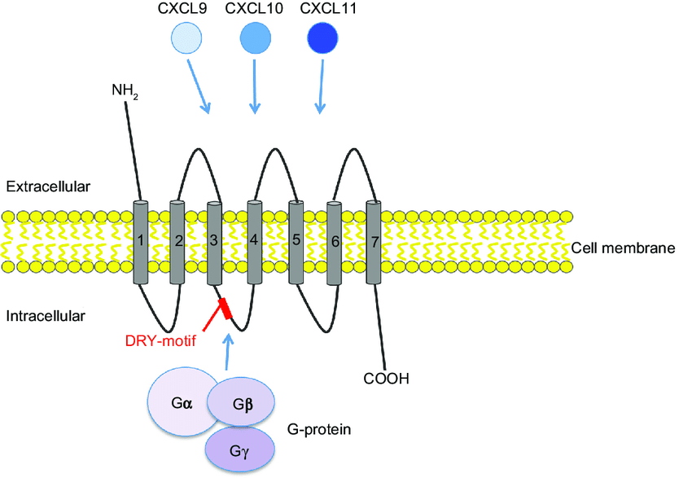
Reseptors of chemokine
7TM)Transmembrane Protein)
Serine/Theronin
GRKs
5

Slide 8
1) Pathway of
(GPCR)(G- protein coupled receptors) :Conventional chemokine receptors
6

Slide 9
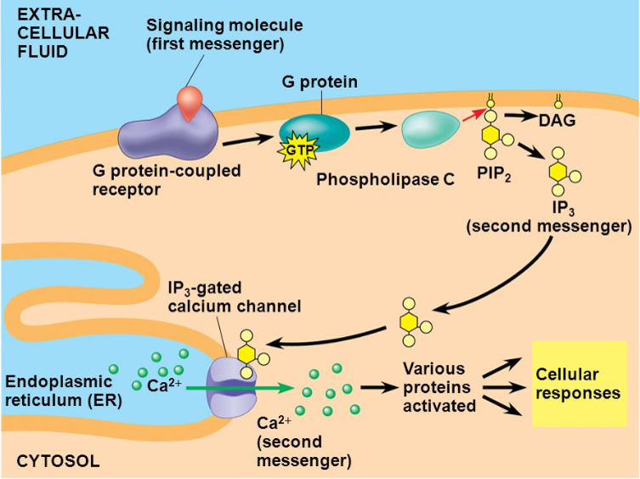
Reseptors of chemokine
7TM)Transmembrane Protein)
5

Slide 10
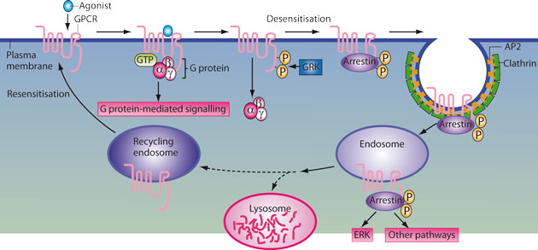
2) Pathway of
GPCR kinases (GRKs) :atypical chemokine receptors (ACKRs)
7

Slide 11
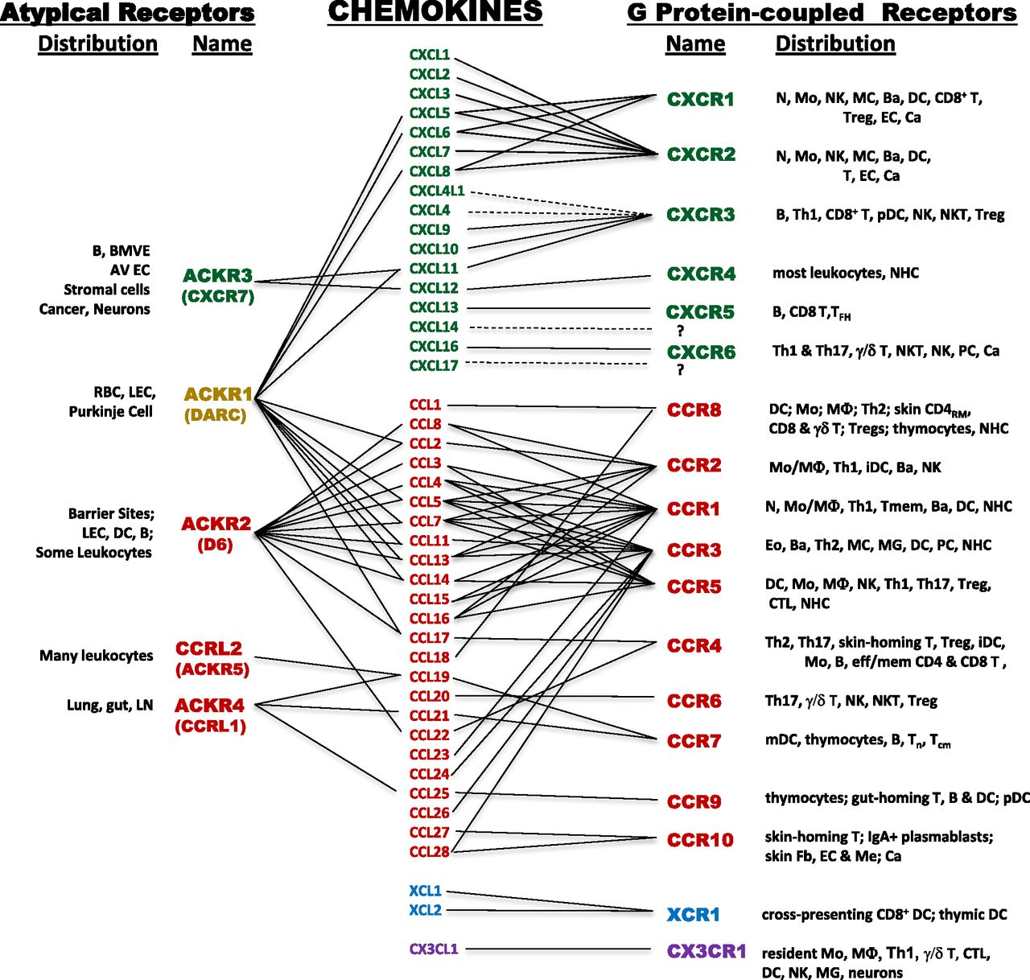
expressed by RBC , ENDO …
chemokine degradation
Atypical chemokine receptors (ACKRs)
chemokine receptor regulation.
inability to couple to G proteins
…. .
8

Slide 12
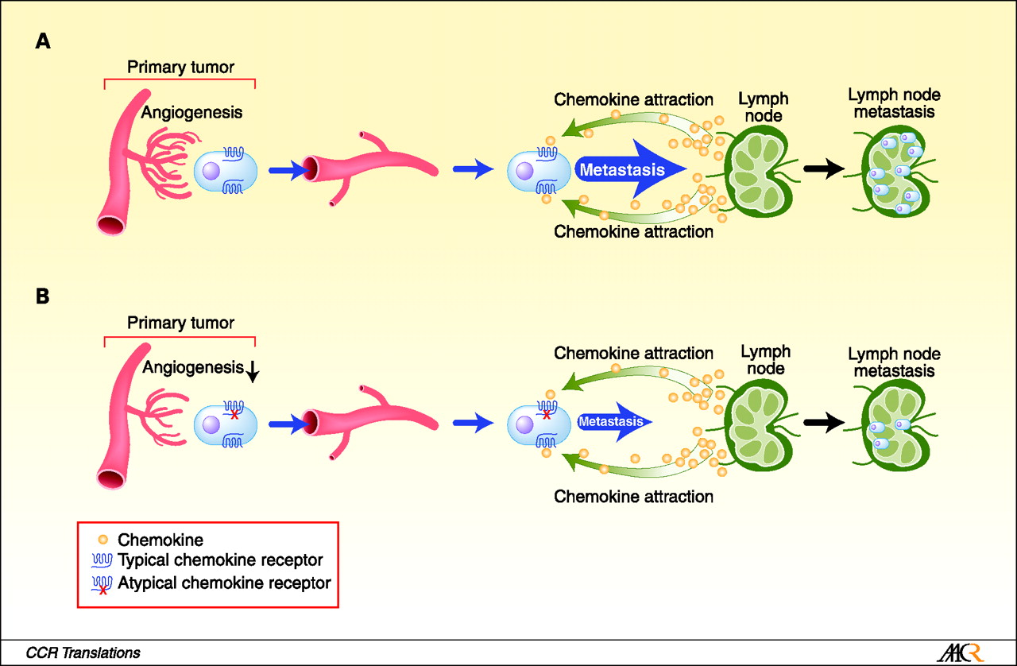
9

Slide 13
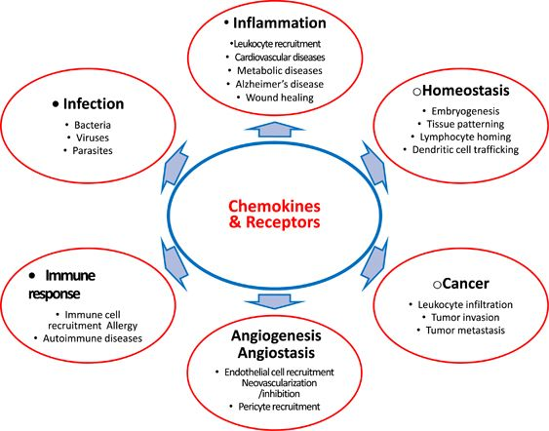
10

Slide 14
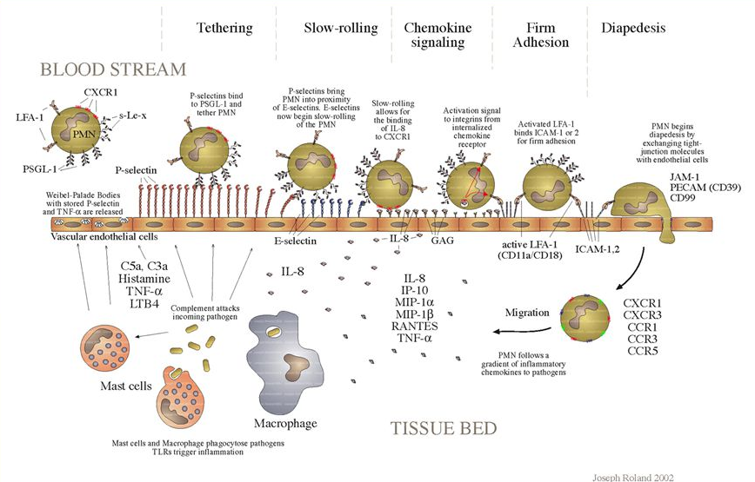
Cell recruitment (chemoattractant)
11

Slide 15
11

Slide 16
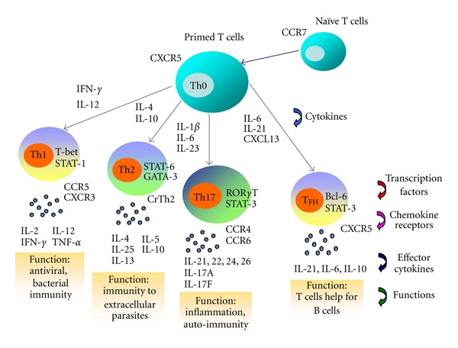
Th1/Th2
development
12

Slide 17
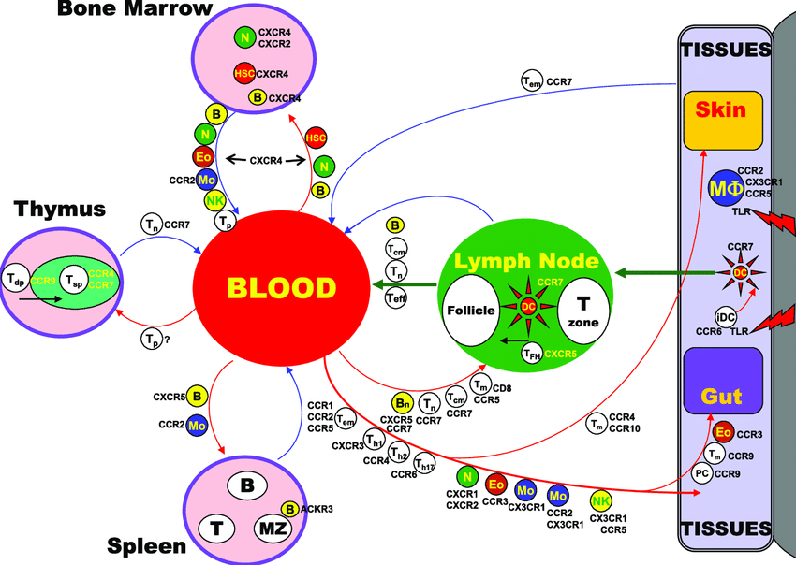
lymphoid trafficking
Lymphoid organ development
leukocyte trafficking
13

Slide 18
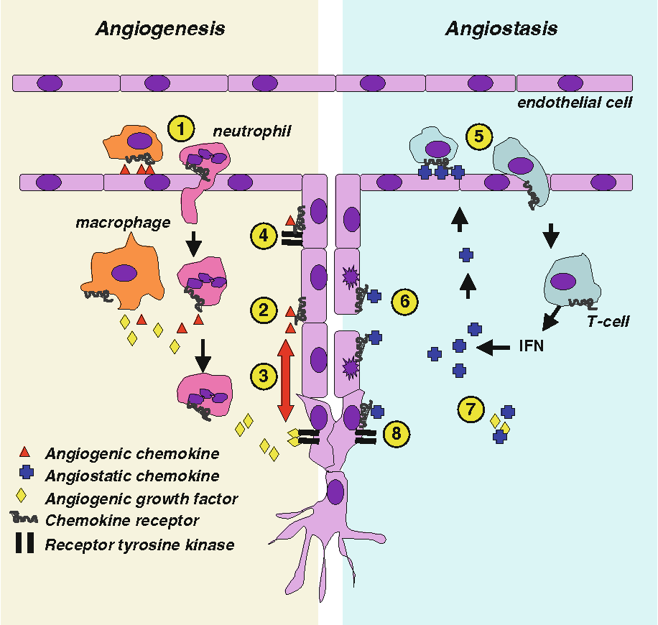
14

Slide 19
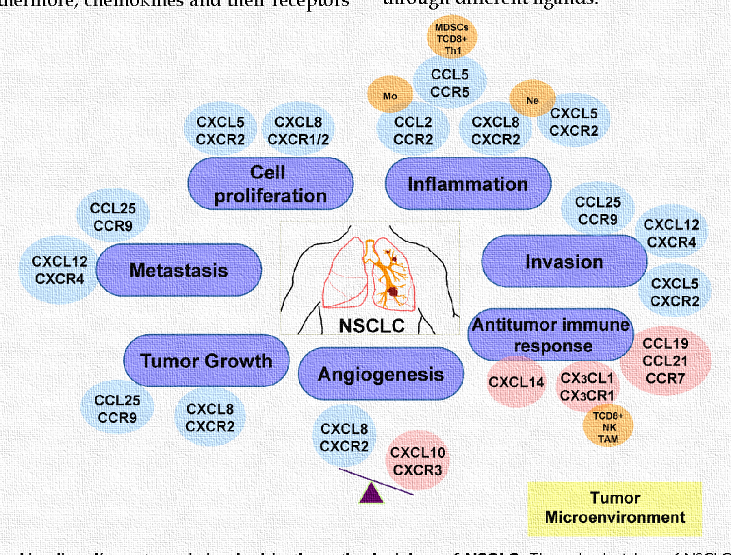
Chemokines in cancer
15

Slide 20
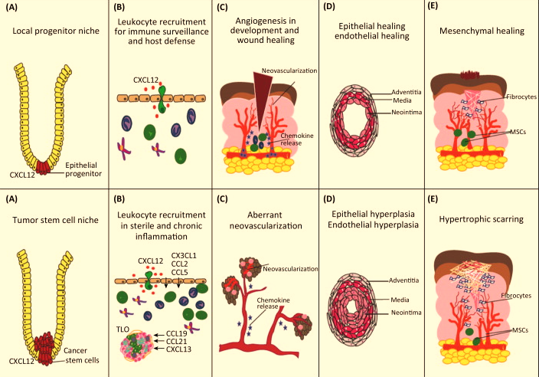
Chemokines in cancer
16

Slide 21
Hodgkin’s lymphoma (HL)
adult T cell leukaemia/lymphoma (ATLL)
T-Cell Acute Lymphocytic Leukemia(ALL)
T-cell cutaneous T-cell lymphomas (CTCLs)
Nasal natural killer/T-cell lymphoma (NNKTL)
DLBCL) Diffuse large B-cell lymphoma(
B-cell acute lymphoblastic leukemia (ALL)
B-cell precursor ALL (BCP-ALL)
childhood acute lymphoblastic leukemia(ALL)
Chronic Lymphocytic Leukemia (CLL)
B-cell chronic lymphocytic leukemia (B-CLL)
Chemokines ccl17 , ccl22
in some of the
Leukemia & lymphoma
17

Slide 22
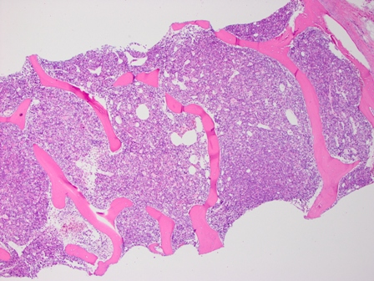
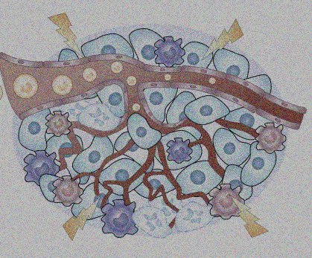
Leukemic B.M
DC
Mon
18

Slide 23
DC
ccl17
ccl22
Mon
18

Slide 24
DC
Mon
18

Slide 25
ccr4
Treg
DC
Mon
Th2
18
ccr4

Slide 26
Treg
DC
Mon
Th2
Treg
Th2
Treg
Treg
Treg
Th2
Treg
Th2
Th2
Treg
Th2
Treg
Th2
Treg
Th2
Treg
Th2
18

Slide 27
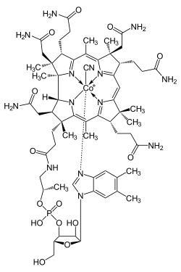

Seminar of hematology
با تشکر از حضور شما

