Slide 1
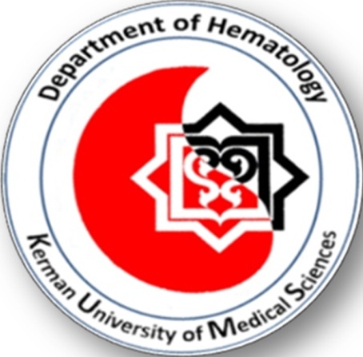
Kerman University of Medical Science
Hematology Journal Club
Title:
Urine-derived cells for human cell therapy
Presented by:
Mohadeseh rostamipoor
Advisor:
Dr.Farsinejad

Slide 2
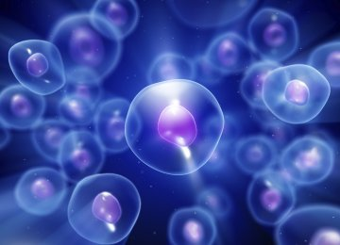
Cell therapy
Cell therapy aims
Restore diseased or injured tissues
Replacing lost cells with functional cells
Re-establish normal function
Stem cell & somatic cell

Slide 3
Stem cell
Stem cells can differentiate into various tissue specific lineages
Self-renewal
Differentiate

Slide 4
Stem cell
Classification of stem cells
Source of origin
Differentiation potentials

Slide 5
Stem cell
Differentiation potentials
Totipotent
Pluripotent
Multipotent
Unipotent

Slide 6
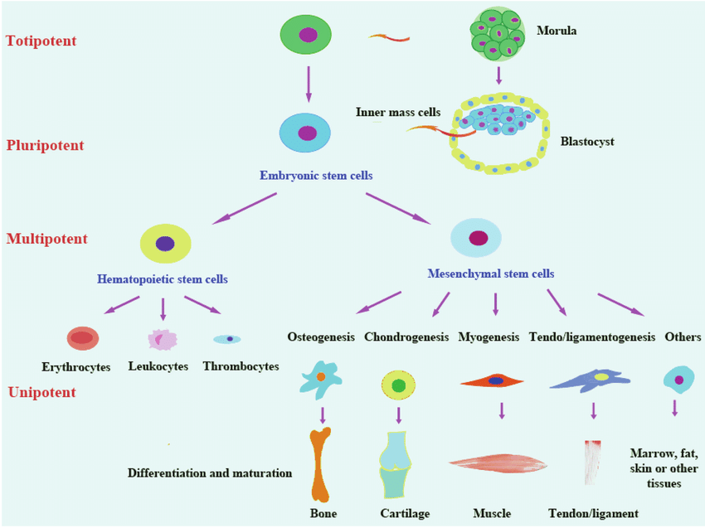

Slide 7
Stem cell
Mesenchymal stem cell (MSC)
Multipotent
Differentiation to mesoderm, endoderm, ectoderm
MSCs derived from different tissue including :
Bone marrow
Adipose tissue
Amniotic
Testis
Liver
Lung
Dental pulp
Umbilical cord blood
Menstrual Blood Stem Cells

Slide 8
Stem cell
Source of origin
Embryonic
ips
Adult stem cell
Cord blood SC
Fetal stem sell

Slide 9
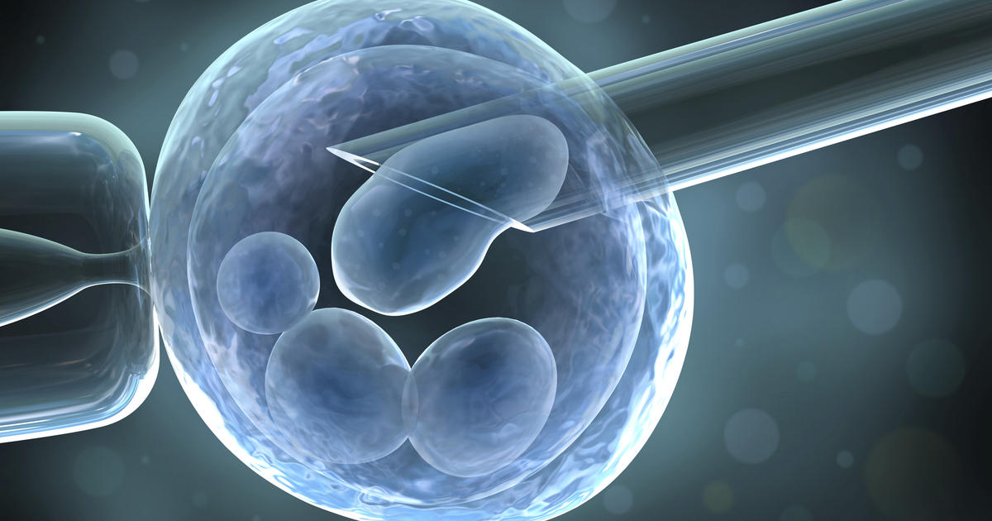
Stem cell
Embryonic stem sell
Inner cell mass of blastocysts
Advantages:
Totipotent
Pluripotent
Have the ability to produce all type
Disadvantages:
Teratoma
Ethical issues

Slide 10
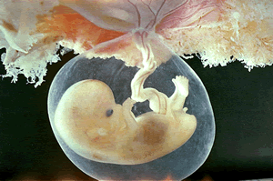
Stem cell
Fetal stem cell
Amniotic
Advantages:
Multipotent
No teratoma
Disadvantages:
Autologus

Slide 11
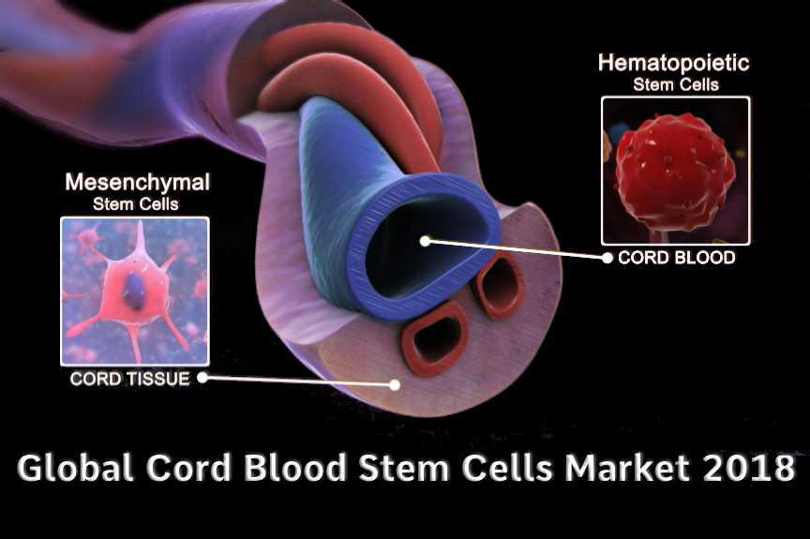
Stem cell
Cord blood stem cell
Advantages:
Mesenchymal stem cell (MSC)
Haematopoietic stem cells (HSC)
Multipotent
Low immune response
Disadvantages:
Autologus

Slide 12
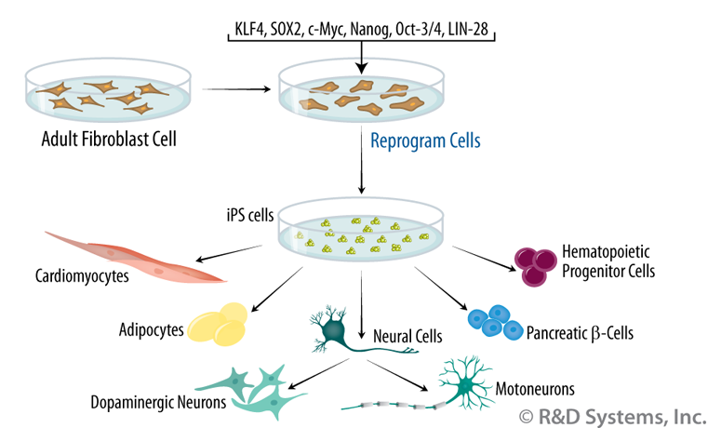
Stem cell
Induced pluripotent stem cell (ips)
Advantages:
Pluripotent
Reprogramming and differentiation
KLF4
C-MYC
OCT4
SOX2
Disadvantages:
Oncogenes

Slide 13
Stem cell
Adult stem cell
Bone marrow
Adipose tissue
Amniotic
Testis
Liver
Lung
Dental pulp
Umbilical cord blood
Menstrual Blood Stem Cells

Slide 14
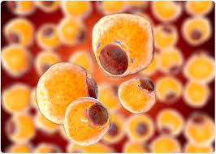
Stem cell
Adipose derived Stem Cells
Advantages:
MSC
Differentiate to
Bone
Cartilage
Fat
Muscle
Disadvantages:
liposuction or invasive methods for isolation

Slide 15
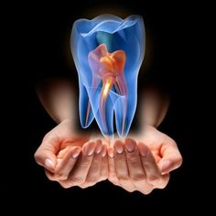
Stem cell
Dental pulp
Advantages:
MSC
High division
Differentiate
Autologus

Slide 16
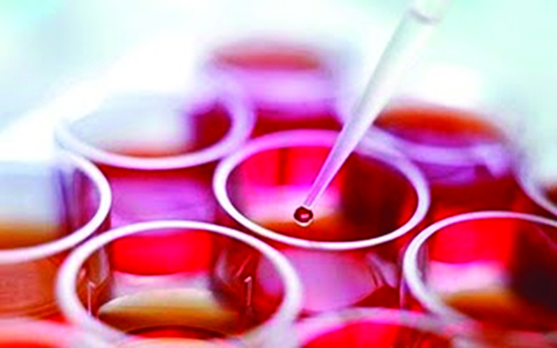
Stem cell
Menstrual Blood Stem Cells
Advantages:
Multipotent
Express MSC & ESC markers

Slide 17
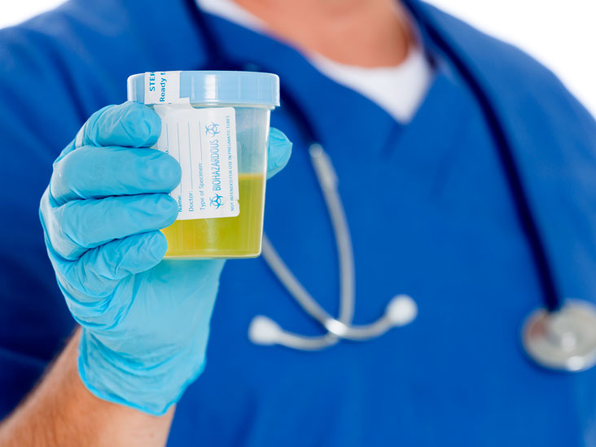
Stem cell
Urine-derived stem cells
Ease of isolation
No invasive and painful procedures
Cost of biopsy
Suitable for auto-transplantation
Not induce immune responses or rejection

Slide 18
Stem cell
Urine-derived stem cells
Isolation of urine-derived cells
Centrifugation
Antibacterial wash
Seeding them onto culture plates

Slide 19
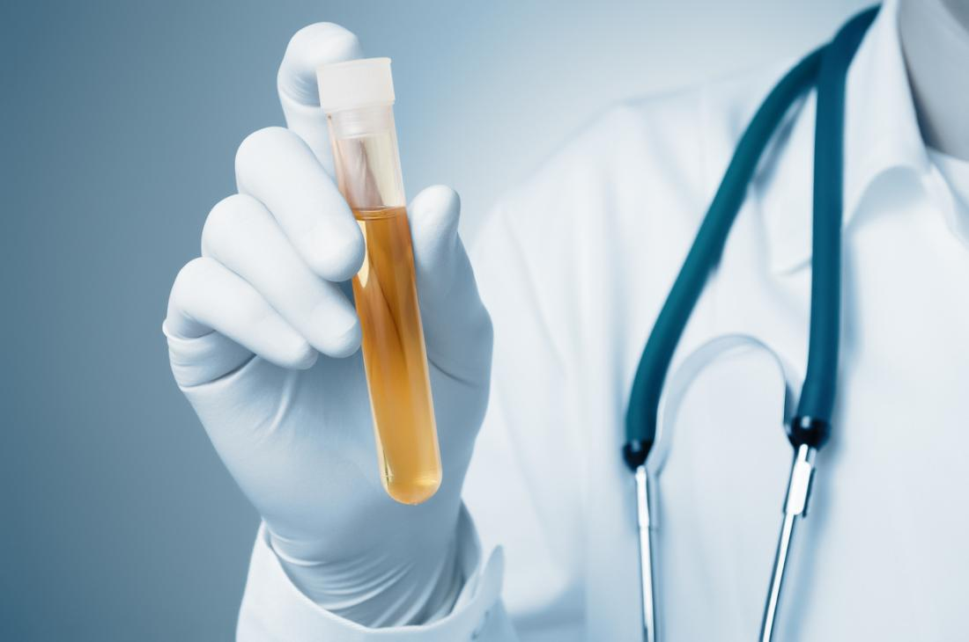
Stem cell
Urine-derived stem cells
MSC
Progenitor cells that can be converted into cells of multiple lineages
Expression kidney cortex markers
Originate from the kidney

Slide 20
Stem cell
Urine-derived stem cells
USC have high expandability
Doubling time of 21– 24 h
Secrete angiogenic paracrine growth factors
Vascular endothelial growth factor (VEGF)
Fibroblast growth factor (FGF)
Insulin growth factor (IGF)
Hepatocyte growth factor (HGF)
Platelet-derived growth factor (PDGF)

Slide 21
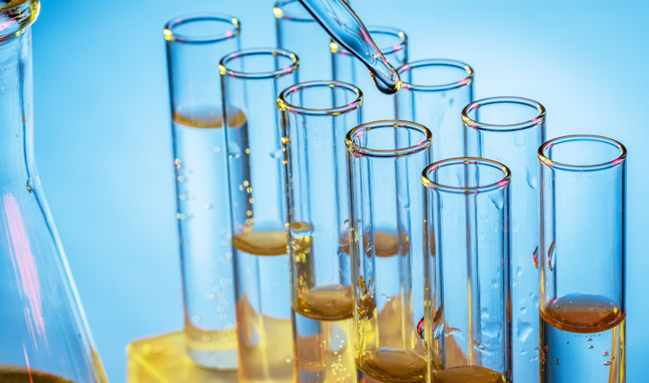
Stem cell
Urine-derived stem cells
Therapeutic applications
Lack of robust donor-derived cells
Non-invasively
Differentiated into multiple lineage
Autologous transplant

Slide 22
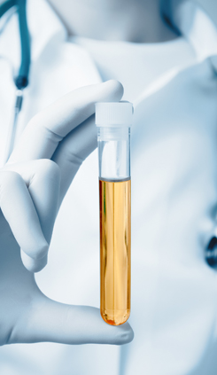
Stem cell
Urine-derived stem cells
Therapeutic applications
Ease of donor sample collection
Minimal ethical issues
Low costs
Simple method of cell isolation
No immune rejection
Widespread clinical applications

Slide 23
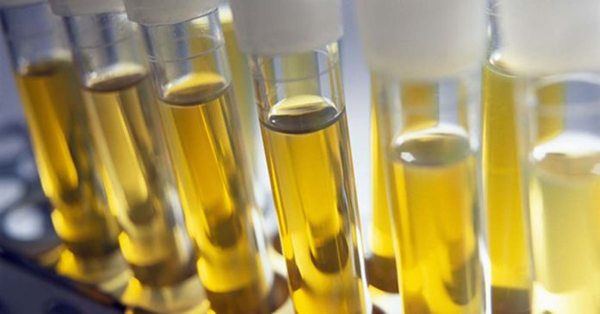
Stem cell
Urine-derived stem cells
Therapeutic applications
Autologous cell therapy
Kidney bioengineering
Cardiac repair
Liver reconstruction
Diabetes treatment
Bone engineering
Muscle engineering

Slide 24
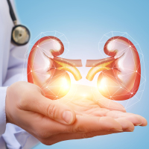
Stem cell
Urine-derived stem cells
Kidney bioengineering
Differentiated in to:
Smooth muscle
Myocytes
Epithelial cell
Endothelial cells
Reduce inflammation, oxidative stress, and tubular injury
Bioartificial kidneys

Slide 25
Stem cell
Urine-derived stem cells
Genitourinary repair
Treat end-stage bladder diseases or bladder pain syndrome
Treat stress urinary incontinence (SUI)

Slide 26
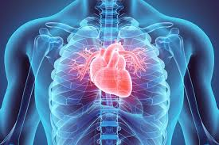
Stem cell
Urine-derived stem cells
Cardiac repair
Pluripotent cells are hard to obtain
Differentiated myocytes from urine cells expression
Myofibrillar proteins
Myogenic differentiation (MyoD)
Myogenic factor 5 (Myf5)

Slide 27
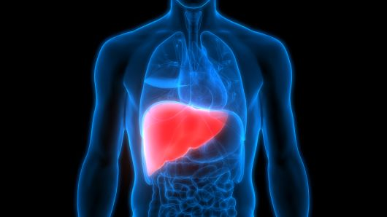
Stem cell
Urine-derived stem cells
Liver reconstruction
In acute liver failure transplantation
Donor tissue insufficiency
Immunogenicity
Patient-specific hepatocytes

Slide 28
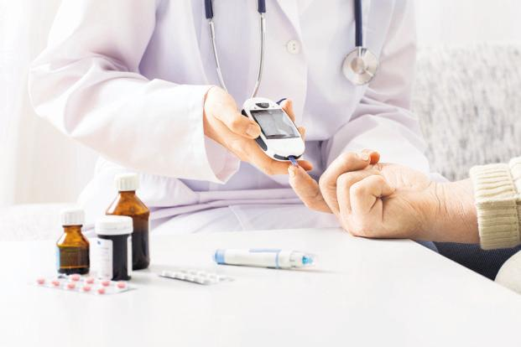
Stem cell
Urine-derived stem cells
Diabetes treatment
Requires a large number of cells
Using urine cells these numbers are achievable
Require life-long immune suppression
Urine cells can bring revolutionary changes in diabetes treatment

Slide 29
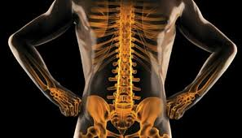
Stem cell
Urine-derived stem cells
Bone engineering
Large number of cell
ESC- and iPSC and Adipose derived stem cells are generally used
Non-invasively

Slide 30
Stem cell
Urine-derived stem cells
Muscle engineering
Differentiated muscle cells from urine cells can be more effective
May require more than one transplant using autologous self-renewing functional cells

Slide 31
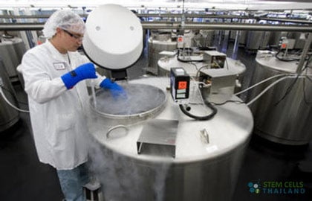
Stem cell
Urine-derived stem cells
The growth of urine cells is age-dependent
source of cells for therapy
USC have better immune tolerance
USC have better expandability
ideal choice for generating a donor cell bank

Slide 32
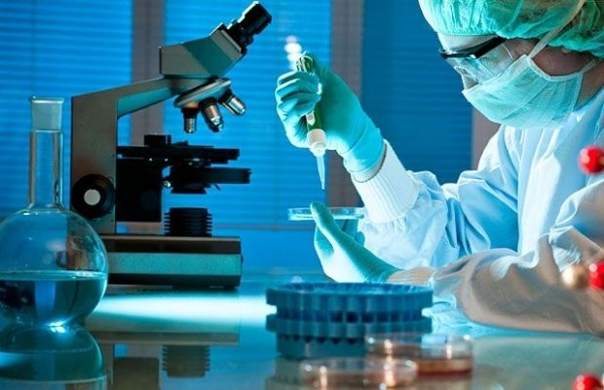
Thank you

