Slide 1
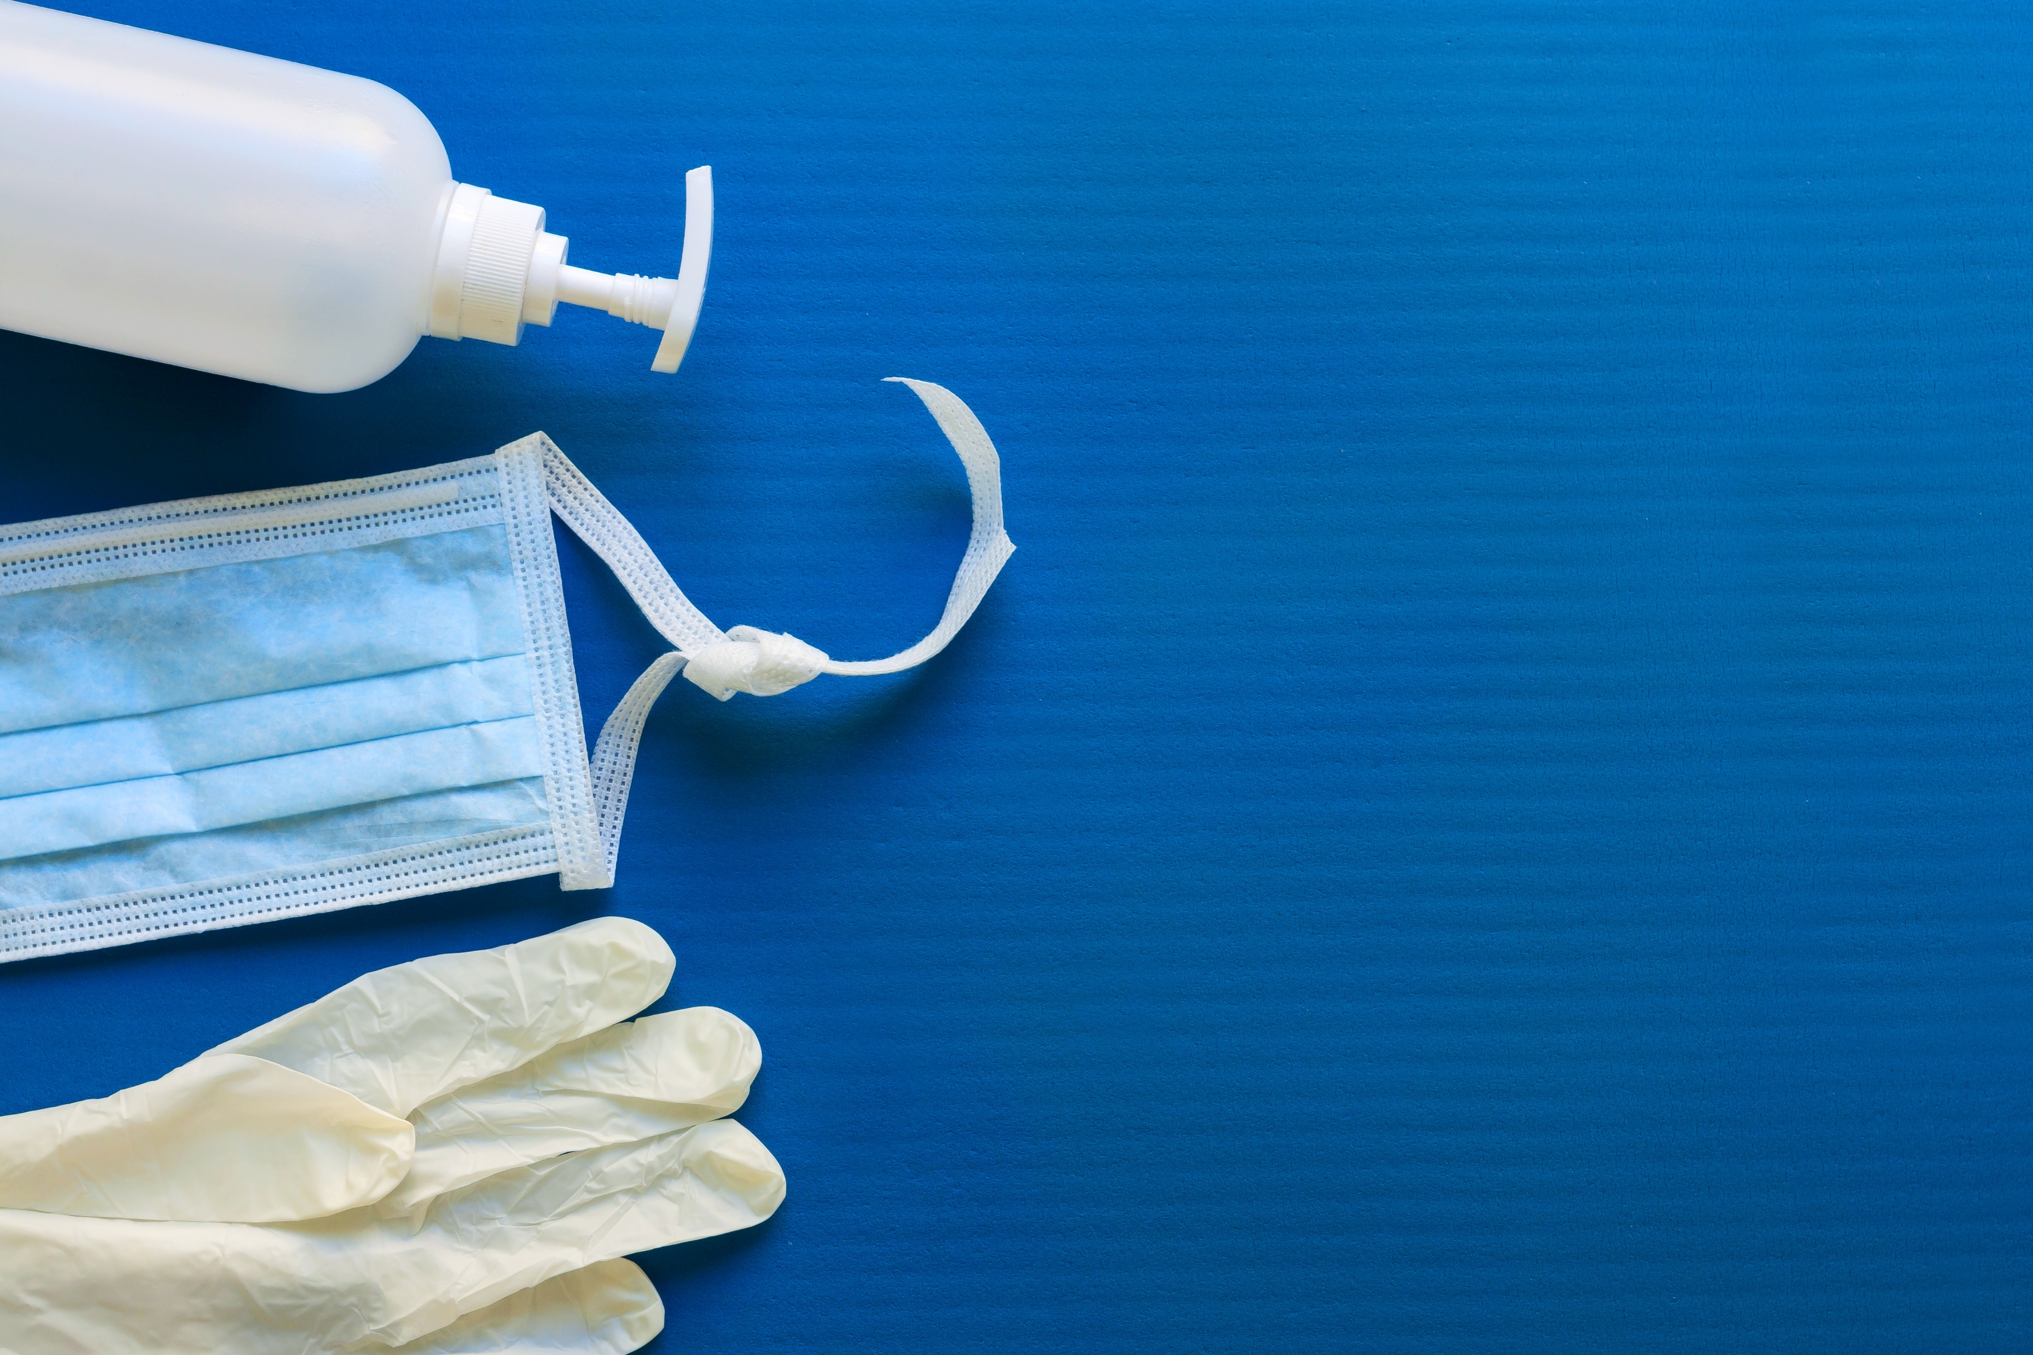
Human umbilical cord-derived mesenchymal stem cell therapy in patients with COVID-19: a phase 1 clinical trial
Presented by :
Sohaib Mohammadyar
MSc student of Hematology

Slide 2

Signal Transduction and Targeted Therapy
2 Year Impact Factor: 18.187* 5 Year Impact Factor: 21.177*

Slide 3


Slide 4


Slide 5
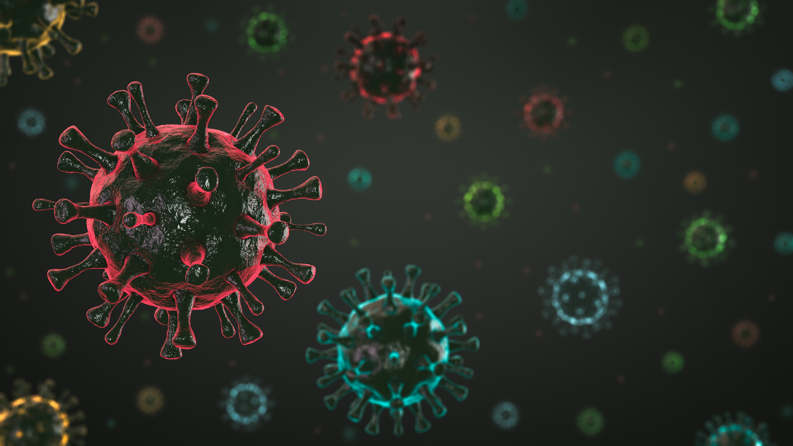


Coronaviruses (CoV) :
Middle East Respiratory Syndrome (MERS-CoV)
Severe Acute Respiratory Syndrome (SARS-CoV)
SARS-CoV-2

Slide 6
SARS-CoV-2
SARS-CoV-2 is enveloped, positive-sense, single-stranded RNA virus
79.6% sequence identity the same to SARS-CoV
It was first isolated using human airway epithelial cells
enters its host cell by binding to the angiotensin converting enzyme 2 (ACE2) receptor

Slide 7
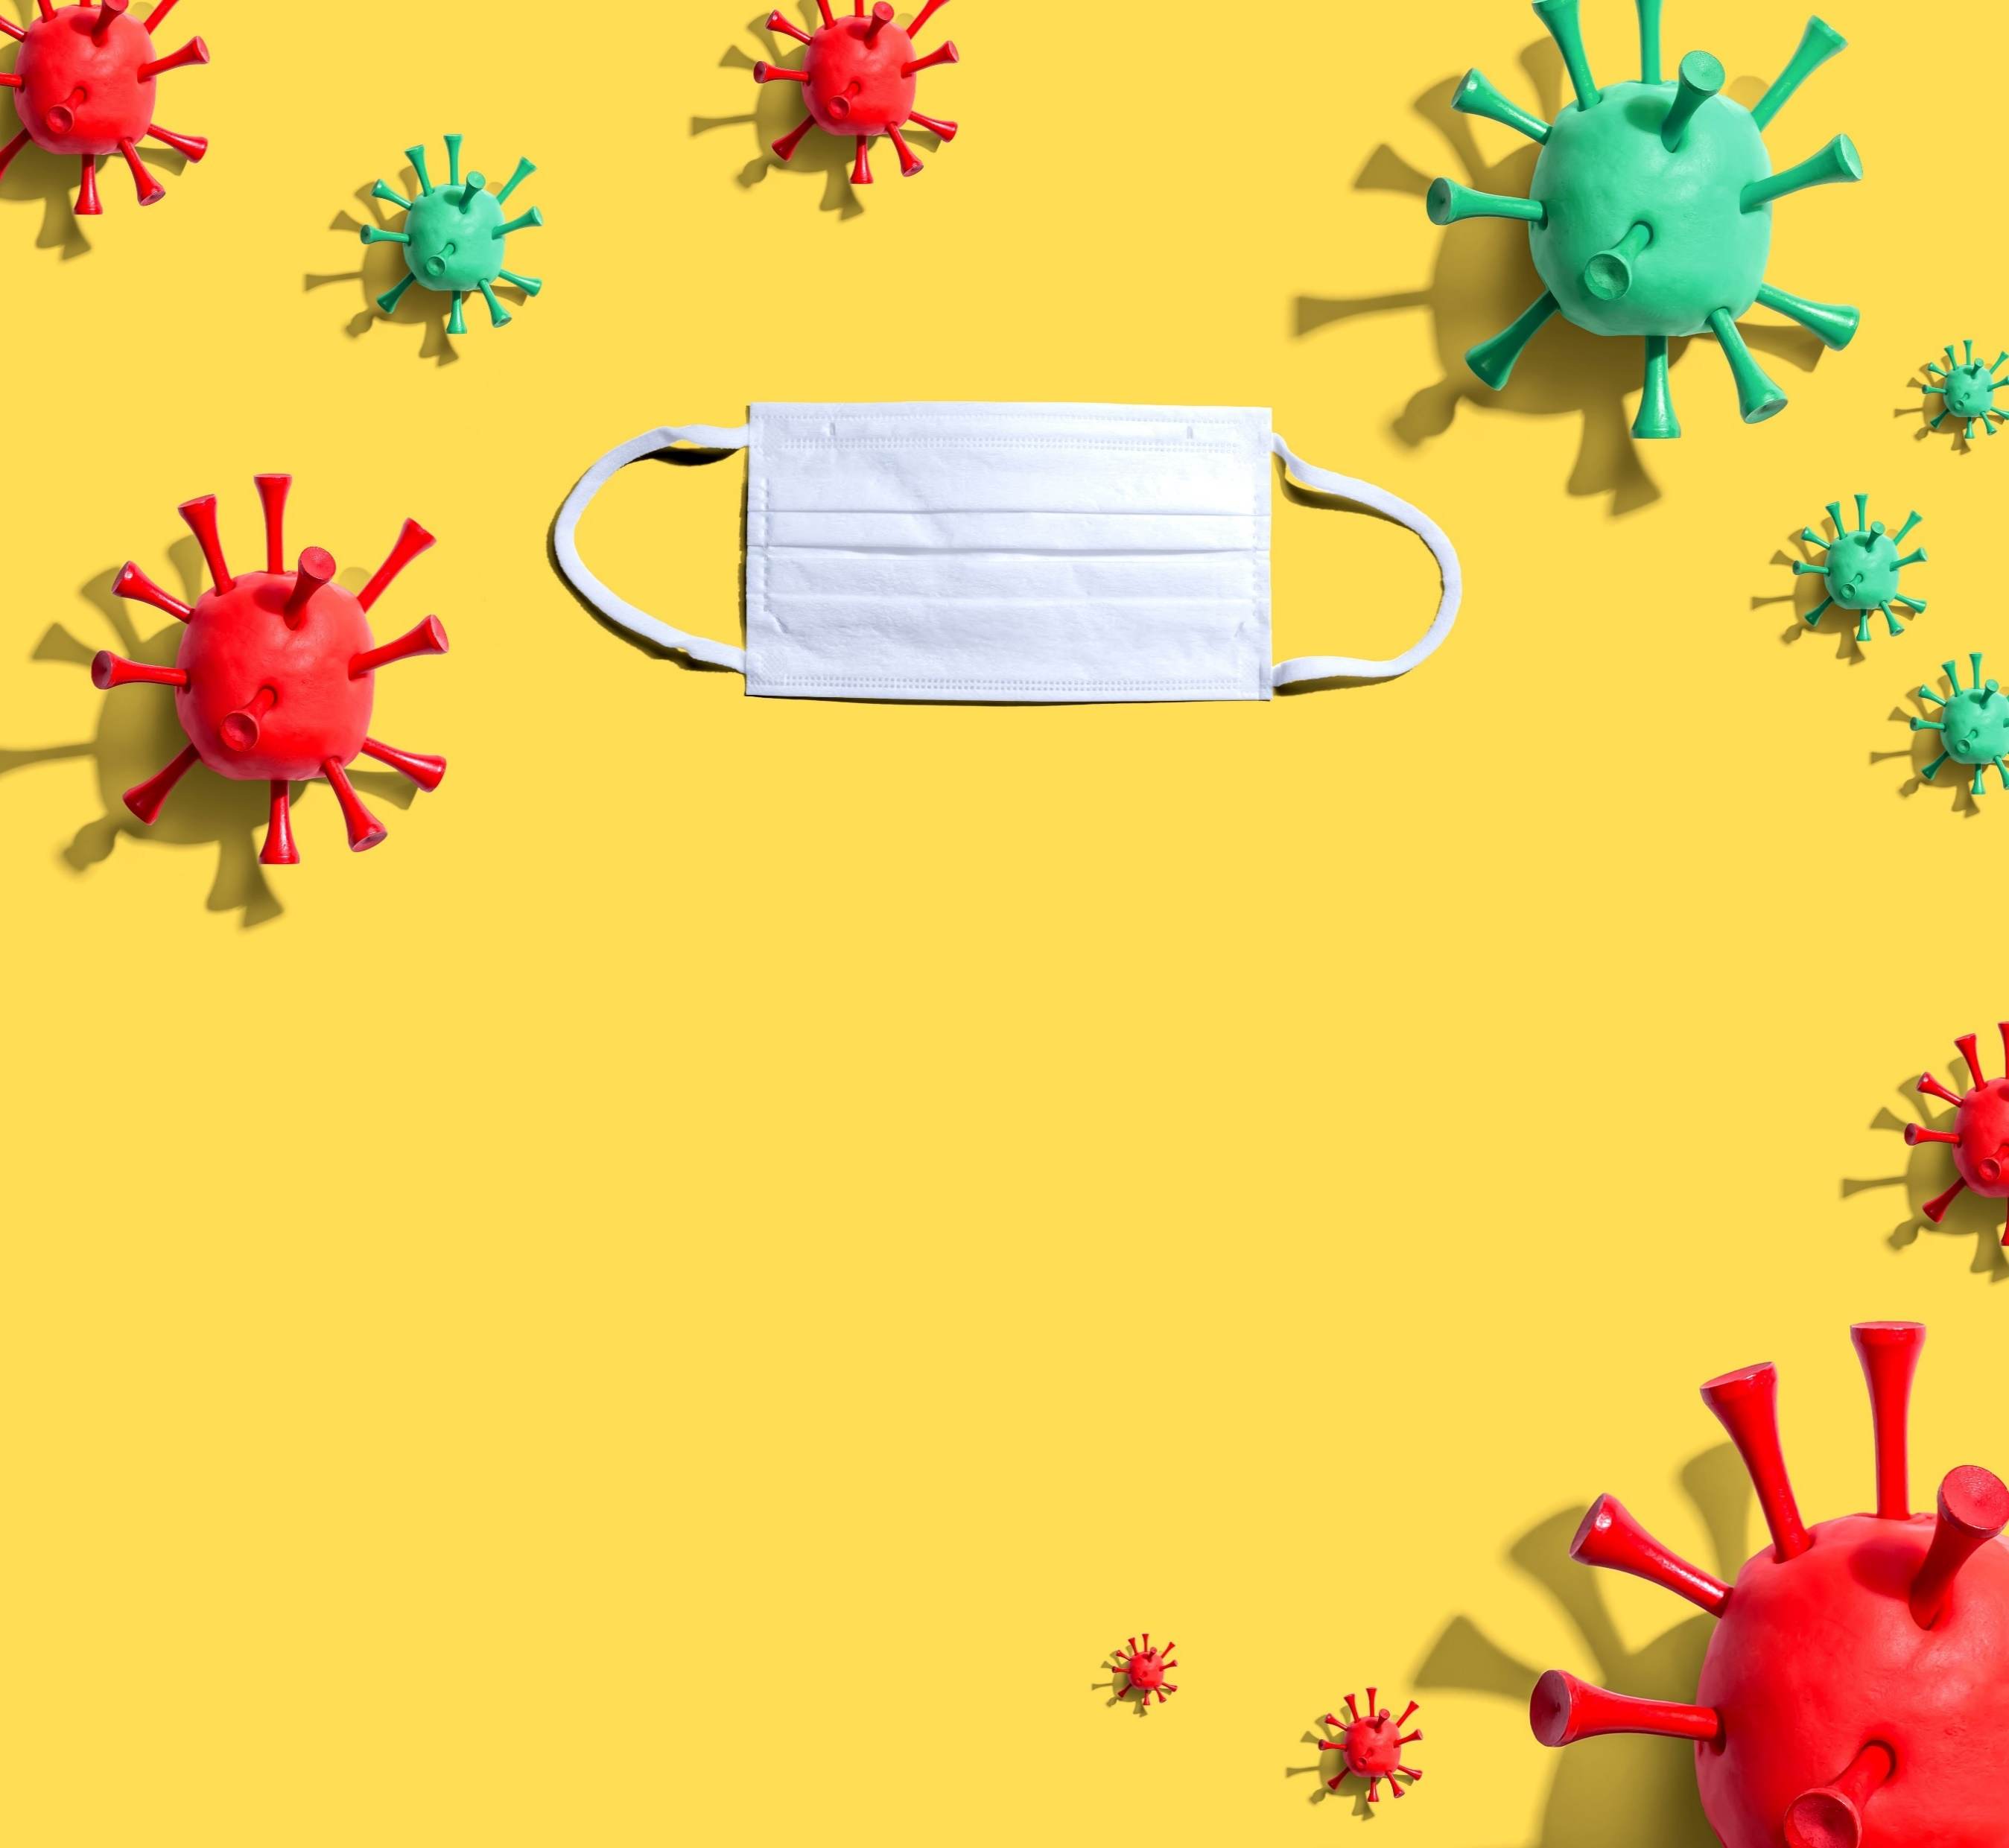
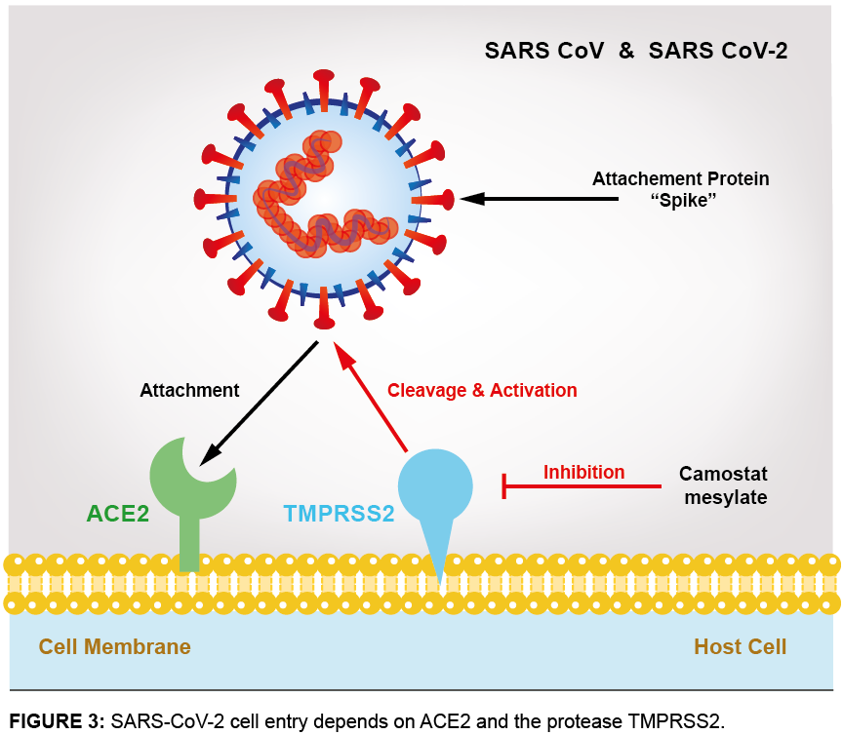
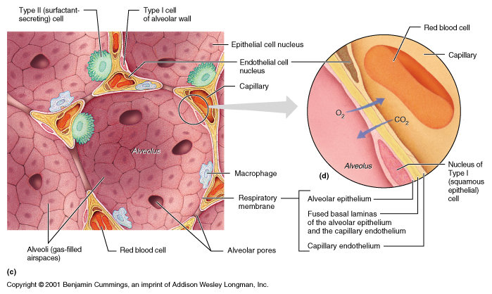
Pathogenesis
first stage of the pathogenesis of this type of virus is the identification of angiotensin-converting enzyme-2 (ACE2) receptor by its spike protein.
Another study has shown that the cellular protease TMRRSS2 is also required to allow the entry of coronavirus into host cells.

Slide 8
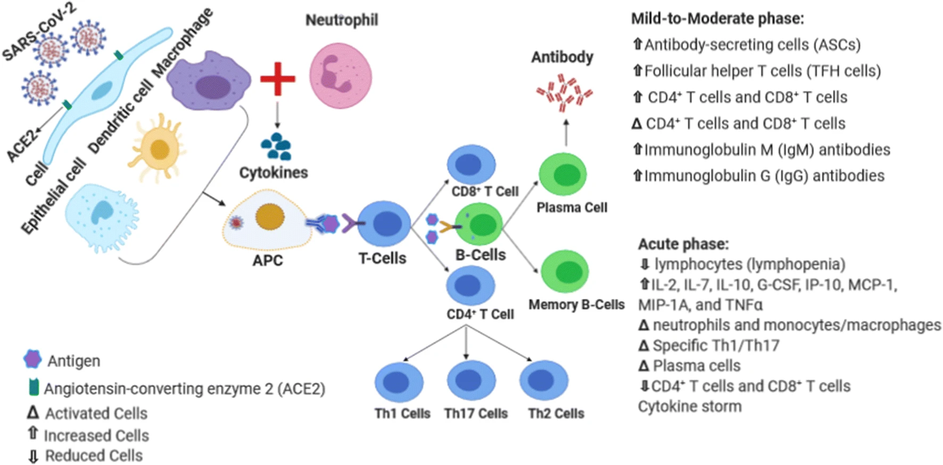

Slide 9

superiority in using MSC therapy in comparison with other treatments :
easily accessible
They are multipotent stem cells
expand to clinical volume in a suitable period of time
stored for repetitive therapeutic usage
haven’t shown adverse reactions to allogeneic MSC
Safety and effectiveness

Slide 10
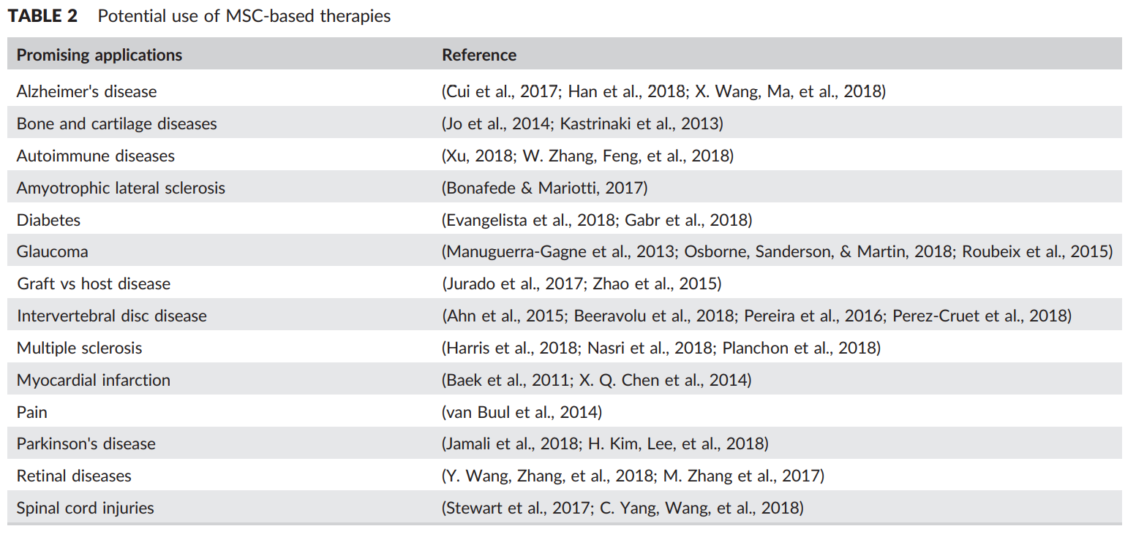

Slide 11
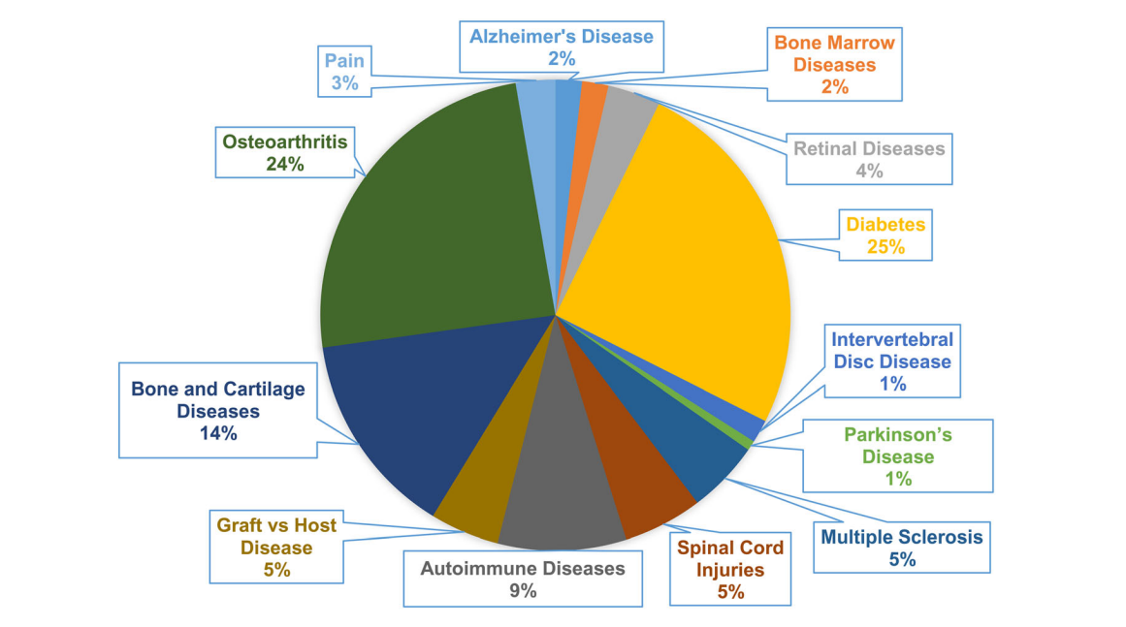

Slide 12
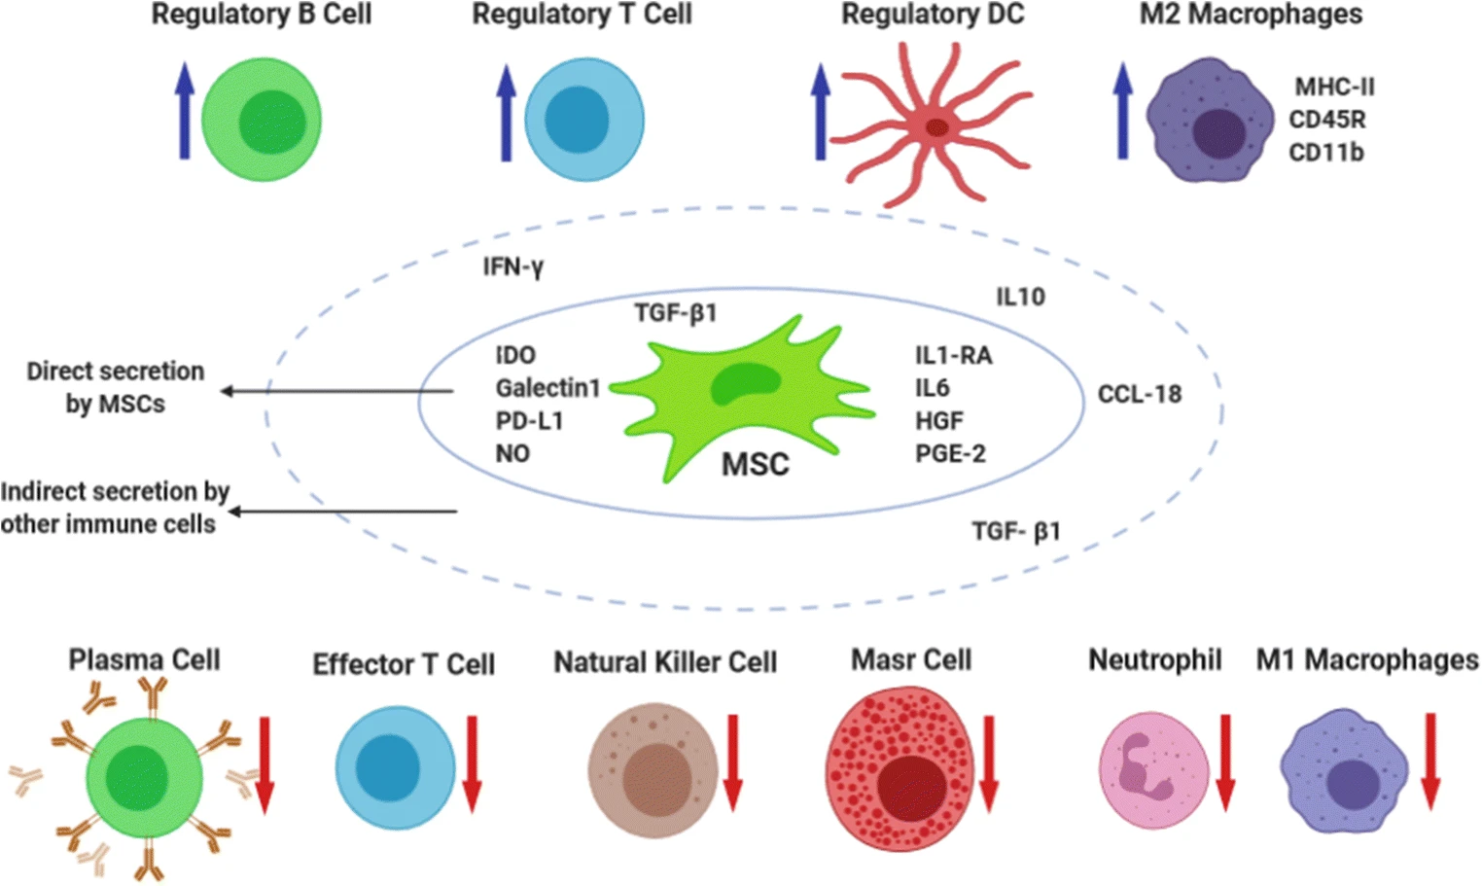

Slide 13
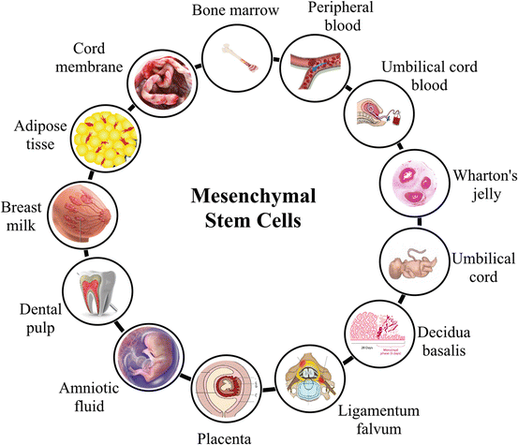

Slide 14
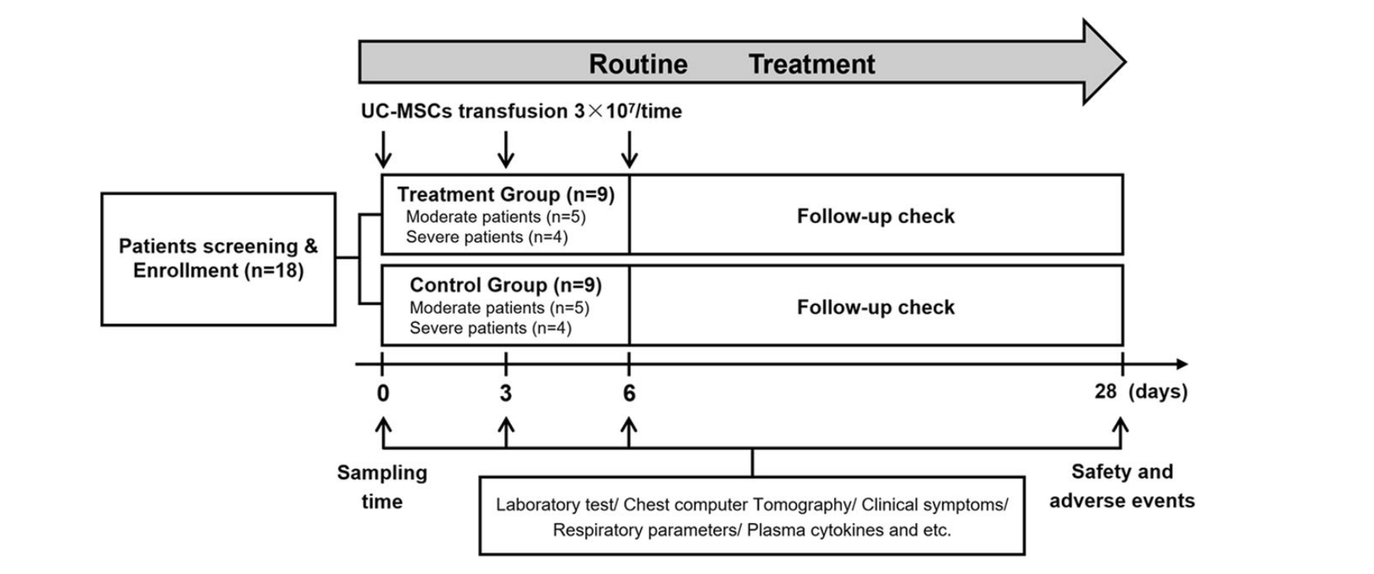

Slide 15

The inclusion criteria were :
Either male or female, aged 18–70 years old
Confirmed COVID-19 cases diagnosed using RT-PCR
Pneumonia was evidenced using chest radiography or CT
Exclusion criteria were :
Pregnancy
Patients with a malignant tumor, other serious systemic diseases, or psychosis
Patients who are participating in other clinical trials.
Inability to provide informed consent or to comply with blood test requirements.
Co-infection of HIV, tuberculosis, influenza virus, adenovirus, and other respiratory pathogens

Slide 16
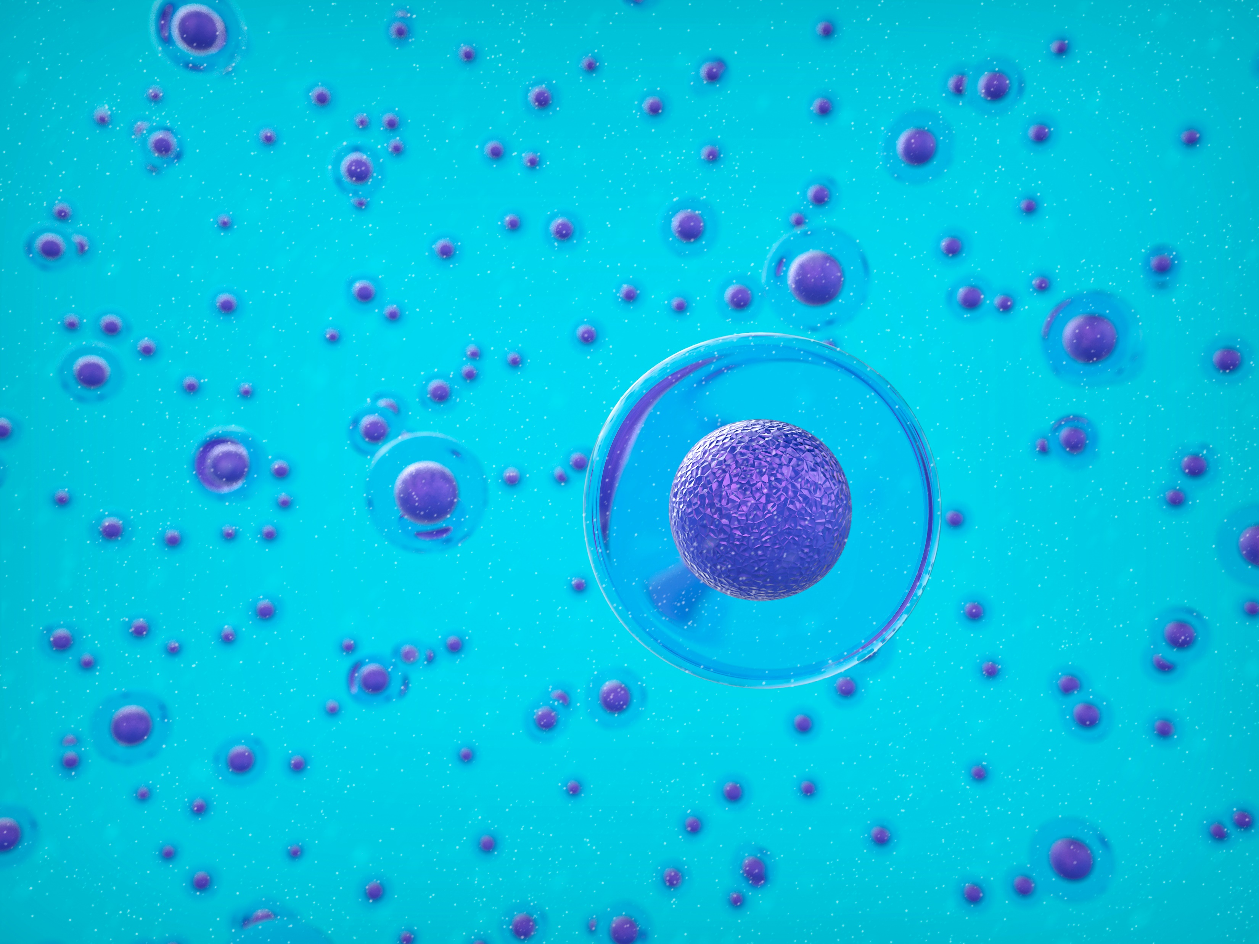
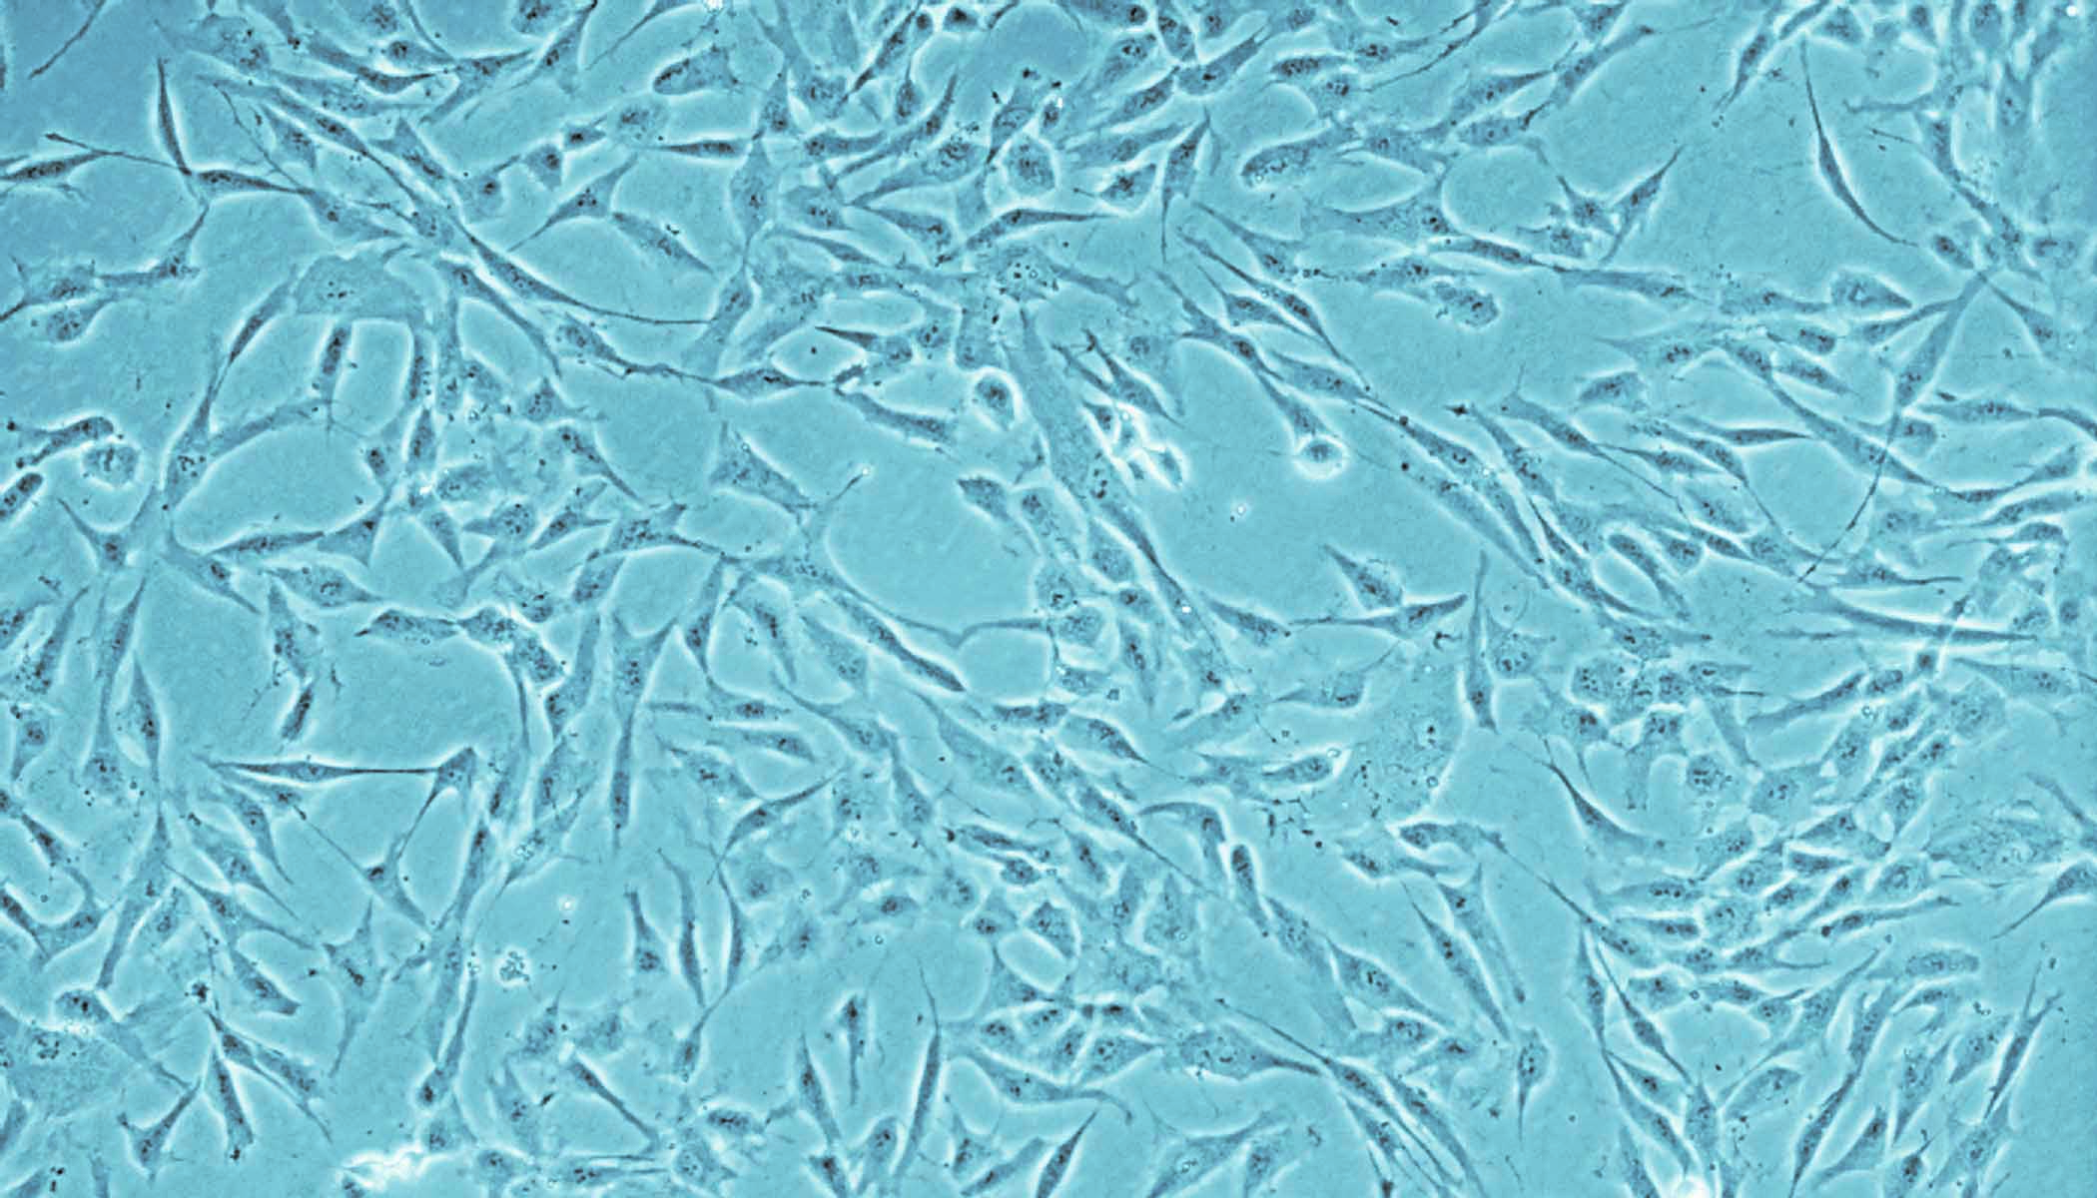
MSCs are characterized by :
fibroblast-like morphology
expression of cell surface markers including CD19, CD34, CD11b, CD45, CD73, CD105, CD90, and HLA-DR

Slide 17
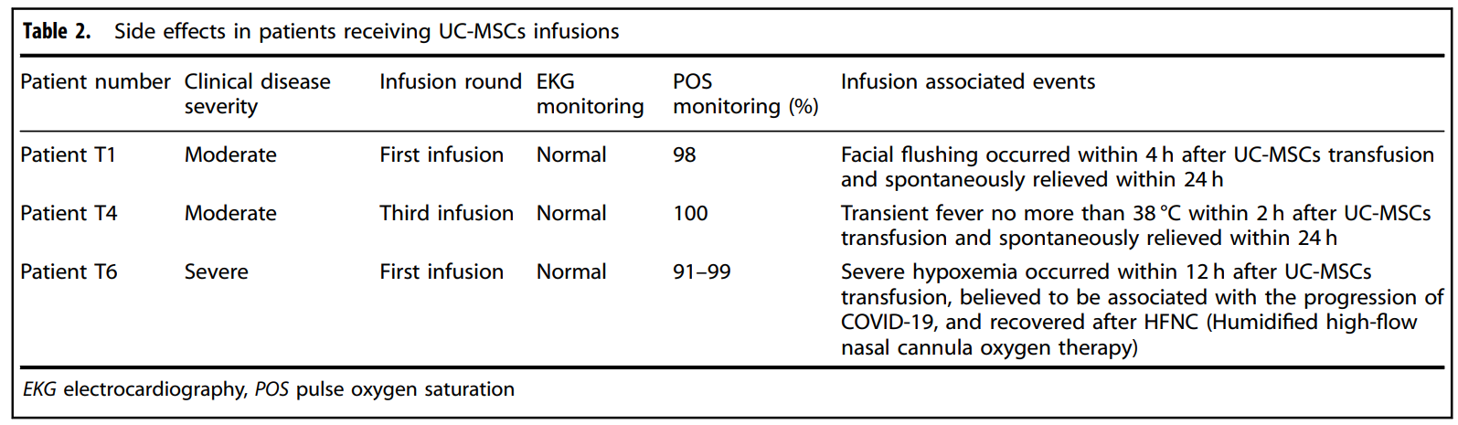

Slide 18
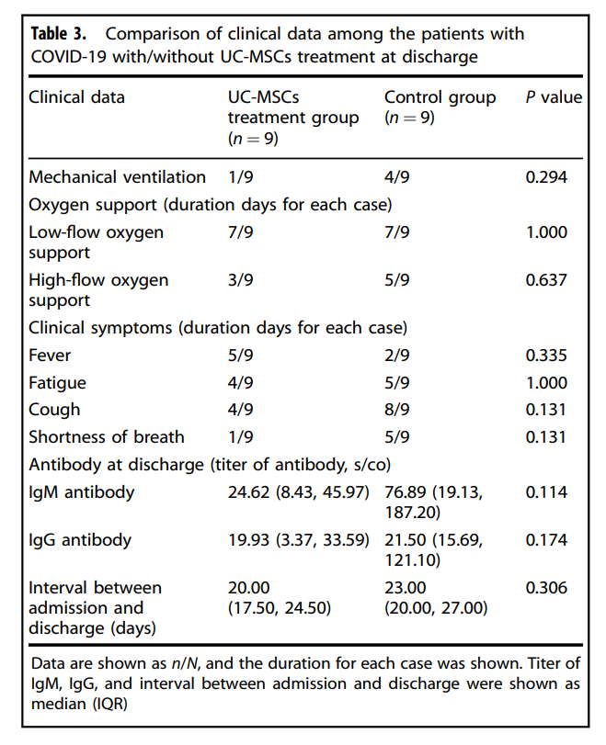

Slide 19
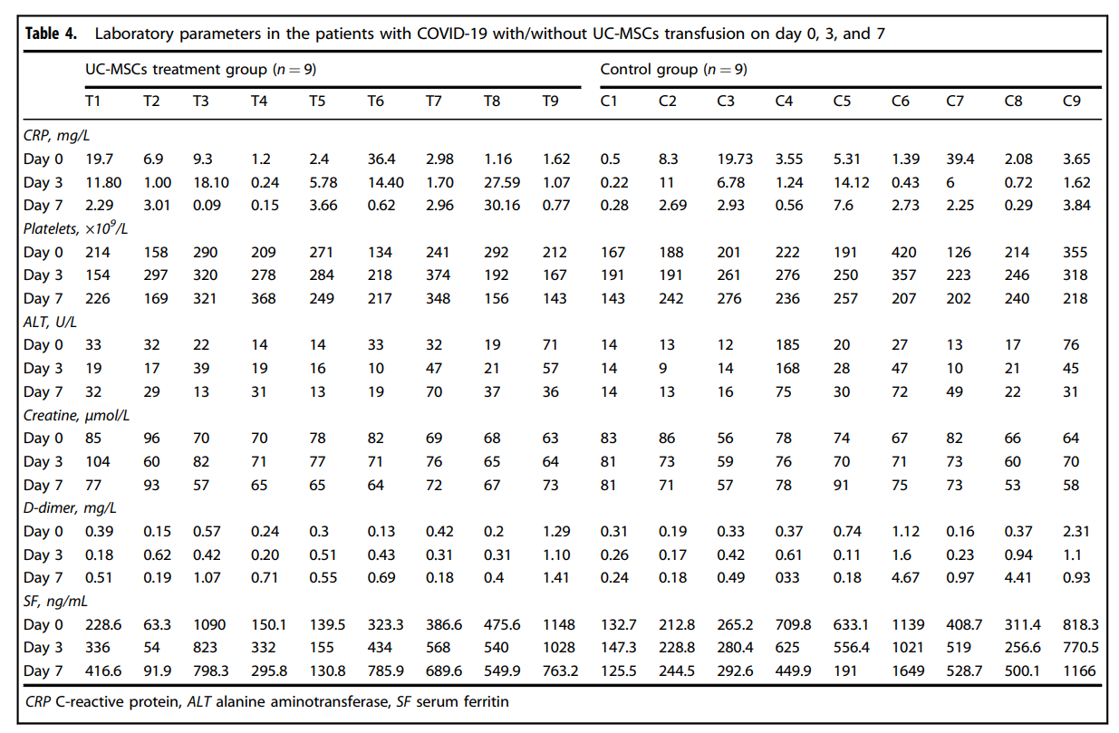

Slide 20
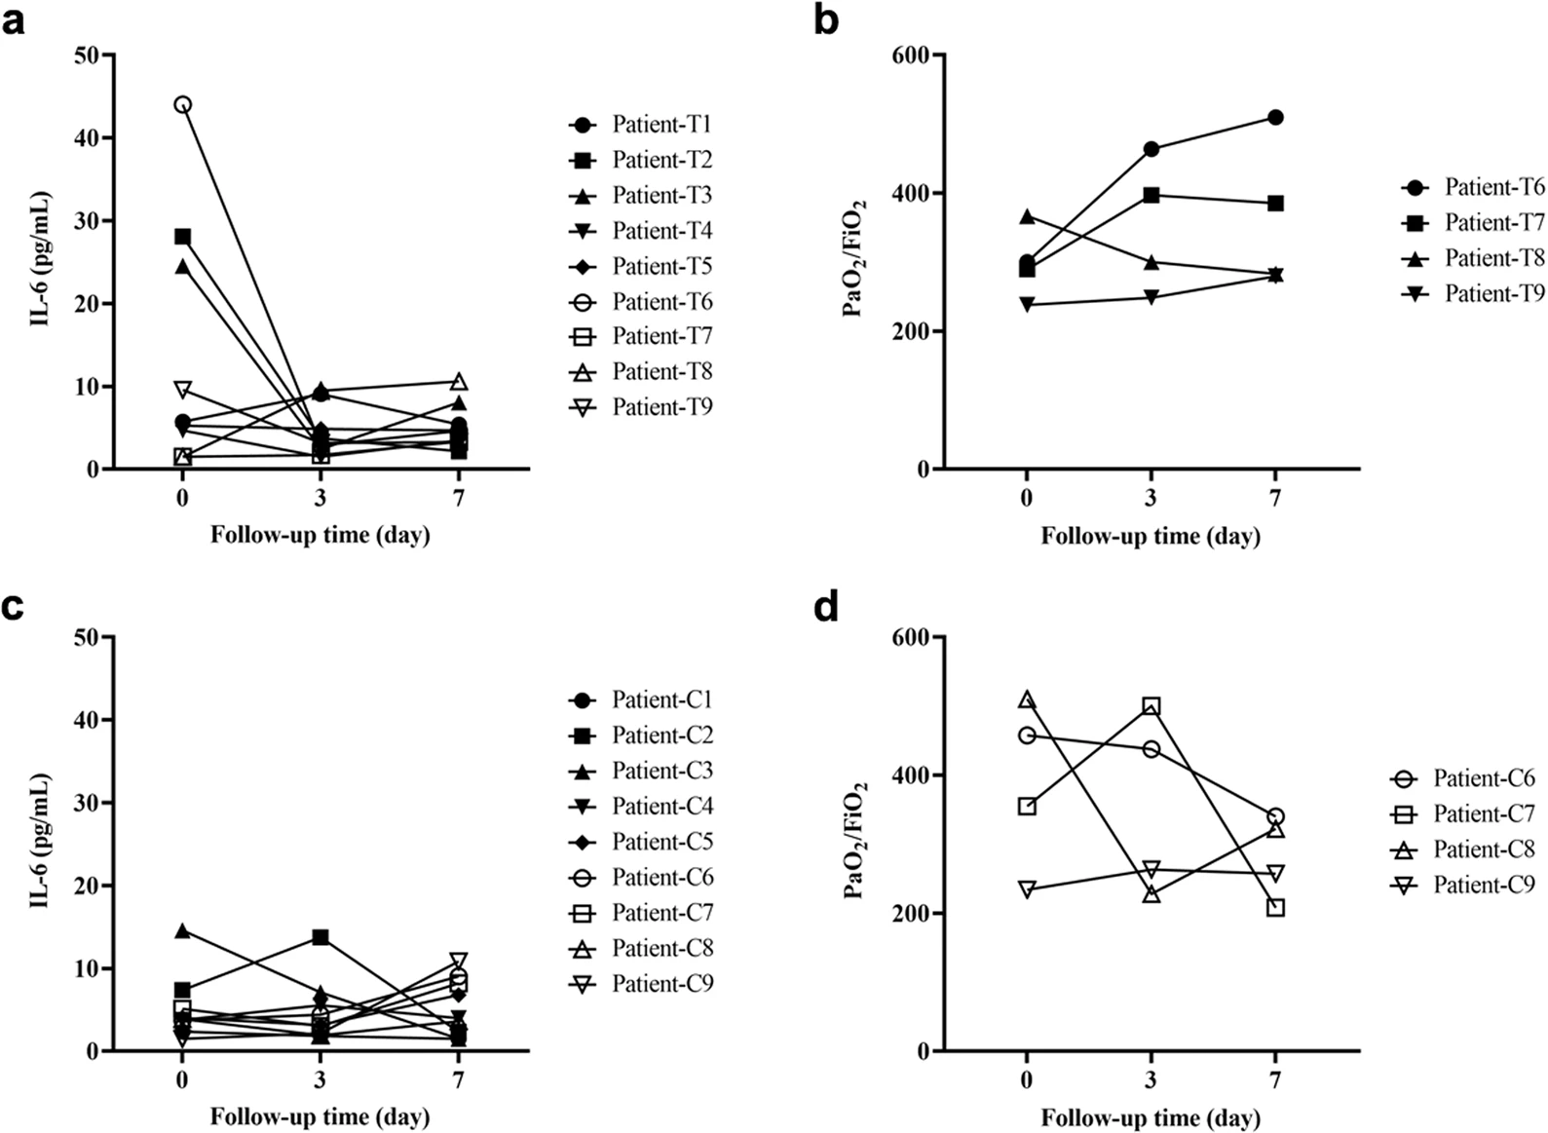

Slide 21
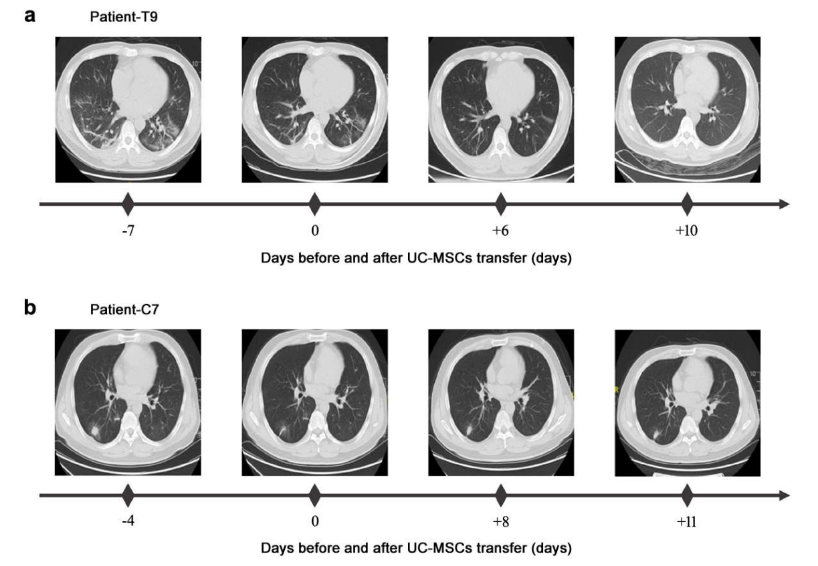

Slide 22
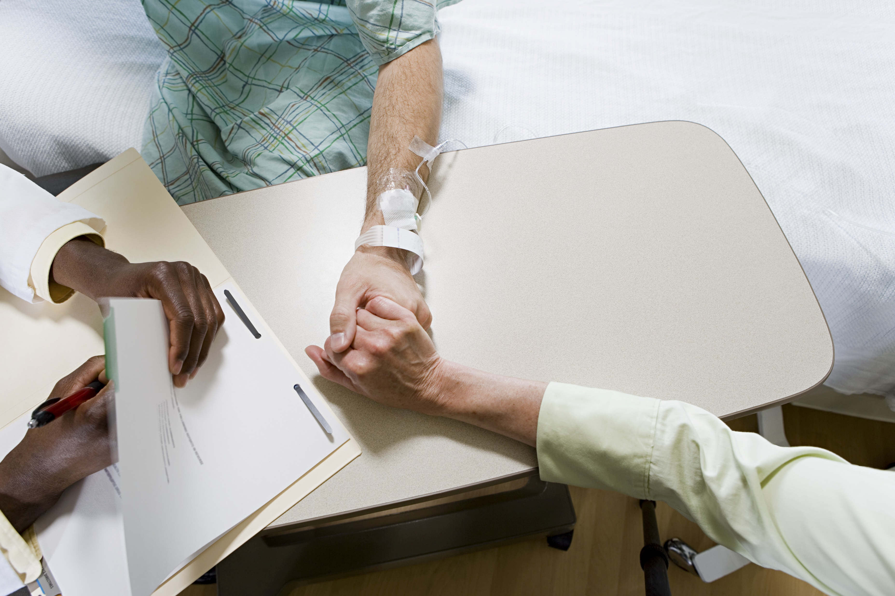
Case report
65-year-old female patient diagnosed in critical condition with COVID-19, then identified the exact 2019nCoV variant now called SARS-CoV-2 :
neutrophil 87% lymphocyte 9.8%
Treatment : lopinavir / ritonavir, IFN-α and oseltamivir as well as intravenous injection of moxifloxacin, Xuebijing, methylprednisolone and immunoglobulin
patient was treated with cord MSCs alone and with α1 thymosin 5 × 107 cells each three times
serum albumin, CRP, and ALT / AST other vital signs improved
Removed from the ventilator and able to walk
number of white blood cells

Slide 23
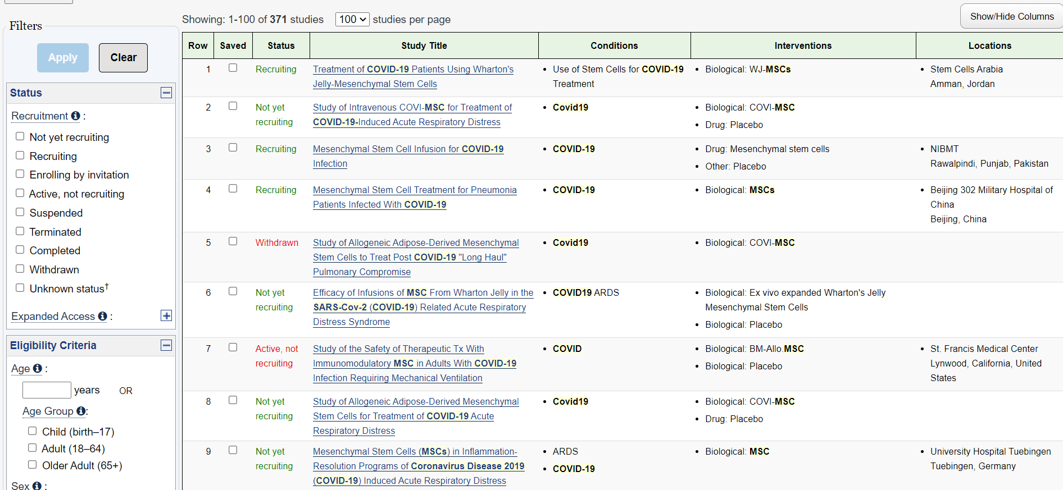

Slide 24


Slide 25


