Slide 1

به نام خالق زیبایی

Slide 2

Hematology Journal Club
Title:
Automation In Heamatology
Presented by:
Maryam Katoeezadeh
1

Slide 3

Automation in Hematology
2

Slide 4
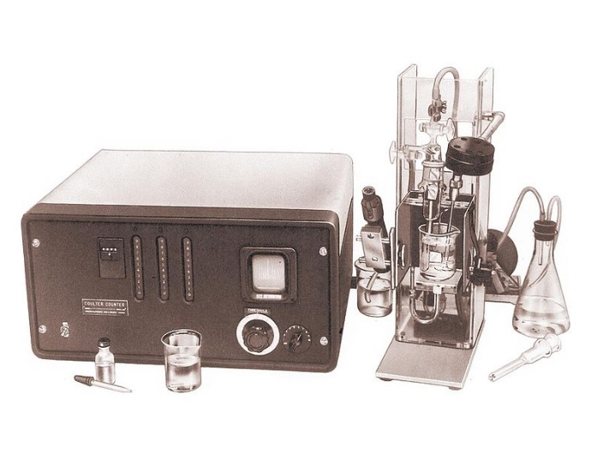
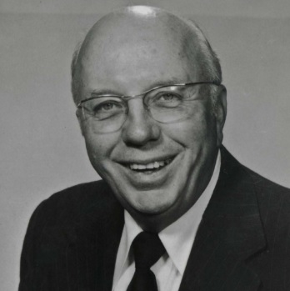
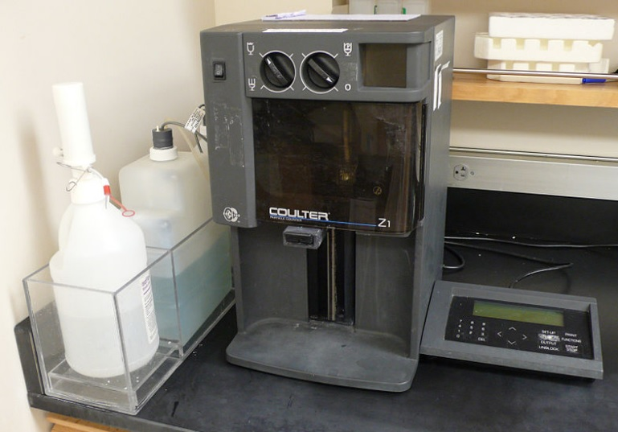
* History
Wallace H. coulter
(February 17, 1913 – August 7, 1998)
3

Slide 5
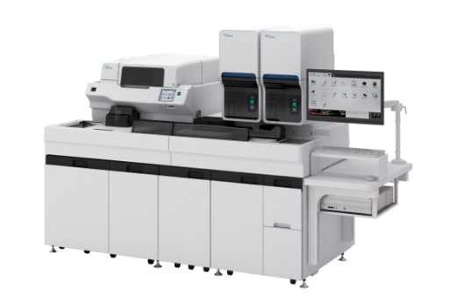


* Why Automation
4

Slide 6
Hematologic Analyzers are produced by many factories:
Abbott Laboratories
Horiba Medical
Siemens Healthcare Diagnostics,Inc
Beckman Corporation
5

Slide 7
Principle Of Working
Electrical Impedance
Light Scattering
6

Slide 8
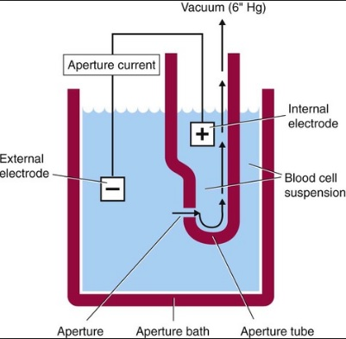
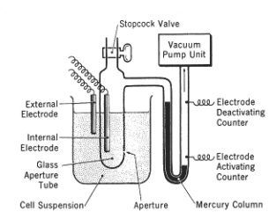
Electrical Impedance
7

Slide 9
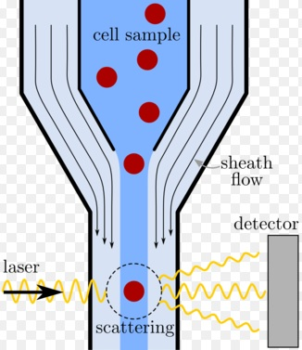
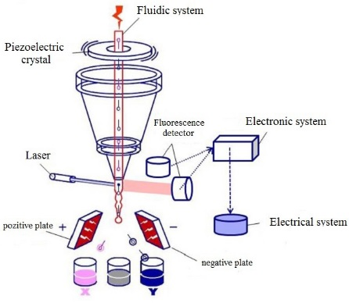
Light Scattering
8

Slide 10
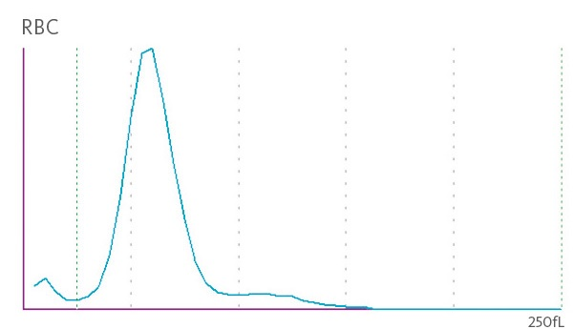
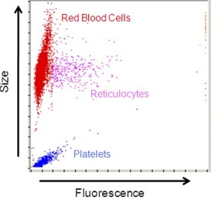
Histograms and cytograms
9

Slide 11
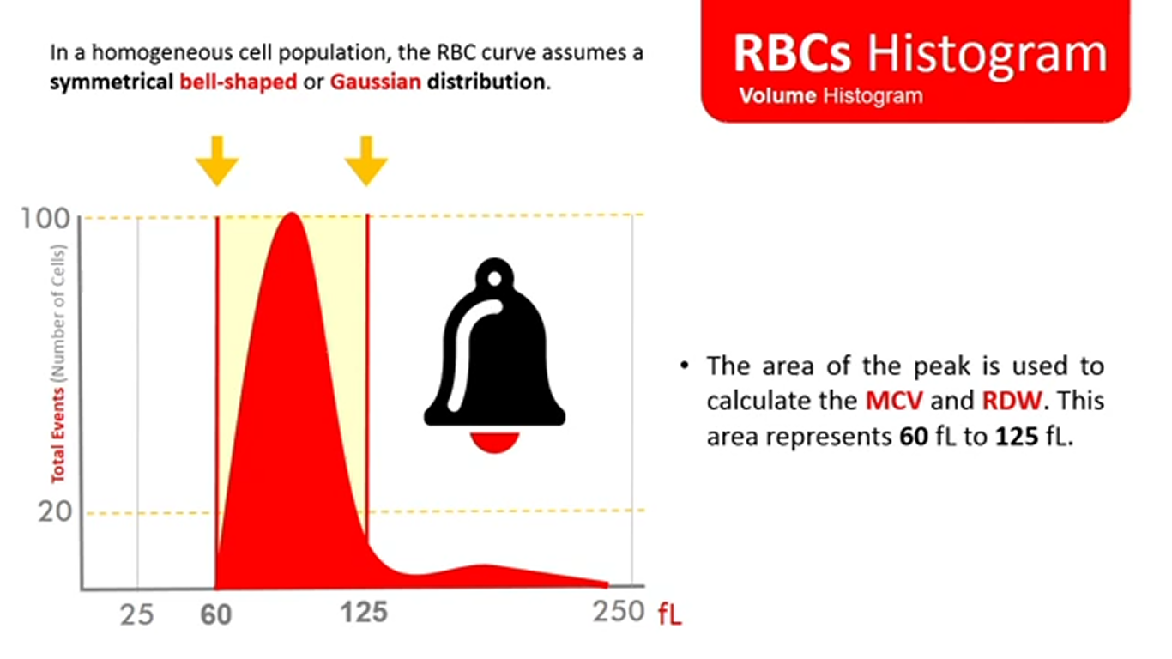
10

Slide 12
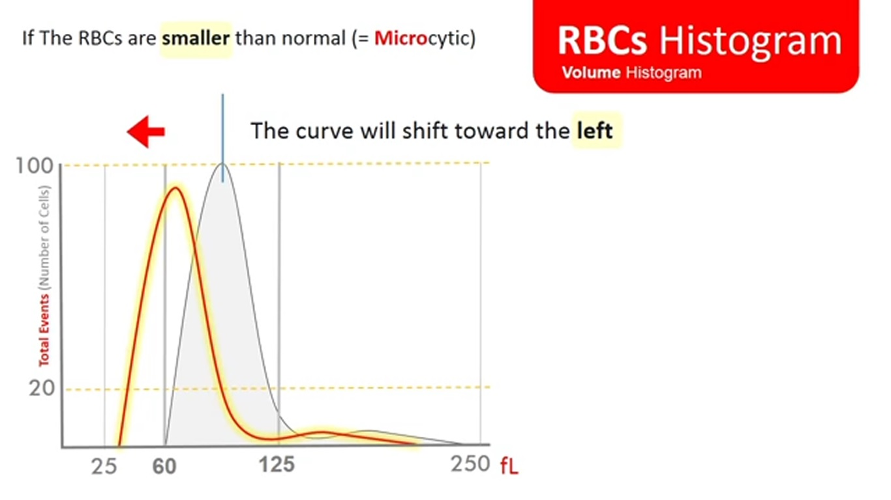
11

Slide 13
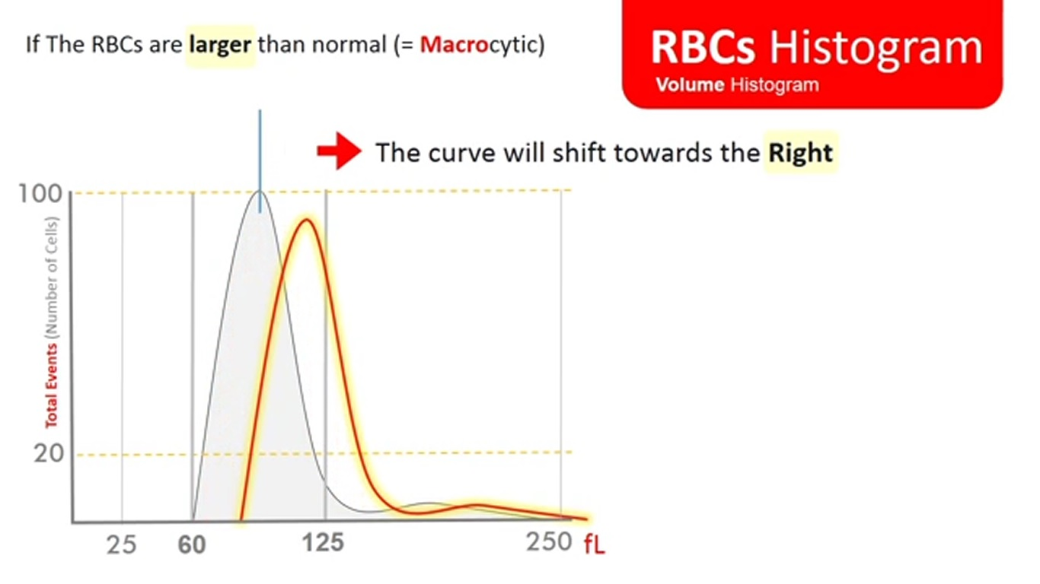
12

Slide 14
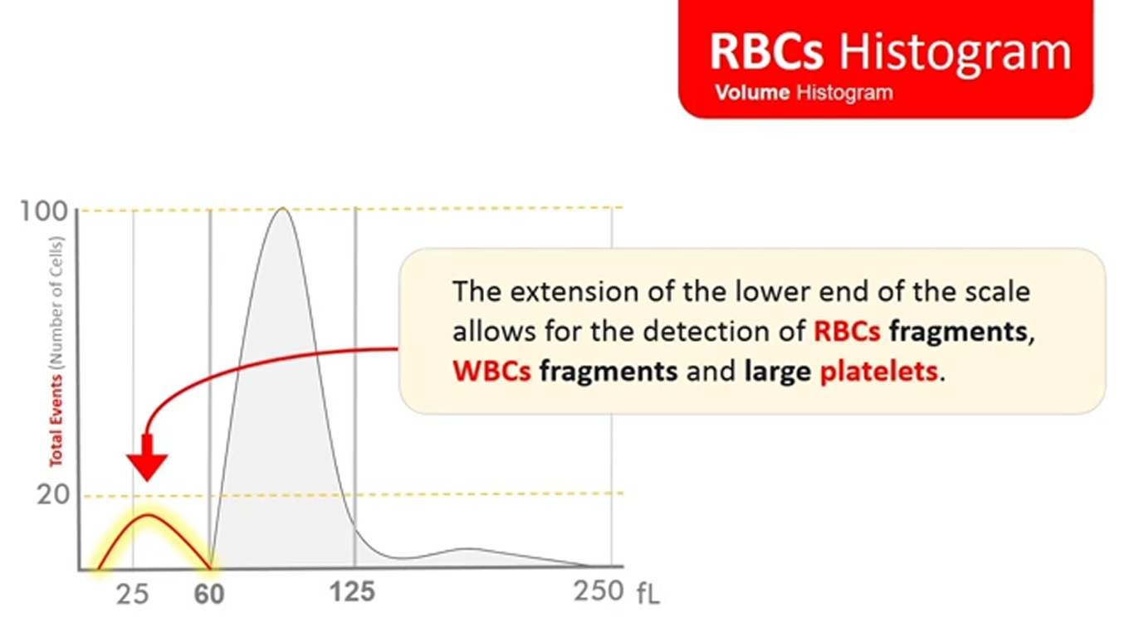
13

Slide 15
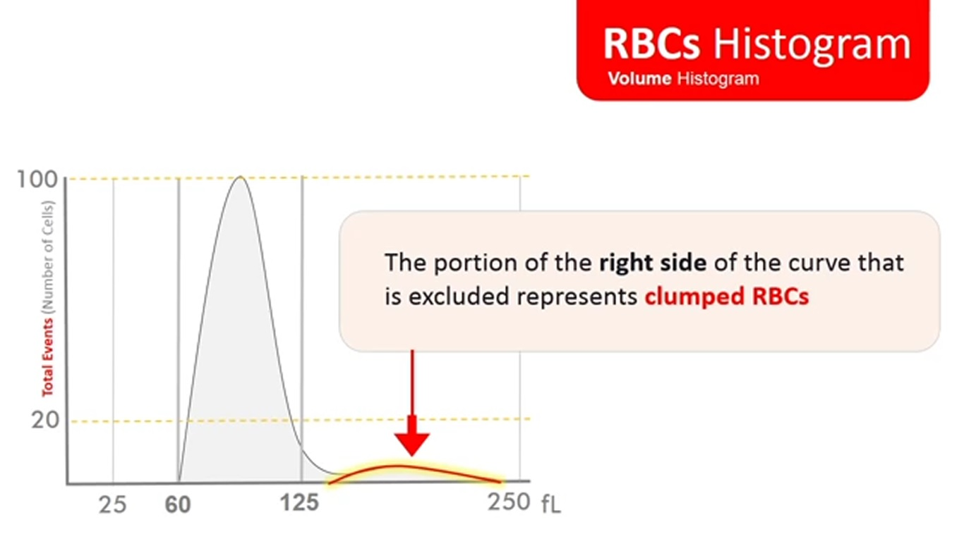
14

Slide 16
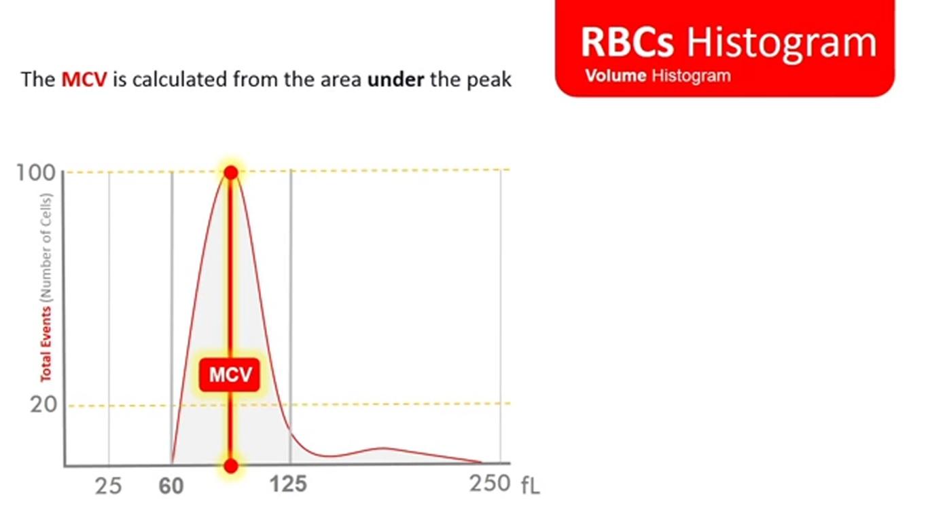
15

Slide 17
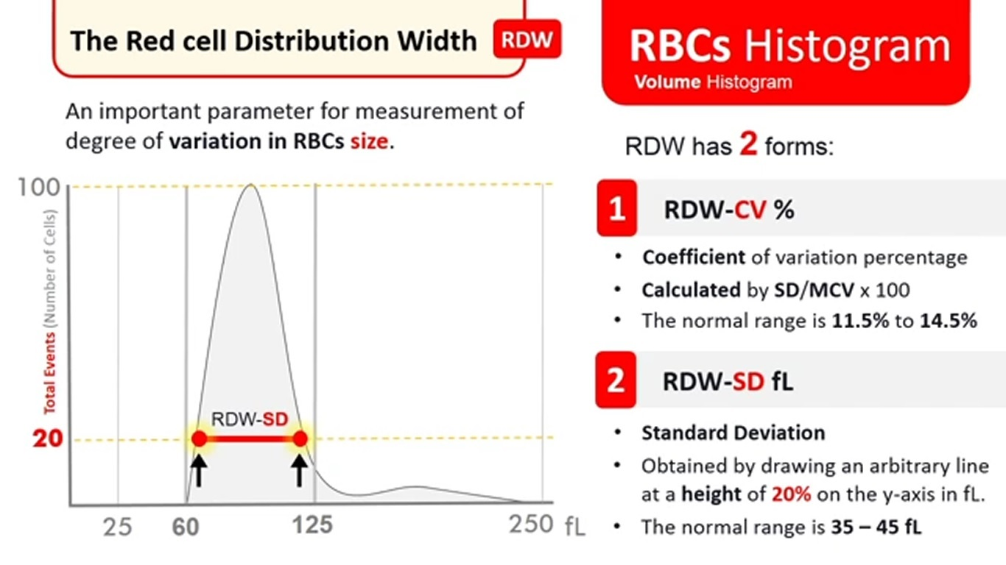
16

Slide 18
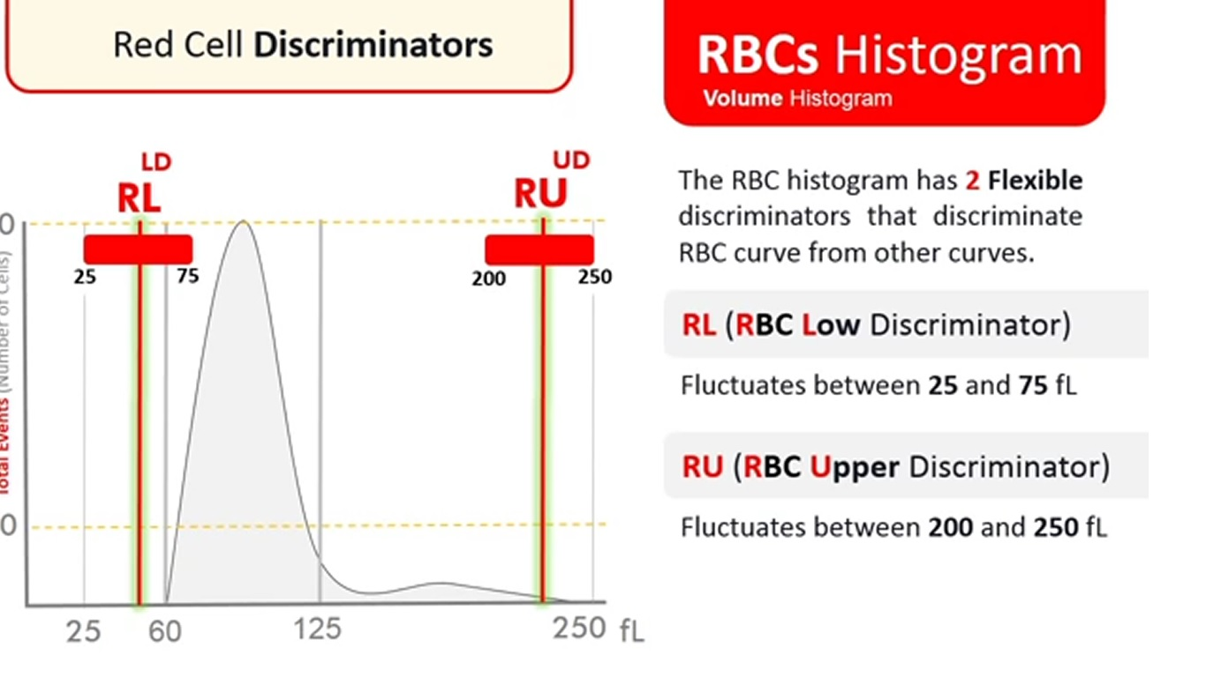
17

Slide 19
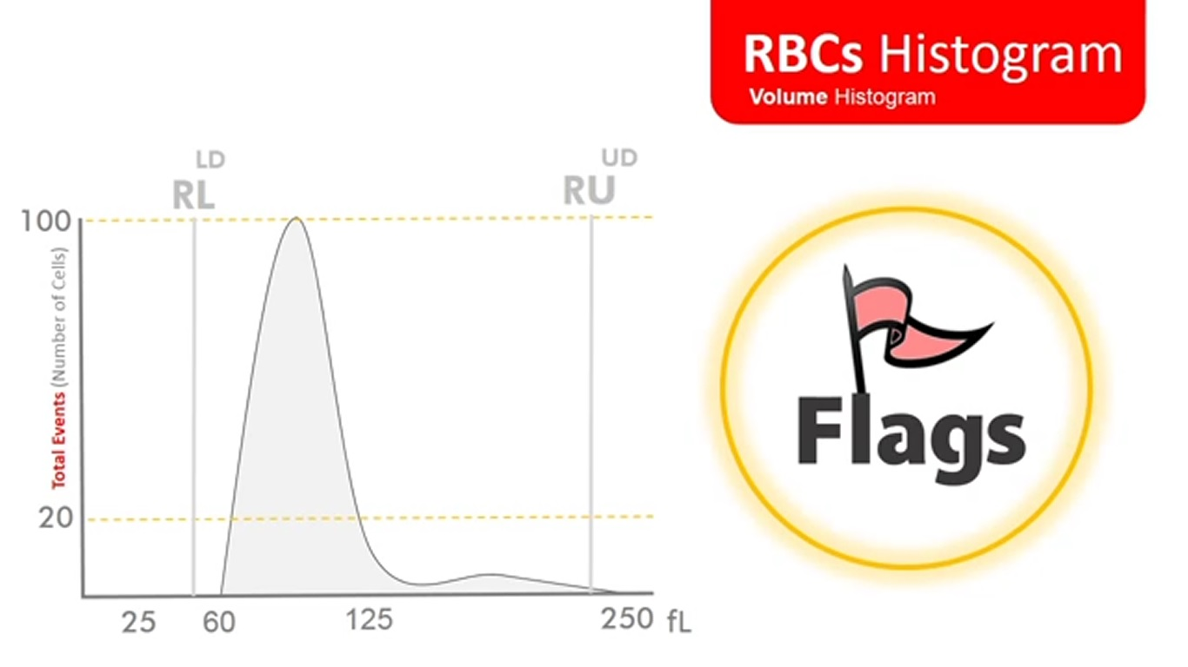
18

Slide 20
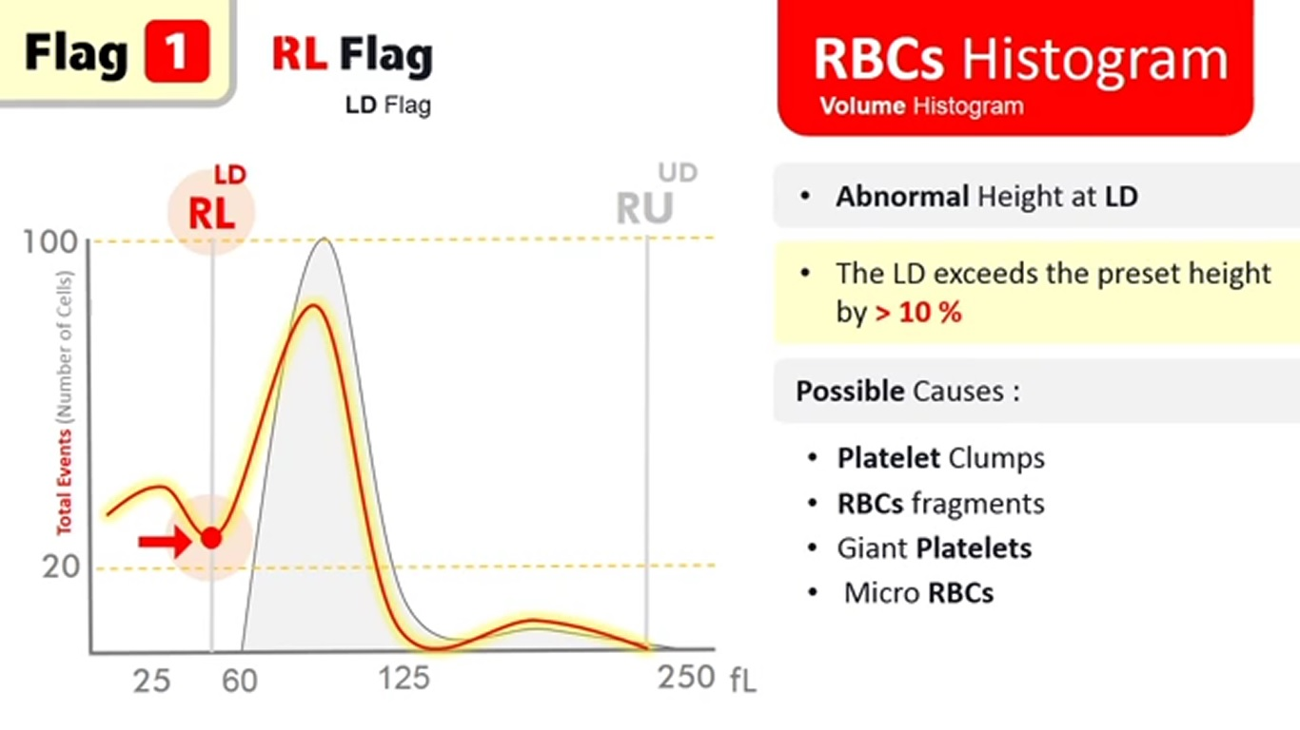
19

Slide 21
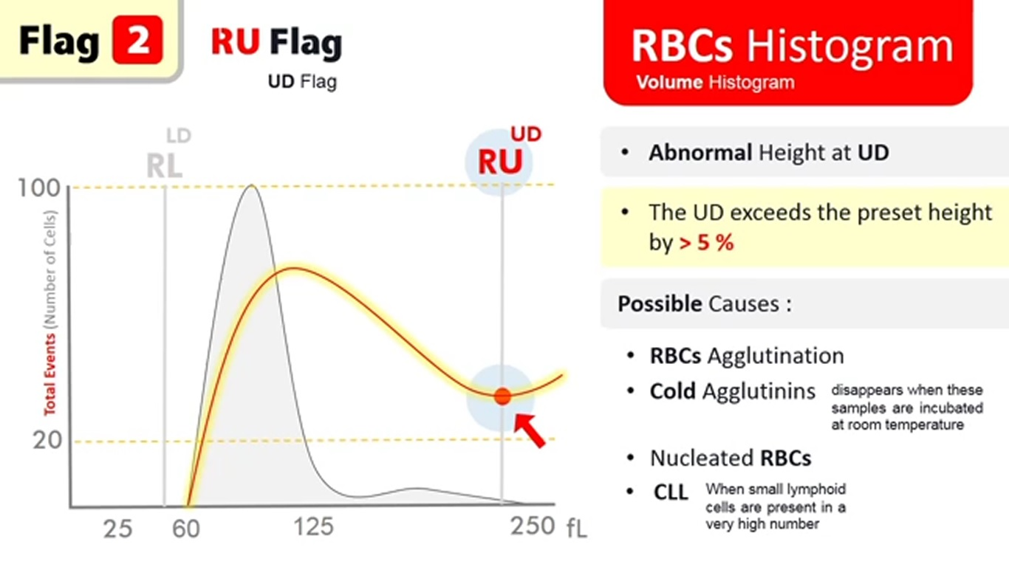
20

Slide 22
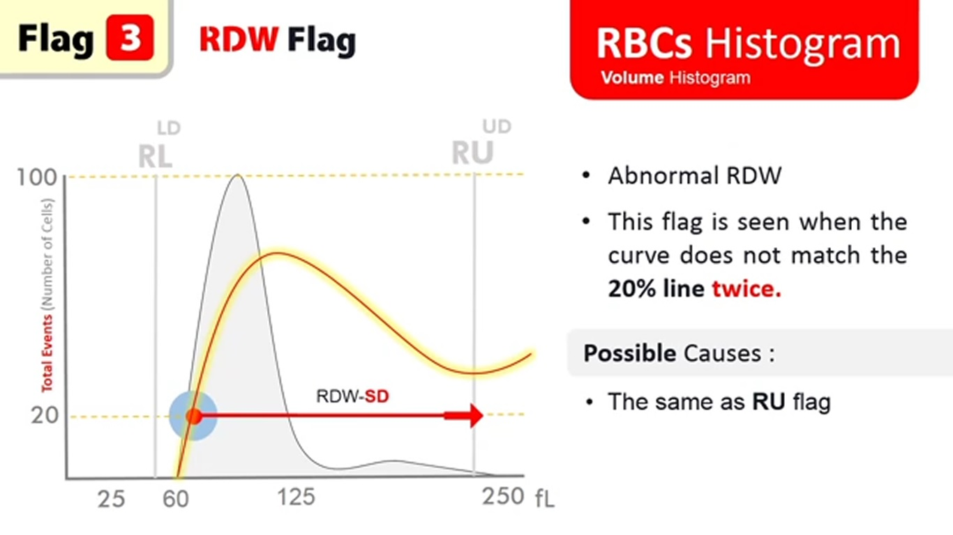
21

Slide 23
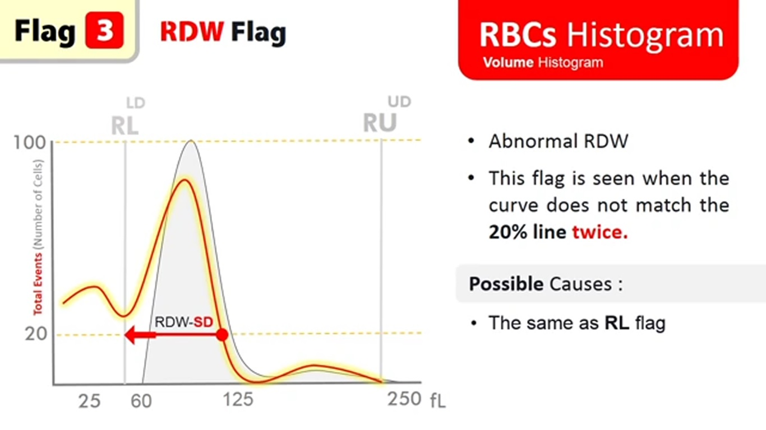
22

Slide 24
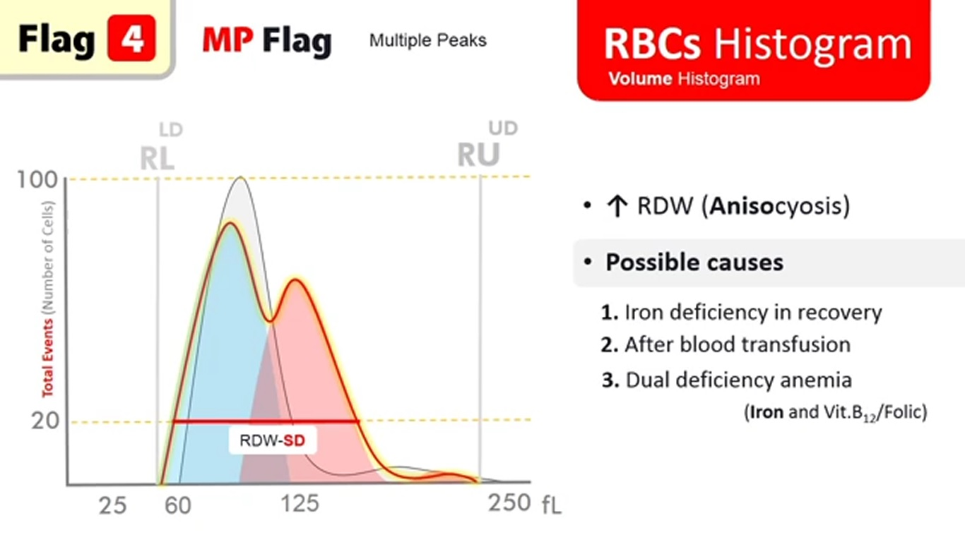
23

Slide 25
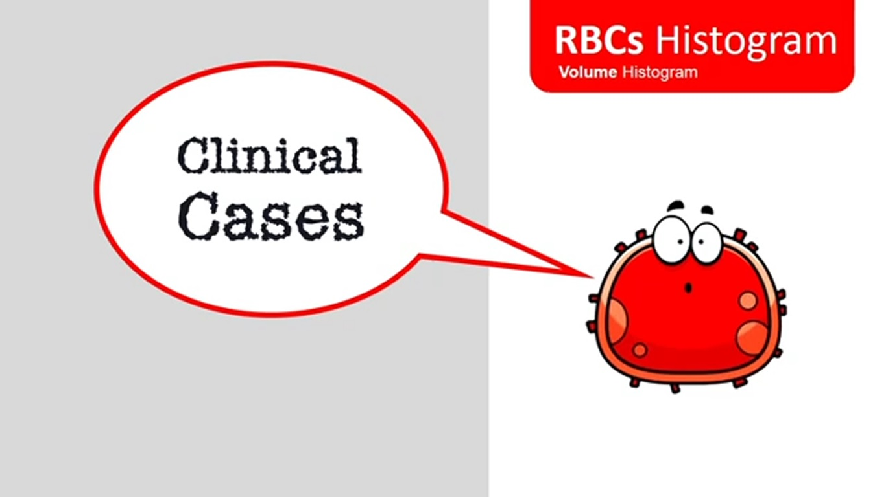
24

Slide 26
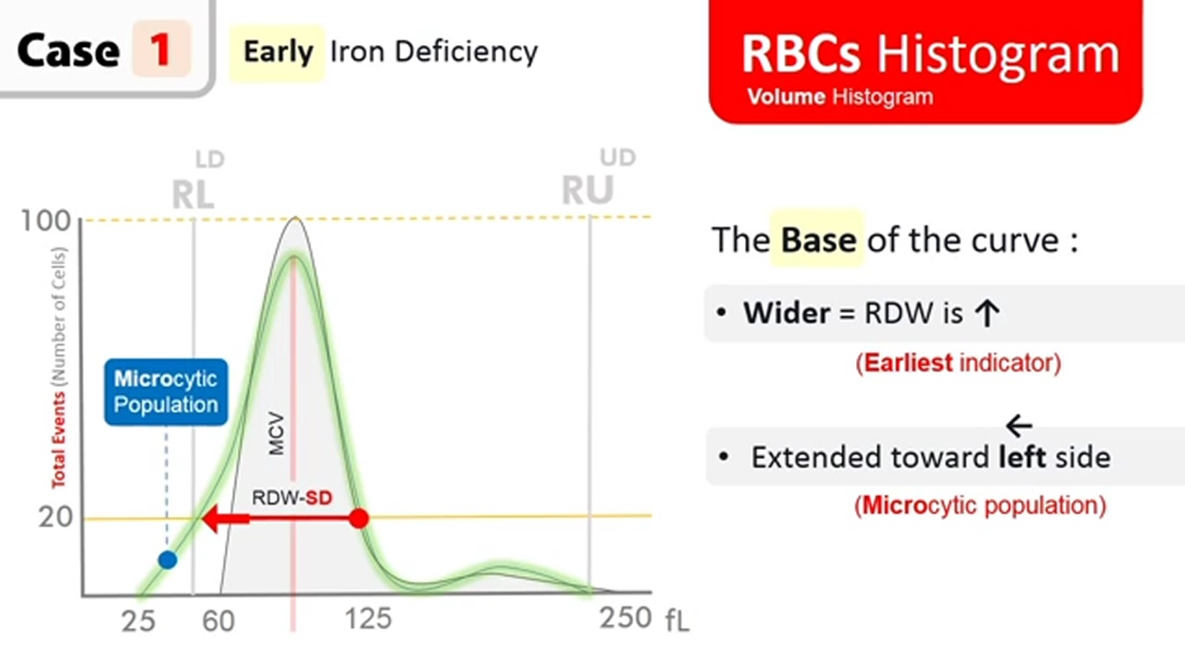
25

Slide 27
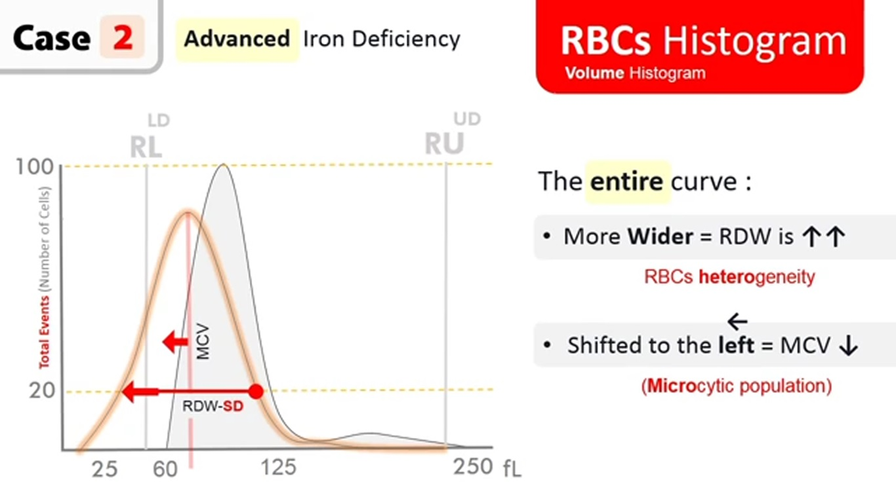
26

Slide 28
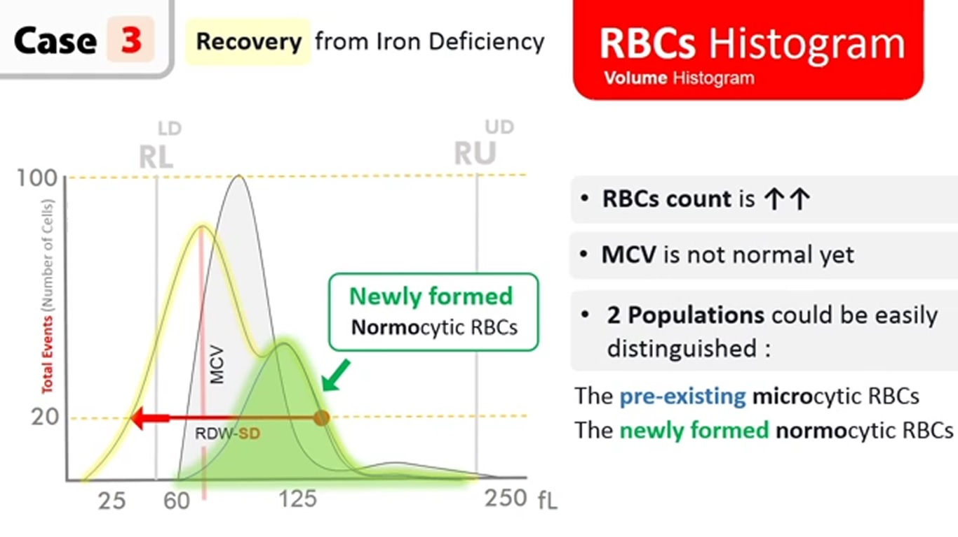
27

Slide 29
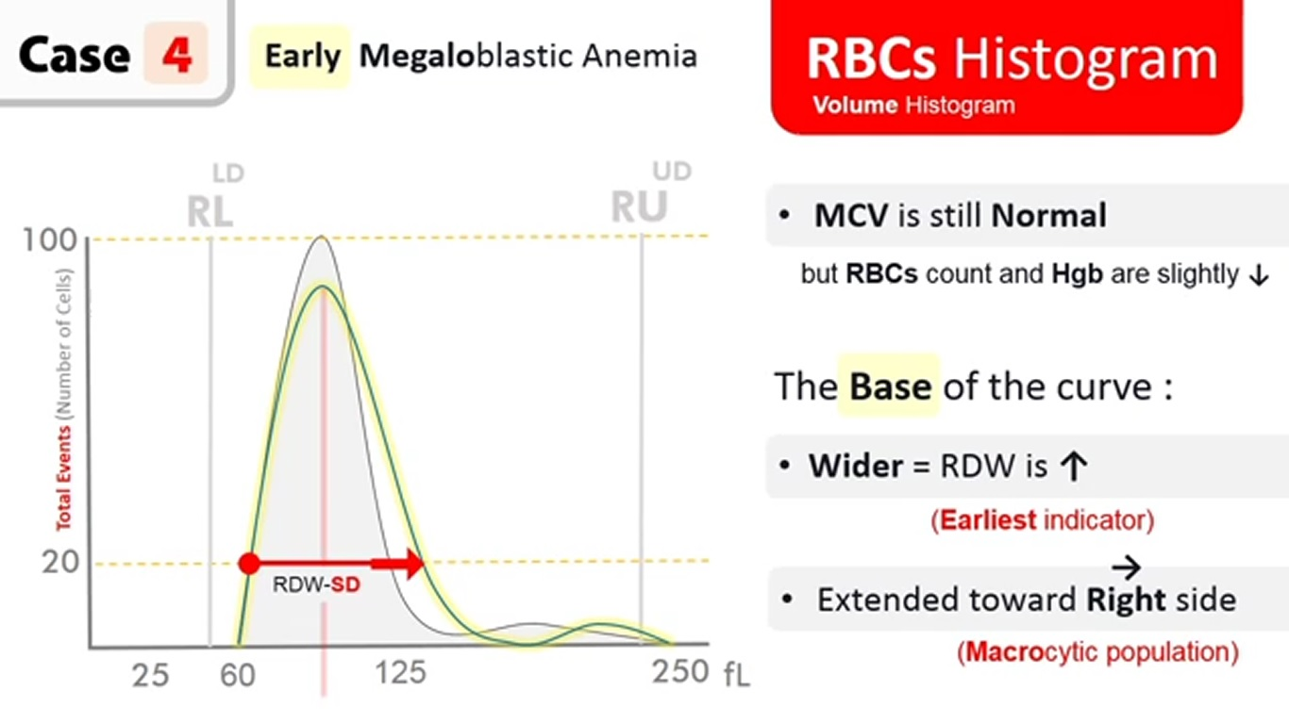
28

Slide 30
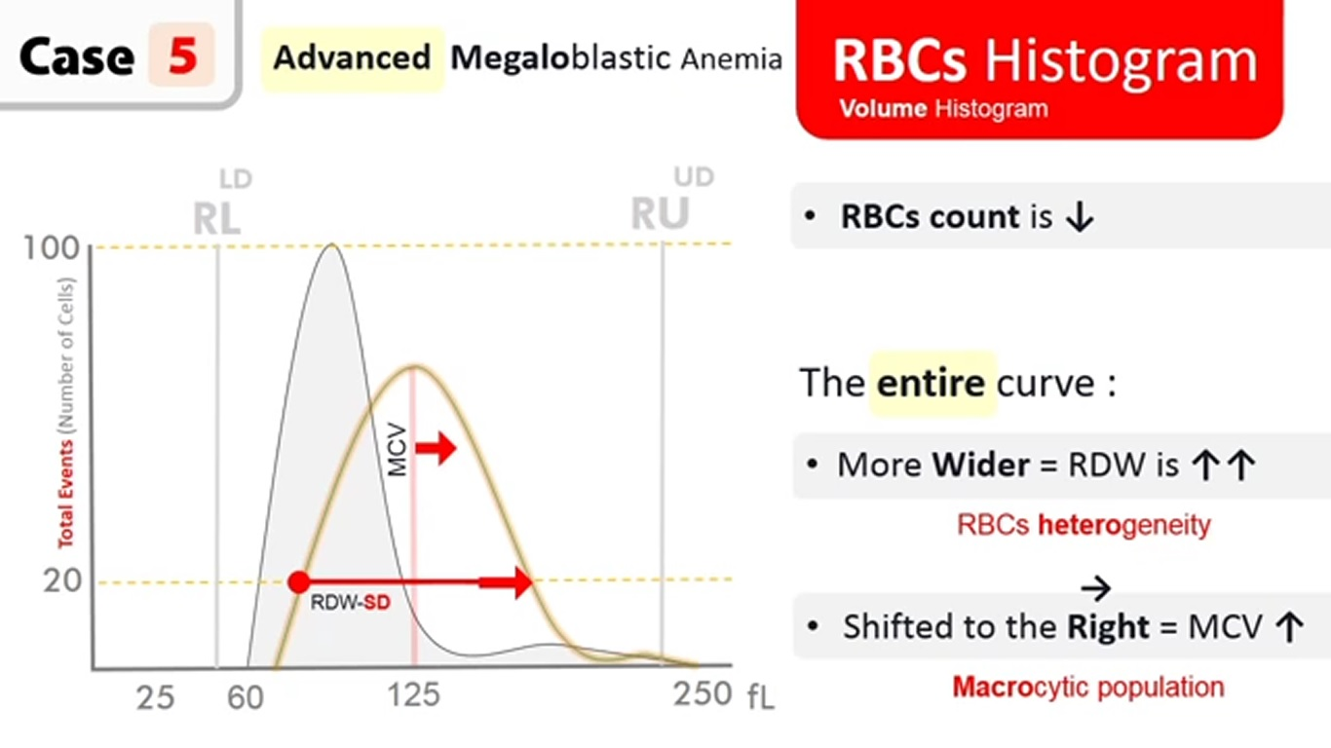
29

Slide 31
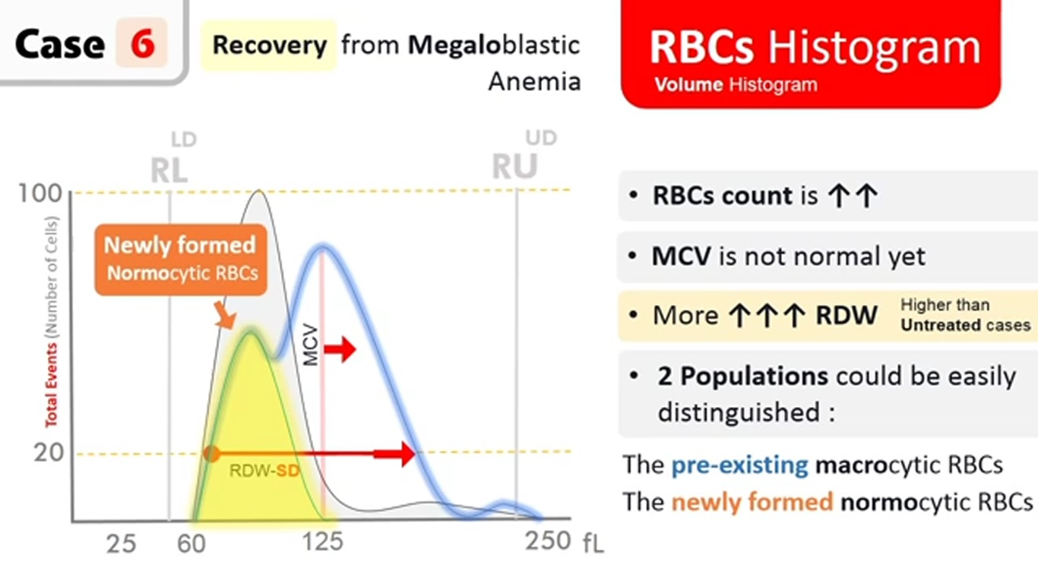
30

Slide 32
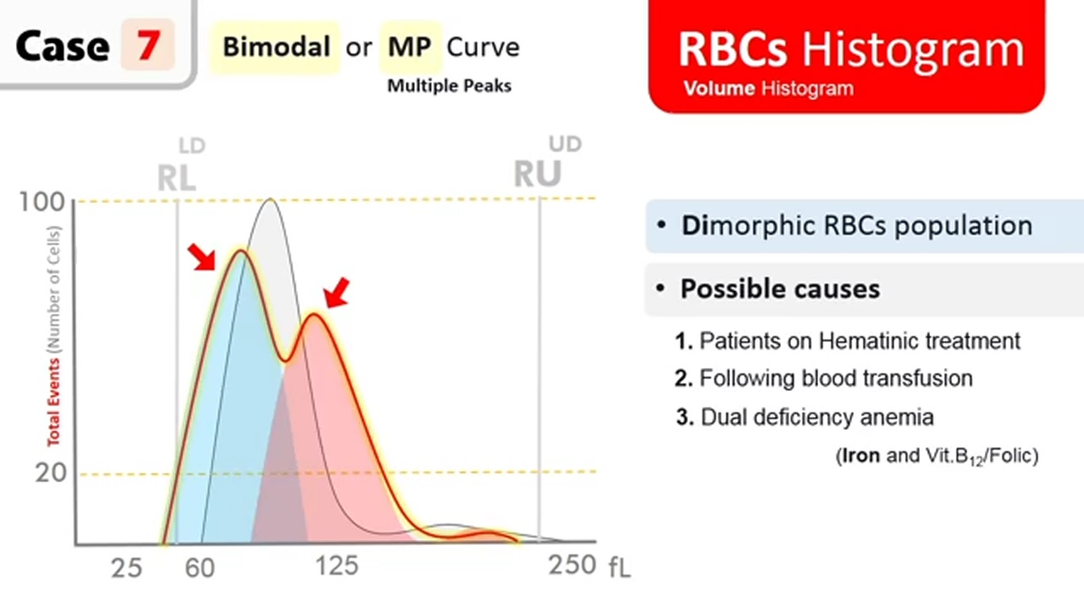
31

Slide 33
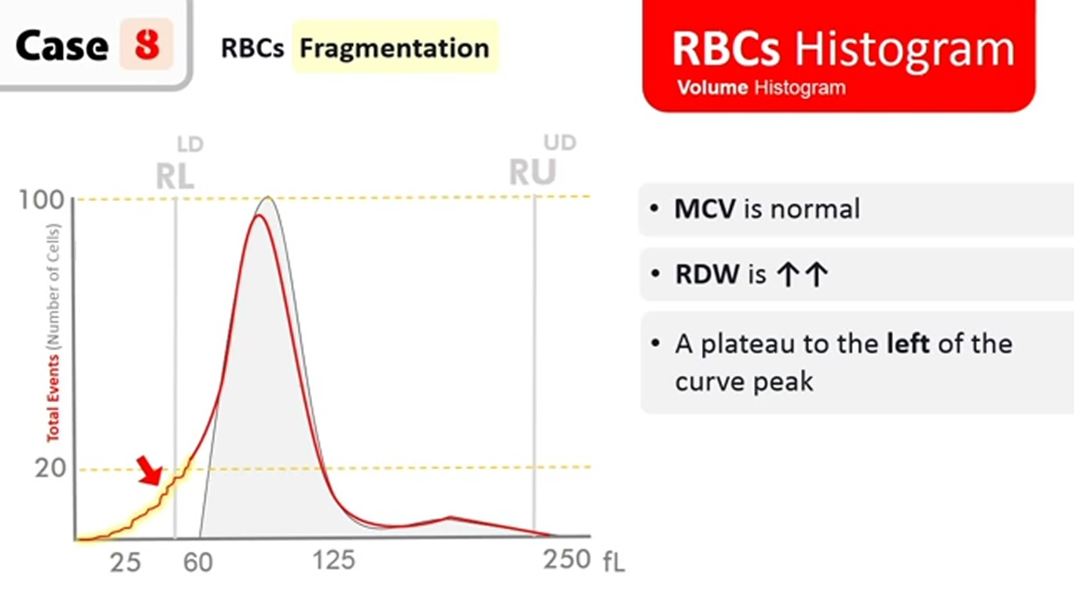
32

Slide 34
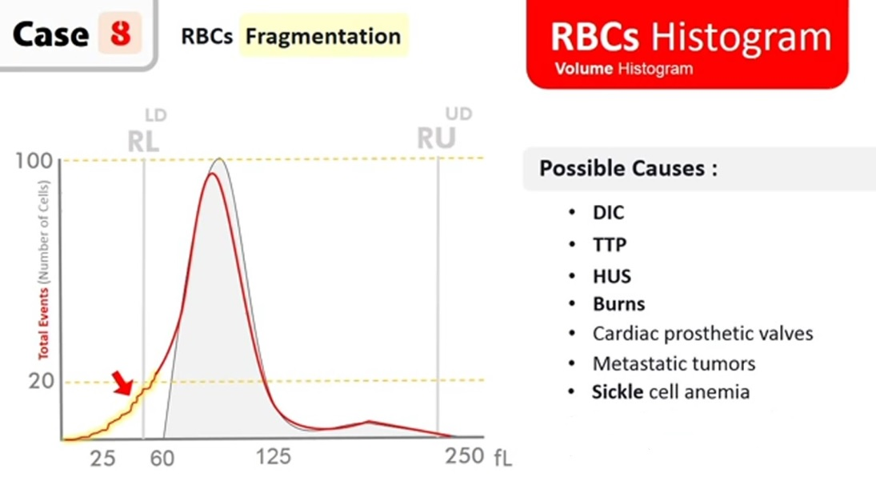
33

Slide 35
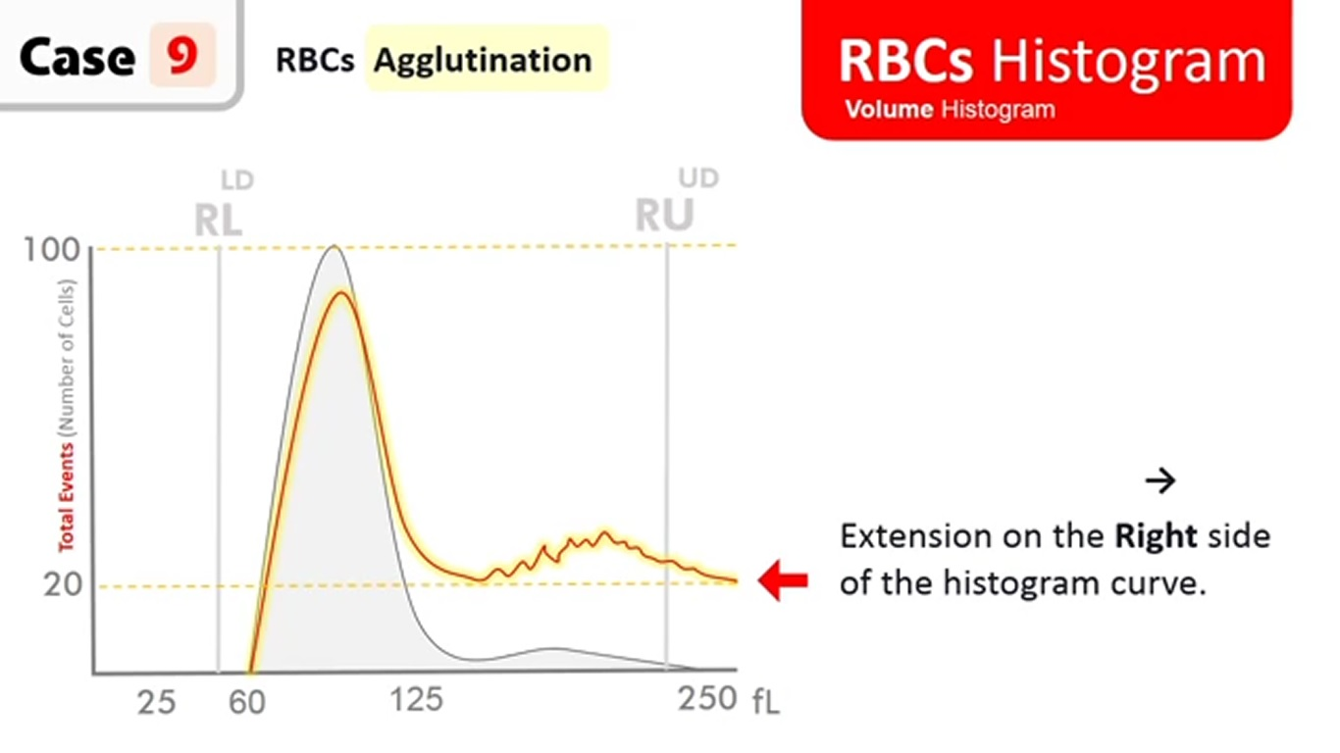
34

Slide 36
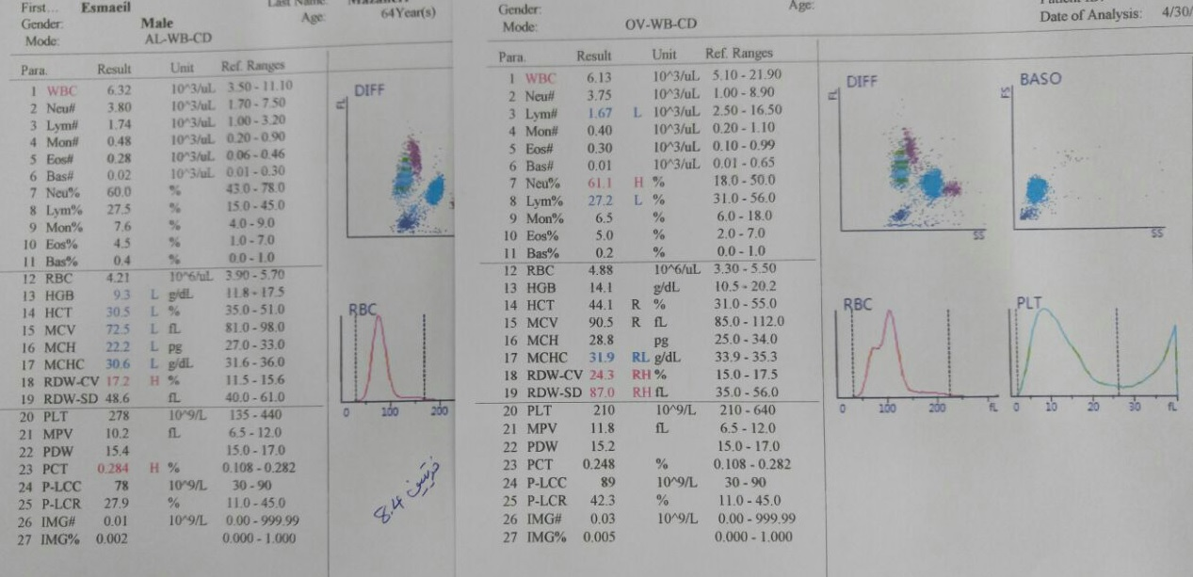
35

Slide 37
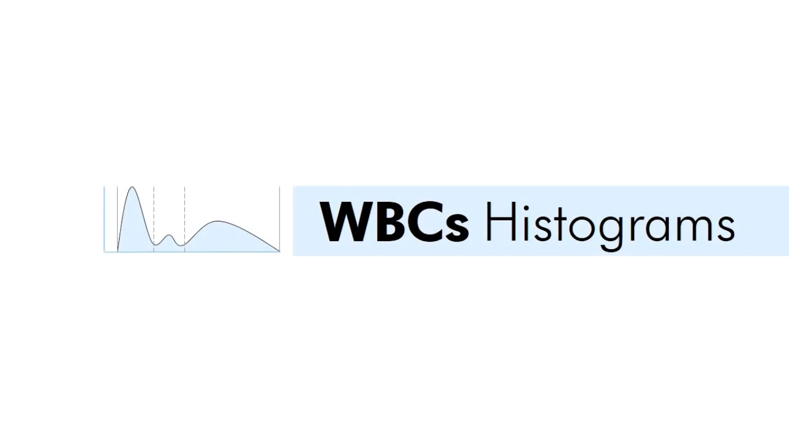
36

Slide 38
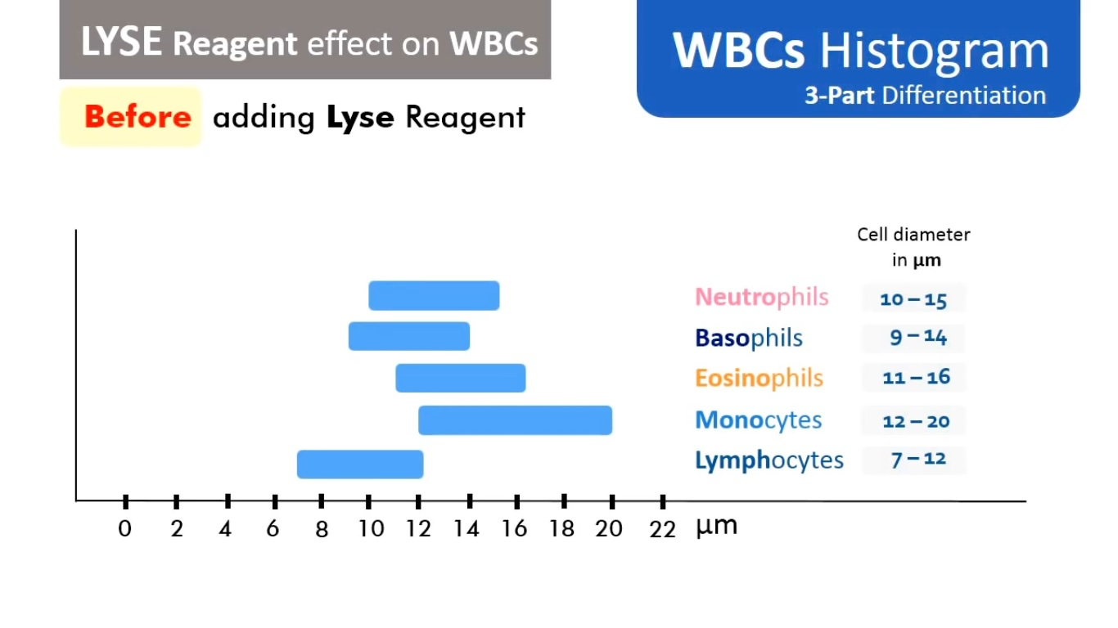
37

Slide 39
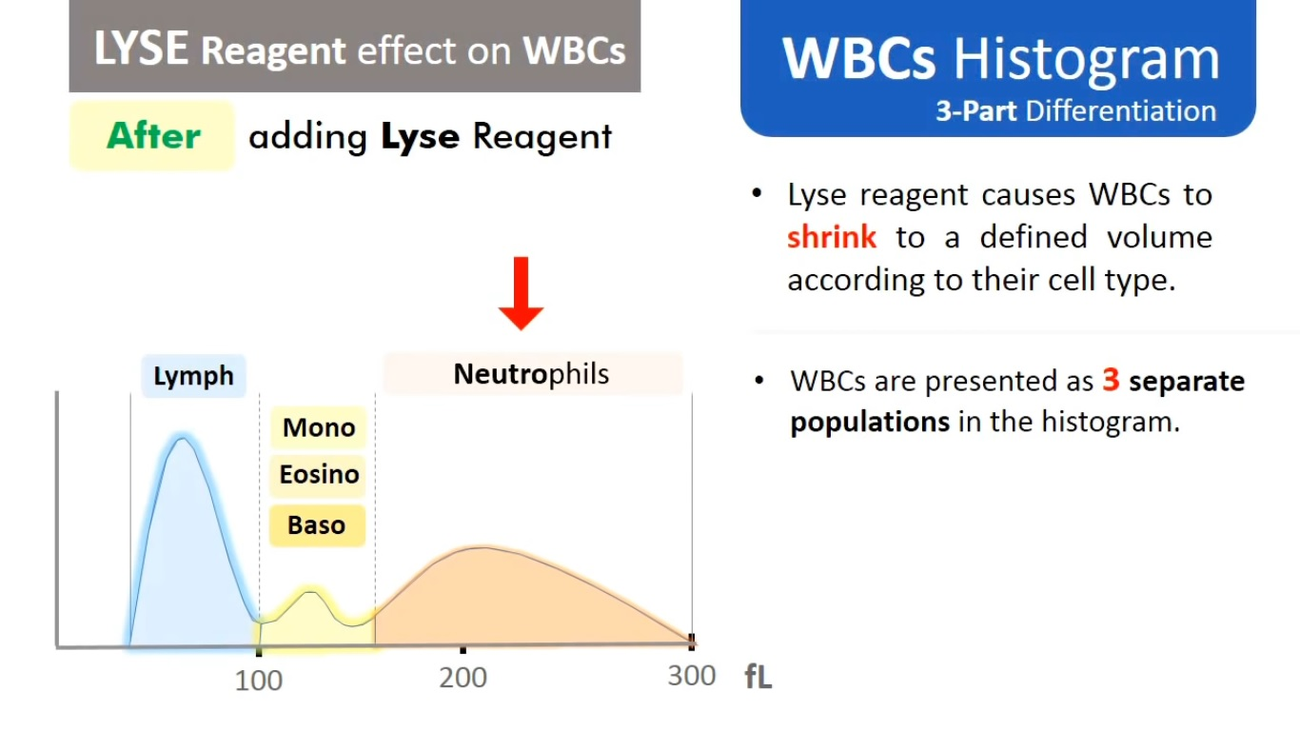
38

Slide 40
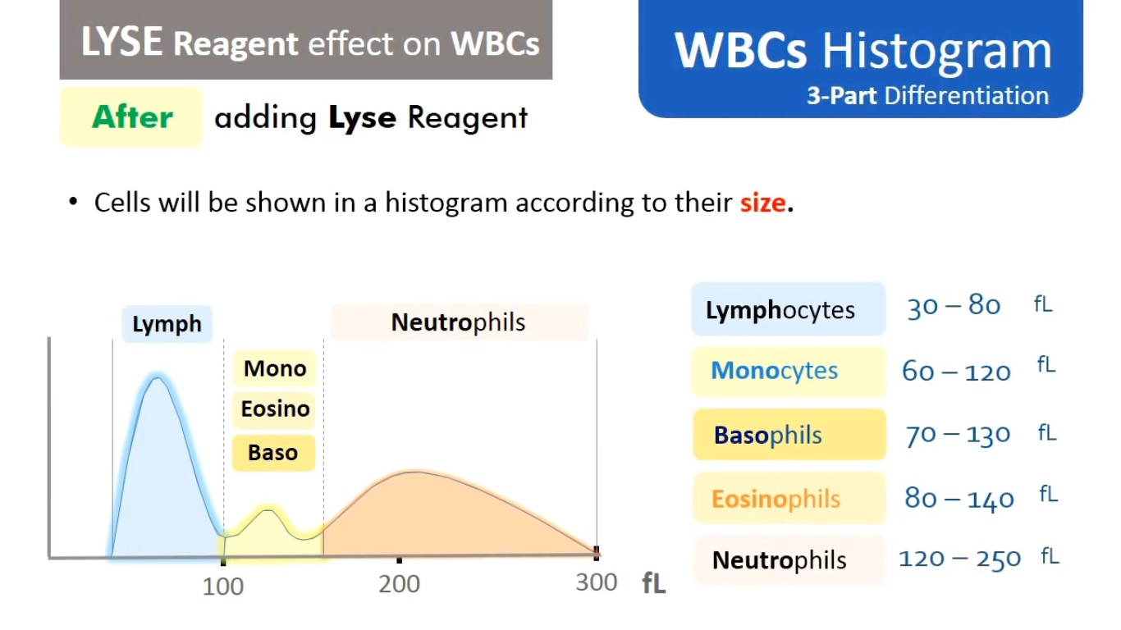
39

Slide 41
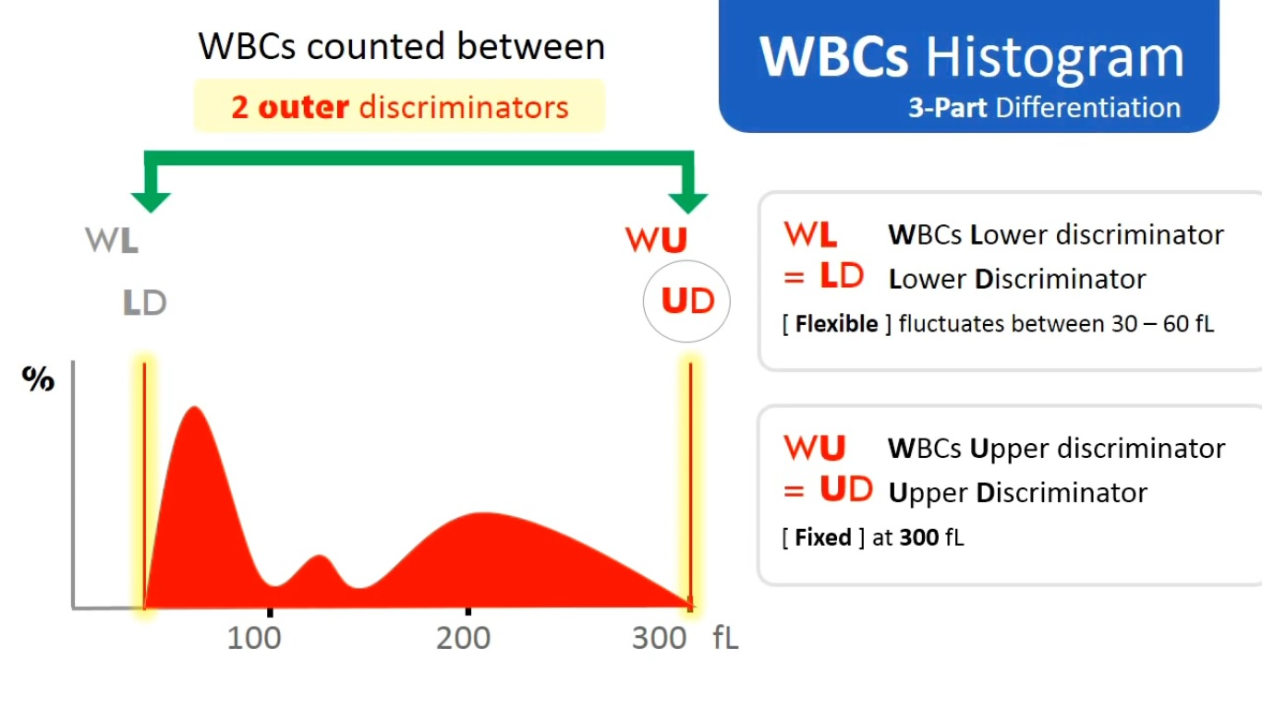
40

Slide 42
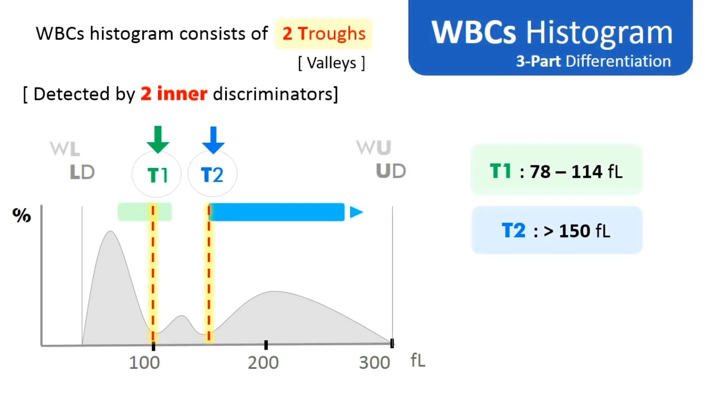
41

Slide 43
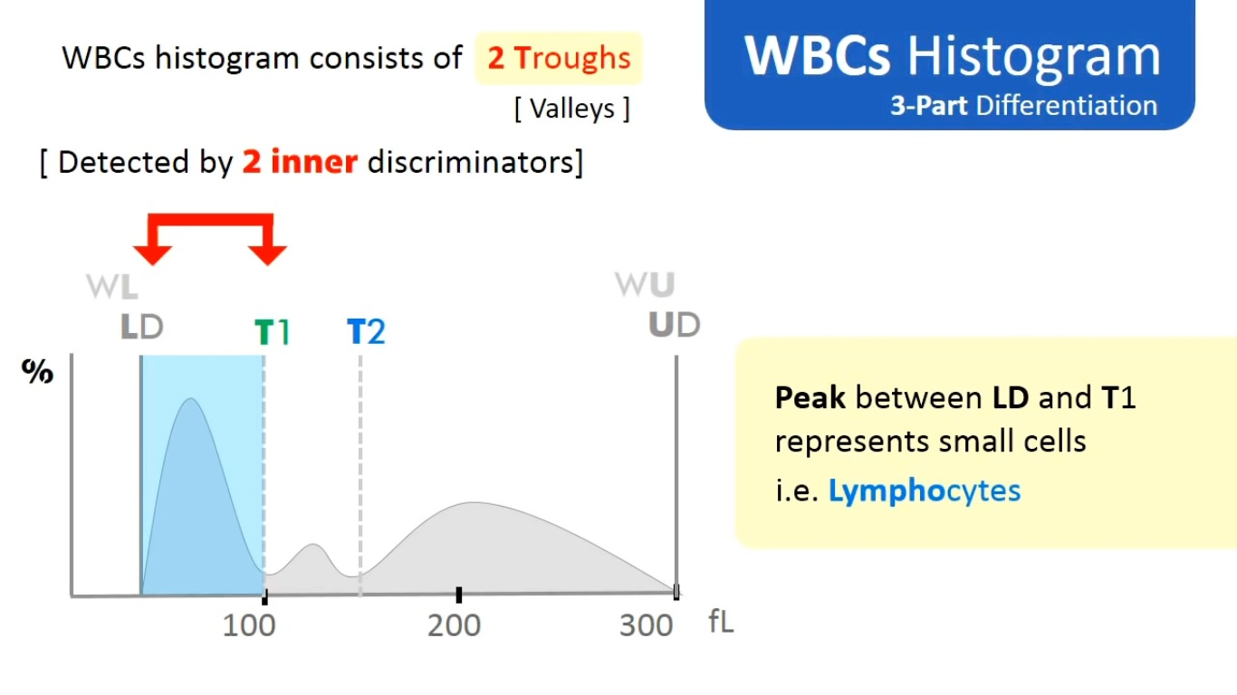
42

Slide 44
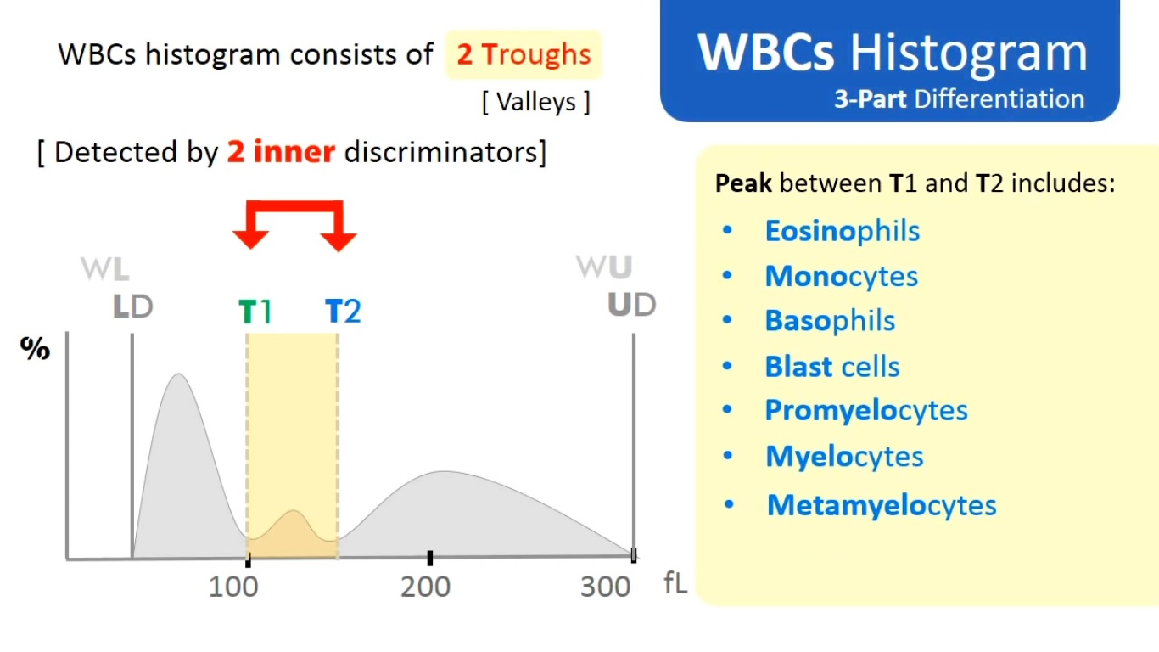
43

Slide 45
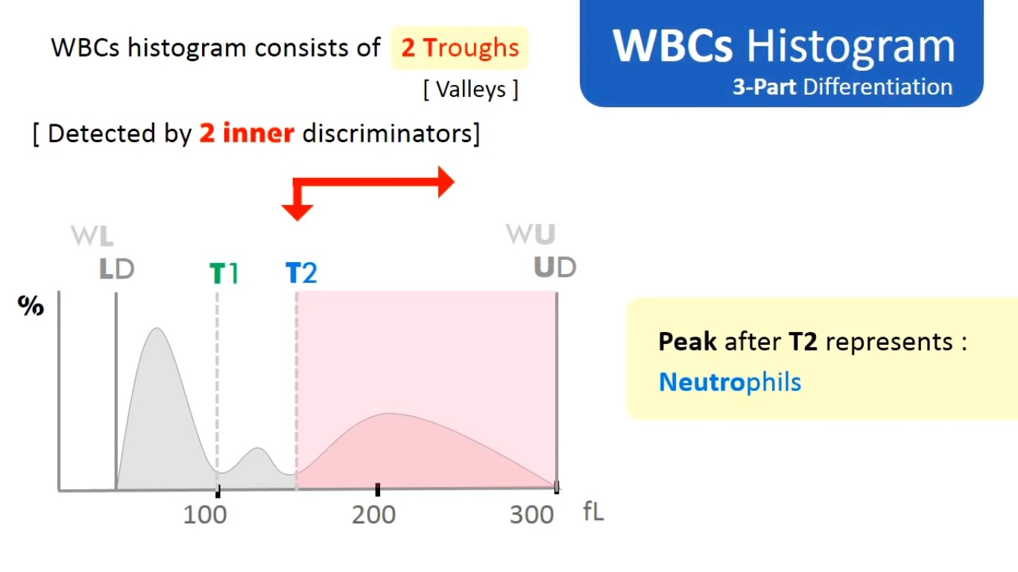
44

Slide 46
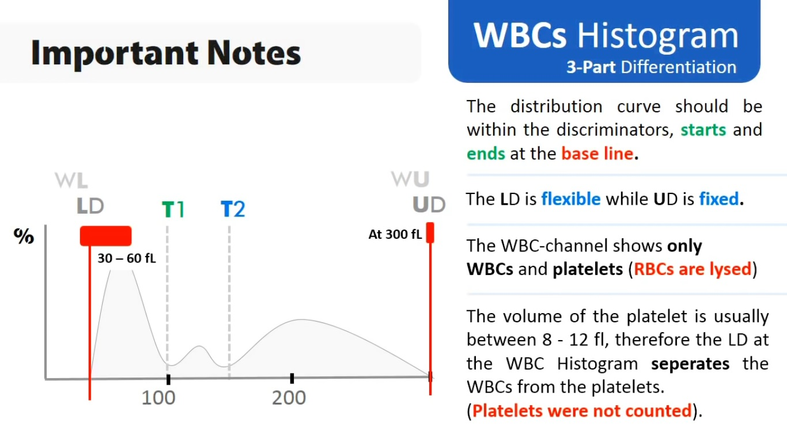
45

Slide 47
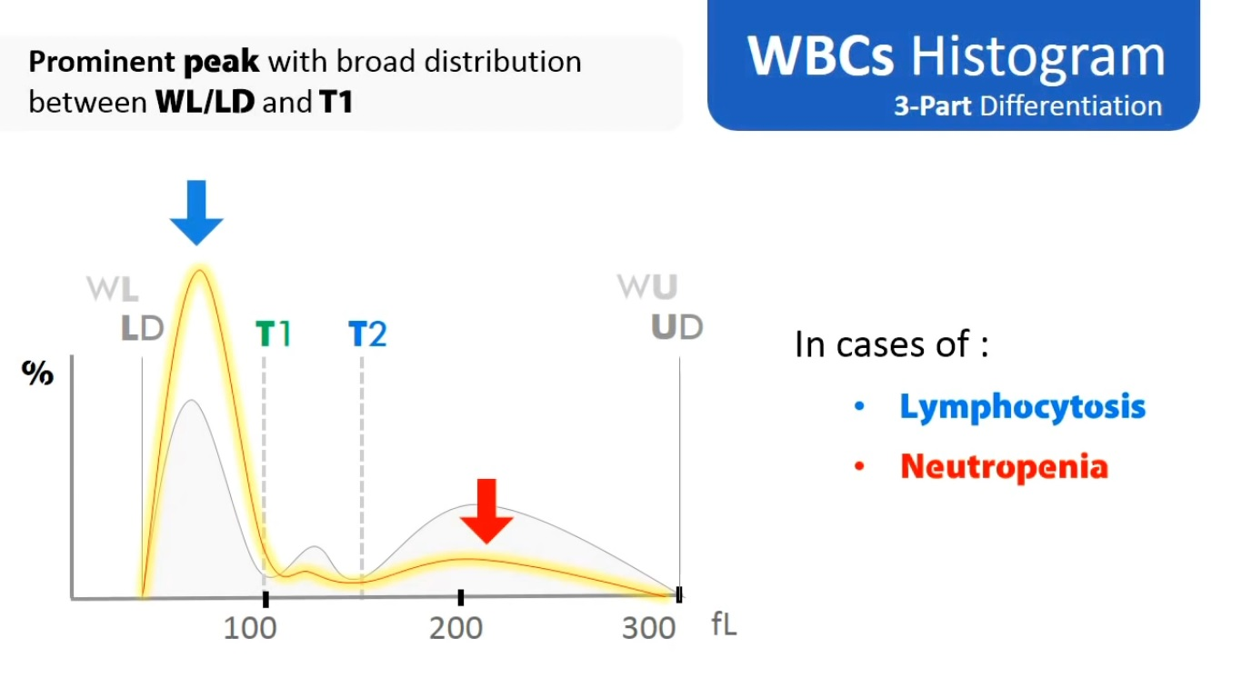
48

Slide 48
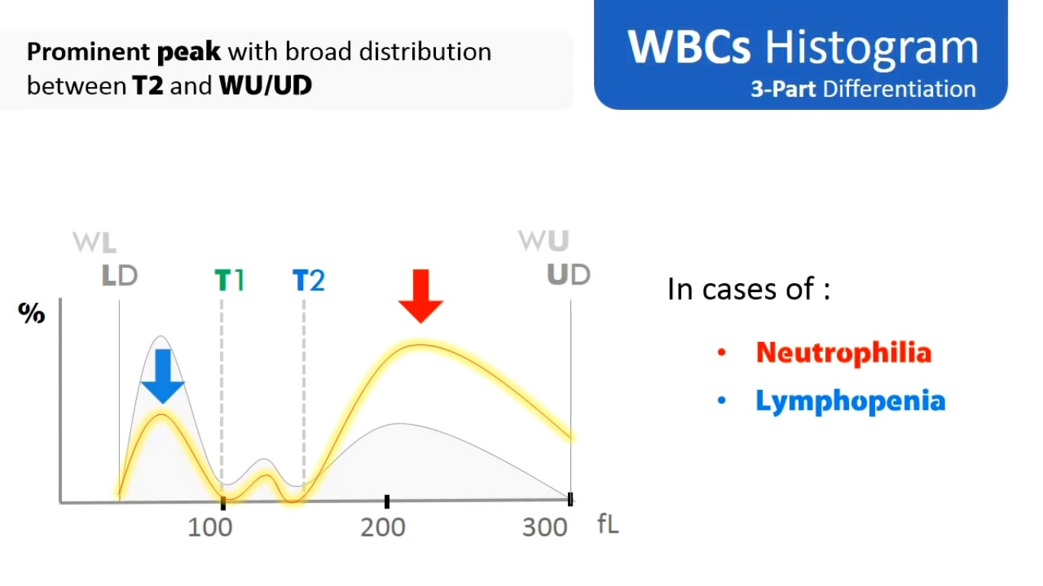
49

Slide 49
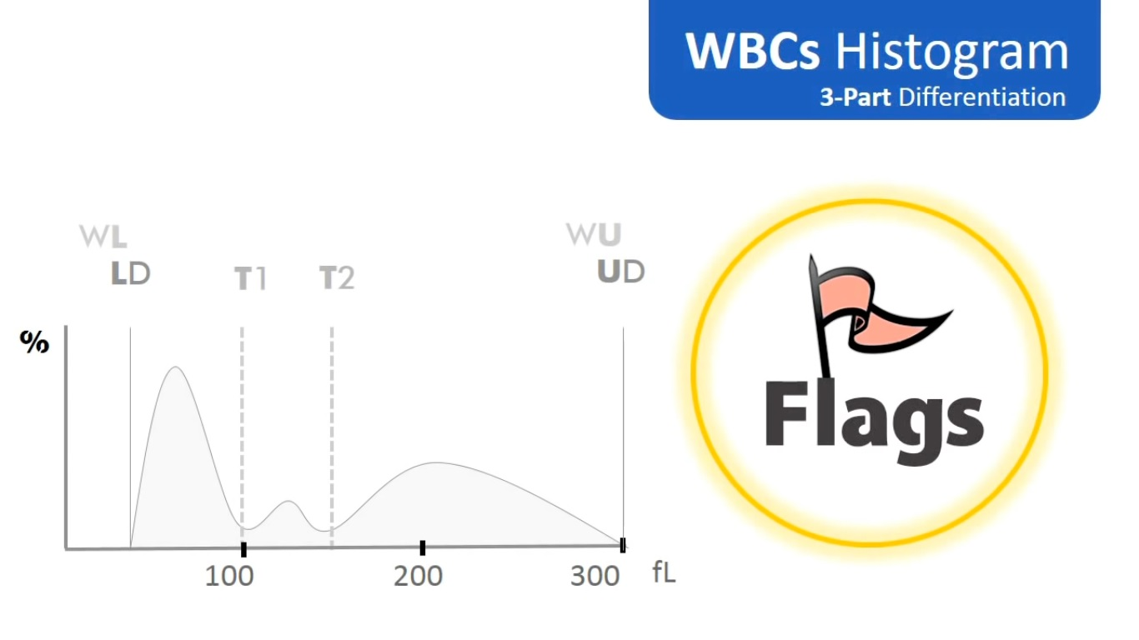
48

Slide 50
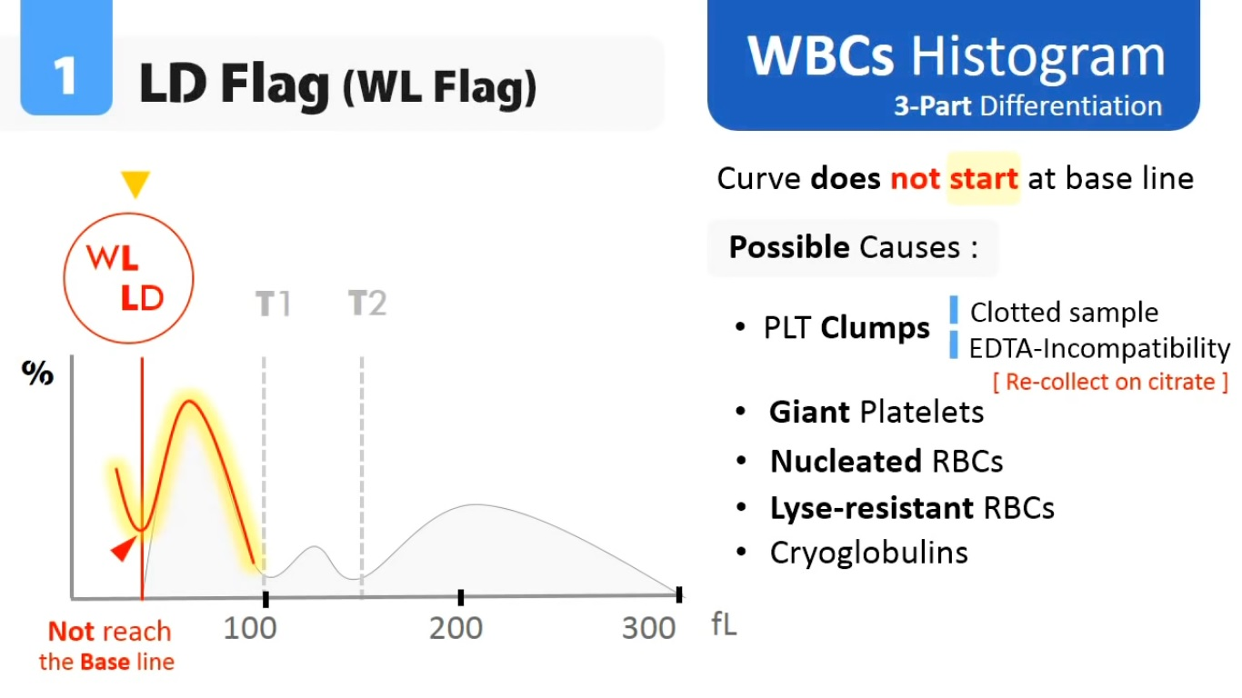
49

Slide 51

50

Slide 52

51

Slide 53

52

Slide 54

53

Slide 55

54

Slide 56


55

Slide 57

56

Slide 58

57

Slide 59

58

Slide 60

59

Slide 61

60

Slide 62

61

Slide 63

62

Slide 64

63

Slide 65

Cell fragments
Contaminated reagent
64

Slide 66

65

Slide 67

66

Slide 68

67

Slide 69


Slide 70

68

Slide 71

69

Slide 72

70

Slide 73

71

Slide 74

72

Slide 75

73

Slide 76

74

Slide 77

75

Slide 78

76

Slide 79

77

Slide 80

78

Slide 81

79

Slide 82

80

Slide 83

Good luck

