Slide 1

Hematology Journal Club
Title:
The 2016 revision to the World Health Organization classification of myeloid neoplasms and acute leukemia
Presented by:
Mehdi kohansal

Slide 2

Introduction (I)

Slide 3
Introduction (II)
this revision has been influenced by several factors including the following:
The discovery of recently identified molecular features
Improved characterization and standardization of morphological
features clinical-pathological studies

Slide 4
Myeloproliferative neoplasms (MPN)
Chronic myeloid leukemia (CML), BCR-ABL11
Chronic neutrophilic leukemia (CNL)
Polycythemia vera (PV)
Primary myelofibrosis (PMF)
PMF, prefibrotic/early stage
PMF, overt fibrotic stage
Essential thrombocythemia (ET)
Chronic eosinophilic leukemia, not otherwise specified (NOS)
MPN, unclassifiable
Mastocytosis

Slide 5
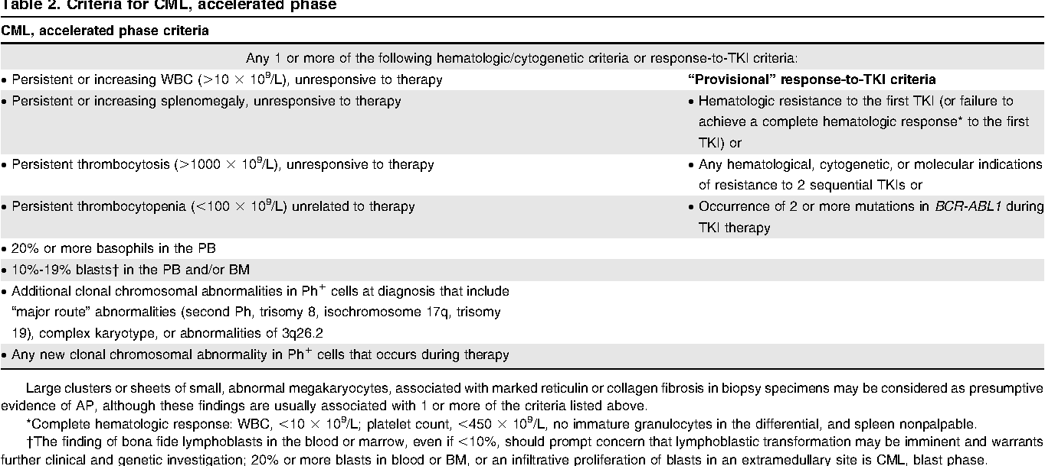

Slide 6
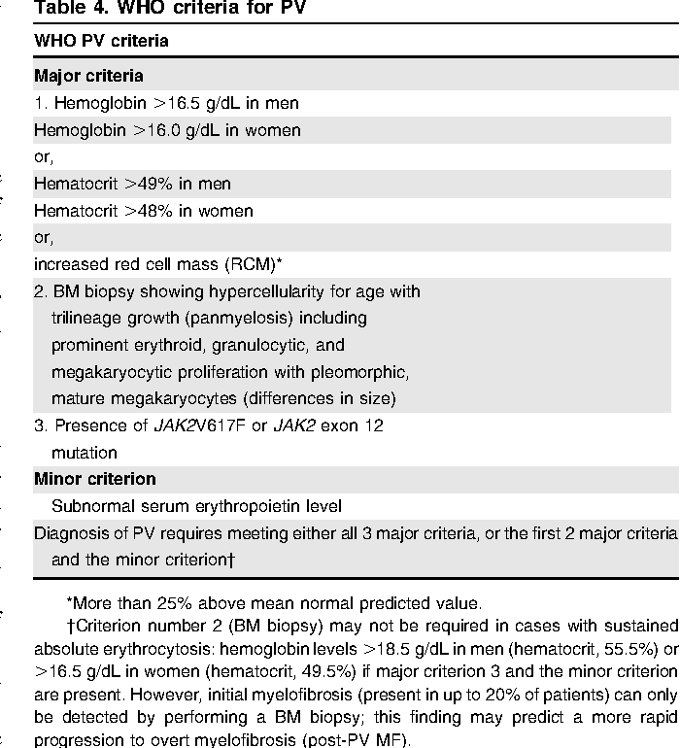

Slide 7
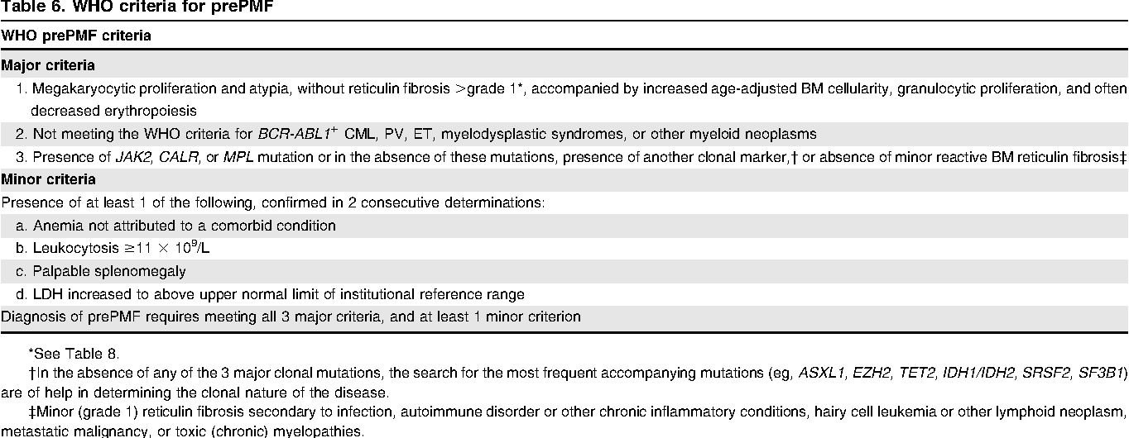

Slide 8
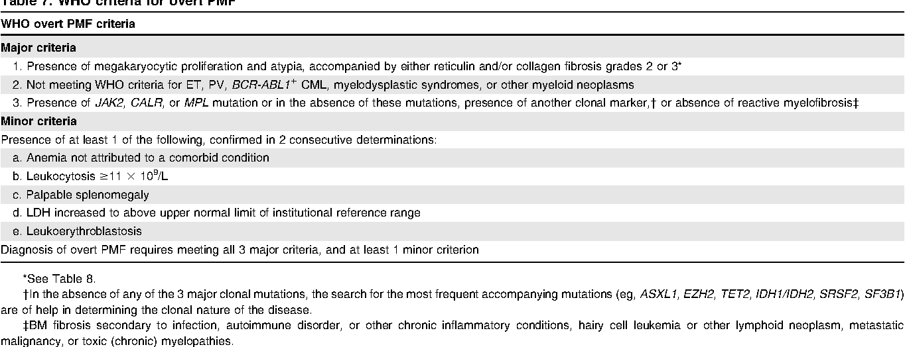

Slide 9
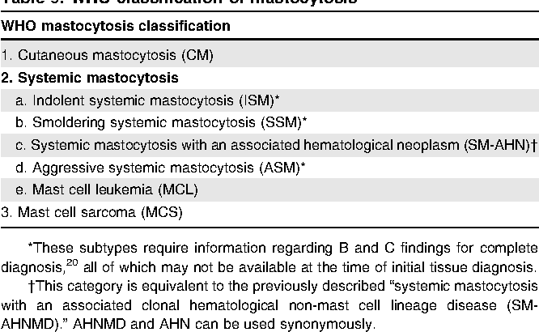
Mastocytosis

Slide 10
Myeloid/lymphoid neoplasms with eosinophilia and rearrangement of PDGFRA, PDGFRB, or FGFR1, or with PCM1-JAK2
Myeloid/lymphoid neoplasms with PDGFRA rearrangement
Myeloid/lymphoid neoplasms with PDGFRB rearrangement
Myeloid/lymphoid neoplasms with FGFR1 rearrangement
Provisional entity: Myeloid/lymphoid neoplasms with PCM1-JAK2

Slide 11
Myeloid/lymphoid neoplasms with PCM1-JAK2
rare entity
Eosinophilia
BM findings:
left-shifted erythroid predominance
lymphoid aggregates
myelofibrosis
rarely present as T- or B-lymphoblastic leukemia
responds to JAK inhibition

Slide 12
Myelodysplastic syndromes (MDS)
MDS with single lineage dysplasia
MDS with ring sideroblasts (MDS-RS)
MDS-RS and single lineage dysplasia
MDS-RS and multilineage dysplasia
MDS with multilineage dysplasia
MDS with excess blasts
MDS with isolated del(5q)
MDS, unclassifiable
Provisional entity: Refractory cytopenia of childhood
Myeloid neoplasms with germ line predisposition

Slide 13
Acute myeloid leukemia (AML) and related neoplasms (I)
AML with recurrent genetic abnormalities
AML with t(8;21)(q22;q22.1);RUNX1-RUNX1T1
AML with inv(16)(p13.1q22) or t(16;16)(p13.1;q22);CBFB-MYH11
APL with PML-RARA
AML with t(9;11)(p21.3;q23.3);MLLT3-KMT2A
AML with t(6;9)(p23;q34.1);DEK-NUP214
AML with inv(3)(q21.3q26.2) or t(3;3)(q21.3;q26.2); GATA2, MECOM
AML (megakaryoblastic) with t(1;22)(p13.3;q13.3);RBM15-MKL1
Provisional entity: AML with BCR-ABL1
AML with mutated NPM1
AML with biallelic mutations of CEBPA
Provisional entity: AML with mutated RUNX1
AML with myelodysplasia-related changes
Therapy-related myeloid neoplasms

Slide 14
Acute myeloid leukemia (AML) and related neoplasms (II)
AML, NOS
AML with minimal differentiation
AML without maturation
AML with maturation
Acute myelomonocytic leukemia
Acute monoblastic/monocytic leukemia
Pure erythroid leukemia
Acute megakaryoblastic leukemia
Acute basophilic leukemia
Acute panmyelosis with myelofibrosis
Myeloid sarcoma
Myeloid proliferations related to Down syndrome
Transient abnormal myelopoiesis (TAM)
Myeloid leukemia associated with Down syndrome

Slide 15
AML with BCR-ABL1
BCR-ABL mutation in AML-NOS,CBF leukemia,AML with myelodysplastic changes
Lack of clinical and laboratory features of CML like splenomegaly,basophilia,…
Mostly expresses p210 BCR-ABL transcript
Distinguish from CML blastic phase: 1.IKZF1 2.CDKN2A
Treatment: AML chemotherapy with TKI like imitanib

Slide 16
AML with mutated RUNX1
de novo AML that are not associated with MDS-related cytogenetic abnormalities
The majority were classified as M1 and M2 according to FAB
Strong associations to trisomy 13,mutation in splicesome coding gene,chromatin modifiers
Worse prognosis than other AML types

Slide 17
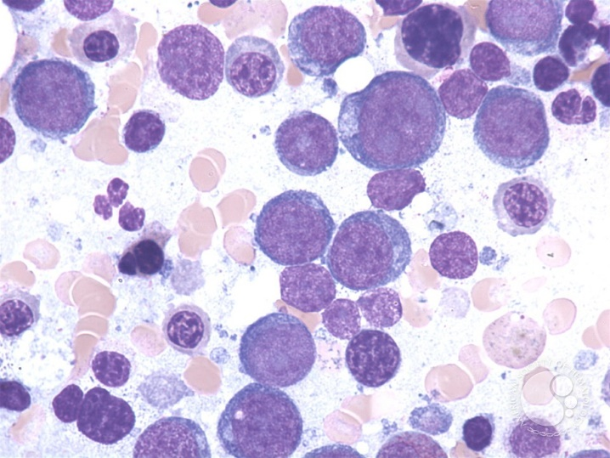
AML NOS
NOS subcategories has only one single change:
the subcategory of acute erythroid leukemia is no longer an aml
Pure erythroid leukemia remains as an AML, NOS subtype and is now the only type of acute erythroid leukemia

Slide 18
B-lymphoblastic leukemia/lymphoma
B-lymphoblastic leukemia/lymphoma, NOS
B-lymphoblastic leukemia/lymphoma with recurrent genetic abnormalities
B-lymphoblastic leukemia/lymphoma with t(9;22)(q34.1;q11.2);BCR-ABL1
B-lymphoblastic leukemia/lymphoma with t(v;11q23.3);KMT2A rearranged
B-lymphoblastic leukemia/lymphoma with t(12;21)(p13.2;q22.1); ETV6-RUNX1
B-lymphoblastic leukemia/lymphoma with hyperdiploidy
B-lymphoblastic leukemia/lymphoma with hypodiploidy
B-lymphoblastic leukemia/lymphoma with t(5;14)(q31.1;q32.3) IL3-IGH
B-lymphoblastic leukemia/lymphoma with t(1;19)(q23;p13.3);TCF3-PBX1
Provisional entity: B-lymphoblastic leukemia/lymphoma, BCR-ABL1–like
Provisional entity: B-lymphoblastic leukemia/lymphoma with iAMP21

Slide 19
B-lymphoblastic leukemia/lymphoma, BCR-ABL1–like
B-ALL with translocations involving tyrosine kinases or cytokine receptors
childhood ALL with gene expression similar to ALL with BCR-ABL1
activation of EPOR
involving the cytokine receptor-like factor 2 (CRLF2)
involve many different genes including ABL1, ABL2, PDGFRB,JAK2,..

Slide 20
B-lymphoblastic leukemia/lymphoma with iAMP21
B-ALL with intrachromosomal amplification of chromosome 21
detected by FISH with a probe for the RUNX1 gene
It occurs in about 2% of children with ALL, especially children with low WBC counts
uncommon in adults

Slide 21
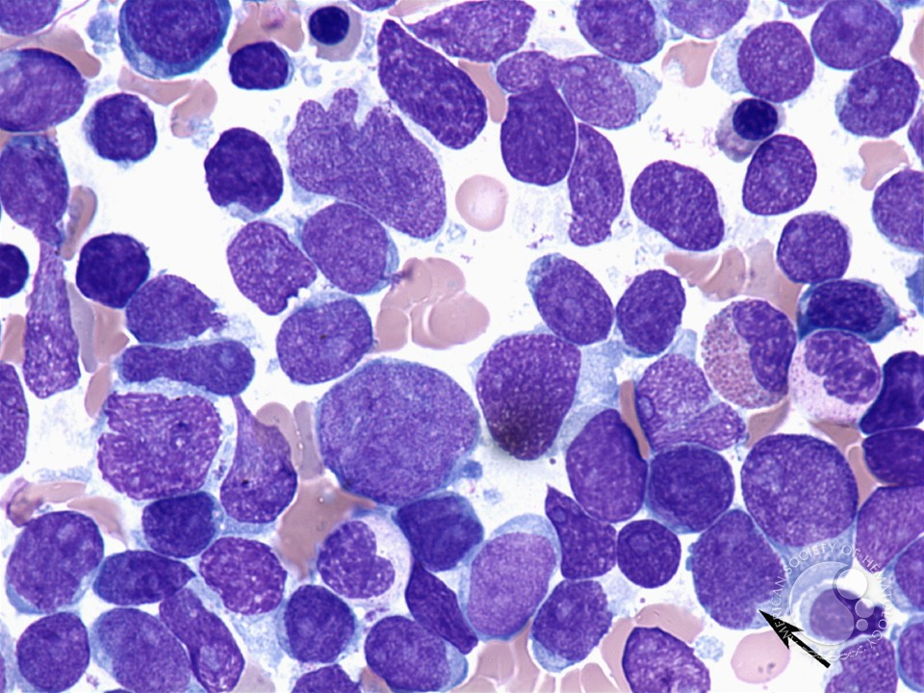
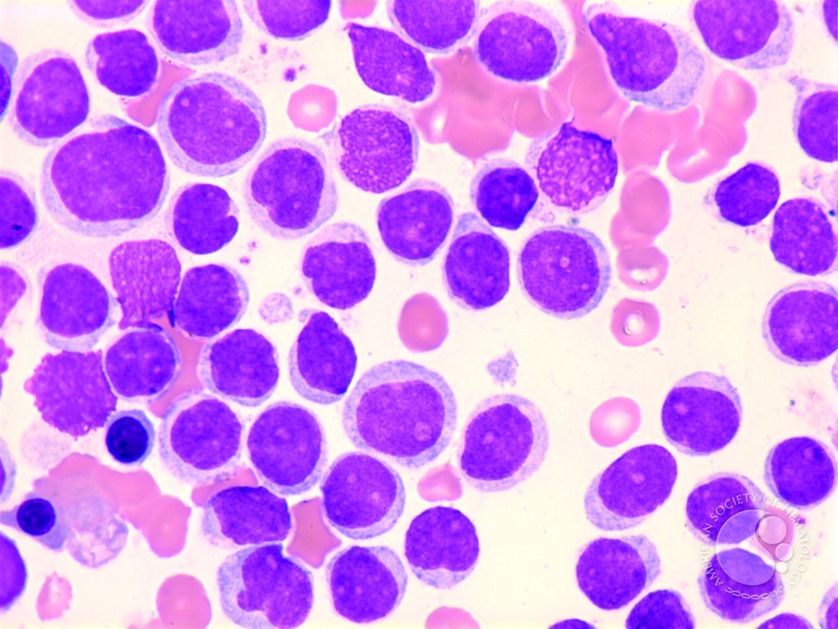
T-lymphoblastic leukemia/lymphoma
Provisional entity: Early T-cell precursor lymphoblastic leukemia
Provisional entity: Natural killer (NK) cell lymphoblastic leukemia/lymphoma

Slide 22
Natural killer (NK) cell lymphoblastic leukemia/lymphoma
Defined as Acute leukemia of ambiguous lineage in 2008 classification
Expressing CD56 along CD2,CD7
Absence of B-cell and myeloid markers
Phenotype identical to Acute myeloid leukemia with minimal differentiation

Slide 23
Indolent T-lymphoblastic proliferation
Nonneoplastic entity that may mimic T-lymphoblastic lymphoma
Involves lymphoid tissue of the upper aerodigestive tract
Distinguish from T-lymphoblastic lymphoma:
nonaberrant phenotype
the proliferations are not clonal

Slide 24
Early T-cell precursor lymphoblastic leukemia
blasts in ETP ALL express CD7 but lack CD1a andCD8
positive for 1 or more of the myeloid/stem cell markers:
Express CD2 and cytoplasmic CD3 and may express CD4
Myeloid associated gene mutations have high frequency
mutations in NOTCH1 or CDKN1/2 are infrequent

Slide 25


