Slide 1
IN THE NAME OF GOD
Kerman University of Medical Sciences
Mahla satarzadeh

Slide 2



Artificial Blood is a bad news for vampires…

Slide 3

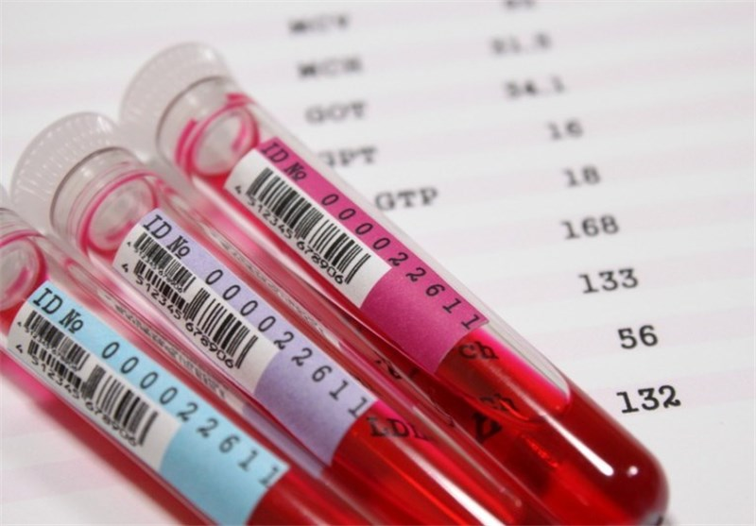
Artificial
Blood
Substitutes

Slide 4
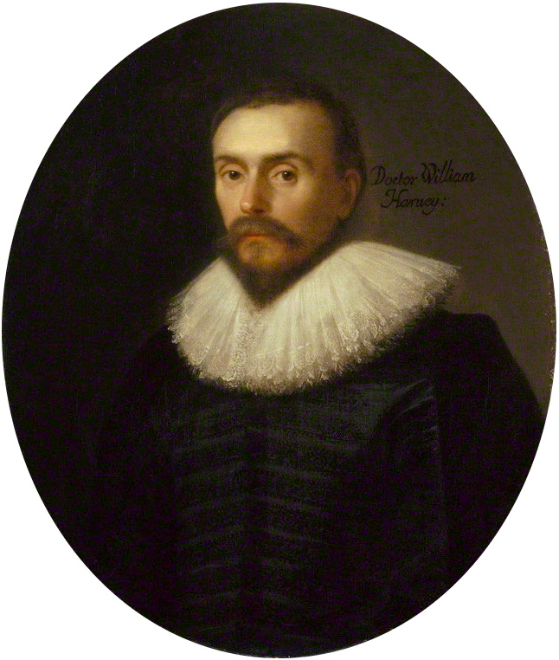
Introduction
Being alive is impossible without blood, the complex liquid containing millions of chemicals and cells.
When William Harvey for the first time described blood circulation, scientists started to think about a proper replacement such as an artificial blood.

Slide 5

In 1616
William Harvey described the circulation of blood
In 1665 the first blood transfusion on dog by Richard Lower.
In 1854 patients were injected with milk to treat Asiatic cholera.
In 1883 there was a creation of Ringer's solution.
In 1909 Karl Landsteiner classified human blood into four different groups
During World War I, galactoso-gluconic acid was used to extend plasma
During World War II, human plasma was used to replace blood.
In 1947 establishment of blood banks by the American Red Cross.

Slide 6

In 1966, experiments with mice suggested a new type of blood substitute, perfluorocarbons (PFCs).
during the Vietnam conflict:
This prompted some researchers to begin looking for hemoglobin solutions

Slide 7


Artificial blood was highlighted after emergence of HIV in 1980 due to the risk of its transmission by blood transfusion:
higher costs due to the necessary detection tests
low blood supplies especially in developing countries
lower number of donors due to the aging of population
consequently increased demand for blood products
short storage period
and urgent needs for blood supplies during wartime and natural disasters

Slide 8

The 21st century is challenging for human beings:
Increased population growth
population aging
generation of new infectious agents
and natural disasters are some threatening factors for the current state of blood transfusion.

Slide 9

Advantages of RBC substitutes
ability to transport oxygen and carbon dioxide
Low cost
no need for crossmatching and blood typing
lack of contamination and infectious agents
Easy access
trouble-free storage conditions
extended half-life in circulation
full excretion from body and being not accumulated in various tissues
lack of toxicity, nonimmunogenicity, nonantigenicity, and
noncarcinogenicity

Slide 10
Types of blood substitute:
1. Plasma expander:
2. oxygen carriers
Colloid
Gelatin
risk of anaphylaxis
Dextran
decrease blood viscosity
Hydroxyethyl Starch (HES)
Albumins and Purified Protein Derivatives
Crystalloids
Perfluorochemical-based RBC substitutes
Hb-based RBC substitutes

Slide 11

O2
O2
Carriers…

Slide 12
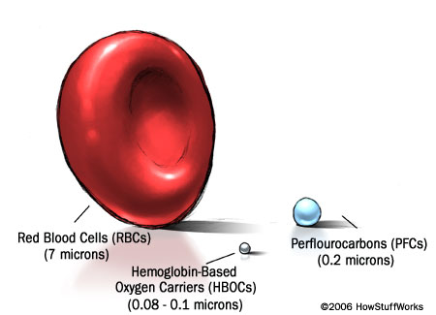
RBC substitutes or synthetic oxygen transporters studied so far are of mainly two types:
Perfluorochemical-based RBC substitutes
Hb-based RBC substitutes
Hb-based oxygen carriers (HBOCs)
Perfluorocarbons (PFCs)

Slide 13
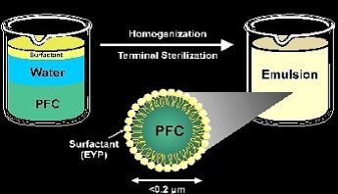
Perfluorocarbons
The capacity of PFCs in carrying oxygen was demonstrated for the first time by Clark in 1966.

Slide 14

Advantages of PFC emulsions
Cheap and easy to manufacture in large quantities
Can be stored at room temperature for more than 1 year
Can be mixed safely with any blood group without the need to check first
The molecules are smaller than red blood cells, allowing them to bypass arterial blockages and penetrate small capillaries with ease, delivering oxygen to areas which need it most

Slide 15

Allergy
Repeated doses
may cause hepatic
engorgement
Adverse
Effects
Of PFC
Retained in RE
system
Decrease
platelet count
Impaired neutrophil
function
Early: Headache
Late: Flu like
symptoms

Slide 16
OxygentTM | Alliance pharmaceuticals (USA) | Discontinued
OxycyteTM | Oxygen biotherapeutics (USA) | Discontinued
PHER-O 2TM | Sanguine Corp (USA) | In research
PerftoranTM | PERFTORAN (Russia) | Approved in Russian clinical application.

Slide 17
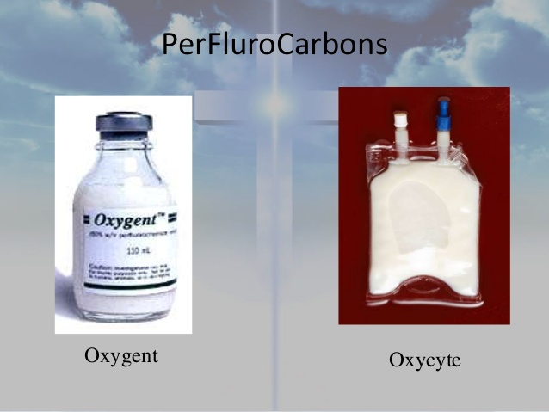
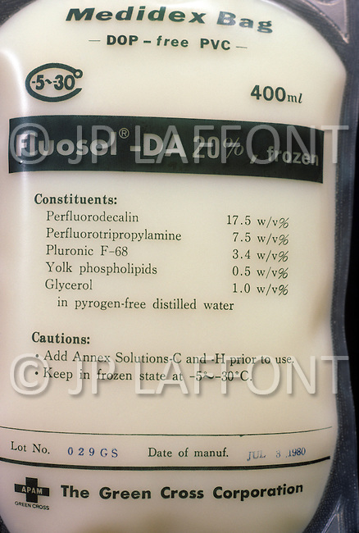
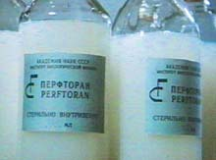
Fluosol-DATM
PerftoranTM

Slide 18
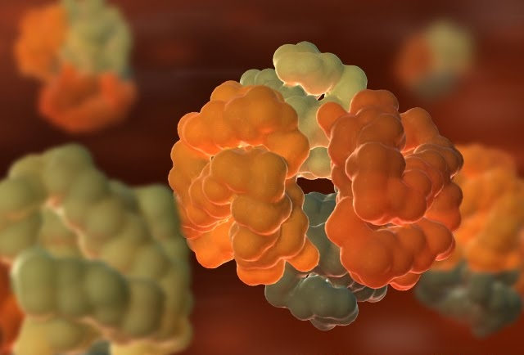
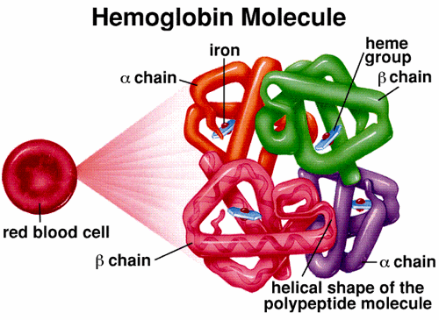
The Hb-based oxygen carriers (HBOCs)

Slide 19
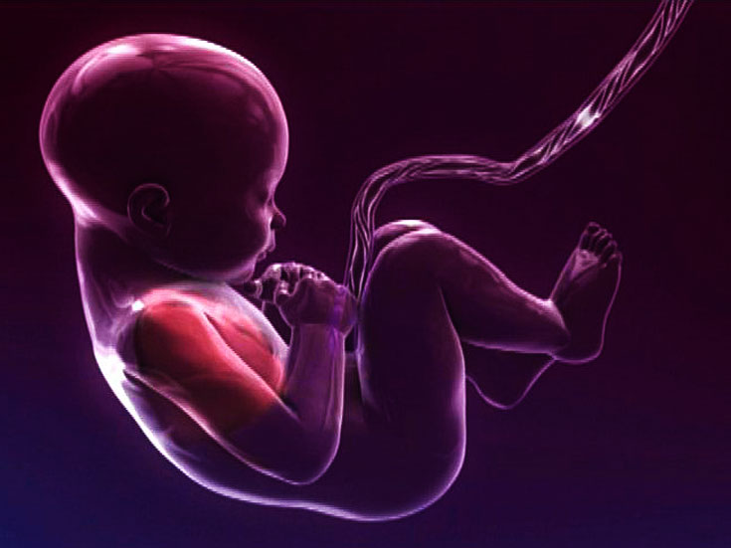


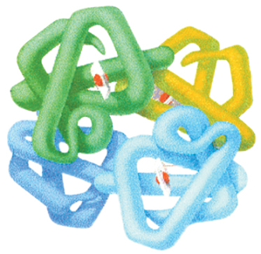

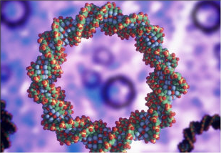
Sources of Haemoglobin
Highlevel production of recombinant Hb using simple Escherichia coli expression system has been reported
by Hoffman et in 1990.

Slide 20
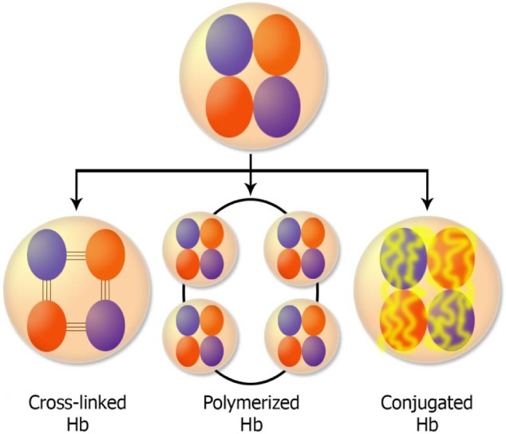
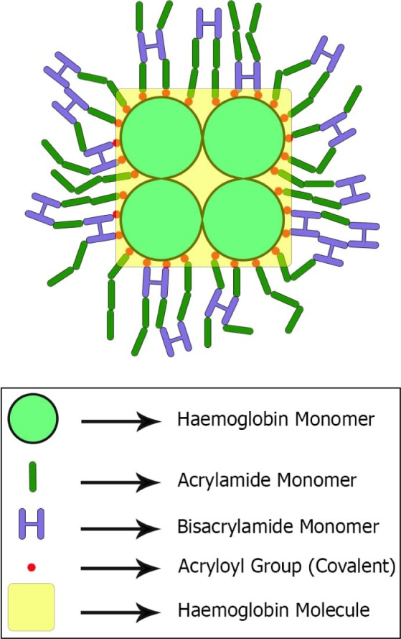
The Hb-based oxygen carriers (HBOCs) are divided into the following two groups:
Acellular
cellular

Slide 21
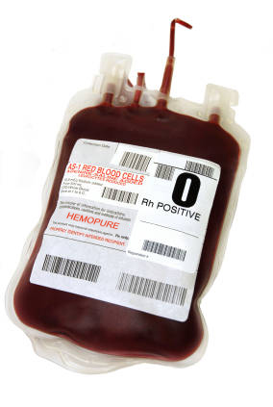
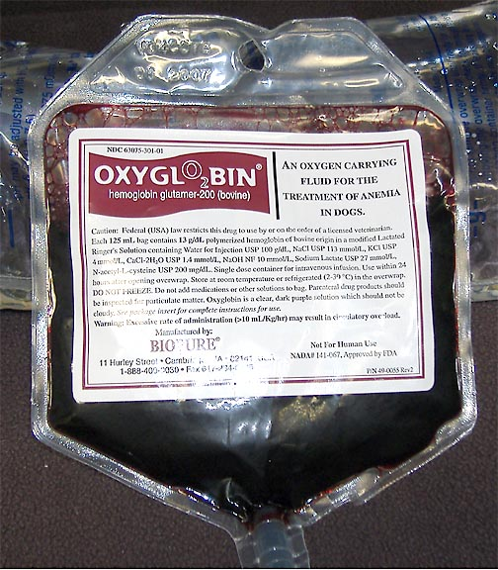

Slide 22
Benefits of HBOCs
No prior planning
Faster & better O₂ distribution
Ready to use
Long shelf life
No refrigeration
Universally compatible
Immediately offloads oxygen

Slide 23
Side effects of HBOCs
Vasoactivity
hypertension
Gastrointestinal side effects
Pancreatic and liver enzyme elevation
Antigenicity
Cardiac involvement
Platelet aggregation
Neurotoxicity
Renal effects

Slide 24

controversy
Blood substitutes may be misused as performance-enhancing drugs.
Doctors abandoned the use of HemAssistTM in the United States, after patients who received the HBOC died more often than those who received donated blood.
Haemoglobin-based blood substitutes may increase the odds of deaths and heart attacks

Slide 25
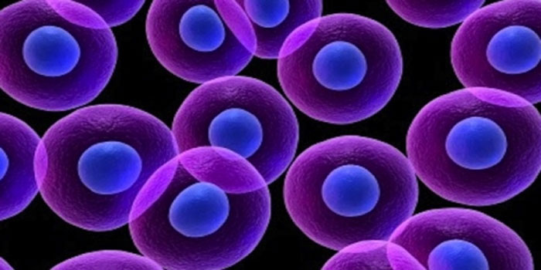

Other Promising Technique:
RBCs Differentiated From Stem Cells
To date, the use of red blood cells (RBCs) produced from stem cells in vitro has not proved for routine transfusion

Slide 26

Conclusion
In fact, production of a liquid that mimics all blood functions is still a dream.
However, although many important steps have been taken to date, no oxygen-carrying blood substitutes are approved for use by the US FDA.
Side effects and short half-life are the two main reasons that they did not met criteria for being approved.
Hence, by considering the first steps that have been taken successfully toward this ideal product, it would be expected in the near future to have a source of required RBCs with minimum complications and maximum similarity to replace RBCs derived from donated blood.

Slide 27


Thanks
Thank you
for

