Slide 1
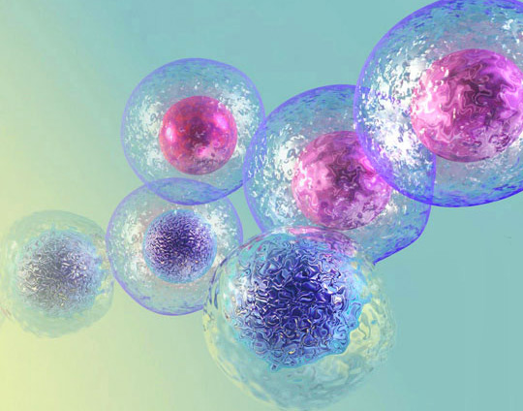

In The Name of GOD
Platelet lysate induces chondrogenic differentiation of umbilical cord-derived mesenchymal stem cells
Peresenter: Niloofar Pilehvari

Slide 2
Platelet lysate induces chondrogenic differentiation of umbilical cord-derived mesenchymal stem cells
What is the Platelet lysate???
Platelet lysate (PL) contains a relatively large number of growth factors, including TGFβ/ PDGF/EGF , and has been shown to ameliorate cartilage repair and this is substitute for fetal bovin serum(FBS) in MSCs culture and has been investigated for its ability to accelerate wound healing and support regeneration.
What is the chonderogenic?
Perichondrium is A layer of constricted irregular connective tissue that is essential for the growth and maintenance of cartilage that have 2 layers:
1- is an outer strand layer
2-an internal cartilaginous layer

Slide 3
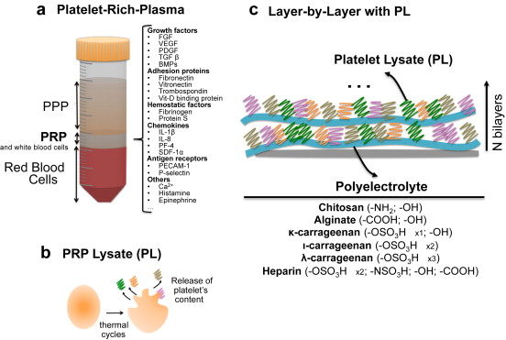
Here, they investigated the ability of PL to direct chondrogenic differentiation of MSCs along with other standard differentiation components in a pellet culture system.

Slide 4
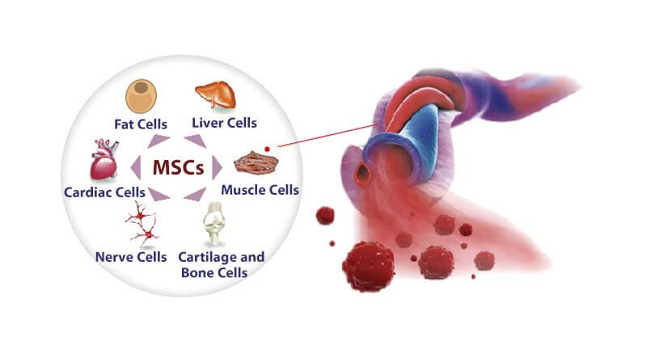
Why in this article use sc of umbilical cord?????
Becase the umbilical cord contains MSCs with higher proliferation potential and allows relatively easy and noninvasive isolation procedures

Slide 5
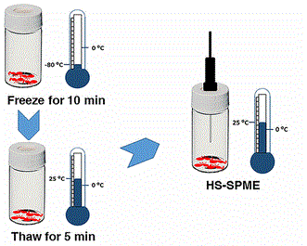
The methods to prepare PL:
1-freeze–thaw (FT)
2-sonication
3- chemical stimulation
4-physiological stimulation
Infact FT is simple ,fast and effective , In the simple FT method, PL is produced by
repeatedly freezing and thawing platelet-rich plasma (PRP).

Slide 6
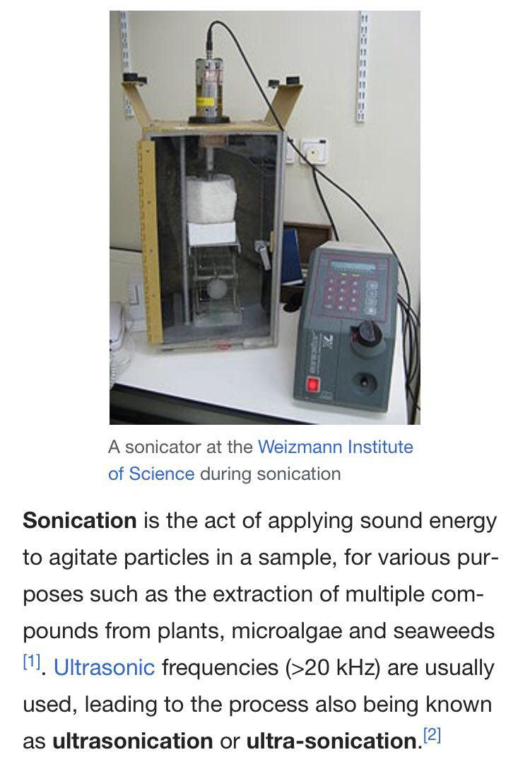
Sonication is the act of applying sound energy to agitate particle in sample.

Slide 7
Material and method:
Immunophenotypic of MSC
Chondrogenic differentition
Histochemical analysis of pellet
RT-PCR
Preparation Pl
Culturing MSCs
Adipogenic and ostegenic diffrentiation

Slide 8
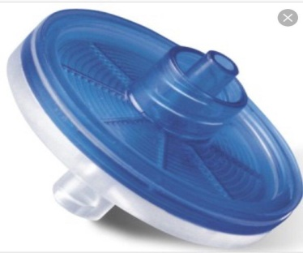
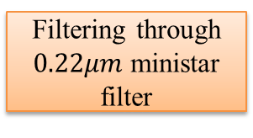



1. Preparation of platelet lysates and measurement of TGF-β content
PRP from 3 donor
pooled
Frozen at $−80℃$ and thaw at $37℃$
Filtering through $0.22μm$ministar
filter
Then PL was centrifuge for 20 min at 15000g and $4℃$
The FT cycle Repeat three times
Heparin(2u/ml) adding
into filtered PL
Aliquots and storing at $−20℃$ until use
And measure TGFB1 with
TGFB1 ELISA-KIT

Slide 9
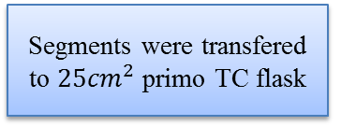
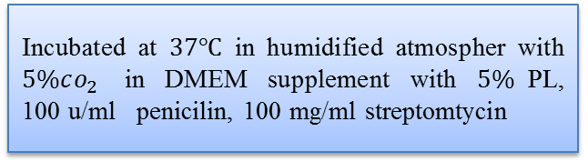
2.Culturing mesenchymal stem cells
MSCs was isolated from 3 umbilical
cord
Umbilical cord cut into
5-cm 2 segments
Segments were transfered to $25{cm}^{2}$ primo TC flask
On day 14 segments was removed and adherent cell were allow to expand until they reached 80% confluence
Incubated at $37℃$in humidified atmospher with $5\%co_{2}$ in DMEM supplement with $5\%$PL, 100 u/ml penicilin, 100 mg/ml streptomtycin
Then detach cell with trypsin and EDTA 0.05% and centrifuge at 200g for 5 min
Subcultured by plating on 12-wellplates at density of 10000 cell/well (repeated until passage3)
The morphology of the MSCs assessed ussing an Olympus IX50 inverted microscope

Slide 10
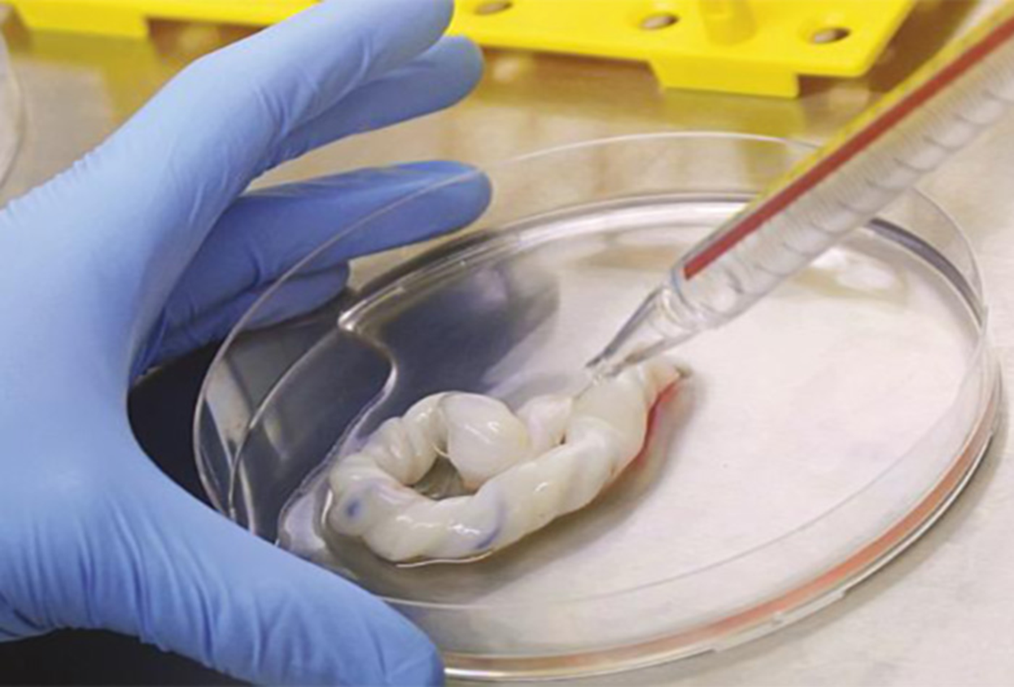

Slide 11
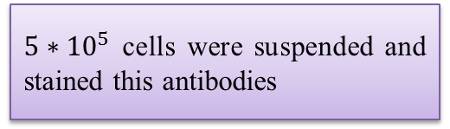
3.Immunophenotypic characterization of MSCs
Cells at passage 2 were washed with PBS and trypsin
$5∗{10}^{5}$ cells were suspended and stained this antibodies
CD105-PE, CD90-FIT
CD44-PE
CD34-PE
CD45-PE
And data were analyzed with CellQuest software and following Software V2.5.1
Cells were analyzed using a FACS-Calibur

Slide 12
4.Adipogenic and osteogenic differentiation
MSCs at passage2 were induce to differentiate into adipocytes using the hMSC Adipogenic Differrentiation kit and into osteocytes using the hMSC osteogenic Differentiation kit
To detect the adipocytes and osteocytes after 3 weeks of differentiation
Stained with 2% sudanIII for 5 min or 2% alizarin red(PH:4.2) for 20 min at room temperature
The cells were fixed with 10%formaldehyde
Lipid droplets and clacium deposits were detected using on Olympus IX50 interverted microscope

Slide 13
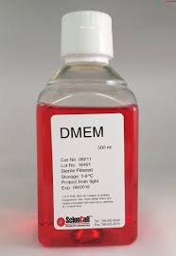
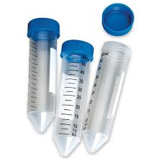
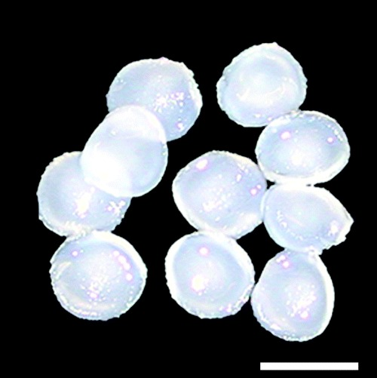
5.Chondrogenic differentiation:
On million MSCs at passage2 were centrifuged at 200g for 5 min
Pellets were cultured in 15ml conical tubes containing 1ml of chondrogenic differentiatian medium consist of DMEM,100nm dexamethasone,50mg/l ascorbic acid and 5% PL
After 3 weeks chondrogenic differentiation was assessed via histochemical staining and RT-PCR
Pellets maintained in DMEM with 5% PL were used as negative controls and chicken articular cartilages were used as positive controls.

Slide 14
6.Histochemical analysis of pellets:
Pellets were fixed in 10%formaldehyde for 3h at room temperatute
Dehydrated through a series of graded Ethanol bath and embededded in praffin
Section wered deparaffized in xylol and rehydrated through as series of graded Ethanol and bath
Paraffin-embedded pellets were sectioned using a microtome
Stained in 1% alcian blue for 30 min
For acridine orange staining,slides were incubated for 30 min in a 0.02mg/ml acridine orange acetic solution

Slide 15
7.Reverse transcription PCR (RT-PCR):
Total RNA was extracted from pellets at the end of week 3 using TRI Reagent
We utilize GAPDH that is a house keeping gene and is known as a reference for RT-PCR
Reverse transcription was carried out using a Revert Aid First Srand Synthesis Kit
RT-PCR was performed using Dream Taq to detect the expression of the SOX9 gene.

Slide 16
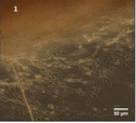
Mesenchymal stemcell culture and immunophenotyping
RESULTS:
The MSCs isolated and expanded in the PL-supplemented medium showed a Fibroblast-like Morphology with multiple nucleoli.(Migrating cells appeared at the edge of the explants after 7 days)

Slide 17
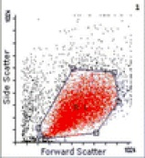
Mesenchymal stemcell culture and immunophenotyping
RESULTS:
In the flow cytometry, they tested positive for CD90, CD105 and CD44 and negative for CD34 and CD45.(FSC and SSC distribution of gatedmcells).The flow cytometry data are representative from one out of three donors tested

Slide 18
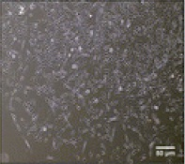
Morphology and characterization of MSCs cultured in medium supplemented with 5% PL
RESULTS:
Fibroblast-like morphology of MSCs in passage3.

Slide 19
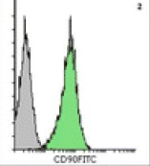
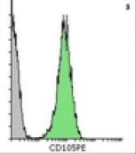
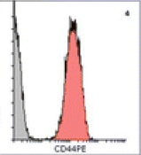
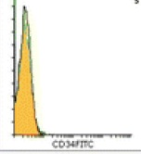
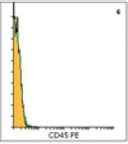





Flow cytometry of UCMSCs cultured in medium supplemented with 5% PL.
RESULTS:
$${CD90}^{+}$$
$${CD105}^{+}$$
$${CD44}^{+}$$
$${CD34}^{−}$$
$${CD45}^{−}$$

Slide 20
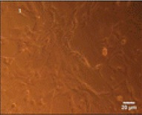
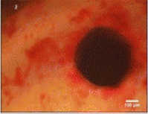
Adipogenic and osteogenic differentiation of MSCs.
RESULTS:
Differentiated cells stained with alizarin red

Slide 21
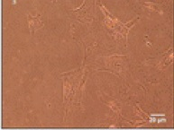
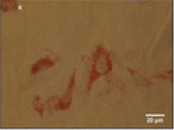
Adipogenic and osteogenic differentiation of MSCs.
RESULTS:
Differentiated cells stained with sudan III

Slide 22
Adipogenic and osteogenic differentiation of MSCs.
RESULTS:
Show the controls

Slide 23
Adipogenic and osteogenic differentiation of MSCs.
RESULTS:
shows positive for mineralization indicating osteogenic differentiation

Slide 24
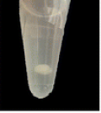
Characterization of differentiated MSCs pellets in chondrogenic differentiation medium supplemented with 5% PL.
RESULTS:
Three-dimensional round tissue pellet after 3 weeks of culture in differentiation medium.

Slide 25
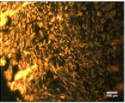
Characterization of differentiated MSCs pellets in chondrogenic differentiation medium supplemented with 5% PL.
RESULTS:
Acridine orange staining and the distribution of the cells in the pellets. (Sections of undifferentiated pellets (negative control), image at 150× magnification)

Slide 26
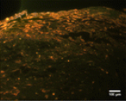
Characterization of differentiated MSCs pellets in chondrogenic differentiation medium supplemented with 5% PL.
RESULTS:
Acridine orange staining and the distribution of the cells in the pellets. (Sections of differentiated pellets, image at 150× magnification)

Slide 27
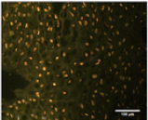
Characterization of differentiated MSCs pellets in chondrogenic differentiation medium supplemented with 5% PL.
RESULTS:
Acridine orange staining and the distribution of the cells in the pellets. (Sections of chicken articular cartilage (positive control), image at 600× magnification.)

Slide 28
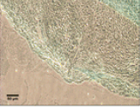
Characterization of differentiated MSCs pellets in chondrogenic differentiation medium supplemented with 5% PL.
RESULTS:
Alician blue staining. (Sections of undifferentiated pellets (negative control), image at 150× magnification.)

Slide 29
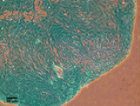
Characterization of differentiated MSCs pellets in chondrogenic differentiation medium supplemented with 5% PL.
RESULTS:
Alician blue staining. (Sections of differentiated pellets, image at 150× magnification.)

Slide 30
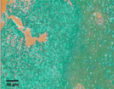
Characterization of differentiated MSCs pellets in chondrogenic differentiation medium supplemented with 5% PL.
RESULTS:
Alician blue staining. Sections of chicken articular cartilage, image at 300× magnification.

Slide 31
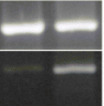
2% agarose gel electrophoresis
RESULTS:
1
2
2% agarose gel electrophoresis for amplified transcripts of SOX9 and GAPDH.
1.Amplified transcripts in undifferentiated pellets.
2. Amplified transcripts in differentiated pellets.

Slide 32
Thanks For Your Attention

