Slide 1

Role of Extracellular Vesicles in Hematological Malignancies
Zahra shakeri niya
MSc Student Of Hematology

Slide 2
Cell-to-cell communication
soluble factors
Extracellular matrix components
ion channels
tunneling nanotubules,
extracellular vesicles (EV)

Slide 3
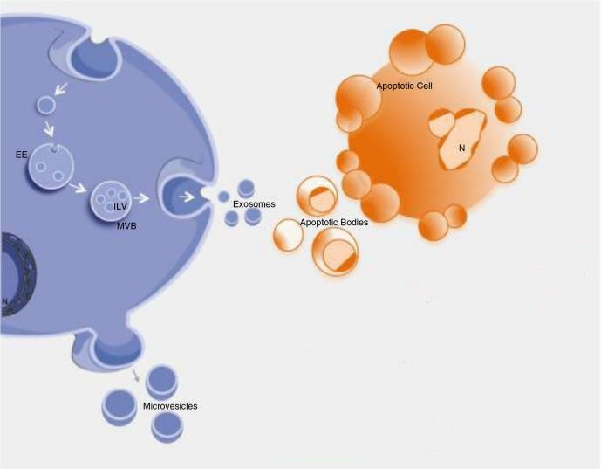
EV
Microvesicle
Exosome
Apoptotic body

Slide 4
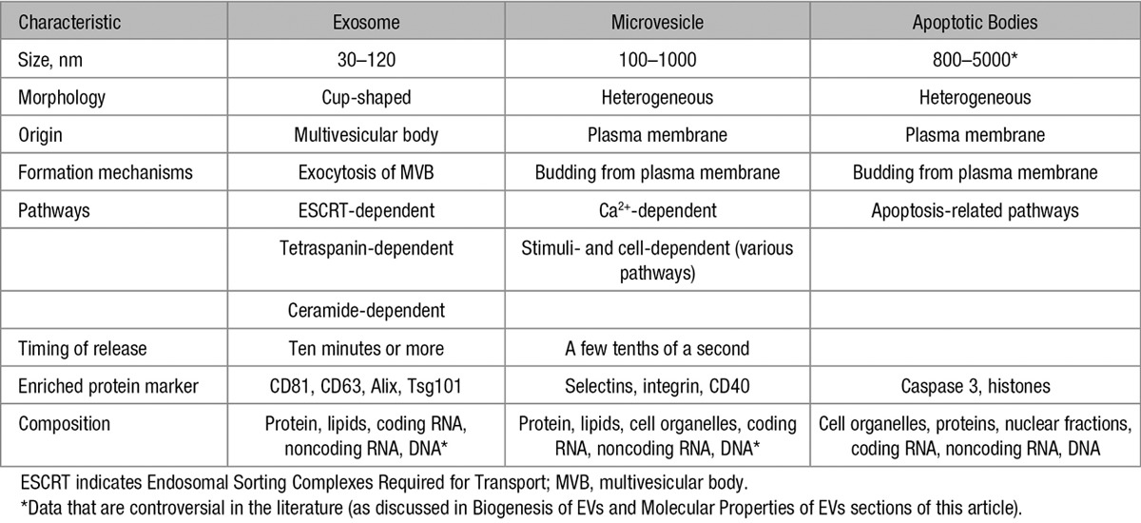

Slide 5
composition of EV
depending on:
the type cell
physiological and pathological state
proteins
specific lipids
coding and noncoding RNAs
DNA may be present in EV

Slide 6
microenvironmental stressors such as low pH, heat, and oxidative stress modulate the molecular composition of EV

Slide 7
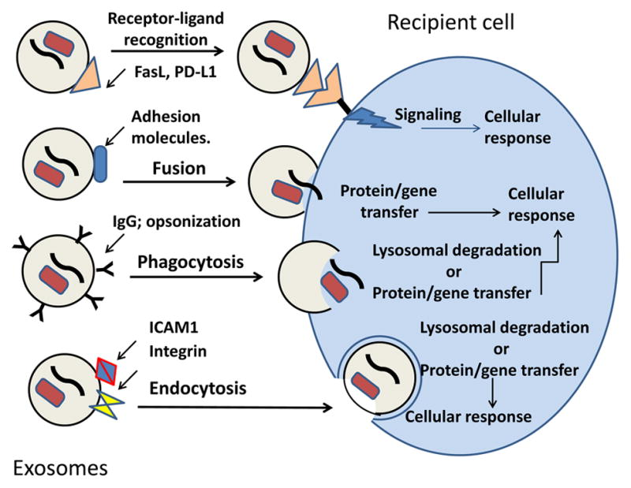
internalization

Slide 8
TMV
Microvesicle derived cancer cell named tumor-microvesicle (TMV)

Slide 9
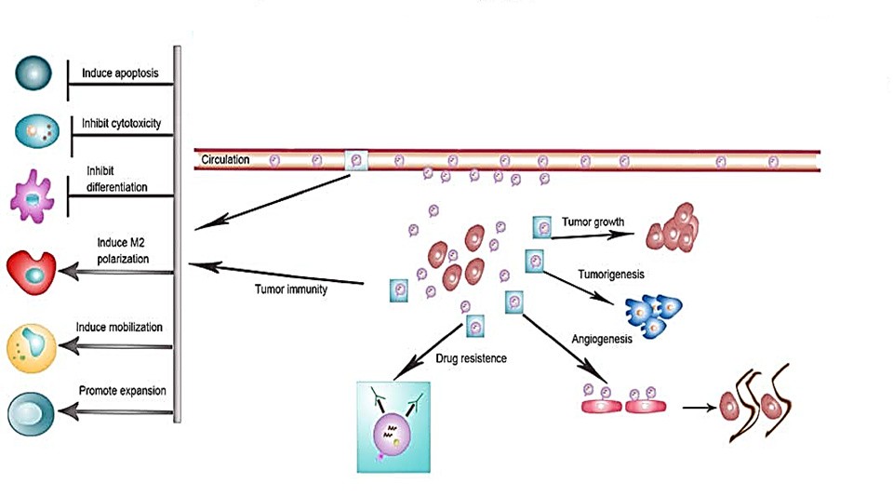
EV cause intracellular communication between cancer cell and microenviroment inhibits physiological function of stromal cells AND promote tumor growth and metastasis.

Slide 10
Tumorigenesis
EV derived from malignant cells affect other cells and change phenotype of normal cells to malignant cell
EV isolated from plasma of B-cell chronic lymphocytic leukemia (CLL) patients can interact and modulate BMSC, thus providing a “homing and nurturing” environment for CLL B cells

Slide 11
Tumor growth
CML derived exosomes are able stimulate bone marrow stromal cells (BMSC) to release IL8, which acts as an in vitro and in vivo prosurvival factor for CML cells.
The inhibition of IL8 receptors, using SB225002, was able to abrogate the IL8- driven CML cell survival in vitro as well as the growth of CML xenograft in vivo.

Slide 12
connect hematopoietic malignant cells and resident cells
Prosurvival factor
IL8
Activate an AXL mediated pathway
CXCLl8/CXCR1-2 signaling

Slide 13
CLL EV
maintain the state of activation
AKT/mTOR/p70S6K/HIF-1𝛼
modulate the AKT/GSK3𝛽 or AKT/𝛽-catenin signaling pathways
Provide tumormicroenvironment that favors disease progression

Slide 14
that multiple-myeloma-BM-mesenchymalstromal-cell- (MM-BMSC-) derived exosomes played a role in multiple myeloma (MM) disease progression in vivo.
BMSC transfer exosomes containing miR-15a into MM cells, inducing their proliferation and survival.

Slide 15
K562 cells
Normal neutrophil
EV
Incubation of neutrophils with K562-EV for 24 hours resulted in the expression of the Bcr/Abl hybrid gene in 20% of the cells
Injection via tail vein of K562 EV into rats or mice caused several symptoms of CML in the animals, such as weakness, loss of weight, splenomegaly, and neutrophilia, but reduced neutrophil phagocytic activity.
Finally transfer BCR/ABL gene with EV to normal neutrophils may promote in vivo transformation of normal cells.

Slide 16
Apoptosis
LAMA84-derived exosomes showed a reduction of the pro-apoptotic genes BAD, BAX and PUMA and an increase in mRNA levels of the anti-apoptotic genes survivin, BCL-xl, and BCL-w.

Slide 17
heat shock proteins (HSP70 and HSP90) and survivin in exosomes
cellular stresses
inhibit apoptosis and increase cellular proliferation

Slide 18
Angiogenesis
growth, invasion, and metastasis are depending on angiogenesis
Increased angiogenesis in hematologic disorders :
AML and CML
acute and chronic lymphocytic leukemia
MM
lymphomas

Slide 19
EV composition changes in target cells or by delivering angiogenic proteins or miRNAs that can stimulate EC function

Slide 20
exosomes released from CML cells directly affect ECs by modulating the process of neovascularization with release of proangiogenic cytokines, such as Interleukin-8

Slide 21
angiogenic miRNAs
miR-92
released from K562
enhanced EC migration and tube formation

Slide 22
miR-126
expressed 6-fold more in LAMA84 exosomes compared with the parental cells
modulating adhesive and migratory abilities of CML cells

Slide 23
hypoxia boosting tumor angiogenesis with increase of many proangiogenic factors in EV
Hypoxic human leukemia cell line K562 secretes exosomal miRNAs such as miR-210 higher than normoxic exosomes. suppress the expression of specific genes in endothelial cells, resulting in enhanced pro-angiogenic activity

Slide 24
BM angiogenesis also plays an important role in the pathogenesis and progression of MM
exosome stimulation promotes EC proliferation and the invasion and the secretion of the proangiogenic factors IL6 and VEGF

Slide 25
Tumor immune escape
TMV impairing differentiation and maturation of dendritic cells.
which changed their role from effective APCs into negative modulators of immune response

Slide 26
thermal and oxidative stress
exosomes enriched in Natural Killer Group 2, member D (NKG2D)
leukemia/lymphoma T- and B-cells
Nk cell cytotoxicity
NKG2D

Slide 27
Drug resistance
many anticancer drugs can be encapsulated in exosomes and effluxed outside of cells, and shedding of exosomes is closely related to drug resistance in many cancers.

Slide 28
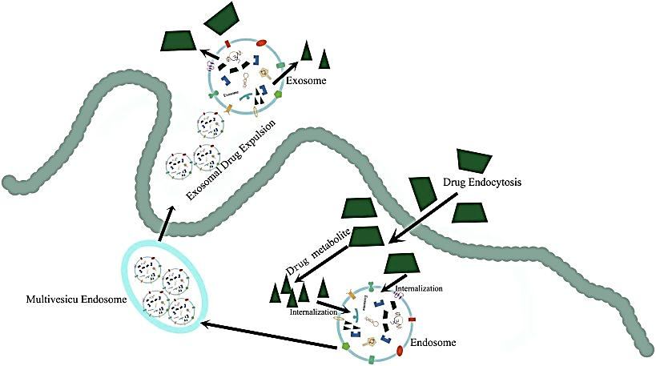

Slide 29
The effect of BMSC-derived exosomes on the survival and drug resistance of MM cells, using both a murine model and human MM samples, has been investigated in MM
drug resistance to bortezomib in MM cells treated with BMSC-derived exosomes, as well as the activation of several pathways related to drug resistance and cell survival, such as NOTCH1, STAT3, NF-𝜅B, and AKT

Slide 30
B-cell lymphoma-derived exosomes carried the protein CD20, exposed in the membrane, able to intercept rituximab, and thus allowing lymphoma cells to escape from humoral immunotherapy
Because exosomal CD20 is a decoy target for rituximab , drug sequestered by circulating exosomes may reduce the efficacy of pharmacological treatment

Slide 31
EV as Biomarkers
EV (both MV and exosomes) contain genetic and proteomic contents that reflect the cell of origin
EV enhancing during cancer progression
EV from body fluids and the circulation of cancer patients is a source of new predictive biomarkers involved in cancer development
EV can protect their cargo from nucleases and proteases, increasing the biomarker half-life

Slide 32
EV-associated cancer biomarkers have been extensively described in a great number of solid cancers, such as prostate cancer, melanoma, and lung cancer
in patients affected with melanoma and other solid tumors, total protein levels of exosome fractions isolated from plasma were reported to reflect disease stage, tumor burden, response to therapy, and survival
in AML, exosomal protein levels may reflect the Extent of disease and correlate with its relapse after therapy

Slide 33
exosomal protein levels
1. predictive of long-term disease survival
2. response to chemotherapy
3. detect residual leukemia cells in patients considered in complete remission
e.x : the TGF-𝛽1 levels upon AML diagnosis were higher than those in exosomes of normal controls. Following chemotherapy treatment, TGF-𝛽1 levels were significantly reduced, while patients in long-term complete remission had low exosomal TGF-𝛽1 levels

Slide 34
exosomes, released from malignant cells, are enriched in tumor antigens
exosomes isolated from ovarian or breast cancer ascites contain tumor specific antigens HER2/NEU
MART1 is found in nanovesicles recovered from serum of patients with melanoma

Slide 35
mRNAs and miRNAs
EV including mRNAs and miRNAs, to recipient cells, and affect the metabolism of target cells.
That miRNA content from their originating cancer cells is similar to that found in circulating exosomes
Exosomes derived from both AML and CML cells were enriched for several coding and noncoding RNAs relevant to both cancer prognosis and treatment, as well as to the leukemic niche function

Slide 36
miR-155 as a useful biomarker in individuals with monoclonal B-cell lymphocytosis and in patients with B chronic lymphocytic leukemia
higher miR-155 levels expression in patients who failed to respond to chemotherapy compared with those who experienced complete response
At present, miRNA-based clinical trials involving exosomes have not been initiated because an improved characterization of these carriers and their cargos in normal and disease models is still needed

Slide 37
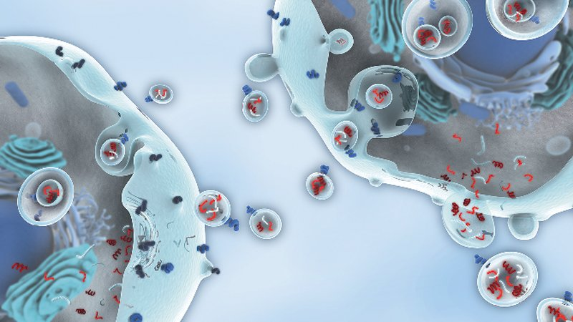
با تشکر از توجه شما
The end

