Slide 1

Hematology Seminar
Blood cells microparticles
Advised by
Dr. Mirzayi
Presented by:
Mahla Lashkari
Nov-2018

Slide 2
Objective:
Introduction & History
Erythrocyte Microparticles
Platelet Microparticles
Endothelial Microparticles
Conclusion
2

Slide 3

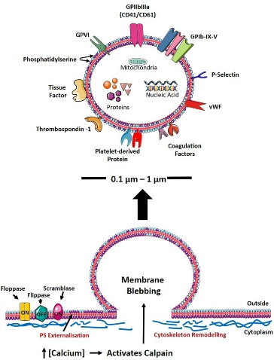
Introduction & History
Microparticles OR Microvesicles
3

Slide 4
Introduction & History
Platelets dusts
Wolf Peter (1967)
Trams
John stom & stahl
Recently . . .
4

Slide 5
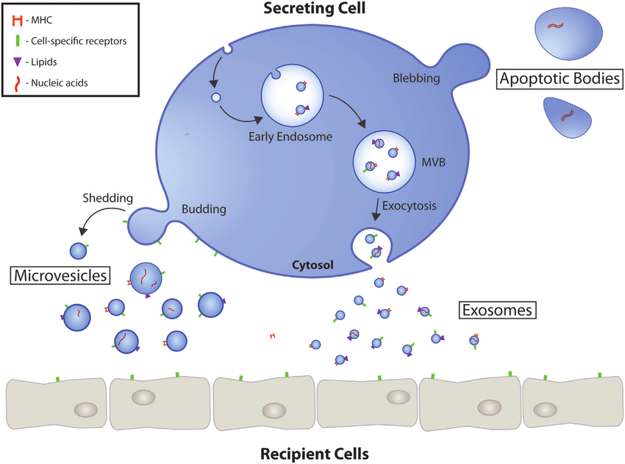
Introduction & History
Microparticles biogenesis
Three mechanisms of microparticles releasing
5

Slide 6
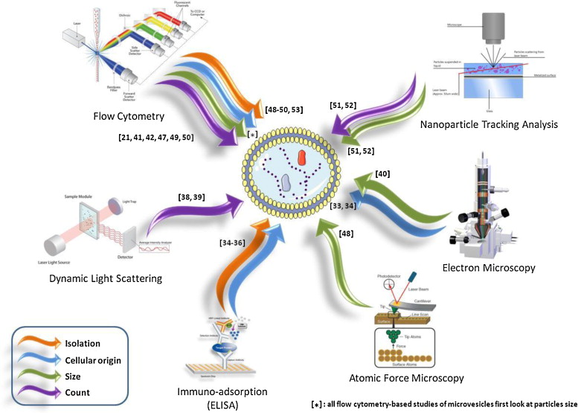
Introduction & History
Microparticles detection
6

Slide 7

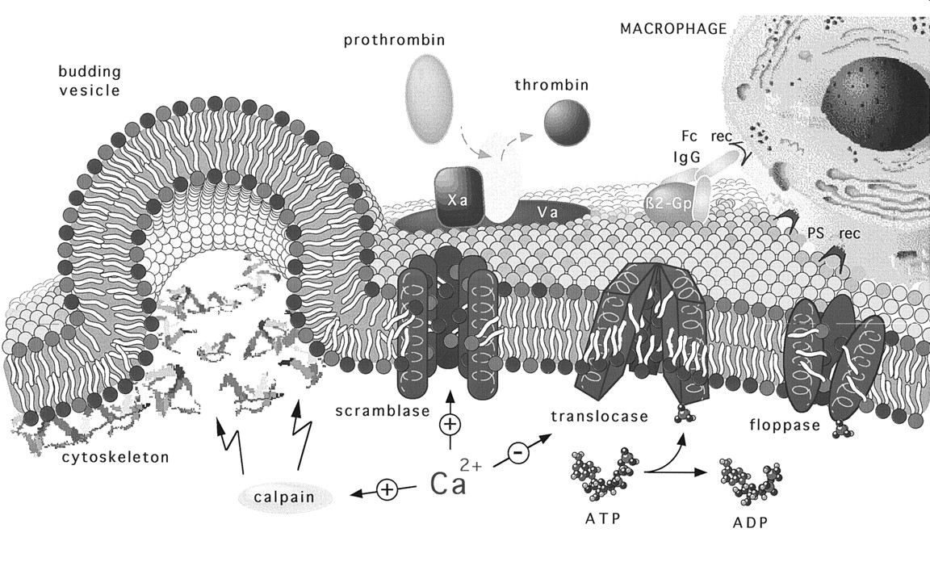
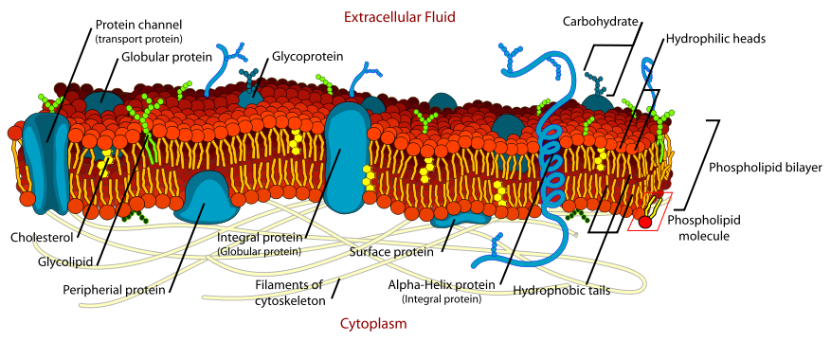
Cell membrane structure
Neutral phospholipids
Negative phospholipids
Ca²⁺
7

Slide 8
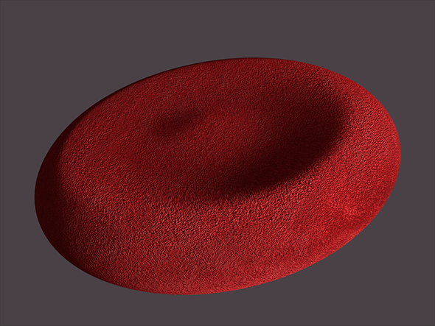
Erythrocytes Microparticles
Size : mostly 0.5 micron
4-8% of platelet rich plasma microparticles
Lesion of storing P.C at blood bank medicine
RBCs lose their 20% of their volume
Release their waste substances
Survival
Eliminate
8

Slide 9
Erythrocytes Microparticles
Role of Erythrocytes Microparticles in:
Sickle cell disease
PNH (paroxysmal Nocturnal Hemoglobinuria)
GVHD (Graft Versus Host Disease)
Malaria infection
9

Slide 10
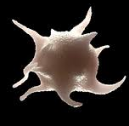
platelets Microparticles
Initiation of thrombosis
Tissue factor release
PMPs
Propagation of thrombosis
Exposure of phosphatidylserine
Inhibition of fibrinolysis
PAI-1 activity
Platelet microparticles and coagulation
10

Slide 11
platelets Microparticles
ICAM-1
Leukocyte migration
vessel wall
Activation
Local Thrombosis
Endothelial activation
Leukocytes activation
Inflammation
Angiogenesis
GP||b\|||a
Platelets
PMPs
Activation
P-selectin
Leuko-Leuko adhesion (PSGL-1)
Leuko-Endo
Activate Neutrophils (increase CD11b)
Activation
Activation
Leukocytes
Platelet microparticles and the vessel wall
11

Slide 12
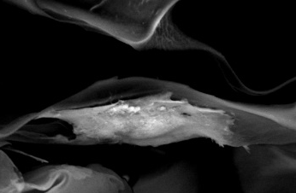
Endothelial Microparticles
Endothelium refers to cells that line the interior surface of blood vessels
Have basic properties like other MP
Have some specific markers like : ICAM-1, CD62E, CD62P, CD31
12

Slide 13
Endothelial Microparticles
In acute throma
In some diseases:
sickle cell anemia
TTP
PNH
13

Slide 14

Conclusion
Diagnostic markers
Prognostic markers
Risk factors in asymptotic diseases
Therapy
14

Slide 15

Don’t dream your life
Live your dreams . . .
Thanks for your attention….

Slide 16
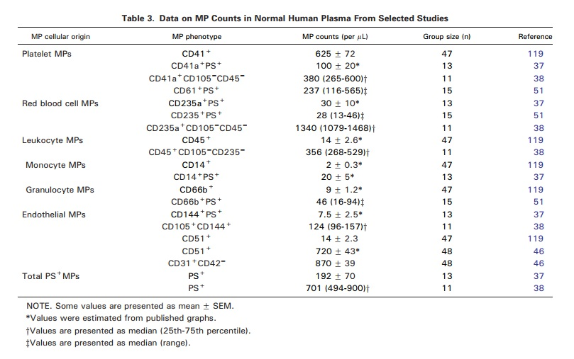


Slide 17
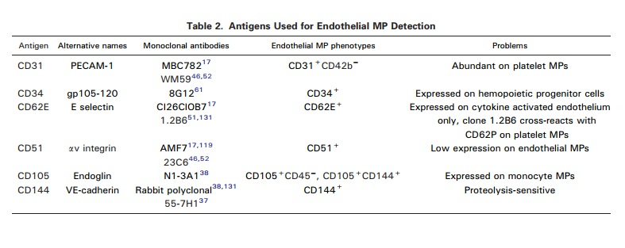

Slide 18
