Slide 1


Slide 2

Hematology Journal Club
Title:
clinical utility of automated blood cell analysis
(New parameters)
Presented by:
Maryam Katoeezadeh
1

Slide 3
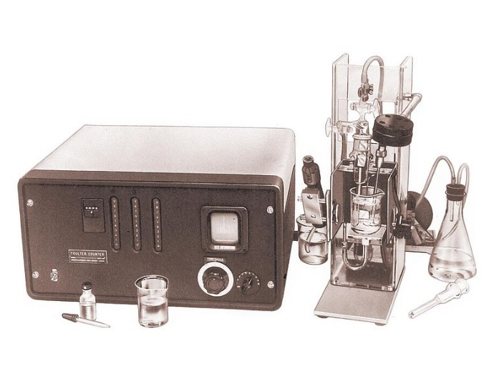
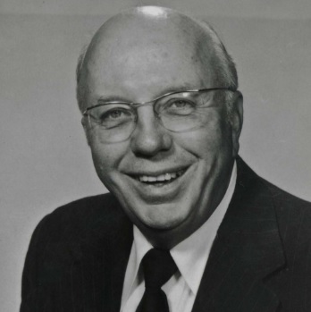
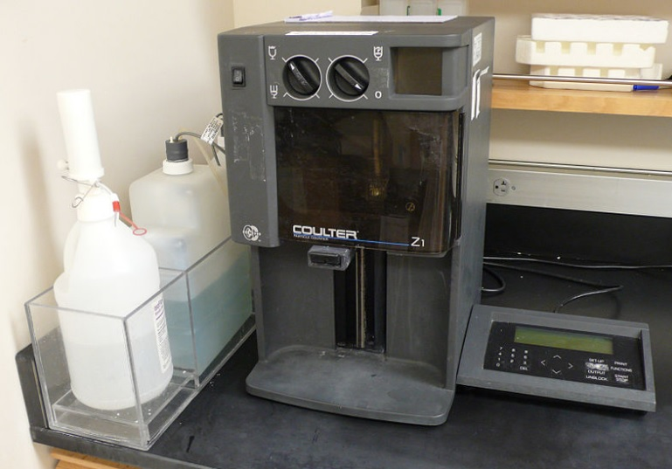
History
Wallace H. coulter
(February 17, 1913 – August 7, 1998)
3

Slide 4
Hematologic Analyzers are produced by many factories
Abbott Laboratories
Horiba Medical
Siemens Healthcare Diagnostics,Inc
Beckman Corporation

Slide 5
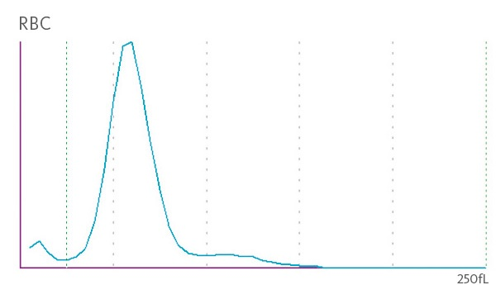
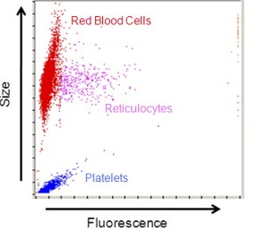
New Parameters
NRBC
Cellular Hb Concentration Mean (CHCM)
Immature Granulocyte (ImG)
Haematopoietic Progenitor Cells
Immature Reticulocyte Fraction
RBC Fragments ( Shistocytes)
Reticulocyte Index
Malarial Parasites
RHE ( RET – He )

Slide 6
Principle Of Working
Electrical Impedance (volume)
Conductivity (Nuclear Volume)
VCS
CHCM
Light Scattering

Slide 7
Reticulocytes
DEFINITION OF RETICULOCYTES
History
The Mid 1800s: Discovery of “Granulated” Erythrocytes
The Late 1800s: Discussions About the Meaning of the Granular Basophilic Filamentous Substance
The Early 1900s: Reticulocytes Are Young Red Cells
The Mid 1900s: Studies on Biochemical Characteristics and Reticulocyte Maturation

Slide 8
Reticulocytes
HFR : High Fluorescent Retic
Grade I
IRF
MFR : Mid Fluorescent Retic
Grade II & III
LFR : Low Fluorescent Retic
Grade IV
IRF : Immature Retic Fraction
IRF : ( HFR + MFR )
RHE ( RET – He , CHr) : Retic Hb Equivalent

Slide 9
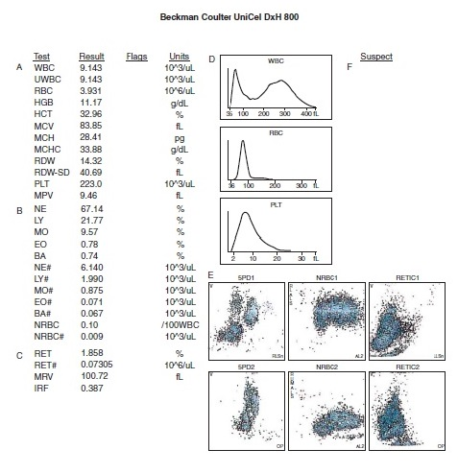

Slide 10
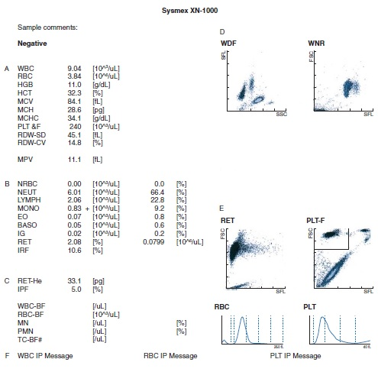

Slide 11
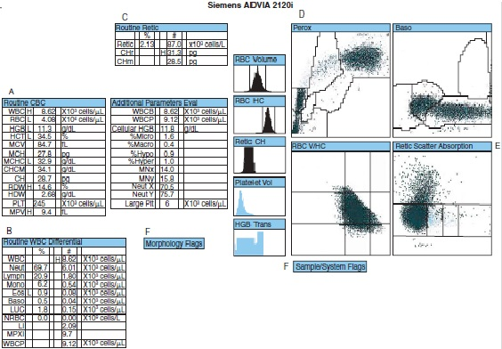
Retic = 2.13
CHr = 31.3 H
RDW = 14.6 H

Slide 12
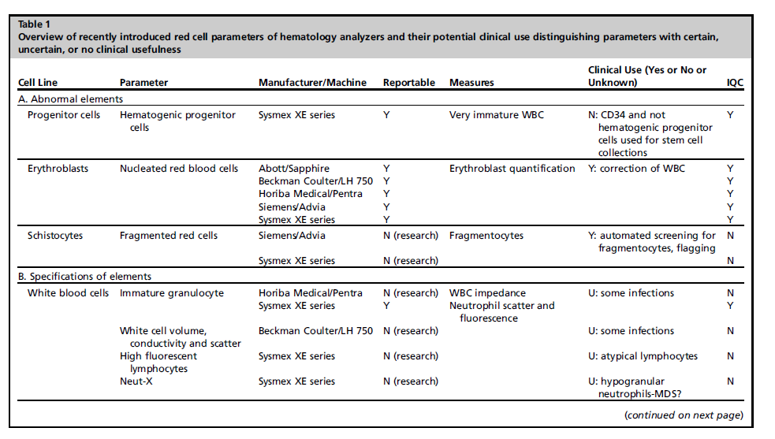
ImG

Slide 13
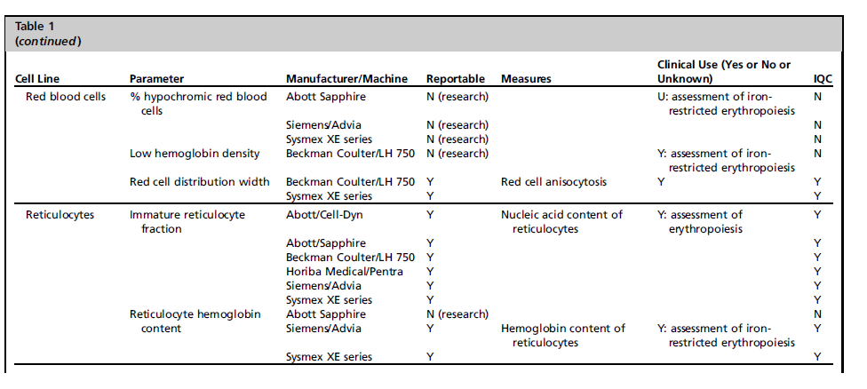
RDW
IRF
CHr

Slide 14
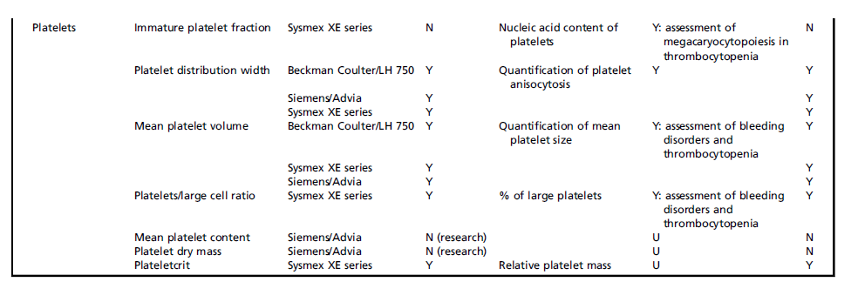
Cell Line
Parameter
Manufacturer/Machine
Reportable Measures
Clinical Use (Yes or No or
Unknown)
IQC
IPF
PDW
MPV
P-LCR

Slide 15


Evaluation of parameters IRF and IPF as a predictor factor in BMT
Absolute neutrophil count (ANC) > 0.5 × ${10}^{9}$ /L
IRF
Current criteria
IPF
Plt Count > 20 × ${10}^{9} /L$
IRF
New indicators
IPF

Slide 16
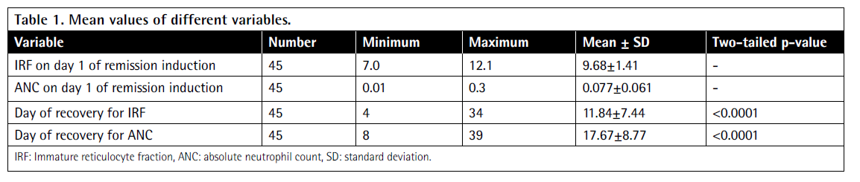
IRF and ANC as Predictor of Hematopoietic Recovery in Patients with ALL on Remission Induction Chemotherapy

Slide 17
Screening of hereditary spherocytosis and pyruvate kinase deficiency by automated blood count using erythrocytic and reticulocytic parameters
Hemoglobin level
Reticulocyte count
IRF
MicroR
%HypoHe

Slide 18
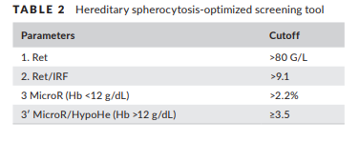
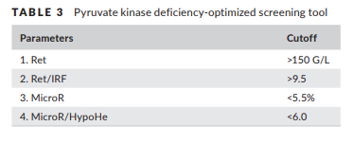
screening strategy
HS
PKD

Slide 19


Slide 20


