Slide 1

The human MHC and childhood leukemia
Presented by:
Mehdi kohansal

Slide 2
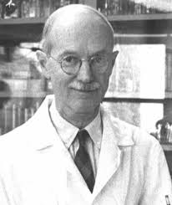
Discovery of MHC
George Snell
In 1940s, analyzed the rejection of transplanted skin between strains of laboratory mice.

Slide 3
The human major histocompatibility complex
a barrier to the free exchange of organs and tissues between individuals
HLA primary function orchestration of the immune response
On the short arm of chromosome 6 (6p21.3)
spans about 7.6 megabase DNA
It includes 421 loci, of which 252 are expressed

Slide 4
locus
a locus (plural loci) is the specific location of a gene, DNA sequence, or position on a chromosome

Slide 5
Allele
An allele is a variant form of a gene

Slide 6

HLA classes
class I A/B/C
HLA related loci
class II DP/DQ/DR
Polymorphism: HLA-B $>HLA$-DR $>$…

Slide 8
HLA usage
Transplantation of tissues and organs
Anthropology studies
Forensic medicine
Investigate association of alleles HLA and disease

Slide 9
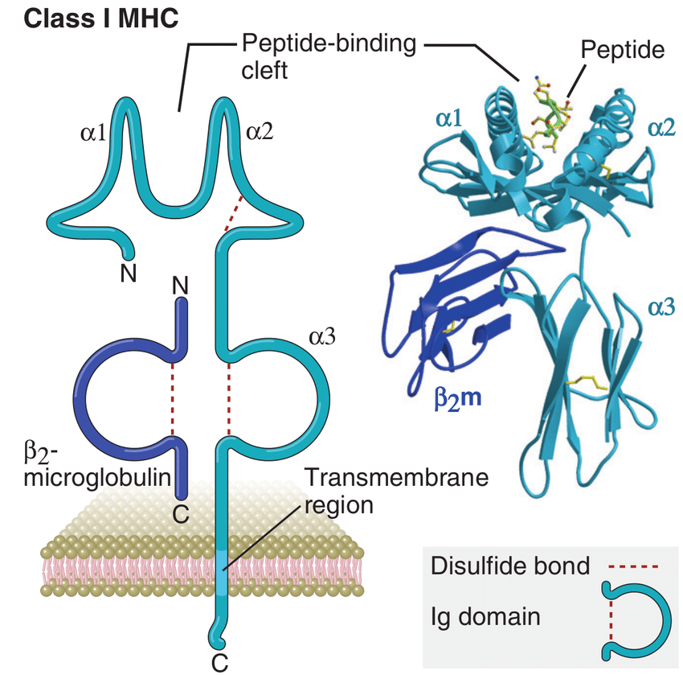

MHC $I$
Autosomal codominant
Hetrodimer
Available in all nucleated cells & PLT
Function: presentation of endogenic Ag to T cell CD8+
CD8 attachment to MHC-I
Cytosolic pathway
Self MHC restriction
TCR
Specification

Slide 10
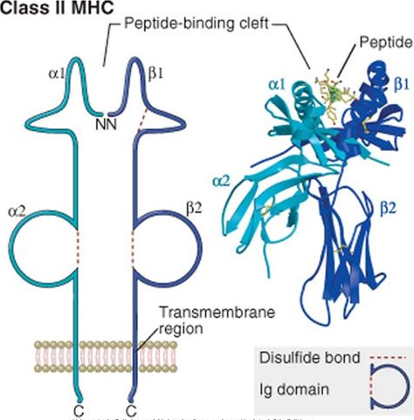

MHC $II$
Autosomal codominant
Hetrodimer
Available in DC/MQ/B cell
Function: presentation of exogenic Ag to T cell CD4+
Endosomal –lysosomal pathway

Slide 12
xMHC
The xMHC includes 67 other genes, comprising about 28% of expressed MHC genes Includes genes of the SIgF, inflammation-associated genes, such as TNF and LT, leukocyte maturation, complement genes, non-classical HLA genes, and immune regulation and stress response genes
not related to the immune system: cell cycle regulation, apoptosis, transcription and translational machinery, signaling,..

Slide 14
The MHC and childhood leukemia
majority of HLA-associated diseases have an autoimmune pathogenesis
Reason: pathogens molecular mimicry cross-reactive T cell responses to self protein
1960 susceptibility to Gross retroviral leukemia in the mouse was linked to the H-2 complex
First investigation of childhood leukemia & HLA class I failure
1990 increase of surviving,advances in SNP genotyping,…

Slide 15
HLA & LEUKEMIA & INFECTIONS
One of the major difficulties in establishing an etiological role for infection in childhood leukemia has been in the identification of a causal agent
Solution: Reverse immunogenetic
T cell epitope prediction algorithm
TEPITOPE T cell epitope mapping app
Requires prior knowledge of the infection

Slide 16
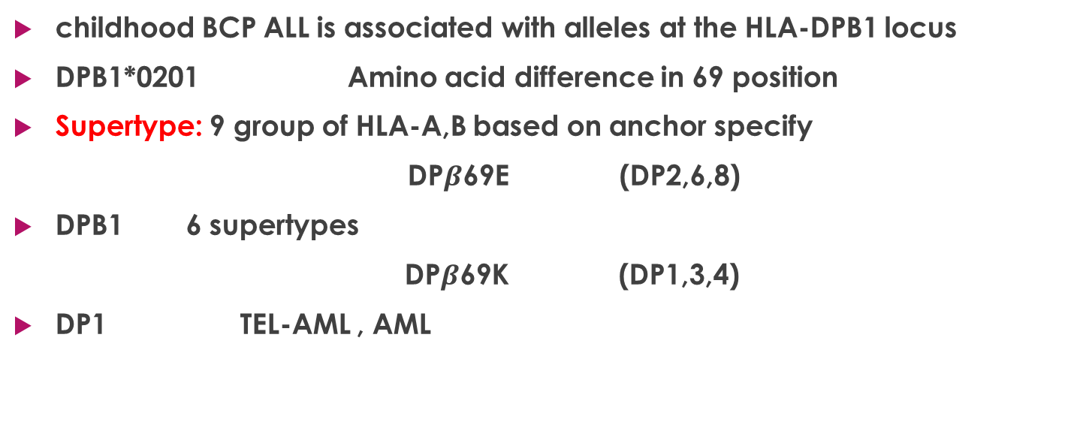
Childhood BCP ALL & HLA
childhood BCP ALL is associated with alleles at the HLA-DPB1 locus
DPB1*0201 Amino acid difference in 69 position
Supertype: 9 group of HLA-A,B based on anchor specify
DP$β$69E (DP2,6,8)
DPB1 6 supertypes
DP$β$69K (DP1,3,4)
DP1 TEL-AML , AML

Slide 17
Greave’s hypothesis
Transient inflammatory response mediated by cytokines selectively suppresses normal hematopoiesis, leaving a pre-leukemia clone with a selective growth advantage

Slide 18
HLA & LEUKEMIA & INFECTIONS
P1,6 F
P1,4,6,9 P4 K
P9 A & V
FXXKXFXXV
FXXKXFXXA
BACTERIA:Bordetella pertussis, Candida albicans, Clostridium tetani, Escherichia coli, Haemophilus influenzae,Helicobacter pylori,…
VIRUSES:HHV-1,2,5,6

Slide 19

CMV & BCP leukemia
HHV5 (HCMV)
US3 61-69 FTEKHFVNV (similar to CD49a)
CD49a/CD29(VLA-1) expressed by BM stromal myofibroblasts
BM stromal myofibroblasts BCP proliferation
CMV infection T CD8+ activation, suppressor
cytokines

Slide 20


