Slide 1
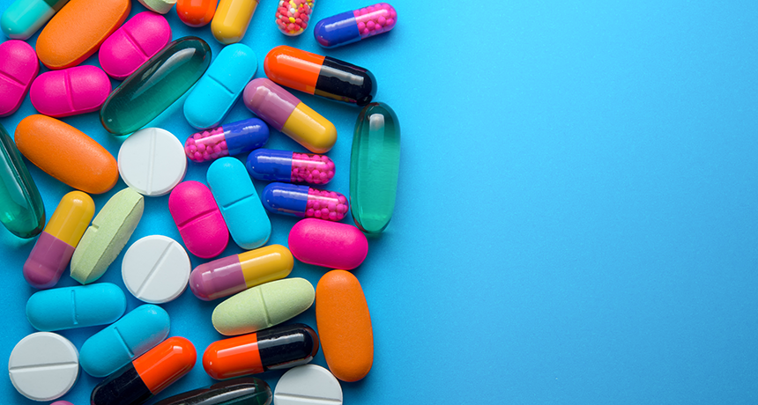

Hematology Seminar
Liposomes:
A Novel Drug Delivery System
Advised by
Dr. Hassanshahi
Presented by:
Mahsa Rahgoshay

Slide 2
CONTENT
Drug Delivery System
Conventional Drug Delivery System
Novel Drug Delivery System
LIPOSOME:
History
Definition of liposome
Classification of Liposomes
Preparation of Liposome
Application
Advantages & Disadvantages
Current marketed drug
Conclusion

Slide 3
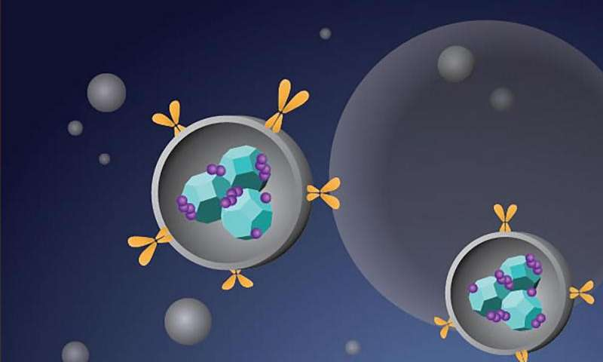
Drug Delivery System (DDS)
Drug delivery refers to approaches, formulations, technologies, and systems for transporting a pharmaceutical compound in the body as needed to safely achieve
its desired therapeutic effect

Slide 4
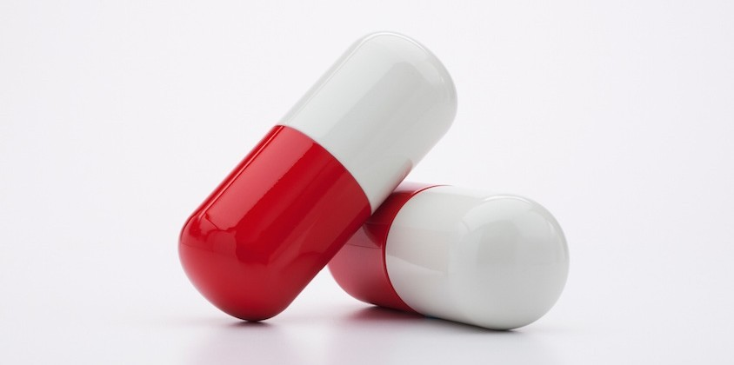
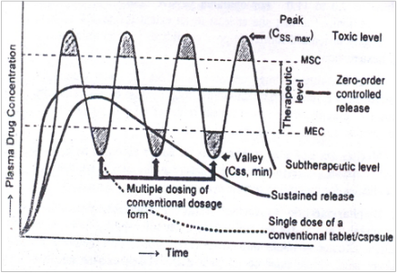
Drug Delivery System
Conventional drug delivery system

Slide 5
Drug Delivery System
Conventional drug delivery system
High Systemic concentration can be toxic
Low concentration can be ineffective
Periodic Administration
Non-Specific Administration
.

Slide 6
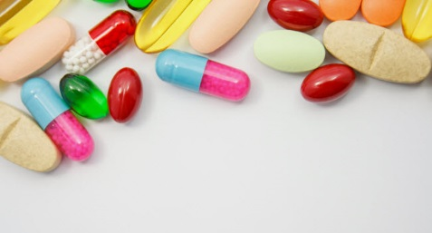
Novel Drug Delivery System (NDDS)
Novel Drug Delivery System
or
(Controlled Drug Delivery System)

Slide 7
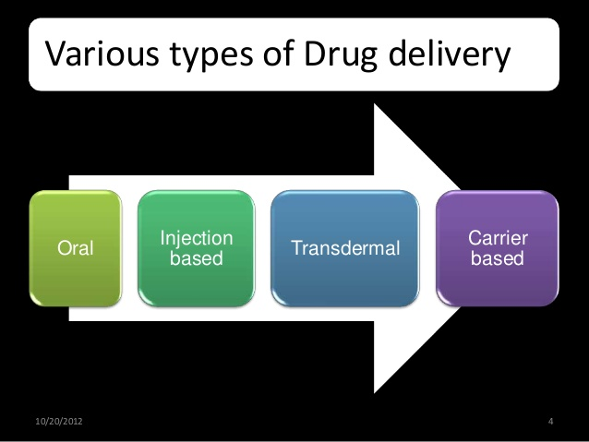
Novel Drug Delivery System (NDDS)
Conventional drug delivery System
Controlled drug delivery system

Slide 8
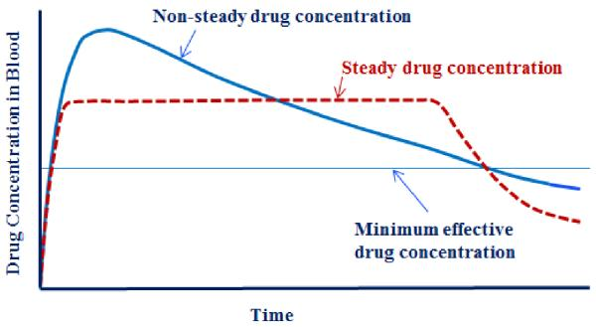
Novel Drug Delivery System (NDDS)
Why do we need NDDS?
Sustained and consistent blood level within the therapeutic window

Slide 9
Novel Drug Delivery System (NDDS)
Why do we need NDDS?
Decreased dosing frequency.
Reduced rate of rise of drug concentration in blood.
Enhanced bioavailability.
To achieve a targeted drug release.
Reduced side effects.
Improved patient compliance
Low cost
Notes:
افزایش نفوذپذیری غشا

Slide 10
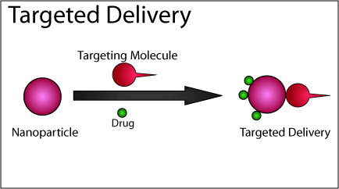
Novel Drug Delivery System (NDDS)

Slide 11
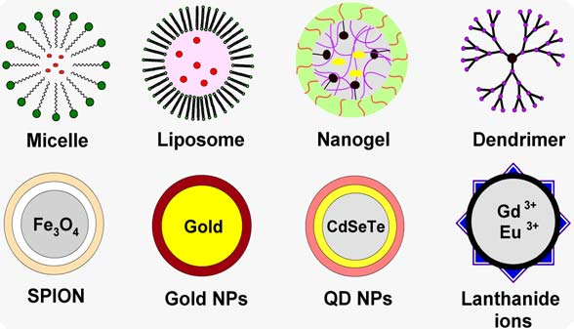
Carrier-Based Drug Delivery System
Nano Carrieres Used for Drug Delivery System

Slide 12

Definition of liposome
Liposomes are consisted of single or multiple lipid bilayers formed by
hydrophilic and hydrophobic interactions
Their diameter ranges from 80nm to 100um
aqueous spaces

Slide 13

History of liposome
Alec Bangham, a leading hematologist who
was known as the father of liposomes

Slide 14
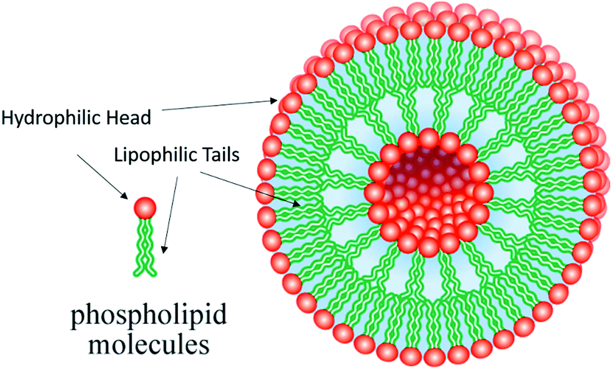
Basic Component Of Liposome
Phospholipids

Slide 15
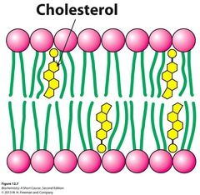
Basic Component Of Liposome
2) Cholesterol
decreases the permeability of the bilayer
stabilises the liposomes
keep the intended drug
entrapped
Notes:
خواصیت سیالیت غشا را کنترل میکند
کاهش نفوذپذیری غشا
کاهش نشت دارو پایداری لیپوزوم

Slide 16
CLASSIFICATION OF LIPOSOME
Based On Size and Shape
MLV
Multi lamellar vesicles
(>100nm)
OLV
Oligo lamellar vesicles
(0.1-1 μm)
ULV
Uni lamellar
vesicles
MVV
Multi vesicular vesiculed
(>0.5μm)
SUV
Small uni lamellar vesicles
(20-100 nm)
LUV
Large uni lamellar vesicles
(>100nm)

Slide 17
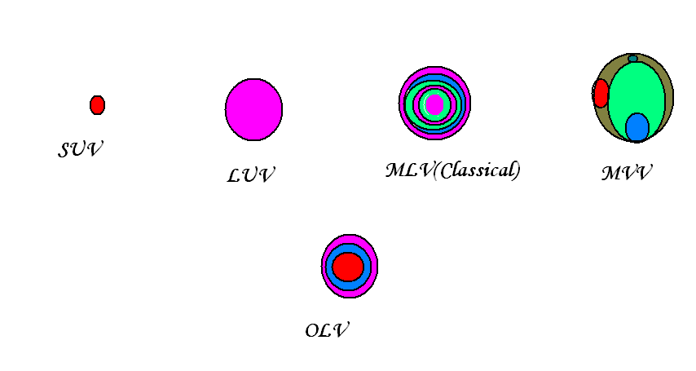
CLASSIFICATION OF LIPOSOME
Based On Size and Shape
Notes:
بيشتر داروهاي موجود در بازار suv
Luv به دليل فضاي مركزي بزرگ مي توانند به نسبت دسته قبلي مقادير بيشتري از داروهاي محلول درآب را در خود جاي دهند

Slide 18
CLASSIFICATION OF LIPOSOME
Based On liposome loading techniques
passive loading techniques
Active loading techniques
Mechanical dispersion method
Solvent
dispersion method
Detergent
removal method
Sonication.
French pressure cell: extrusion.
Freeze-thawed liposomes.
Lipid film hydration by hand shaking, non-hand.shaking or freeze drying.
Micro-emulsification.
Membrane extrusion
Ethanol injection.
Ether injection.
Double emulsion vesicles.
Reverse phase evaporation vesicles.
Stable pluri lamellar vesicles
Dialysis.
Column chromatography.
Detergent adsorption method

Slide 19
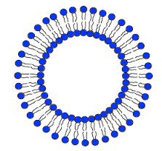
Classification Of Liposome: Component and Application
Conventional liposome
the first generation of liposomes to be developed
Component: Natural phospholipids + cholesterol
Application:
To target REE system (liver metastasis، candidiasis، lishmaniasis)
Disadvantage: rapid clearance from the blood stream by
1)opsonization of plasma components
2)uptake by macrophages of the reticuloendothelial system

Slide 20
Classification Of Liposome: Component and Application
Long circulatory liposome Liposome (LCLs)
1)coating the liposome with a hydrophilic polymer (PEG)
2) Use of neutral lipids with a high TC like Cholesterol and sphingomyelin
Advantage:
reducing invivo opsonization and the rapid uptake by RES
These liposomes have a very long circulation half life, of up to 40 hours
Disadvantage:
offsetting reduction in the ability to interact with the intended targets
Stealth liposome

Slide 21
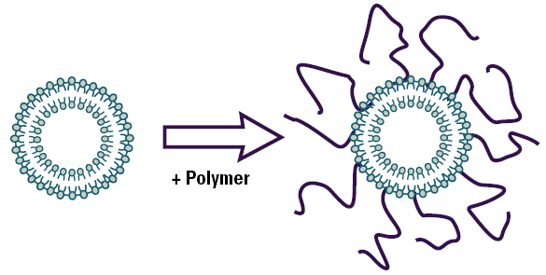
Classification Of Liposome: Component and Application
Long circulatory liposome Liposome (Stealth Liposome)
PEG
(PEG)
Stealth Liposome

Slide 22
Classification Of Liposome: Component and Application
Cationic liposomes
Application:
delivery of macro molecules that have a negative charge includes the delivery of DNA and RNA
Non viral vectore for gene delivery
Disadvantage: toxic in high doses and a short lifespan, thus restricting them to local administration.
Notes:
این لیپوزوم ها دارای بار مثبت هستد
در انتقال ماکروملکول هایی با بار منفی همچون DNA و RANA miRNA و SIRNA نقش دارند
عنوان وکتورهای غیر ویروسی در انتقال ژن
ژن ها را از تجزیه حفظ کرده و ثبات آن ها را در گردش خون تضمین کنند

Slide 23
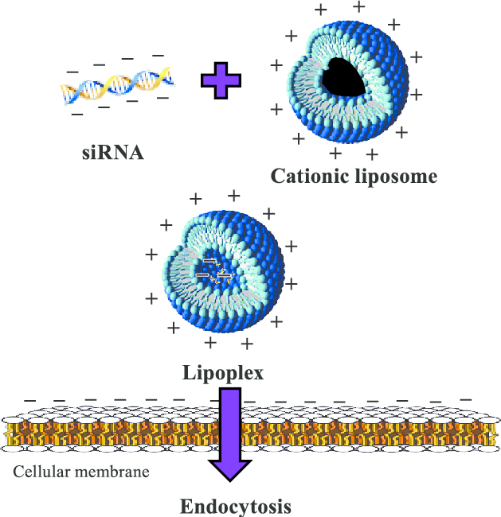
Classification Of Liposome: Component and Application
Cationic liposomes
DNA

Slide 24
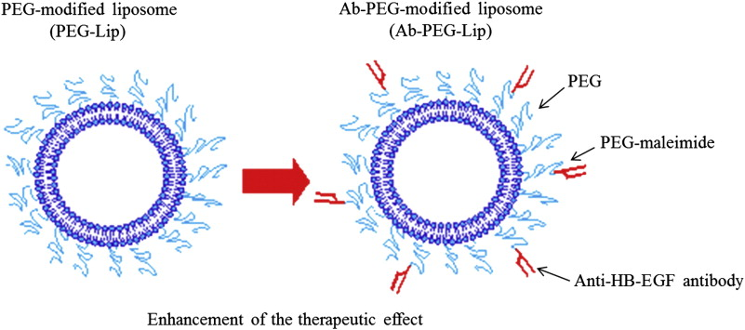
Classification Of Liposome: Component and Application
Immunoliposome
Component: Conventional liposomes (CL) or Long Circulating Liposomes (LCL) + mAb

Slide 25
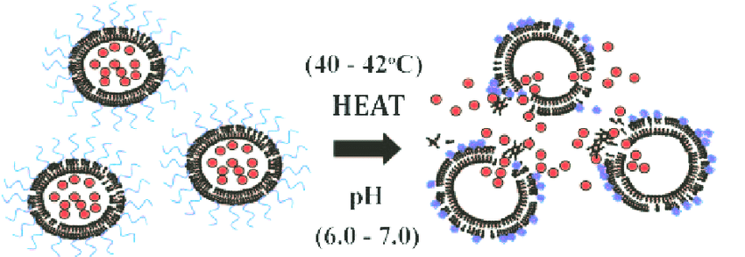
Classification Of Liposome: Component and Application
Temperatures Sensitive Liposome (TSL)
Component: lisophosphid or Palmitoyl glycero-3-phosphocholine
Temperature-sensitive liposomes for doxorubicin delivery

Slide 26
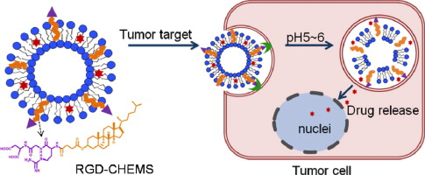
Classification Of Liposome: Component and Application
PH Sensitive Liposome
Component: phosphatidyl ethanolamine (PE), oleic acid (OA) cholesterol hemi succinate
These liposomes fuse with cells when the pH is low, thus releasing its content into the cell cytoplasm

Slide 27
Preparation Of Liposome
General methods of preparation
.
Dispersing the
lipid in aqueou media
Drying down lipids
from organic solvent
Dispersing the lipid in aqueous media
Purifying the resultant liposome.
Analyzing the final product

Slide 28
Liposome Characterization
Evaluation of liposome
Mean vesicle size and size distribution
Vesicle shape
Lamellarity
Surface charge
Surface PH
Entrapment efficiency (EE)
Drug Release

Slide 29
Application of Liposome
LIPOSOMES AS DRUG DELIVERY VEHICLES
liposomes can mimic biological cells so they are highly biocompatible، biodegenerable، non toxic، non immunogenic
Antibacterial drugs ، antiviral drugs، antiparasite drugs، fungicides، enzymes ، anti cancer drug
Positive Effects of liposome on drugs:
.
Dispersing the
lipid in aqueou media
Improve pharmacokinetic and and pharmacodynamics effect
Enhanced drug solubilization (amphotericin B, minoxidil, paclitaxel, cyclosporin),
Protection of sensitive drug molecules and Increase half life of drug (cytarabine)
Entrap both hydrophilic and hydrophobic drugs

Slide 30
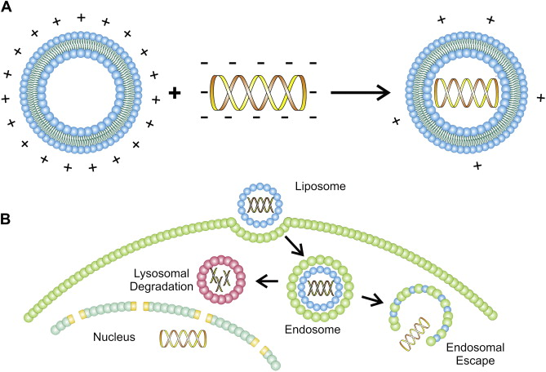
Application of Liposome
LIPOSOMES AS GENE DELIVERY VEHICLES
.
Dispersing the
lipid in aqueou media

Slide 31
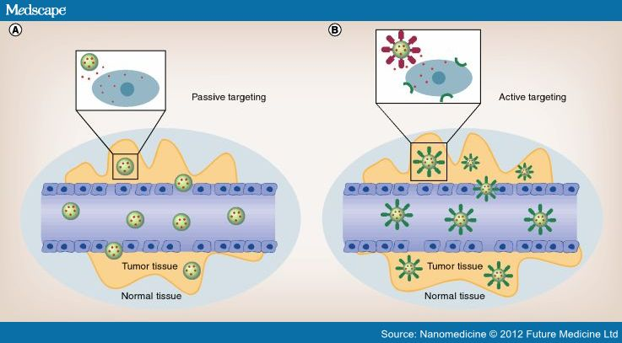
Drug Targeting To Tumor
The tumor targeting consists in “passive targeting” and. “active targeting

Slide 32
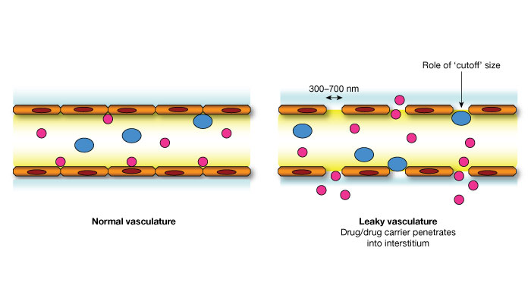
Passive Targeting: EPR Effect
The vasculature of solid tumors different from that of normal vasculature
1) Leaky vasculature
2 ) dysfunctional lymphatic drainage

Slide 33
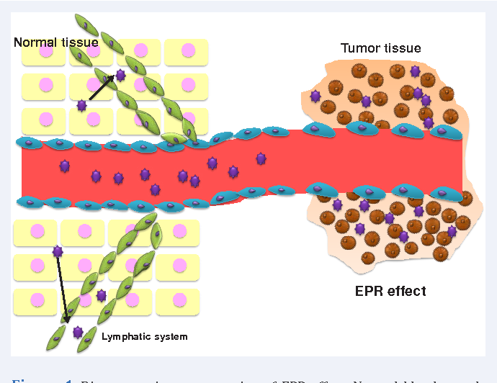
Passive Targeting: EPR Effect
Enhanced Permeability And Retention (EPR) Effect

Slide 34
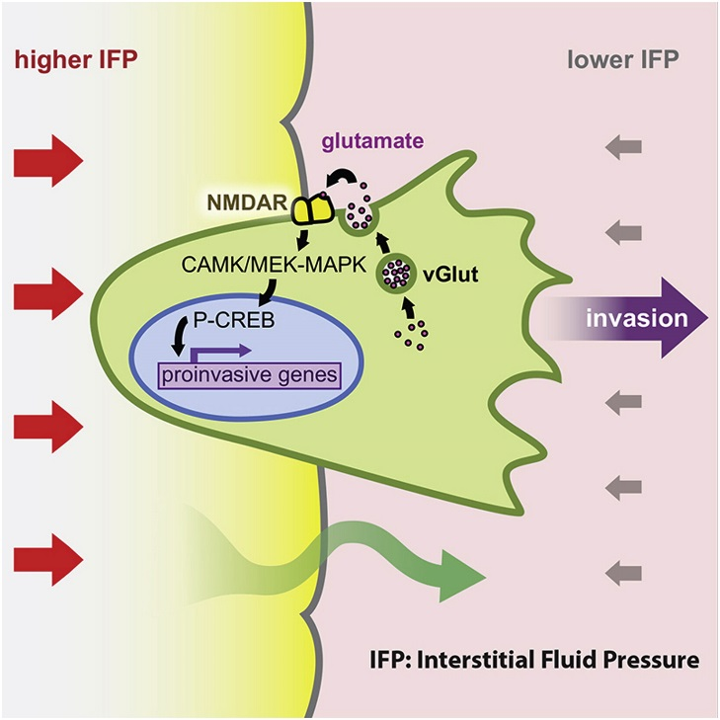
Passive Targeting: EPR Effect
The problems associated with passive targeting include:
High interstitial fluid pressure (IFP) in most solid tumors
Lack of angiogenesis in big solid tumor

Slide 35
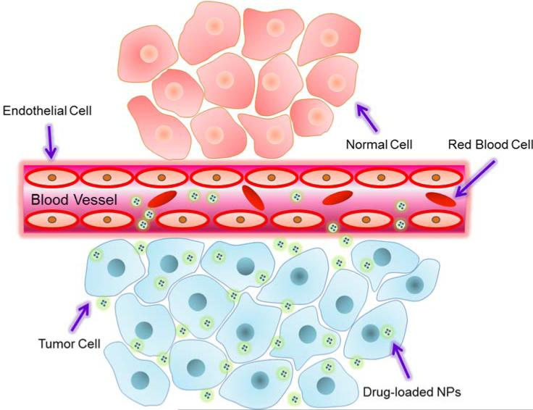
Passive Targeting: EPR Effect
The EPR effect is influenced particle size, shape, and surface charge:
PEGylated nanoparticles
Nano particles smaller than 100nm
Nano particle with negative surface charge
circulate longer in blood

Slide 36
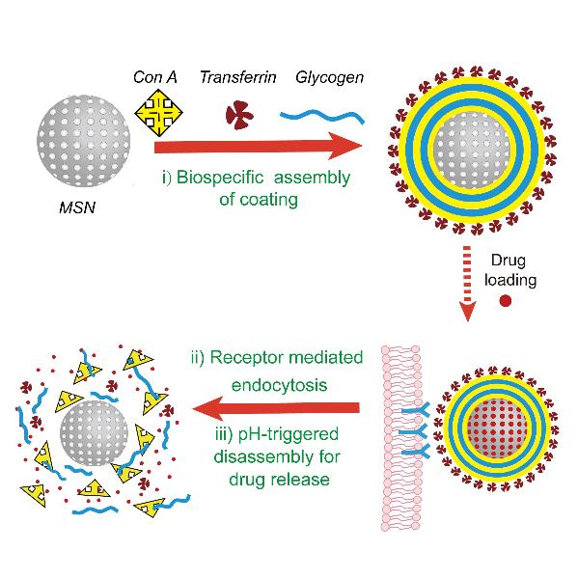
Passive Targeting: PH Sensivity
tumor cells use glycolysis to acquire extra energy, producing an acidic environment
The pH-sensitive liposomes are designed to be stable at a physiological pH of 7.4 but are degraded the acidic environment of tumor cells

Slide 37
Liposomal Drug
Marketed liposomal-based therapeutics and products in clinical development
Type of liposomal-based drug delivery | Status | Disease | Drug
Conventional | FDA Approved in 1996 | Leukemia and solid tumors | Daunorubicin
PEGylated | FDA Approved in 1995 | Leukemia, breast cancer, bone cancer, lung cancer, brain cancer | Doxorubicin (DOXIL)
Conventional | Phase I/II | Acute lymphoblastic leukemia (ALL) | Annamycin
Conventional | Phase II | Acute promyelocytic leukemia (APL) | Tretinoin
Conventional | FDA Approved in 2012 | Non-Hodgkin lymphoma | Vincristine
Cationic | Phase I | Acute myeloid leukemia | Mitoxantrone LEM-ETU
PEGylated | FDA Approved in 2007 | Relapsed or refractory multiple myeloma | Doxorubicin and bortezomib

Slide 38
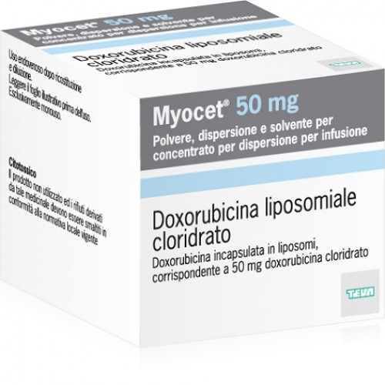
Liposomal Drug
Myocet
Liposome–encapsulated doxorubicin–citrate
Component: Phospholipid and cholesterol
Application: Drug delivery to Macrophage of RES system
Low cardio- toxicity than free doxorubicin

Slide 39
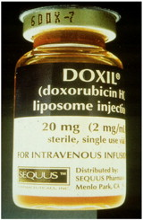
Liposomal Drug
DOXIL
Developed in 1995
Liposome-PEG doxorubicin
PEG (polyethylene glycol) makes the liposome less vulnerable
to immune system
Anti-cancer drug used in:
Leukemia, breast cancer, bone cancer, lung cancer, brain cancer
treatment of HIV-related Kaposi’s sarcoma، breast cancer, ovarian cancer
Low cardio- toxicity than free doxorubicin

Slide 40
Dissadvantages of liposome
Their rapid clearance from circulation due to uptake by RES system
Less stable as phospholipids are easily susceptible to oxidation
Leakage and fusion of encapsulated drug / molecules
Short half life
Low solubility
Production cost is high

Slide 41
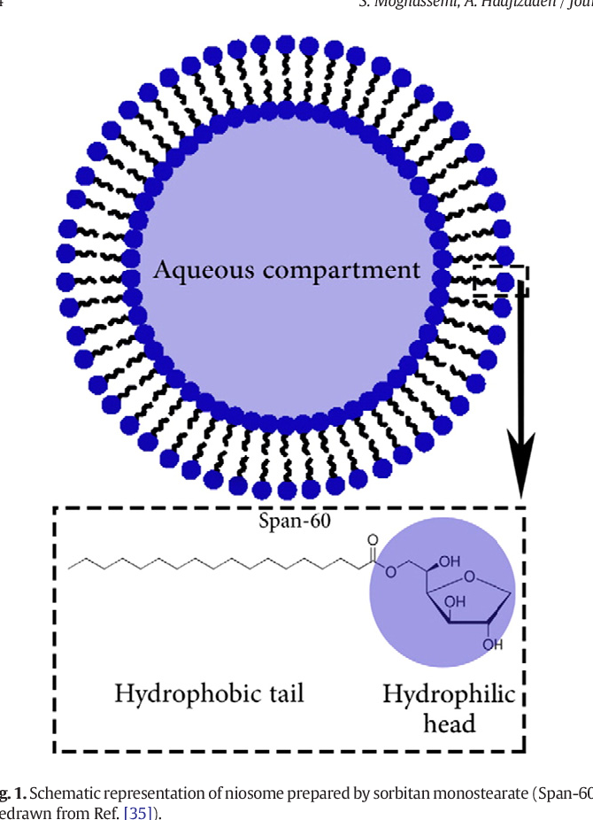
Niosome
Similar to liposome in that way they are also made up of a bilayer lipid and can entrap both hydrophilic and hydrophobic drugs
Component:
non-ionic surfactant (Tween,Span ) + Cholesterol
Advantage:
storage of surfactants require no special conditions
Less Expensive
Non-ionic surfactant are safer and less toxic
More Stable

Slide 42


