Slide 1
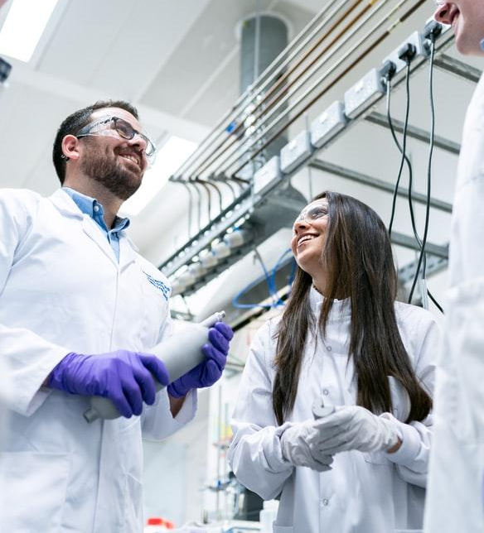

Various Aspects of Calcium Signaling in the Regulation of Apoptosis, Autophagy, Cell Proliferation, and Cancer
SUPERVISOR:DR.MARDANI,PHD
PRESENTED BY PIROUZBAKHT

Slide 2
Abstract
A General Overview of Ca2+ Signaling
Role of Ca2+ in Apoptosis and Cancer
Cancer Therapies with inhibitors Ca2+ Signaling
1
3
5
2
4
Ca2+ Homeostasis during Cell Cycle and Tumor Growth
The Regulation of Autophagy by Calcium Signals and Its Involvement in Cancer

Slide 3
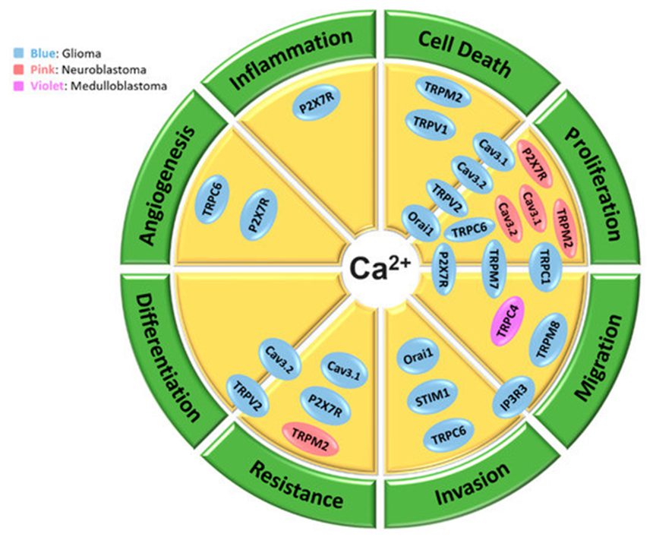
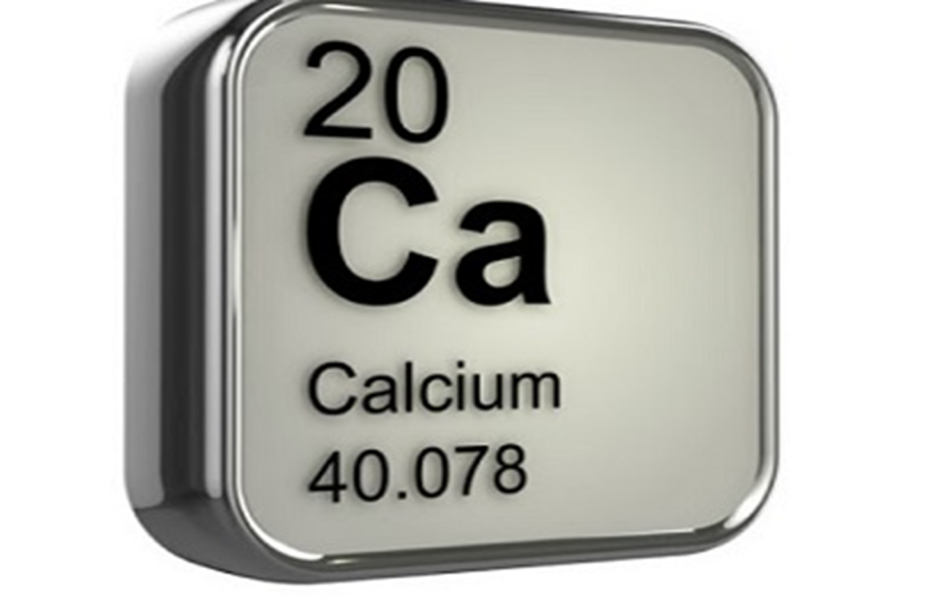
ncer

Slide 4
Introduction
1
A General Overview of Ca2+ Signaling and channel
4

Slide 5
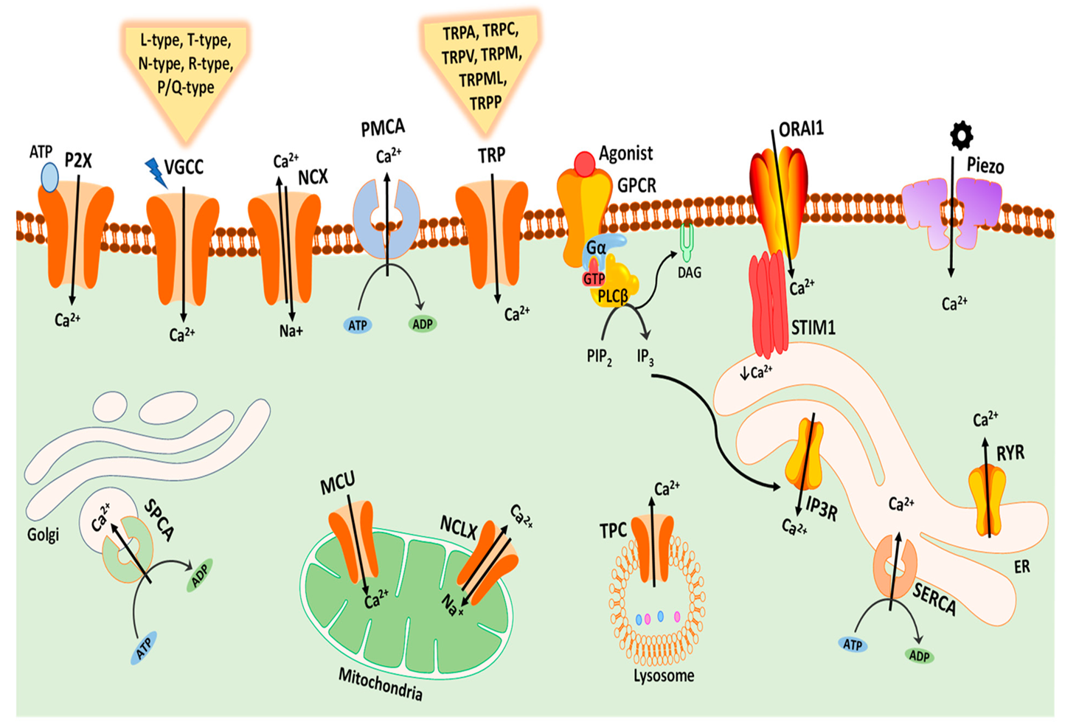

Slide 6
Ca2+ Homeostasis during Cell Cycle and Tumor Growth
2

Slide 7
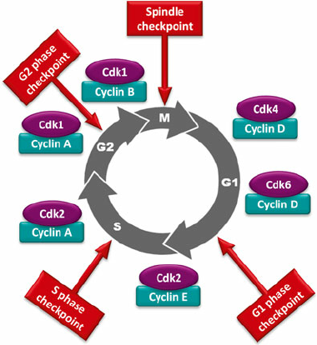

Slide 8
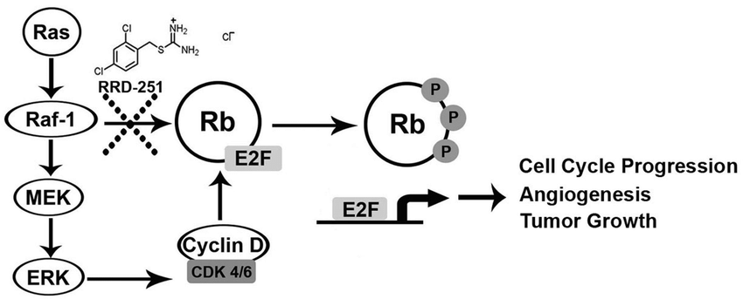

Slide 9
3
Role of Ca2+ in Apoptosis and Cancer

Slide 10
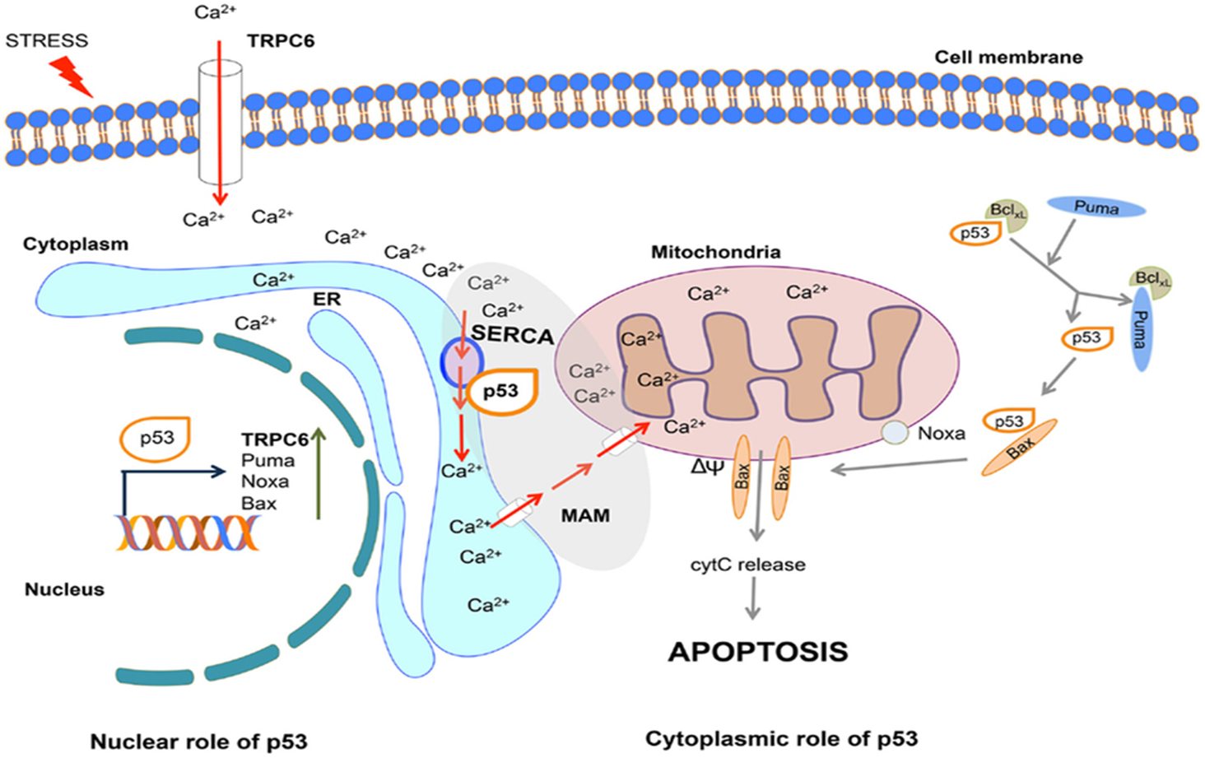
Bcl2

Slide 11
4
The Regulation of Autophagy by Calcium Signals and Its Involvement in Cancer

Slide 12
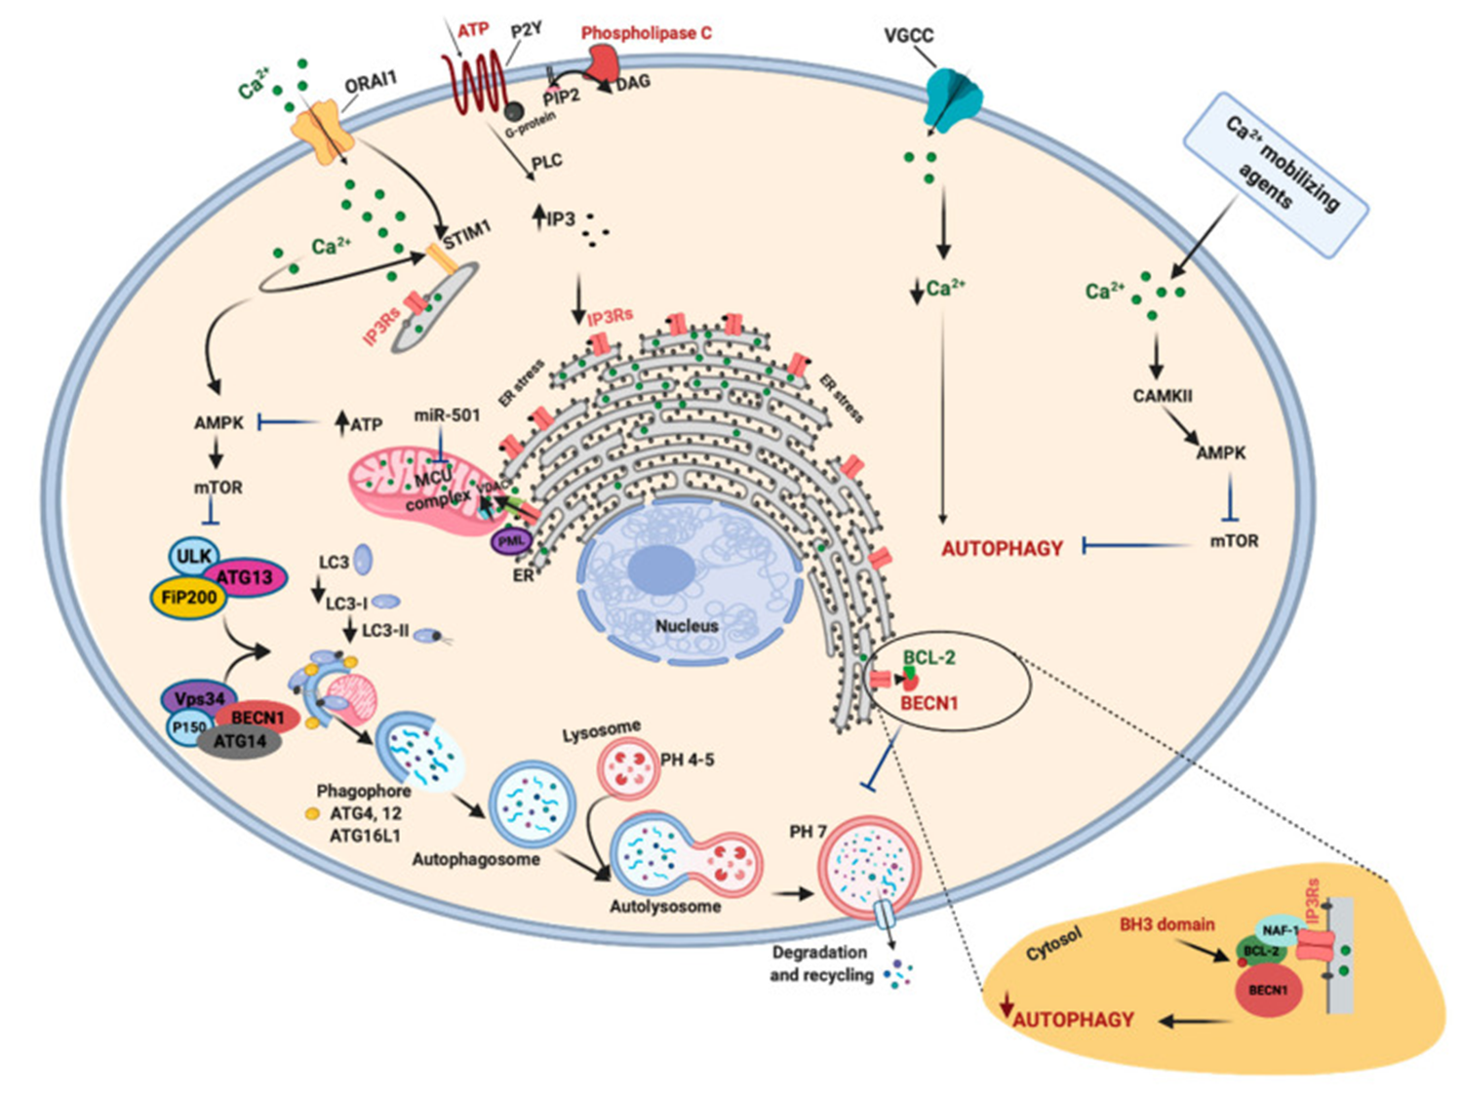

Slide 13
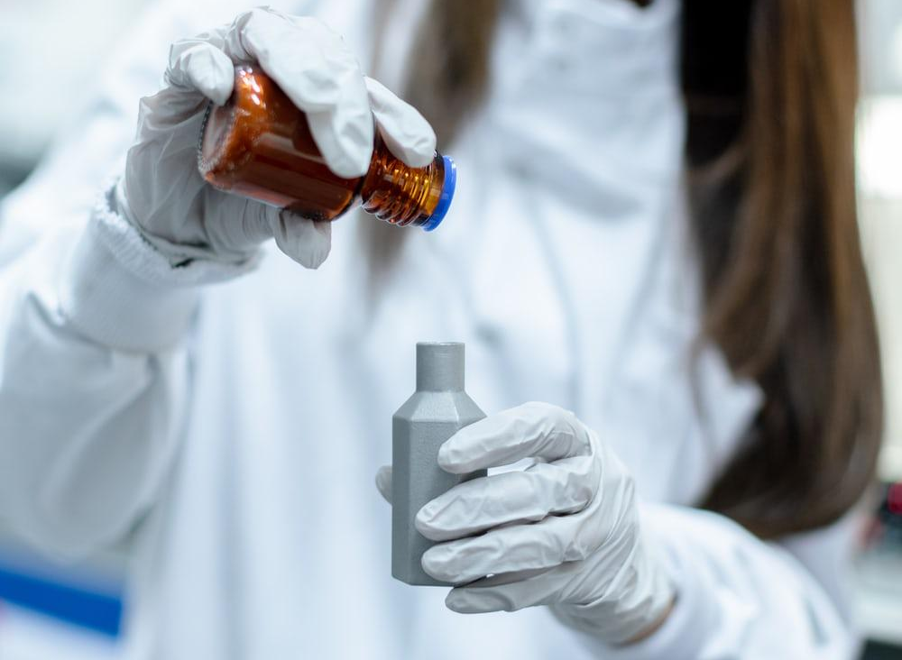
Cancer Therapies with inhibitors Ca2+ Signaling
1.Fluorouracil
2. Paclitaxel
3.Cisplatin
4. Chloroquine

Slide 14
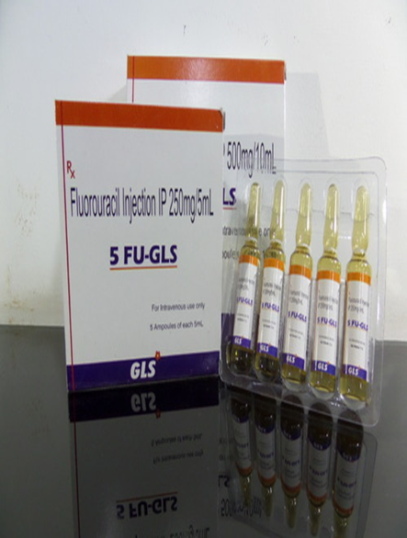

Slide 15
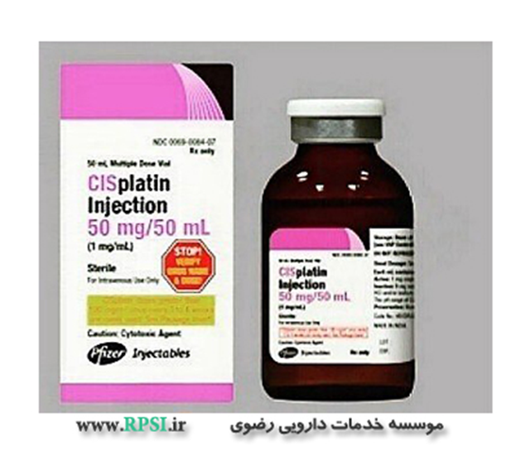

Slide 16
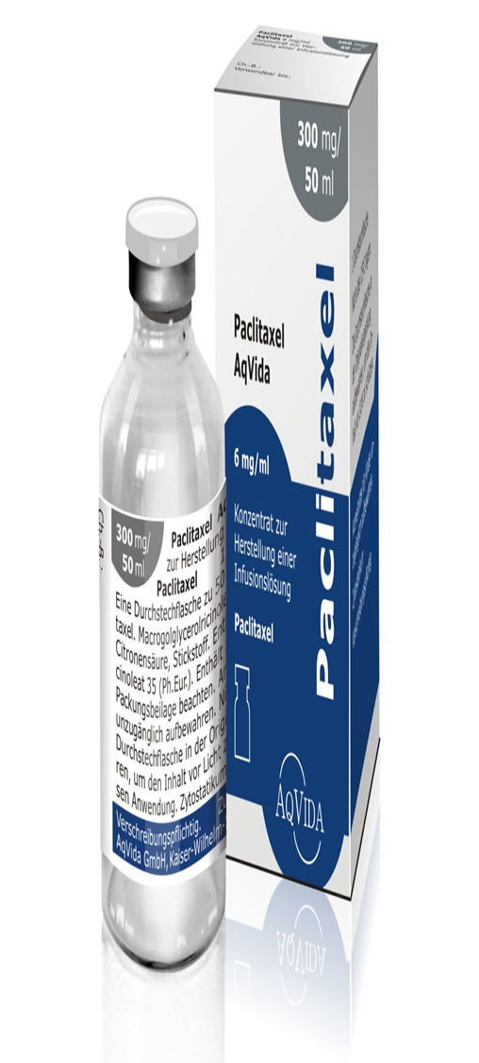

Slide 17
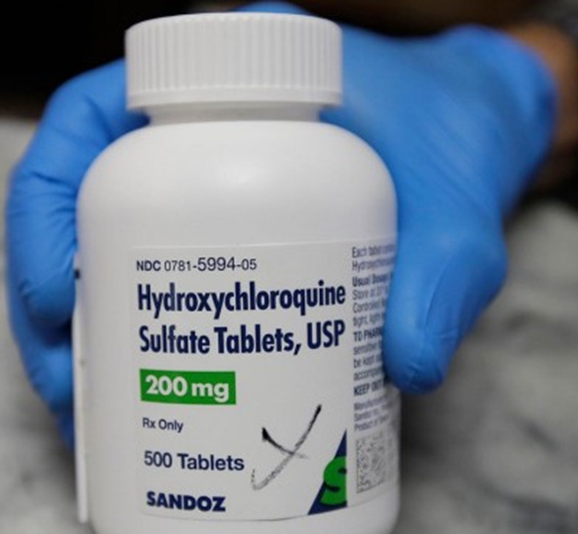

Slide 18
THANKS!
Any questions?

