Slide 1

In the name of God
Zahra Barzang
Msc of hematology & blood banking kerman university medical sciences

Slide 2
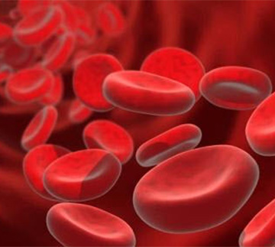
Erythrocytosis: the HIF pathway in control

Slide 3
Epo: the driving force of erythropoiesis
Epo, a glycoprotein hormone, is the principal stimulator of erythropoiesis and is induced under hypoxic conditions.
the kidney was ﬁrst identiﬁed as the primary Epo-producing organ in adult mammals.
the liver is the major source of Epo during embryogenesis.

Slide 4
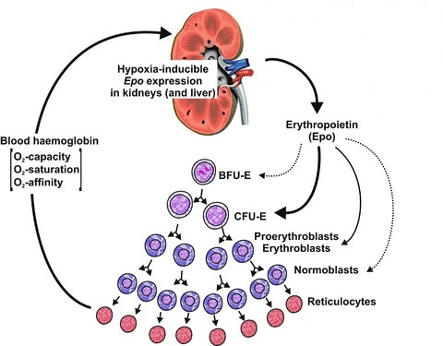

Slide 5
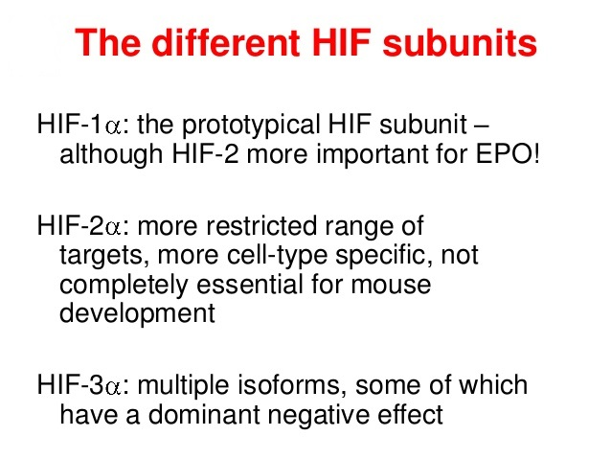

Slide 6
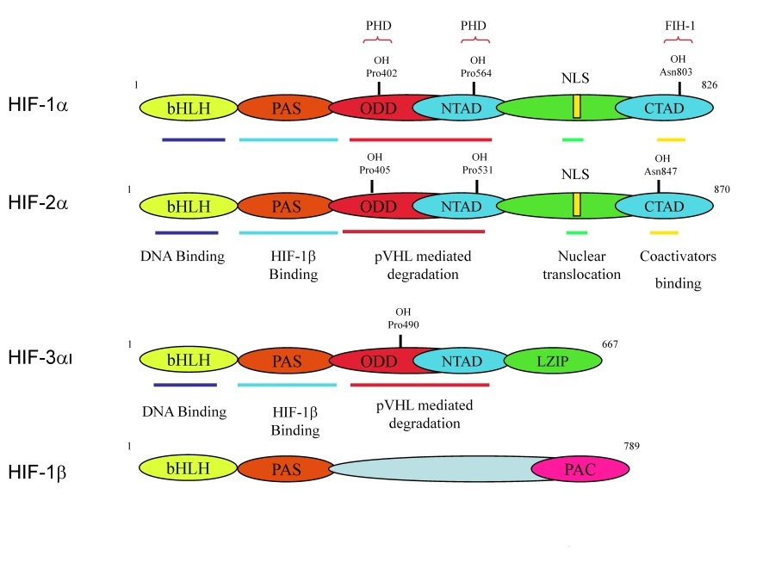

Slide 7
The HIF pathway
The HIF pathway is present in virtually every cell of the body.
More than a decade ago, the groups of Ratcliffe and Kaelin discovered that both HIF1a and HIF2a are regulated at the posttranscriptional level by the HIF prolyl-hydroxylase domain enzymes (PHDs).

Slide 8
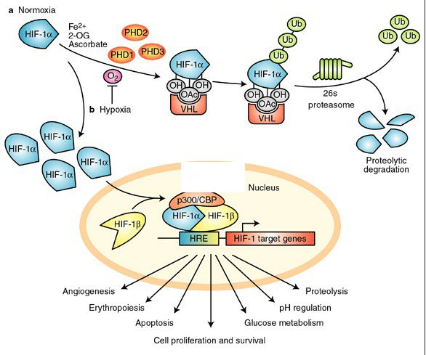

Slide 9
Mutations in HIF pathway proteins can lead to erythrocytosis in humans
Erythrocytosis is an aberrant increase in red blood cell numbers and comprises a heterogeneous group of disorders.
primary erythrocytosis is polycythemia vera.

Slide 10
Polycythemia vera
polycythemia
absolute
Primary
(Epo orN)
Secondary
(EPO )
relative
Polycythemia
familial
Hypoxia
normoxic

Slide 11
Erythrocytosis or polycythemia:
Relative polycythemia
Secondary polycythemia:
Hypoxic
Normoxic
Familial polycythemia
Chuvash
Vera polycythemia

Slide 12
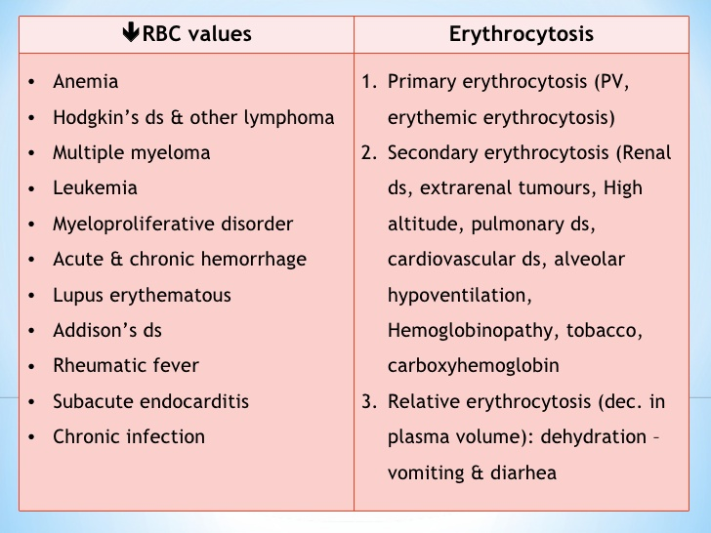

Slide 13
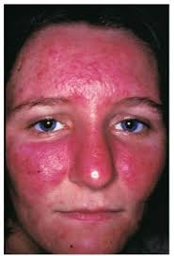
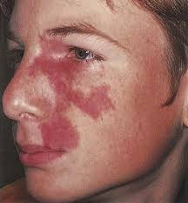

Slide 14
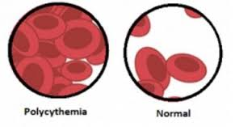

Slide 15
Hypoxia inducible factor: It’s role in angiogenesis and tumor
Angiogenesis, as the process of new vessel formation from pre-existing vessels is dependent on a delicate equilibrium between endogenous angiogenic and antiangiogenic factors.
Angiogenesis is a complex process that includes many gene products that are produced by different cells.

Slide 16
Tumor development
Steps in carcinogenesis
Gene defects
Metastases
Tumor
Normal cell
Cancer cell
Cell population
Transformation
Uncontrolled cell growth
Anti-apoptosis
Angiogenesis
Hypoxia
Apoptosis: programmed cell death
Spreading
Invasive growth
Angiogenesis: growth of blood vessels
Therapy
Notes:
To understand why hypoxia arise in tumors, we need some background in development of the cancer disease, that is what we call carciinogenesis developemnt

Slide 17

Thank you

