Slide 1
Journal club presentation
S. Karimi
Dr. Farsinejad
Nov.2021

Slide 2
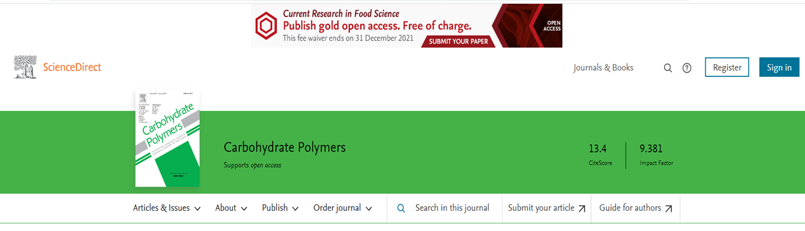
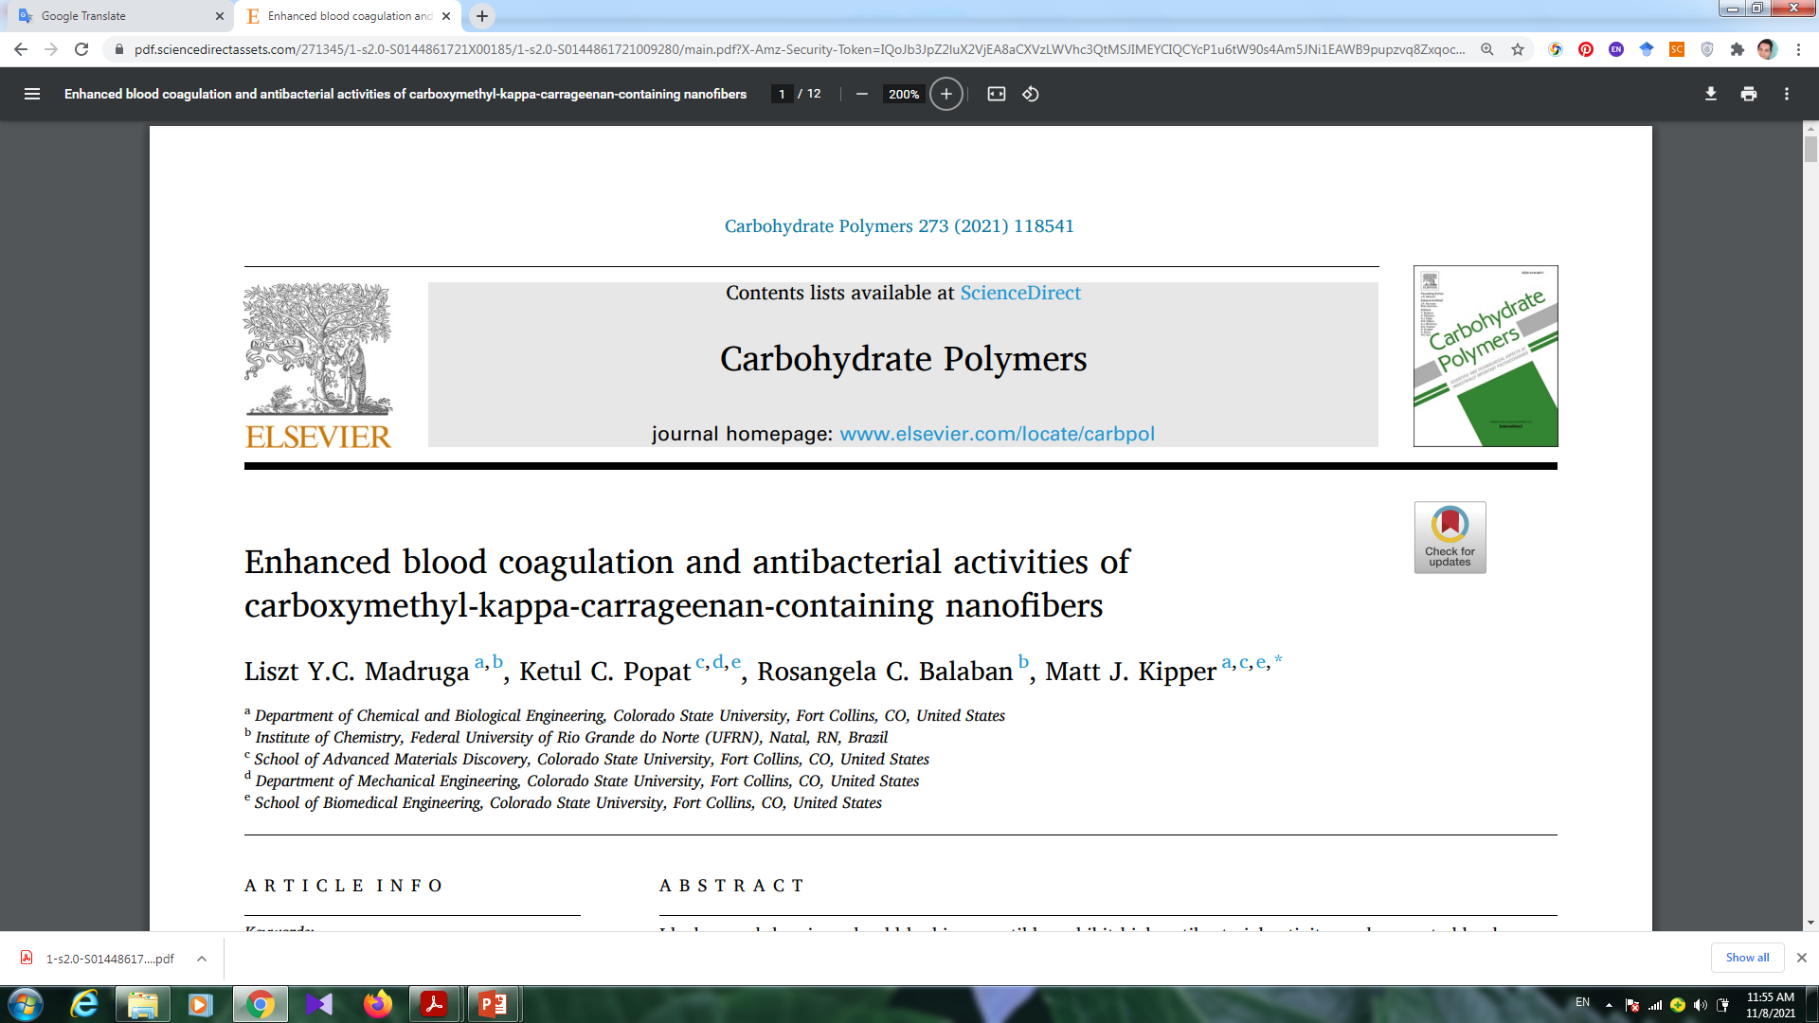

Slide 3
Introduction
Electrospun nanofibers
Wound dressings
Properties of nanofiber-based dressings for wound healing
Carboxymethyl kappa-carrageenan (CMKC) + polyvinyl alcohol (PVA)

Slide 4
Mterials & Methods
CMKC + PVA
Carboxymethylation of kappa-carrageenan
Electrospinning of PVA-CMKC nanofibers
Characterization of PVA-CMKC nanofibers

Slide 5
Mterials & Methods
Antibacterial activity: Bacteria adhesion and morphology on the nanofibers
Hemostatic activity : Protein adsorption on the nanofibers
Platelet adhesion and activation
Whole blood clotting

Slide 6
Results
Characterization of PVA/CMKC nanofibers
 | % C1s | % N1s | % O1s | % S2p
PVA | 70.53 | 0.00 | 29.47 | 0.00
PVA-CMKC 25% | 66.78 | 0.00 | 32.79 | 0.43
PVA-CMKC 50% | 60.99 | 0.00 | 38.50 | 0.51
PVA-CMKC 75% | 65.15 | 0.00 | 34.18 | 0.67

Slide 7
Nitrogen content of the nanofibers before and after protein adsorption experiments, obtained from XPS survey scans.
% N (before) | % N (fibrinogen) | % N (albumin)
PVA | 0.00 | 5.28 | 3.03
PVA-CMKC 25% | 0.00 | 3.38 | 1.83
PVA-CMKC 50% | 0.00 | 4.69 | 0.17
PVA-CMKC 75% | 0.00 | 3.13 | 0.61

Slide 8
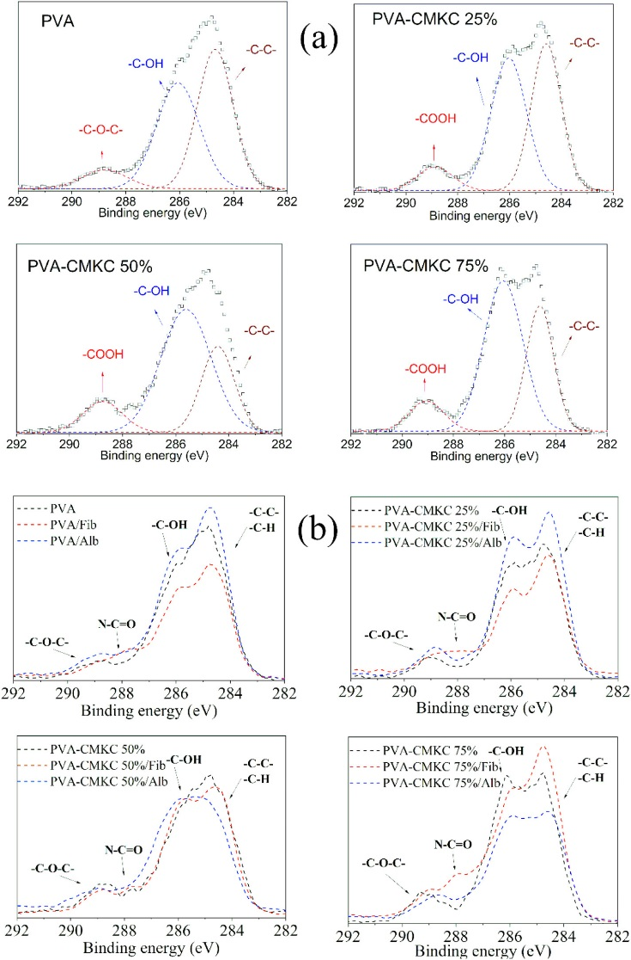
Results

Slide 9
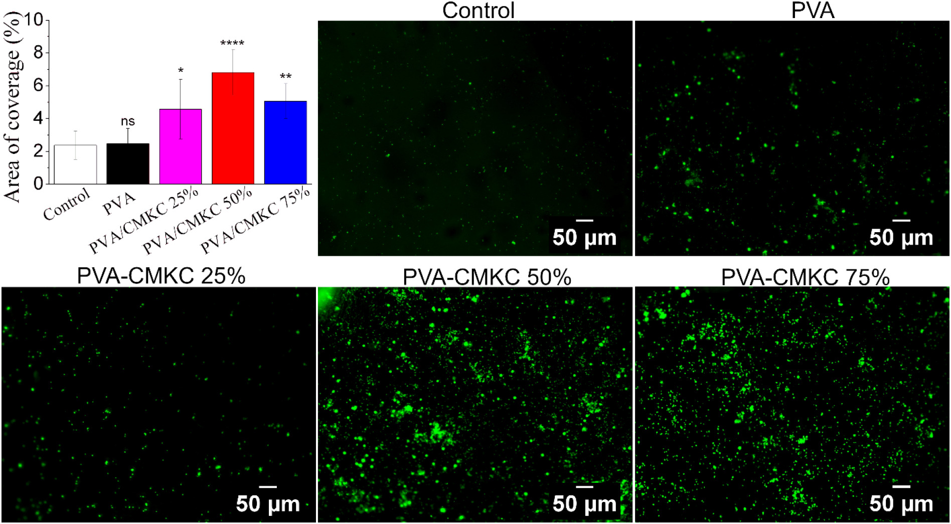
Results
Hemostatic activity

Slide 10
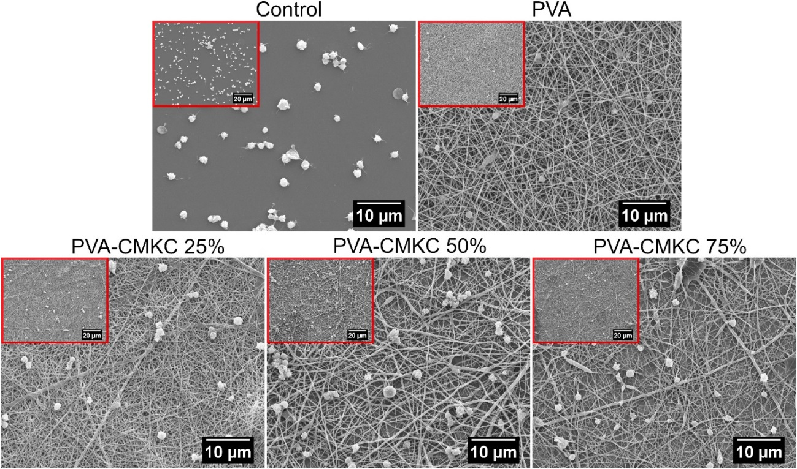
Results
SEM micrographs of adhered platelets
SEM micrographs of adhered platelets

Slide 11
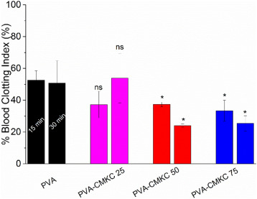
Results
Whole blood clotting

Slide 12
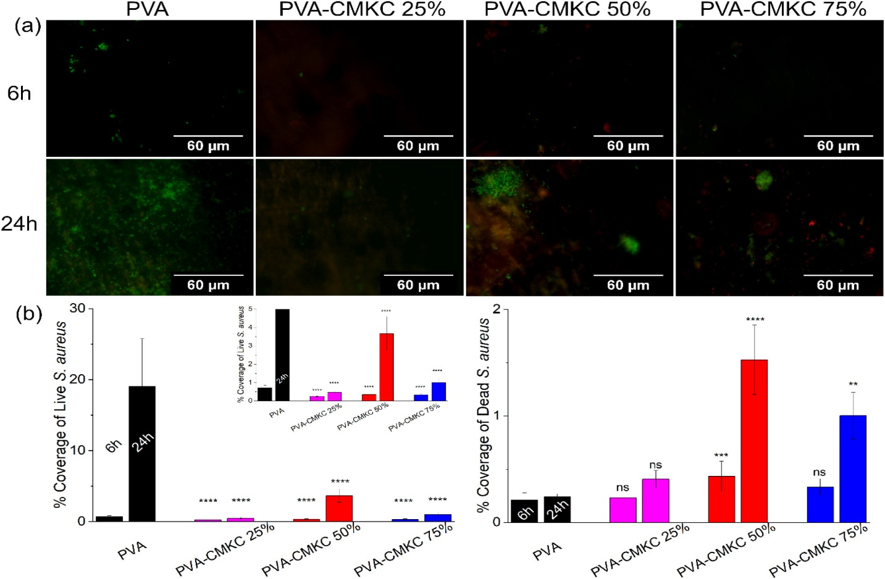
Results
Bacteria adhesion on the nanofibers

Slide 13
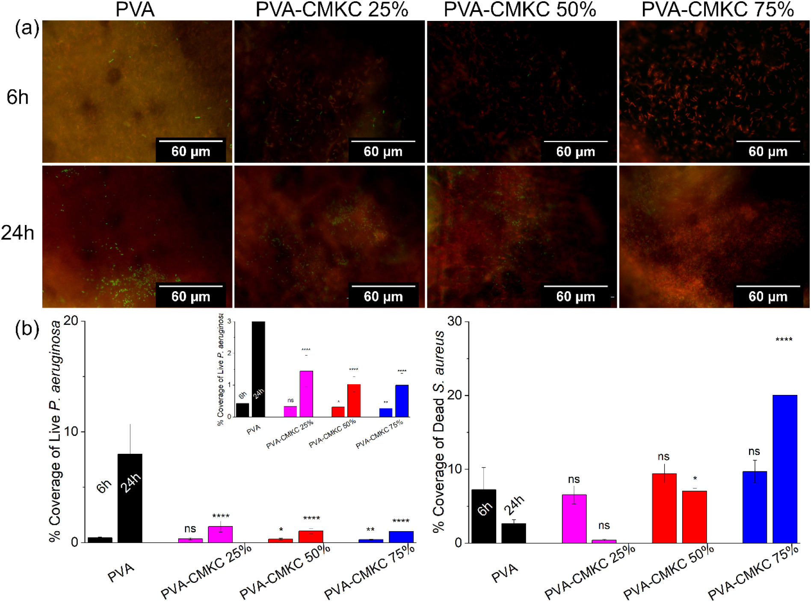
Results

Slide 14
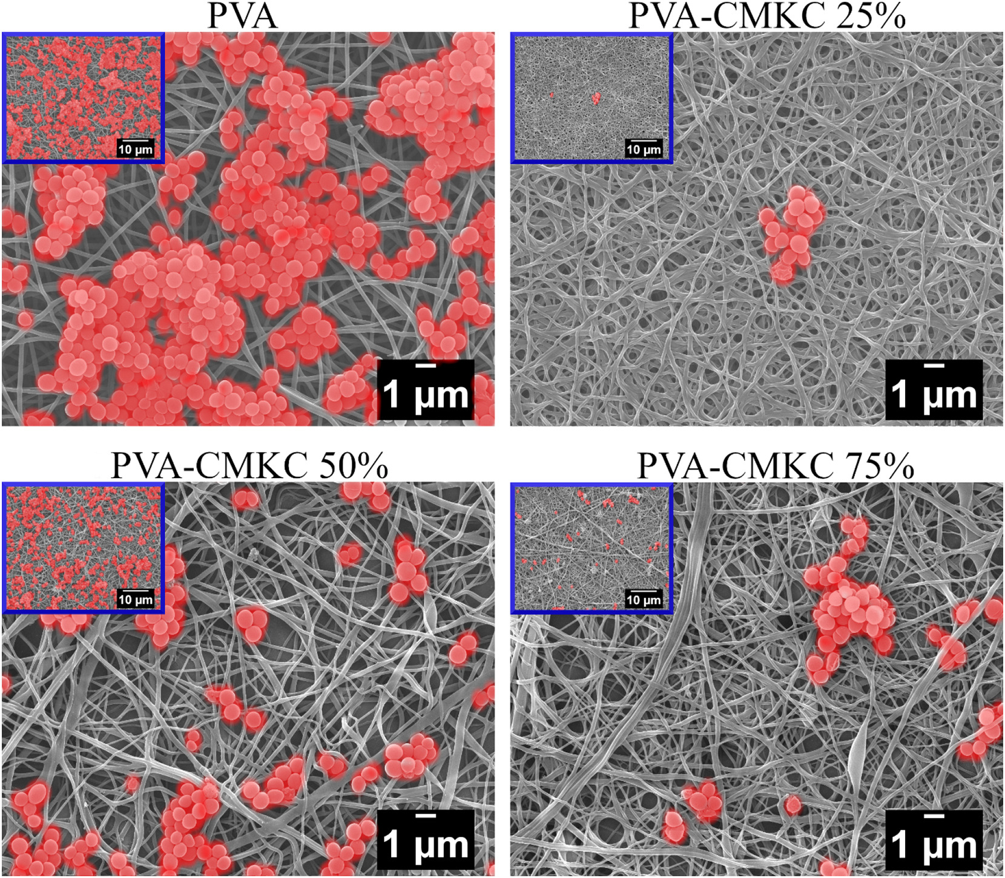
Results SEM images of S. aureus on the nanofibers after 24 h of incubation

Slide 15
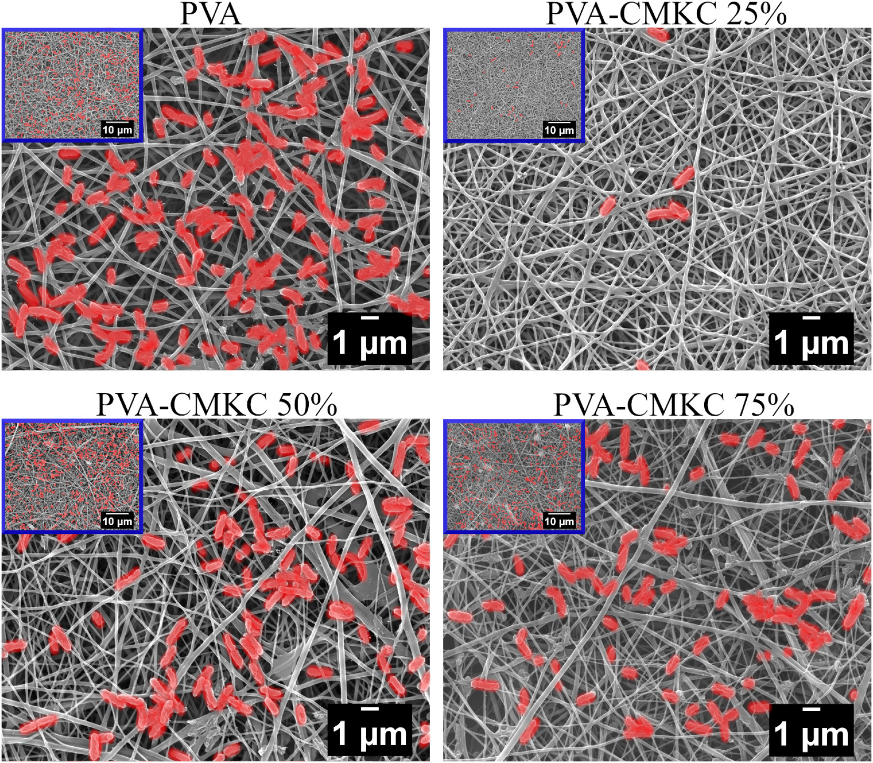
Results SEM images of P. aeruginosa on the nanofibers after 24 h of incubation.

Slide 16
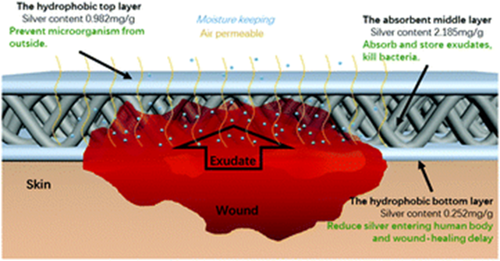
Conclusion
PVA-CMKC nanofibers

Slide 17


