Slide 1

lncRNA SNHG3 facilitates acute myeloid leukemia cell growth via the regulation of miR-758-3p/SRGN axis
Presenter: Hanieh Karimi
Advisor: Dr. Mardani
1

Slide 2
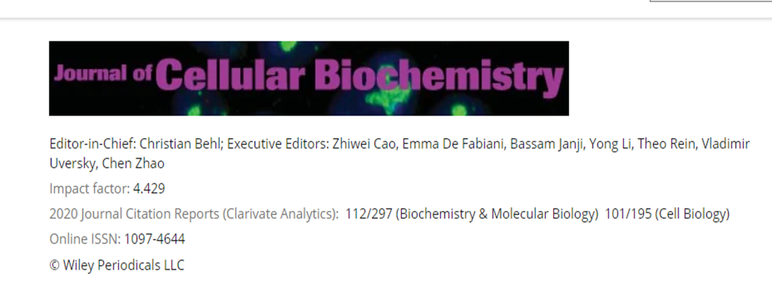
Journal of cellular biochemistry

Slide 3
Introduction
3

Slide 4
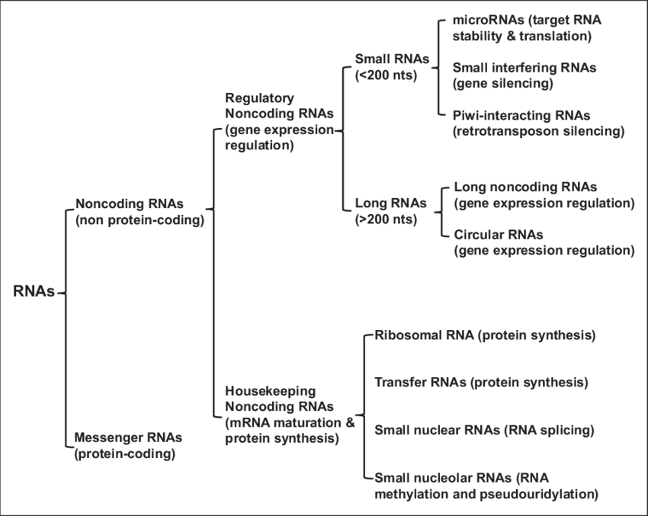
Noncoding RNAs

Slide 5
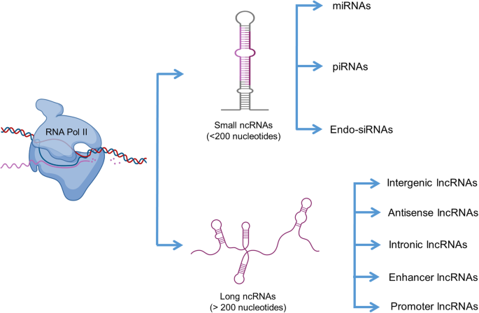
Noncoding RNAs

Slide 6
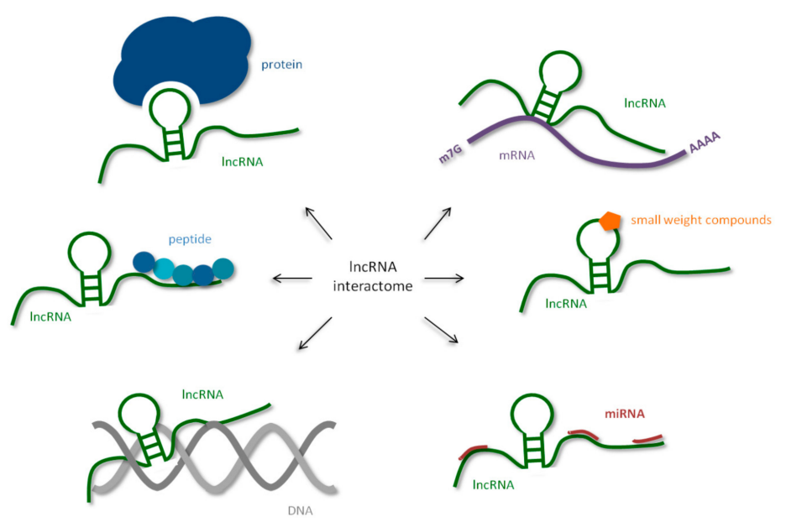
Human long non-coding RNAs (lncRNA) interactome, interaction of human lncRNA with cellular biomolecules

Slide 7
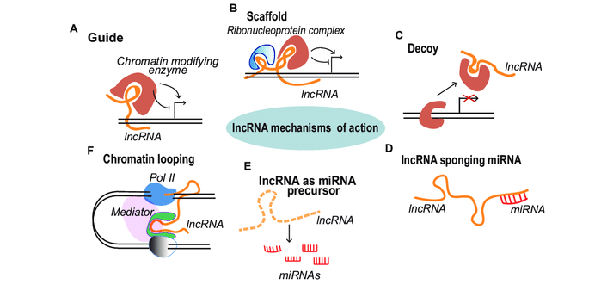
LncRNAs mode of action

Slide 8
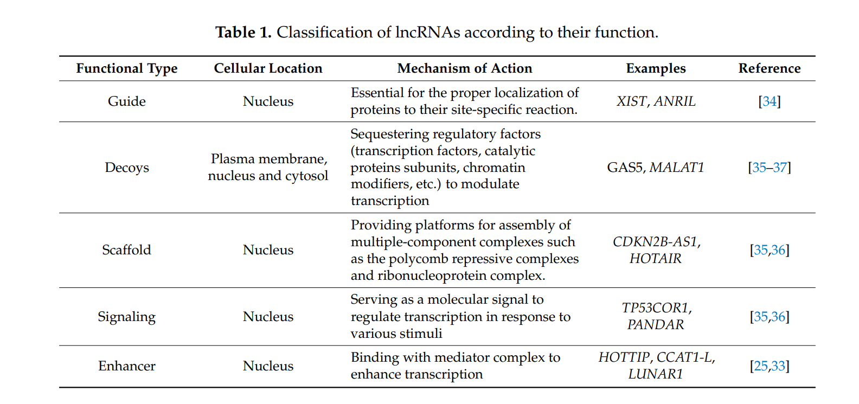

Slide 9
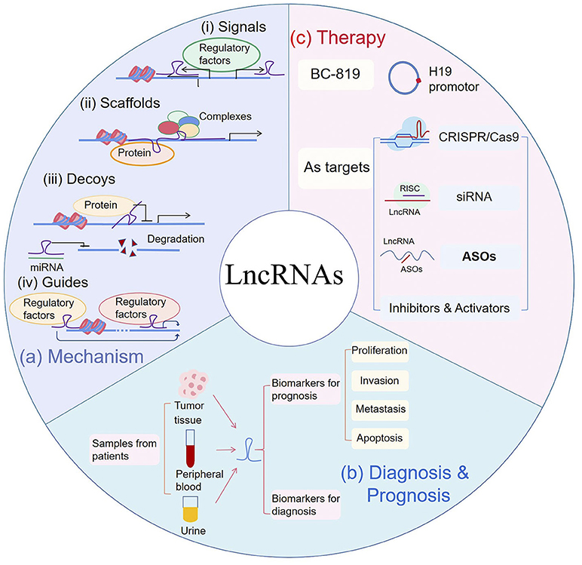

Slide 10
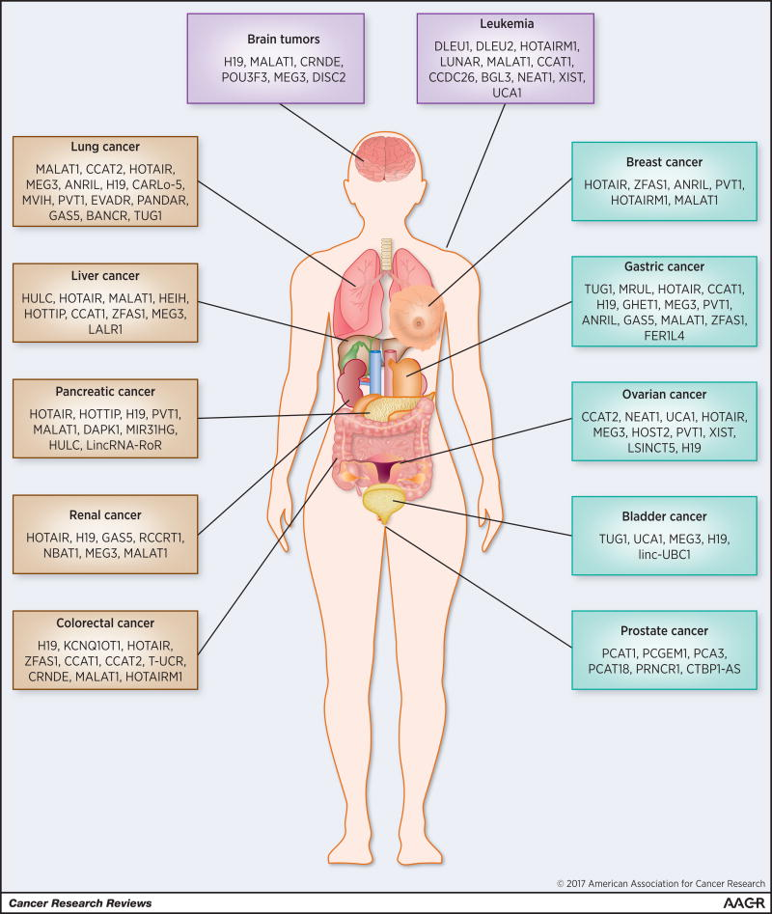
LncRNAs and Cancer

Slide 11
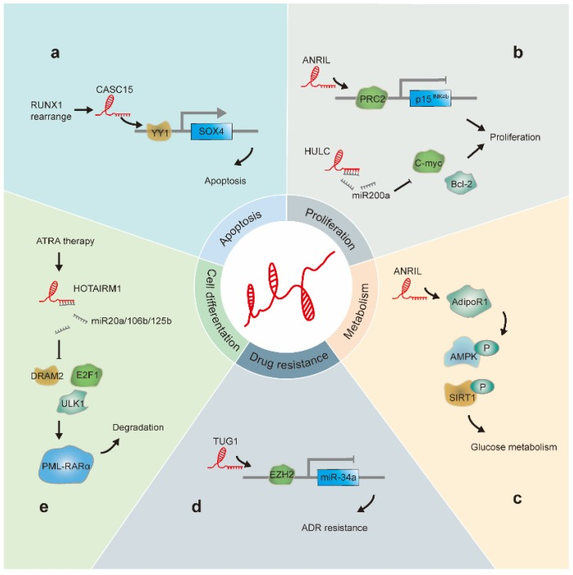
LncRNAs and leukemia

Slide 12
Serglycin (SRGN)
a hematopoietic cell granule proteoglycan
myeloid leukemia and lymphoid leukemia
SRGN has been reported to be upregulated in AML

Slide 13
MATERIALS AND METHODS

Slide 14
MATERIALS AND METHODS
1. Patients and clinical samples
62 AML patients and healthy volunteers
3. Cell transfection
Short hairpin RNAs (shRNA)
pcDNA3.1/SRGN
Lipofectamine 2000
2. Cell lines and cell culture
HL‐60 NB4
MOLM‐14 KG‐1
THP‐1
4. RNA extraction and quantitative real-time PCR

Slide 15
MATERIALS AND METHODS
5. MTT assays
viability
7. Western blot analysis
protein
6. Cell apoptosis analysis
Annexin V‐FITC/propidium iodide (PI)
8. Luciferase reporter assay

Slide 16
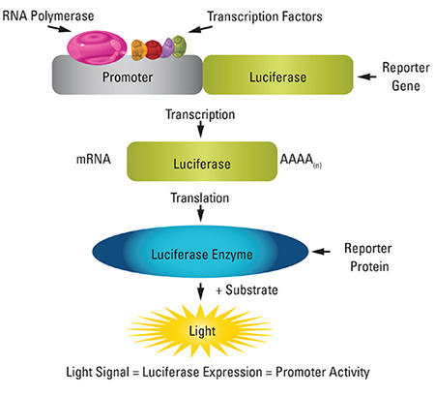

Slide 17
MATERIALS AND METHODS
9. RNA Pull down assay

Slide 18
Results
Upregulated SNHG3 and SRGN predict poor outcome in adult AML patients

Slide 19
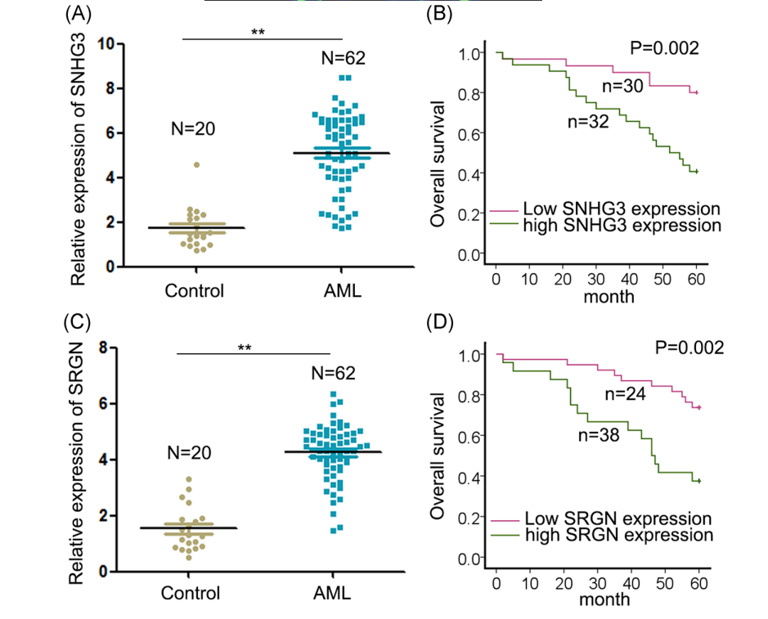

Slide 20
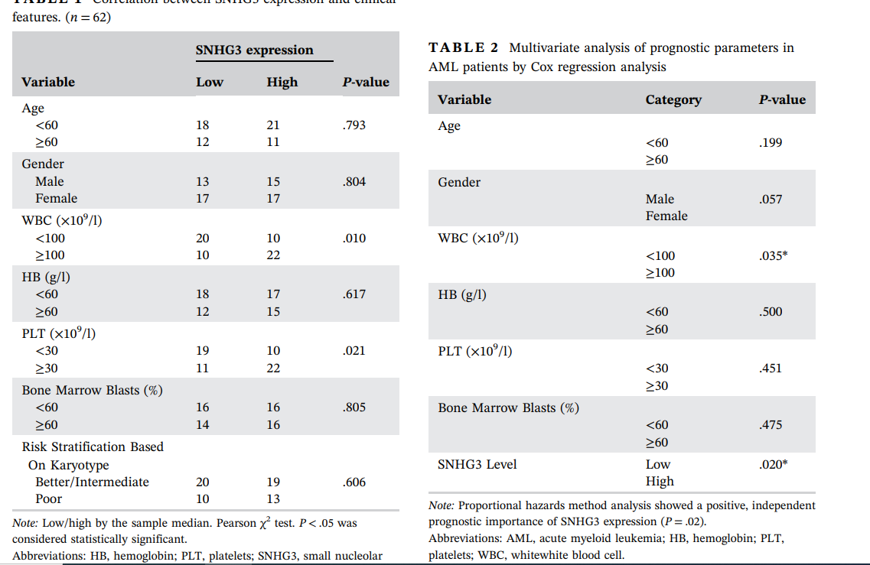

Slide 21
Results
Silencing SNHG3 or SRGN results in suppressed cell growth in AML cells

Slide 22
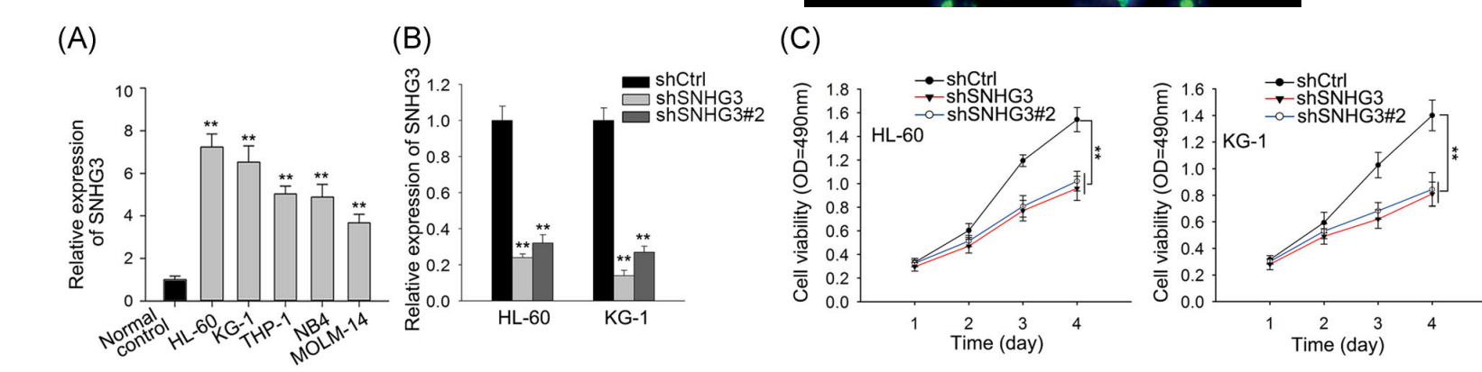

Slide 23
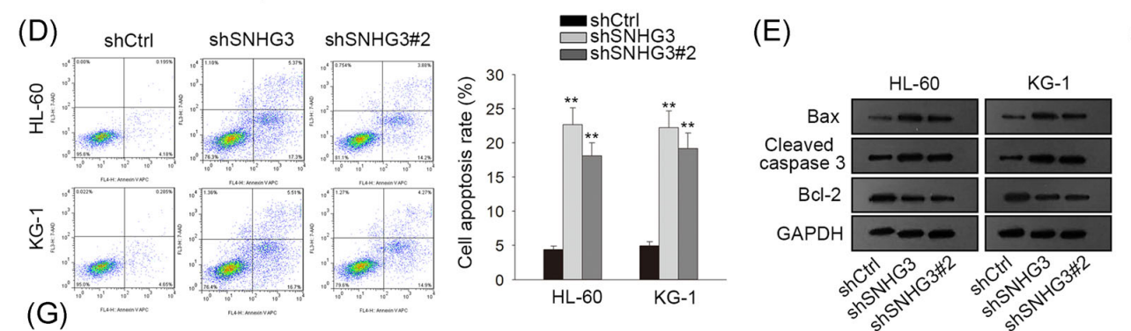

Slide 24
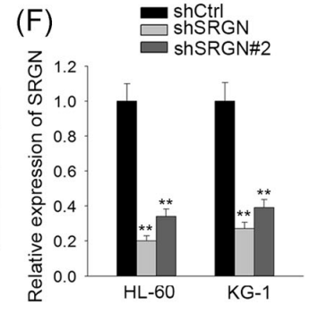
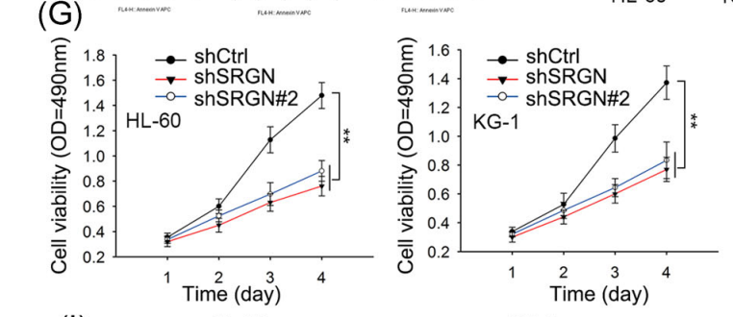

Slide 25
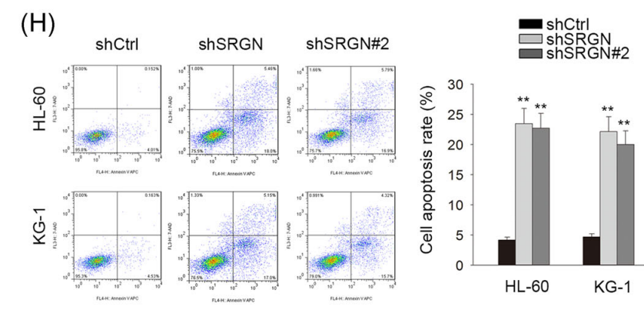
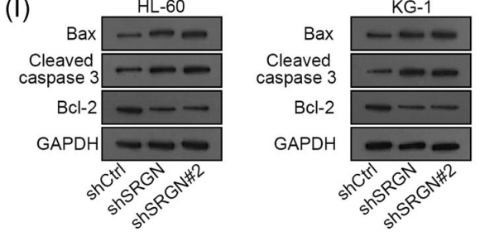

Slide 26
Results
SNHG3 modulates SRGN expression via sponging miR‐758‐3p

Slide 27
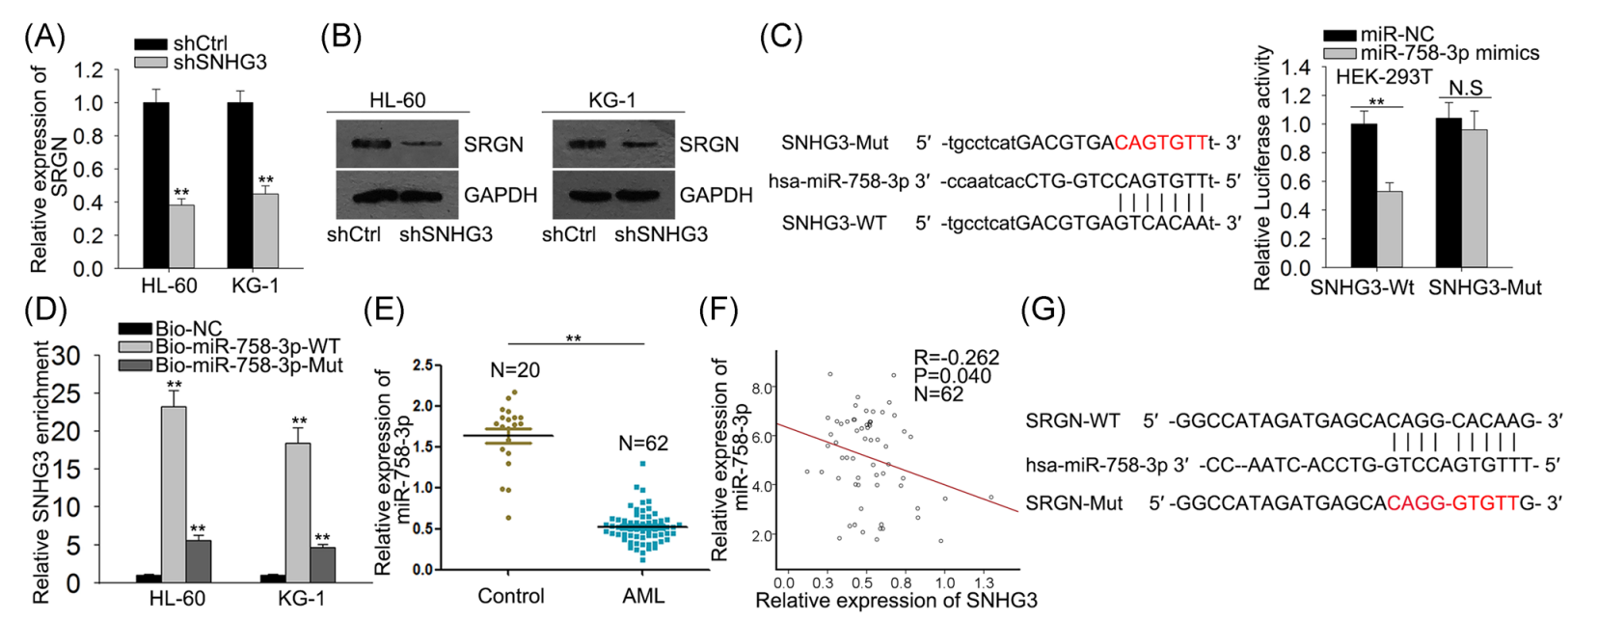

Slide 29
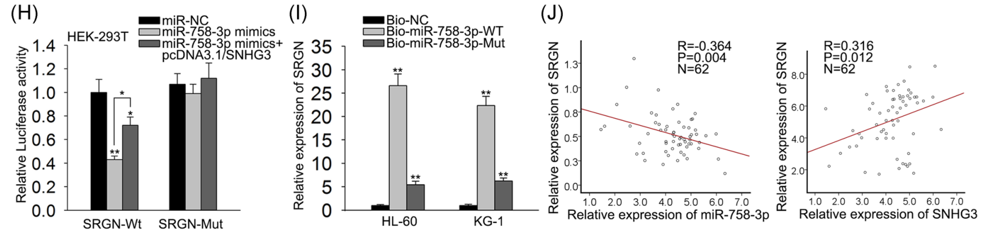

Slide 30
Results
SNHG3 modulates AML cell growth through regulating miR‐758‐3p/ SRGN axis

Slide 31
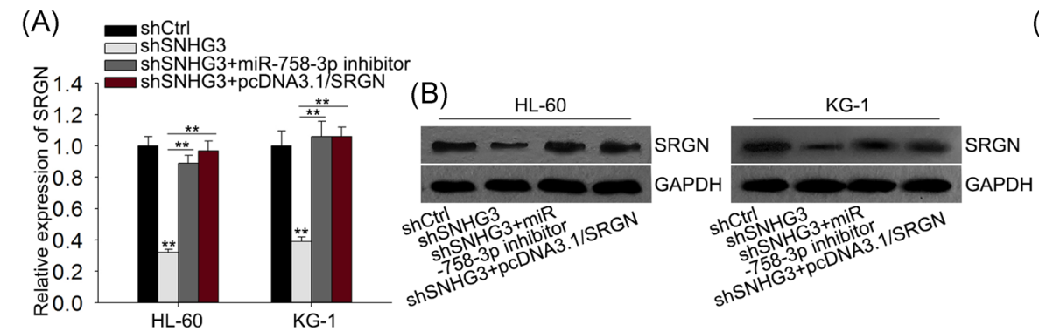
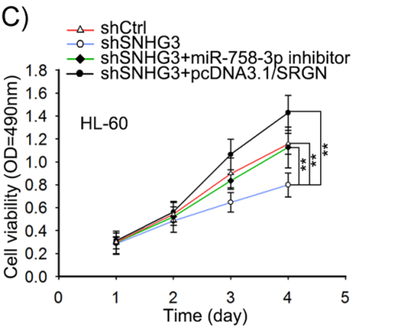

Slide 32
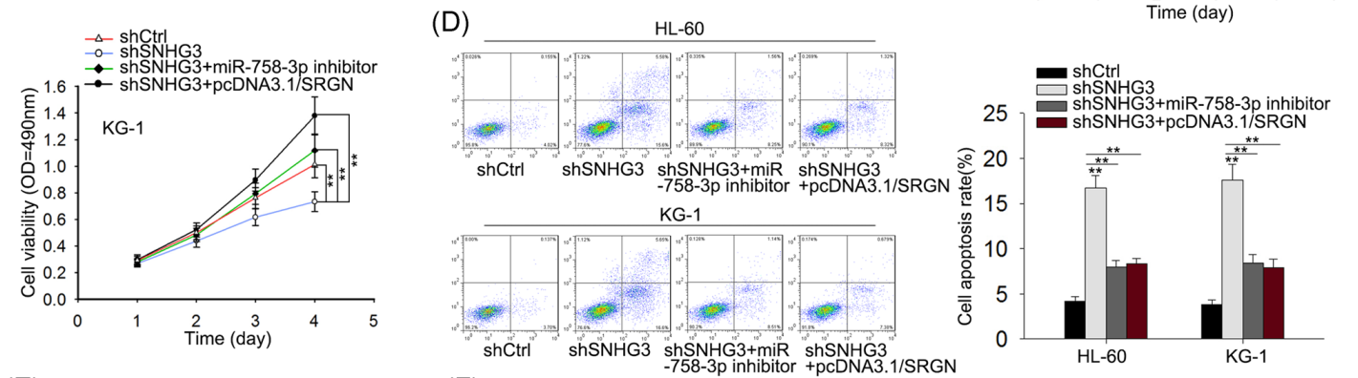

Slide 33
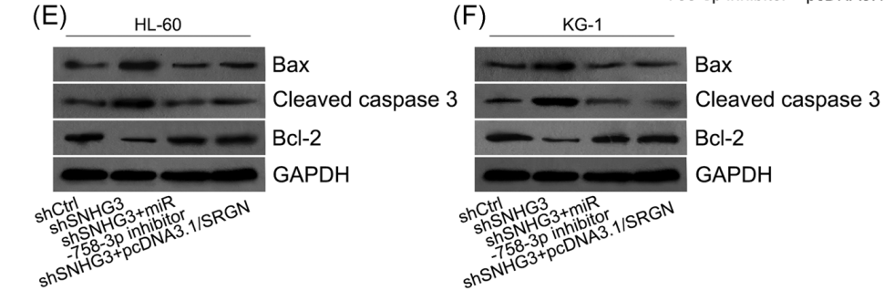

Slide 34

Discussion

Slide 35
Thanks!
Any questions ?

