Slide 1

Proteomic analysis of MSC-derived apoptotic vesicles identifies Fas inheritance to ameliorate haemophilia a via activating platelet functions
Presenter: Hanieh kariminejad
Advisor: Dr. Mardani

Slide 2
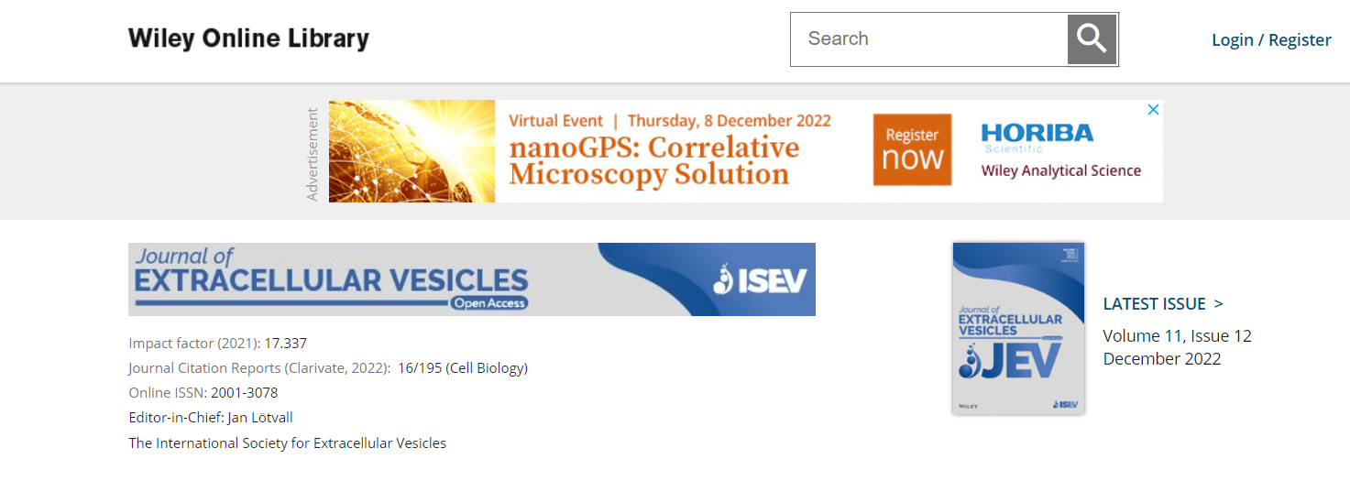

Slide 3
Introduction
1

Slide 4
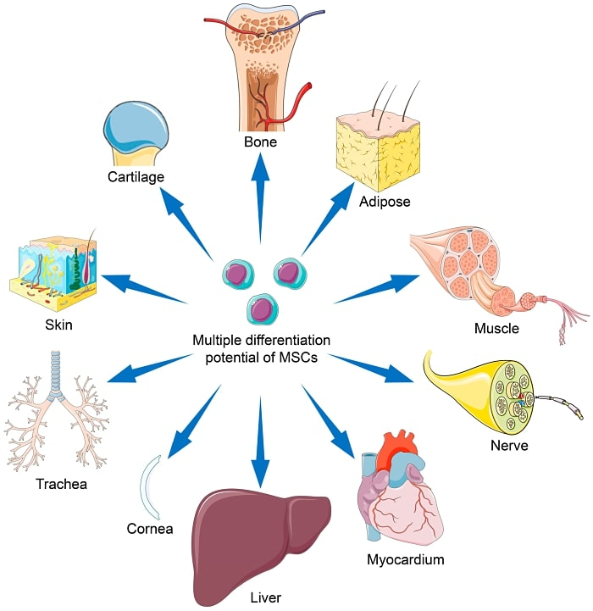
mesenchymal stem cell

Slide 5
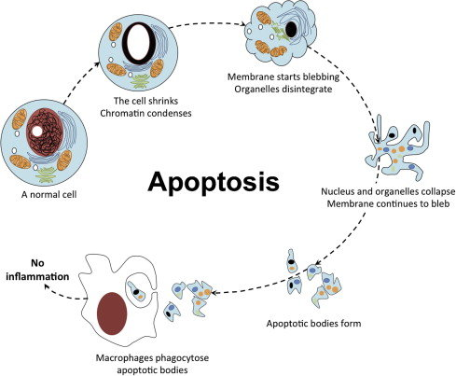
Apoptosis

Slide 6
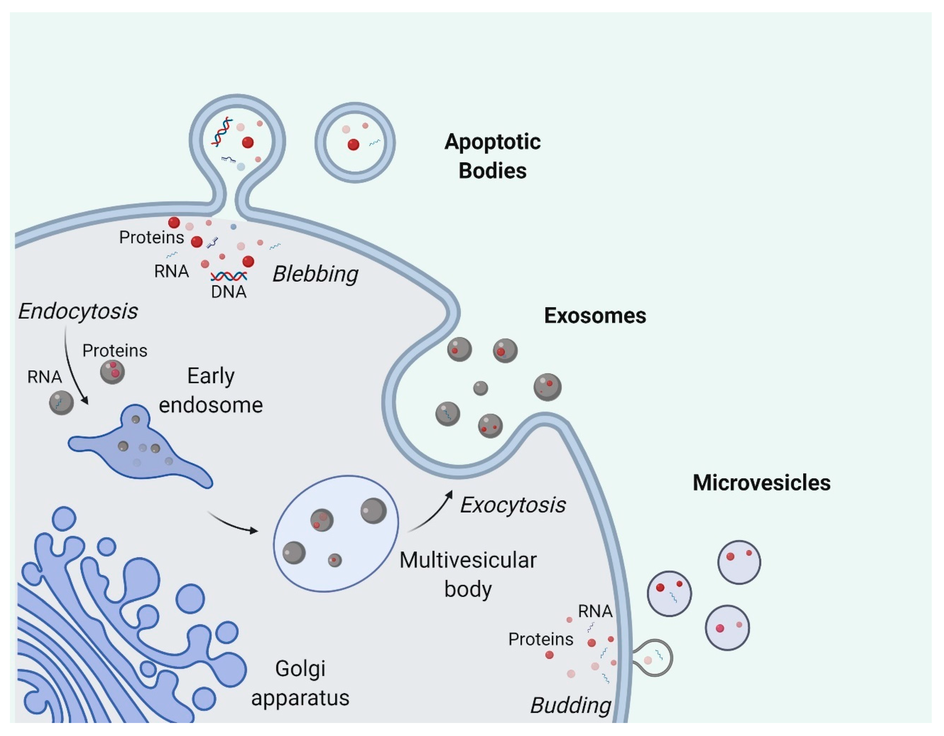
Extracellur vesicles

Slide 7
MSC-derived apoVs
Osteopenia
inhibits multiple myeloma cell growth and attenuates myeloma bone disease
counteracts type 2 diabetes via restoring liver macrophage homeostasis

Slide 8
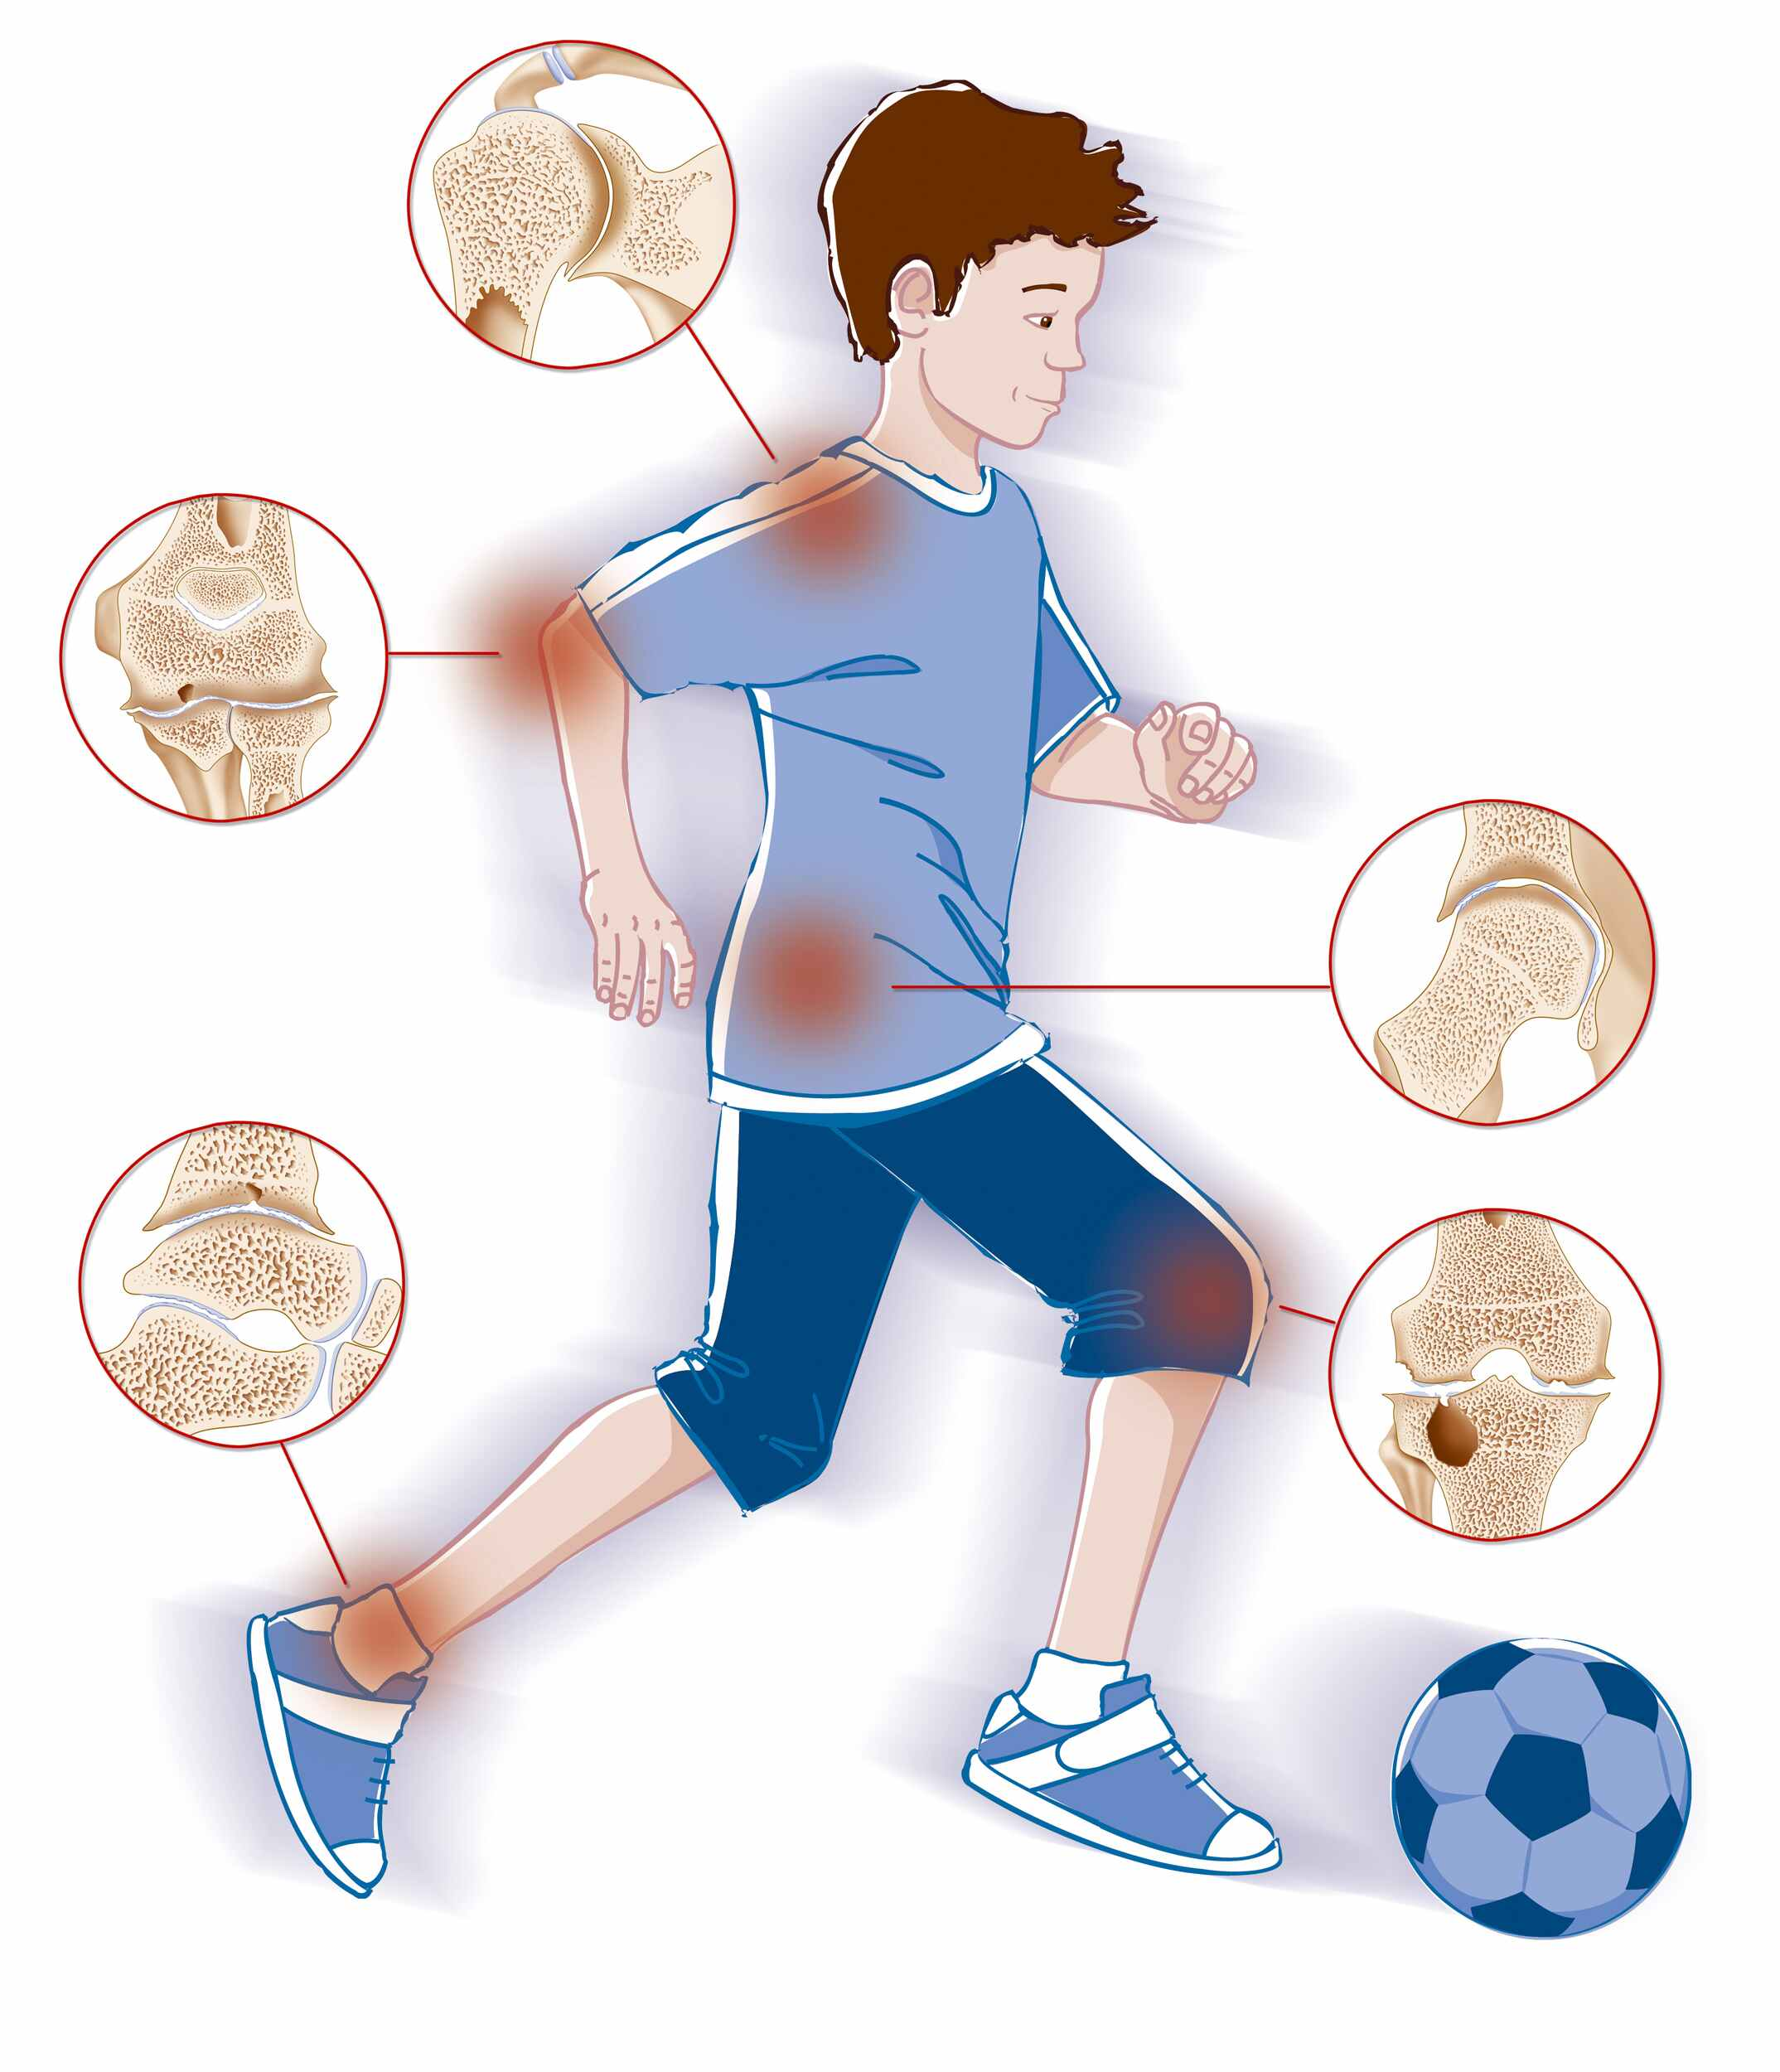
Haemophilia
17.1 and 3.8 cases per 100,000 males
Current approaches to haemophilia treatment:
factor replacement therapy
gene therapy
non-factor therapy
substitution therapy

Slide 9
MATERIALS AND METHODS
2

Slide 10
Isolation, culture and characterization of MSCs
MSCs:
Primary human bone marrow mesenchymal stem cells (hBMSCs)
human adipose mesenchymal stem cells (hASCs)
Mouse bone marrow mesenchymal stem cells (mBMSCs)
Characterization:
CD29
CD44
CD90
CD34
CD45

Slide 11
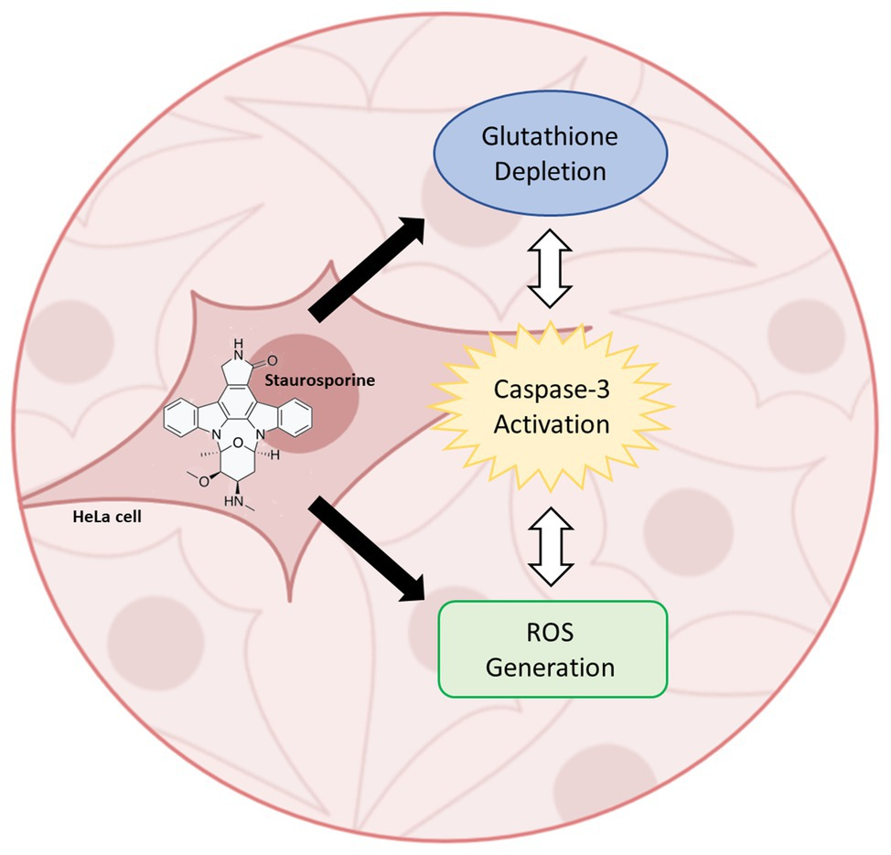
Induction of MSC apoptosis and isolation of apoVs
staurosporine
H2O2
Starvation
sequential centrifugation

Slide 12
Identification of MSC-derived apoVs
Cryo-electron microscopy
nanoparticle tracking analysis (NTA)
Identification of the surface markers of MSC-derived apoVs:
Annexin V
Lactadherin
CD44
CD90
CD34
CD63
CD81

Slide 13
Isolation of exosomes
Isolation of exosomes
Proteomic analysis
Confirmation of specific markers for MSC-derived apoVs

Slide 14
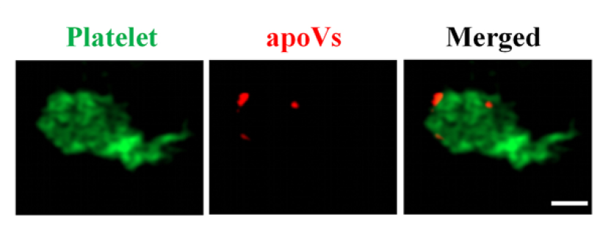
Platelet function analysis
Platelet preparation
Confirmation: flow cytometry (CD41, CD61, FASL)
detection of the binding of apoVs to human or mouse platelets in vitro

Slide 15
Platelet function analysis
Platelet aggregations: PL-12 platelet function analyzer (Epinephrine: positive control)
Platelet morphology: confocal microscope
Ultrastructural changes of human or mouse platelet morphology: SEM
Platelet activation: CD62P (P-selectin) or TF (CD142)
platelet-derived microparticles (PMPs)
Platelet spreading analysis

Slide 16
Hemostasis assays of haemophilia A (HA) mice
apoVs on HA mice
bleeding volume
Coagulation analysis
Activated partial thromboplastintime (APTT)
prothrombin time (PT)
fibrinogen
Platelet activation: CD62P (P-selectin) or TF (CD142)
platelet-derived microparticles (PMPs)

Slide 17
Hemostasis assays of haemophilia A (HA) mice
platelet-derived microparticles (PMPs)
PKH26-labeled apoVs
Haematological analysis
Biochemical analysis

Slide 18
Results
3

Slide 19
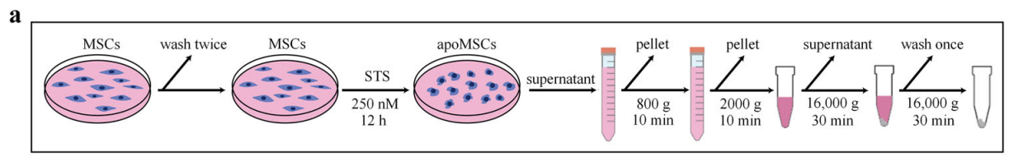
Isolation and characterization of apoVs from hBMSCs, hASCs, and mBMSCs

Slide 20
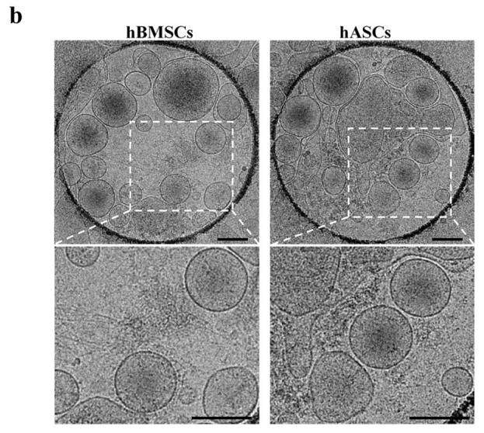
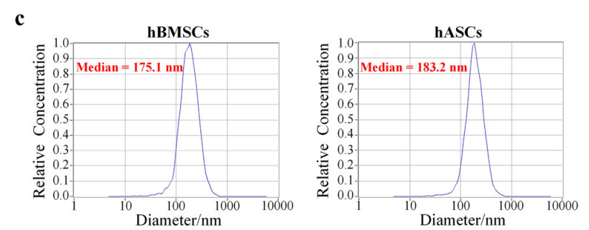
Isolation and characterization of apoVs from hBMSCs, hASCs, and mBMSCs

Slide 21
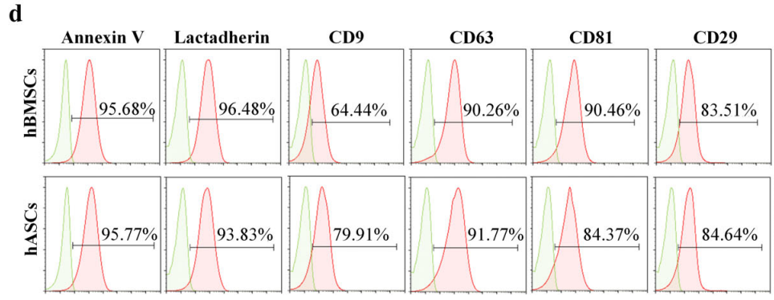
Isolation and characterization of apoVs from hBMSCs, hASCs, and mBMSCs

Slide 22
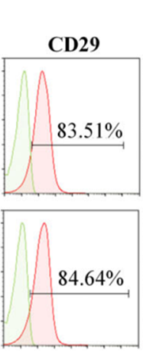
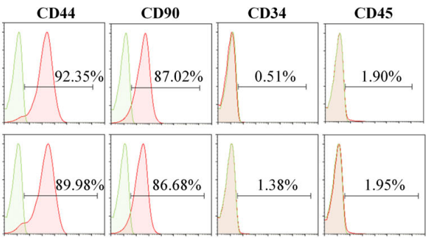
Isolation and characterization of apoVs from hBMSCs, hASCs, and mBMSCs

Slide 23
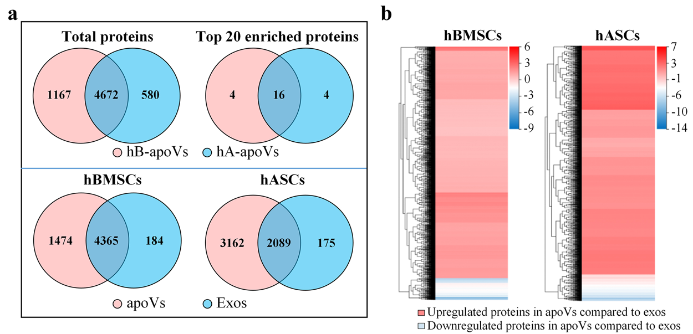
Proteomic profiling of MSC-derived apoVs and exosomes

Slide 24
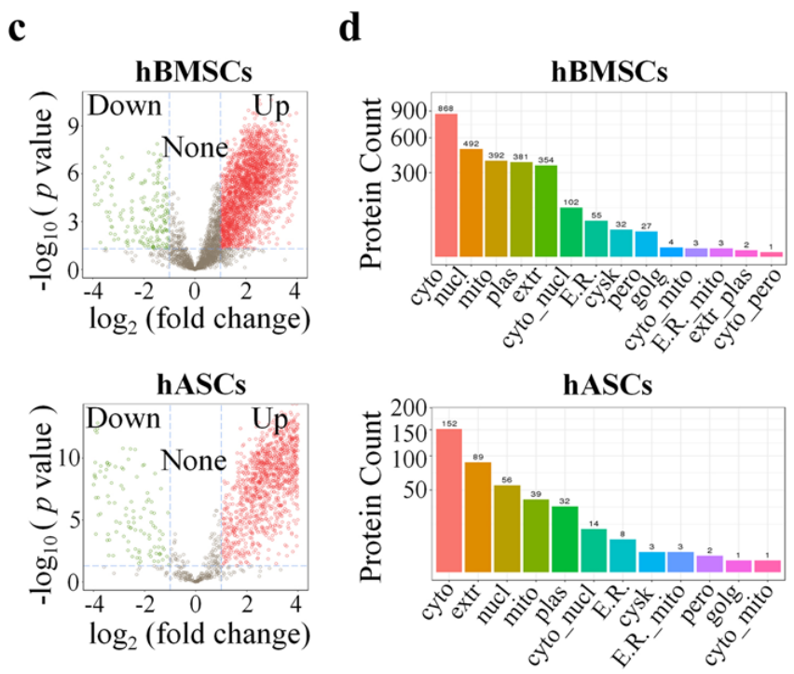

Slide 25
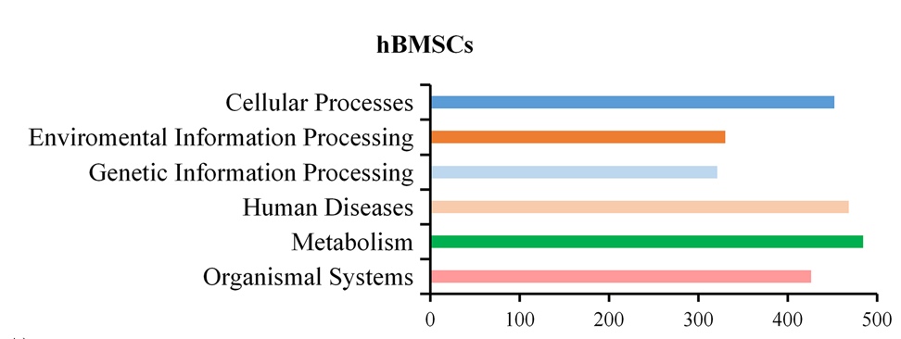

Slide 26
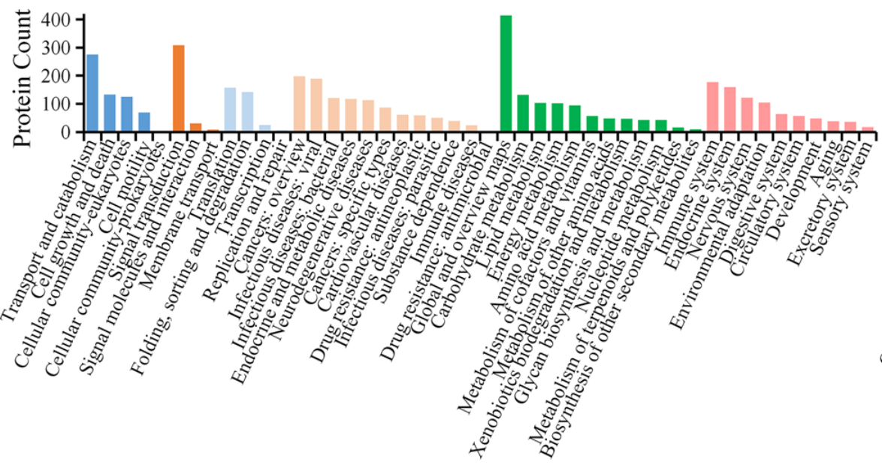

Slide 27
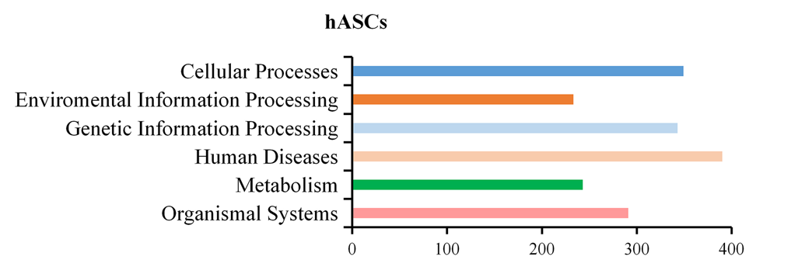

Slide 28
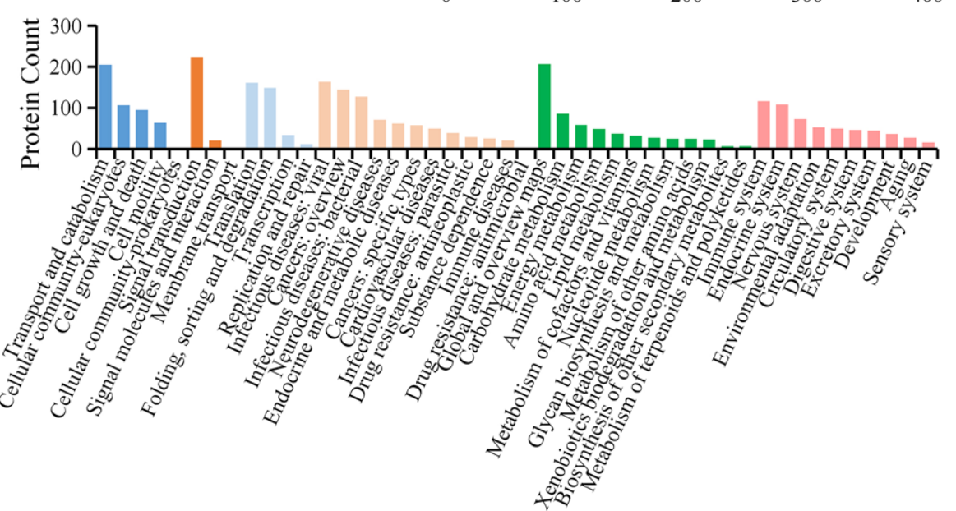

Slide 29
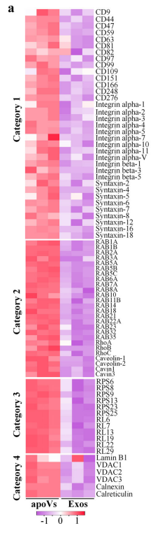
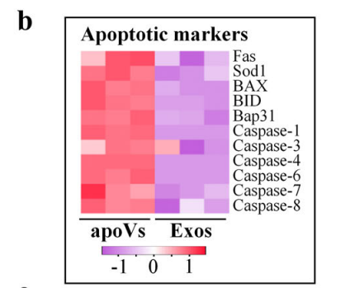
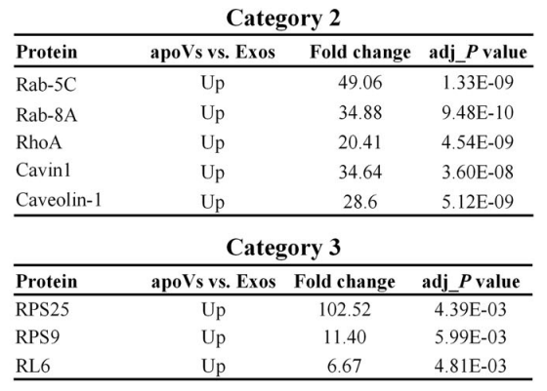
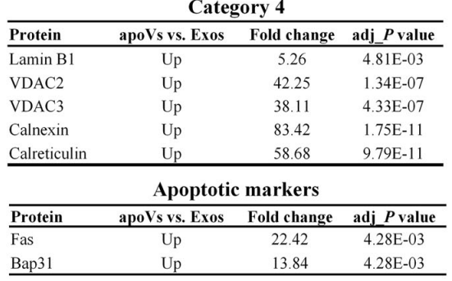
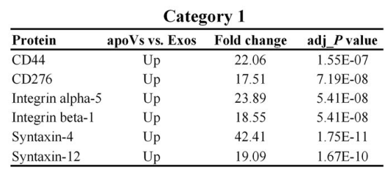

Slide 30
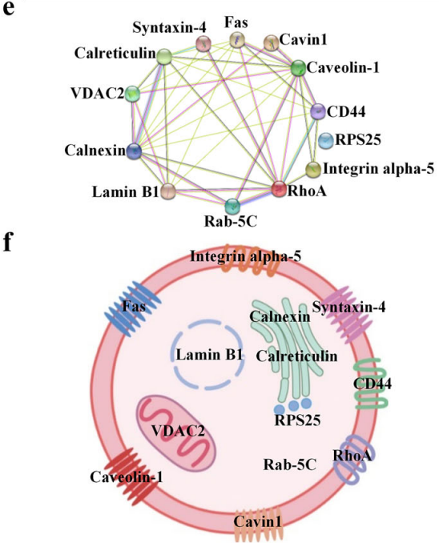
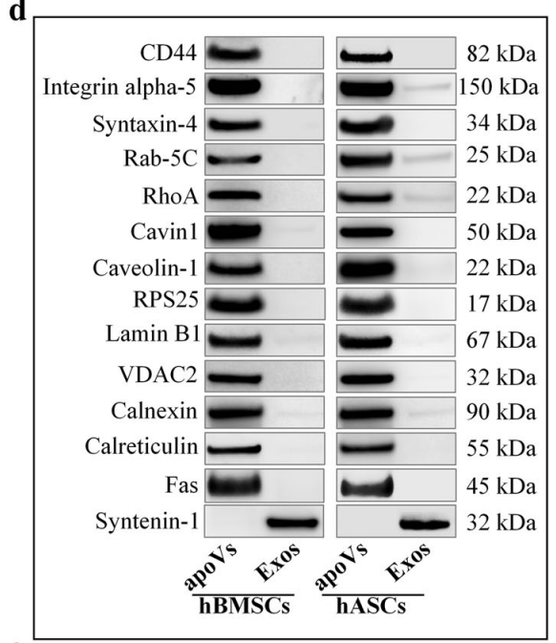

Slide 31
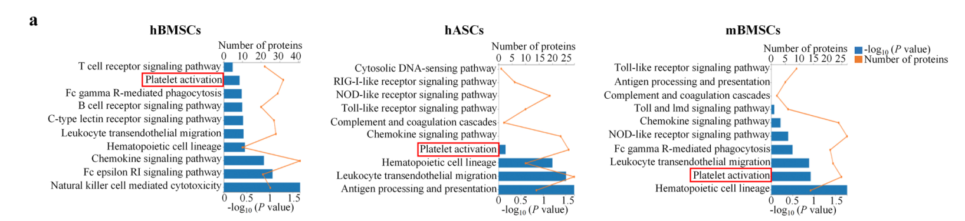
MSC-derived apoVs activate platelet functions in vitro

Slide 32
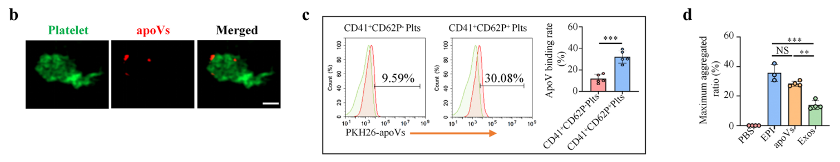
MSC-derived apoVs activate platelet functions in vitro

Slide 33
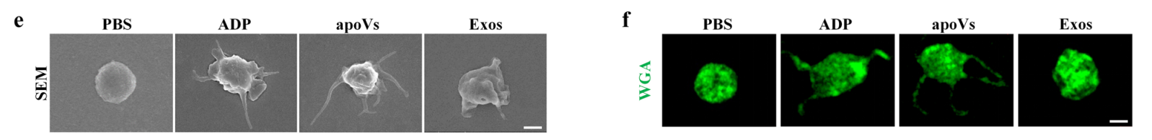
MSC-derived apoVs activate platelet functions in vitro

Slide 34
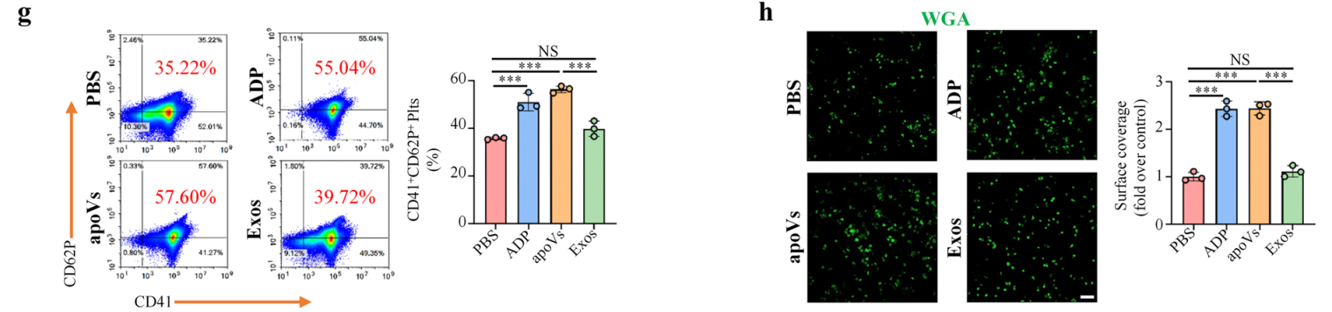
MSC-derived apoVs activate platelet functions in vitro

Slide 35
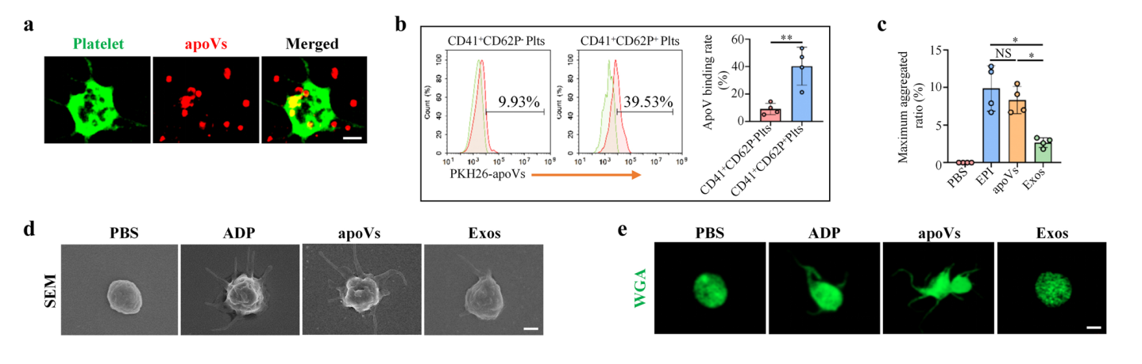
MSC-derived apoVs use Fas to upregulate platelet activity in vitro

Slide 36
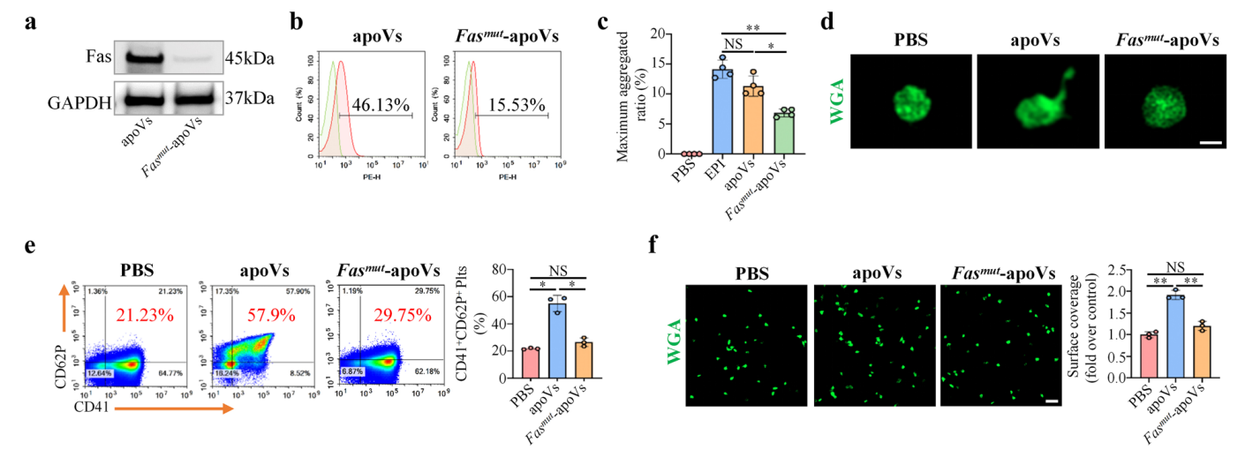
MSC-derived apoVs use Fas to upregulate platelet activity in vitro

Slide 37
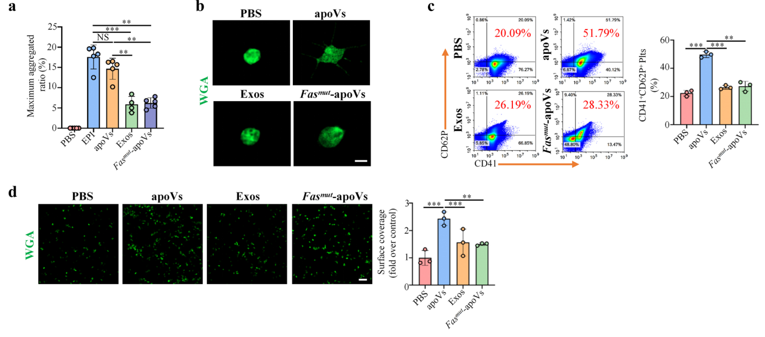
MSC-derived apoVs upregulate platelet activity of haemophilia A (HA) mice in vitro

Slide 38
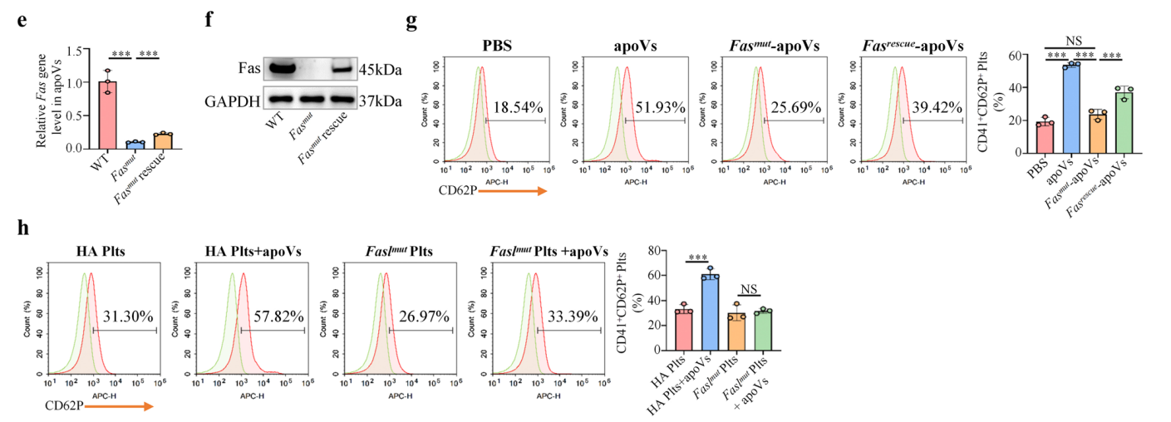
MSC-derived apoVs upregulate platelet activity of haemophilia A (HA) mice in vitro

Slide 39
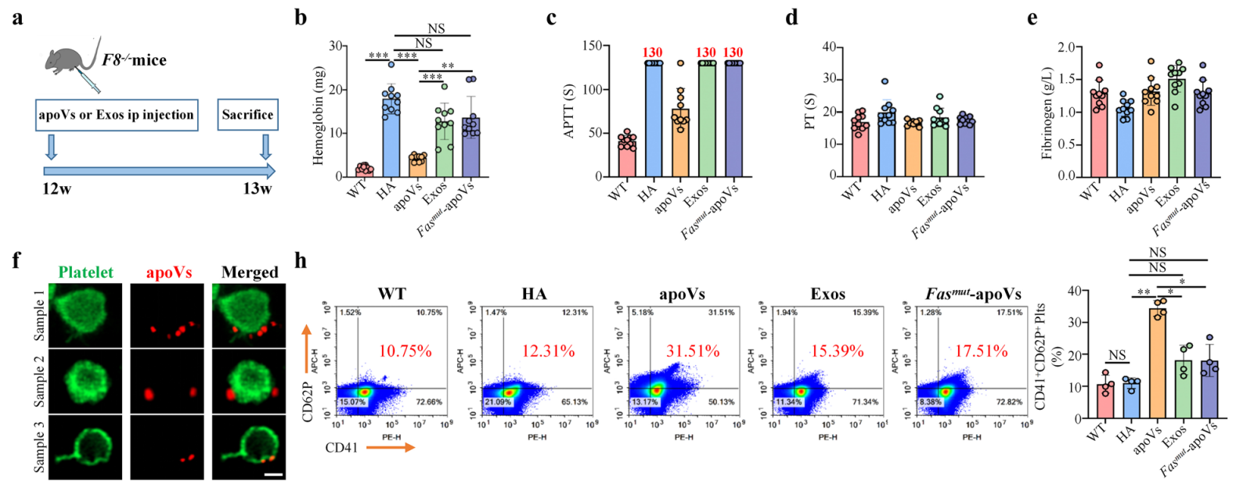
MSC-derived apoVs ameliorate HA via upregulating Fas-mediated platelet activit

Slide 40
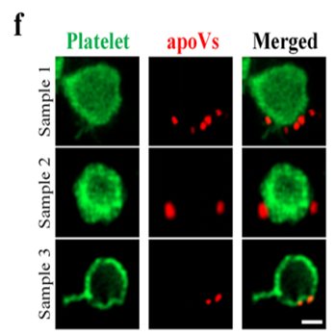
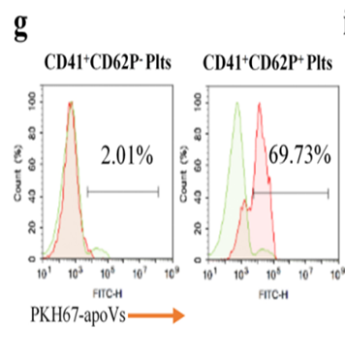
MSC-derived apoVs ameliorate HA via upregulating Fas-mediated platelet activit

Slide 41
MSC-derived apoVs ameliorate HA via upregulating Fas-mediated platelet activit

Slide 42
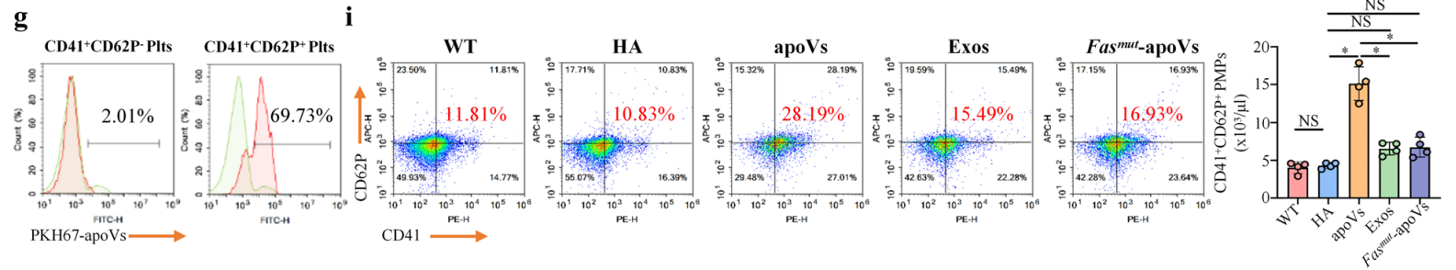
MSC-derived apoVs ameliorate HA via upregulating Fas-mediated platelet activit

Slide 43
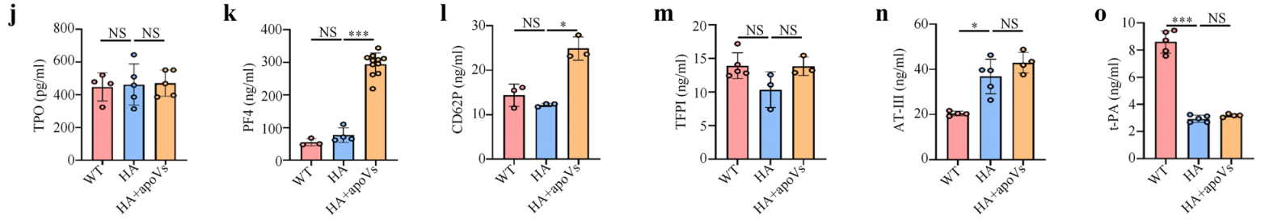
MSC-derived apoVs ameliorate HA via upregulating Fas-mediated platelet activit

Slide 44
DISCUSSION

Slide 45


