Slide 1
IN THE NAME OF GOD
Dental Pulp Stem Cells Derived From Adult Human Third Molar Tooth
Advisor : Dr.Farsinejad
Presented by : Zahra yousefi
z.yousefi74156@gmail.com

Slide 2
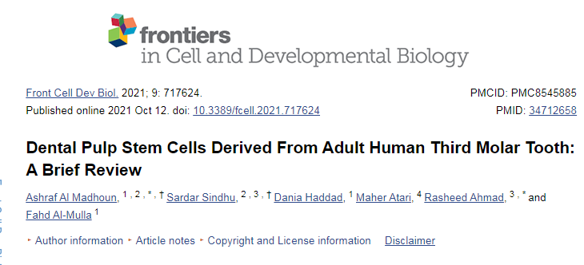


Slide 3
Object:
Clinical applications
Proliferation and Differentiation
DPSCs
Culture
Conditions
Isolation
Self-renewal
Physiological
properties

Slide 4
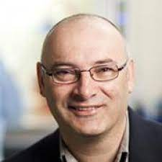
INTRODOCTION:
DPSCs were initially
isolated and characterized
by Gronthos in 2000.

Slide 5
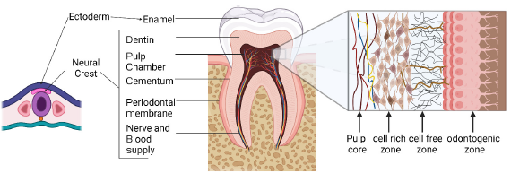
Anatomical Structure of The Tooth:

Slide 6
fibroblast
fibroblast
macrophage
cell-rich zone
odontoblast
capillaries
mesencal cells

Slide 7
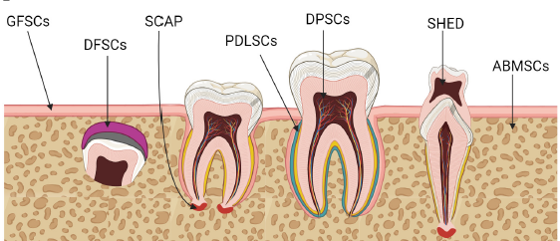
Stem Cells In The Tooth Compartments
Sources of dental progenitor cells:
DPSC
SHED
PDLSC
DFSC
SCAP
GING SC

Slide 8
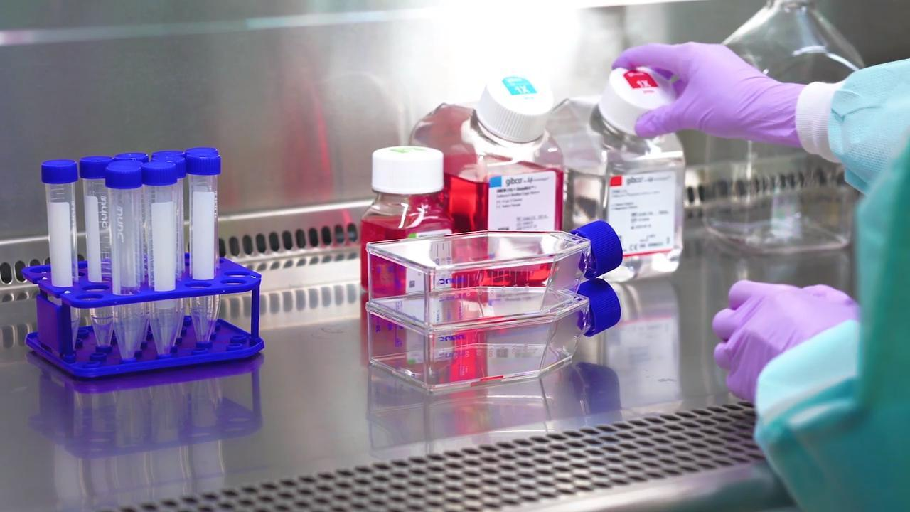
DPSCs Isolation Procedures And Culture Conditions:
Sterilization
Incision
Digestion
Filtering( 40 nm )
Culture

Slide 9
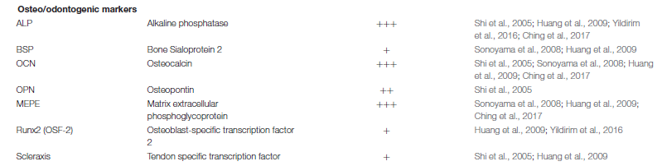
DPSCs Markers

Slide 10
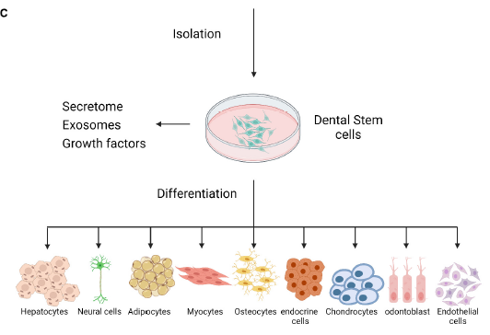
Vary Surface Marker

Slide 11
Heterogeneity of DPSCs
Different donors
Progenitors of different lineages
Conditions and media components
Isolation procedures
Growth factors supplements

Slide 12
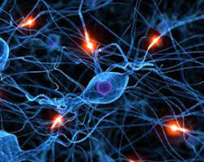
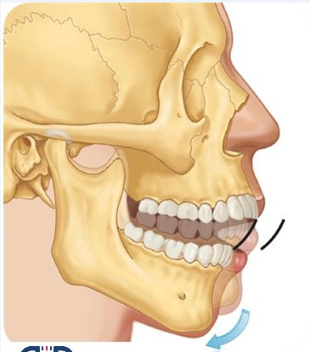
DPSCs Crosstalk With Microenvironment In Homeostasis
Biochemical
Mechanical

Slide 13
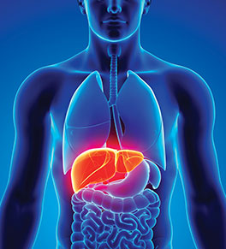
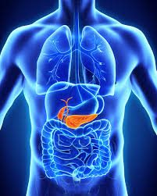
DPSCs Potential Role In Tissue Repair And Flourishment
Differentiation of Dental Pulp Stem
Cells Into Hepatocytes
Differentiation of Dental Pulp Stem
Cells Into Pancreatic Insulin-Producing Cells

Slide 14
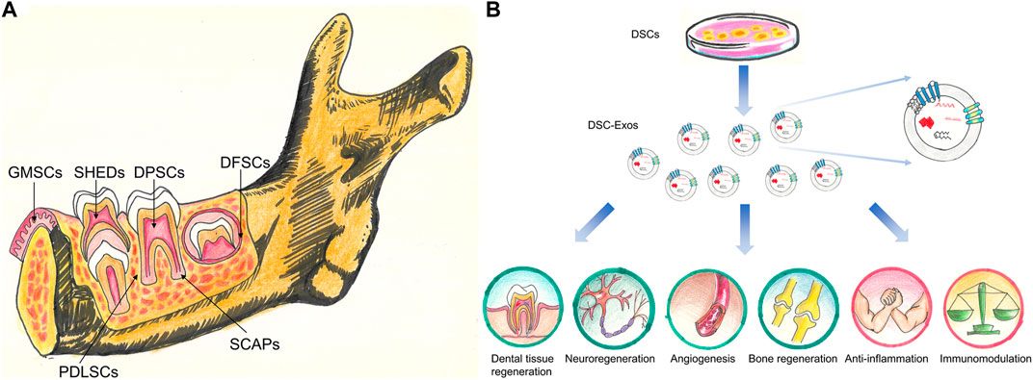
Paracrine Activity of DPSCs : Secretome And Exosomes

Slide 15
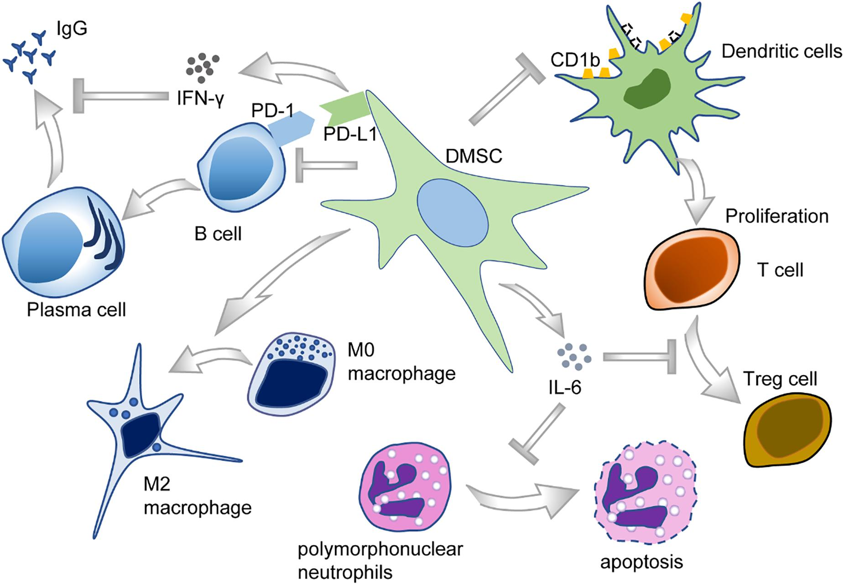
Immunomodulatory Properties of DPSCs

Slide 16
Clinical application
Neuropathy
Diabete
Hepatic diseases
Oculopathy
Spinal cord injury
Cerebral ischemia
Muscular dystrophy
Myocardial infarction
Parkinson
lung injury
Stroke

Slide 17
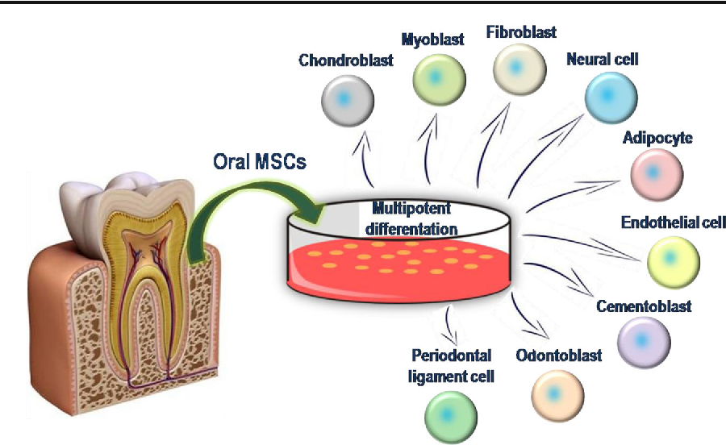
Concluding Remarks And Future Prospectives
more comprehensive clinical applications as compared to MSCs
easy access

Slide 18

Further research toward standardization of DPSCs’ isolation and culture protocols is still needed
Identifying the markers that more specifically and consistently represent DPSCs
Further studies will also be required to better understand the molecular mechanisms that regulate interactions between DPSCs

Slide 19

Importance of DPSCS as an adult stem cell model is a prospective contribution in the future development of treatment strategies
for human diseases

Slide 20

thanks for your attention

