Slide 1

Mahla sattarzadeh
Kerman University of Medical Sciences
Department of hematology

Slide 2
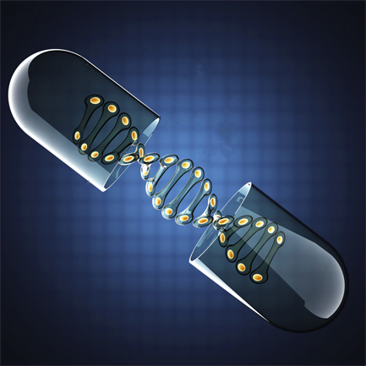

PHARMACOGENETICS

Slide 3

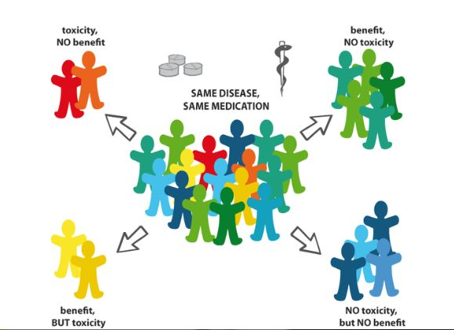
Introduction

Slide 4
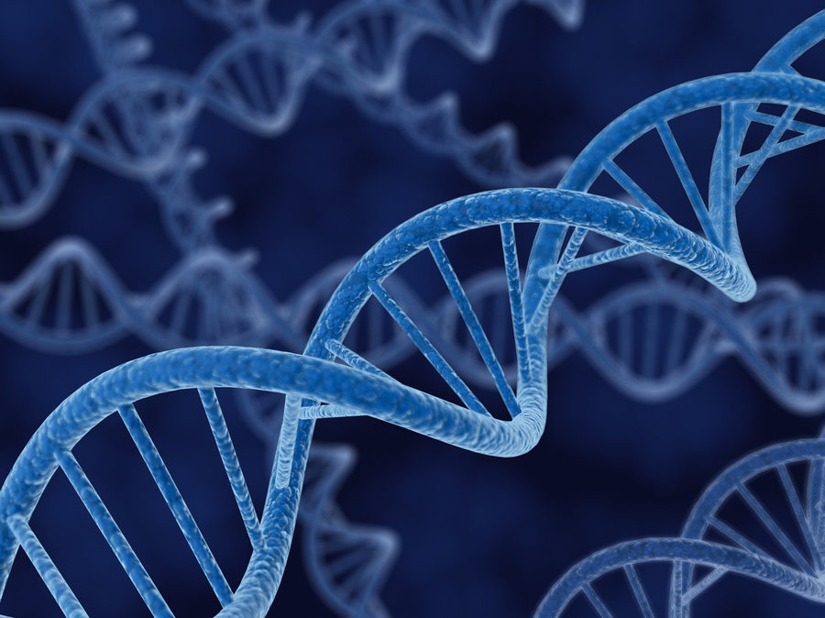
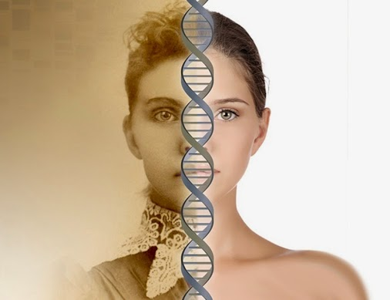
Factors contributing to variation in drug response:
Age
Gender
Ethnicity
Weight
Diet
Lifestyle
Exercise
Renal and hepatic function
Concomitant Diseases
Concomitant Drugs

Slide 5
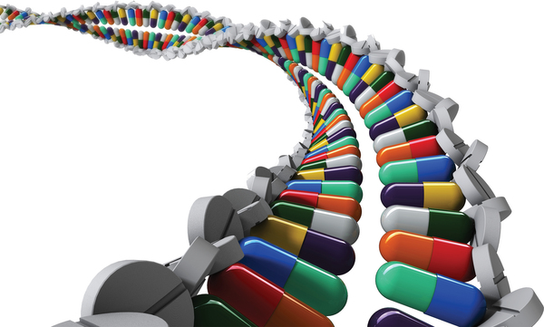
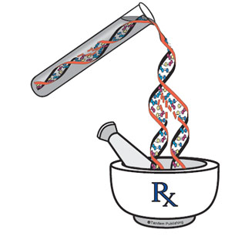
Pharmacogenetics:
is the study of inherited genetic differences in drug metabolic pathways which can affect individual responses to drugs, both in terms of therapeutic effect as well as adverse effects.
Pharmacogenomics: PGx
(pharmaco- + genomics)
is the study of the role of the genome in drug response

Slide 6


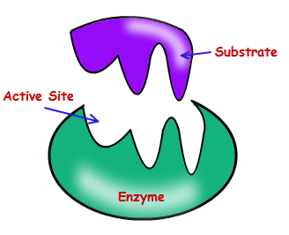
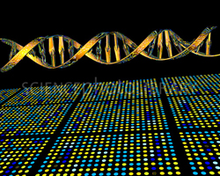
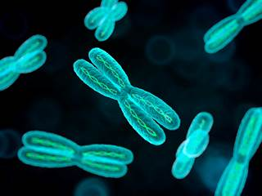
HISTORY
The term “pharmacogenetics” was first published by the German physician Friedrich Vogel.
First period
1850-1910
The second period
1910-1950
The third period
1950-1990
Fourth period
1990s later

Slide 7
The two main areas of pharmacology are:
Pharmacokinetics
Pharmacodynamics
• Absorption
• Distribution
• Metabolism
• Excretion
• Receptors
• Ion channels
• Transporters

Slide 8
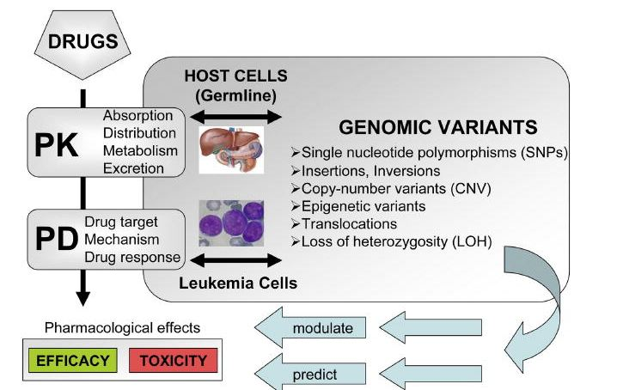

Slide 9

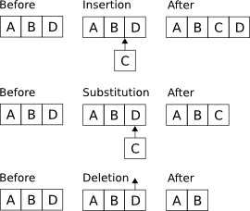
2 major types of polymorphism:
SNP:
Insertions/deletions:

Slide 10


Acute Lymphoblastic Leukemia
Acute lymphoblastic leukemia (ALL) is the major pediatric cancer in developed countries, accounting for 30% of all malignancies in children

Slide 11

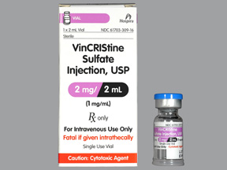
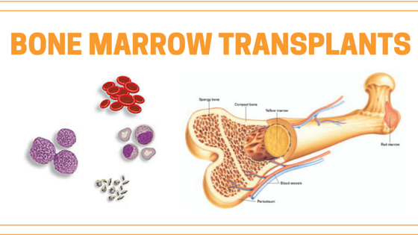
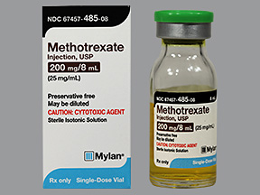
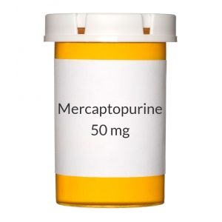
Treatment protocols for pediatric ALL
induction
consolidation
maintenance

Slide 12
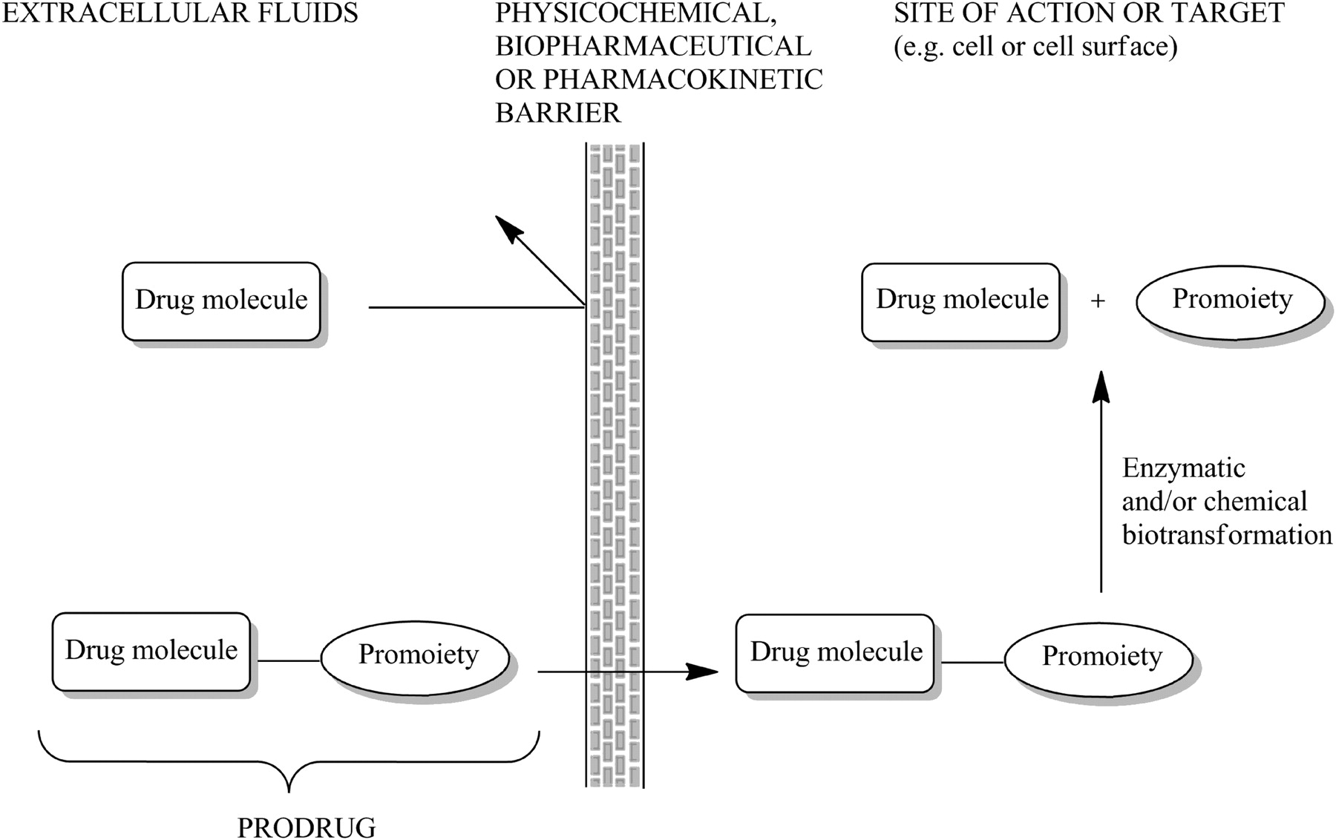
Prodrug

Slide 13

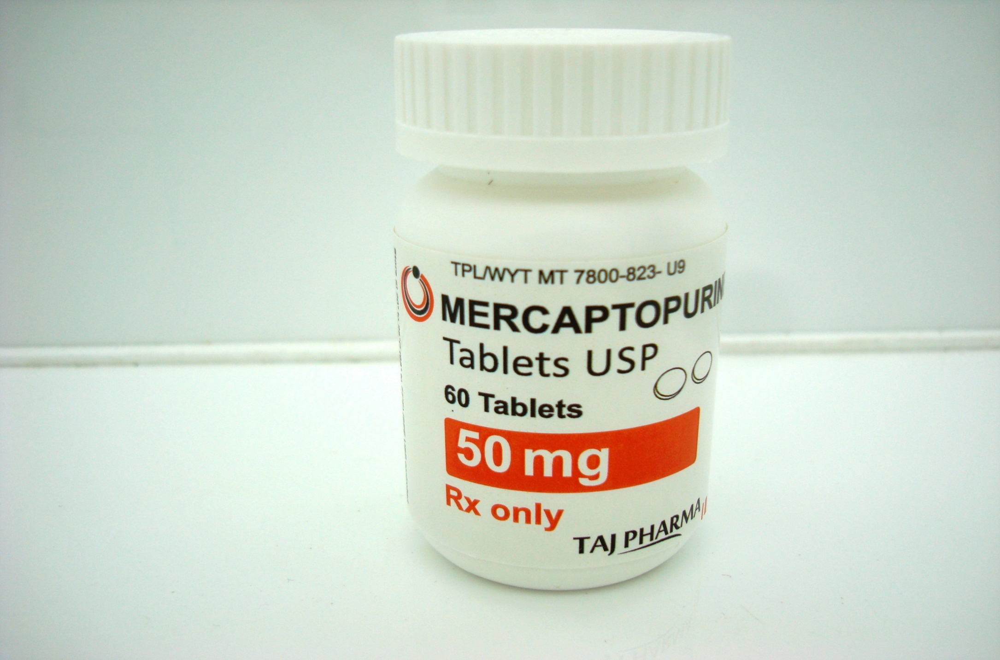
6- mercaptopurine and ALL

Slide 14
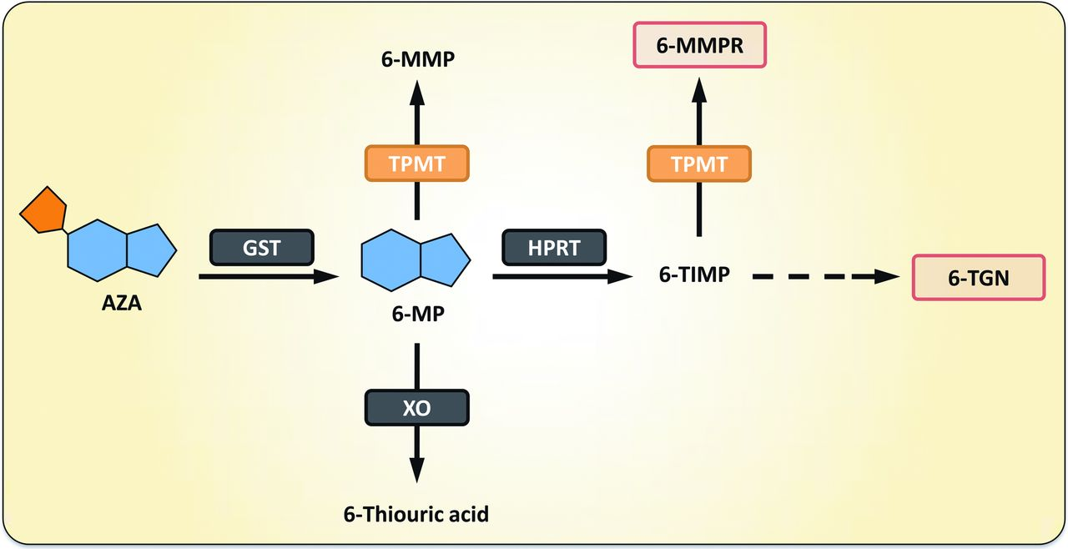
The interaction between variants in the gene for thiopurine methyltransferase (TPMT) and hematologic toxicity due to 6-mercaptopurine (6-MP) is one of the earliest, and perhaps the best known, example of pharmacogenetics.

Slide 15
Hematologic Toxicity
Suppression of hematopoiesis is one of the most common TRTs, leading to leucopenia, neutropenia, anemia, and thrombocytopenia.
TPMT*2 (G238C)
decrease in enzyme activity
TPMT*3A (G460A)
TPMT*3C (A719G)
Increase toxicity

Slide 16

Benefits of pharmacogenetics:
To predict a patient's response to drugs
To minimize or eliminate adverse events
Improvements in the drug discovery
Better, safer drugs the first time
To improve the accuracy of determining appropriate dosages of drugs
Advanced screening for disease
Decrease in the overall cost of health care

Slide 17

Barriers to pharmacogenomics progress:
Limited drug alternatives
Complexity of finding gene variations that affect drug response
Many genes are involved in drug action, making the drug target very difficult
Insufficient validation of study results
Expensive
Ethical issues

Slide 18

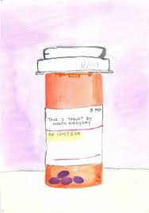

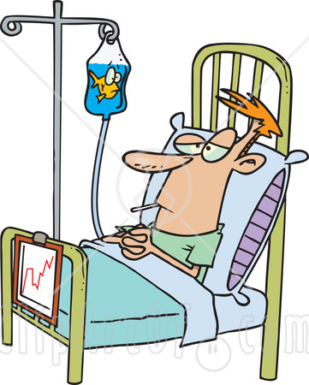
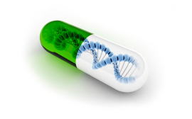

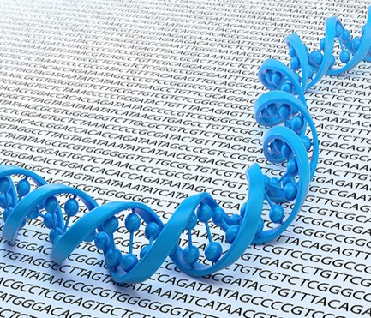
It is all about your genome, and I have something just for you..
conclusion

Slide 19
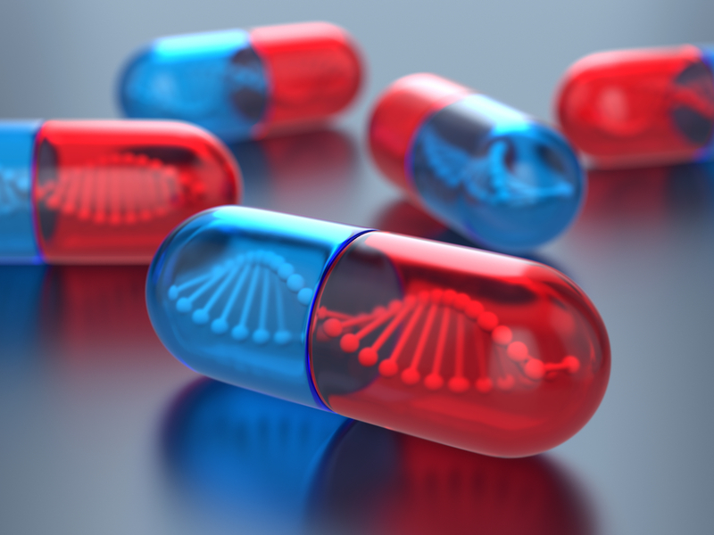
Thank you
October-2017

