Slide 1


Slide 2

Hematology Journal Club
Title:
Evaluating of OCT- 4 and NANOG was differentially regulated by a new derivative indole in leukemia cell line
Presented by
Reza mahdavi

Slide 3
Acute myeloid leukaemia (AML) is a type of blood cancer that starts from young white blood cells called granulocytes or monocytes in the bone marrow. Adults and children can get it but it is most often diagnosed in older people. Chemotherapy is the main treatment, you might also have a bone marrow or stem cell transplant.

Slide 4
symptoms
General weaknes
Filling tired(fatigue)
A high temperature (fever)
Frequent infections
Bruising or bleeding easily
Weight loss
Pain in your bones or joint
Breathlessness
Swollen lymph glands
Pale skin

Slide 5
Risks and couses
Smoking
Being overweight
Drinking alcohol during pregnancy
Radiation and radon exposure
Exposure to benzene
Genetic reasons
Past chemotherapy
Auto immune conditions

Slide 6
types
M0, M1 and M2
Together these are types of myeloblastic leukaemia. They make up just under half of all cases.
M3
This is called acute promyelocytic leukaemia (APL). This makes up 1 in 10 cases of AML (10%).
M4 and M4eos
These are both types of acute myelomonocytic leukaemia. Together they make up 1 in 4 cases (25%).
M5
This is called acute monocytic leukaemia. It makes up 1 in 10 cases (10%).
M6
This is acute erythroleukaemia. It's very rare.
M7
This is acute megakaryoblastic leukaemia. It's very rare.
World Health Organisation (WHO) types } Granulocytic sarcoma } Panmyelosis
} Mixture of AML/ALL

Slide 7
treatment
Decisions about your treatment
Chemotherapy
Growth factors
Bone marrow or stem cell transplants for acute myeloid leukaemia (AML)
Treatment to remove abnormal white blood cells

Slide 8
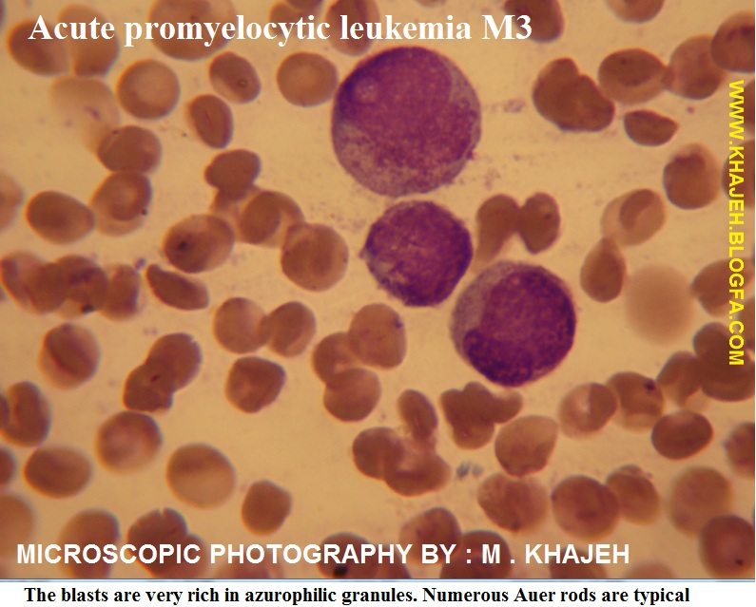

Slide 9
NB-4
established from the bone marrow of a 23-year-old woman with acute promyelocytic leukemia (APL = AML FAB M3) in second relapse in 1989; patented cell line; cells carry the t(15;17) PML-RARA fusion gene

Slide 10
APL is described as an AML, subset accounting for 10–15% of all AML cases [1]. APL is characterized by the selective expansion of immature hematopoietic precursors inhibited at the promyelocytic stage [1]. Cancer stem cells was been reported to have similarities with stem cells, in ultiple aspects, such as exhibiting self-renewal, immortality and differentiation. The concept of cancer stem cell concerns the fact that only a subset of cancer cells represent the unique ability of selfrenewal its accompanied by unlimited proliferation

Slide 11
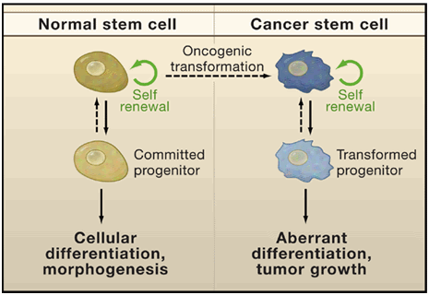

Slide 12
OCT4 AND NANOG
descriptions of these cells are restricted, due to their small number and lack of appropriate markers. The OCT-4 and NANOG which serve as pluripotent-asocial factors are the key regulators of self-renewal in embryonic and induce pluripotent features of stem cells. The POU (Pit- Oct-Unc) transcription factor family, OCT-4 (also known as OCT-3, OCT-3/4 and POU5F1), is a key regulator of self-renewal and differentiation in embryonic stem cells [4,5]. Expression of OCT-4 is claimed to be restricted to pluripotent cells, and its expression down regulates with the onset of differentiation and loss of pluripotency in these cells

Slide 13
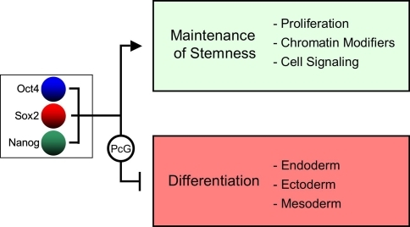

Slide 14
oct4
Recently, Tai et al., also revealed that OCT-4 is expressed in multiple human adult stem cells [10] (e.g. breast, pancreas and liver stem cells)
Matthai et al., reported OCT-4 expression in normal human endometrium [24]. Jeter, C.R and coworkers showed ectopic

Slide 15
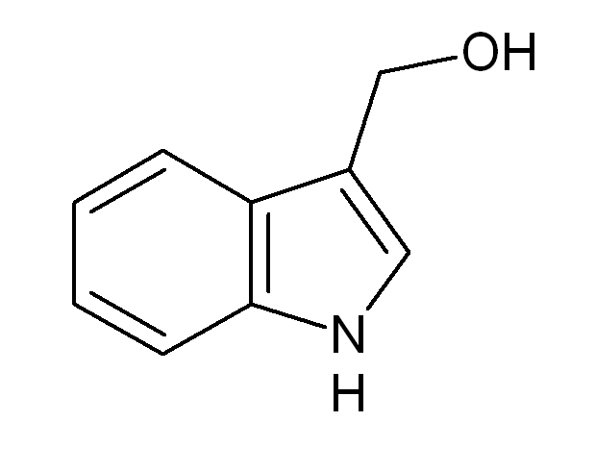
Chemical structure of NI-3-CD.

Slide 16
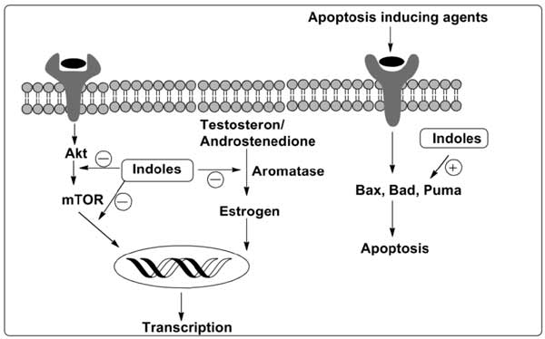
Indole chemotherapy drugs

Slide 17

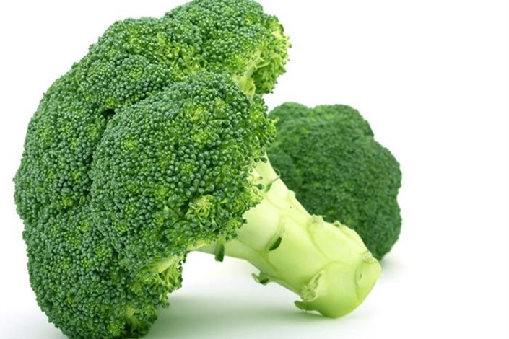
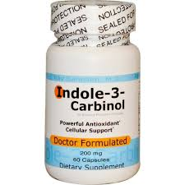

Slide 18
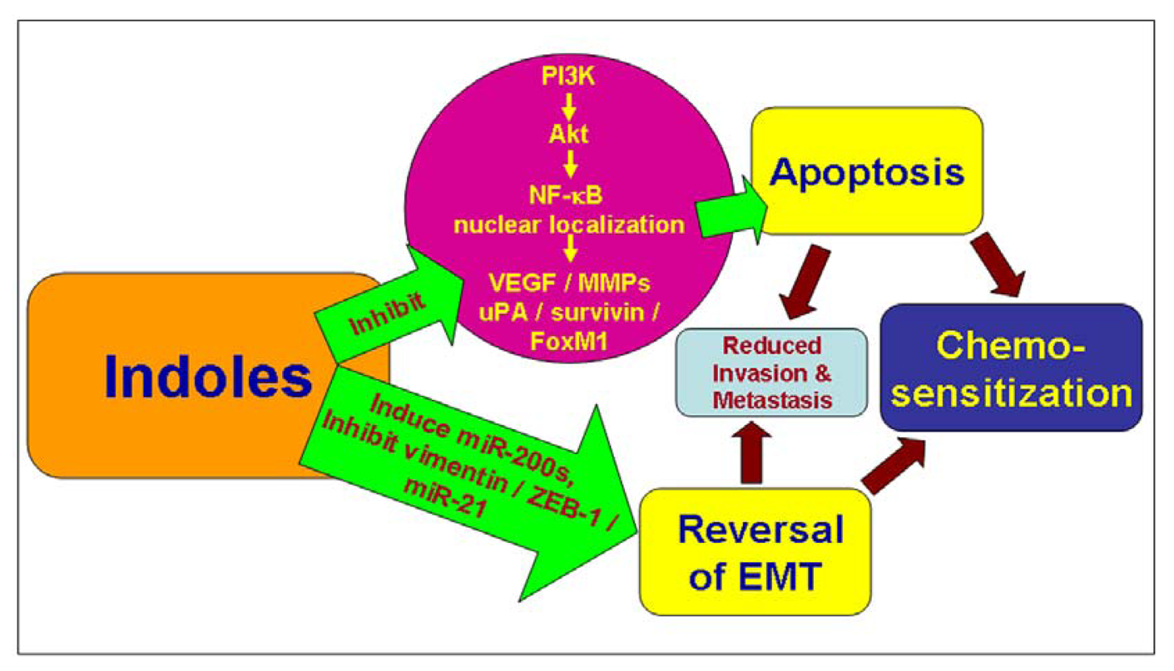

Slide 19
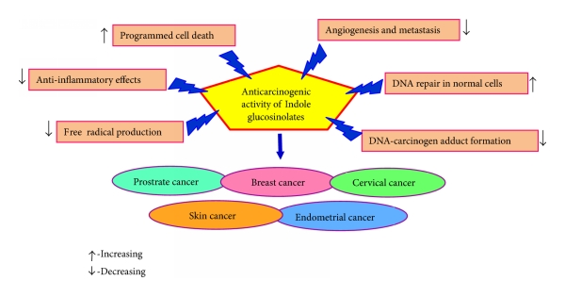
Sources of anticancer effect of indole glucosinolates (I3C and DIM) and its mode of action.

Slide 20
INDOLE CHEMOTHERAPY DRUGS
CF3 groups to the compound elevating its antitumor activity
NI-3-CD are not limited for inducing apoptosis in cancer cells.
NI-3-CD was shown to induce a decrease in the expression of stem-cell-related markers.
These stem cell markers are associated with pluripotency, such as NANOG, OCT-4.

Slide 21
CONCLUSION
Indole derivatives have been a topic of substantial research interest and continue to be one of the most active areas of heterocyclic chemistry
may lead to intensive research and worthwhile contribution in the field of medicinal chemistry

Slide 22


