Slide 1
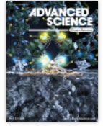
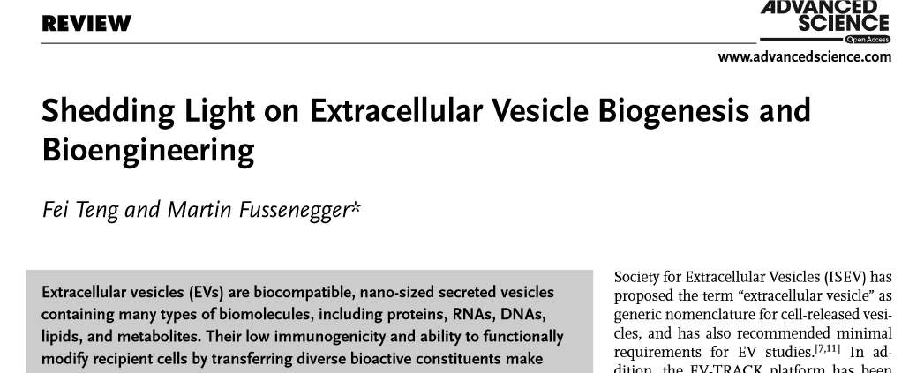
2020 Impact Factor of 16.806
Supervisor : Dr . mardani
Presenter : f.eshagh

Slide 2
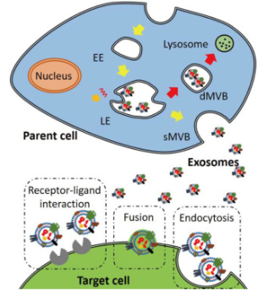
INTRODUCTION
EV biogenesis and secretion
EV uptake and cell-cell communication
EV bioengineering
conclusions

Slide 3
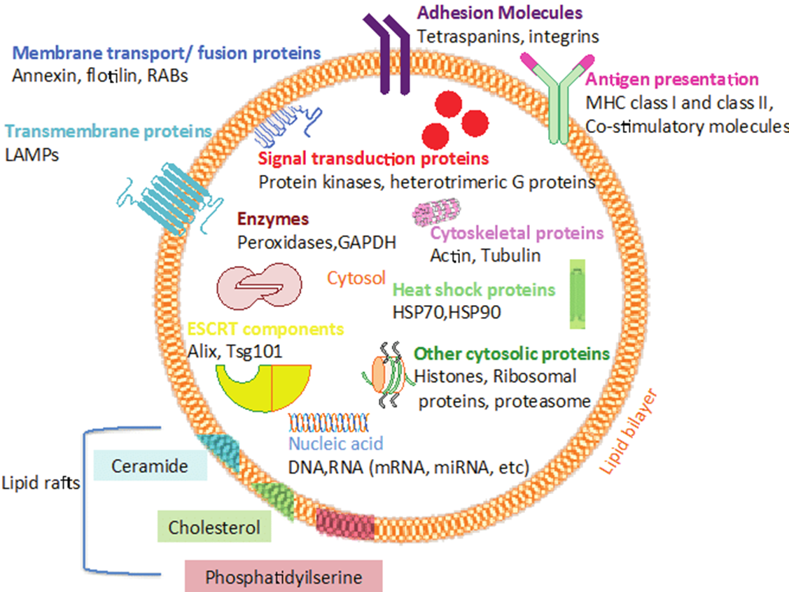
INTRODUCTION
there are three major subtypes of Evs
deﬁned on biological pathways:
Exosomes
micro vesicles
and apoptotic bodies
Evs:
cell-derived membrane structures
enclosing proteins, lipids, RNAs, metabolites, growth factors, and cytokines
intercellular communication regulators
biocompatible
nano-sized
low immunogenicity
ability to functionally modify recipient cells by transferring diverse bioactive constituents
candidate for a next-generation drug delivery system

Slide 4
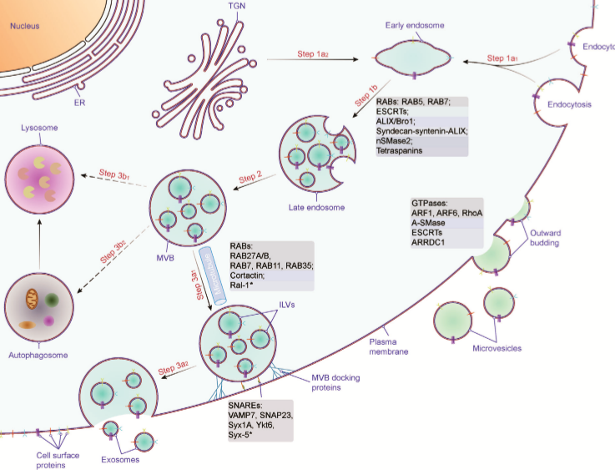
2. EV Biogenesis and Secretion

Slide 5
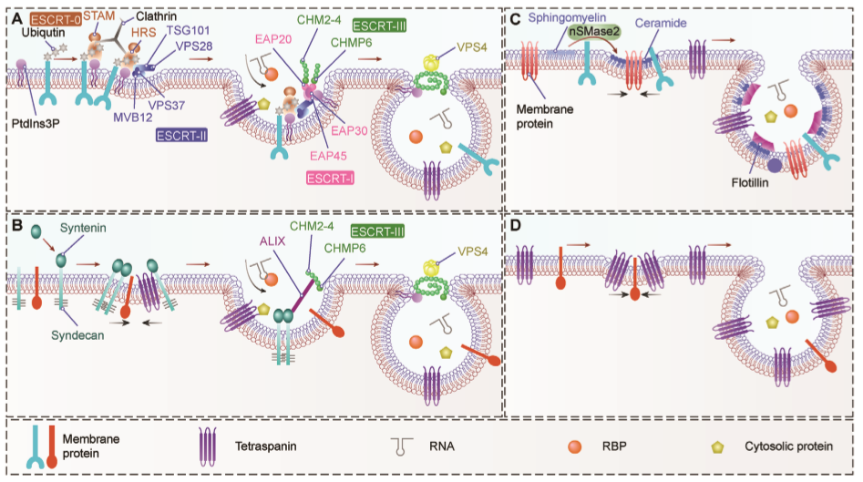

2.1. MVB Biogenesis

Slide 6
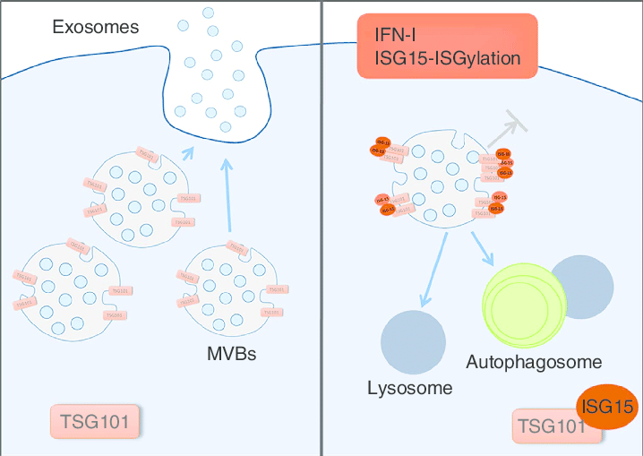
MVB exosome
degradation → ISGylation TSG101 & tetraspanin6
macro
autophagy
EV
Secretion

Slide 7
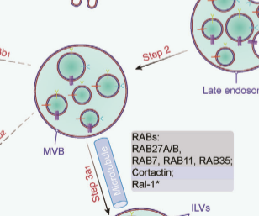
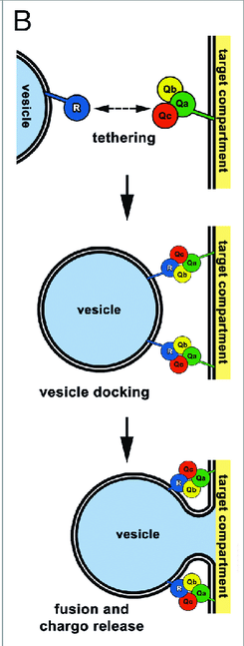
2.2. MVB Transport
interaction with the cytoskeleton, molecular motor and small GTPases
Cortactin : EV secretion
RAB GTPases:
RAB11 → TFR & HSP 70 (K562)
the regulation of EV secretion by RAB proteins is cell-type-dependent.
(HELA) RAB 9A → EV secretion
5A
27A/B
RAB7 → secretion of syndecan-syntenin-ALIXE Vs

Slide 8
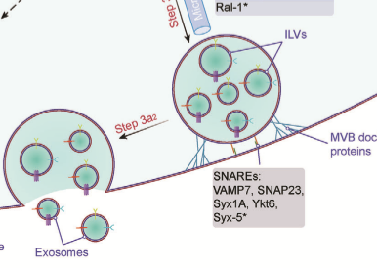
2.3. Fusion of MVBs with the Plasma Membrane
VAMP7 → release of EVs in K562 leukemia cells
Syx1A → secretion of EVs containing Evi
Ykt6 → secretion of EVs containing wnt
The ﬁnal step of exosome secretion is the fusion of MVBs to the plasma membrane, driven by soluble NSF attachment protein receptor (SNARE) proteins

Slide 9
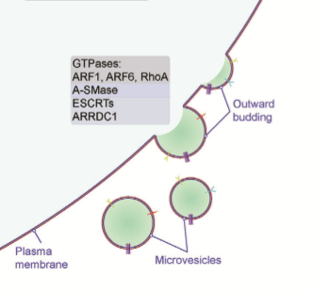
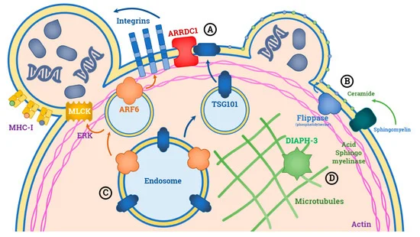
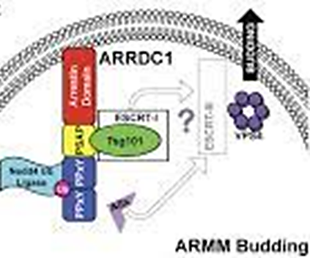
2.4. Biogenesis and Release of Microvesicles
1- ESCRT ------ MV secretion
2- ARRDCT------TSG101 & VPS4 ------ ARRMS
3- GTPasas : ARF1 / ARF6 / Rho A
4- A-Smase ----- ceramide

Slide 10
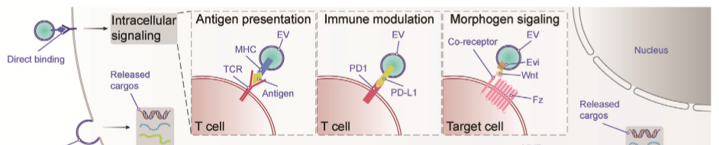
3. EV Uptake and Cell–Cell Communication
1) They can transmit information to recipient cells by direct contact via their surface ligands
2) they can transfer proteins and nucleic acids, including RNAs and DNAs to target cells.

Slide 11
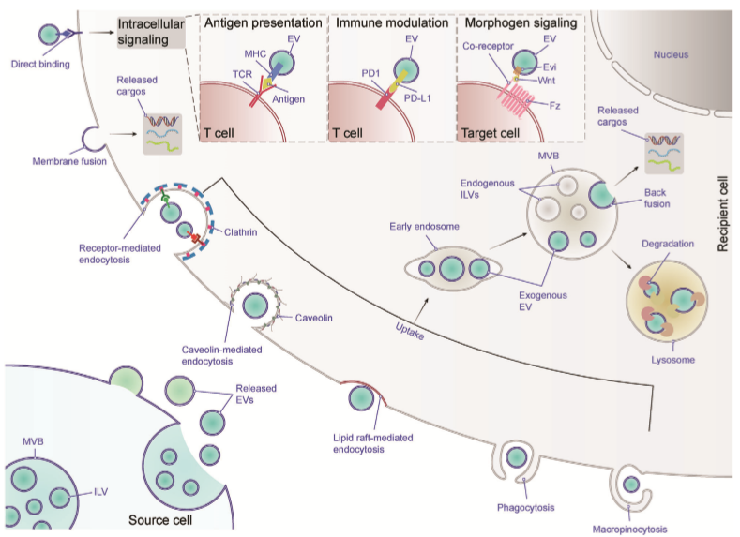

Slide 12
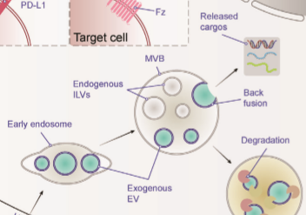
EV tetraspanins CD9 and CD81 and cellular integrin 𝛼v/𝛽3 → EV uptake by DCs.
CD11a and its ligand CD54 → EV uptake by DCs.
Integrins 𝛼6/𝛽4 and 𝛼v/𝛽5 on tumor-derived EVs and scavenger receptors on endothelial cells and macrophages → cell-speciﬁc uptake of EVs.
EV uptake
chemical or antibody intervention or genetic deﬁciency →
Endocytosis is a more common entry route of Evs: →
lysosomal degradation →→→ back-fusion

Slide 13
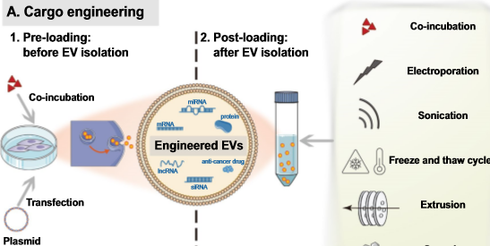
4. EV Bioengineering
All cells can secrete Evs
to apply bioengineered EVs for clinical applications : MSCs* / ESCs / iPSCs
EVs can be obtained from cell cultures → drug delivery
or body fluids, such as blood, saliva, cerebrospinal fluid,
urine, semen, and tracheal aspirates → detection tools for different disease diagnostic biomarkers
two strategies are applied to maximize therapeutic
efficacy of Evs:
cargo engineering
Pre‑loading
Post‑loading
surface engineering

Slide 14
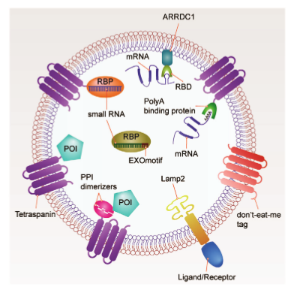

4. EV Bioengineering
surface engineering
load small RNAs into Evs through cell
transfection approaches
RBP: hnRNPA2B1 → EXOmotif GGAG
SYNCRIP → EXOmotif GGCU
to encapsulate anti-inflammatory proteins
into Evs : OPtogenetic methodology
“EXPLORs”
To concentrate therapeutic proteins
into the lumen of Evs → PPI dimerizers
reversible protein protein interaction dimerizers

Slide 15
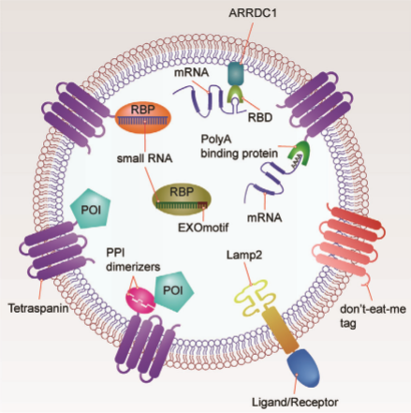
tetraspanins: CD9, CD63 or CD81
To change the tropism of Evs
Diﬀerent ligands or receptors
can be fused with EV surface proteins
To protect Evs from phagocytosis
CD47/CD59/CD55/CD200
fuse a poly(A) binding protein with EV membrane proteins to selectively recruit mRNAs into EVs
To load therapeutic mRNAs : RBDs can be fused with EV membrane proteins → recruit mRNAs with their 3′UTR fused with an RBD recognition element
CD47/55/59/200
RVG

Slide 16

5. Conclusions
Various ESCRT-dependent and -independent pathways have been uncovered
balance between exosome secretion and lysosomal degradation have emerged
Molecules involved in MVB traﬃcking have been partially uncovered
Molecules on the EV surface certainly inﬂuence recognition and capture by acceptor cells
To change the tropism of Evs Diﬀerent ligands or receptors can be fused with EV surface proteins
produce engineered EVs in clinically authorized cell types, such as (MSCs), (ESCs), (iPSCs)

Slide 17



