Slide 1


Slide 2
Targeted regulation of autophagy using nanoparticles
New insight into cancer therapy
Supervisor
Dr.Farsinejad
Presenter
Mahsa Mottaghizadeh

Slide 3
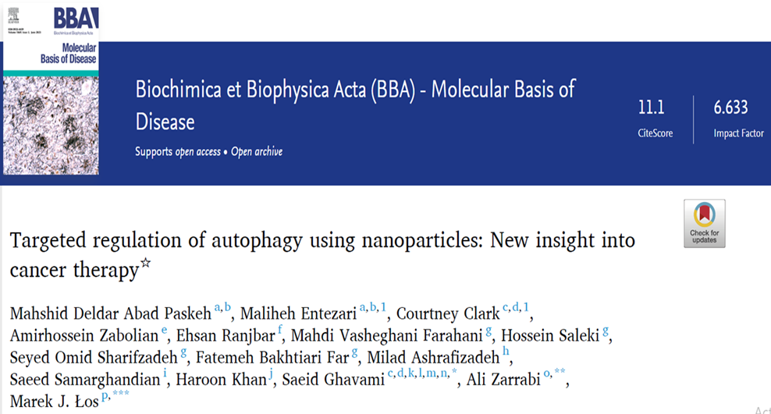

Slide 4
Introduction
Cells are continuously exposed to various stressors, requiring strategies or mechanisms to maintain homeostasis and prevent cell death.
Autophagy is a highly-conserved eukaryotic process that functions to degrade and recycle cellular components.
Compounds administered in autophagy regulation often suffer from poor bioavailability that can benefit from the use of nanoparticles for their delivery.

Slide 5
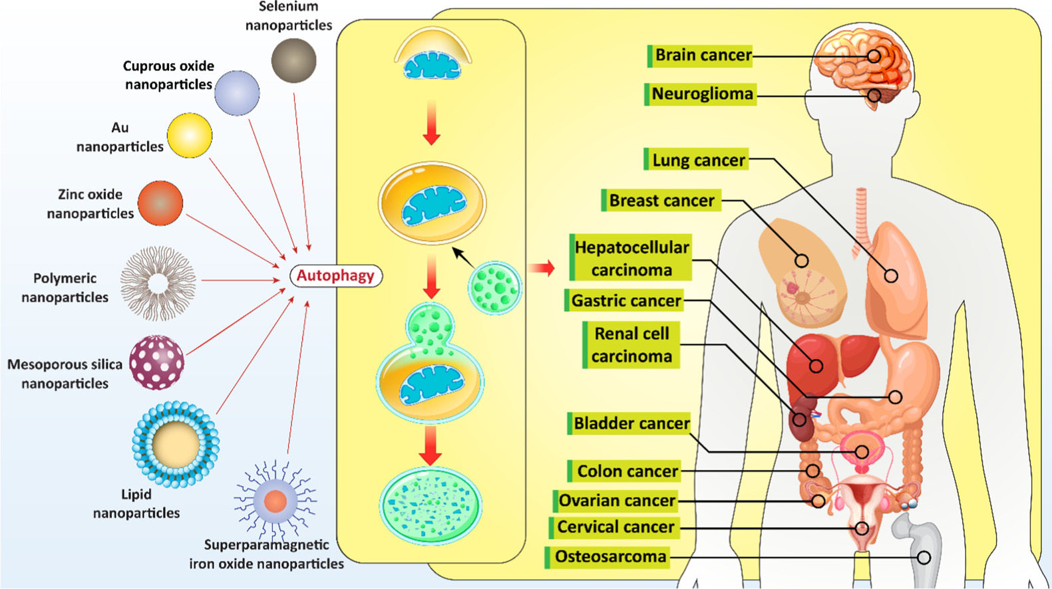
Introduction

Slide 6
Introduction
In the present review, we aim to focus on autophagy regulation by nanoparticles.
First, provide an overview of the autophagy machinery, related molecular pathways, and its role in oncology.
Then, describe how nanoparticles can be used to regulate autophagy for cancer treatment.

Slide 7
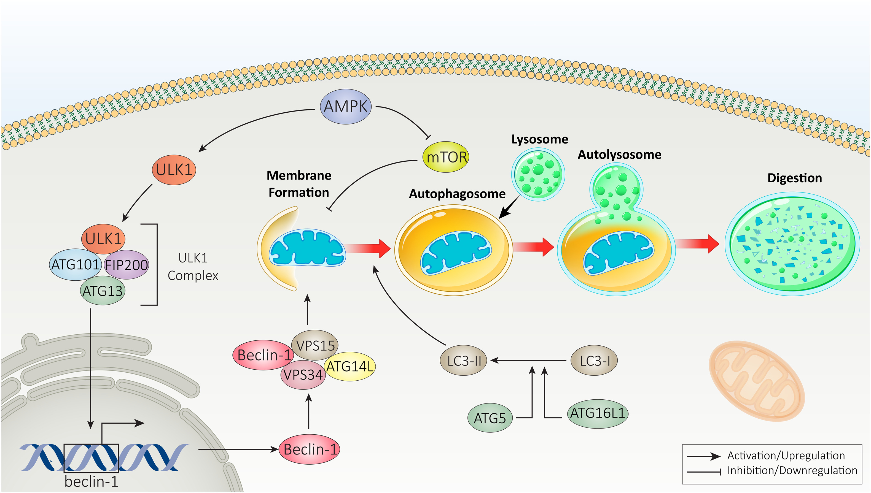
Autophagy machinery
Fig. 1. Molecular pathways of autophagy.

Slide 8
Autophagy role in oncology
Autophagy's dual role as a tumor-promoting and a tumorsuppressing factor in cancer cells makes it a particularly complex issue.
Autophagy induction as a promising strategy in cancer treatment, while another experiment may suggest autophagy inhibition in cancer therapy.
However, this complexity illustrates the “double-edged sword” nature of autophagy in tumors and autophagy regulation depends on its activity.

Slide 9
Autophagy role in oncology
According to new experiments, apoptosis induction and stimulating pro-death autophagy can significantly decrease survival of glioma cells, as one of the malignant brain tumors. However, pro-survival autophagy may prevent apoptosis in tumor cells.
Matrine is an anti-tumor agent that induces apoptosis in reducing breast cancer progression. Notably, matrine simultaneously induces autophagy that functions as a prosurvival mechanism .
In this case, autophagy inhibition can be beneficial in promoting cytotoxicity of matrine against breast cancer cells.

Slide 10
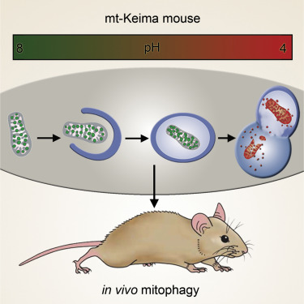
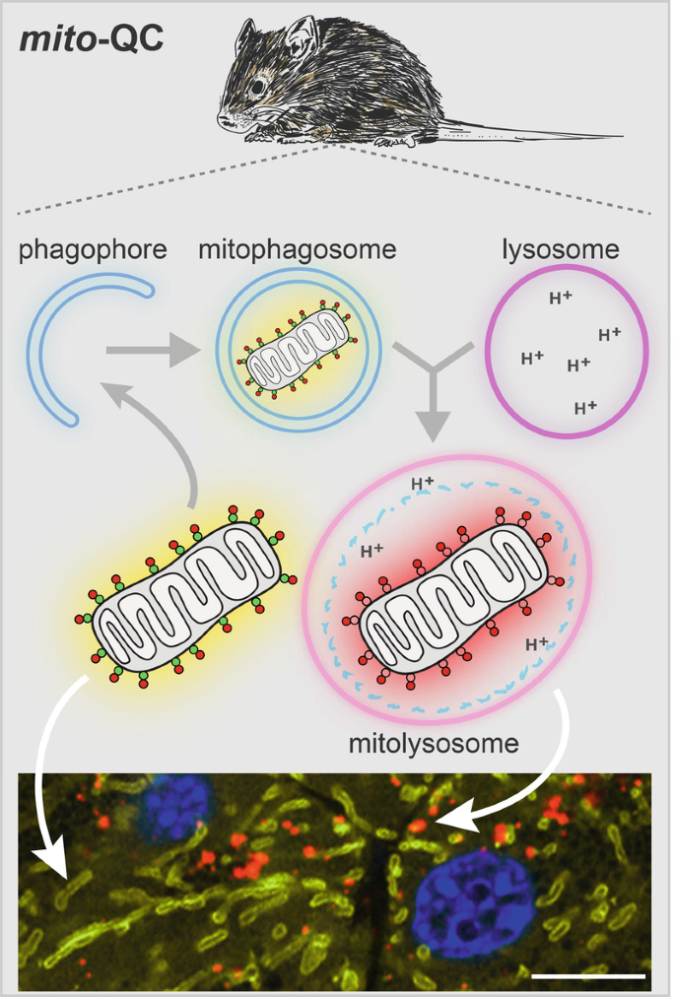
Pre-clinical models of autophagy

Slide 11
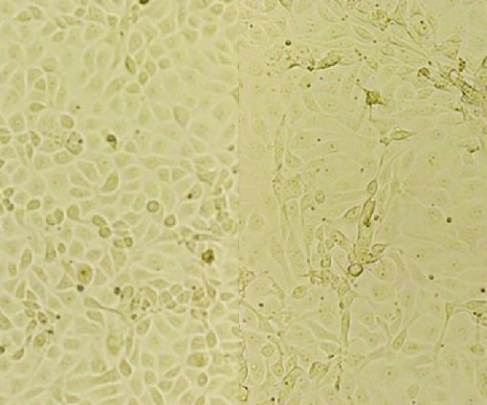
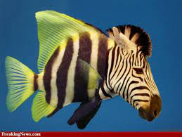
Pre-clinical models of autophagy Animal models have been developed for studying autophagy.
monkey kidney MARC-145 cells
Zebra Fish

Slide 12
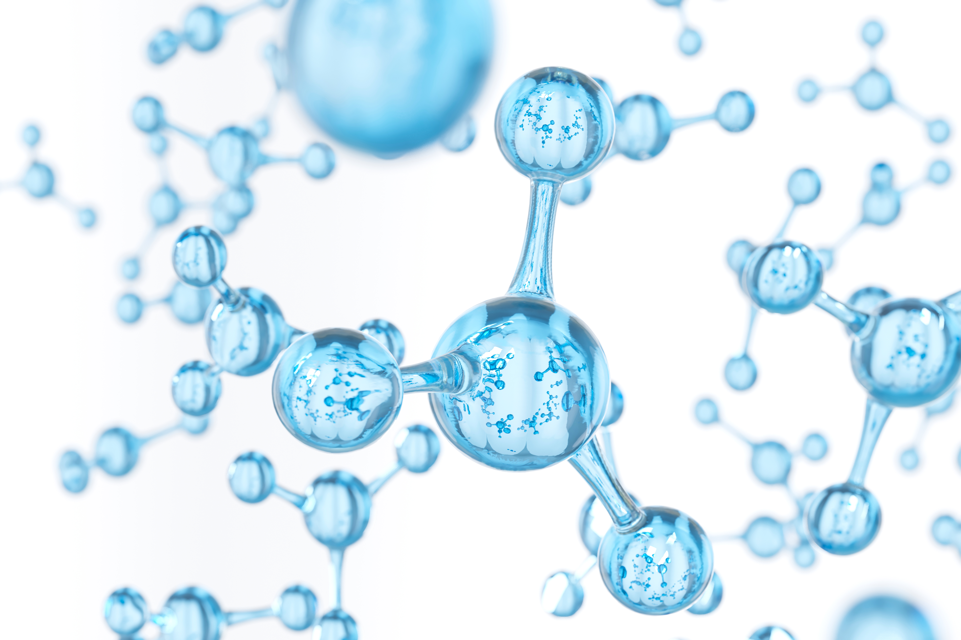
Nanomaterials and autophagy regulation
Polymeric nanoparticles
polymeric nanoparticles have demonstrated considerable potential in cancer therapy
Different polymers can be used to synthesize polymeric nanoparticles such as collagen, gelatin, PLGA and albumin.
This section describes the role of polymers in the synthesis of nanocarriers and evaluates their potential for delivery of autophagy regulators in cancer treatment.

Slide 13
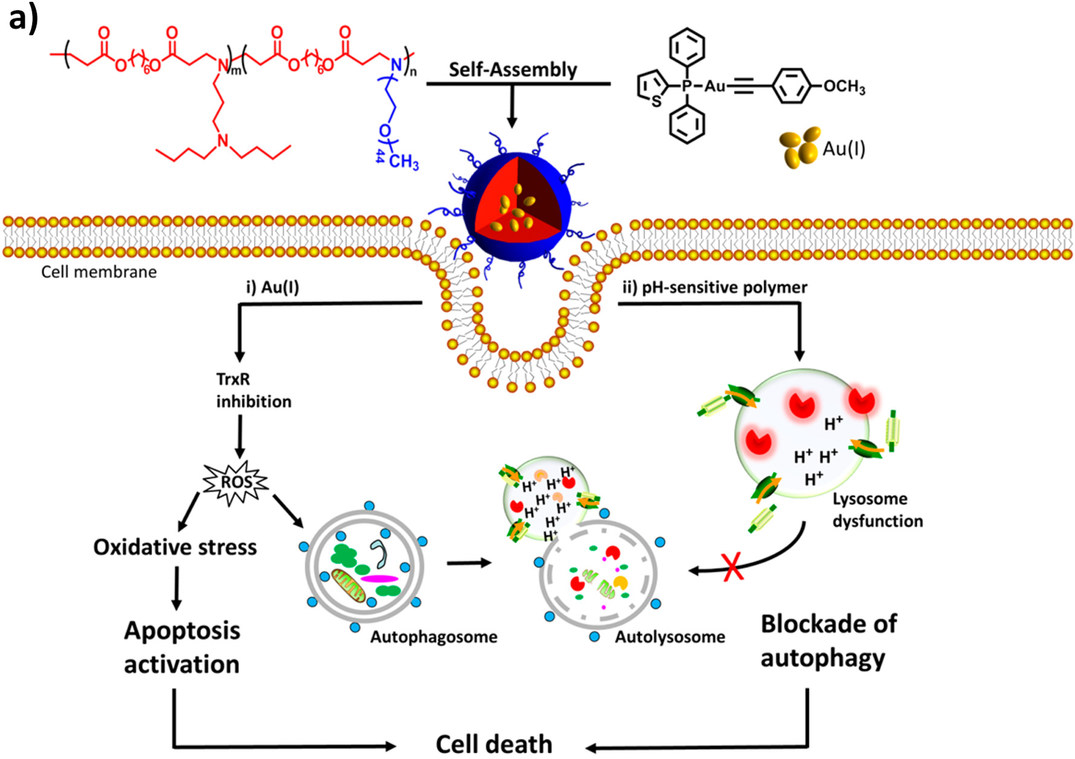
Polymeric nanoparticles
Poly B amino ester+AU/MCF7
Fig. 2. A) The synthesis of nanostructures and their impact on cell death and providing synergistic cancer therapy

Slide 14
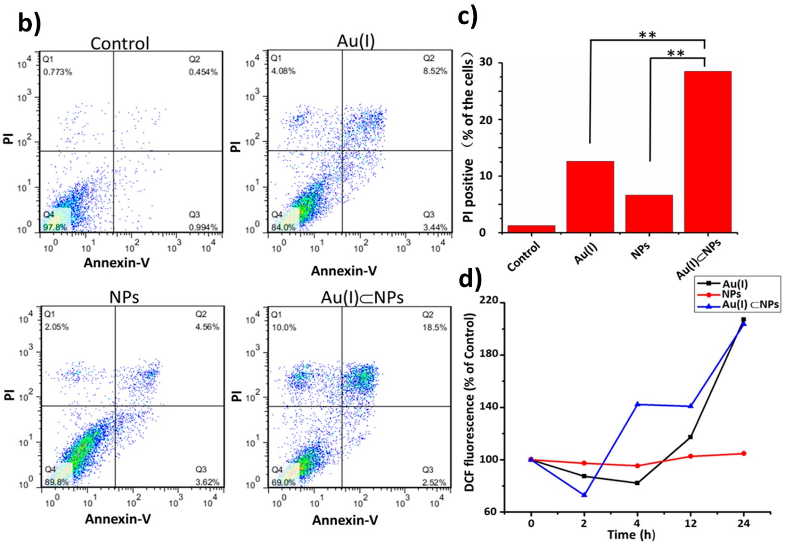
Polymeric nanoparticles
Fig. 2. B) Apoptosis assay by Flow-cytometry; C) Quantitative clarification; D) Investigating the level of ROS production in MCF-7 cells after exposing to nanoparticles.

Slide 15
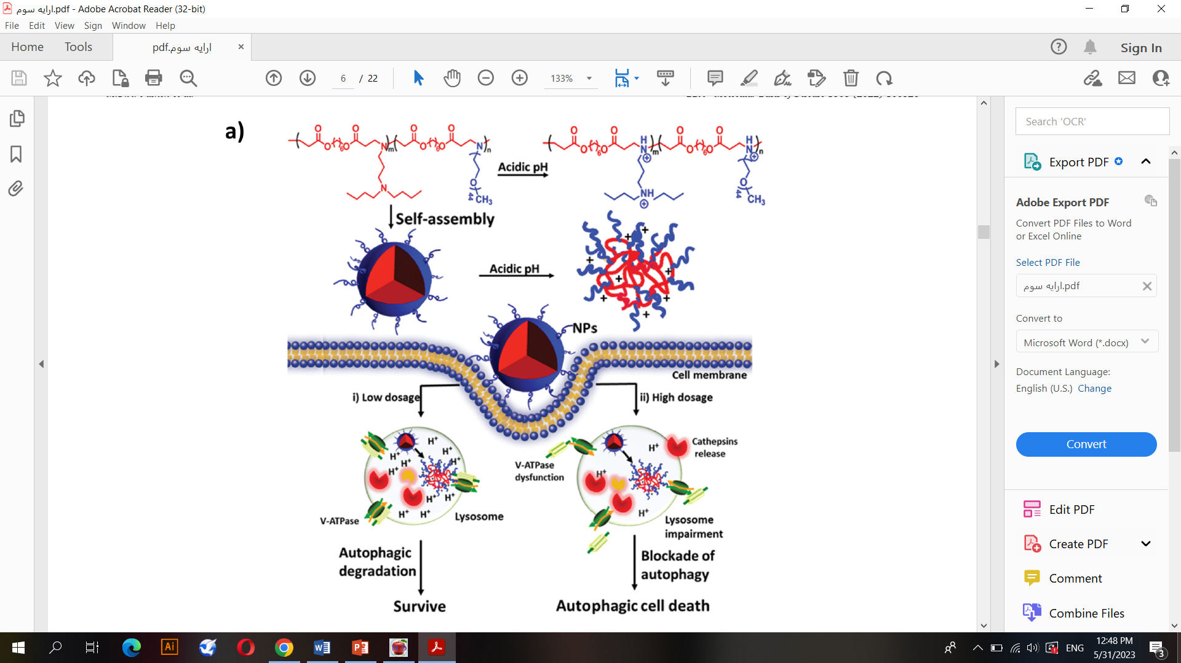
Polymeric nanoparticles
Fig. 3. A) The regulatory impact of prepared nanostructures on autophagy;

Slide 16
Nanomaterials and autophagy regulation
2. Green-modified nanoparticles
Polymers derived from natural sources: high potential for cargo delivery and high biocompatibility.
CITOSAN is derived from chitin has several beneficial features
biocompatibility, biodegradability and its ability to undergo changes by different methods.
Co-delivery of shRNA-ATG-5 and gefitinib by CS-based nanocarriers
These nanoparticles inhibit autophagy and promote apoptosis.

Slide 17
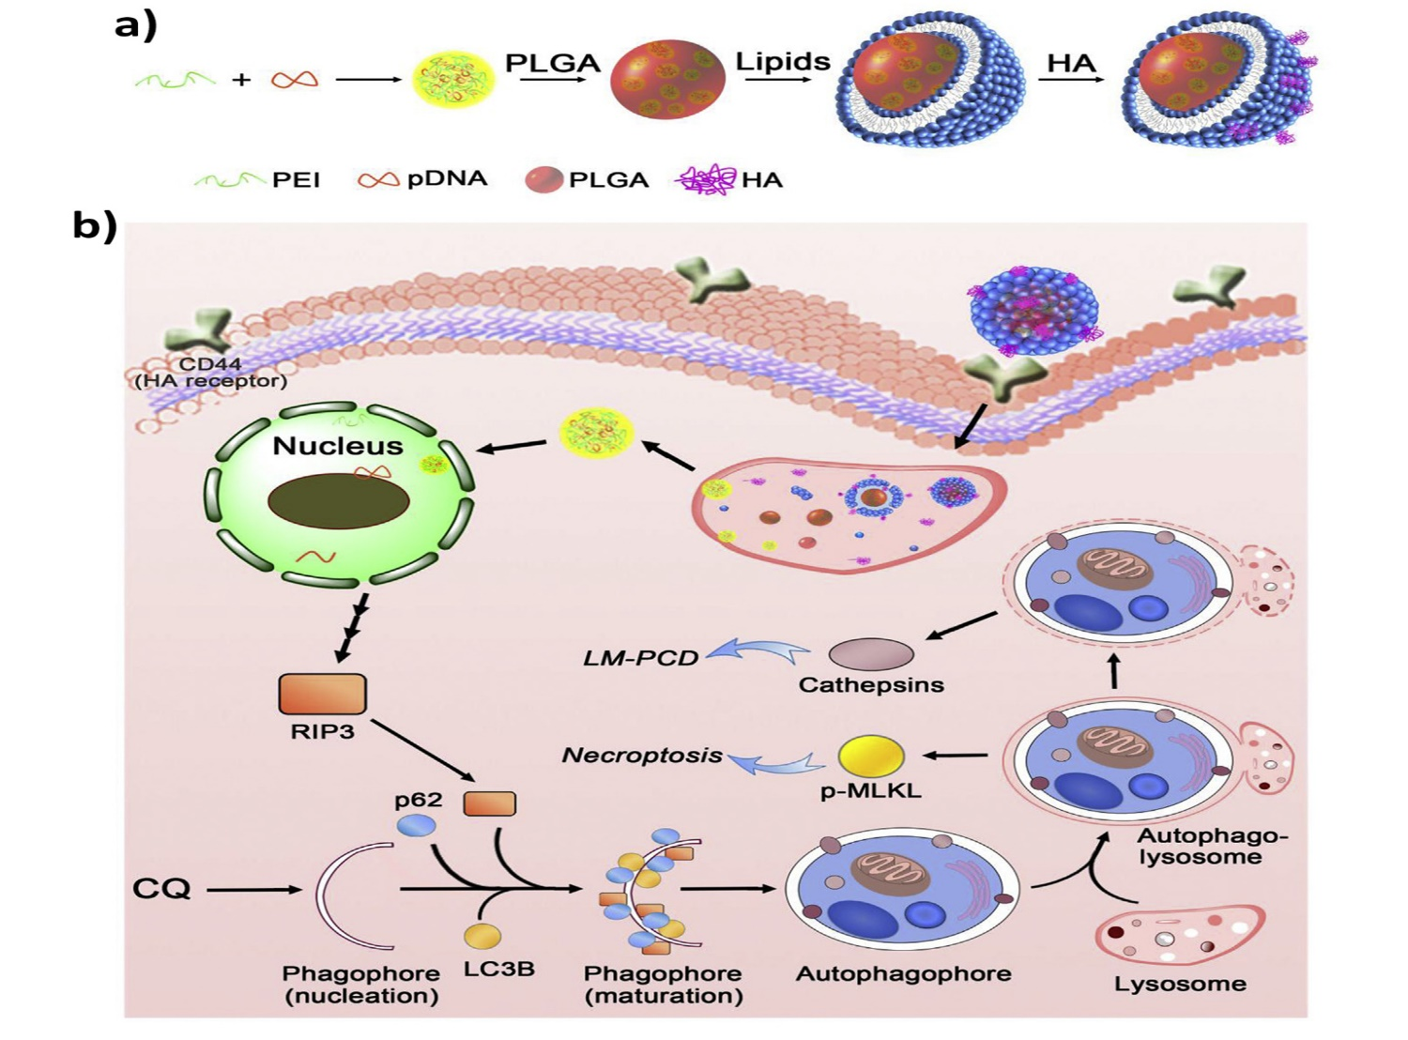
Green-modified nanoparticles
Fig. 4. A and B) Nanostructure synthesis and evaluating their impact on autophagy mechanism

Slide 18
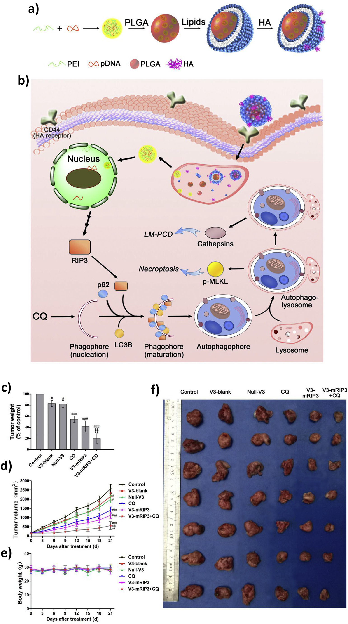
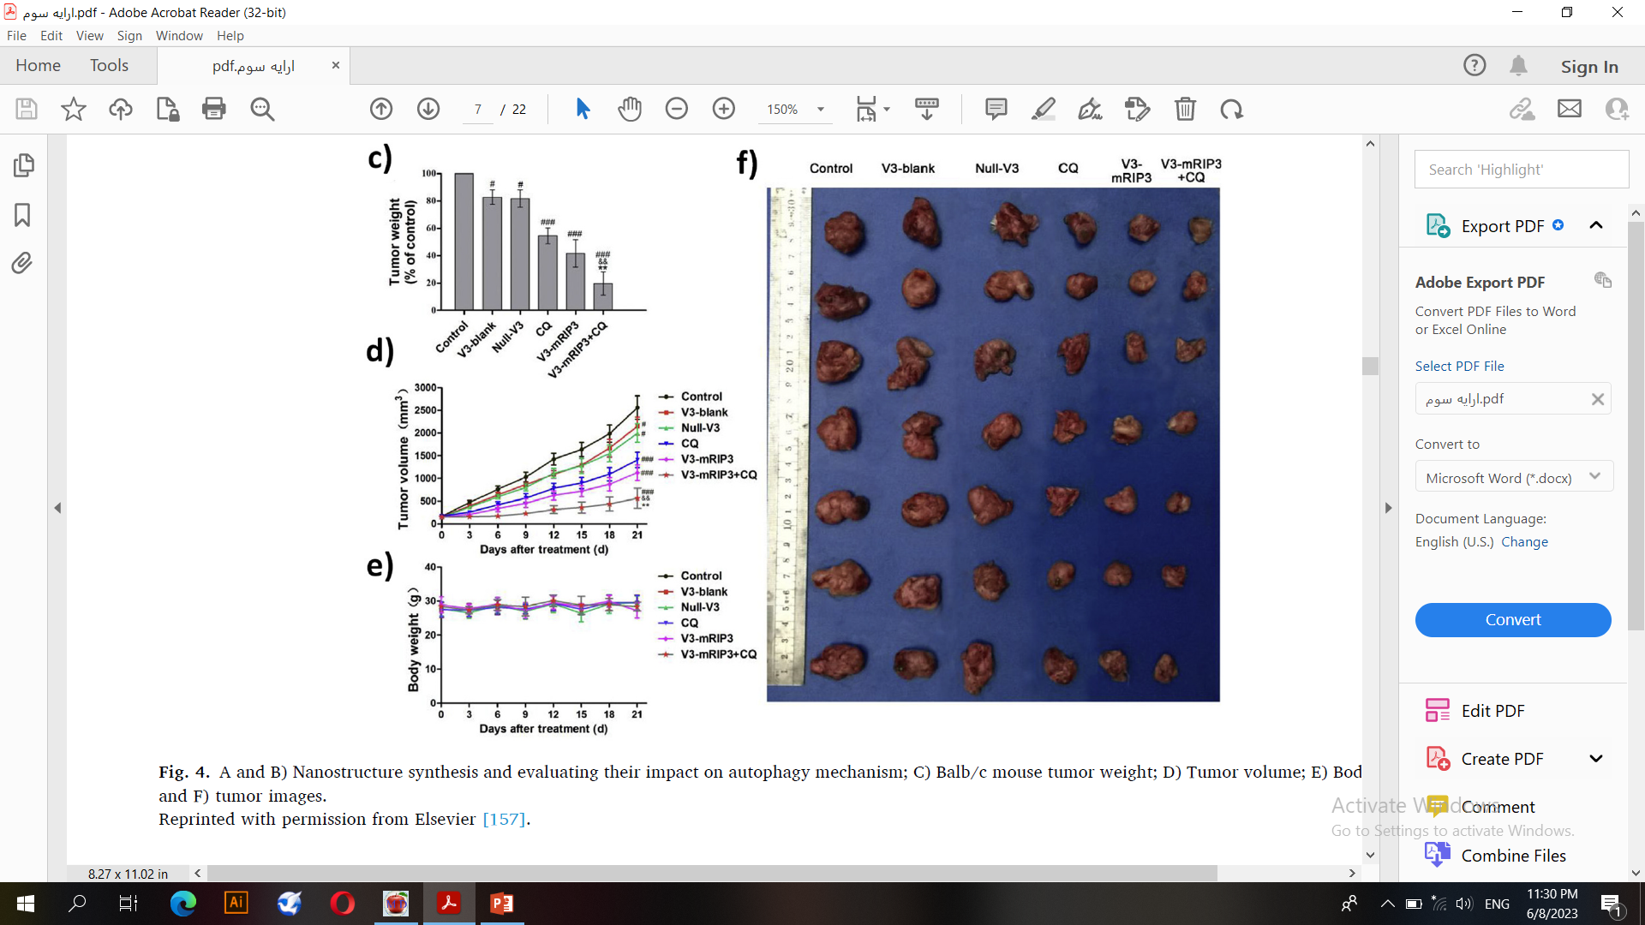
Green-modified nanoparticles
Fig. 4. F) tumor images.
Notes:
HA is a linear glycosaminoglycan that is negatively charged and
hydrophilic in physiological conditions [153]. High biocompatibility,
biodegradability and lack of immunogenicity are among the benefits of
HA, making it an appropriate agent for application in drug delivery
systems [154,155]. Further, surface modification of nanoparticles with
HA promotes their selectivity towards cancer cells by binding to CD44
receptors [156]. An experiment has prepared PLGA core-shell nanoparticles
for co-delivery of chloroquine and receptor-interacting protein
kinase 3 (RIP3) in colon cancer therapy. The surface of these nanoparticles
was modified with HA to enhance selectivity towards cancer
cells. The investigation of molecular pathways revealed that RIP3- and
chloroquine-loaded HA-modified PLGA nanostructures could increase
the expression of p62 and LC3-II and trigger autophagy

Slide 19
Nanomaterials and autophagy regulation
3. Lipid-based nanoparticles
1. Liposomes
Ease of synthesis, biocompatibility, biodegradability and capacity in loading hydrophilic and hydrophobic drugs are among the benefits of liposomes, making them appropriate choices in nanoscale delivery.
2. Micelles
Micelles are another ideal candidate in cancer therapy that belong to lipid-based nanocarriers. By enhancing the intracellular accumulation of anti-tumor compounds, micelles can effectively suppress cancer progression.

Slide 20
Nanomaterials and autophagy regulation
4.Carbon-based nanomaterials
1. Carbon dots
As an abundant element, carbon has various allotropes, and to date, different kinds of agents such as fibers, nanotubes and carbon dots (CDs) have been synthesized from carbon
2. Graphene nanomaterials
Graphene is another allotrope of carbon. It has a honeycomb structure with a high affinity for binding and its electrons involved in aromatic conjugate domains

Slide 21
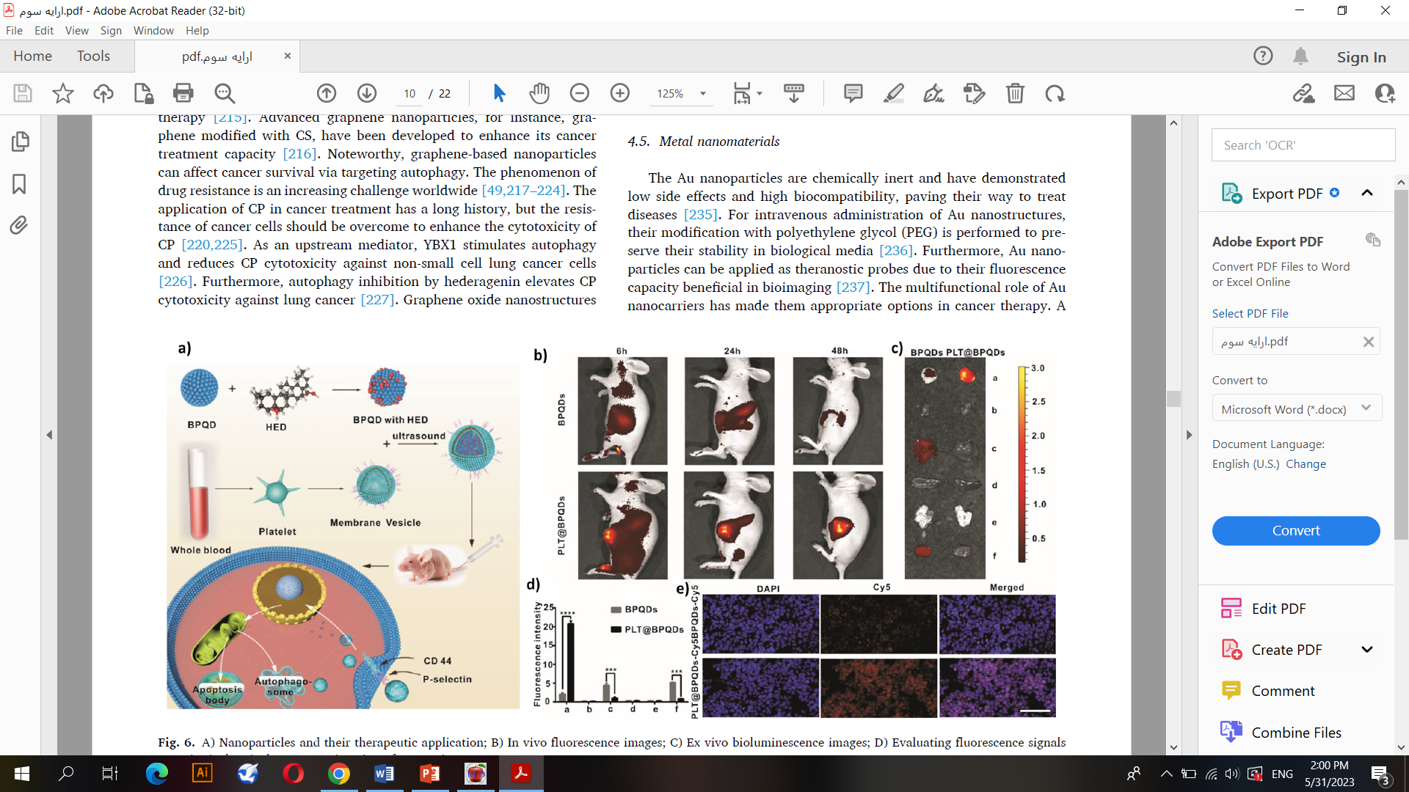
Carbon dots
Fig. 6. A) Nanoparticles and their therapeutic application; B) In vivo fluorescence images; C) Ex vivo bioluminescence images; D) Evaluating fluorescence signals
quantitatively; E) Fluorescence imaging of tumor tissues.
Notes:
The efficiency of QDs is attributed to the increased
bioavailability of anti-tumor agents in cancer chemotherapy. Recently,
an experiment has prepared black phosphorus quantum dots (BPQDs)
camouflaged with a platelet membrane (PLTm) for delivery of Hederagenin
(HED) in breast tumor treatment (MCF-7 cells). These HEDloaded
QDs stimulated autophagy by upregulating Beclin-1 and LC3-II
to enhance the anti-tumor activity of HED against breast cancer
(Fig. 6) [208]. Future experiments will shed more light on the potential
of carbon-based nanoparticles in delivery of autophagy regulators and
its association with cancer treatment [192].

Slide 22
Graphene nanomaterials
Graphene is another allotrope of carbon. It has a honeycomb structure with a high affinity for binding and its electrons involved in aromatic conjugate domains.
Graphene oxide nanostructures have been shown to activate autophagy, enhance CP cytotoxicity against colon cancer cells, and mediate necrosis.

Slide 23
Nanomaterials and autophagy regulation
5. Metal nanomaterials
The Au nanoparticles are chemically inert and have demonstrated low side effects and high biocompatibility, paving their way to treat diseases.

Slide 24
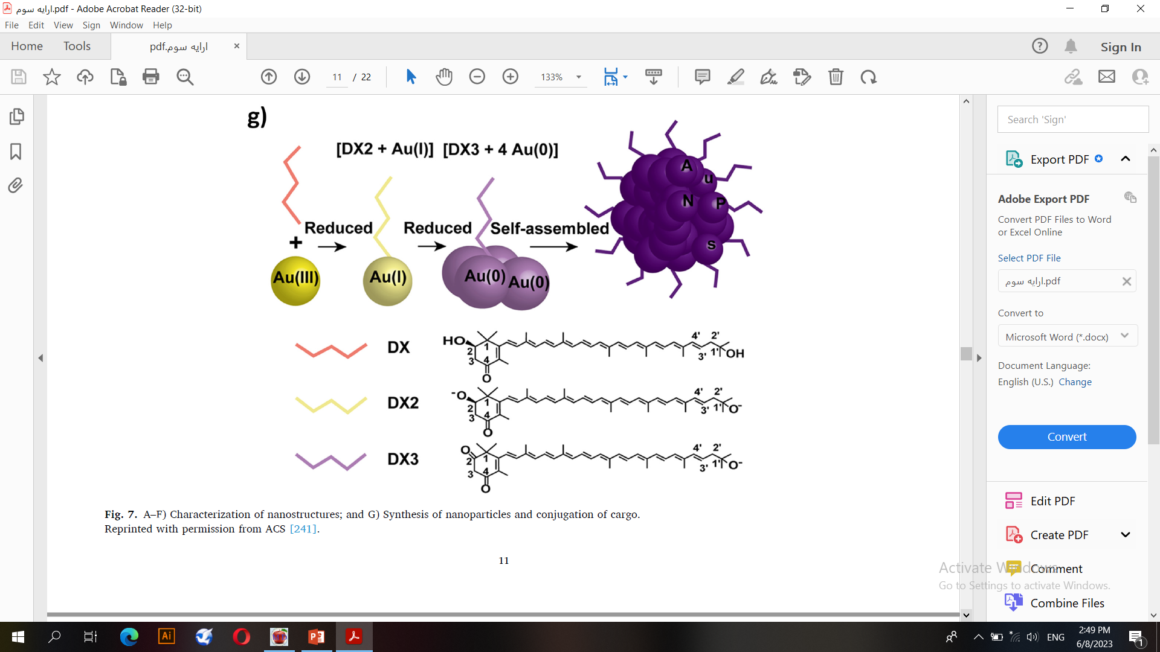
Metal nanomaterials
Fig. 7. Synthesis of nanoparticles and conjugation of cargo.

Slide 25
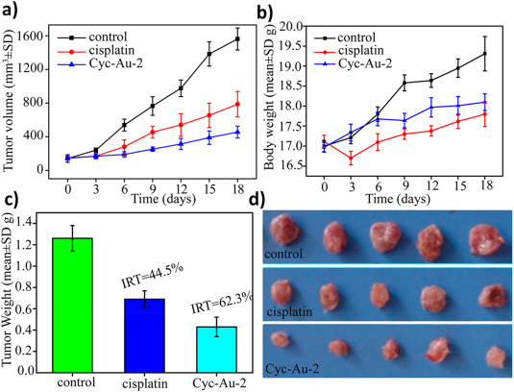
Metal nanomaterials
Lung cancer/A549
Fig. 8. A) Tumor volume; B) Bodyweight; C) Tumor weight; and D) Tumor images.

Slide 26
Metal nanomaterials
Silver (Ag) nanocarriers are applied in various fields such as the pharmaceutical industry, cosmetic products, biomedicine for wound healing, infection therapy and suppressing cancer progression.
Iron nanoparticles have also been applied in cancer therapy.
These nanocarriers can induce apoptosis, provide photothermal therapy and remain at the tumor site.
iron nanoparticles can accumulate in the mitochondria affecting glucose metabolism of colorectal cancer cells and triggering autophagy.

Slide 27
Metal nanomaterials
Fig. 9. Nanoparticles regulating autophagy in cancer treatment.

Slide 28

Conclusion and remarks
Modulation of autophagy is an important but challenging strategy in cancer therapy since autophagy possesses both tumor-promoting and tumor-suppressing roles .
Targeting autophagy should be considered after determining its role.
More investigation should be conducted about clinical application of nanoarchitectures for delivery of autophagy modulators.
which nanocarrier type is better for clinical application and delivery of autophagy modulators?
Large-scale production
Biocompatibility
Safety
Tolerance

Slide 29

گل ها بدون آنکه بدانند چه کسی در برابرشان قرار گرفته، به همه یکسان بو می دهند اما آدم ها برای انجام دادن یک کار برای کسی، به هزاران چیز نامربوط فکر می کنند و اگر با ذهن خودشان جور در آمد آن را انجام می دهند.
حضرت امیرالمومنین علیه السلام می فرمایند: «اگر در مقامی قرار گرفتید که می توانید برای مردم کاری بکنید، این کار را با اشتیاق و با تشکر از خداوند انجام دهید زیرا خداوند شما را لایق این کار دانسته اند و این جای سپاسگزاری دارد.»
20/خرداد/1402

Slide 30



