Slide 1


Mahsa Rahgoshay
MSc Student Of Hematology

Slide 2
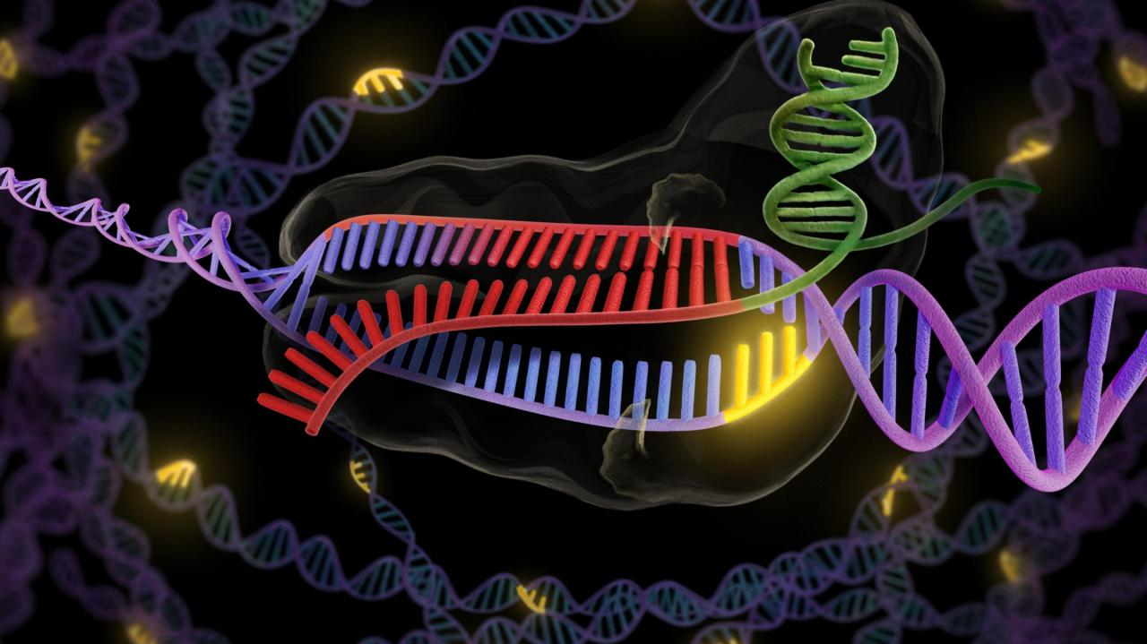
crispr
CRISPR-CAS9
a promising tool for gene editing

Slide 3

CRISPER – CAS9
CRISPR-Cas9 is a unique technology that enables geneticists and medical researchers to edit parts of the genome by removing, adding or altering sections of the DNA Sequence
the most rapidly evolving technology which has revolutionized biological research
It represents a family of DNA repeats in most archaeal (~90%) and bacterial (~40%) genomes
provides acquired immunity and resistance to foreign genetic elements such as virus and phages

Slide 4
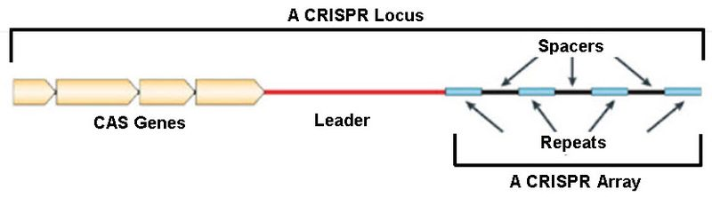
CRISPR: clustered regularly interspaced short palindromic repeat
The system CRISPER /CAS9 consists of three parts
CAS genes There are 4-20 different CASs
CRISPR area Repeat + spacer DNA
Leader A-T rich region، located on the upstream side of the Crisper array

Slide 5

HISTORY OF CRISPER
1987- CRISPR sequences were first discovered in Escherichia coli
2002- Identification of Cas genes that are associated with DNA repeats in prokaryotes.
2007- CRISPR provides acquired resistance against viruses in prokaryotes.
2012- Idea of using CRISPR- Cas9 as a genome engineering tool was published by Jennifer Doudna and Emmanuelle Charpentier
Breakthrough Prize
Awards, 2015

Slide 6
There are six distinct types of bacterial CRISPR systems
three main types (types I to III)
Three additional types (types IV to VI)
Owing to their simplicity, class 2 systems have been adopted for genome engineering
The CRISPR-Cas9 Type II consists of two key molecules
From Streptococcus pyogenes
crRNA + tracrRNA
Enzyme cas9
guide RNA

Slide 7
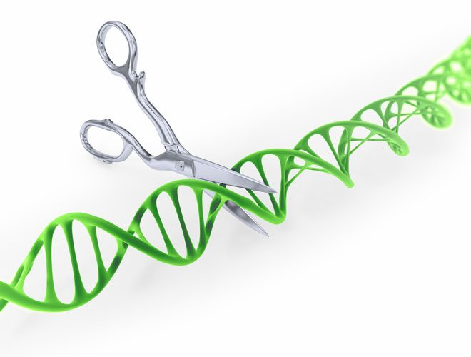
CAS-9
CRISPER associated protein
known as ‘molecular scissors
RNA-guided DNA endonuclease enzyme
associated with the CRISPR adaptive immunity system in Streptococcus pyogenes

Slide 8
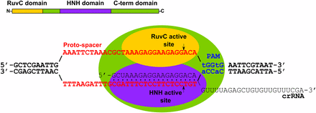
Cas9 contains two nuclease domains:
HNH domain
cleaves the strand complementary to the cr RNA-guide sequence
2) RuvC-like domain
cleaves the non complementary strand
Cas9 protein induce double-strand breaks (DSBs) at the target site

Slide 9
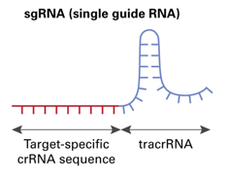
Guide RNA (g- RNA)
The guide RNA directs the Cas9 protein to a target site
Cr RNA + tracer RNA = guide RNA (g RNA)
Cr RNA (Crisper RNA)
cr RNA is a 20 nucleotide sequence that is complementary to a target region in your gene
tracrRNA(trans-activating crRNA)
tracrRNA provides a scaffold for the crRNA binding and stabilization

Slide 10
CRISPR-mediated adaptive immunity
The immune system created by CRISPR in the bacteria consists of two main phases
Immune phase
2) Immunization phase

Slide 11
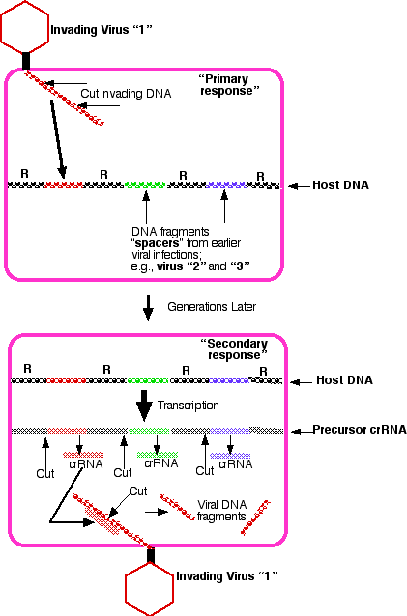
Immune phase
foreign DNA (viral or plasmid) is
inserted into the CRISPR locus of the host
CRISPR loci are transcribed and formed a Mrna called crRNA

Slide 12
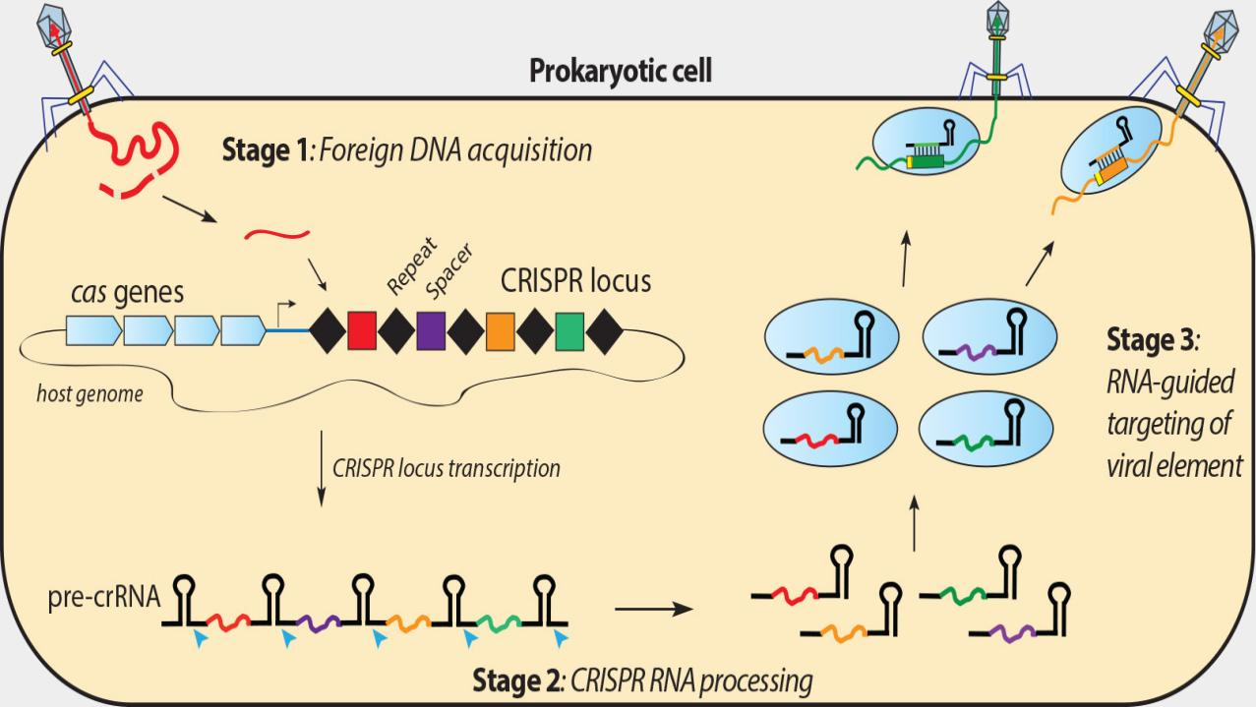

Slide 13
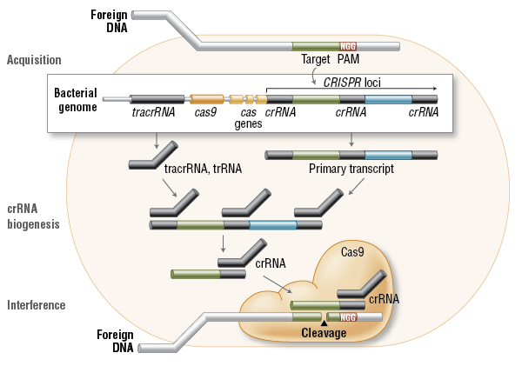
transcription and translation of cas9 genes
Translation of tracrRNA
tracrRNA bind to crRNA an formed gRNA (((tracrRNA + crRNA)
guide RNA bound to cas9 and formed Complex (crRNA + tracrRNA+cas9 + CAS9)

Slide 14
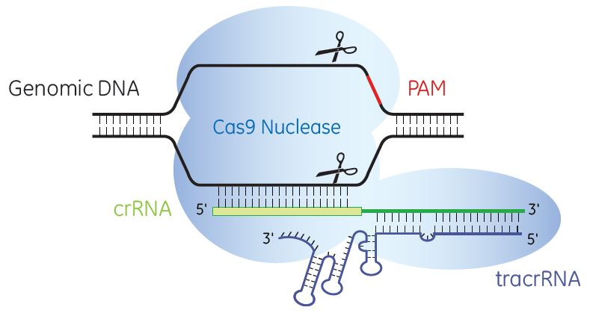
Complex (crRNA + tracrRNA + CAS9) goes through target DNA until finding a PAM and match sequence with crRNA
PAM : Protospacer Adjacent Motif
Short conserved sequences )NGG N is A, T, C, or G(
required for Cas9-DNArecognition
Double stranded DNA is cleaved by CAS9
DNA is repaired by the cell

Slide 15
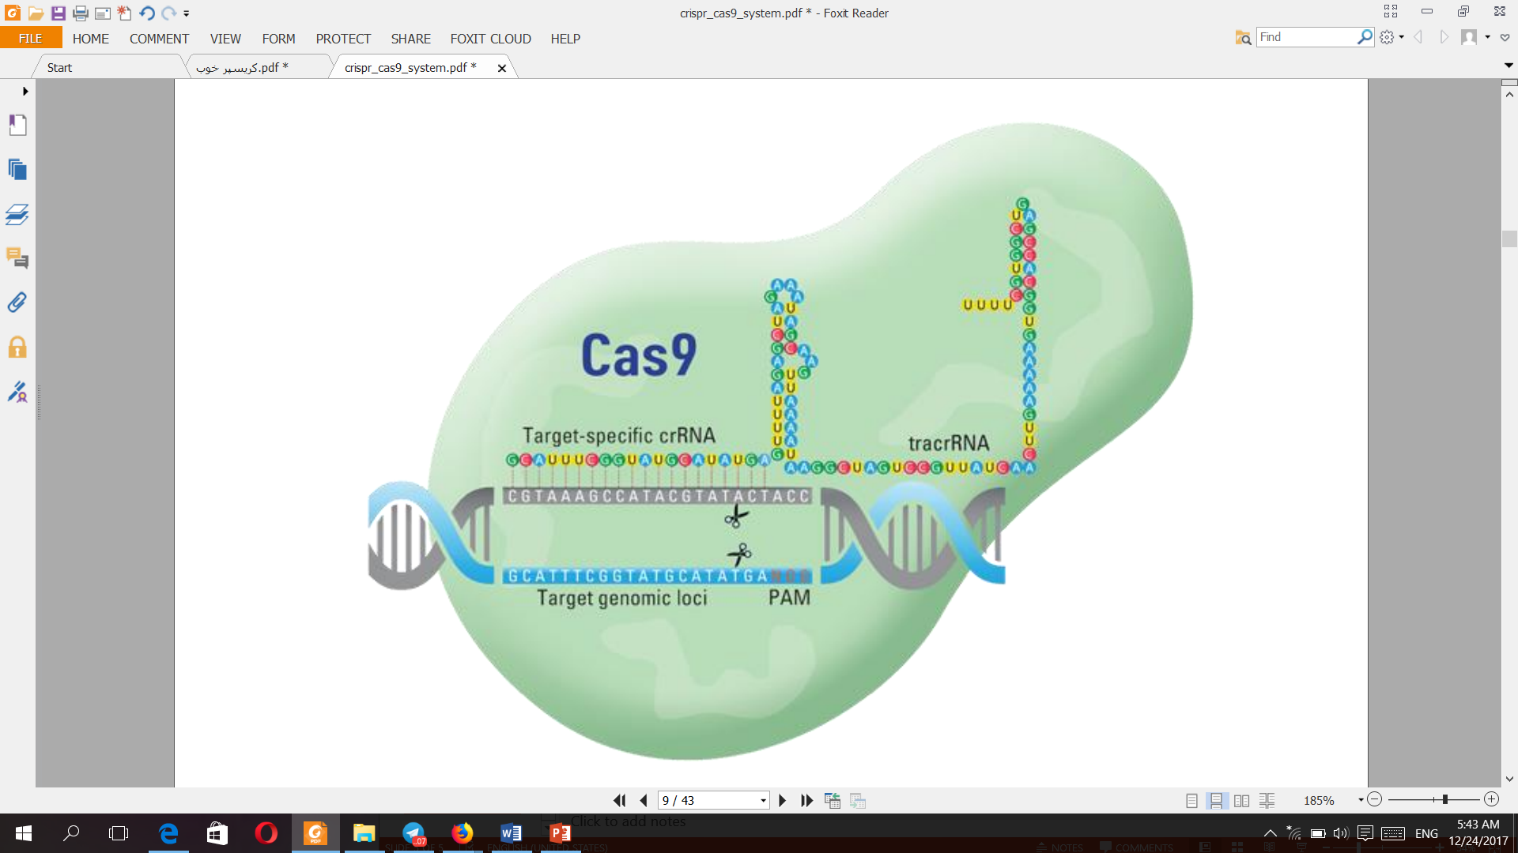

Slide 16
Genome Manipulation by CRISPER
CRISPR is a remarkably flexible tool for genome manipulation
Genomic manipulation requires only :
Cas9 protein
Engineered small guide RNA (sgRNA)
DNA Template Sequence

Slide 17
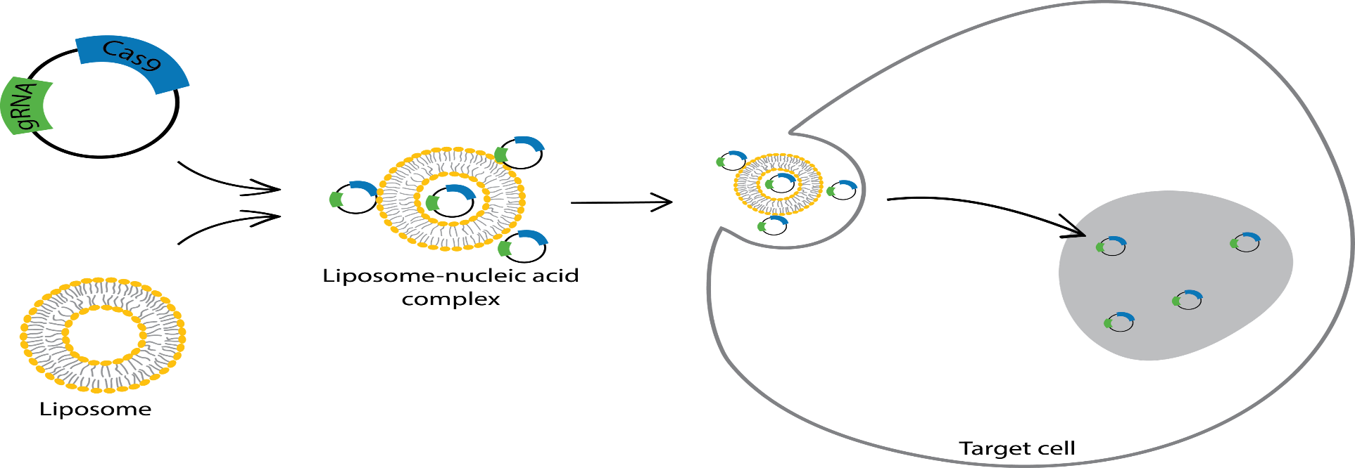
Delivery System Of CRISPER
Non-Viral Gene Delivery:
Electroporation
calcium phosphate transfection
lipid mediated transfection
Advantage: decrease the frequency of off-target effects and cell toxicity

Slide 18
Delivery System Of CRISPER
Viral Gene Delivery
Lentivirus
Adeno Virus
AAV Low degree of immune stimulation
Target diverse tissue
most common delivery system
approved for clinical use

Slide 19
Two major endogenous Double-strand Breaks repair pathways
1) Nonhomologous end joining (NHEJ)
does not require a he break ends are directly ligated without the need for a repair template,
forms short insertions or deletions (indels)
indels can cause frame - shift mutations that lead to the production of nonfunctional
incomplete proteins
2) Homology-directed repair (HDR) Thus, exploitation of HDR has allowed researchers to insert new genetic information at a target site
exchange of genetic information with similar sequences
More accurate and suitable repair mechanism

Slide 20
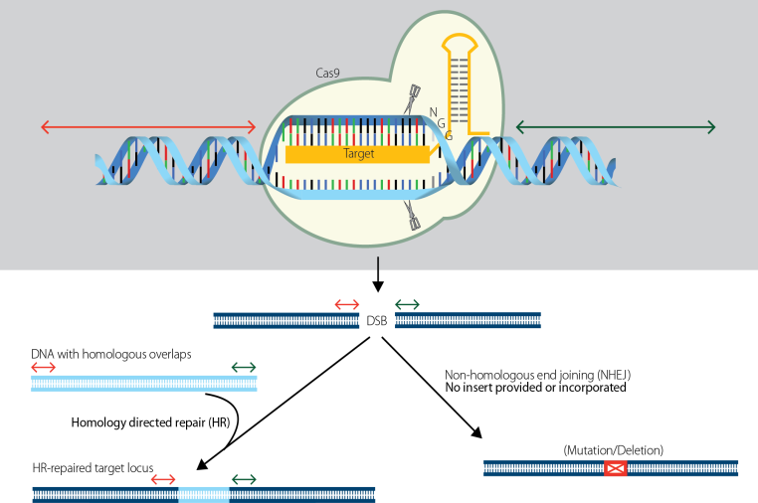
two major endogenous Double-strand Breaks repair pathways

Slide 21
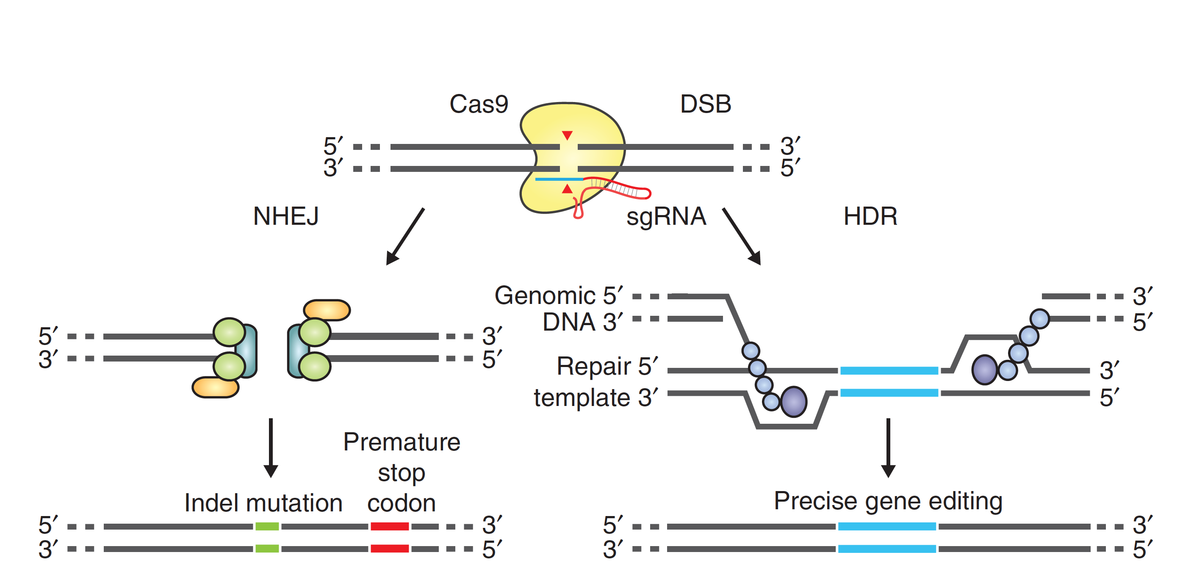
:

Slide 22
Nuclease Based Genome Editing
Engineered nucleases which will cut at a desired position in the genome
Methods:
1) Mega nuclease
2) Zinc Finger nucleases (ZFN)
3) Transcription activator-like effector nucleases (TALEN)
4) CRISPR / Cas
A recent and more innovative process It is faster, cheaper and more accurate than previous techniques of editing DNA

Slide 23
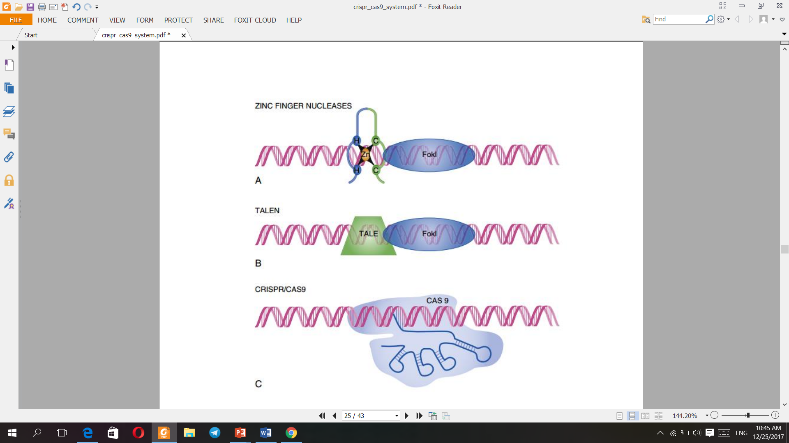

Slide 24
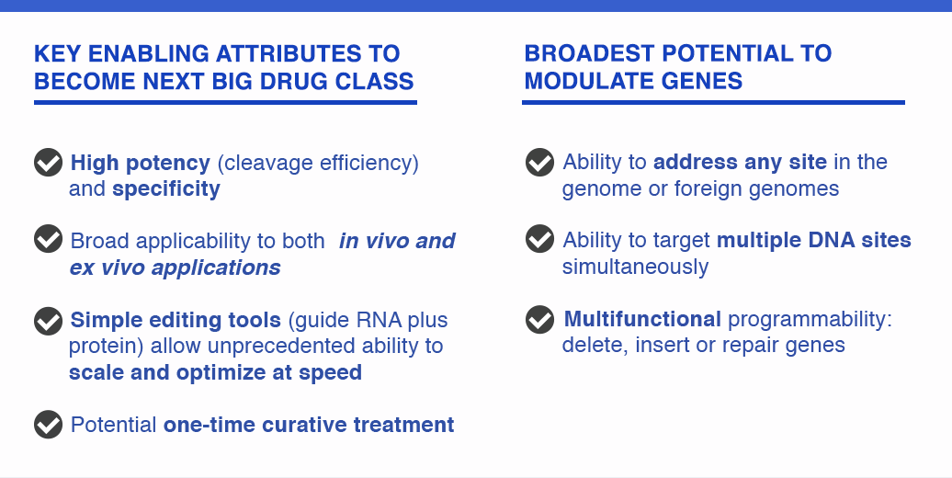
What makes CRISPR system the ideal technology

Slide 25

Off Target Effect In CRISPR/Cas9
The most important drawback of using CRISPR/Cas9 in clinical use is unwanted mutations at off-target sites that resemble the on-target sequence
Off-target mutations arise when genomic modifications take place at unintended sequences in the genome.
Unexpected off-target mutations may cause cells to become carcinogenic or functionally impotent

Slide 26
Improvements in CRISPR/Cas9 technology and reduce off target effect
The rate of HDR is inherently low because of:
1) HDR components are expressed only during the S/G2 phase, limiting the use of HDR-based
editing approaches in post-mitotic cells, such as neurons and cardiac myocytes
2) require a repair template
HDR efficiency improvement: suppression of a key enzyme in the NHEJ pathway induction of HDR-like corrections in post-mitotic cells

Slide 27
Improvements in CRISPR/Cas9 technology and reduce off target effect
1) Improvement for the design of the gRNA–Cas9 comple
Use lower concentrations of gRNA–Cas9
truncated-Grna
fusion protein of catalytically inactive Cas9 and FokI nuclease (fCas9) can recognize the target DNA site with 140-fold greater specificity
Delivery system improvements
Non-viral method
Improving HDR efficiency

Slide 28
Ex Vivo Gene Editing
the target cell population(T cell- HSCs-IPS) is removed from the body
genome-editing reagents (CRISPER cas9+ Grna+ template DNA) is delivered to cells in culture by viral or non viral delivery system
The therapeutically cells are expanded in the culture
modified cells transplanted back into the original host
In Vivo Gene Editing
genome-editing reagents (CRISPER cas9+ Grna+ template DNA) is packaged in a delivery vehicle such as AAV
The therapeutic is delivered to a target organ

Slide 29
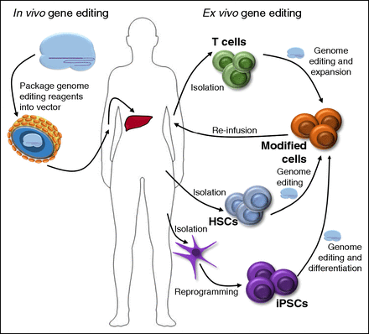

Slide 30
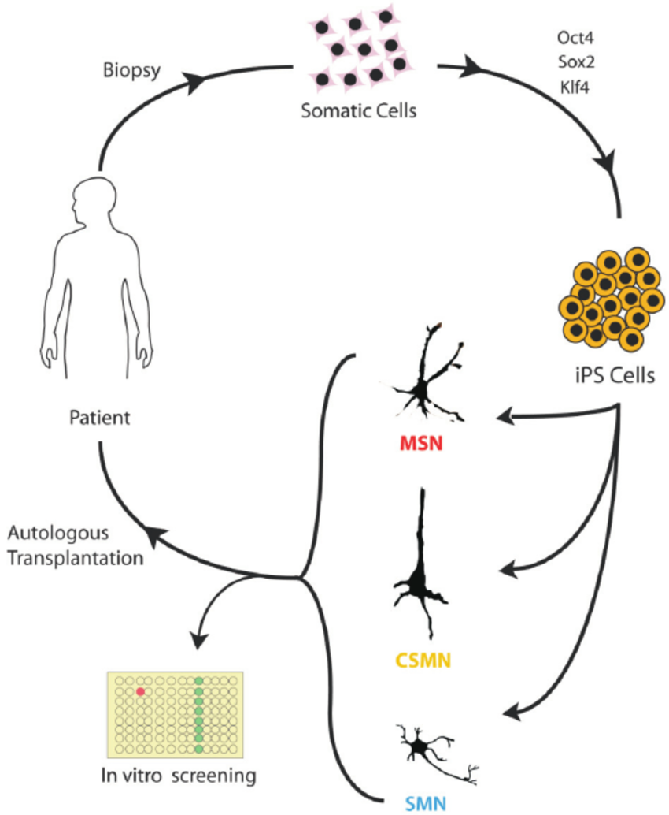
Induced Pluripotential Stem Cell
(IPS)
pluripotent cells that are very similar to embryonic stem cells
high self-renewal rate
differentiate into almost all cell types
can be derived from the patients themselves so avoid immune rejection when transplanted
less ethical controversy than embryonic stem cell

Slide 31
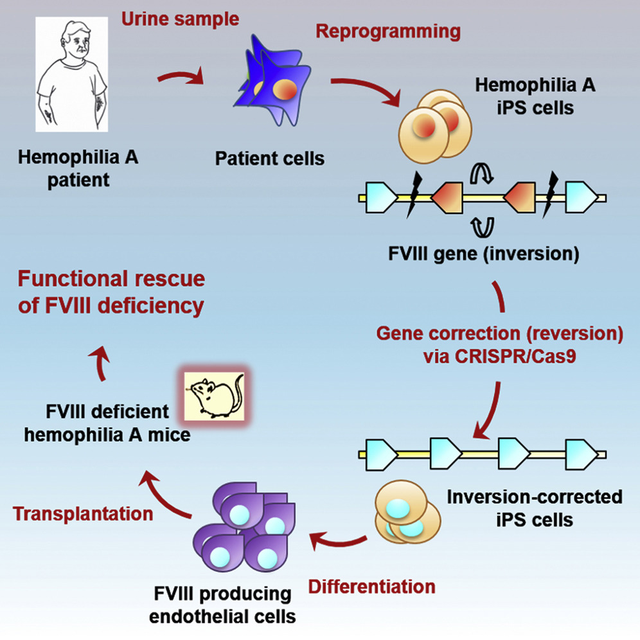
CRISPR/Cas9 shows great potential to correct disease-causing mutations in haemophilia A mice

Slide 32
References“:
Sander, J.D. and J.K. Joung, CRISPR-Cas systems for editing, regulating and targeting genomes. Nature biotechnology
Nihongaki, Y., et al., Photoactivatable CRISPR-Cas 9for optogenetic genome editing. Nature biotechnology
Barrangou, R. and J. van der Oost, RNA-mediated Adaptive Immunity in Bacteria and Archaea, in CRISPR-Cas Systems
Barrangou ,R. and J.A. Doudna, Applications of CRISPR technologies in research and beyond. Nature biotechnology
Tsai, S.Q. and J.K. Joung, Defining and improving the genome-wide specificities of CRISPR-Cas 9nucleases. Nature Reviews Genetics
Gaj, T., C.A. Gersbach, and C.F. Barbas, ZFN, TALEN, and CRISPR/Cas-based methods for genome engineering. Trends in biotechnology,
Rath, D., et al., The CRISPR-Cas immune system: biology, mechanisms and applications. Biochimistry

Slide 33
T h a n k s F o r y o u r a t t e n t i o n

