Slide 1
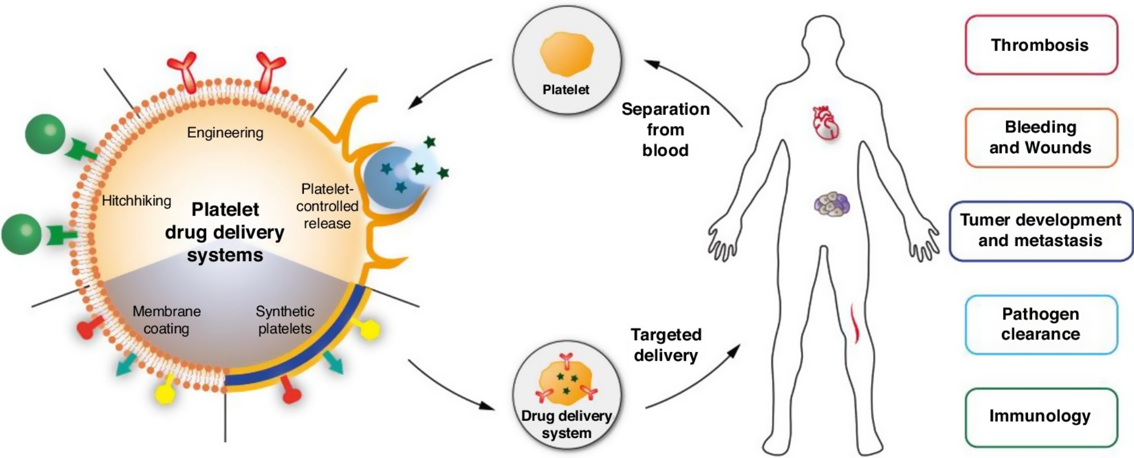
Platelet-Based Drug Delivery for Cancer Applications
Adviser : Dr.Mardani

Slide 2
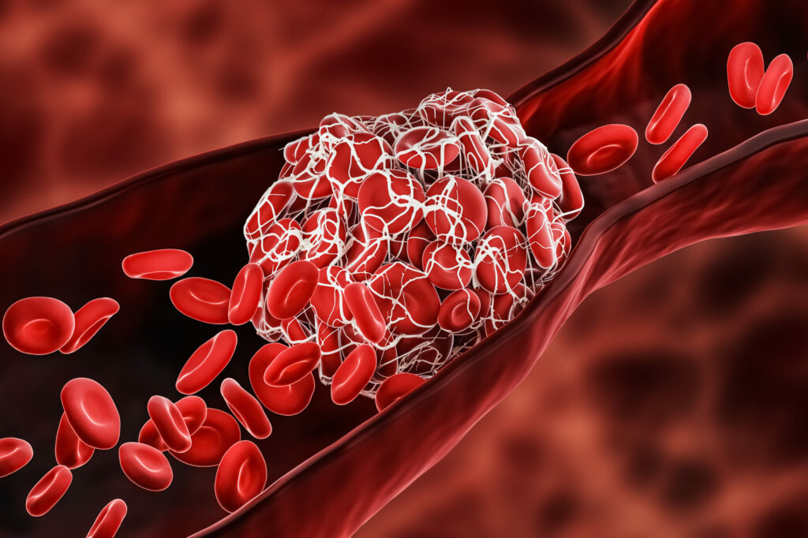
1 Cancer Metastasis
1.1 Primary tumor support
Cancer-associated thrombosis
tumor microenvironment -------> P-MP -----> VEGF /PDGF /PF4 /MMP,…
P-MP -----> MAPK , AKT ------> overexpression tumor cell proliferation.
VEGF -----> vascularization to supply nutrients and oxygen -------> tumor overgrowth --------> MMP
-------> more invasive phenotype in malignant cells
P-MP -----> deliver adhesion molecules to tumor cells

Slide 3
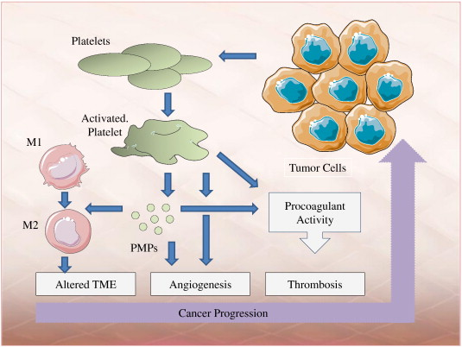
P-MPs are considered a vital part of the TME
their roles depend on the level of platelet activation
platelet activation : express tissue factor (TF) --------- thrombin synthesis
----------- PARs (protease-activated receptors)
alteration in the k-ras oncogene
TF expression
loss of p53
positive feedback between tumor cells and platelets ------- proliferation, invasion, metastasis.

Slide 4
1.2 Epithelial-Mesenchymal Transition and Intravasation
EMT : Epithelial-mesenchymal transition
morphological change
Reversible
invasive phenotype
intracellular adhesion complex ------- tumor cells migrate and invade the vasculature
trigger EMT activation in tumor cells
growth factors
contact between platelet and tumor cells ----> adhesion molecules :
GPIIb/IIIa
plasma proteins :
fibrinogen, fibronectin,vWF
tumor cells
ανβ3
NF-kB -----> EMT
TGF-β and NF-kB -------> MMP --------> ECM degradation -----> tumor cell invasion

Slide 5
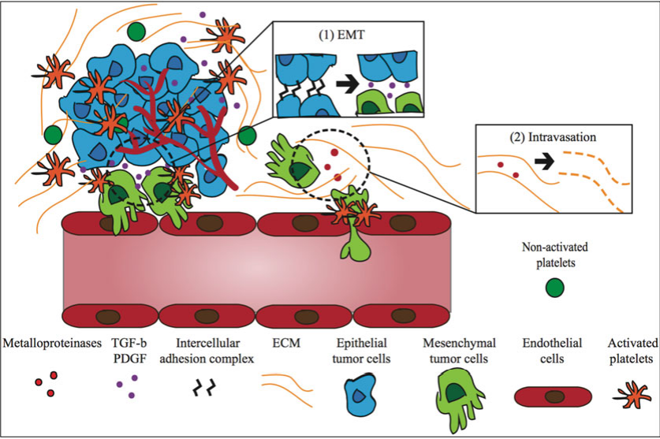

Slide 6
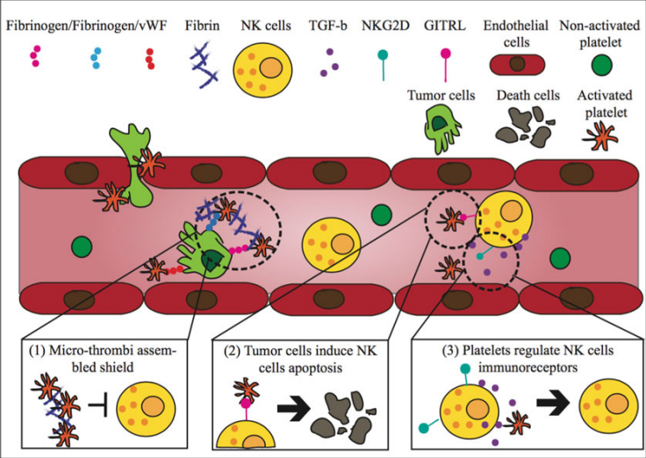
1.3 Protection Conferred to Circulating Tumor Cells

Slide 7
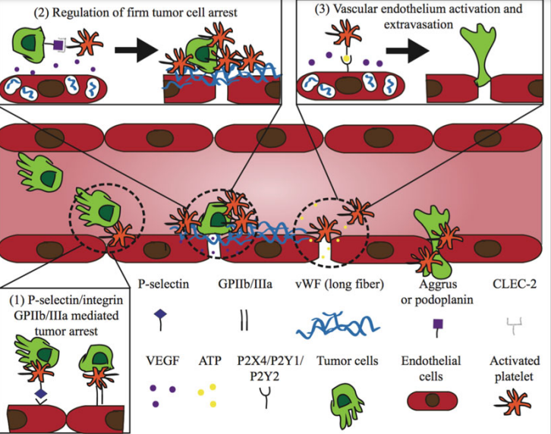
1.4 Circulating Tumor Cell Arrest and Extravasation

Slide 8
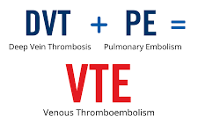
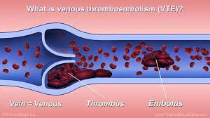
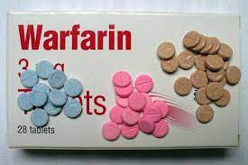
2- Platelet-Based Cancer Therapy
2.1 Anticoagulants as Cancer Therapy
Venous thromboembolism (VTE)
tissue factor (TF) and cancer procoagulant (CP)
Common anticoagulants : warfarin and LMWH
aspirin ------> inhibition COX-1

Slide 9
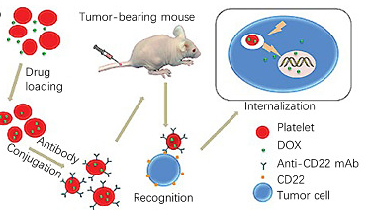
2.3 Drug Delivery Systems Using Platelets as Carrier
Internal
Surface binding
GPIIb/IIIa
lb/V/Lx
P-selectin

Slide 10
Surface binding
Advantages :
more volume and larger diameter ------> can deliver more therapeutic drugs
platelets can remain up to 9 days in circulation > nanoparticle stay for 2–50 h
deep tumor penetration / involvement in metastasis and angiogenesis

Slide 11
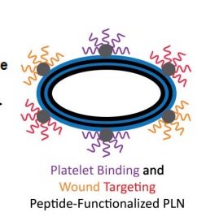
2.4 Drug Delivery Systems
Inspired by Platelets
silica particles that are coated with platelet membranes conjugated with tumor necrosis factor-related apoptosis-inducing ligands (TRAIL) to target circulating tumor cells
engineered platelets to express TRAIL on their surface by
a genetic modification in hematopoietic stem
and progenitor cells
platelet membrane coated Nano gel-based Nano carriers was used to deliver TRAIL and doxorubicin

Slide 12
