Slide 1


Slide 2

Hematology Journal Club
Title:
Clinical application of platelet-rich plasma for cartilage defects and osteoarthritis
Presented by:
Zahra Barzang

Slide 3
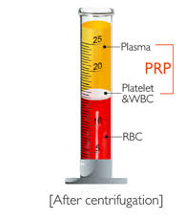
PRP Definition
Platelet-Rich Plasma Therapy (PRP) is defined as a sample of autologous blood with concentrations of platelets in a given volume of plasma that is above the concentration found in whole blood.

Slide 4
Growth factor in platelets
PDGF (platelet- derived growth factor)
TGF-B1 (transforming growth factor B1)
VEGF (vascular endothelial growth factor )
EGF (epidermal growth factor )
IGF-1 (insulin-like growth factor )
HGF (hepatocyte growth factor )
b FGF (basic fibroblast growth factor )

Slide 5
Products of PRP
P-PRP (pure platelet-rich plasma )
PRGF (plasma rich in growth factor )
L-PRP (leukocyte and platelet-rich plasma )
P-PRF (pure platelet-rich fibrin )
L-PRF ( leukocyte and platelet-rich fibrin )

Slide 6
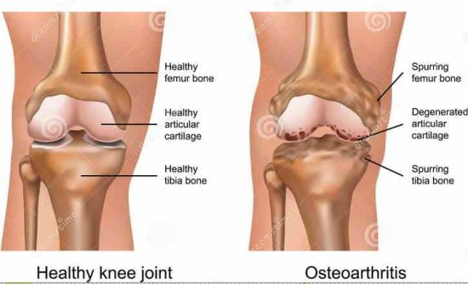
cartilage defects and osteoarthritis:
Cartilage defects (CDs) and the most common joint disease, osteoarthritis (OA), are characterized by degeneration of the articular cartilage that ultimately leads to joint destruction.

Slide 7
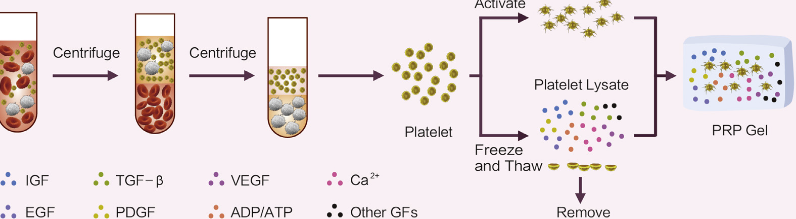
The most basic method to prepare PRP is centrifugation, divided in to a one-step and two-step-centrifugation protocol

Slide 8
TGF-B roles :
Decreases type 1 collagen gene expression
Increases type II collagen and aggrecan gene expression.

Slide 9
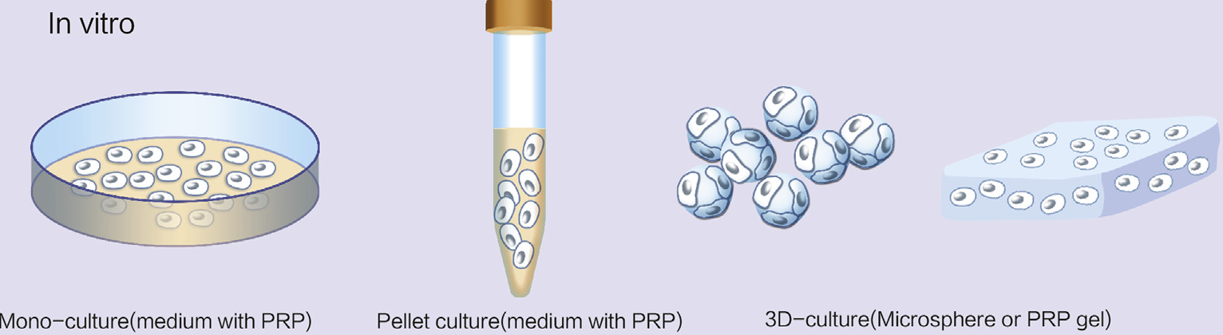
Application of PRP for cartilage cell culture:

Slide 10
PRP for MSC differentiation to cartilage cells in vitro:
PRP added to the culture medium retains the immune-regulatory effect of MSCs.
It can decrease alloantigen -induced cytotoxic activity, favors differentiation of CD4‏ T-cell subsets expressing a Trig phenotype and increases early secretion of IL-10 as well as induces a striking augmentation of IL-6 production.

Slide 11
PRP for OA in animal model
In an OA model induced by formalin, collagenase, or anterior cruciate ligament transfection, treatment with PRP/gelatin hydrogel injected in knee joints increased mRNA expression of proteoglycan core protein in the articular cartilage and decreased chondrocyte apoptosis and suppressed progression of OA.

Slide 12
PRP for CDs in animal model
partial thickness defects, with the defect entirely contained in the cartilage layer.
full-thickness defects, with the defect extending down to but not into the subchondral bone.
osteochondral defects that extend into the subchondral bone.

Slide 13
PRP for cartilage defects divided three modalities:
Acellular repair technology
PRP with cells
Cell-based tissue engineering

Slide 14
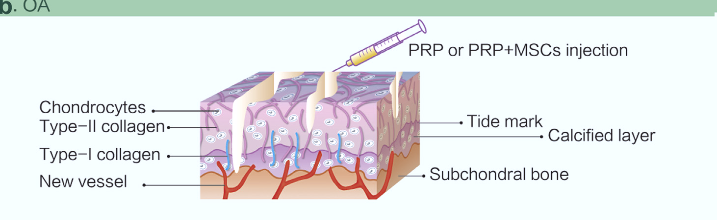
PRP for clinical application in OA
PRP is used for hemostasis and for total joint arthroplasty for OA.

Slide 15
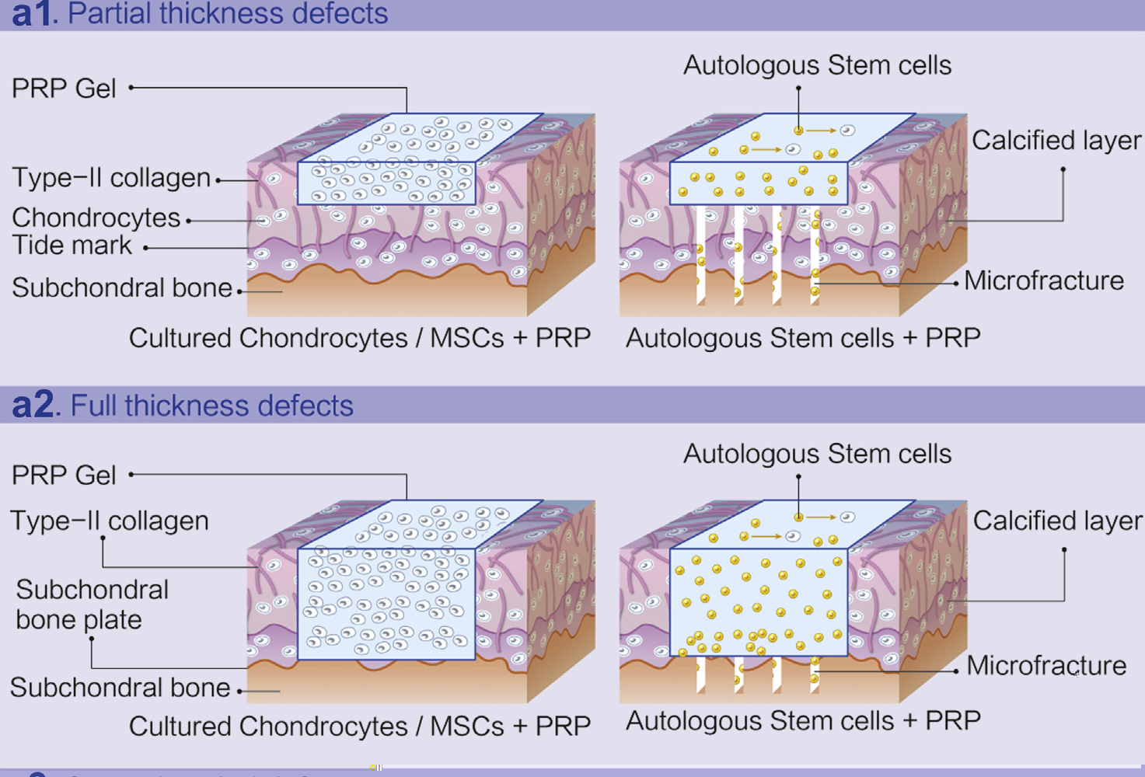
PRP for CDs in the clinic

Slide 16
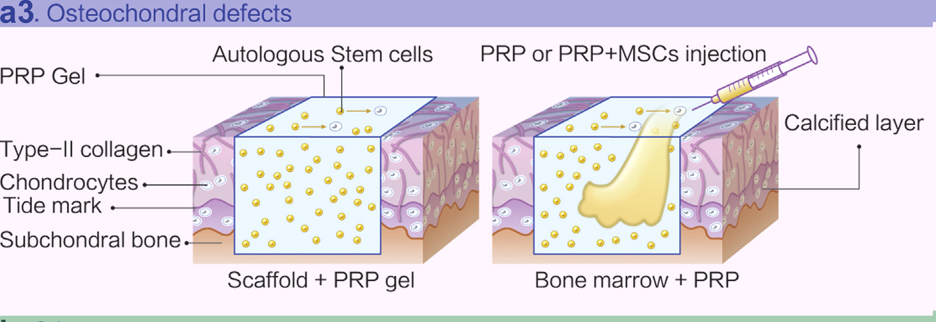

Slide 17
Safety of PRP treatment
Many studies have suggested safety, pain relief, and functional improvements with PRP injections for OA.
adverse effects include infection, bleeding, bruising, peripheral nerve injury, allergy to local anesthetics.

Slide 18
Conclusions
PRP when added on scaffolds of cartilage tissue-engineered constructs ،it can enhance the regeneration of cartilage cells and repair CDs .
Future directions of PRP application may concentrate on seeking an appropriate and innocuous agent like anti-VEGF antibody that can modulate and control the effect of PRP.

Slide 19


