Slide 1
Development of luspatercept to treat ineffective erythropoiesis
Adviser by: Dr.Mirzai

Slide 2


LR-MDS
MDS with ring sideroblasts (RS) and/or SF3B1 mutation
MDS/MPN-RS-T
TD beta thalassemia
it can now be prescribed in the second-line setting after erythropoiesis-stimulating agents (ESAs) have failed or for patients who are not eligible because of high serum erythropoietin (sEPO) levels.

Slide 3
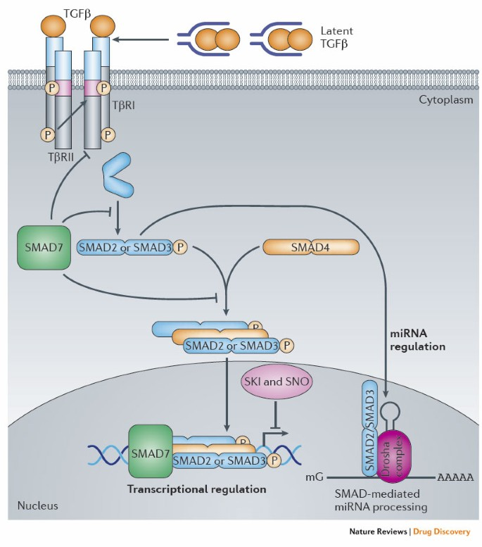
Biological background
GDF

Slide 4
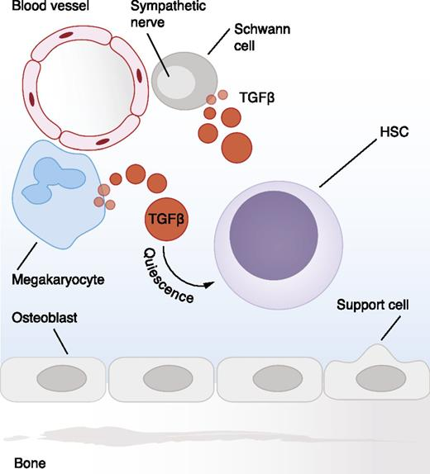
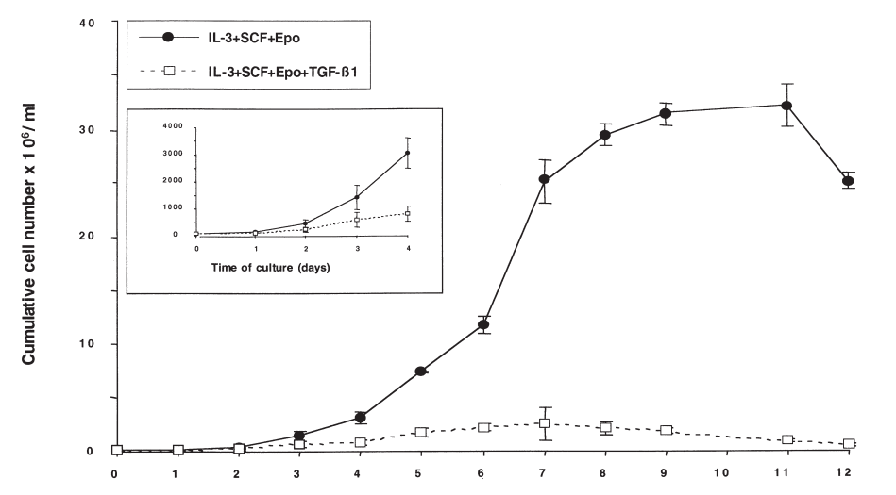
TGF-b1 accelerates erythroid differentiation and reduces proliferation of intermediate and late erythroid progenitors

Slide 5
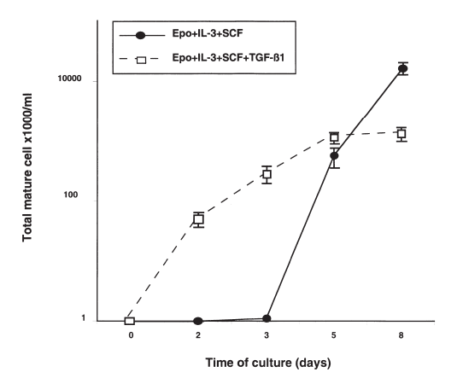
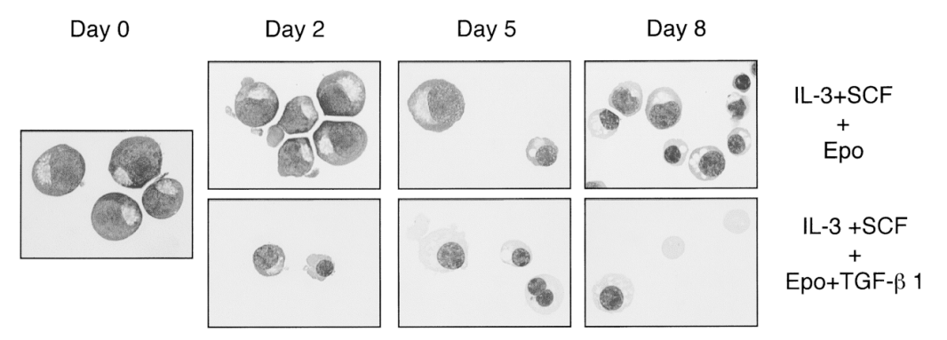
TGF-b1 accelerates and allows full terminal erythroid differentiation including enucleation

Slide 6
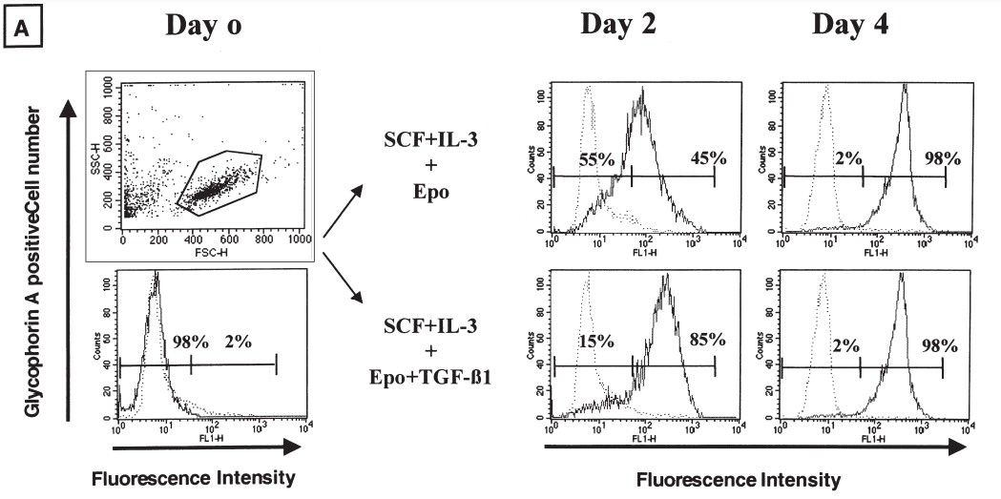
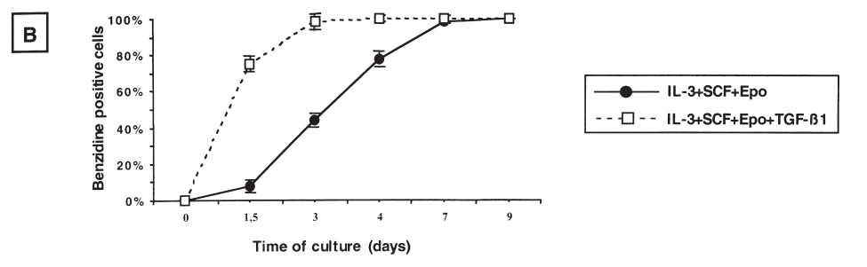
TGF-b1 accelerates erythroid differentiation and reduces proliferation of intermediate and late erythroid progenitors

Slide 7
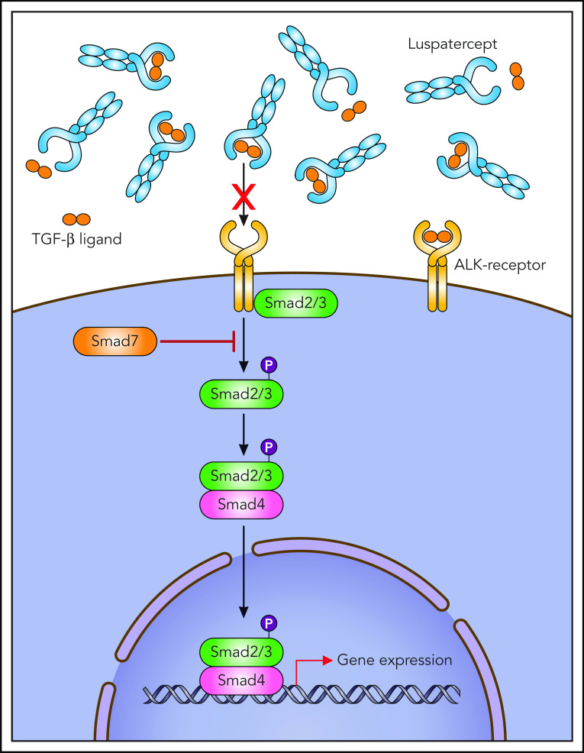
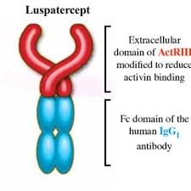
luspatercept

Slide 8
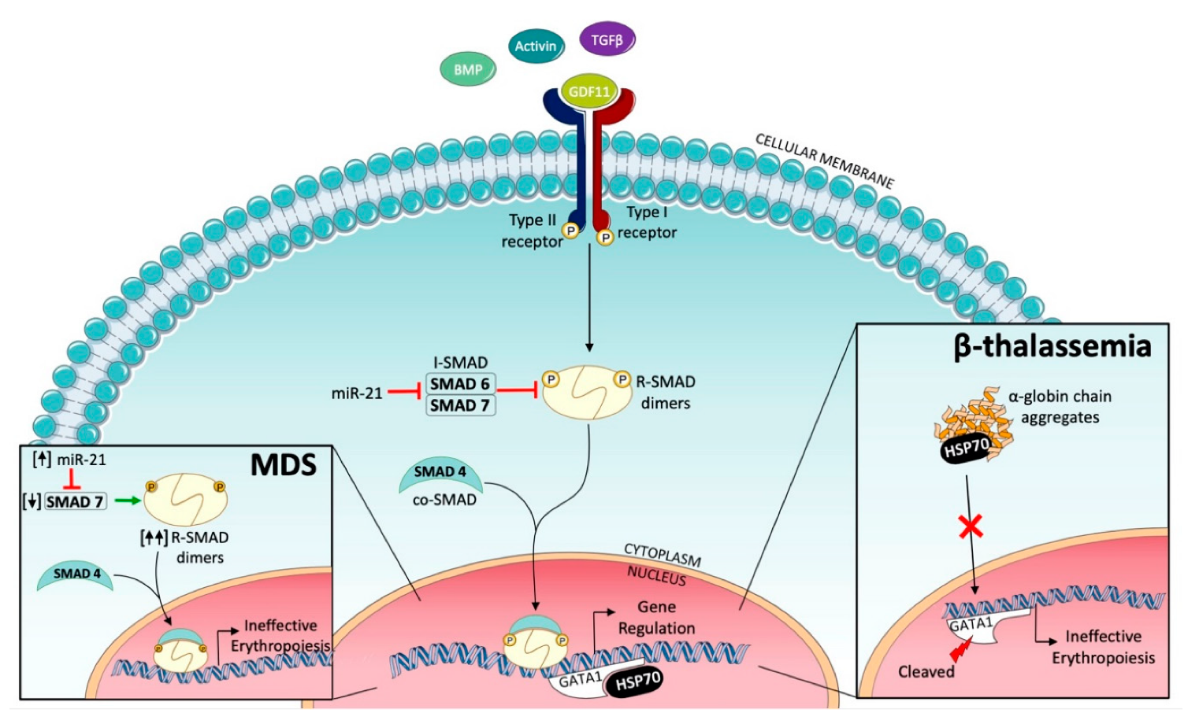

Slide 9
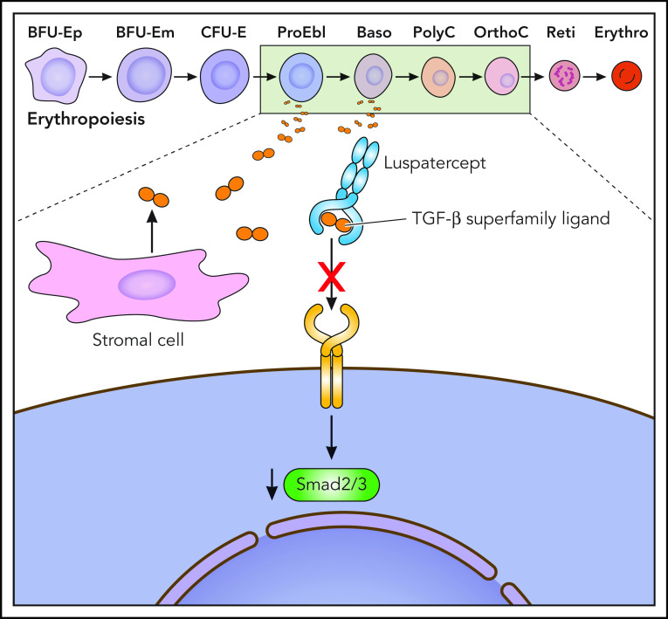

Slide 10
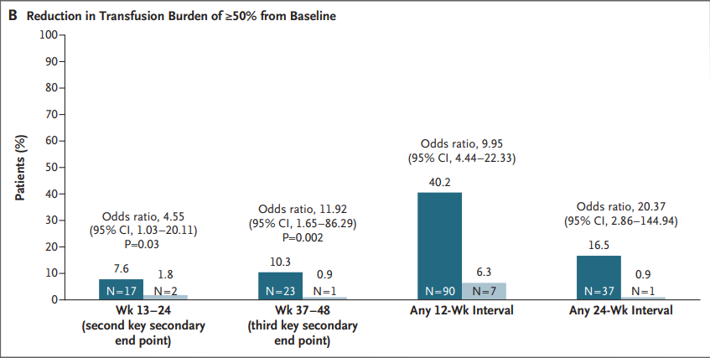
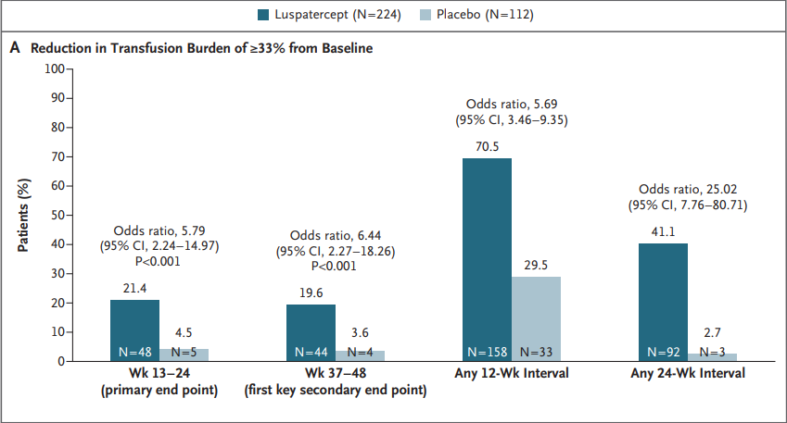
result

Slide 11
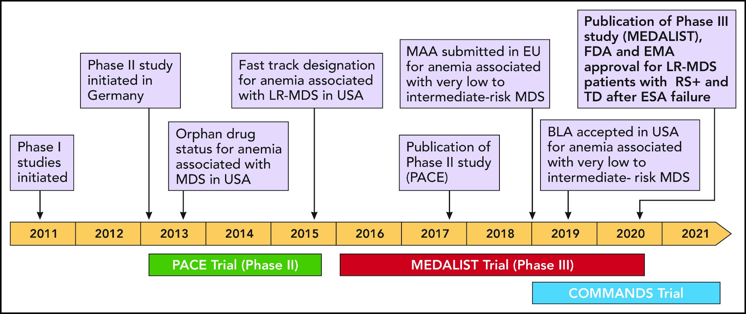

Slide 12
