Slide 1





Bone marrow mesenchymal stem cell exosomes suppress JAK/STAT signaling pathway in acute myeloid leukemia in vitro
Presentation by : Ramin Alizadeh

Slide 2



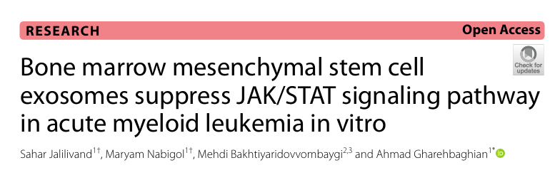
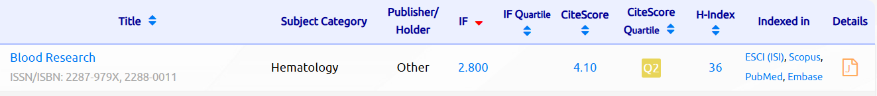

Slide 3
Introduction
Acute myeloid leukemia (AML) is a common and heterogeneous hematologic malignancy characterized by uncontrolled clonal proliferation and differentiation arrest of hematopoietic precursors. AML accounts for about 1% of all new cancer cases each year and represents nearly 80% of adult leukemia cases.
The primary goal of AML treatment is to achieve complete remission (CR) through induction chemotherapy. However, 50–70% of patients who initially reach CR eventually relapse within three years. Therefore, consolidation chemotherapy or allogeneic stem cell transplantation is commonly used to reduce relapse risk.

Slide 4
Introduction
Mesenchymal stem cells (MSCs)
- non-hematopoietic stem cells
- originally identified in the bone marrow
They regulate various cellular pathways through direct cell–cell interactions or by secreting factors such as exosomes, growth factors (e.g., VEGF), interleukins (IL-6, IL-8), and cytokines (e.g., TGF-β)

Slide 5
Introduction
Exosomes
Nanosized extracellular vesicles (30–200 nm)
Have a single membrane and are secreted by cells
Act as essential mediators of MSC functions
Carry biomolecules: nucleic acids, proteins, lipids, etc.
Transfer cargo from donor to recipient cells
Influence:
Cell viability
Proliferation
Apoptosis (programmed cell death)
Drug sensitivity

Slide 6
Introduction
JAK/STAT Pathway
A rapid membrane-to-nucleus signaling pathway
Activated by cytokines, growth factors, and hormones
Regulates expression of key cancer-related genes
A central pathway in cancer, especially important in AML pathogenesis
Hyperactivation contributes to uncontrolled proliferation and survival of AML cells

Slide 7
Introduction
JAK/STAT Pathway
Components of the JAK/STAT Pathway
JAKs: JAK1, JAK2, JAK3, TYK2
STATs: STAT1, STAT2, STAT3, STAT4, STAT5a, STAT5b, STAT6
Ligand–receptor complexes

Slide 8
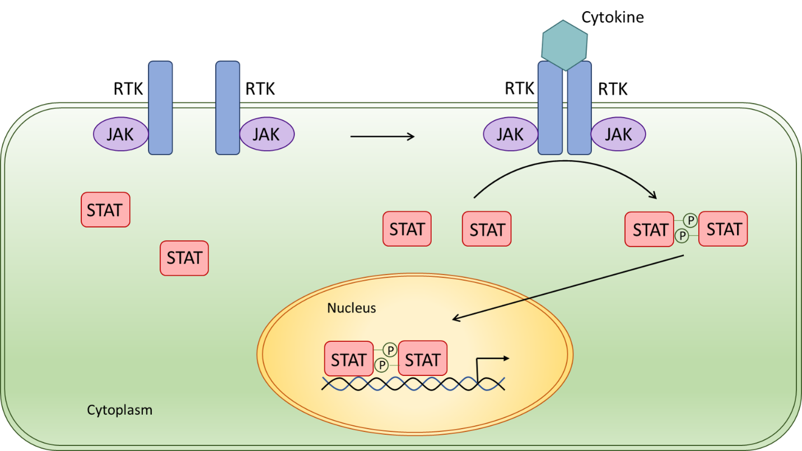
Introduction
JAK/STAT Pathway

Slide 9
Introduction
JAK/STAT Pathway
Constant activation (due to mutations or overexpression) occurs in myeloid blasts.
Therapeutic Implication :
Inhibiting the JAK/STAT pathway can reduce leukemic cell proliferation.
This pathway represents a promising targeted therapy approach for AML.

Slide 10
Introduction
Study Aim & Hypothesis
Investigate the effect of BM-MSC–derived exosomes on AML cells.
Examine whether these exosomes regulate JAK2, STAT3, and STAT5 expression in HL-60 cells.
These genes are key regulators of cell survival, proliferation, apoptosis, and drug response in AML.
Hypothesis: BM-MSC exosomes suppress AML by downregulating JAK2, STAT3, and STAT5 in HL-60 cells.

Slide 11
Methods and materials
1) Cell Preparation
a) HL-60 Leukemia Cells
Obtained from the Pasteur Institute.
Cultured in RPMI-1640 medium supplemented with serum and antibiotics at 37°C in 5% CO₂.

Slide 12
Methods and materials
1) Cell Preparation
b) Bone Marrow Mesenchymal Stem Cells (BM-MSCs)
Collected from a healthy donor.
Cultured in α-MEM medium until reaching over 80% confluency.
Examined under an inverted microscope (spindle-shaped morphology confirmed MSC identity).
Further validated using flow cytometry:
Positive markers: CD73, CD90, CD105
Negative markers: CD14, CD34, CD45

Slide 13
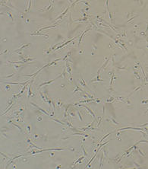
Methods and materials

Slide 14
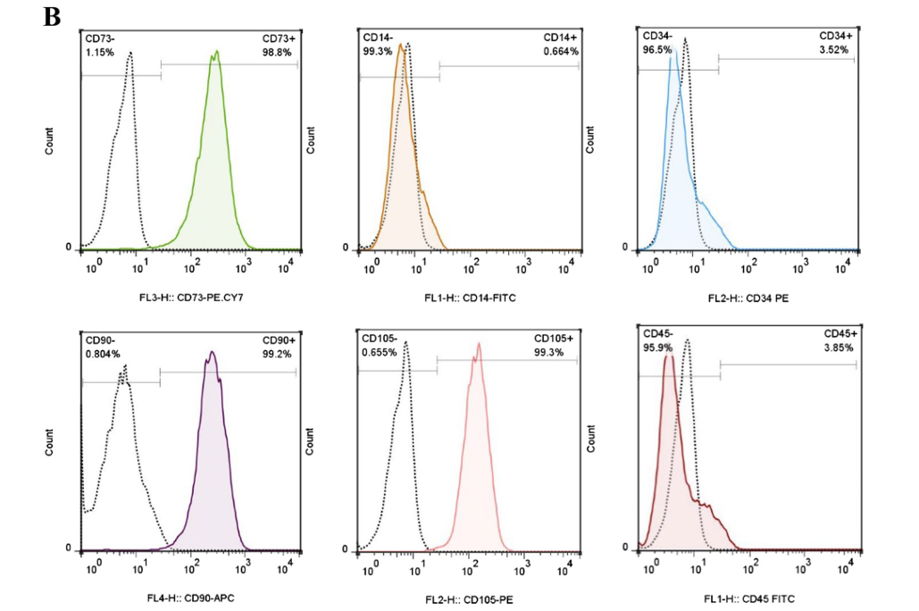
Methods and materials

Slide 15
Methods and materials
2) Exosome Isolation
BM-MSCs served as the source of exosomes.
Steps:
When MSCs reached 90% confluency, the medium was replaced with FBS-free α-MEM.
After 72 hours, the conditioned medium was collected.
Exosomes were isolated using the Exocib kit:
Centrifugation to remove cells and debris
Addition of precipitation reagent
Overnight incubation at 4°C
Final centrifugation
Exosome pellet resuspended in PBS
Exosomes were stored at −20°C for later experiments.

Slide 16
Methods and materials
3) Exosome Characterization
To confirm successful exosome isolation, three assays were performed

Slide 17
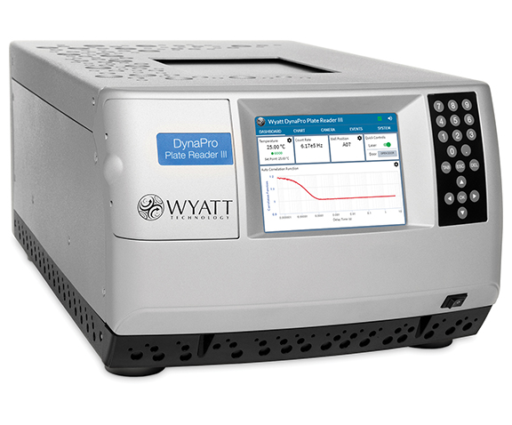
Methods and materials
3) Exosome Characterization
a) DLS (Dynamic Light Scattering)
Most particles measured between 80–100 nm, consistent with exosome size.

Slide 18
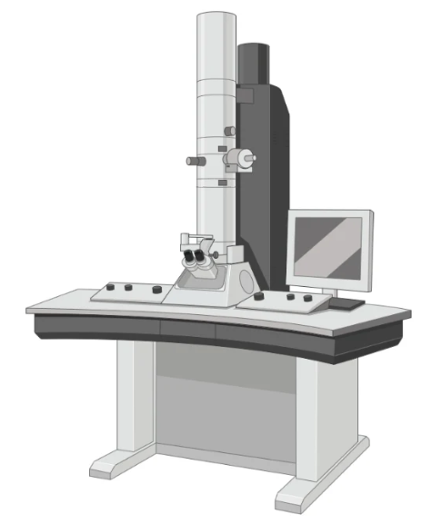
Methods and materials
3) Exosome Characterization
b) TEM (Transmission Electron Microscopy)
Exosomes appeared round and spherical in morphology.

Slide 19
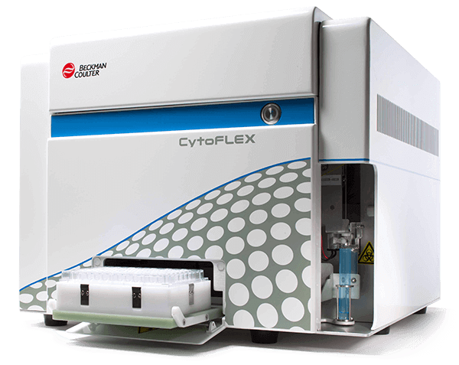
Methods and materials
3) Exosome Characterization
c) Flow Cytometry
Confirmed the presence of typical exosomal surface markers: CD9, CD63, CD81 (all positive).

Slide 20
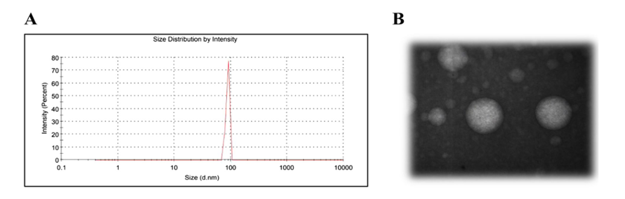
Methods and materials

Slide 21
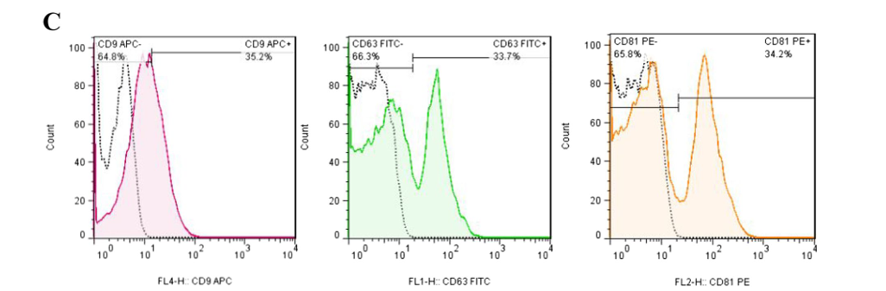
Methods and materials

Slide 22
Methods and materials
4) Exosome Quantification
Protein concentration of exosomes was measured using the BCA assay to determine the appropriate treatment dose.

Slide 23
Methods and materials
5) Treatment of HL-60 Cells With Exosomes
Based on prior findings, the optimal concentration was 100 μg/mL.
HL-60 cells were exposed to this dose for 24 hours.

Slide 24
Methods and materials
6) RNA Extraction and cDNA Synthesis
Total RNA was extracted using TRIzol reagent.
RNA purity was assessed using a NanoDrop spectrophotometer.
Purified RNA was then reverse-transcribed into cDNA.

Slide 25
Methods and materials
7) Gene Expression Analysis by qRT-PCR
Objective: Determine how exosomes affect the JAK/STAT signaling pathway.
Details:
Reactions were performed in triplicate.
GAPDH was used as the housekeeping gene.
The Livak method (2^−ΔΔCt) was applied to calculate fold changes in gene expression.
Target genes:
JAK2
STAT3
STAT5

Slide 26
Methods and materials
8) Statistical Analysis
Data reported as mean ± SD.
t-test used to compare treated and control groups.
Statistical significance defined as p < 0.05.

Slide 27
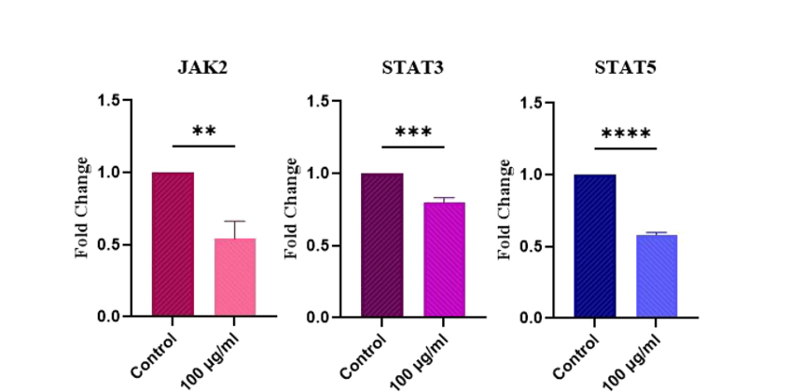
Methods and materials

Slide 28
Discussion
MSC-Derived Exosomes
Immunomodulatory
Regenerative
Anti-inflammatory
Advantages
Easy to store and transport
Low immunogenicity
Strong potential as therapeutic tools for various diseases

Slide 29
Discussion
several studies have indicated an inhibitory role of MSC exosomes in AML.
Zhang et al. exposed THP-1 cells to BM-MSC-derived exosomes, which BM-MSC exosomes suppress proliferation, induce cell cycle arrest, and increase apoptosis of KG-1a cells .
Jiang et al. demonstrated that miR-7-5p from BMSC exosomes reduces survival and inhibits AML development by targeting OSBPL11.
Cheng et al. showed that MSC exosomes could inhibit AML cell growth through miR-23b-5p delivery.
Recent findings indicated that BM-MSC-derived exosomes increase the Th1/Th2 ratio and induce apoptotic cell death in AML cells.
In 2023, Wen et al. engineered MSC-derived exosomes with enhanced bone marrow homing and leukemic stem cell (LSC) targeting. These engineered vesicles, loaded with miR-34c-5p, selectively eliminated LSCs and impeded AML progression.
These results suggest that MSC exosome-based therapies are promising for treating AML.
In this study, we evaluated the effect of BM-MSC exosomes on the expression of JAK/STAT signaling genes, which play a role in the proliferation and survival of AML cells.

Slide 30
Discussion
Previous findings showed that 100 μg/mL BM-MSC exosomes :
reduced AML cell survival and proliferation
Increased ROS levels
Induced apoptosis

Slide 31
Discussion
STAT3 in AML :
STAT3 is a transcription factor that promotes carcinogenesis.
Constitutive STAT3 activation is common in AML and correlates with reduced disease-free survival.
Overactivation of the JAK2/STAT3 pathway contributes to AML tumorigenesis.
Targeting this pathway enhances the anti-tumor effects of arsenic trioxide.
Suppression of JAK2/STAT3 reduces AML cell viability.
STAT3 promotes expression of anti-apoptotic BCL2.
study found that MSC exosomes downregulate STAT3, suggesting they suppress BCL2 and promote apoptosis in AML cells.

Slide 32
Discussion
STAT5 in AML
STAT5 is another JAK/STAT pathway member with constitutive activation in hematologic malignancies.
Plays a critical role in AML malignant features.
Inhibition of JAK2/STAT5 signaling induces apoptosis in AML cells.
Study findings: MSC-derived exosomes reduce STAT5 expression, suggesting anti-leukemic effects.

Slide 33
Discussion
JAK2
JAK2 is a kinase essential for the growth of hematologic malignancies, especially myeloproliferative neoplasms.
Hyperactivating JAK2 mutations occur in AML.
Increased p-JAK2 levels in AML bone marrow correlate with poor clinical outcomes.
JAK2 inhibition reduces the growth of AML leukemic stem cells (LSCs) while sparing normal stem cells (in vitro & in vivo).
Abnormal activation of JAK2/STAT signaling drives uncontrolled proliferation of AML cells.

Slide 34
Discussion
This study found that MSC-derived exosomes downregulate JAK2 in AML cells → suggesting exosomes may block JAK2 expression/activation and contribute to anti-leukemic effects.

Slide 35
Discussion
⚠️ Major Limitations and Criticisms of the Study
1) Use of only one AML cell line (HL-60)
2) Lack of functional assays
3) Only one exosome concentration was tested
4) Treatment time was limited to 24 hours
5) No in vivo experiments
6) Exosome content was not analyzed
7) Lack of appropriate control groups
8) No protein-level validation
9) Small biological variation
10) Conclusions are stronger than the data support

Slide 36
Conclusion
BM-MSC–derived exosomes significantly reduced JAK2, STAT3, and STAT5 expression in AML cells.
Since the JAK/STAT pathway is essential for AML cell proliferation and survival, its downregulation by exosomes may inhibit AML growth.
BM-MSC exosomes may serve as a promising component of targeted AML therapy.

Slide 37
Thank You

Slide 38
Welcome to Question Time

