Slide 1
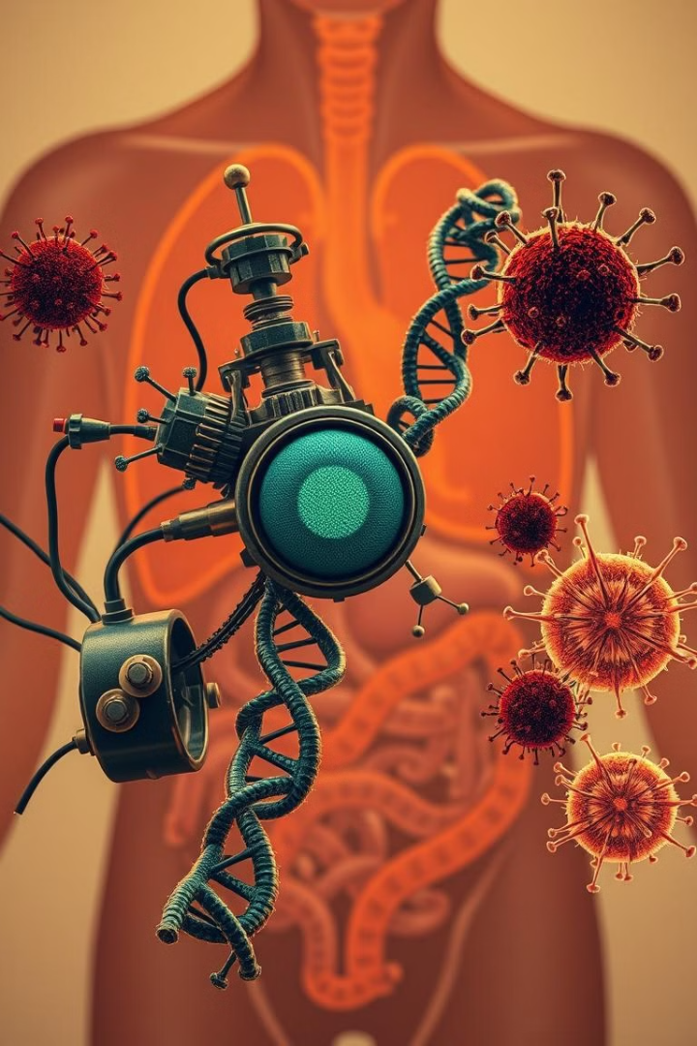
Combination Cancer Treatment: Using Engineered DNAzyme Molecular Machines for Dynamic Inter- and Intracellular Regulation
This presentation explores a novel combination cancer therapy using engineered DNAzyme molecular machines to dynamically regulate cell-cell interactions and intracellular processes, ultimately leading to cancer cell apoptosis.
RR
by RAHA RAHNAMA

Slide 2
The Challenge of Current Cancer Therapies
Side Effects
Limited Efficacy
Traditional chemotherapy drugs, while effective, often cause severe side effects by damaging healthy cells.
Combination therapies, such as immunotherapy with nanoparticle-based drug delivery, have shown promise but still face limitations in achieving optimal efficacy.

Slide 3
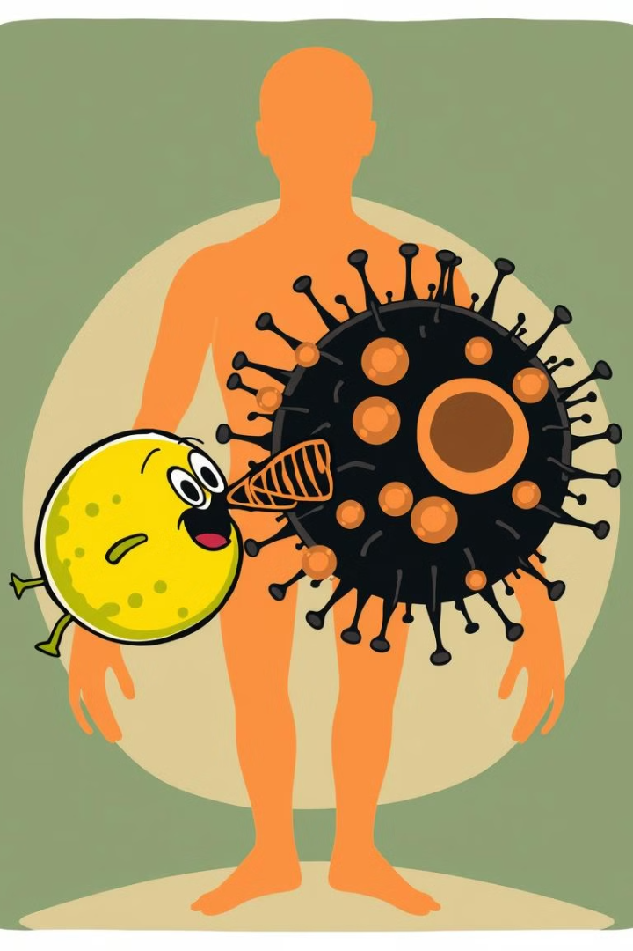



Dynamic Regulation of Cell-Cell Interactions
Recognition
The DNAzyme molecular machine specifically recognizes cancer cells through an aptamer targeting the MUC-1 protein.
Approaching
The acidic tumor microenvironment triggers the folding of an i-motif sequence, shortening the distance between T-cells and cancer cells.
Disassembly
Zinc ions activate the DNAzyme, cleaving the substrate and releasing T-cells from the cancer cells.

Slide 4
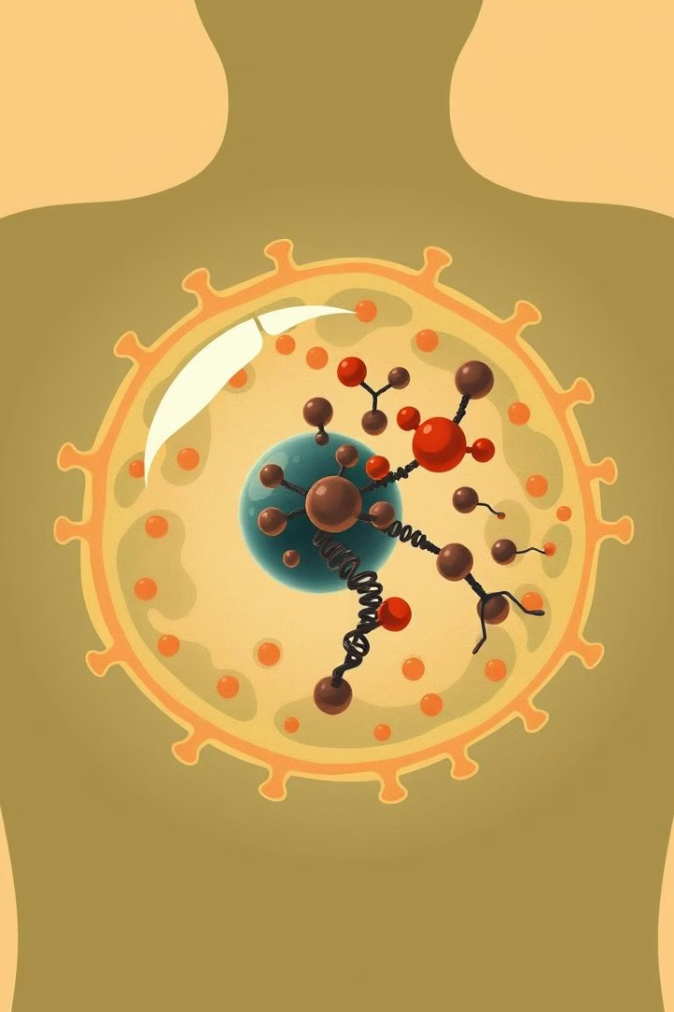
Intracellular Control of Mitochondria
Mitochondrial Targeting
The DNAzyme molecular machine, engineered with mitochondria location peptides, is delivered into cancer cells.
Aggregation
The DNAzyme and its substrate hybridize, causing mitochondria to aggregate and generate excessive ROS.
Disassembly
Zinc ions activate the DNAzyme, cleaving the substrate and disassembling the mitochondrial aggregates.

Slide 5
Experimental Validation
External Regulation
Internal Regulation
Experiments demonstrated the dynamic regulation of T-cell/cancer cell interactions, including recognition, approaching, and disassembly.
Mitochondrial aggregation was observed in PANC-1 cells, leading to increased ROS production and cancer cell death.

Slide 6
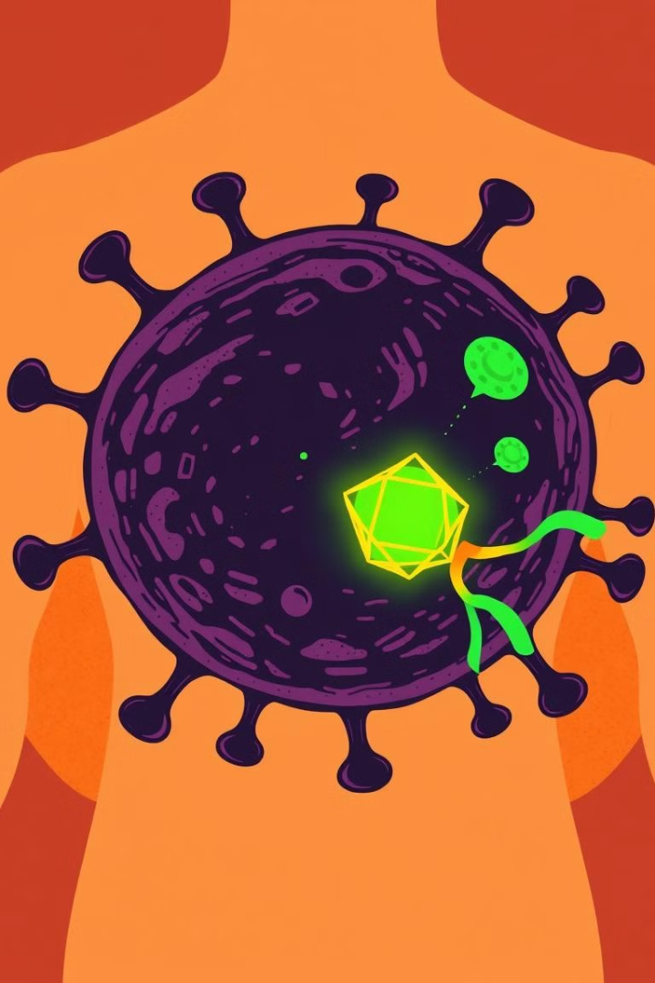
Combination Therapy: Synergistic Effects
External Control
Internal Control
The DNAzyme molecular machine regulates T-cell/cancer cell interactions, enhancing the immune response.
The DNAzyme molecular machine induces mitochondrial aggregation, increasing ROS production and promoting apoptosis.
Synergistic Effect
The combination therapy showed a significant increase in cancer cell killing compared to individual treatments.

Slide 7
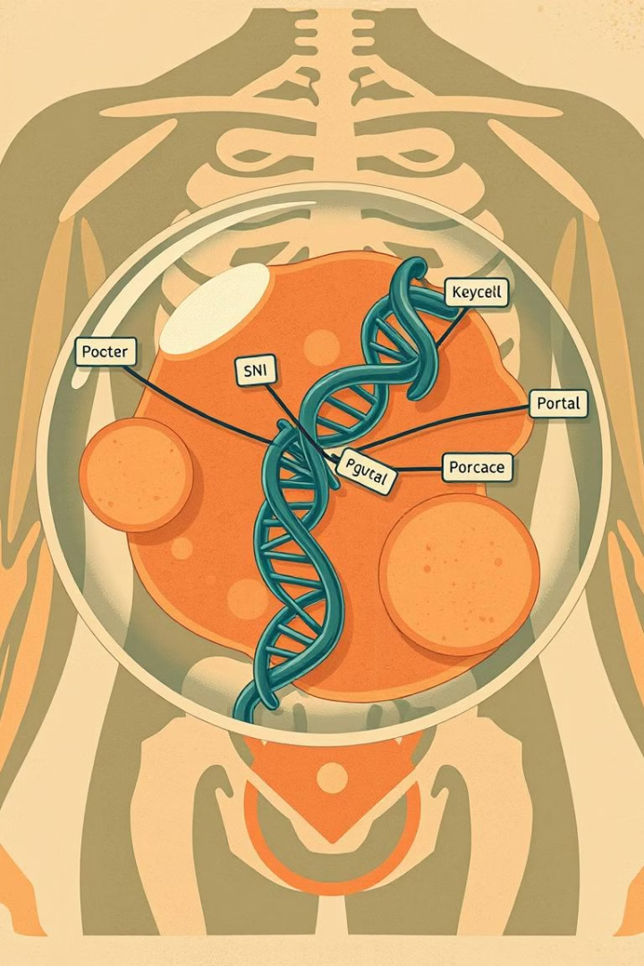
Advantages of the DNAzyme Molecular Machine
1
Dynamic Regulation
2
Targeted Delivery
The DNAzyme molecular machine allows for precise control of cell-cell interactions and intracellular processes.
The aptamer and mitochondria location peptides ensure targeted delivery of the DNAzyme molecular machine.
3
Minimal Side Effects
The DNAzyme molecular machine is designed to minimize cytotoxicity to normal cells.

Slide 8
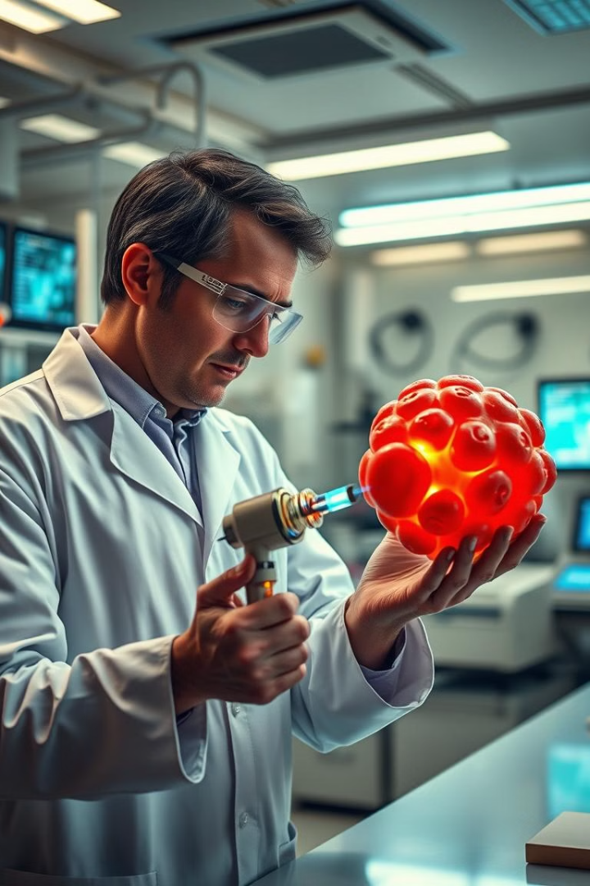



Future Directions and Applications
Further research is needed to optimize the DNAzyme molecular machine and explore its potential in various cancer types.
Clinical trials are necessary to evaluate the safety and efficacy of the combination therapy in human patients.
The DNAzyme molecular machine could be tailored to individual patients based on their specific tumor characteristics.

Slide 9
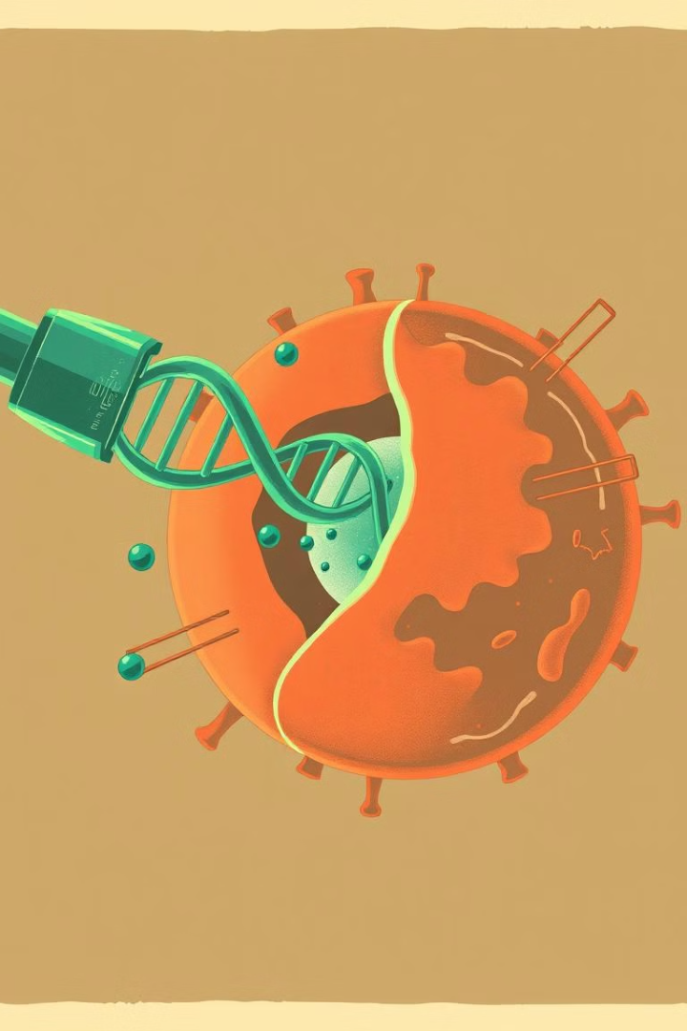
Key Takeaways
This novel combination cancer therapy using engineered DNAzyme molecular machines holds significant promise for improving cancer treatment outcomes.
The dynamic regulation of cell-cell interactions and intracellular processes offers a powerful approach for targeted and nontoxic cancer therapy.

Slide 10
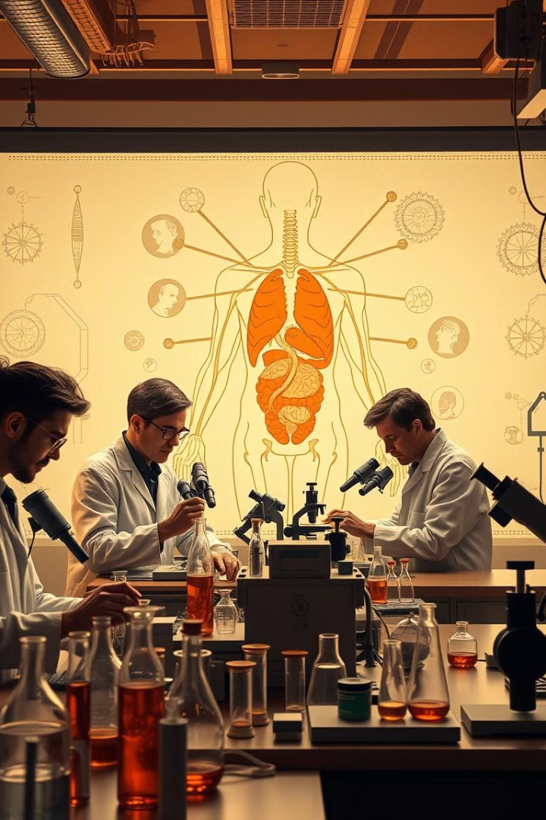
Next Steps
Further research and development are crucial to translate this promising technology into a clinically viable cancer treatment.
Collaboration between researchers, clinicians, and industry partners is essential to accelerate the progress of this innovative therapy.

