Slide 1
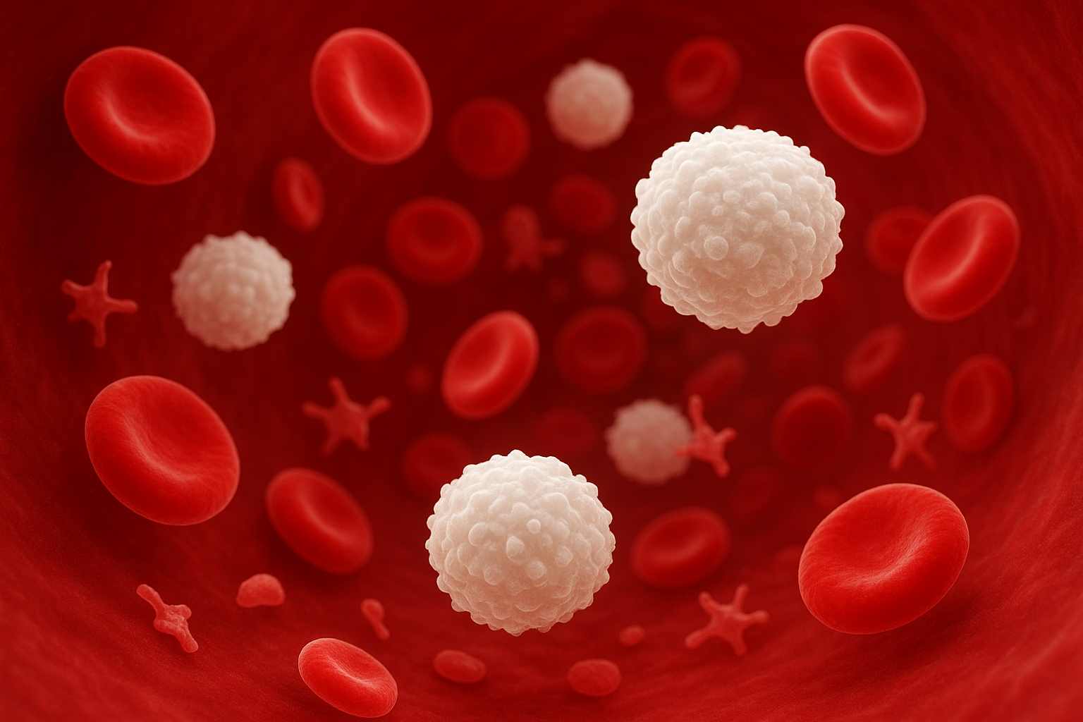
WHO 2022 Classification of Myeloid Neoplasms
Mehrad Dehdashti
MSC student in Hematology and Blood Banking

Slide 2
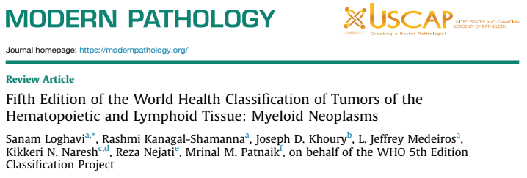
1

Slide 3
Why Classifications Matter
provide a system for diagnosis using clearly defined clinical features and laboratory findings.
provide clinicians and researchers a way to study, select, and compare various therapeutic regimens.
Classification provides insight into disease course. It helps predict outcomes and survival rates.
permit meaningful associations of genetic abnormalities with pathogenesis of neoplastic disease.
2

Slide 4

HISTORY
French-American-British Classification system
2001
Morphology
Before 2001
2008
Immunophenotype
morphology and cytochemistry
2016 R4th WHO-Hem
Genetic Profile
2022 5th WHO-Hem
Clinical Features
3

Slide 5
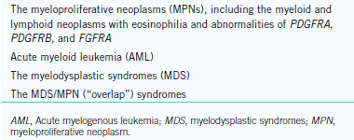
2016 classification:
Myeloid
Lymphoid*
histiocytic/
dendritic cells
B-cell lymphoid proliferations and lymphomas
T-cell lymphoid proliferations and lymphomas
4

Slide 6
Myeloid Neoplasms:
AML
WHO 2016
With recurrent genetic abnormalities
AML with myelodysplastic-related changes
Therapy-related myeloid neoplasms
AML,NOS
Myeloid sarcoma
Myeloid prolifrations related to Down Syndrom
1976 & revision in 1985
leukemia-associated
genetic changes, in the 1980s
FAB Classification
5

Slide 7
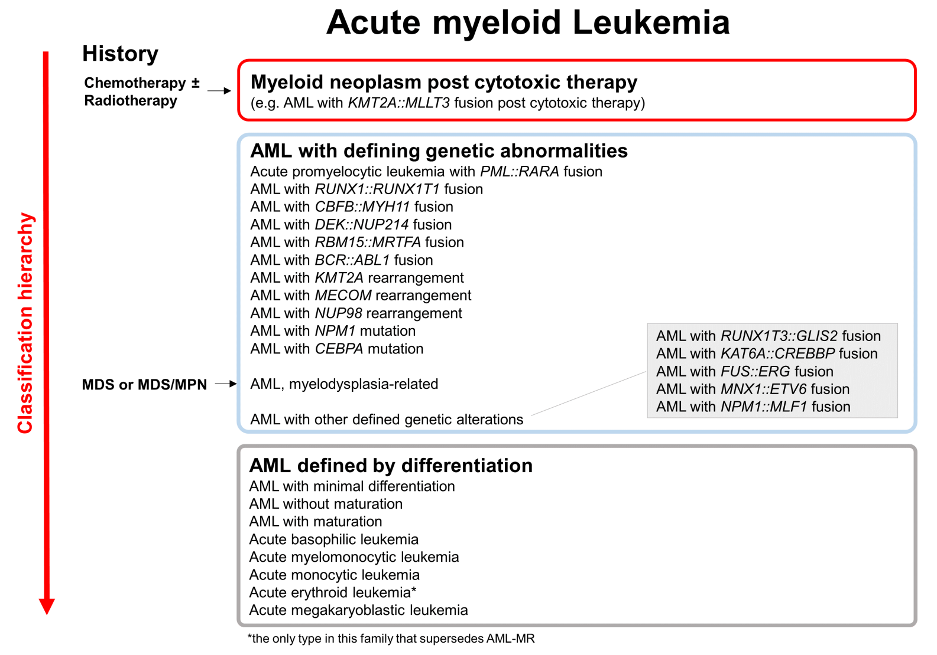
6

Slide 8
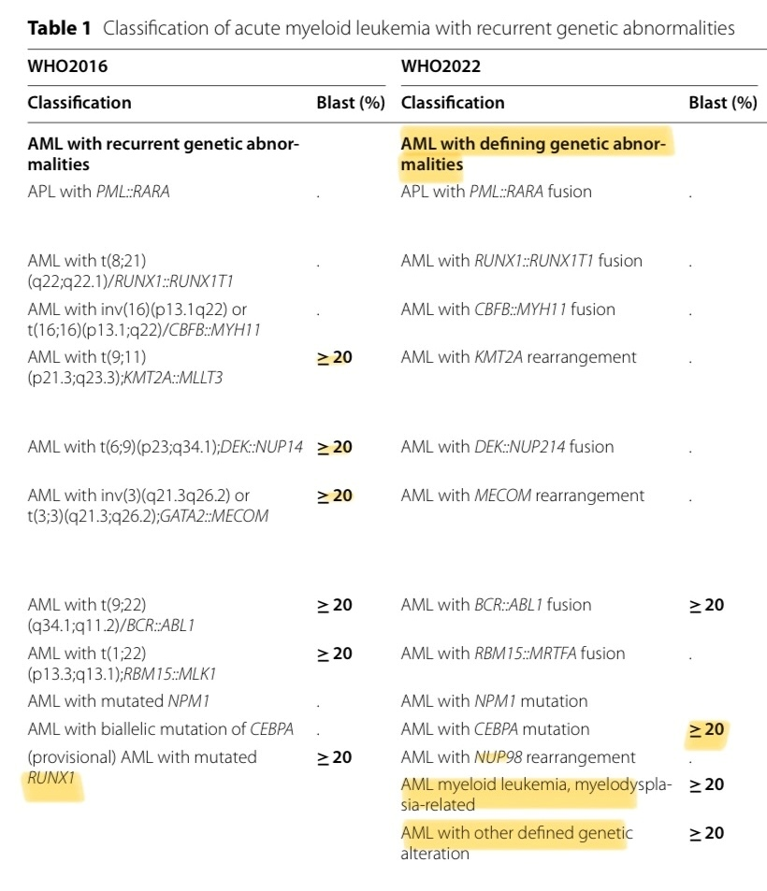
7

Slide 9
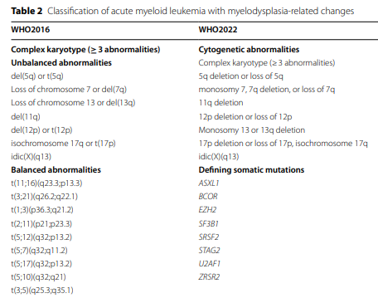
8

Slide 10
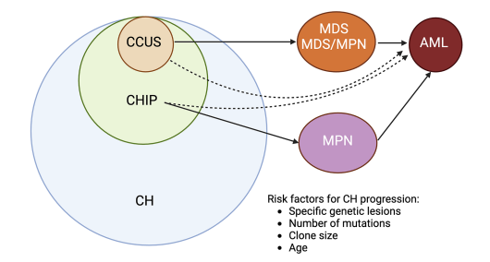
Myeloid Precursor Lesions
Morphologic dysplasia(≥10%)
cytopenia
Blasts ≥20% or AML defining genetics
ASXL1, DNMT3A, TET2
*CH, clonal hematopoiesis. CHIP, clonal hematopoiesis of indeterminate potential. CCUS, clonal cytopenia of undetermined significance
9

Slide 11
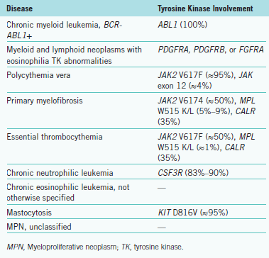
Myeloid Neoplasms:
MPN
BCR::ABL1 / AP
“Myeloid/lymphoid neoplasms with eosinophilia and tyrosine kinase gene fusions” (M/LN-eo-TK) FLT3 fusions and ETV6::ABL1 are now added
minor criterion of measurement of Cr-labeled red cells(red cell mass) has been eliminated
Leukoerythroblastosis and splenomegaly (on clinical examination or by imaging) have been added as minor criteria.
The qualifier “not otherwise specified” has been omitted from the name. There are other changes to the diagnostic criteria
+
JMML
10

Slide 12
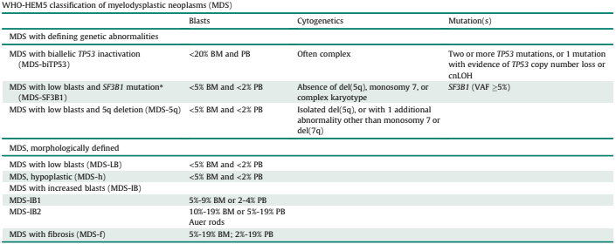
MDS Classification
11

Slide 13
MDS/MPN Classification
Revised Fourth Edition of WHO Classification (WHO 2016) | Fifth Edition of WHO Classification
CMML-0, CMML-1, and CMML-2 MD-CMML and MP-CMML | CMML-1 and CMML-2 MD-CMML and MP-CMML O-CMML | Monocyte count 0.5–1×10⁹/L, but ≥10% of WBC *dysplasia, clonal genetic/molecular abnormality, or abnormal monocyte partitioning in flow cytometry CMML-1: <10% BM blasts, <5% PB blasts CMML-2: 10–19% BM blasts, 5–19% PB blasts
Atypical CML | MDS/MPN with neutrophilia | SETBP1, ETNK1, ASXL1 as supportive molecular criteria
MDS/MPN-RS-T | MDS/MPN-SF3B1-T (in patients meeting morphologic criteria with SF3B1 mutations) Retained MDS/MPN-RS-T (for SF3B1 wild-type cases with 15% BM RS) | thrombocytosis (≥3 months) can replace JAK2/MPL/CALR mutations if absent
MDS/MPN-U | MDS/MPN-NOS
JMML | - | RAS mutation
12

Slide 14
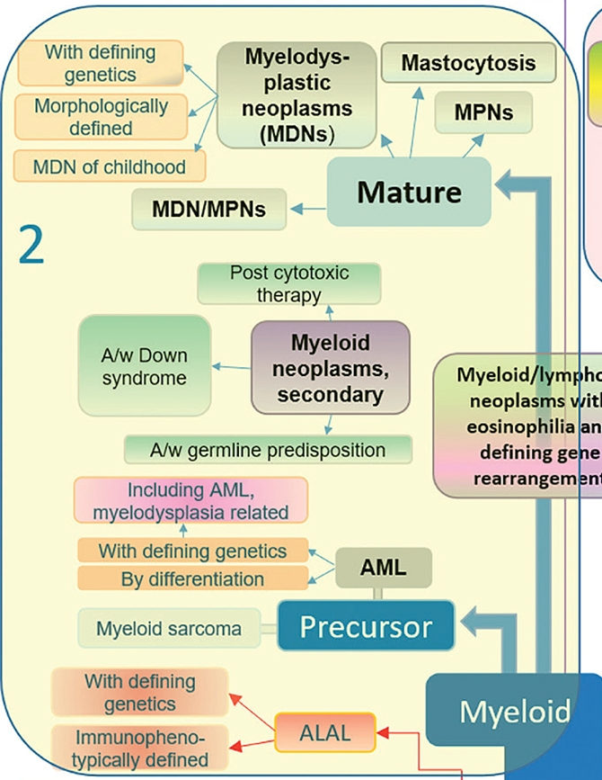
13

Slide 15
Thanks….

