Slide 1


Title:
Primary CD33-targeting CAR-NK cells for the treatment of acute
myeloid leukemia
Advisor: Dr. Roohollah Mirzaee
Presented by : Elahe Reesi
1

Slide 2

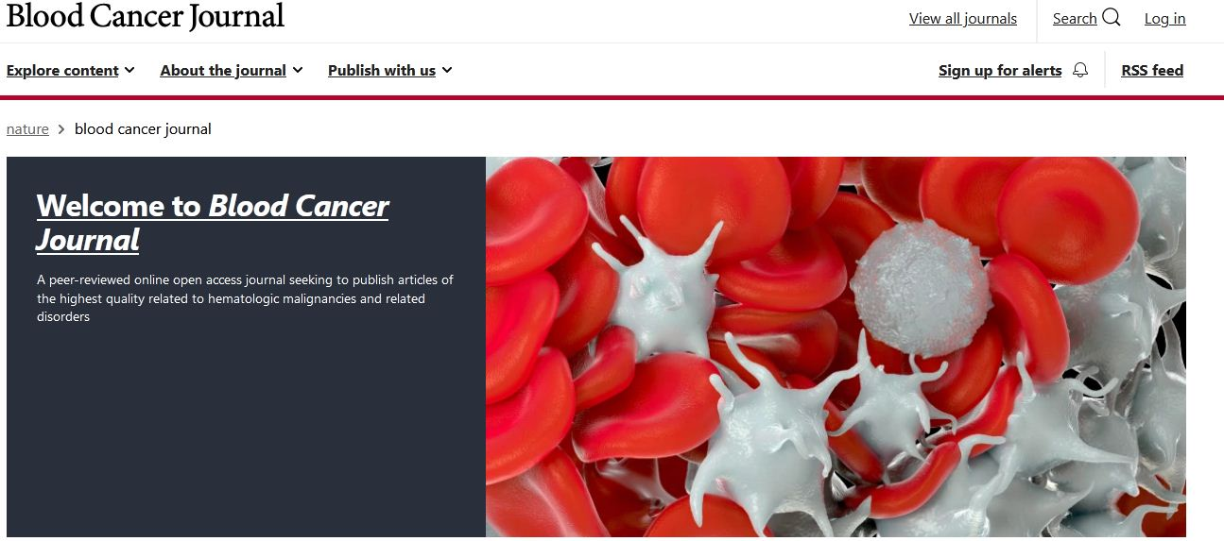
Impact Factor: 11.037
2

Slide 3

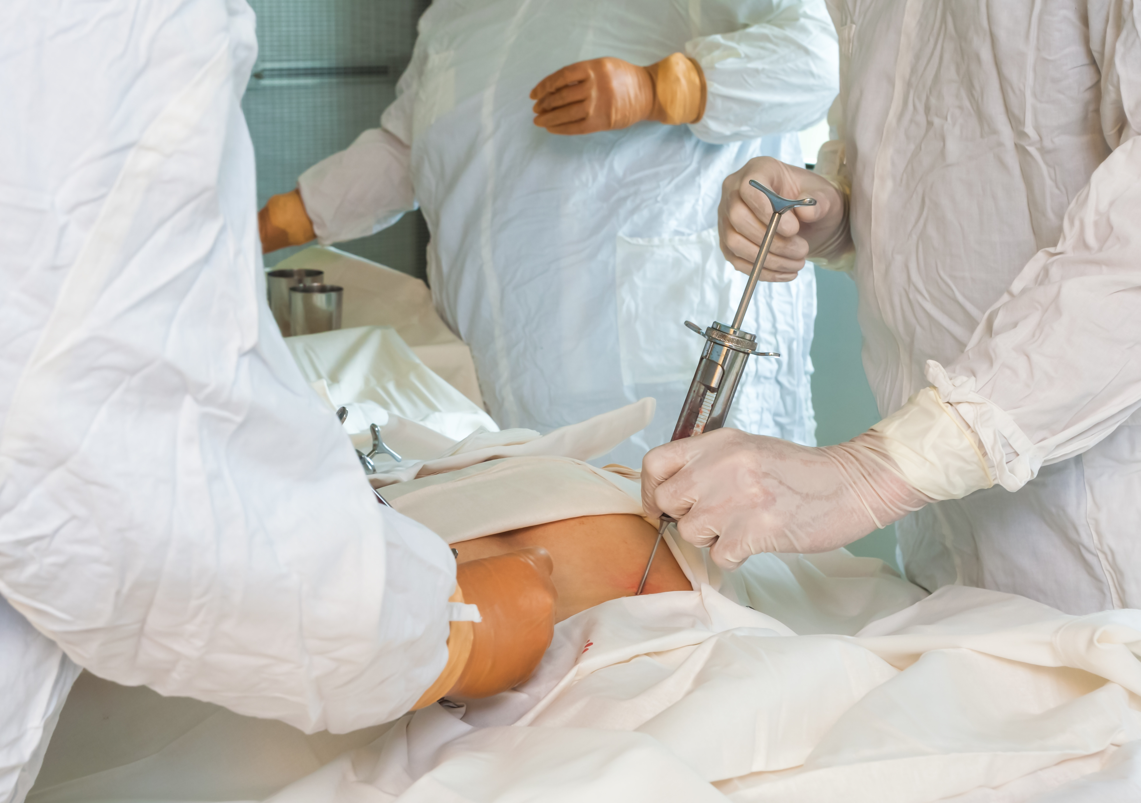

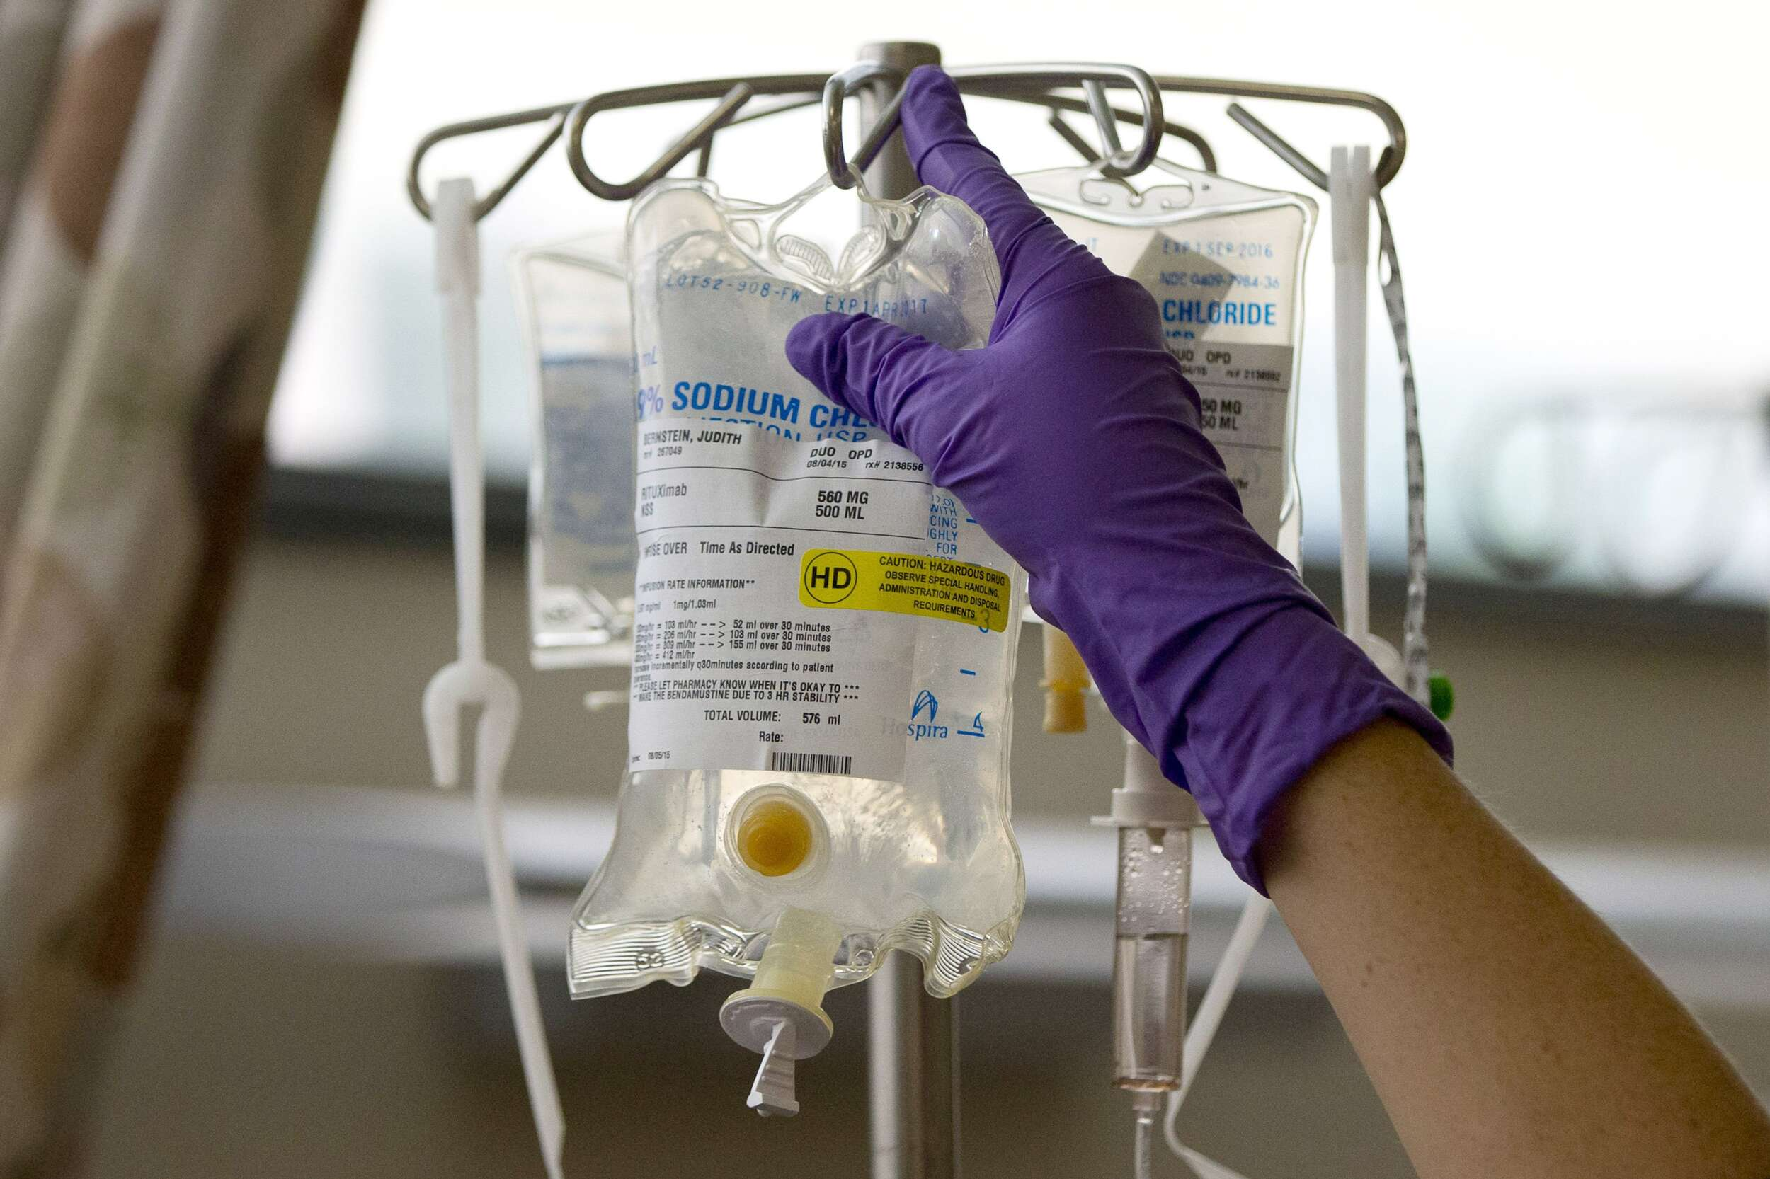
Introduction
High-dose chemotherapy
Allogeneic bone
marrow transplantation
3

Slide 4


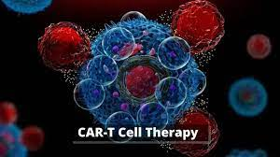

Treatment of AML with CAR-T cells
lack of AML-specific antigens
tremendous molecular heterogeneity of the disease
CD33 : As a promising target
4

Slide 5


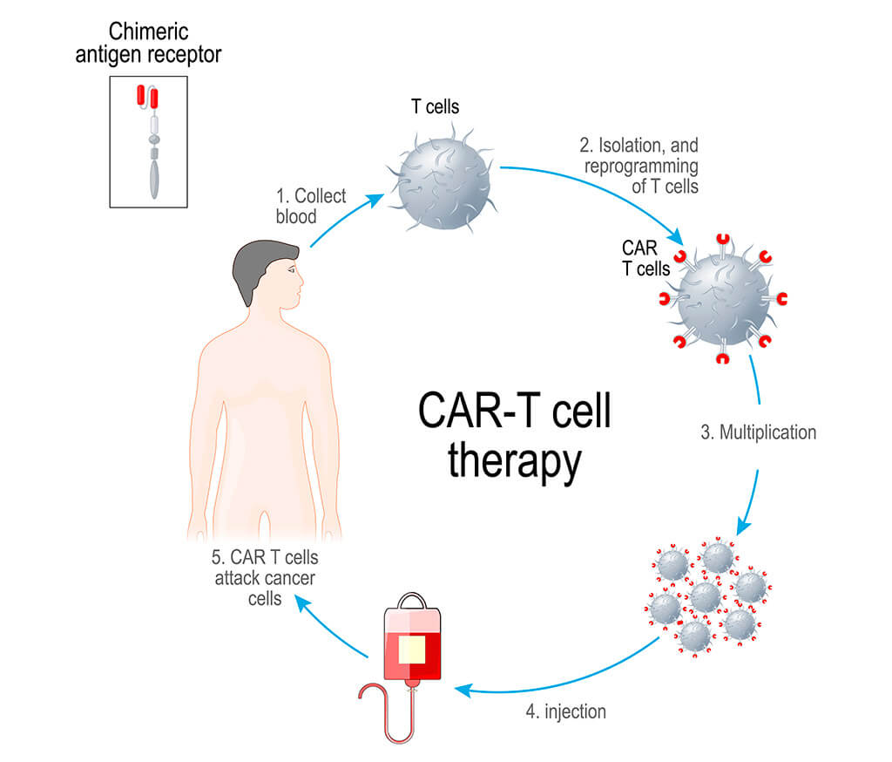
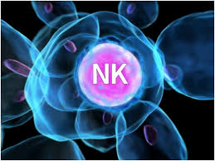

adoptively transferred: possess a shorter
lifetime and fewer side effects
intrinsic CAR-independent killing capacity against AML
NK cells do not induce GVHD.
long-term suppression of hematopoiesis
Autologous sources :cost and time intensive
not possible from heavily pre-treated patients
5

Slide 6

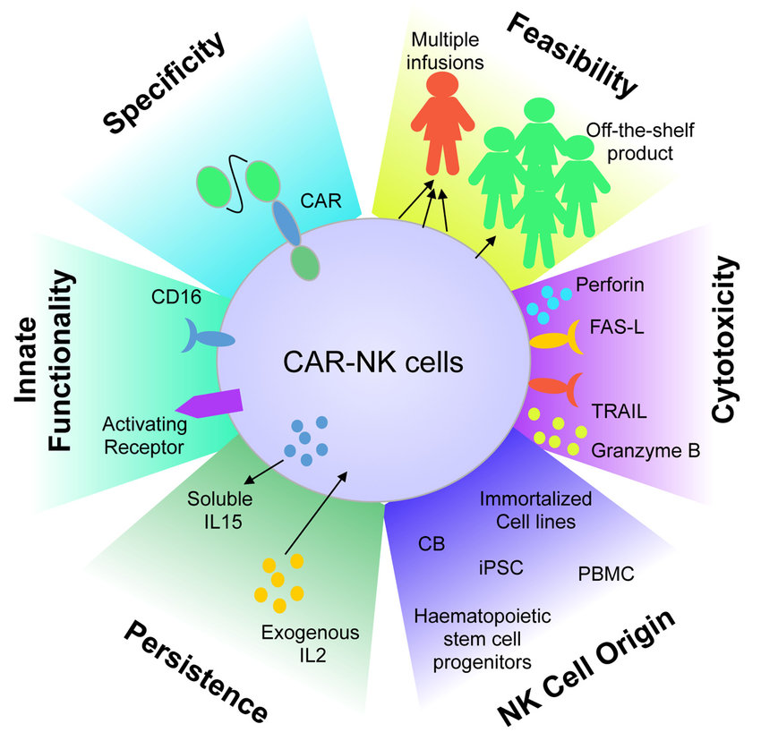

—“off-the-shelf” product
Improve the availability and
reduce the costs of such an immune-cell based
therapy.
6

Slide 7

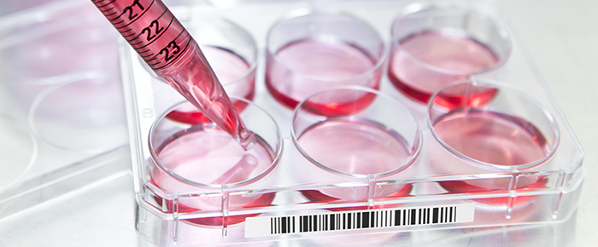
Cell culture
MATERIALS AND METHODS
CD33-expression analysis
CD33 expression on AML cell lines as well as primary AML and NK cells were analyzed by flow cytometry using anti-CD33-PE
AML cell lines cultivated in DMEM medium
Cells were seeded with 700,000 cells in 3 ml per well of a six-well
plate
7

Slide 8


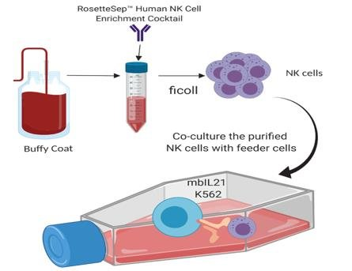
Isolation of NK cells
PBMC
ficoll
Human NK Cell Enrichmet Kit
Freshly isolated NK cells were cultured in NK MACS®
Medium
8

Slide 9

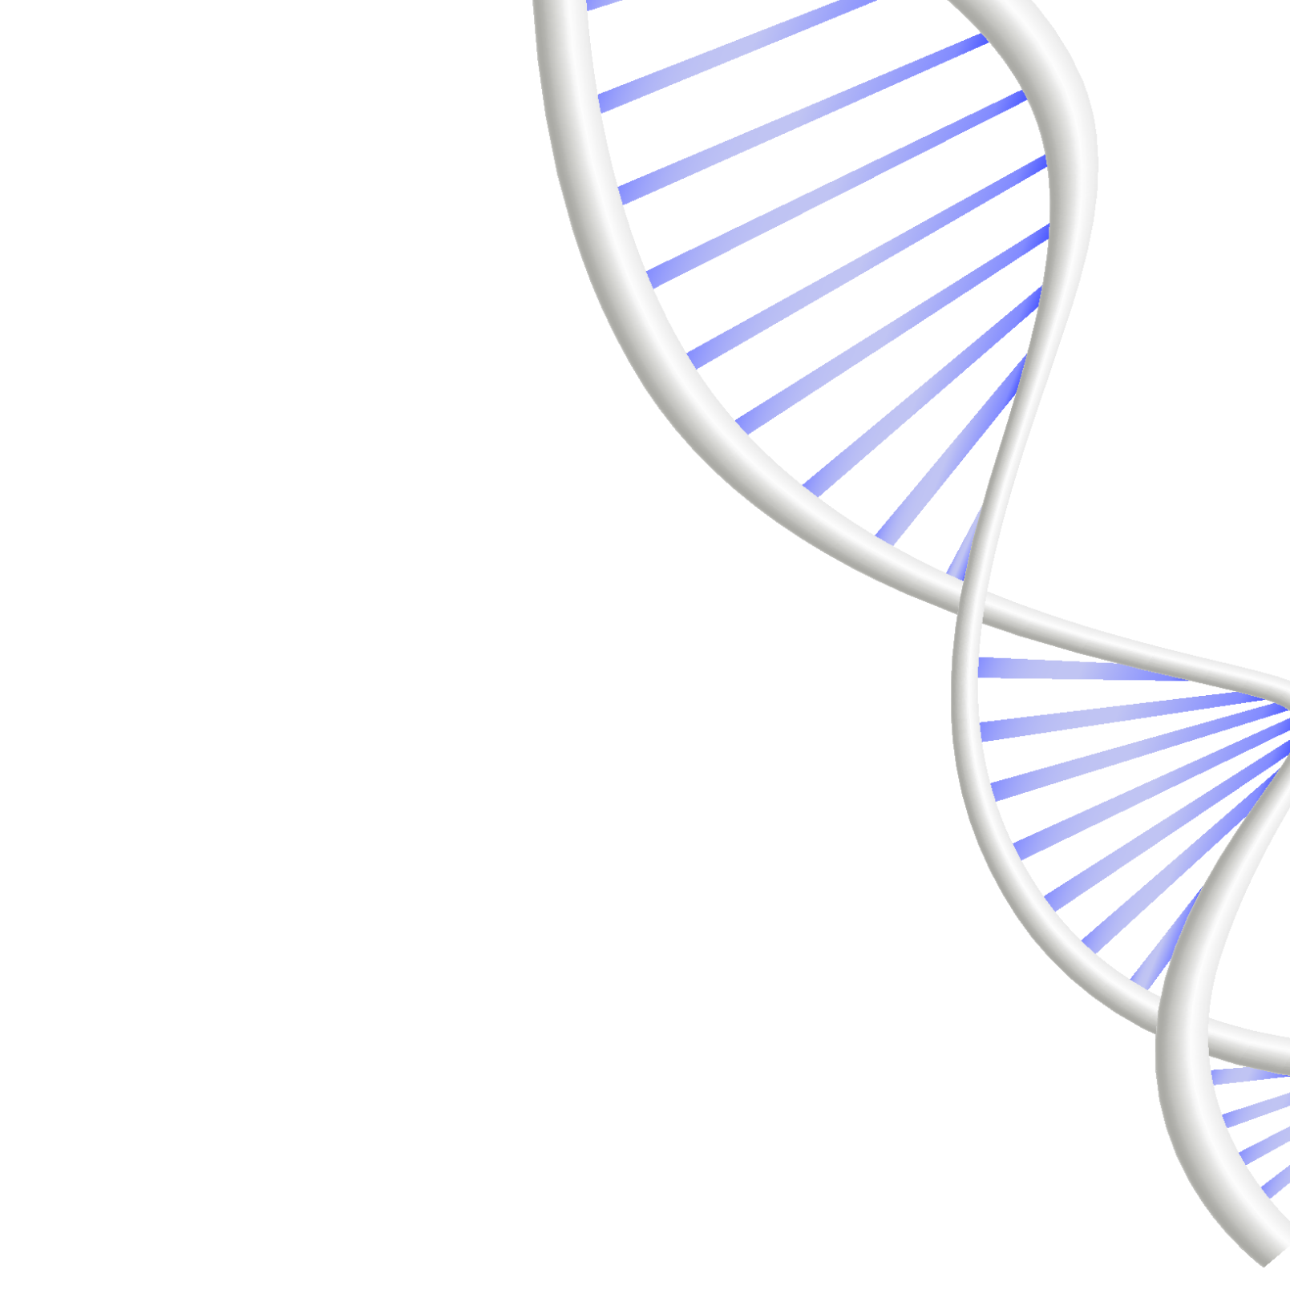
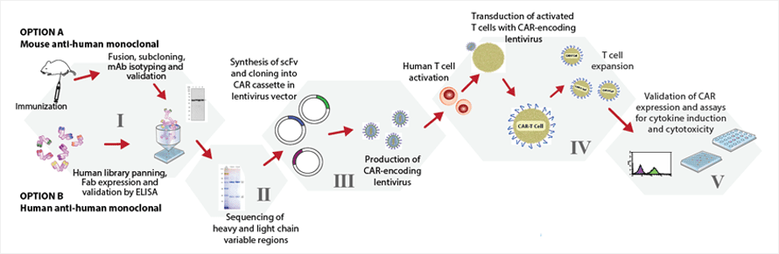

CAR construction and lentiviral vector production
9

Slide 10



Transduction of NK cells
0.5 × 106 cells per well were seeded in a flat bottomed 48-well plate
lentiviral particles and Vectofusin-1 were mixed in identical volumes
the plate was centrifuged at 400 × g for 2 h at 32 °C
10

Slide 11

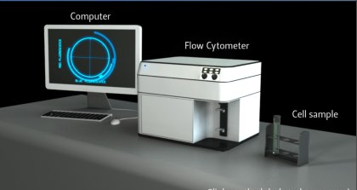
Flow cytometry analysis of transduced NK cells
CD33-CAR
possible contamination with CD3-positive cells
anti-KIR2D-VioBlue
anti-CD16-VioGreen
anti-CD56-APC
anti-CD33-VioBright515
NK and CAR-NK
CD33-CAR Detection Reagent
anti-CD3-BUV395
11

Slide 12


Cytotoxicity of CAR- and UTD-NK cells
Cytotoxicity upon repetitive tumor challenge
Cytotoxicity over time
3
1
CAR-NK cell functional assay
3
GFP or stained with Cell Trace CFSE proliferation kit
DAPI or PI
viability of target cells :a BD FACSCelesta
1
rechallenging every 2 days with fresh target cells and 50% of new culture medium
flow cytometry 24 h after each target cell addition
2
2
Real-time monitoring using the IncuCyte S3 system
Phase contrast and green fluorescence images:
every 2 hours for 4 days.
12

Slide 13


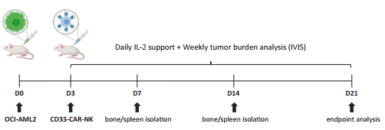

In vivo functional studies of CD33 -CAR-NK cells in xenografted mice
GFP-positive tumor cells or CD56 and CD33-CAR expression were analyzed using a flow cytometer
13

Slide 14


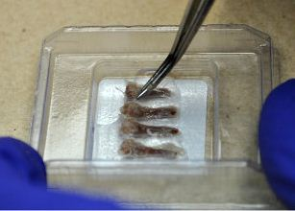
Bone embedding and sectioning
Bones incubated in a series of 4% PFA, EDTA- and sucrose solutions before embedded in gelatin
7 µm-sections of bones were generated (CryoStarTM NX70 cryostat )
NK cells (Nkp46 antibody)
CD33-CAR-NK cells (CD33-biotin , streptavidin AF647 antibody)
14

Slide 15

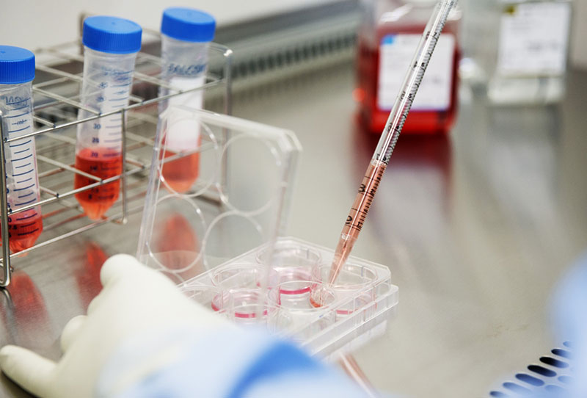
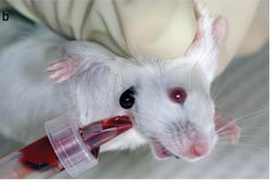
MACSPlex Cytokine Assays
Supernatants of co-cultures from
cytotoxicity assays
BD CBA Flex Sets were used to measure cytokine
concentrations
GM-CSF
IFN-γ
(TNF)-α
blood was obtained by cheek vein penetration
15

Slide 16

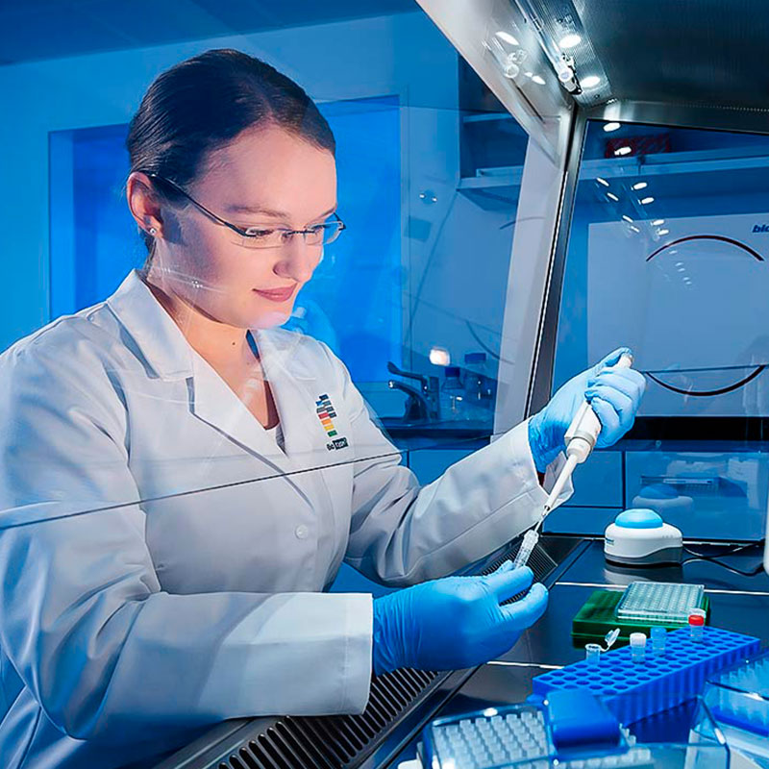
Chimerism analysis
Mouse whole blood collection
DNA extraction using the QIAamp Mini spin
column kit
Determination DNA content with NP80 nanophotometer
The proportion of human DNA was assessed by a quantitative real-time PCR
The ratio of human NK and AML-target cells was calculated by STR-markers using the Powerplex16 kit marker panel
16

Slide 17
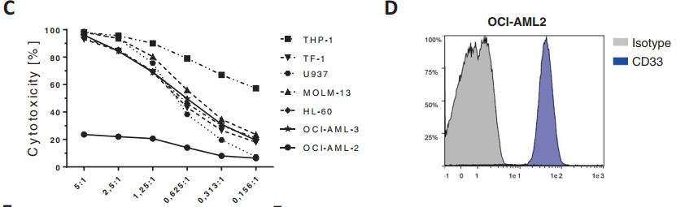
Results
OCI-AML2 was selected as target-AML cell line
17

Slide 18


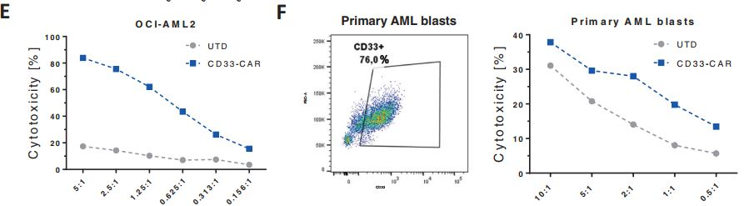
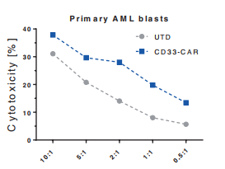

CD33-CAR-NK cells were more potent in eliminating
OCI-AML2 and CD33-positive primary AML cells
18

Slide 19


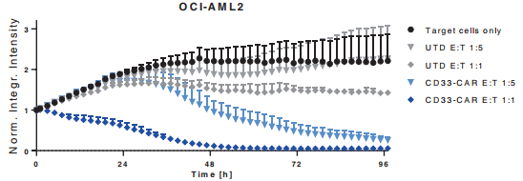
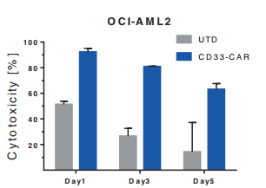
Cytolytic activity
sustained serial killing
capacity of CD33-CAR-NK
19

Slide 20

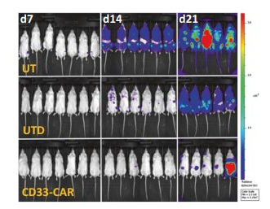
A single dose of CD33-CAR-NK cells shows effective clearance
of leukemic cells in the majority of OCI-AML2-engrafted NSGSGM3 mice
20

Slide 21


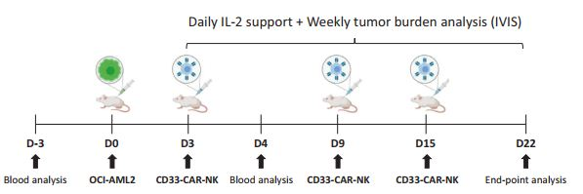
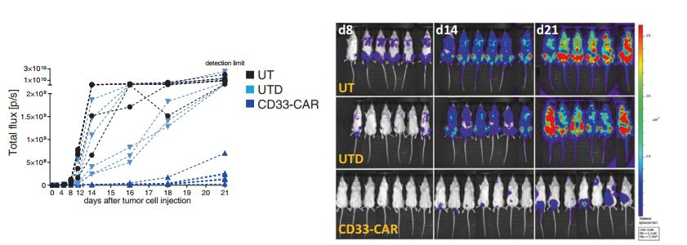
strong
reduction of AML burden by day 21
21

Slide 22


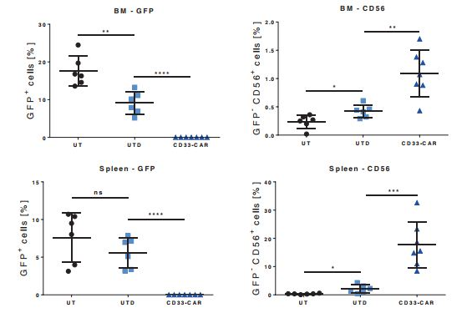
flow cytometry analysis of isolated cells from BMs or
spleens
22

Slide 23


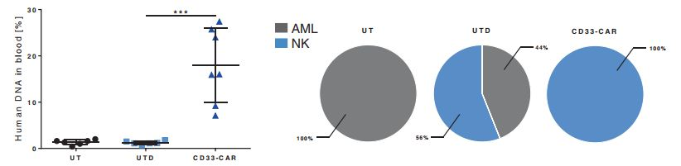
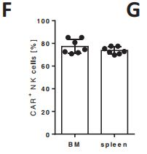




Chimerism analysis of PB
majority of NK cells were
identified as CAR-positive
23

Slide 24



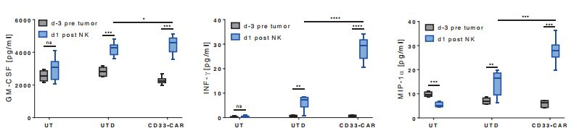
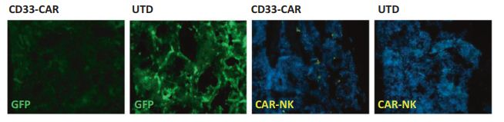


24

Slide 25

DISCUSSION
25

Slide 26

THANKS
DO YOU HAVE
ANY QUESTIONS?
Elahe.raeesi.er@gmaill.com
26

