Slide 1
The effect of microvesicles derived from K562 cells on proliferation and apoptosis of human bone marrow mesenchymal stem cells
Present by: Zohreh Faghihi

Slide 2
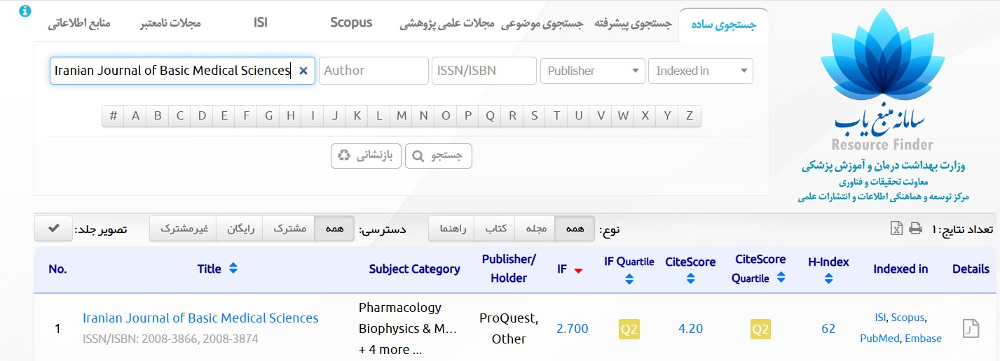

Slide 3
Introduction
Methods
Results
Discussion
Conclusion
Limitation
CML
CML as a myelodysplastic neoplasm that accounts for about 15% of all cases of leukemia in adults.
Originates in the bone marrow microenvironment.

Slide 4
Introduction
Methods
Results
Discussion
ConclUsion
Limitation
Bone marrow microenvironment:
bone marrow niche:1-Hematopoietic stem cells (HSCs)
2-leukemic stem cells
3- mesenchymal stem cells (MSCs)
Communication between cells in the bone marrow

Slide 5
Introduction
Methods
Results
Discussion
ConclUsion
Limitation
Hypothesis:
Interactions between hBM-MSCs might be regulated by K562-MVs transferred to hBM-MSCs
K562-MVs might be able to change the phenotype of normal hBM-MSCs to a leukemic-like phenotype, enhance proliferation and increase resistance to apoptosis.

Slide 6
Introduction
Methods
Results
Discussion
ConclUsion
Limitation
In this Research:
HBM-MSCs have used as a target for MVs derived from the K562 cell line
to seek evidence of apoptosis or survival of hBM-MSCs in vitro.

Slide 7
Introduction
Methods
Results
Discussion
Conclusion
Limitation
K562 cells culture
Isolation of MVs And measuring The protein concentration MVs
Dynamic light scattering technique (DLS)
Transmission electronic microscope (TEM)
Human bone marrow-derived MSC (BMSC) culture

Slide 8
Introduction
Methods
Results
Discussion
Conclusion
Limitation
Detection of MVs in hBM-MSCs
MTT assay
Annexin V FITC assay
real-time quantitative PCR
Alizarin Red staining
Oil red O staining

Slide 9
Introduction
Methods
Results
Discussion
Conclusion
Limitation
K562 cells culture:
K562 was obtained from the Pasteur Institute of Iran.
The viability of the cells was detected by trypan blue staining.
The medioum was used is RPMI 1640 that was supplemented with 10% fetal bovine serum (FBS)
Cultured cells were centrifuged at 300 g at 25°C for 5 min
The supernatant was collected and stored at -20 °C for MVs isolation.

Slide 10
Introduction
Methods
Results
Discussion
Conclusion
Limitation
Isolation of MVs And measuring The protein concentration MVs
Supernatant was centrifuged at 2,000 rpm at 4 °Cfor 10 min.
The supernatant was centrifuged at 7000 g and 4 °C for 20 min to remove all debris and apoptotic bodies
Ultracentrifuged was used at 20000 g for 1 hr at 4°C twice to obtain MVs.
The protein concentration of isolated MVs was measured with the BCA Protein Rating
Kit

Slide 11
Introduction
Methods
Results
Discussion
Conclusion
Limitation
Dynamic light scattering technique (DLS):
The DLS technique was used to measure the diameter of MVs.
The absorption of MVs suspension in 1 ml PBS was measured at 630 nm by Zetasizer set.

Slide 12
Introduction
Methods
Results
Discussion
Conclusion
Limitation
The morphology of the MVs was visualized using TEM.
Uranyl acetate as anegative stain.
Transmission electronic microscope (TEM)

Slide 13
Introduction
Methods
Results
Discussion
Conclusion
Limitation
Human bone marrow-derived MSC (BMSC) culture:
(DMEM) supplemented with 10% FBS and 1% penicillin-streptomycin was used.
After incubation for 48 hr, the medium was changed all the non-adherent cells were washed away.
Afterward the medium was changed every 3 or four days.
After reaching a confluence of 70-80%, they were isolated by 0.25% trypsin-EDTA and passaged.
Cells were seeded in 6-well tissue culture plates Cells were seeded in 6-well tissue culture plates and then treated with isolated MVs at 0, 15, 30, and 60 μg/ml

Slide 14
Introduction
Methods
Results
Discussion
Conclusion
Limitation
Detection of MVs in hBM-MSCs:
Using CFSE
One ml of MVs in phosphate-buffered saline was labeled with 1 μl CFSE then was added to 5 ml DMEM with 10% FBS and incubated in the dark for 15 min (37 °C, 5 % CO2).
After it was centrifuged at 20000 g at 4 °C for 60 min to remove the extra CFSE and to provide the pellet of MVs.
Finally, MVs were resuspended in DMEM and added to hBM-MSCs in DMEM with 10% FBS and incubated for 60 min (37 °C, 5 % CO2).
Using A fluorescence microscope

Slide 15
Introduction
Methods
Results
Discussion
Conclusion
Limitation
MTT assay:
The effect of different concentrations of MVs on the viability of hBM-MSCs was assessed by MTT assay.
Using 96-well plates
hBMMSCs (5,000 cells/100 μl/well) were plated onto 96-well plates and treated with different concentrations of MVs at 0, 15, 30, and 60 μg/ml.
After 48 hr, the cells were further incubated with 10 μM of MTT solution at 37 oC for 4 hr.
After 4 hr. 10 μM dimethyl sulfoxide (DMSO) was added .
Using A microplate reader at 570 nm to assess the optical density.
.

Slide 16
Introduction
Methods
Results
Discussion
Conclusion
Limitation
Annexin V FITC assay:
After treatment, apoptosis was detected by flow cytometry.
Using AnnexinV FITC/Propidium iodide (PI) apoptosis detection kit.
The cells were washed in cold PBS and resuspended in an Annexin-binding buffer containing Annexin V FITC and PI.
Then The cells were incubated at room temperature for 15 min in the dark and analyzed by BD FACScalibur flow cytometry.

Slide 17
Introduction
Methods
Results
Discussion
Conclusion
Limitation
Using Trizol
Extracting total RNA from the cultured cells at days 0, 3, and 7 post treatment
Synthetizing cDNA
KI67-BCL-2-BAX--ACTB
real-time quantitative PCR:

Slide 18
Introduction
Methods
Results
Discussion
Conclusion
Limitation
Alizarin Red staining:
Using for investigating the differentiation of hBM-MSCs to osteoblast cells.
Following 14days of hBM-MSCs culture, the medium was removed and washed twice with PBS.
The cells were fixed with 95% ethanol for 10 min and washed twice with PBS.
Finally, Alizarin Red 1% was added for 10 min and then washed.

Slide 19
Introduction
Methods
Results
Discussion
Conclosion
Limitation
Oil red O staining:
Using for investigating the differentiation of hBM-MSCs to adipocyte cells.
Following 14 days of hBM-MSCs culturing, the medium was removed and washed twice with PBS.
The cells were frozen at -20˚C for 20 min, then fixed with 4% paraformaldehyde for 20 min and washed twice with PBS.
Finally, 1 ml of 60% isopropanol and 0.5% Oil red O solution were added to the flask for 20 min, and the cells were subsequently washed twice with PBS.
.

Slide 20
Introduction
Methods
Results
Discussion
Conclosion
Limitation
Statistical analysis:
Experimental results are expressed as the mean value with SD using GraphPad PRISM 8 software.
Two-Way ANOVA test was used to determine statistical significance.
P-value less than 0.05 was considered statistically significant

Slide 21
Introduction
Methods
Results
Discussion
Conclusion
Limitation
Morphology of K562 cells:
Cultured K562 cells are nonadherent and rounded.
.

Slide 22
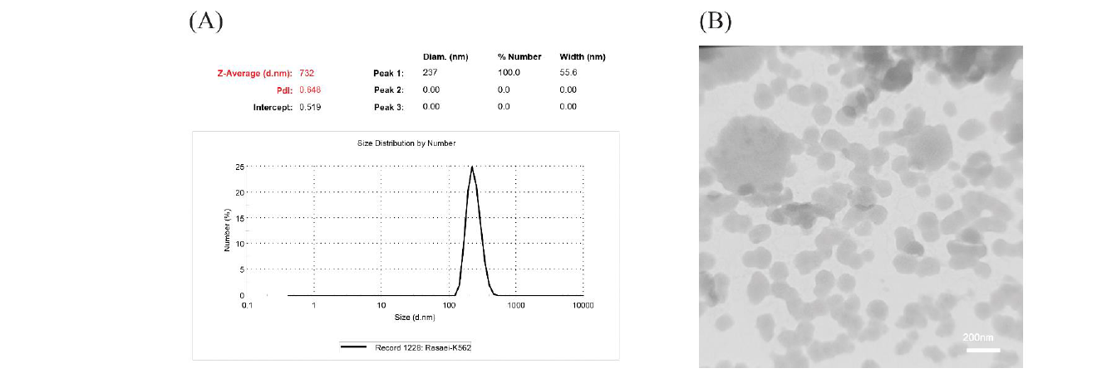
Introduction
Methods
Results
Discussion
Conclosion
Limitation
Detection of the diameter of MVs:

Slide 23
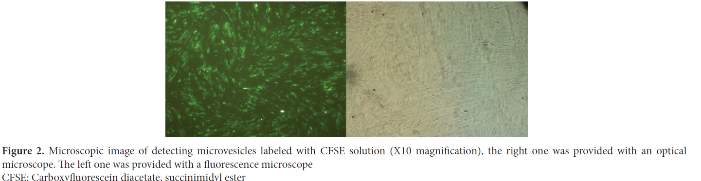
Introduction
Methods
Results
Discussion
Conclosion
Limitation
Detection of MVs in hBM-MSCs:
.
.

Slide 24
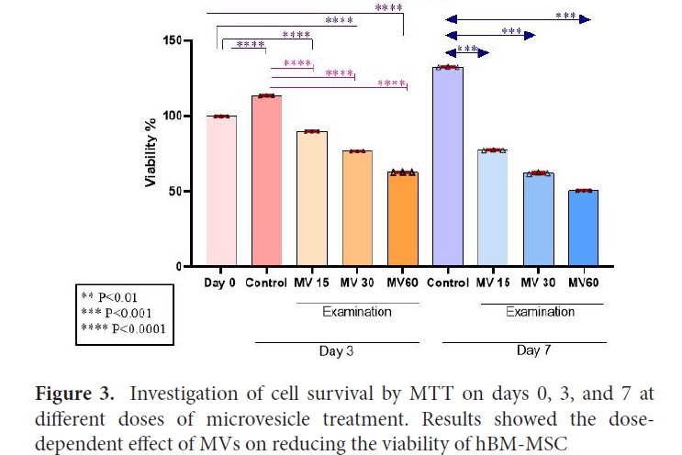
Introduction
Methods
Results
Discussion
Conclusion
Limitation
The effect of different doses of -hBM-MSCs:

Slide 25
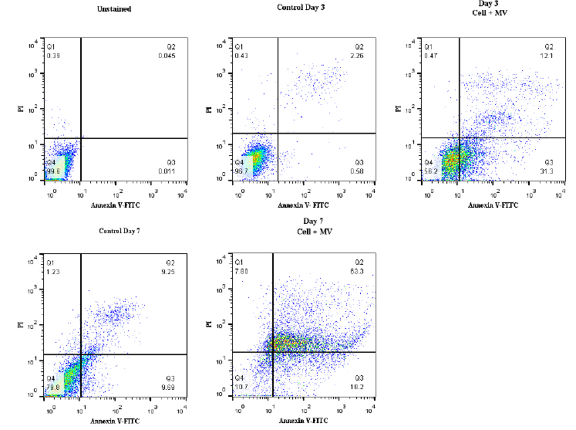
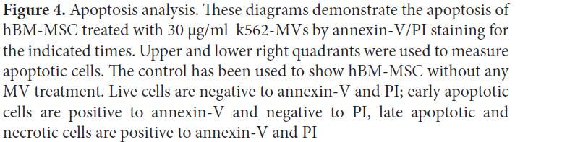
Introduction
Methods
Results
Discussion
Conclosion
Limitation
Effects of K562-MVs on apoptosis in hBM-MSCs:

Slide 26
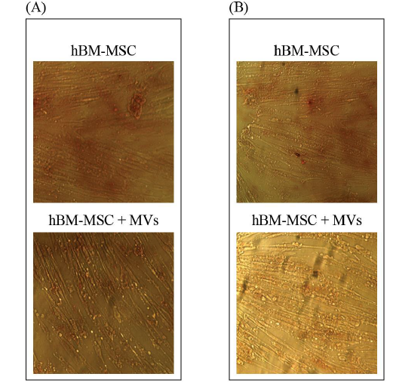
Introduction
Methods
Results
Discussion
Conclusion
Limitation
Differentiation into osteocytes and adipocytes
Figure 5. Oil red O and Alizarin Red staining on day 14. (A) Oil red o staining of hBM-MSC exhibit no adipogenic differentiation in the presence or absence of MVs during 14 days.
(B) Alizarin Red staining of hBM-MSC exhibited no
osteogenic differentiation in the presence or absence of MVs during 14 days

Slide 27
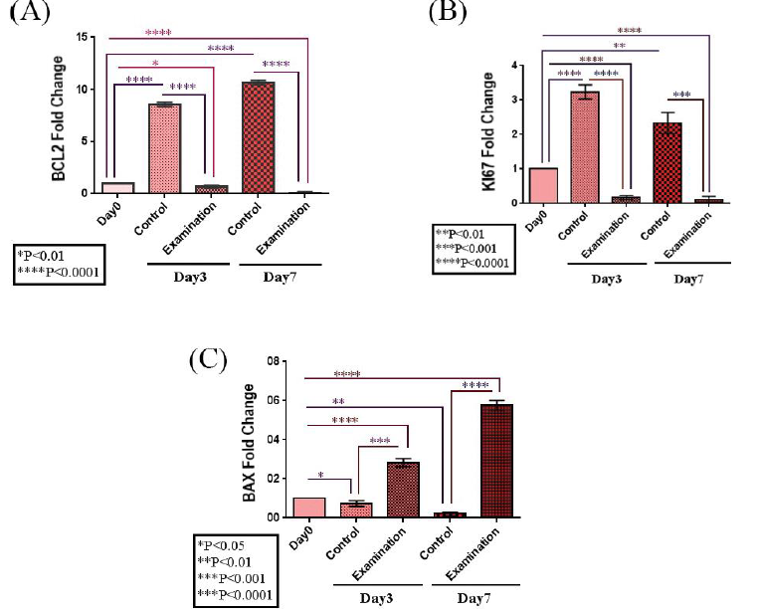

Introduction
Methods
Results
Discussion
Conclusion
Limitation
hBMSC-MVs decreased BCL-2 and KI67 and increased BAX gene expression

Slide 28
Introduction
Methods
Results
Discussion
Conclusion
Limitation
The importance of tumor microenvironment for cancer progression
is becoming widely recognized.
MSC-based therapy has emerged as a promising therapeutic
strategy for several malignancies.

Slide 29
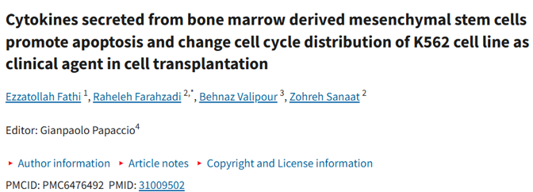
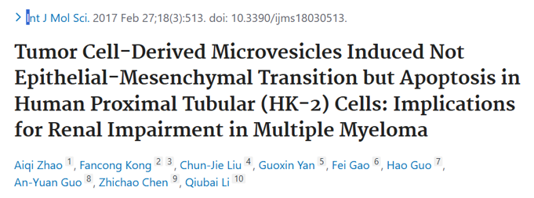
Introduction
Methods
Results
Discussion
Conclusion
Limitation

Slide 30
Introduction
Methods
Results
Discussion
Conclusion
Limitation
Conclusion:
The interaction of leukemic cell-MVs with hBM-MSCs in the bone marrow
microenvironment is essential to realize possible pathways of leukemia progression

Slide 31
Introduction
Methods
Results
Discussion
Conclosion
Limitation
Limitations:
Only in-vitro experiments
focused on the apoptotic effect of K562-MVs on hBMMSCs.
More investigations are needed to clarify the molecular mechanisms involved in leukemia regulation by leukemic-derived MVs

Slide 32
Thanks!

