Slide 1

In the name of god

Slide 2
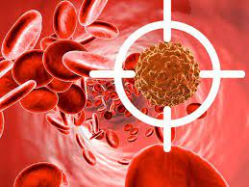
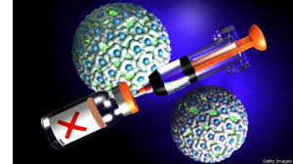
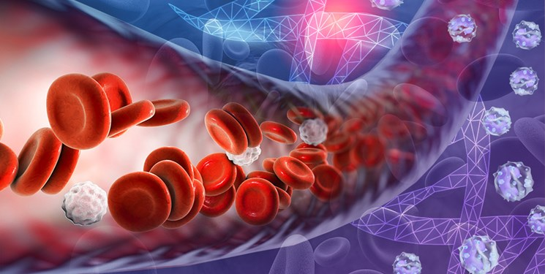

Therapeutic dendritic cell cancer vaccines in hematologic malignancies
Presenter: fatemeh seyed moharrami

Slide 3

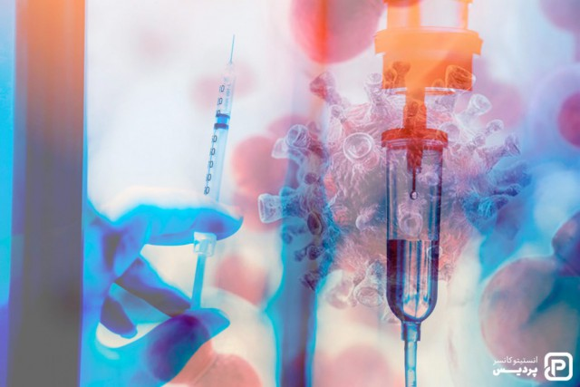
Current approaches for therapeutic cell vaccination in hematological malignancies

Slide 4
Tumor cell
Tumor cell : tumor cells present antigen in the context of negative costimulation and immunosuooressive factors , resulting in the inhibition of Tcell activation and immune tolerance

Slide 5

Dendritic cells (DC)
Dendritc cells(DC): are a complex network of antigen presenting cells that play a critical role in maintaining the equilibrium between immune activation directed against pathogens and tolerance necessary to prevent damage mediated by autoreactive Tcell clones.

Slide 6

DC BIOLOGY
DCs are potent antigen presenting cells with the ability to induce rubust antigen-specific primary immune responses.
DCs are localized tissues where they uptake and internalize foreign antigens.
After antigen processing.peptides are presented in the context of MHC on the surface of DCs.

Slide 7


Classification of dendritic cells based on morphology, function, cell origin and surface marker expression
Myeloid DCs
Plasmacytoid DCs
Dermal DCs
Epidermal Langerhans DCs

Slide 8

Myeloid / cDC
Myeloid/cDCs have been further classified into
Type1 (cDC1s)
Type2 (cDC2s)
Important note
Recent studies have indicated that a vaccine generated from cCD1s elicits long-lasting systemic T-cell mediated cytotoxic responce

Slide 9

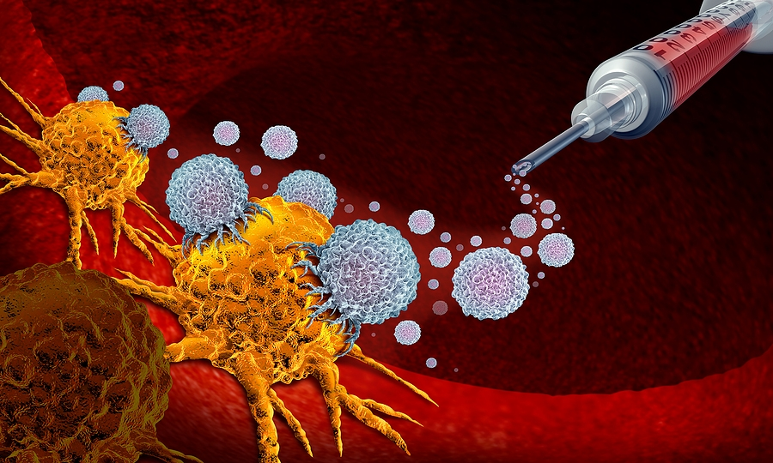
Cancer vaccine design
In this context, the design of a cancer vaccine is based on the effective presentation tumor associated antigens to evoke an antigen specific activated Tcell response , and importantly , immune memory.
It is possible?

Slide 10

conclusion
As such, DCs have played a major role in the development of cancer vaccine therapy ac critical mediators of antigen presentation reversing a major component of tumor mediated immune suppression.
DC based vaccines have involved the loading of individual tumor associated antigens or the use of whole tumor cells have demonstrated potent induction of tumor specific immunity.

Slide 11


But…
The correlation of immune response with clinical outcome and integration of DC vaccines with other immune based therapy is currently being explored.

Slide 12

Immune Surveillance and immune editing
Immune surveillance plays a critical role in protecting against the development and progression of cancer.
Immune scape is further supported by the immunosuppressive milieu of the tumor microenvironment.
Accessory cell populations , such as regulatory T cells and myeloid - derived suppressor cells (MDSCs) suppress immune mediated killing of malignant cells.

Slide 13


Our aim in designing immune-based therapy for hematological malignancies
In designing immune-based therapy for hematological malignancies, it is critical to understand and overcome the factors that permit immune scape.
DCs serve as a backbone to cancer vaccine development as potent antigen-presenting cells that play a critical role in immune stimulation in response to a foreign antigen

Slide 14

Identification of antigen targets
Choosing the optimal antigenic target forms a vital component of cancer vaccine development.
Optimal antigen characteristics
1. Tumor specificity allowing the generation of an immune response that spares the normal host tissues.
2. clonal breadth to capture the clonal diversity within the tumor.
3. functionality to be necessary for cancer cell survival to minimize chances of down-regulation
4. production of stable memory cells
5. High immunogenicity

Slide 15


Cancer vaccine platforms
Initial approaches for cancer vaccine design
1. The introduction of TAA in the context of immunostimulatory adjuvants to induce the recruitment of native of antigen presenting-cells.
2. uptake of antigen in the vaccine bed.
3. subsequent stimulation of antigen-specific T cell responses.

Slide 16

Cancer vaccine platforms using EX-vivo generate DCs
Phenotypically and functionally potent DCs can be generated ex-vivo through the cytokine-mediated differentiation of mature DCs from precursor populations in the peripheral blood or bone marrow.
1. CD14+ monocytes
2. CD34+ stem cells
3. CD123+ plasmacytoid DCs
4. BDCA1+ circulating myeloid DC
The starting cell population for ex-vivo DC vaccine production

Slide 17

Clinical trial related to cancer vaccine using DC cells (Invitro)
Ex-vivo maturation of DCs is attained by culturing them in a cytokine cocktail including:( TNFα, IL-1β,IL-6, PG,GM-CSF,IL-4).
The induction of tumor- specific immunity with an autologous vaccine based on DC cells in the mentioned ia as follows :
1. Patient with follicular lymphoma
2. patient with multiple myeloma
3. Patient with AML

Slide 18

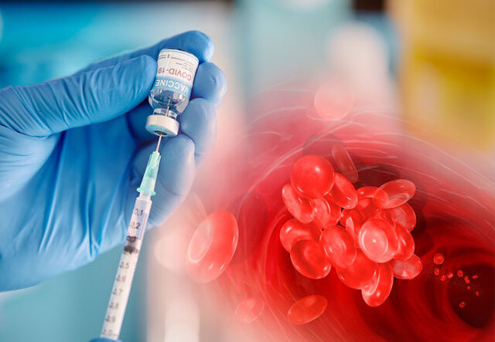
DC /tumor fusion vaccines
Our group has developed a personalized whole-cell vaccine approach whereby patient-drived myeloma or leukemia cells are fused ti Ex-vivo generated autologous DCs.
The DC/Tumor-cells fusion vaccines allow a broad spectrum of tumor associated antigens and neo-antigens to be presented in the context of DC-mediated co-stimulation.

Slide 19

Clinical trial related to a combined DC cells and tumor vaccine
First phase: evaluating DC/multiple myeloma (DC/MM) fusion cells vaccination in patients with multiple myeloma.
The second phase : this DC/MM fusion vaccine can be used in the post-autologous stem cell transplantation (SCT) setting to target post-transplant residual disease.
Conclusion : although the period of lymphopoietic reconstitution was associated with the general suppression of cellular immunity, there was a transient expansion of the myeloma-specific T cells that was further boosted following vaccination with DC/MM fusion cells.

Slide 20

Defining the optimal disease setting
1. pre-malignant disease state
2.post-chemotherapy or radiotherapy-induced pro-inflammatory state of remission.
3. the state of post-transplant

Slide 21

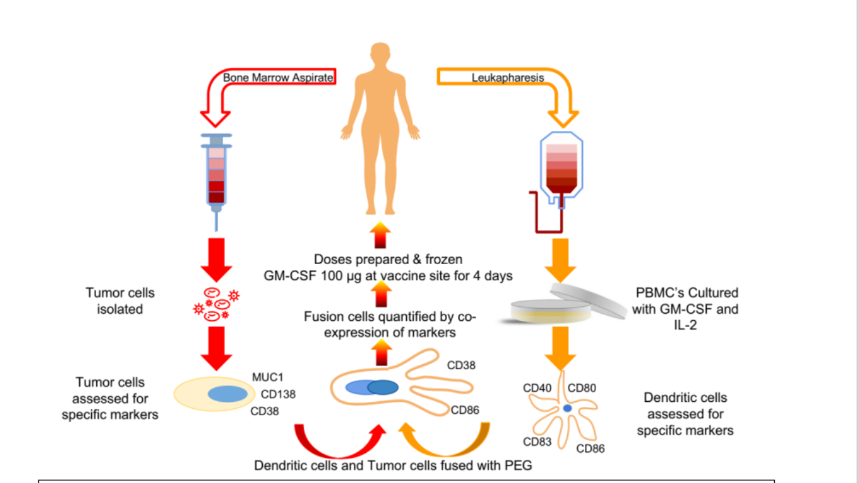
Production process of dendritic cell-tumor fusion vaccines

Slide 22


Combined strategies
A better understanding of the impact of the tumor microenvironment on immune modulation and tumor progression has led to the development of several therapeutic strategies such as vaccines targeting the production of :
1. Targeting the production of TGFβ.
2.Combination of DC vaccines.
3. chimeric antigen receptor (CAR) T cell.

Slide 23


Conclusion
There have been significant advances in the development of DC-tumor vaccines against hematologic malignancies.
DCs provide a critical platform for antigen presentation via the concurrent expression of co-stimulatory signals and inflammatory cytokines necessary for the induction of primary immune responses.
As such, they offer an important strategy to overcome tumor-associated tolerance and targeting shared tumor antigens by low and medium affinity T cells

Slide 24

Thanks for your attention

