Slide 1
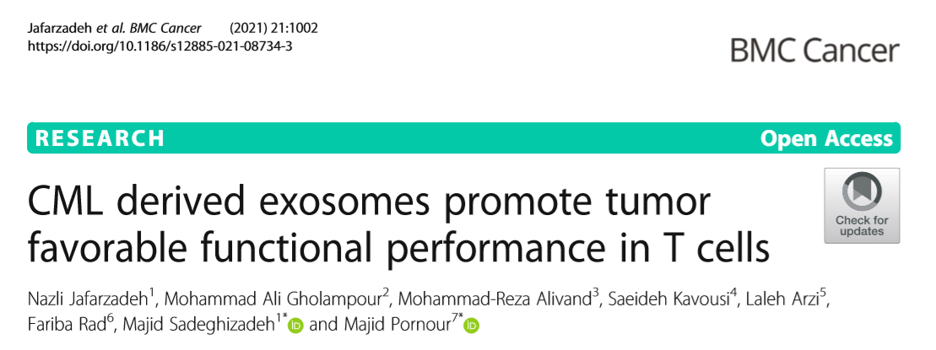
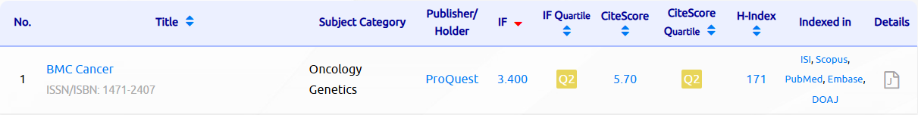

Slide 2
Introduction
Chronic myelogenous leukemia (CML)
dynamic interactions between malignant cells and the host immune system
One major secreted component involved in tumor–immune communication are exosomes
Tumor-derived exosomes have gained attention for their roles in:
tumor progression,
immune evasion,
creating an immunosuppressive tumor microenvironment.
Previous work has shown that CML-derived exosomes can:
Shift BM macrophages towards M2 (immunosuppressive)
switch BM-MSC to tumor-favorable state.

Slide 3
However, there is still insufficient information about the effect of these exosomes on human T cells.
While:
T cells are the most important cells with an anti-cancer role,
and are the main target of immunosuppression in blood cancers.
Therefore, this study was designed to investigate how exosomes released by the K562 CML cell line influence:
expression of immunoregulatory genes,
cytokine production,
nitric oxide (NO) synthesis,
and intracellular reactive oxygen species (ROS) levels
in primary human cord blood–derived T cells.

Slide 4
Method
Cell Culture
Isolation of Cord Blood T Cells (Nylon wool method)
Cord blood was processed as follows:
Density gradient centrifugation (Ficoll-Hypaque) This isolates mononuclear cells (lymphocytes + monocytes).
Adherence step Monocytes adhere to plastic after 3 hours; non-adherent lymphocytes are collected.
Nylon wool column B cells bind to the fibers and are retained; T cells flow through.
The final population was validated by flow cytometry for:
CD3 (T-cell marker),
CD45RA and CD197 (CCR7) indicating naïve phenotype.

Slide 5
Exosome Isolation from K562 Cells
K562 cells were switched to exosome-depleted FBS media to avoid contamination.
Conditioned medium was collected and processed through differential ultracentrifugation:
300 g (30 min) → remove live cells
2,000 g (30 min) → debris
10,000 g (60 min)→ small cellular fragments
20,000 g (120 min)→ remove larger microvesicles
100,000 g (120 min) → pellet exosomes
The pellet was washed in PBS and stored at −80°C.

Slide 6
Exosome Characterization
A) Western Blotting
To confirm exosome identity, expression of canonical markers:
CD9
CD63
CD81
B) Transmission Electron Microscopy (TEM)
C) Scanning Electron Microscopy (SEM)
D) Dynamic Light Scattering (DLS)

Slide 7
Exosome Uptake Assay
Purified exosomes were fluorescently labeled using the PKH26 lipophilic dye .They were incubated with cord blood T cells for 2 or 4 hours.(nuclei stained with DAPI) and imaged by confocal microscopy.
Gene Expression Analysis (qRT-PCR)T cells were treated with 100 μg/mL exosomes for 72 hours.
T-cell inhibition (FOXP3, PD-1) activation signaling (CD3d, NFATc3) cytokines (IL-6, IL-10, IL-17) oxidative stress regulator (NQO1)
Griess Assay: Nitric Oxide Measurement. Supernatants from treated T cells were mixed with Griess reagent. Absorbance at 540 nm reflects nitrite accumulation. Estimates NO production after 48 and 72 hours.
Intracellular ROS Measurement
Cytokine Quantification (ELISA)Supernatants were analyzed for secretion of:IL-6, IL-10, IL-17, IL-1β, TNF-α, IL-8

Slide 8
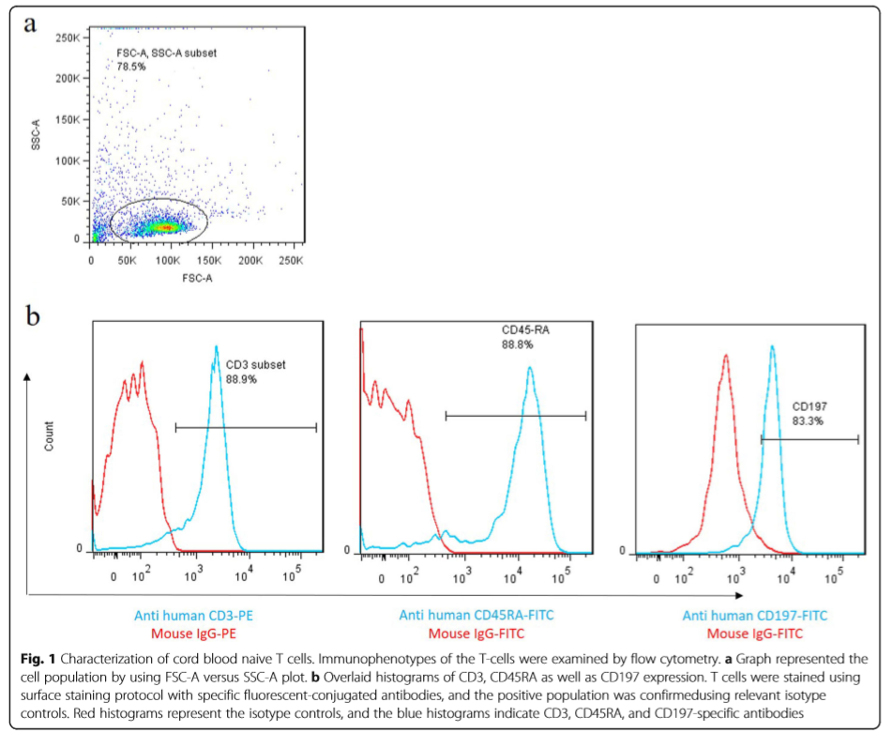
RESULTS
1- Primary human cord blood T cells characterization

Slide 9
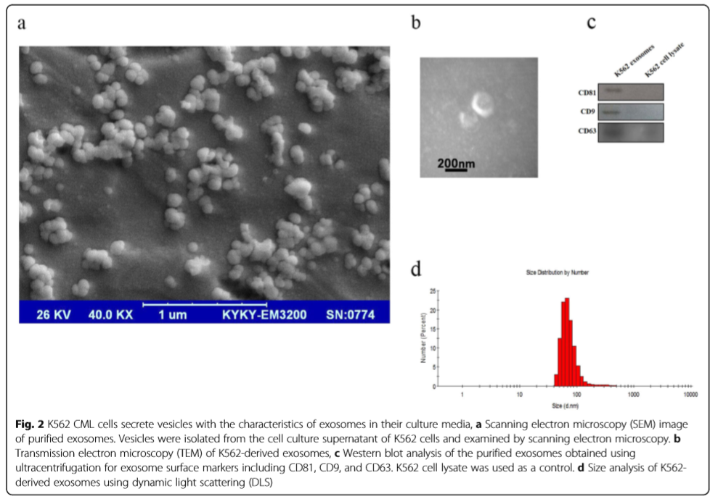
2- Characterization of K562-derived exosomes

Slide 10
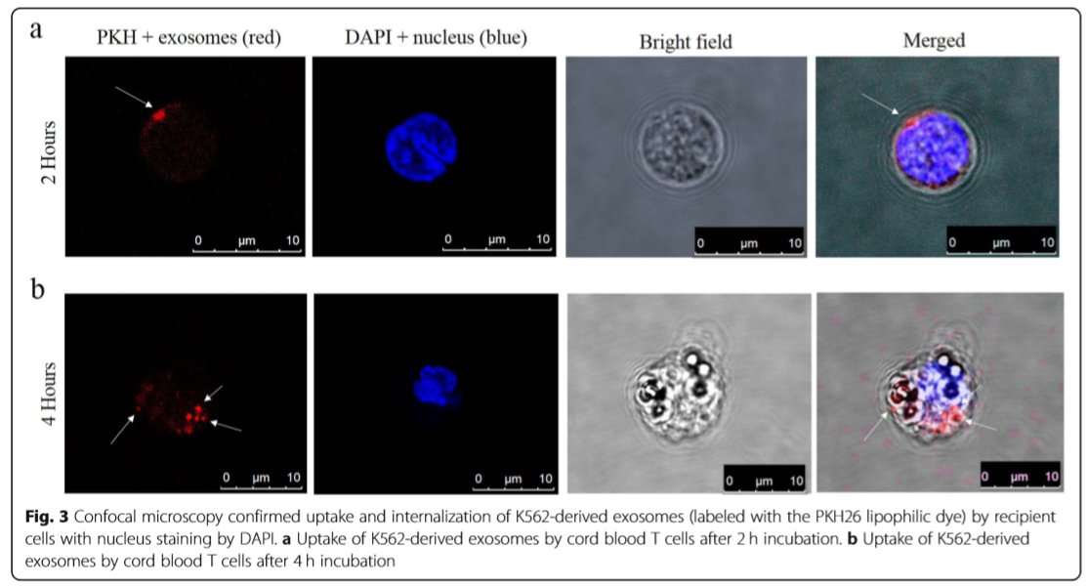
3- Cellular uptake of K562-derived exosomes by human cord blood T cells

Slide 11
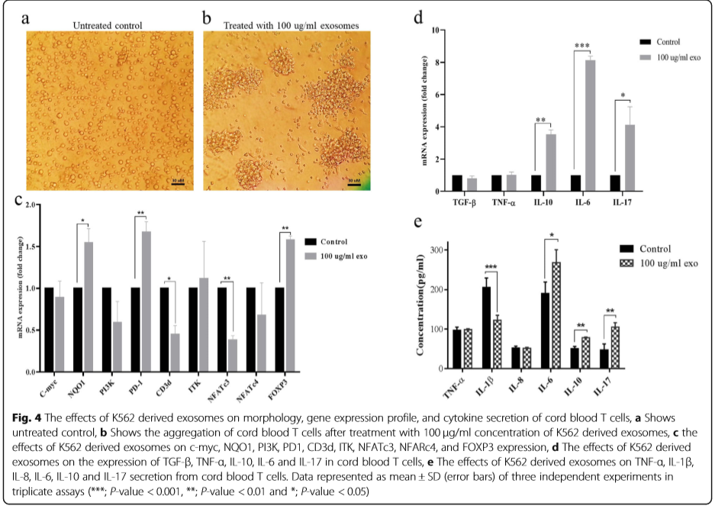
4- K562-derived exosomes induce transcriptional and morphologic changes in cord blood T cells

Slide 12
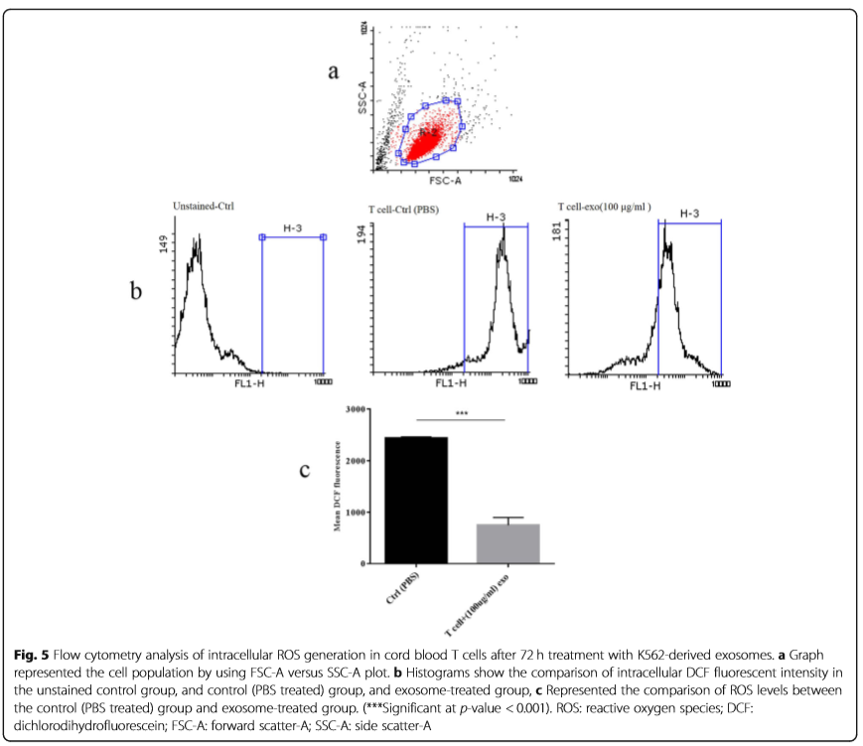
5- Intracellular ROS Measurement

Slide 13
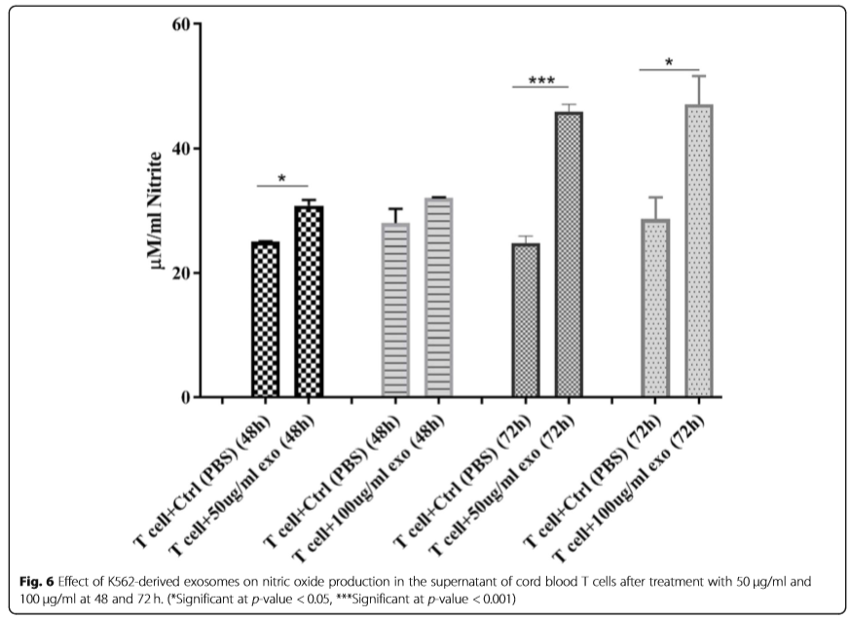
6- Griess Assay

Slide 14
Discussion
All of the evidence in the current study described how K562 derived exosomes may exert immunosuppressive effects in T cells, and how their secretions change the properties of these cells.
↑ FOXP3 and IL-10
↑ PD-1, ↓ cd3d & ITK
↓ NFATc3
↑ NO, ↓ ROS
↑ IL-6 & IL-17
↑ NQO1
↓ IL-1β
represented the properties alteration of these cells toward regulatory T cells.
attenuate T cell receptor triggering signals
Thus, since NFATc3 expression induces the Th1 differentiation, the decrease of this transcription factor in T cells may suppress the cellular immune activation.
reduction of ROS and increasing NO levels are related to the existence of tumor favorable IL-17 producing T cells
Treg-17
↓ ROS
↓ immune response

Slide 15
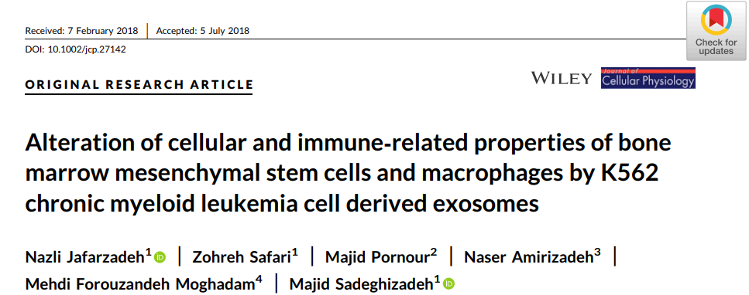
K562‐derived exosomes alter mRNA expression and NO, cytokine and ROS production in BM‐MSCs and macrophages.

Slide 16
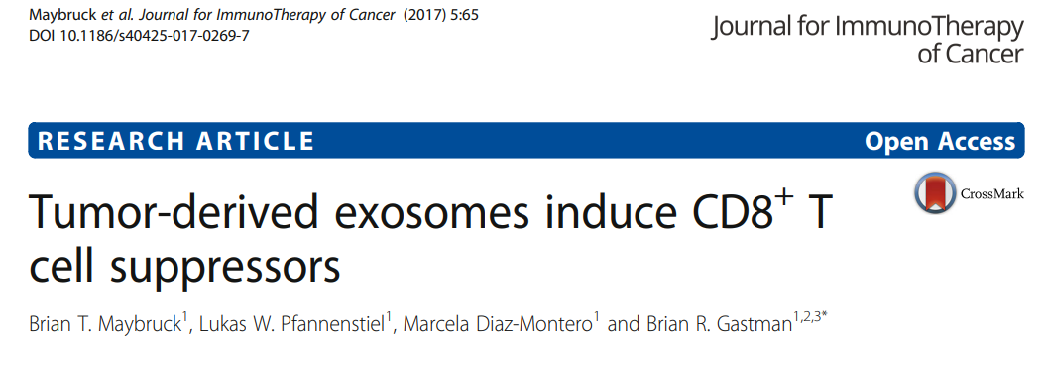
suppression of cytotoxic T cells, apoptosis of activated T cells, obtaining suppressor T cell behavior, and differentiation to regulatory T cells were the major variation of T cells affected by exosomes from tumor

Slide 17
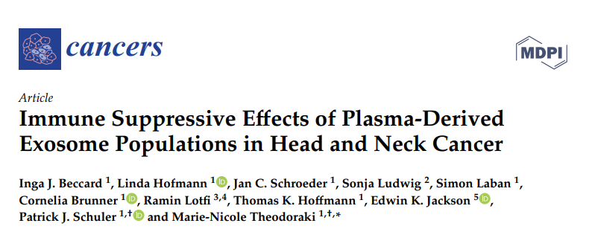
suppression of cytotoxic T cells, apoptosis of activated T cells, obtaining suppressor T cell behavior, and differentiation to regulatory T cells were the major variation of T cells affected by exosomes

Slide 18
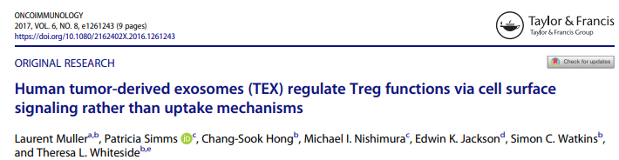
suppression of cytotoxic T cells, apoptosis of activated T cells, obtaining suppressor T cell behavior, and differentiation to regulatory T cells were the major variation of T cells affected by exosomes

Slide 19
Conclusion
K562 exosomes stimulated the immune suppressor functions in CB-derived T cells by inducting anti-inflammatory cytokines such as IL-10, reducting ROS levels, and arising of NO synthesis in these cells. Moreover, considering the elevated FOXP3, IL-6, and IL-17 levels in these cells, CML cell-derived exosomes may induce T cell fate toward tumor favorable T cells instead of conventional activated T cells (Th1, Th2, CTL, etc.)

